Slide 1
Classification by linear models
Classification by nearest neighbor
Variance vs. bias trade-offs
The curse of dimensionality

Slide 2
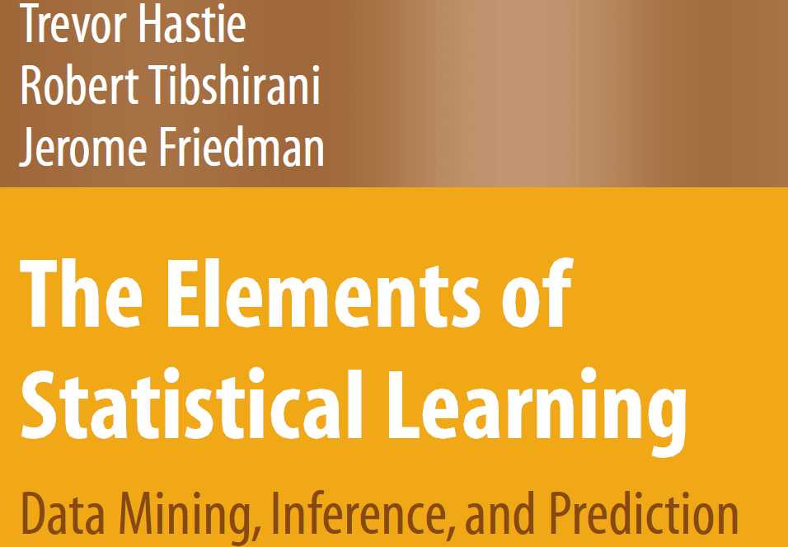
Legal download:
http://www-stat.stanford.edu/~tibs/ElemStatLearn/printings/ESLII_print10.pdf

Slide 3
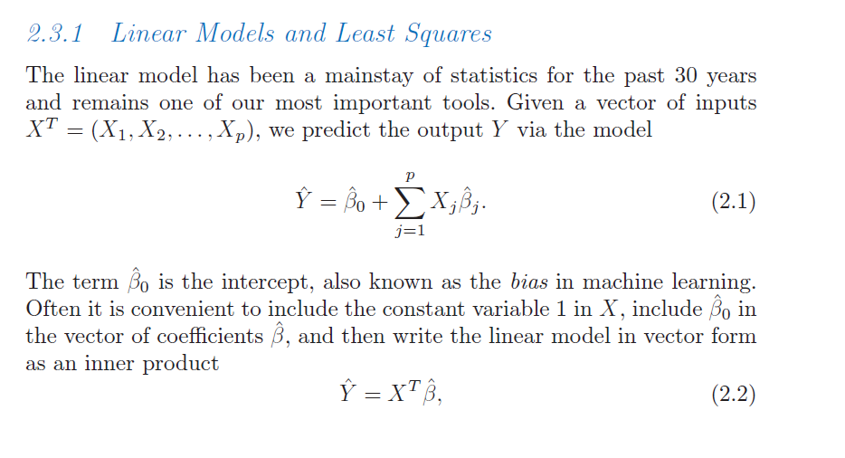
We have our (familiar if you remember stats) linear algebra notation for linear models..
Hastie et al: The elements of Statistical Learning
http://www-stat.stanford.edu/~tibs/ElemStatLearn/download.html

Slide 4
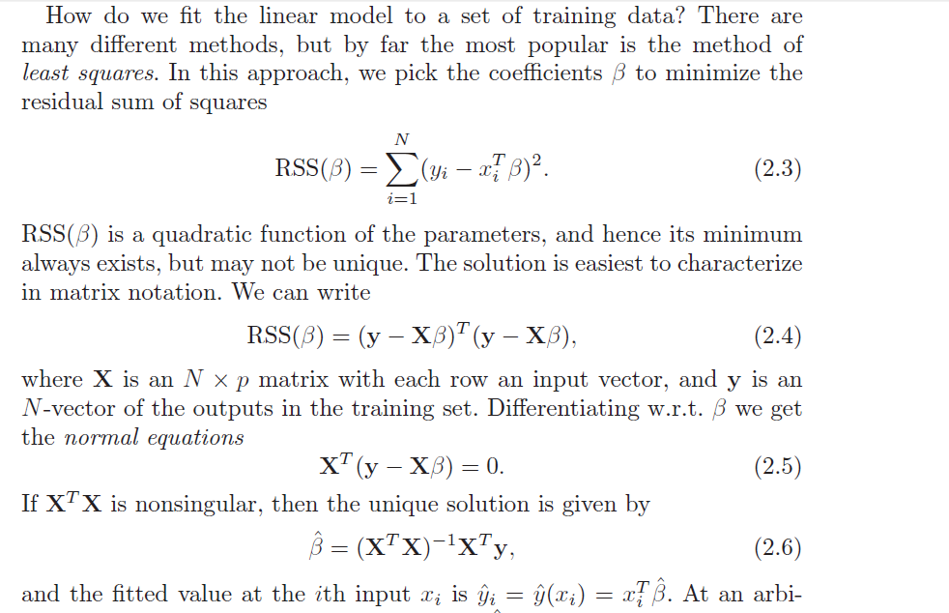

Slide 5
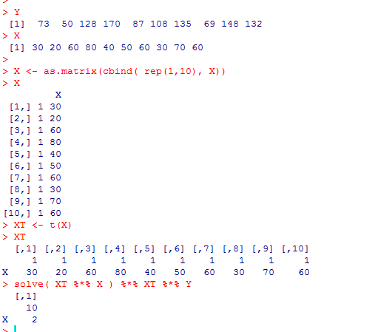
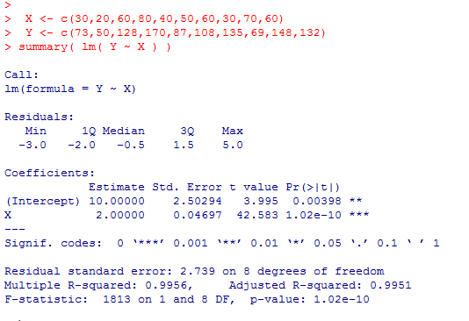

So we can find least square parameters easily with a few line of matrix manipulation
Statistics is primarily concerned with inference
What is the probability that the true values of the parameters are 0?
Dependent on assumptions: normality, equal variance, linearity, etc.
Machine learning is more concerned with classification.
Given a new set of X values, how well can we predict y?

Slide 6
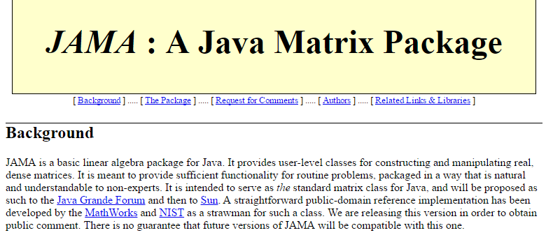
We can as easily do linear algebra as easily in Java as in R…
The JAMA package is very useful for Matrix algebra
(although doesn’t do well on large matrices…)
http://math.nist.gov/javanumerics/jama/

Slide 7
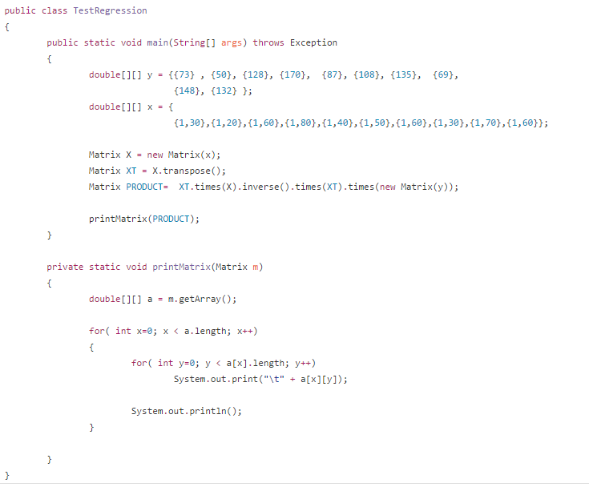

We can obtain the linear least squares fit as easily in Java as in R
https://github.com/afodor/mlExamples/blob/master/src/mlExamples/TestRegression.java

Slide 8
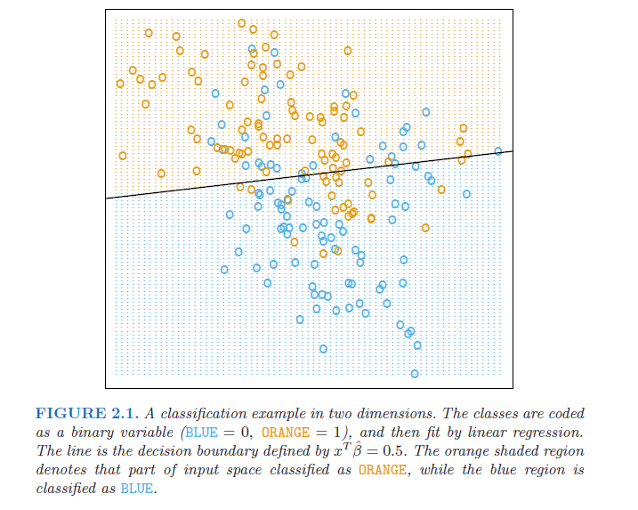
To return to the Elements of Statistical Learning, a two-dimensional classification problem…

Slide 9
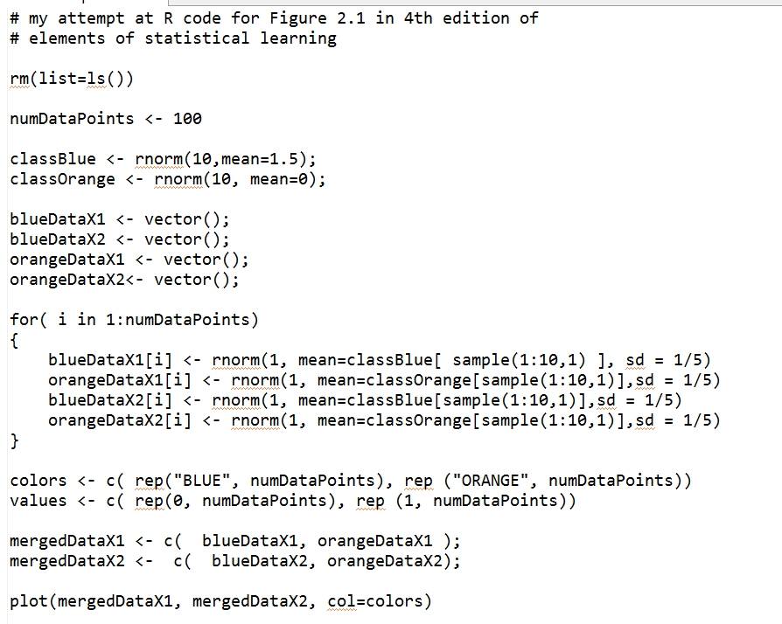
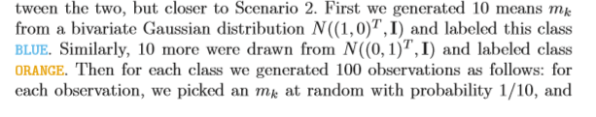
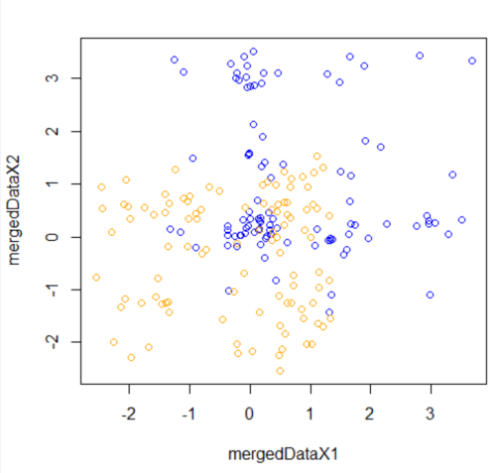
Here is code that generates a similar training set
https://github.com/afodor/metagenomicsTools/blob/master/src/machineLearningExamples/linearExampleInR.txt

Slide 10
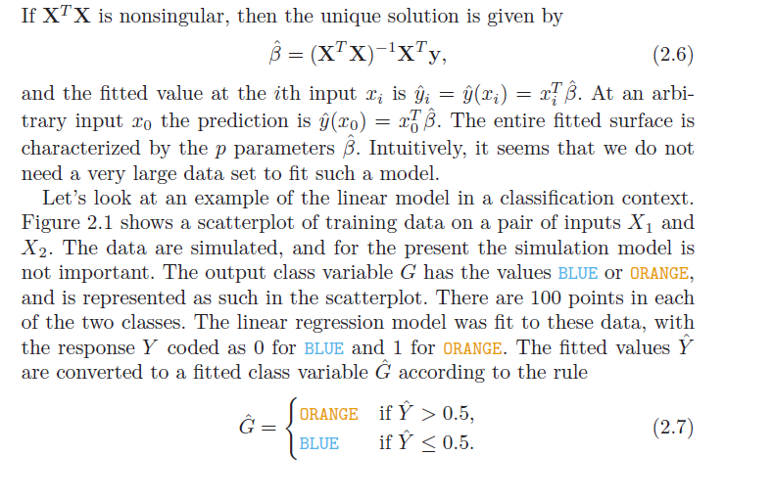
Y = B0 + B1 * X1 + B2 *X2
We want the line where Y = 0.5
0.5 = B0 + B1 * X1 + B2 * X2
X2 = ( 0.5- B0 - B1 * X1 ) / B2

Slide 11
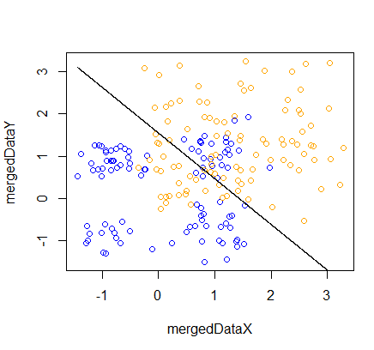
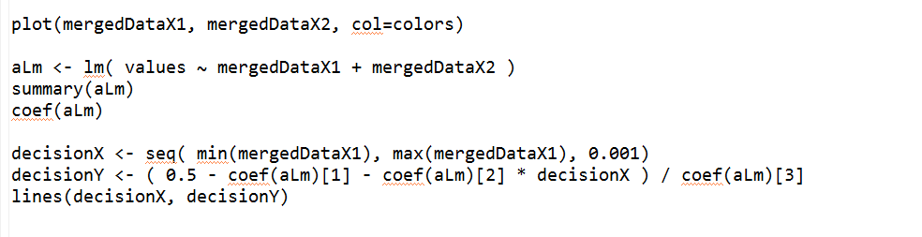
This is very easy to implement in R…
Make a linear model as usual
Solve for 0.5
https://github.com/afodor/metagenomicsTools/blob/master/src/machineLearningExamples/linearExampleInR.txt

Slide 12
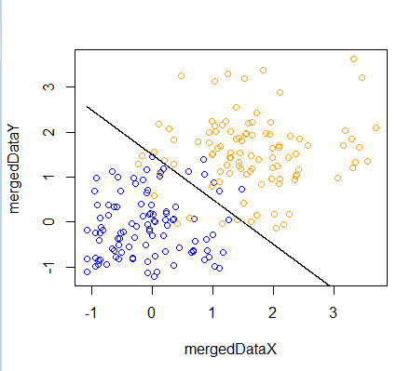
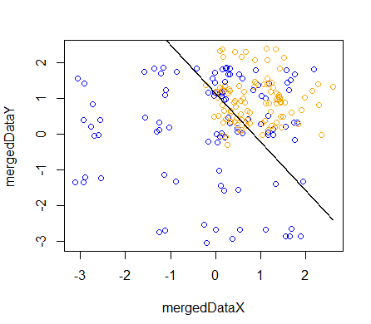
Successive runs on our simulated data set show the linear model sometimes doing
better than others…

Slide 13
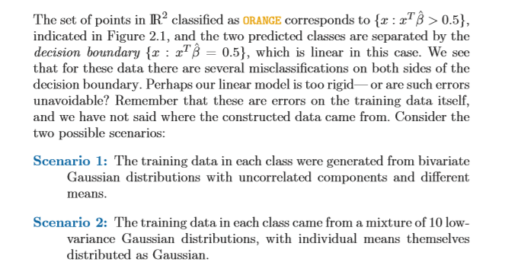

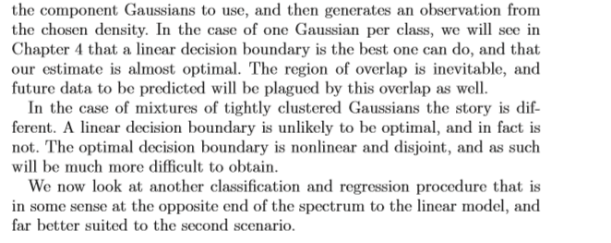
Can we do better than linear models?

Slide 14
Classification by linear models
Classification by nearest neighbor
Variance vs. bias trade-offs
The curse of dimensionality

Slide 15
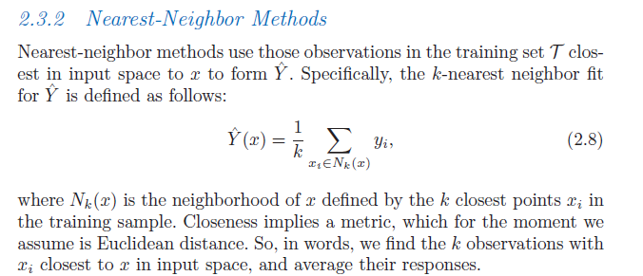

Slide 16
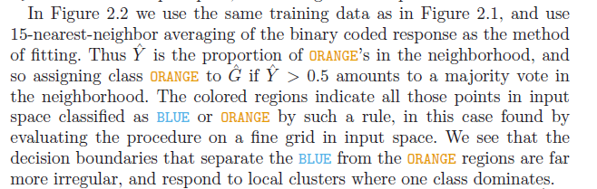
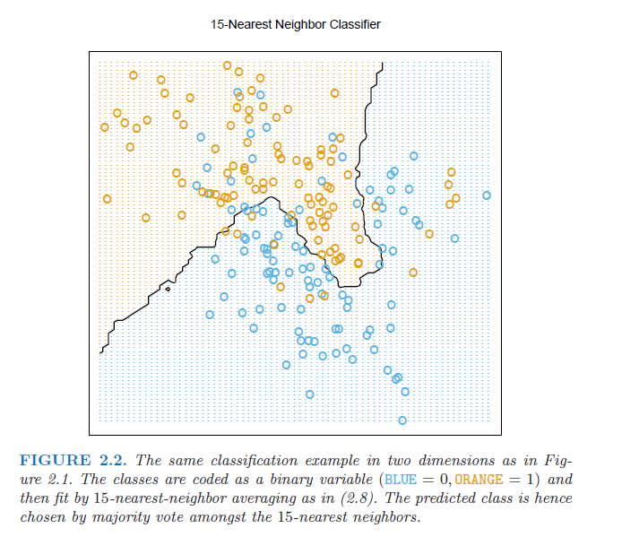
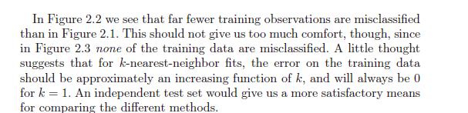

Slide 17
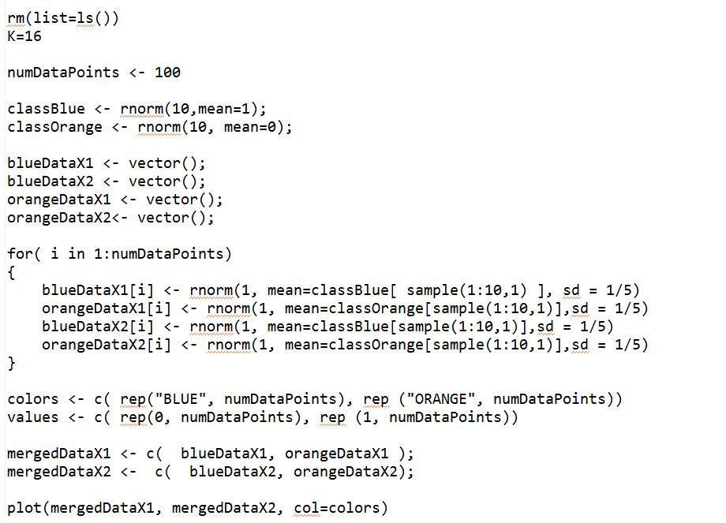
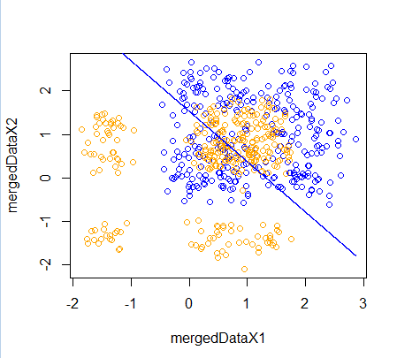
This is a (little) trickier to code up.. We start as before (with the linear fit)..
https://github.com/afodor/metagenomicsTools/blob/master/src/machineLearningExamples/nearestNeighborInR

Slide 18
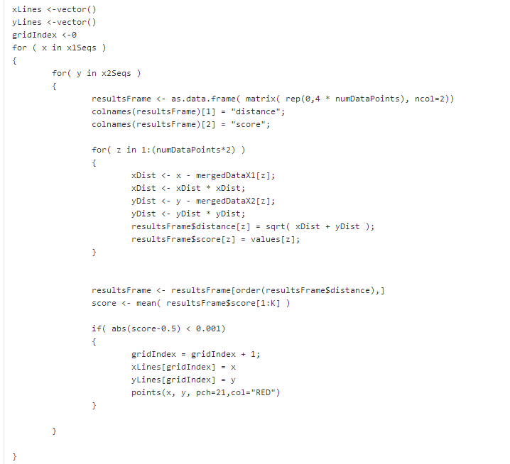
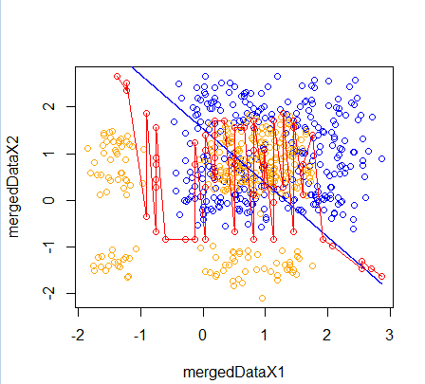
Next we add the nearest neighbor fit..
https://github.com/afodor/metagenomicsTools/blob/master/src/machineLearningExamples/nearestNeighborInR

Slide 19
Next we add the nearest neighbor fit..
Evaluate every point in the grid
Find the distance to all points in the grid
Score the nearest neighbors
Note that k has to be even for this to work!
https://github.com/afodor/metagenomicsTools/blob/master/src/machineLearningExamples/nearestNeighborInR

Slide 20
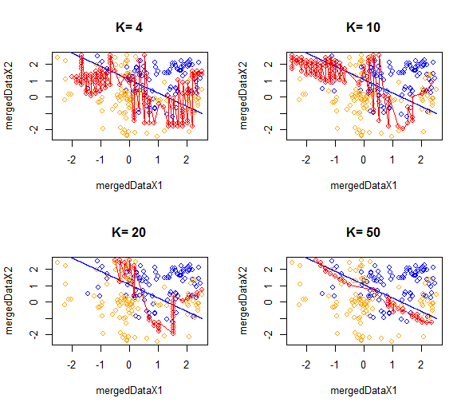
As we increase the nearest neighbor, the models become simpler…
We say we reduce variance but increase bias as k increases…

Slide 21
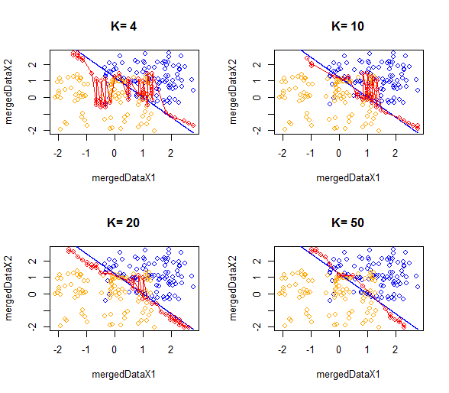

Slide 22
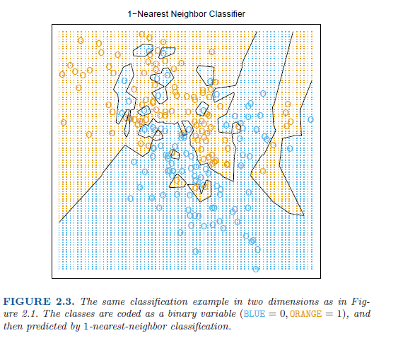
With k=1, over-fitting becomes assured..

Slide 23
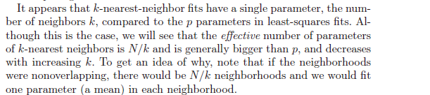
We can more easily over-fit with k-means because there are more effective parameters
How do we choose k? We can’t minimize the sum-squared errors..

Slide 24
One more PCA Example
Classification by linear models
Classification by nearest neighbor
Variance vs. bias trade-offs
The curse of dimensionality

Slide 25
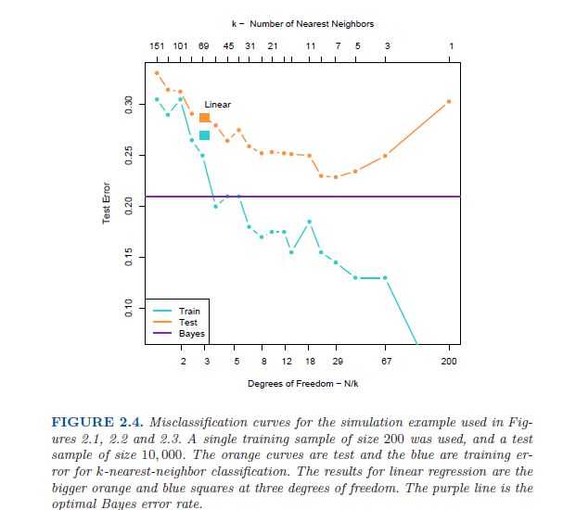
Model is
Under-trained;
High error in
Both training set
And the test set
Model is over-trained;
Low error in the training set
High error in the test set
The theoretically best
model that could be
obtained (if you knew
the “true” distributions)

Slide 26
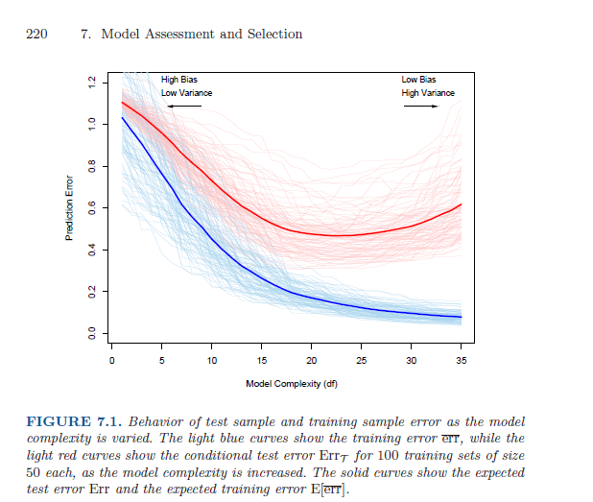
This idea of tuning model complexity to avoid over-fitting and under-fitting
is central to the book (and shows up again in Chapter 7)

Slide 27
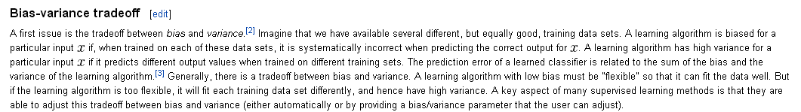
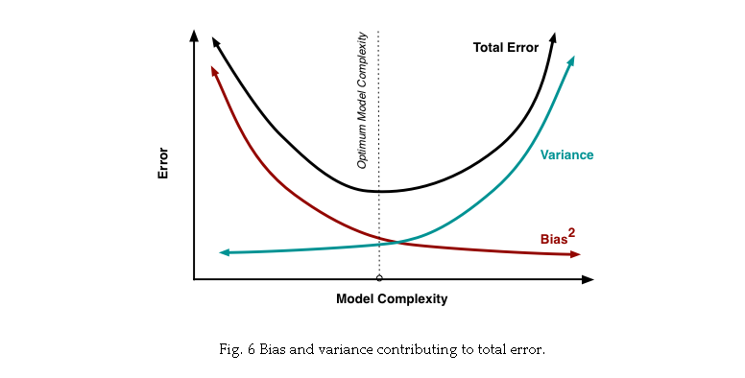
http://scott.fortmann-roe.com/docs/BiasVariance.html

Slide 28
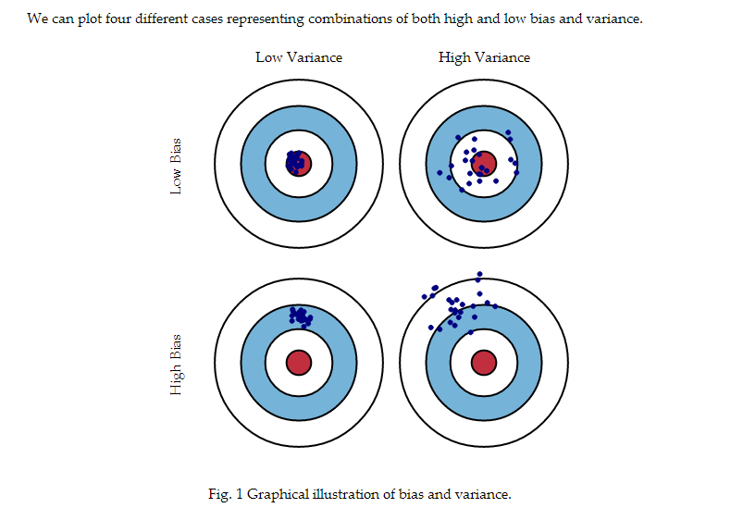
http://scott.fortmann-roe.com/docs/BiasVariance.html

Slide 29
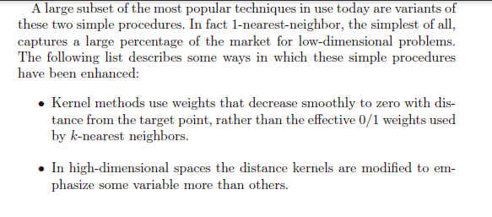
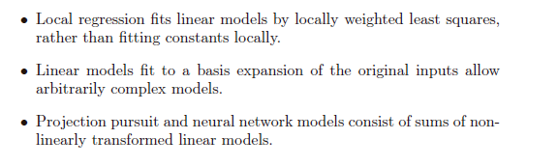

Slide 30
One more PCA Example
Classification by linear models
Classification by nearest neighbor
Variance vs. bias trade-offs
The curse of dimensionality

Slide 31
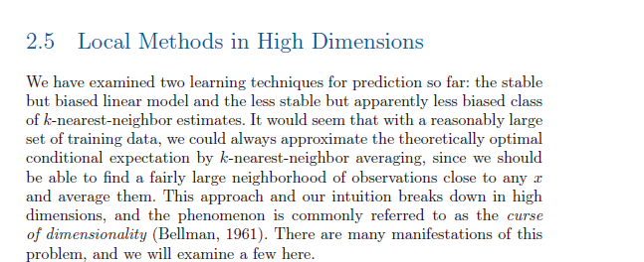
Lots of math towards the end of chapter 2 that we won’t cover…
But this is sort of interesting..

Slide 32
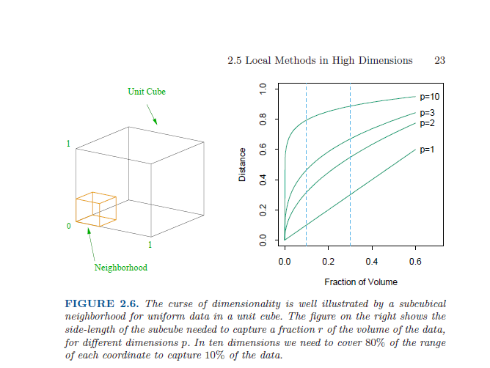
If we have a line, covering 10% of the line take 10% of the total pixels of the line
For a square: I want to cover 10% of all the data. How much of each side (d) do I need?
d ^ 2 = 0.10 ; d = 0.10 ^ (1/2) = 0.31
For a cube: I want to cover 10% of the data: How much of each side (d) do I need?
d ^ 3 = 0.10 ; d = 0.10 ^ (1/3) = 0.46
For 10 dimensions: d ^ 10 = 0.10 ; d = 0.10 ^ (1/10) = 0.794

Slide 33
So for K-means, the “local” space in high dimensions is not local at all!
You’ll need data on the full range of inputs (which you almost certainly will not have)
So we can’t use simple linear models or simple k-nearest neighbors in
high-dimensional space!

