Slide 1
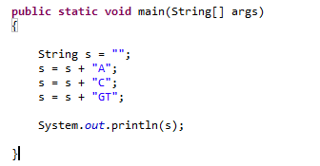
Lab 2 – Random DNA sequences…
The “+” operator is defined to produce String concatenation…
This yields “ACGT”
(For performance reasons, this is sometimes not a good idea, but more on that later!)

Slide 2
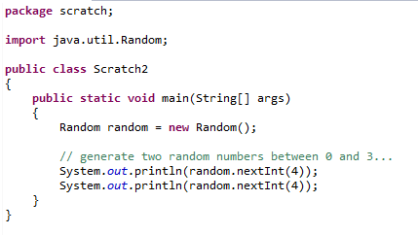
We can use Java’s random number generator to randomly sample
the numbers { 0,1,2,3} from the uniform distribution…
Tell Java we will use the Random class

Slide 3
Lab Exercise for today:
(1) Write code to print to the console 1,000 randomly generated
DNA 3 mers (e.g. “ACA”, “TCG” )
where the frequency of A,C,G and T is 25% and is uniformly sampled.
Have your code track how often it prints out the 3 mer (“AAA”)
How often would you expect to see this 3mer by chance? Is Java’s number
close to the number that you would expect?
Send you code to afodor@uncc.edu and mbrown67@uncc.edu at the end of the lab session.
Make sure the phrase “Lab 2” is in the subject line
(As a better alternative, check your code into a BitBucket or GitHub repositiory and work
with us to make sure that we have access)
(For extra-credit exercise see next slide)

Slide 4
Extra credit
Modify your code so that the frequency of A,C,G and T is
p(A) = 0.12
p(C) = 0.38
p(G) = 0.39
p(T) = 0.11
What is the expected frequency now of “AAA”? Does Java produce “AAA”
at close to the expected frequency?
Hint the code:
Random random = new Random();
float f = random.nextFloat();
produces a random number uniformly between 0 and 1.
(2) For those with a stats background and a lot of time on your hands…
Rerun the above simulation for 10,000 sequences 10,000 times.
Use the chi-square test to show that the p-values for the null hypothesis
that the actual distribution does not match the expected distribution are
uniformly distributed.
Hint: This might help
http://www.vvlasov.com/2013/06/how-to-calculate-pvalue-from-chisquare.html

