Slide 1
Introduction to our mouse dataset for lab..
Estimating mean and variances for the negative binomial fit

Slide 2
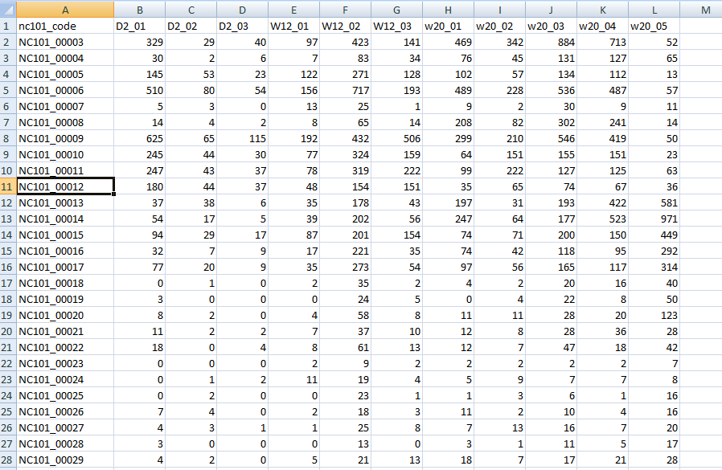
The dataset is at github…
http://afodor.github.io/classes/stats2015/longitdunalRNASeqData.zip
File = nc101_scaff_dataCounts.txt

Slide 3
The dataset is at github…
Week 2
Week 12
Week 20
File = nc101_scaff_dataCounts.txt

Slide 4
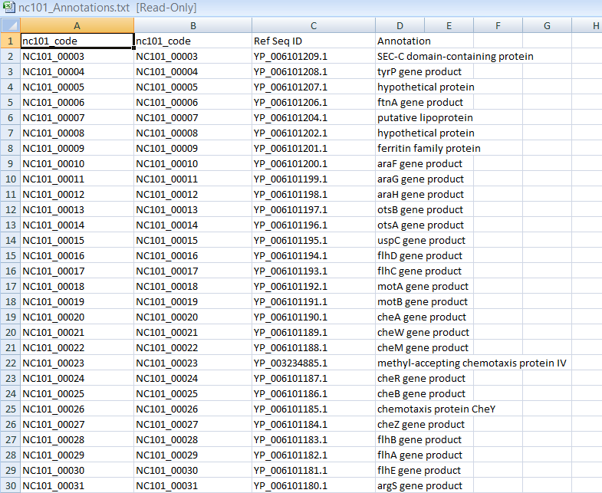
In case you care what these genes are…
File = nc101_Annotations.txt

Slide 5
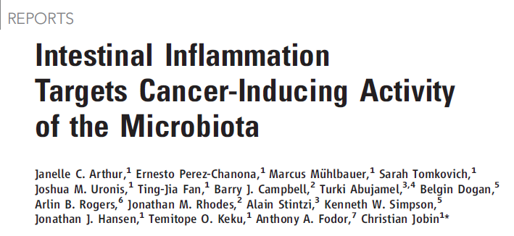

Two papers that describe this experimental system….
http://www.sciencemag.org/content/338/6103/120.full.pdf
Proofs are here: http://afodor.github.io/classes/stats2015/proofs_NatureCommunications.pdf
(since UNCC doesn’t have access to this journal!!)

Slide 6
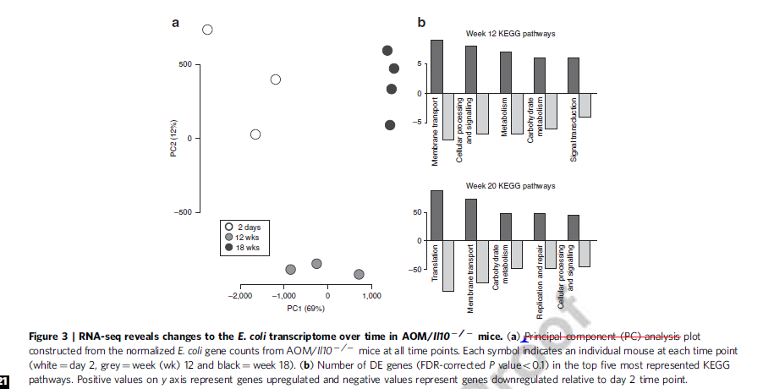
Fig.3 in the 2nd paper is the dataset you have…

Slide 7
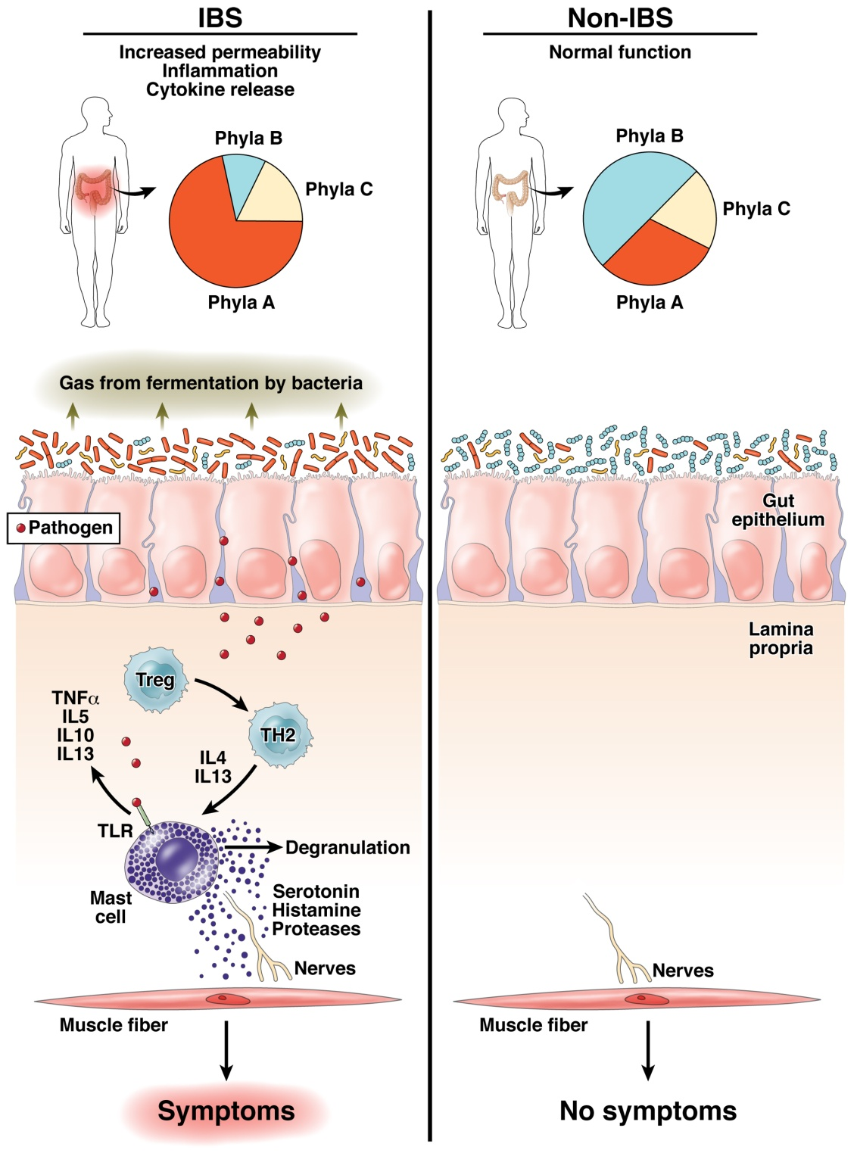
The “dysbiosis” hypothesis linking risk for inflammation related diseases to the microbiome
Fodor & Talley. Gastroenterology. 2011

Slide 8
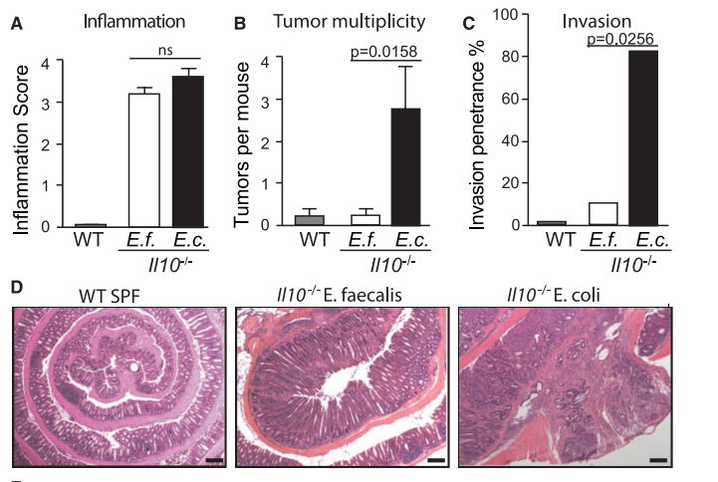
Some bugs, but not others, can cause inflammation to progress to cancer…
Arthur et al, Science, 2012

Slide 9
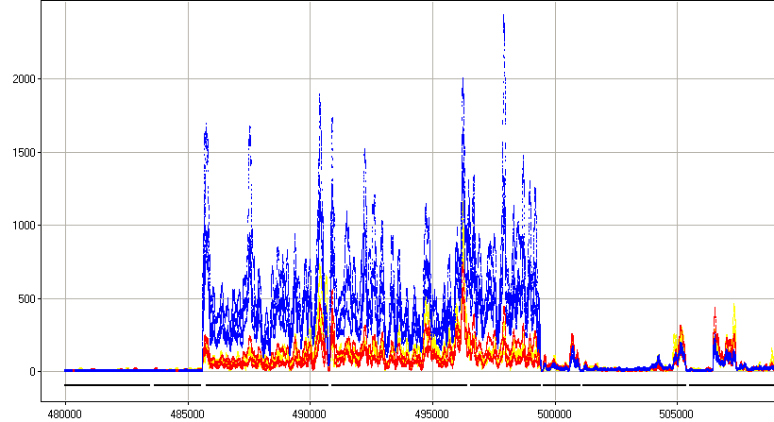



rna-seq shows us gene expression of host-associated E. Coli
Sterile mice
Inoculate with E. Coli
RNA from fecal samples characterized
by RNA-seq on the Illumina platform
2 days
12 weeks (inflammation)
18 weeks (cancer)
Normalized Read Count
Position along the genome
30S ribosomal protein
50S ribosomal protein
preprotein translocase subunit
DNA-directed RNA polymerase subunit

Slide 10
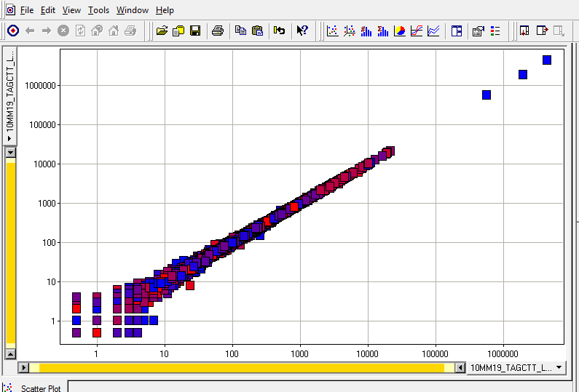
Features of the dataset:
Paired ends are nearly exactly the same
rRNA
unmapped
In your spreadsheet for the homework, we simply merged the paired ends…

Slide 11
One potential problem with this dataset.
Most of the sequences were 16S and 23S rRNA
(Bacteria do not have a poly-A tail on their mRNA )
(We used a bead capture method to remove the rRNA signature with limited success)
rRNA
unmapped

Slide 12
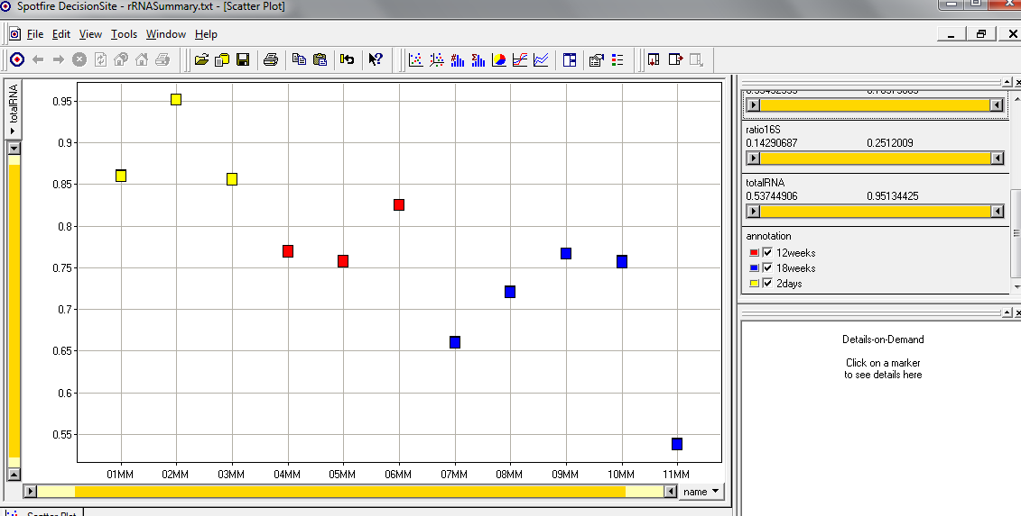
The fraction of 16S rRNA was correlated with time!
(The ribosomal machinery changes with the state of the bug?)
A potentially confounding variable…
16s rRNA reads + 23s rRNA reads
Sample names
In your spreadsheet, we removed the 16S and 23S rRNA sequences
and we will do normalization on the resulting counts…

Slide 13
Introduction to our mouse dataset for lab..
Two approaches to column normalization
Estimating mean and variances for the negative binomial fit

Slide 14
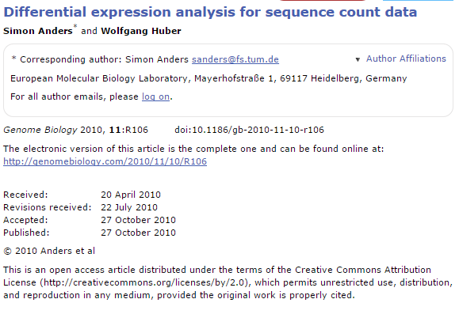
In lab #5, we will fit the Poisson distribution to this mouse/E. Coli dataset.
We will see that this is a poor model..
In this week’s lab, we will use a better model based on the negative binomial distribution.
To fit the negative binomial distribution to our dataset, we need to have a strategy to:
(i) deal with the fact that different samples have different numbers of sequences
(ii) choose a strategy to estimate mean and variance for each gene.
(iii) use those means and variances to produce p-values from the negative binomial
distribution
We follow the logic and equations in this paper:

Slide 15
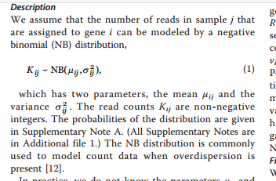
j is an index for samples (columns in our spreadsheet)
i is an index for genes (rows in our spreasheet)
K_{ij} is the # of counts in each cell

Slide 16
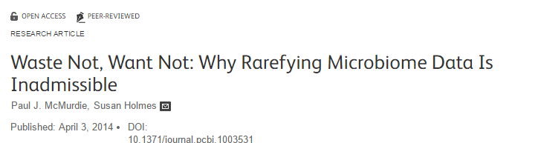
Our first step; normalization….
Each sample in our spreadsheet has a different number of sequences.
We need to correct for this (so that we don’t just reflect in our p-values
that there were more sequences in one sample).
This is a highly controversial and complex question that we will
touch on repeatedly over the semester…

Slide 17
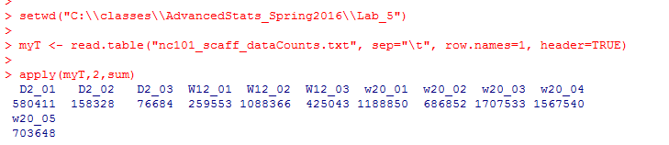
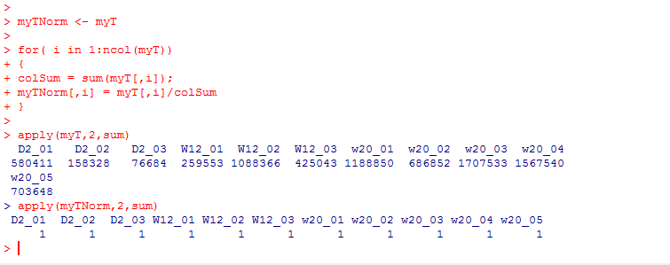
These few lines of code give us the # of sequences in each sample….
“apply” sum to the columns of myT
(if the 2nd parameter were 1, it would be applied to the rows)
One simple normalization scheme is to divide each cell by the sum in the column.
This converts each gene to relative abundance…
https://github.com/afodor/metagenomicsTools/blob/master/src/classExamples/compareNormalizations.txt

Slide 18
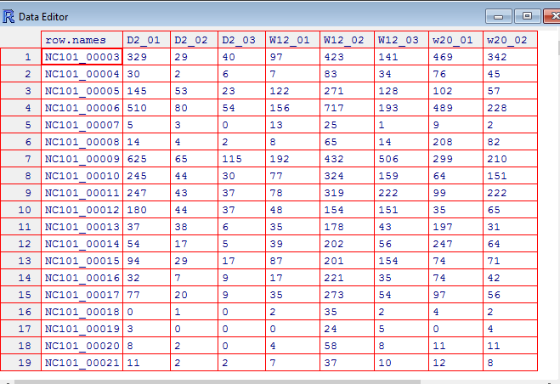
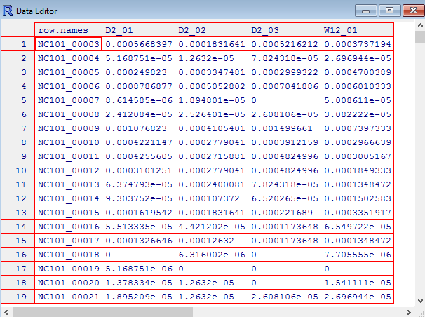
Relative abundance changes counts to fractions (that sum to 1 in each sample)
edit(myT)
edit(myTNorm)

Slide 19
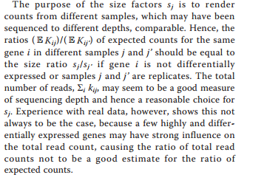
Many people have problems with relative abundance normalization, including the dseq authors
j is an index for samples (columns in our spreadsheet)
i is an index for genes (rows in our spreasheet)
K_{ij} is the # of counts in each cell
They are concerned that outliers may cause problems…
There is also the compositionality problem (which we may talk about more later…)

Slide 20
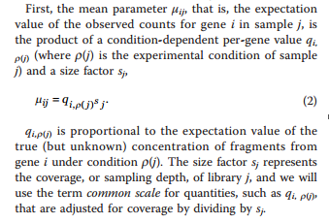
The DeSeq paper formalism describes a “true” expression level and a scaling factor…
q is the true fraction of gene expression under condition p(j)
(in our spreadsheet, p(j) gives us the time 2 weeks, 12, or 20 weeks)
S_{j} is the scaling factor – a normalization factor that will be different for different samples
j is an index for samples (columns in our spreadsheet)
i is an index for genes (rows in our spreasheet)

Slide 21
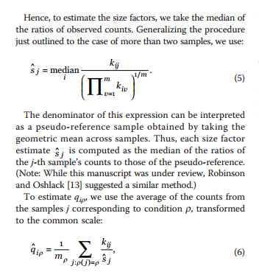
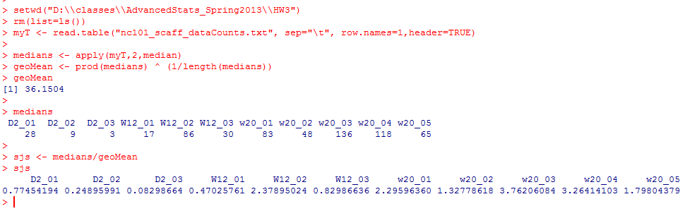
DeSeq proposes an alternative to simple relative abundance….
Geometric mean is sometimes
considered a more robust alternative
to average
To estimate S_{j}, we take the median of each column (and divide by some normalizing constant)

Slide 22
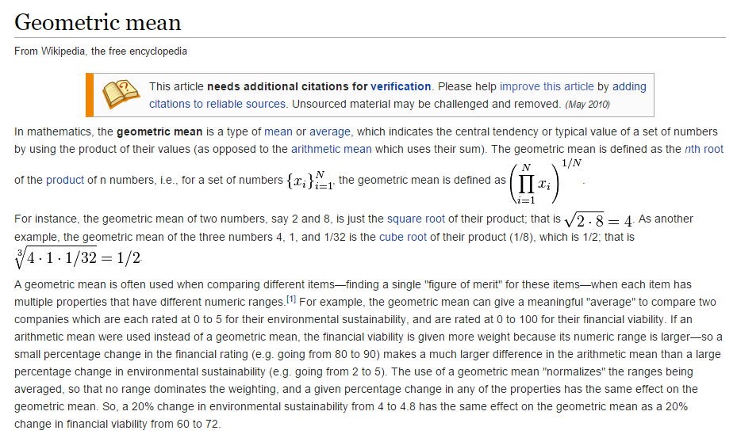

Slide 23
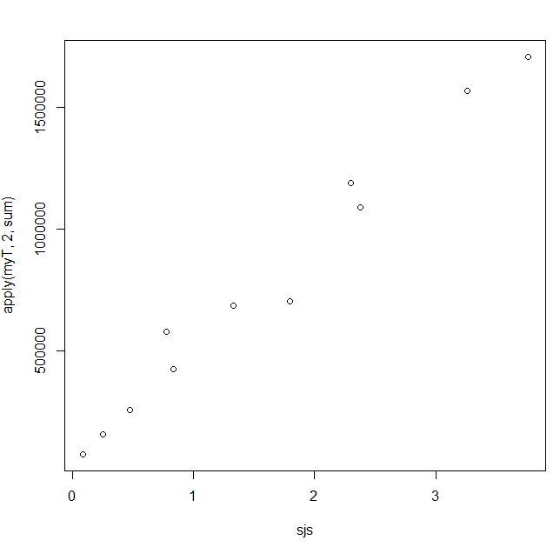
Despite the extra terms, Deseq’s sjs are closely related to the more simple metric
of sequencing depth
plot( sjs, apply(myT,2,sum))
# of replicates in each condition
So in practice (at least for this dataset), dividing by Sj is not that different from
simple relative abundance…

Slide 24
We can use the DeSeq formalism to take weighted averages across our three timepoints
(2 weeks, 12 weeks and 20 weeks)
q_{ip}
will be our estimate of expression, normalized by scaling factor
The times (the p(…) ) in our spreadsheet can be defined by columns…

Slide 25

rm(list=ls())
twoWeeks <- 1:3
twelveWeeks <- 4:7
twentyWeeks <- 7:11
myT <- read.table("nc101_scaff_dataCounts.txt", sep="\t", row.names=1,header=TRUE)
myT <- myT + 1
twoWeeks <- 1:3
twelveWeeks <- 4:7
twentyWeeks <- 7:10
medians <- apply(myT,2,median)
geoMean <- prod(medians) ^ (1/length(medians))
sjs <- medians/geoMean
getQsVals <- function( myT, sjs, range )
{
qs <- vector(length=nrow(myT))
for( i in 1:nrow(myT) )
{
sum = 0;
for ( j in range)
{
sum = sum + myT[i,j] / sjs[j]
}
qs[i] = sum / length(range);
}
return(qs)
}
qsForTwoWeeks <- getQsVals(myT,sjs, twoWeeks)

Slide 26
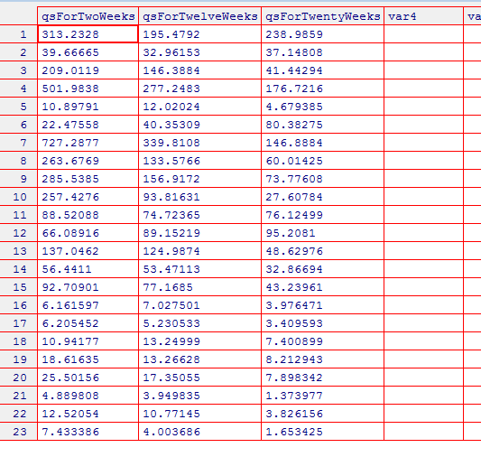
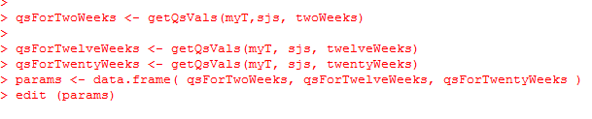

Slide 27
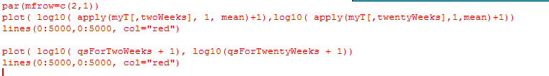
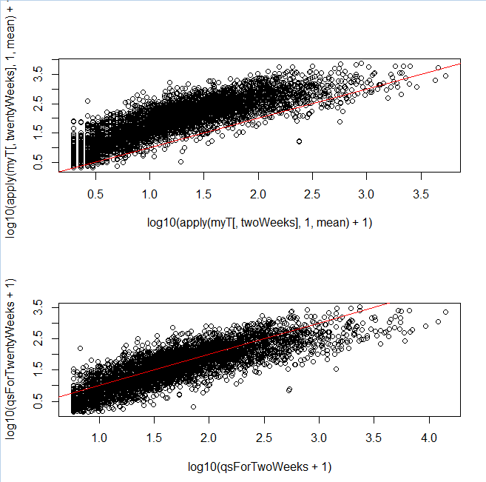
Our normalization makes the different samples more directly comparable…
Without normalization
You can see a local
regression might
have done better!
With normalization

Slide 28
What about the variance?
You might think the variance within a condition would just be something like…
varTwoWeeks <- apply( myT[,twoWeeks], 1, var )
varTwelveWeeks <- apply( myT[,twelveWeeks], 1, var )
varTwentyWeeks <- apply( myT[,twentyWeeks], 1, var )
That is just canonical variance defined within each category
There are going to be numerous reasons why this will not be the variance used in DeSeq

Slide 29
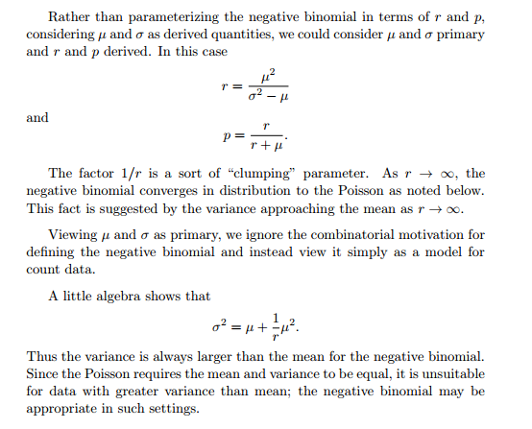
One problem is that the negative binomial distribution is not defined when the variance <= mean!
So if we are going to use the negative binomial, we have to define
the variance as the mean plus something…
http://www.johndcook.com/negative_binomial.pdf

Slide 30

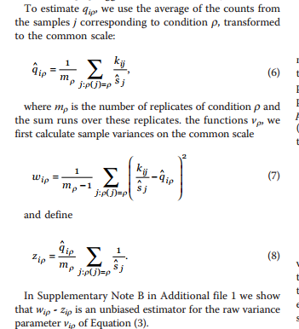
So if we are going to use the negative binomial, we have to define
the variance as the mean plus something…
What the variance would
Be under the poisson
The extra variance
associated with the
negative binomial
Weighted canonical variance
Weighted mean
Raw variance = weighted canonical variance (wip) – weighted mean (zip)
We will see next time that DeSeq never quite settles on a single way to measure the variance…

Slide 31
Next time:
Using DeSeq for inference on RNA-seq datasets

