Slide 1
Lab #8:
Due Friday Nov. 13
For the first part: send an e-mail to
afodor@uncc.edu and rlinchan@uncc.edu
The second part can be email or code check in (as usual) with a follow up e-mail.

Slide 2
Part 1: Add a file menu to prefuse.demos.RadialGraphView so that an xml file can be uploaded by the user.
Steps:
(1) Grab the prefuse github repository…
https://github.com/prefuse/Prefuse
(repository clone URL is https://github.com/prefuse/Prefuse.git )
(2) Show the Git repository window in Eclipse ( Window -> Show View -> Other -> Git Repositories)
Right-click in the Git repository window; choose “Paste Repository path” and paste
https://github.com/prefuse/Prefuse.git
(3) Once the repository is downloaded, right-click in the “Package Explorer” view; choose
new Java project; uncheck the “Use default location” box and navigate to the directory where
Prefuse was just downloaded (on my box this is C:\Users\afodor\git\Prefuse). Click “finish”
(4) To get prefuse to compile, add the Junit test suite jar;
In “Package Explorer”, right click on “Prefuse” -> properties -> “Java Build Path” -> “add external jar” ;
navigate to a path that will be something like:
C:\eclipse\plugins\org.junit_4.12.0.v201504281640\junit.jar
This should resolve all compilation problems…

Slide 3
(5) Within the Prefuse project navigate to demos.RadialGraphView.
Somewhere around line 73, change the file path to point to the data file the viewer needs:
So
public static final String DATA_FILE = "/socialnet.xml";
Becomes something like
public static final String DATA_FILE = "C:\\Users\\afodor\\git\\Prefuse\\data\\socialnet.xml";
Then you can run the RadialGraphView.

Slide 4
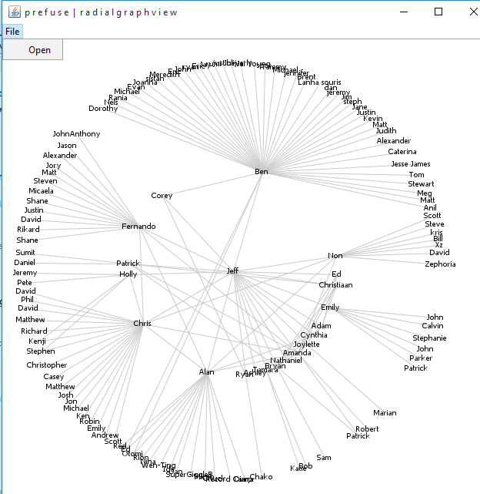
The first part of the lab is to add a File menu that can be used to switch between different input data files…
So this should look something like this….

Slide 5
Hints for the first part…
The menu can be added to the JFrame that is defined in the main method in demos.RadialGraphView.
So somewhere around line 220, define a JMenuBar/JMenu/JMenuItem and add it to the frame.
(2) Big hint: Once you have the file the user has chosen (which you can get with a JFileChooser ),
you can load the visualization with
frame.setContentPane(demo(file.getAbsolutePath(), "name"));
frame.revalidate();
(so those lines of code will go in the MenuItem action listener…)
Once your menu is working, you can switch between two xml files in the Prefuse data directory.
On my machine, these are
C:\Users\afodor\git\Prefuse\data\ socialnet.xml
and
C:\Users\afodor\git\Prefuse\data\terror.xml
When you hand in the e-mail, just send your revised main method in an e-mail to afodor@uncc.edu and rlinchan@uncc.edu.
(That is, don’t send the entire Prefuse library!)

Slide 6
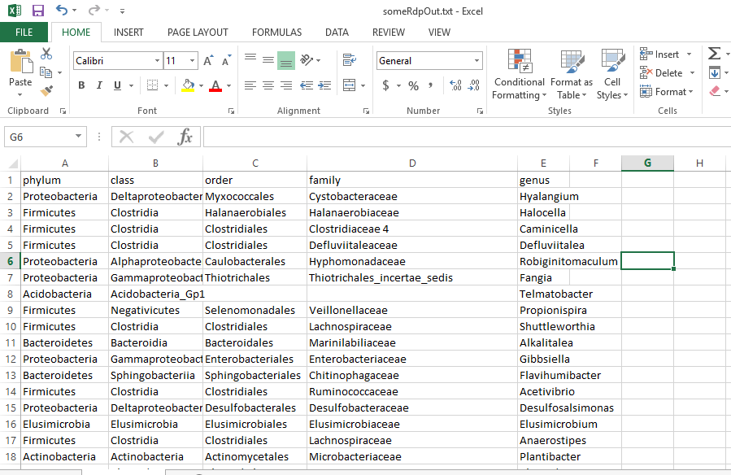
Part 2: Make a new XML file to show taxonomic data in the viewer…
The data that will be your input file will look like this…
Notice there are some missing values!
The file is here…
https://github.com/afodor/afodor.github.io/blob/master/classes/prog2015/someRdpOut.txt

Slide 7
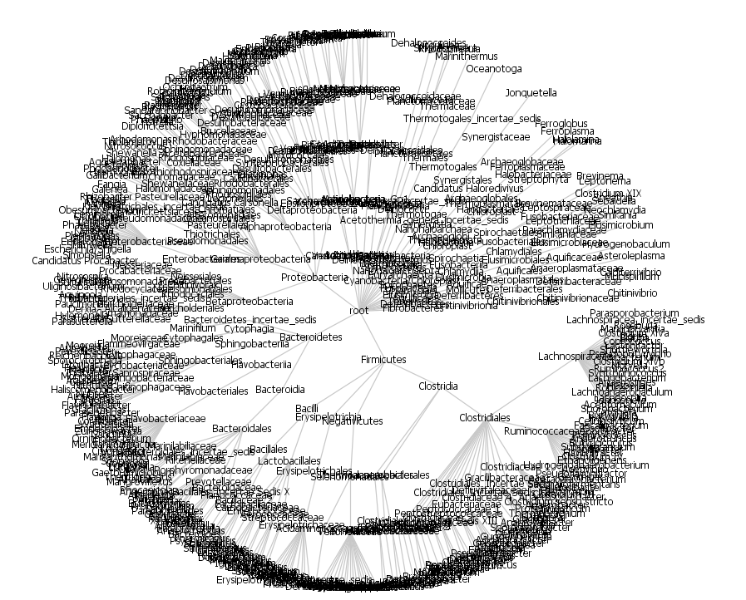
Part (2) of the assignment:
translate the data file in the previous slide to an XML file that can be read by the RadialGraphView

Slide 8
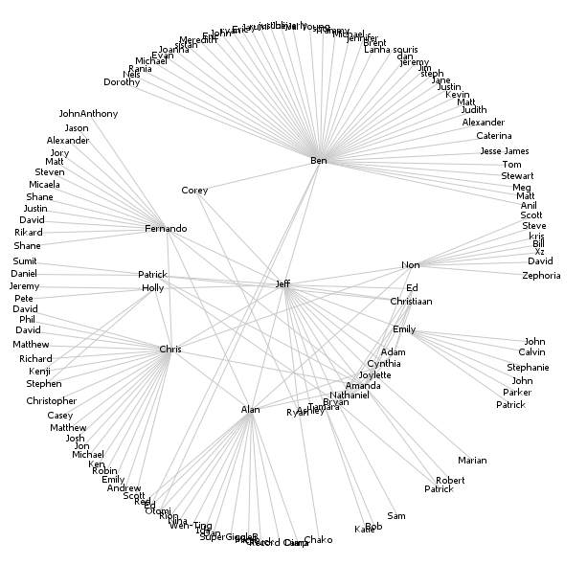
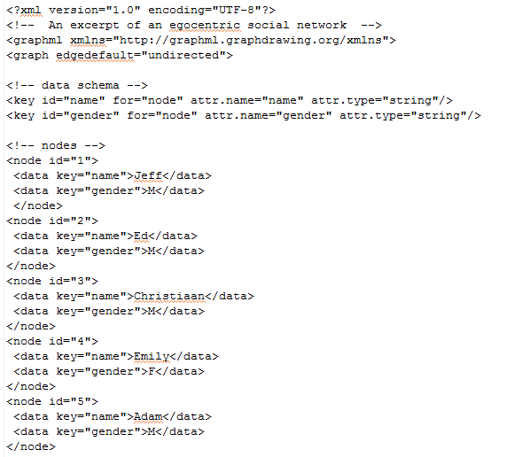
In the prefuse data directory, socialnet.xml
Dump out the beginning of the file verbatim from your Java code

Slide 9
In the prefuse data directory, socialnet.xml
Your data schema will be the name of the taxa and its phylogenetic level (phylum, class, order, family, genus)

Slide 10
In the prefuse data directory, socialnet.xml

Slide 11
Each name in the spreadsheet
should have be entered as a node
(have a “root” node that will be the parent of all phyla)

Slide 12
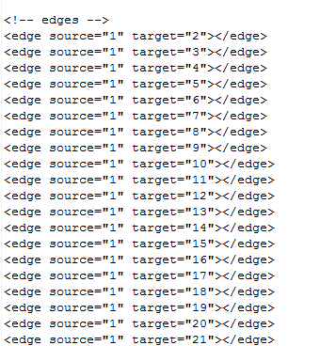
(The hard part: define all the edges between the nodes)
All phyla should be edged with root
All class should be edged with phyla etc. etc.

Slide 13
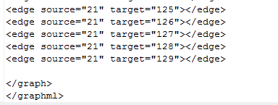
The end of your file has tags you should copy verbatim…

Slide 14
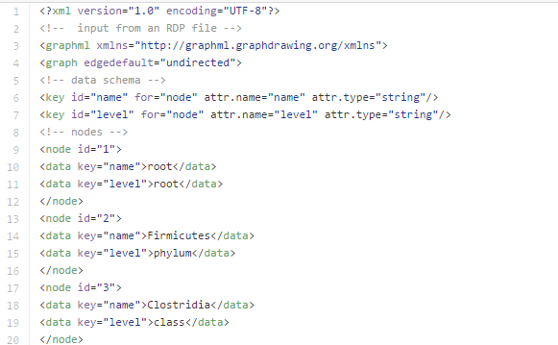
My solution is here
https://github.com/afodor/afodor.github.io/blob/master/classes/prog2015/someRdpOut.xml
Note the inclusion of a root node…

Slide 15
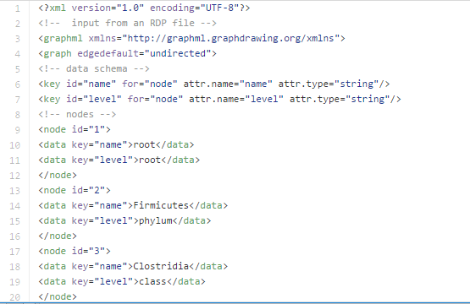
So in summary, in this part of the lab we are looking for code to go from this…
(which you can get at
https://github.com/afodor/afodor.github.io/blob/master/classes/prog2015/someRdpOut.txt )
To this
which for your reference is here….
https://github.com/afodor/afodor.github.io/blob/master/classes/prog2015/someRdpOut.xml

Slide 16
Once you have the xml, you should be able to view it in the RadialGraphView Java program
(navigating to it with the File menu you put in in part 1…)
E-mail (or check in) the code to go from the text file to the xml file…

