Slide 1
Correlated variables in linear models
PCA in concepts
PCA in equations
PCA in Java (for your reference; not covered in class or in final)

Slide 2

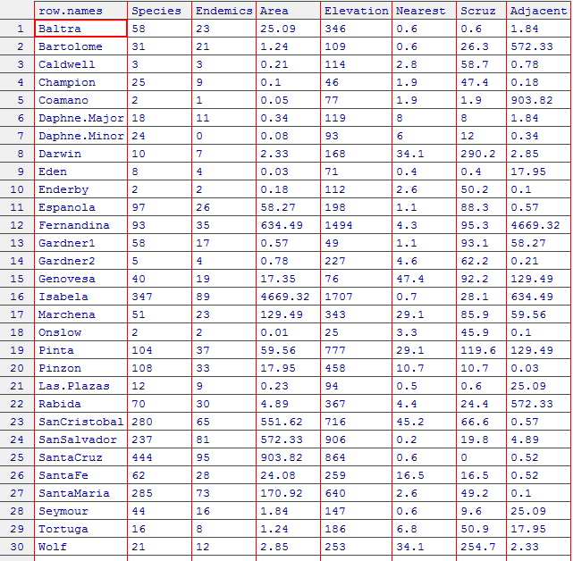
We will use a dataset from the Galapagos islands to think about correlated independent variables

Slide 3
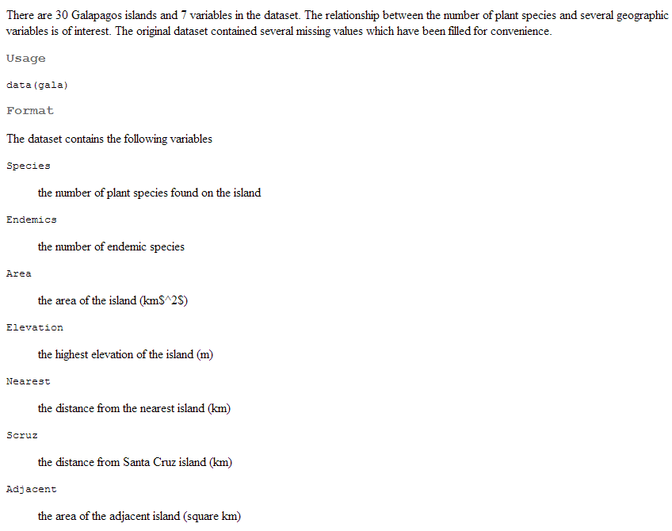
?gala

Slide 4
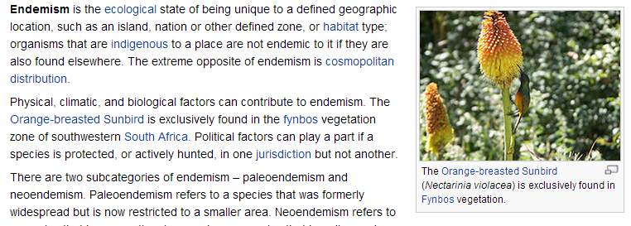
http://en.wikipedia.org/wiki/Endemism

Slide 5
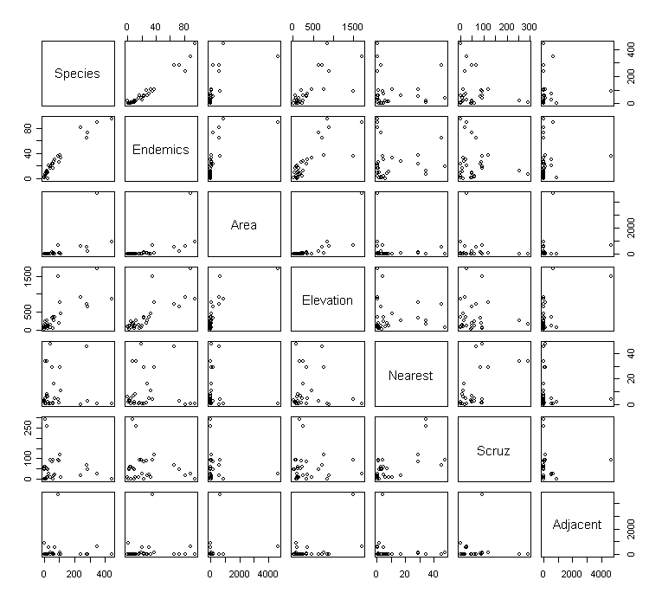
plot(gala) performs all by all scatterplots
Clearly there is redundant information here.

Slide 6
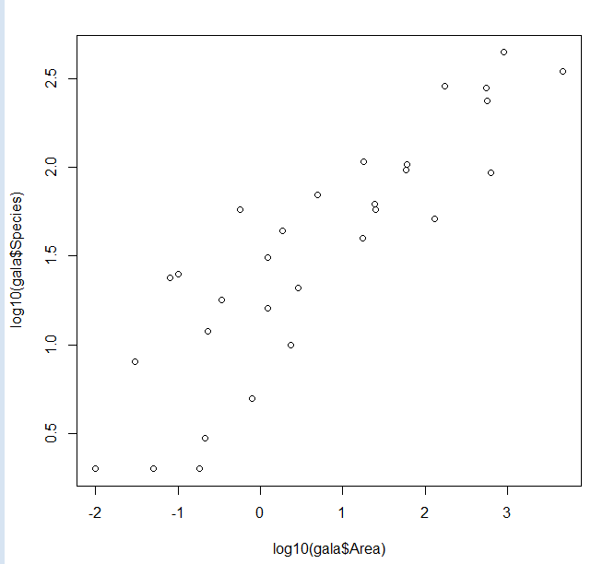
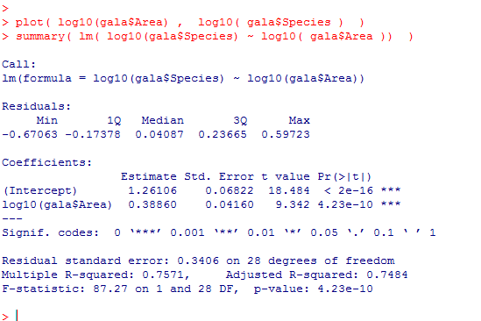
Area, elevation and species count are all correlated with one another…
Species Vs. Area

Slide 7
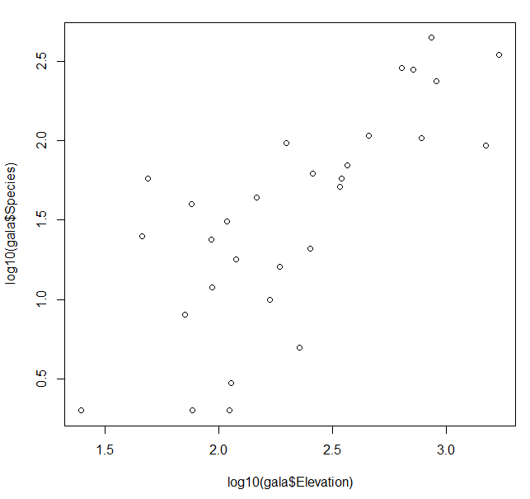
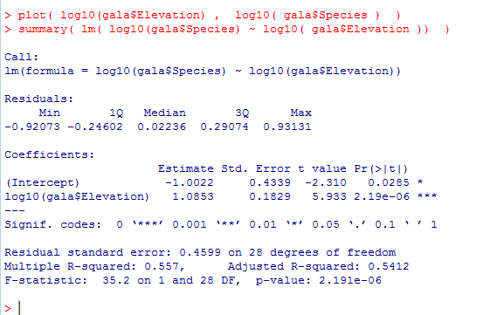
Area, elevation and species count are all correlated with one another…
Species Vs. Elevation

Slide 8
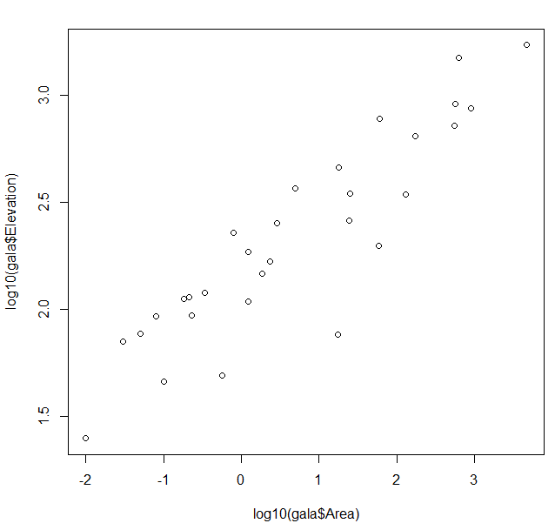
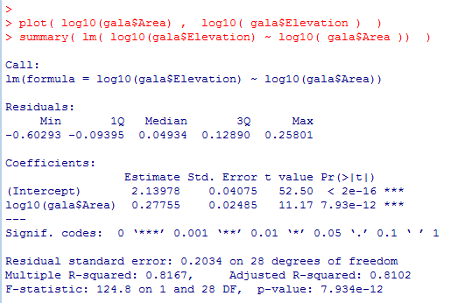
Area, elevation and species count are all correlated with one another…
Elevation Vs. Area

Slide 9
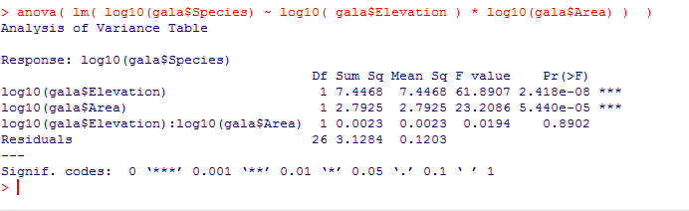
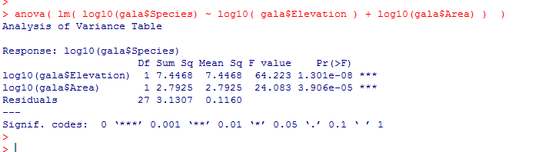
We put them together into a linear model…
We can drop the interaction term…
In the ANOVA view, both Elevation and Area are important
(zeroing them out significantly increases residual sum squared)

Slide 10
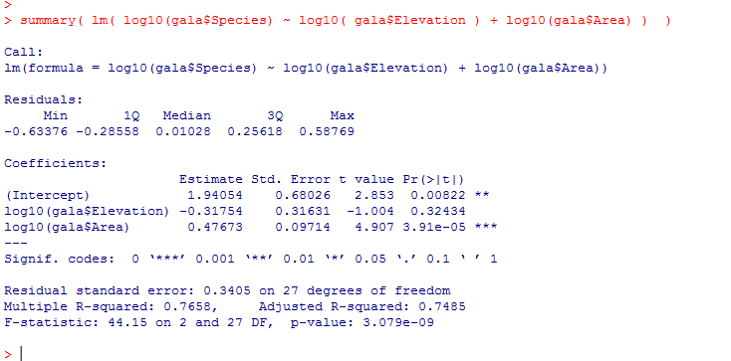
But in the summary view
Here Area “masks” elevation.
Species = B0 + B1 * area + B2 * elevation
Because area and elevation are well correlated, changes in B1 can be compensated for
by changes in B2.
This makes joint estimates of B1 and B2 unreliable and messes up our inference in
this case potentially leading to the incorrect conclusion that Elevation is not correlated with species

Slide 11
There are many possible solutions to problems with correlated data
(that could be a whole class onto itself).
We look at one approach that rotates the data onto new coordinates that
by definition are uncorrelated!
This is PCA (Principle Components Analysis)

Slide 12
Testing for random effects in linear models
Correlated variables in linear models
PCA in concepts
PCA in equations
PCA in Java (for your reference; not covered in class or in final)

Slide 13
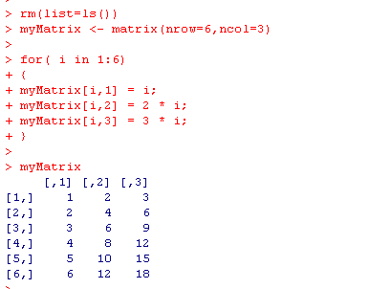
Consider a table that looks like this….
There are 18 data points here, but clearly we could represent this table is a compressed form…

Slide 14
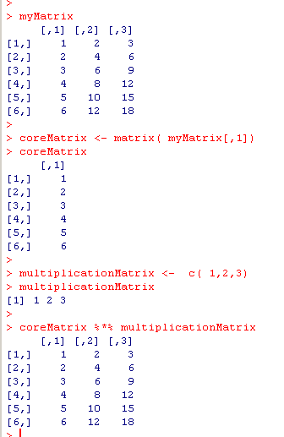
There are 18 data points here, but clearly we could represent this table is a compressed form…
The original matrix with 18 values…
The compressed form of the matrix with 9 total values
in two matrices
Our decompression algorithm!!!
We have achieved lossless compression by removing the redundant information!
We can store the entire table in 9 values instead of 18.

Slide 15
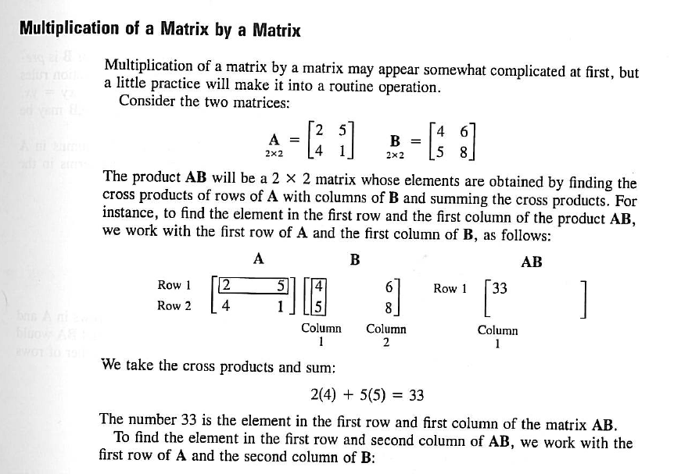
Matrix multiplication in R is the %*% operator
From your textbook…. (Matrix approach to Simple Linear Regression Analysis)

Slide 16
So the definition of matrix multiplication allows us to recover our original matrix
(6,1)
(1,3)
= (6,3)

Slide 17
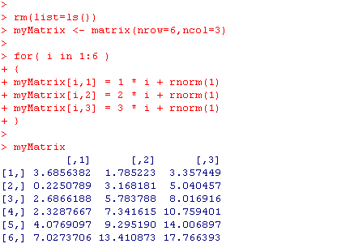
But what about if there is not perfect redundancy in the data?
Now the correlations are not as perfect. The level of redundancy has been reduced.
We can’t compress these data perfectly, but we can still devise a lossy compression strategy

Slide 18
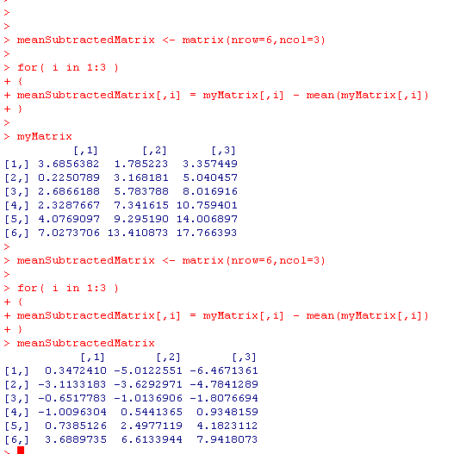
We are going to transform the matrix by subtracting from each column
the mean of each column… (this makes the math easier)
(We can always add them back later if we need to!)
Before subtracting the mean of each column
After subtracting the mean of each column

Slide 19
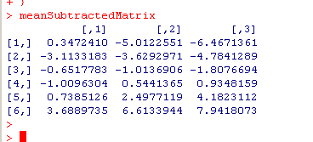
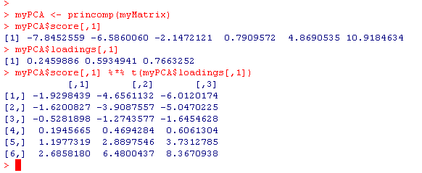
We seek the compressed form of this matrix
The compressed form is in fact…
1st eigen vector
1st principle component
(6,1) * (1,3) = (6,3)
(We will see shortly how R calculates these…)

Slide 20
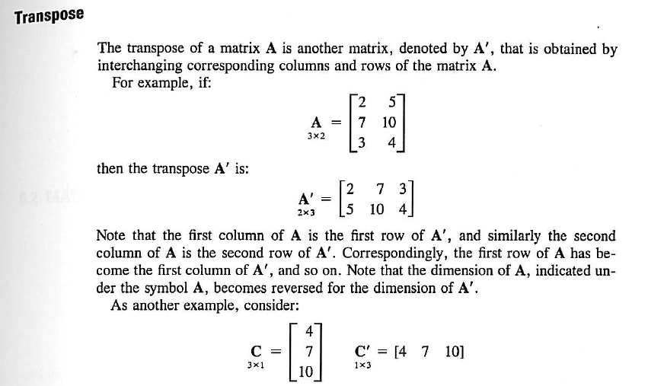
t is transpose. From the Linear Algebra chapter of your book.
(Chapter 5 in 3rd edition)

Slide 21
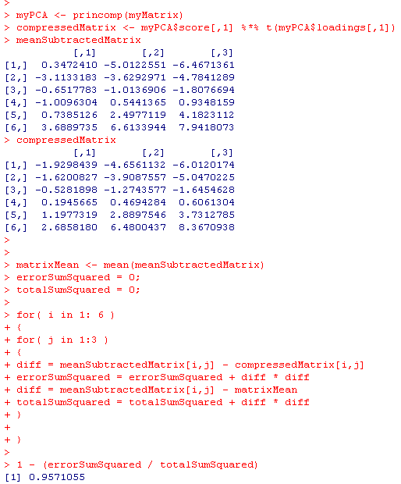
How much did we lose in our lossy compression???
We went from 18 data points to 9 data points, but how much information did we lose?
Error sum squared =
sum(compressed – original)² for all points
in the matrix
Total sum squared = sum(x – x_{avg})²
for all points in the uncompressed matrix.
The compression captures 95.7% of the variance

Slide 22
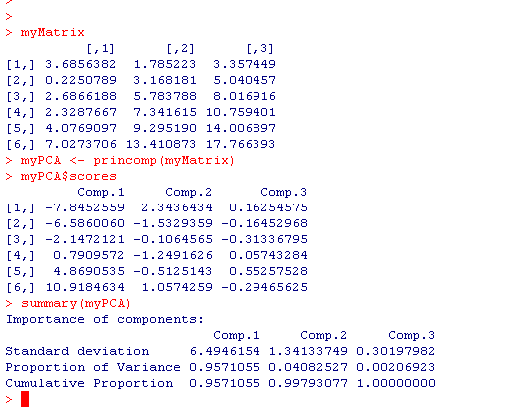
More formally…
This is the first principle component of myMatrix.
It explains 95.7% of the data in myMatrix
That is, if you replace the three columns in myMatrix with this one column
you can still capture 95.7% of the variation.
We are forming a new one-dimensional basis that replaces our three-dimensional dataset.
The PCA guarantees that this new component is the best possible one; that is, no
other possible component could explain more variance

Slide 23
We can improve our compression if we use more data.
If we use two components, we can get 99.8% of our data back…

Slide 24
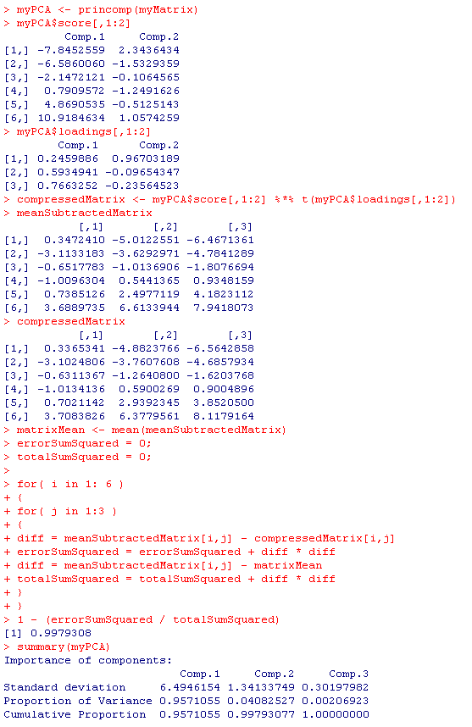
We’ll use out first two components
These are now nearly identical
We’ve captured 99.8% of the data but reduced
the dimensionality from 3D to 2D

Slide 25
Of course, if we use all 3 components, we can get
100% of the data back!
But that is trivial. Essentially just copying the data.

Slide 26
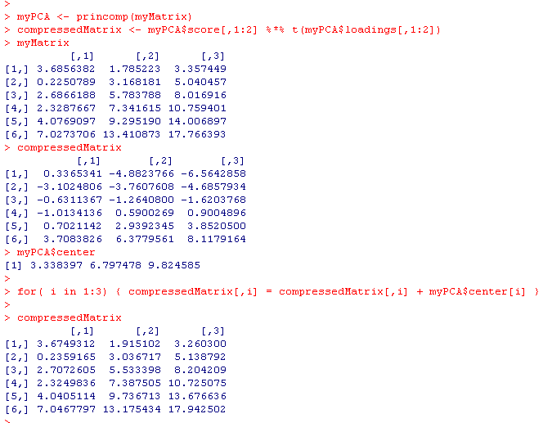
The PCA object stores the means so that we can get all the way back to the original matrix
Use two components
The original matrix
The mean centered compressed matrix
with 2 principle components…
The compressed version with the means added back in

Slide 27
PCA is very useful….

Slide 28

http://www.cff.org/AboutCF/

Slide 29
Ongoing studies in the Wolfgang lab:
Sputum samples from CF patients
23 patients total.
23 patients “exacerbation” and “end of treatment”
Antibiotics used to treat exacerbations include ceftazidime,
tobramycin, minocycline, meropenem, colomycin, clindamycin
3 patients followed through a second “exacerbation” and “end of treatment” event
For 13 patients an additional “stable” timepoint

Slide 30
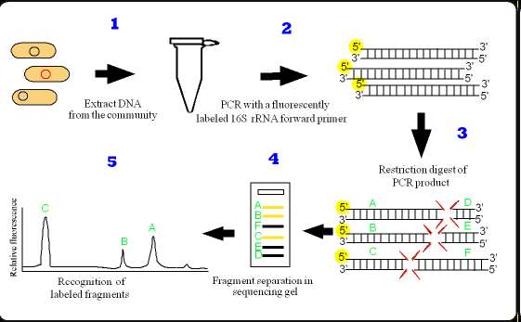
T-RFLP is a low cost “fingerprint” technique
Image:rdp8.cme.msu.edu/html/t-rflp_jul02.html

Slide 31
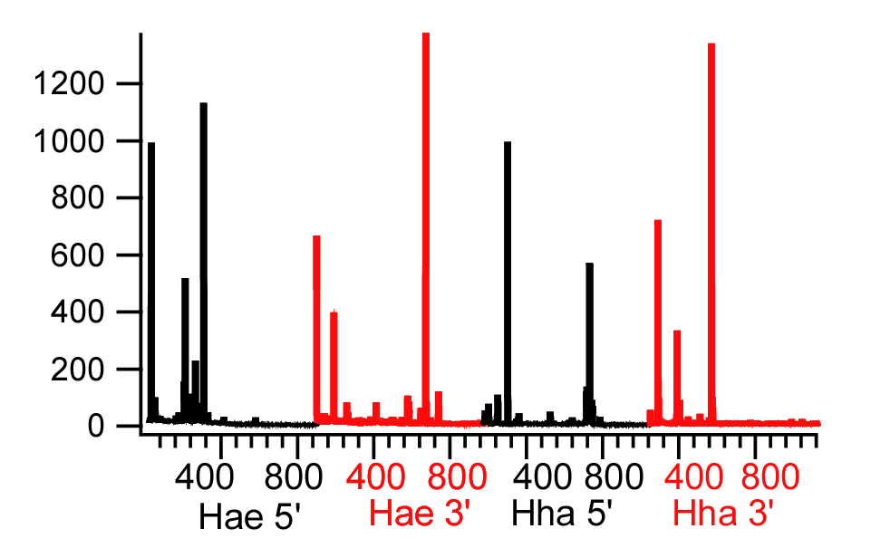
4 T-RFLPs per sample ( 2 enzymes * 5’ or 3’ labeled ends)

Slide 32
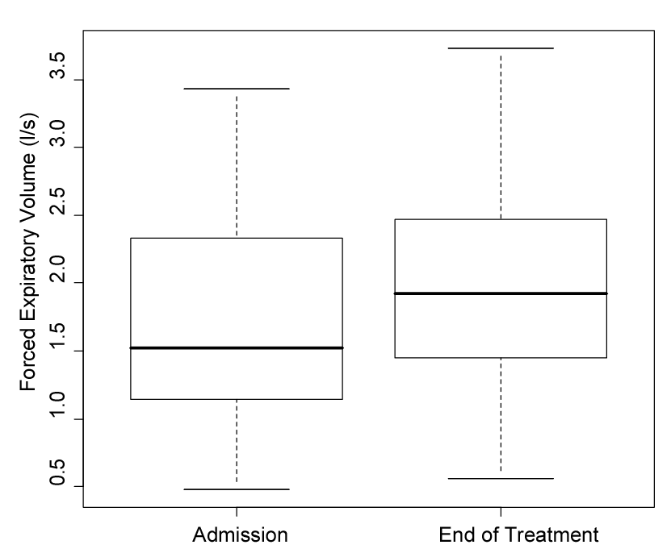
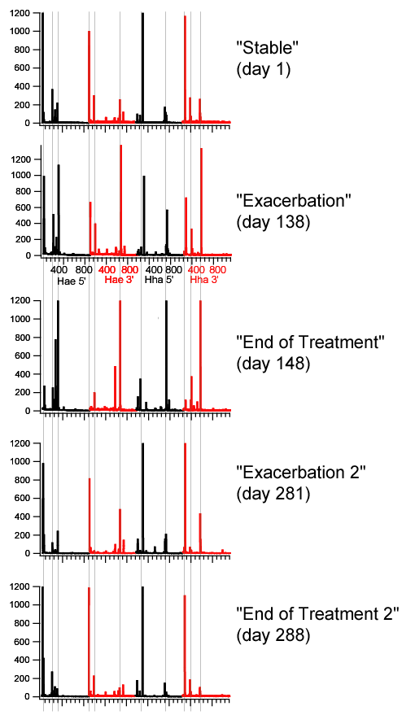
There is extraordinary stability in the
microbial community despite the
passage of nearly a year and
two-rounds of antibiotic treatment.
Patients did respond to antibiotics!
ceftazidime, tobramycin
ceftazidime, tobramycin
Paired t-test p-value = 0.00017

Slide 33
Break the x-axis into 3 basepair bins
Hae5’_0to3
Hae5’_3to6
Hae5’_7to10
…
Hha3’_1197to1200
Sample1
Sample2
Sample3
---
Sample64
Grid that is 64 by ~1000
Toss bins that don’t have peaks over some threshold
Grid that is 64 by 200
PCA

Slide 34
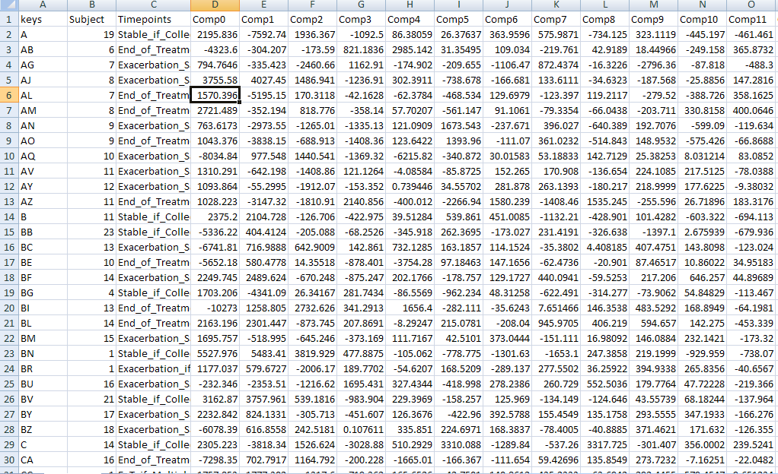
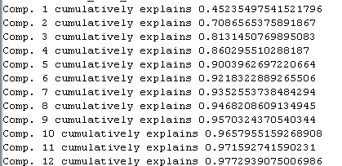
The results of the PCA analysis…..
200 components…
….
64 samples

Slide 35
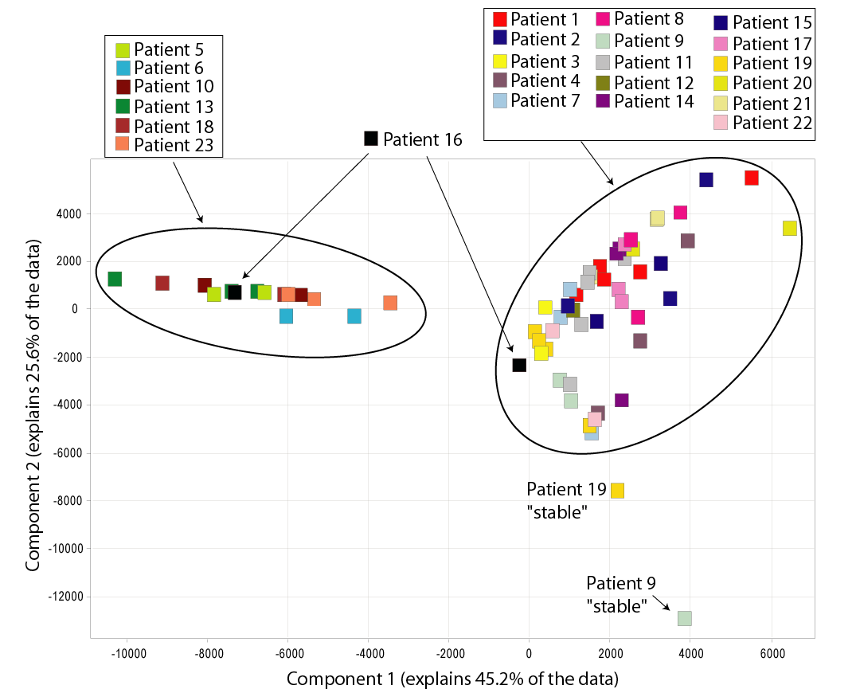
PCA analysis shows two groups of patients…
We have reduced our 200 dimensional dataset to 2D (so that we can plot it!)

Slide 36
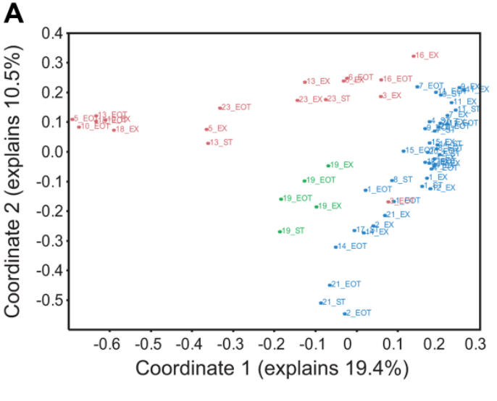
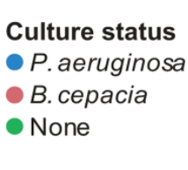

PCA done on sequence counts from the same samples explains what drives the two clusters…

Slide 37
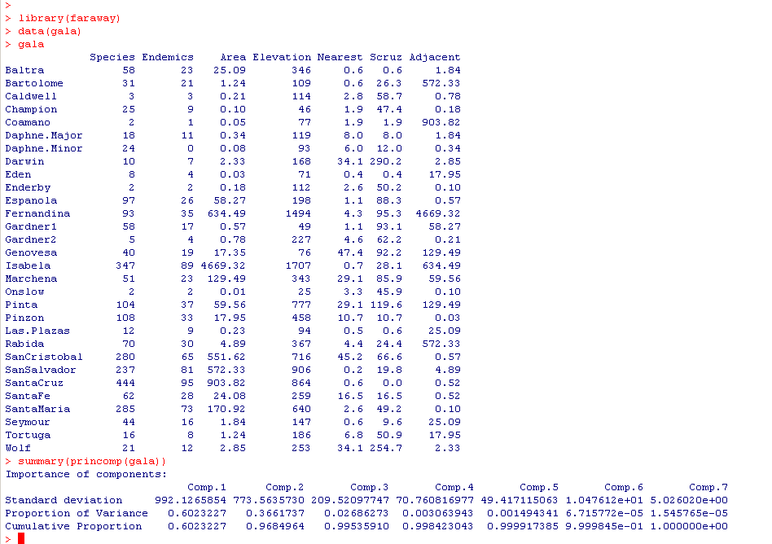
Let’s return to the gala dataset…
There are only 2-3 columns of non-redundant information

Slide 38
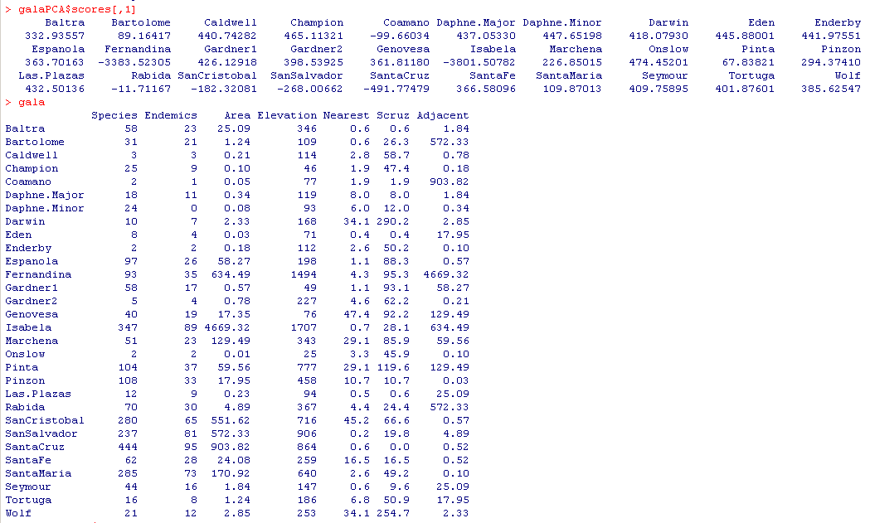
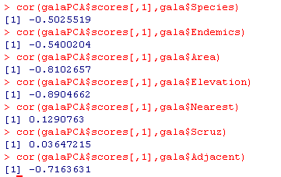
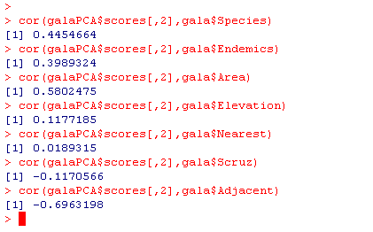

The first component correlates with many of the measured variables…
The second component has much
Less correlation with elevation
The two components, of course,
are not correlated with each other (that’s the point!):

Slide 39

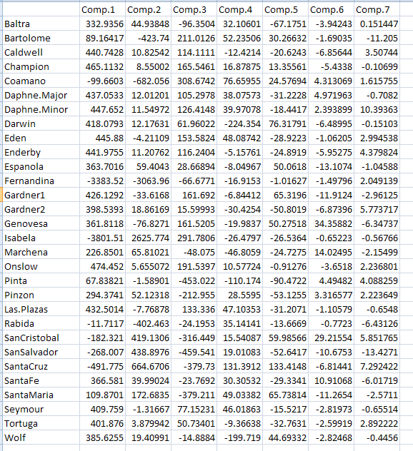

Slide 40
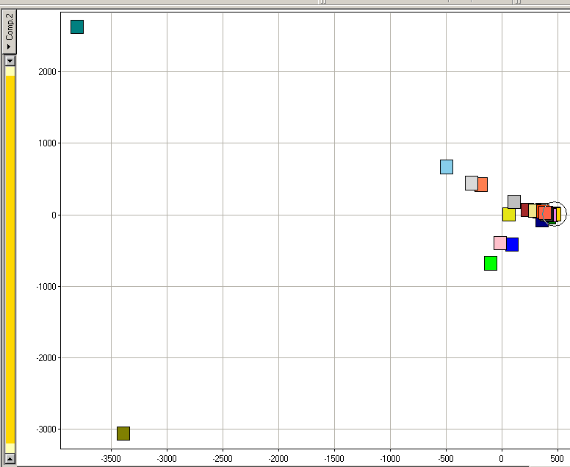
Isabella
Isabella and Fernandina seem really different…
Component 2
Fernandina
Component 1

Slide 41
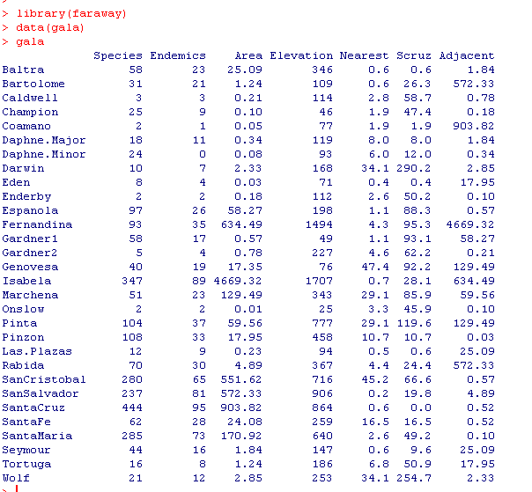
Fernandina is adjacent to Isabela.
The large area of Isabela causes both points to be outliers….
Limitations of PCA become apparent for this dataset…
A single datapoint drives the outliers

Slide 42
Testing for random effects in linear models
Correlated variables in linear models
PCA in concepts
PCA in equations
PCA in Java (for your reference; not covered in class or in final)

Slide 43
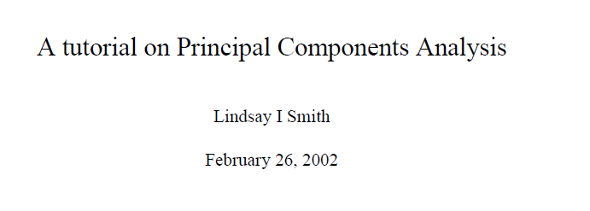
You are NOT responsible for the matrix algebra in this section on the final…
A nice concise summary is here…
http://www.cs.otago.ac.nz/cosc453/student_tutorials/principal_components.pdf
Knowing how to do this means that we can implement PCA in any language
and not be dependent on R.
Plus it is just sort of interesting…

Slide 44
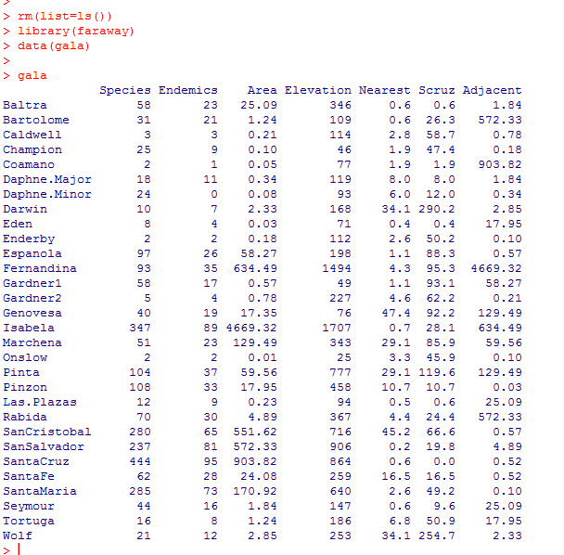
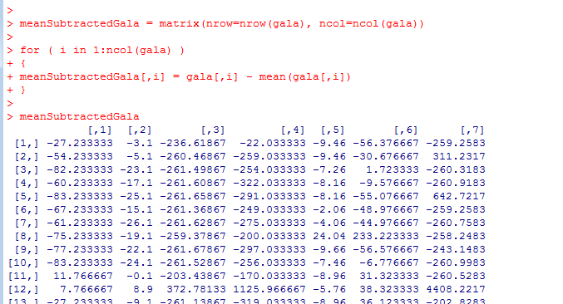
Steps to find the principle components…
Start with your data matrix…
Mean subtract the columns

Slide 45
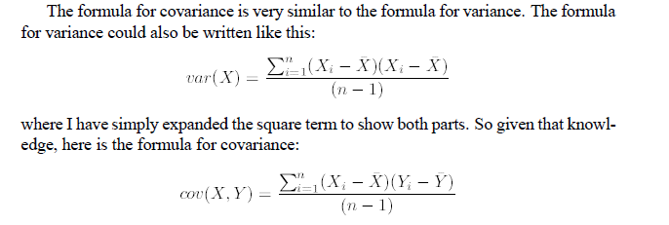
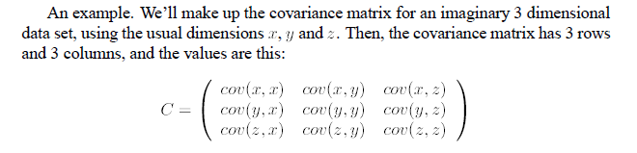
Form a covariance matrix…
For our (6,3) data matrix, the covariance matrix will be (3,3)
Next, generate the Eigenvectors of the covariance matrix.
When we multiply these eigenvectors times the original data, we are transforming the
old coordinates to a new co-ordinate system based on the principle components.
The eigenvectors from the basis of our new coordinate space.

Slide 46
Covariance Matrix
Representing covariance among dimensions as a matrix, e.g., for 3 dimensions:
Properties:
Diagonal: variances of the variables
cov(X,Y)=cov(Y,X), hence matrix is symmetrical about the diagonal (upper triangular)
n-dimensional data will result in nxn covariance matrix

Slide 47
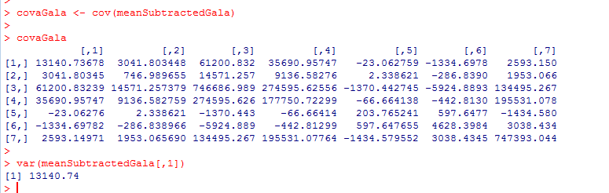

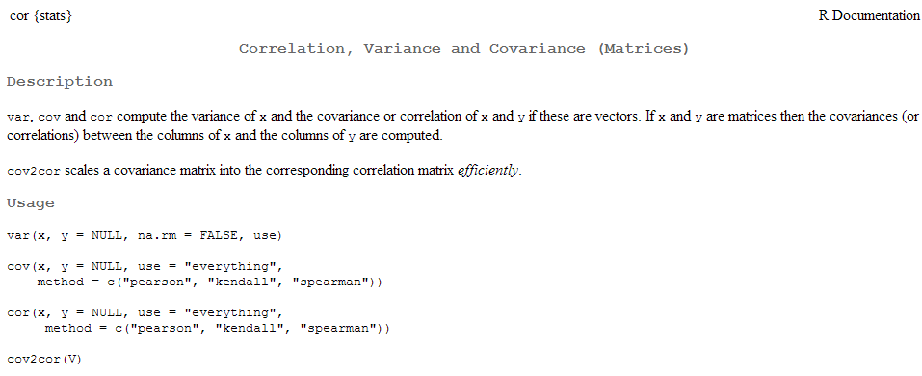
Form a covariance matrix…

Slide 48
Eigenvectors & Eigenvalues
Calculate the eigenvector and eigenvalues of the covariance matrix
Eigenvector: given a nxn matrix (A) there exists a nonzero vector x such that Ax = λx
Eigenvalue: λ is an eigenvalue of A if there is a nontrivial solution of Ax = λx
Example:
Ax =
1 6
5 2
6
-5
-24
20
6
-5
-4x
=
=
-4
=
Data
Eigenvector
Eigenvalue
Eigenvector

Slide 49
Properties of Eigenvectors and Eigenvalues
Eigenvectors can only be found for square matrices and not every square matrix has eigenvectors.
Given an n x n matrix (with eigenvectors), we can find n eigenvectors.
All eigenvectors of a symmetric* matrix are perpendicular to each other, no matter how many dimensions we have.
All eigenvalues of a symmetric matrix are real.
(symmetric matrices are examples of Hermitian matrices)
*Note: covariance matrices are symmetric!

Slide 50
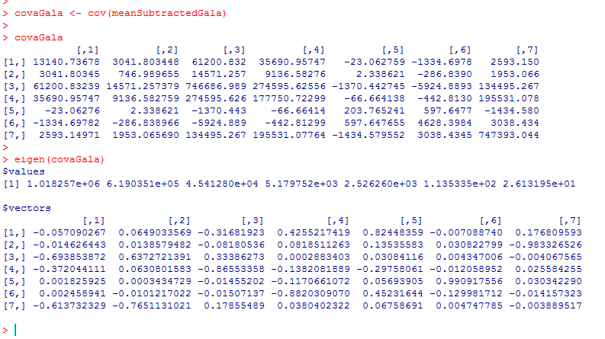
Generate the Eigenvectors of the covariance matrix.
Each of these EignenVectors are orthogonal to each other in some 7 dimensional space…
They form an orthogonal basis..

Slide 51
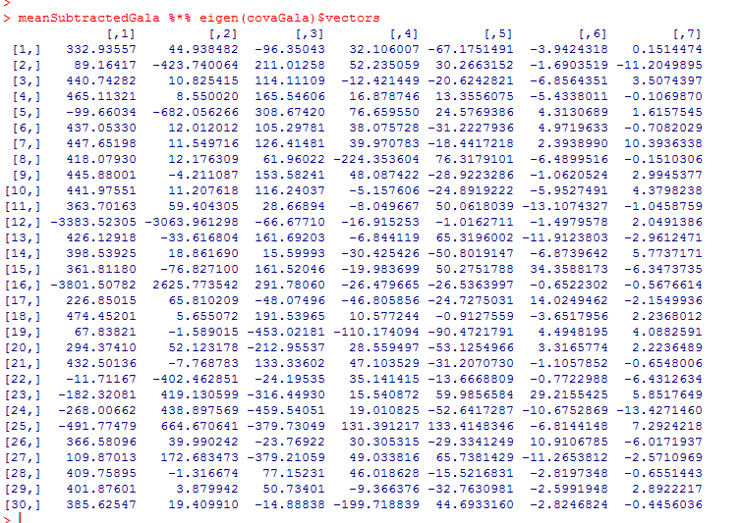
To get the new principle components, multiply the meanSubtractedMatrix times the eigenvectors.
Conceptually, we are “rotating” the data into a new dimensional space with
“orthogonal” vectors generated by the EigenValue decomposition.
We now have our data projected into component space..
These are the principal components of our data..

Slide 52

Alternatively (with much less typing)

Slide 53

Calculating the percent variance
When the λ_{i}’s (eigenvalues) are sorted in descending order, the proportion of variance explained by the p principal components is:

Slide 54


Consider a simulated 2D dataset
https://github.com/afodor/metagenomicsTools/blob/master/src/classExamples/pcaSim.txt

Slide 55


We can rotate these data any way we want to (by any orthornoral basis)
Before rotation
After rotation

Slide 56


The PCA rotation is the rotation that guarantees that PCA1 will capture the most possible variance of the data in one dimension
We have the option of doing inference (comparing for example red. vs. blue)
in one-dimension (with, for example, a simple t-test) even though we started with
two correlated variables)

Slide 57


We have the option of doing inference (comparing for example red. vs. blue)
in one-dimension (with, for example, a simple t-test) even though we started with
two correlated variables)

Slide 58
Correlated variables in linear models
PCA in concepts
PCA in equations
PCA in Java (for your reference; not covered in class or in final)

Slide 59

If you have a linear algebra library, PCA is easy to implement
The National Institute of Standards and Technology has been kind enough to provide
us with one…

Slide 60

1. Subtract column means…

Slide 61


2. Find the covariance matrix

Slide 62




Slide 63


Slide 64


Slide 65




Slide 66




Initial matrix:
Covariance matrix:
Eigen vectors:
,0
,1
,2
Eigen values:
% variance explained
Index in
EigenVector Matrix

Slide 67

R
JAVA
Initial Matrix
Eigen Values
(r has them sorted)
% variance explained
Index in
EigenVector Matrix

Slide 68


One more trivial helper method to reorder the eigenvalues…
Unsorted Eigen Vectors
Sorted Eigen Values
In:
Eigen value
Index
Out:
Sorted EigenVectors

Slide 69



Once we have our Eigenvectors, we are ready to calculate the components….
(or just d.times(eigenVectors))

