Slide 1
ROC curves in WEKA
Visually estimating variance via null permutations
Comparing classifiers

Slide 2
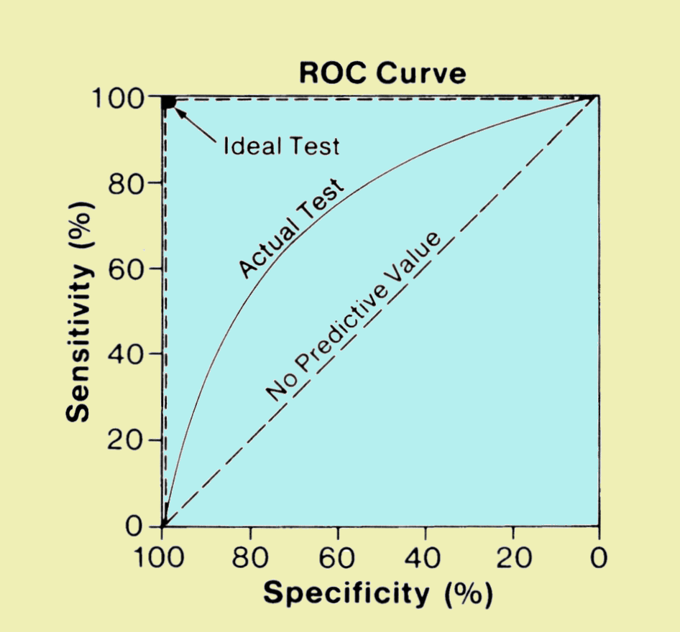
An ROC curve is a efficient visualization to observe classification performance
The “big data” approach to classification problems
Is a voter democratic or republican?
Voters with known affiliation
Training set
Test set
Find features
(income, zip code, gender)
that predict affiliation
Build statistical model
Make predictions on test set
Image: http://www.sprawls.org/ppmi2/IMGCHAR/1IMCHAR12.gif

Slide 3
The “big data” approach to classification problems
Is a sample case or control?
Whole-genome metagenome sequencing
on samples with known disease status
Training set
Test set
Find features
(taxa, genes)
that predict status
Build statistical model
Make predictions on test set
Image: http://www.sprawls.org/ppmi2/IMGCHAR/1IMCHAR12.gif

Slide 4
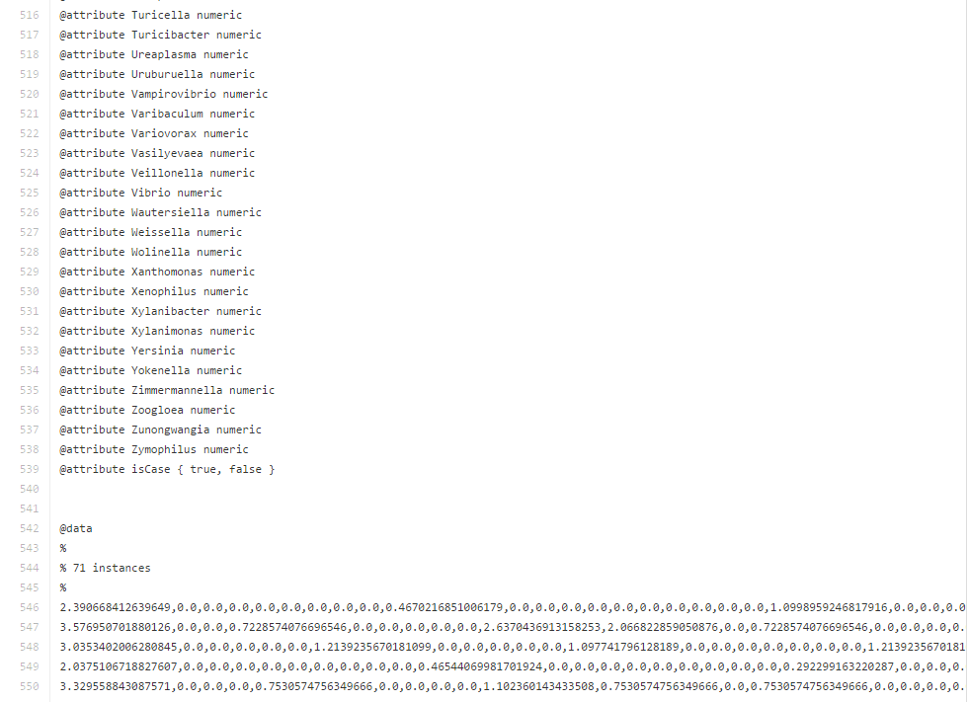
Our data file contains data from 71 patients…
https://github.com/afodor/afodor.github.io/blob/master/classes/prog2016/pivoted_genusLogNormalWithMetadata.arff
genera from PCR experiment
Patient did or did not have colorectal adenomas

Slide 5
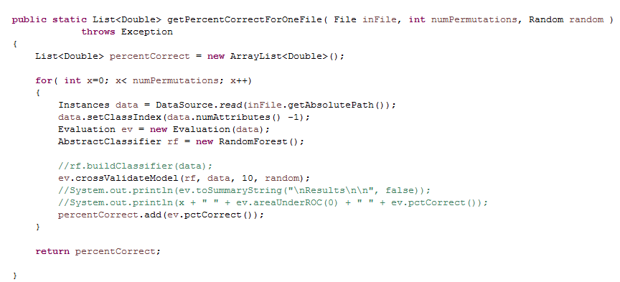
This code performs 10-fold cross validation…
https://github.com/afodor/WekaExamples/blob/master/src/examples/TestClassify.java

Slide 6
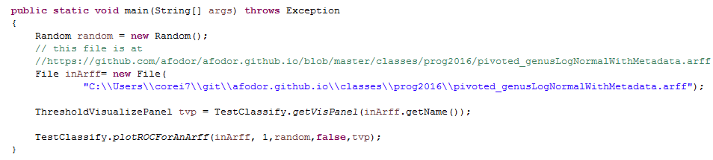
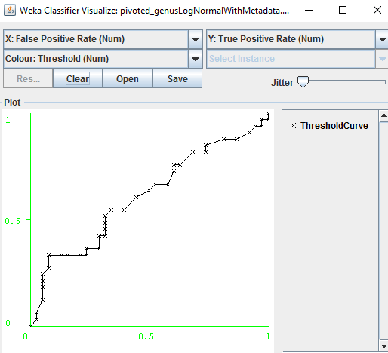
We can easily visualize the ROC code associated with this ten-fold cross validation
https://github.com/afodor/WekaExamples/blob/master/src/examples/RunOneROCCurve.java

Slide 7
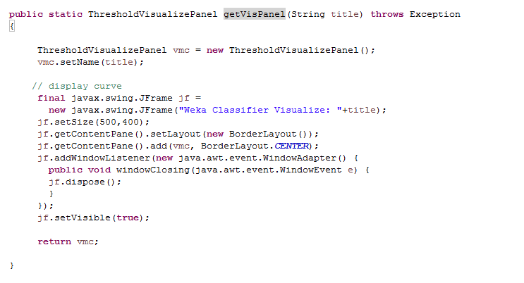
Our initial method just creates a “ThresholdVisualizePanel” and returns it…
Nothing we haven’t seen many times before in this class.
The ThresholdVisualizePanel is just a JPanel (AWT component) that knows how to draw ROC curves
https://github.com/afodor/WekaExamples/blob/master/src/examples/TestClassify.java

Slide 8
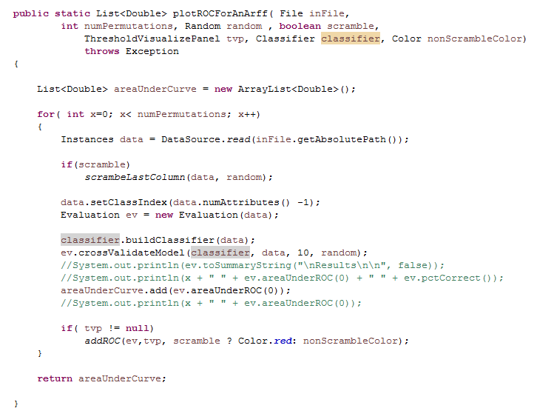
This method proceeds as before, building a classifier and testing it via ten-fold cross-validation
but we add a line for visualization
https://github.com/afodor/WekaExamples/blob/master/src/examples/TestClassify.java

Slide 9
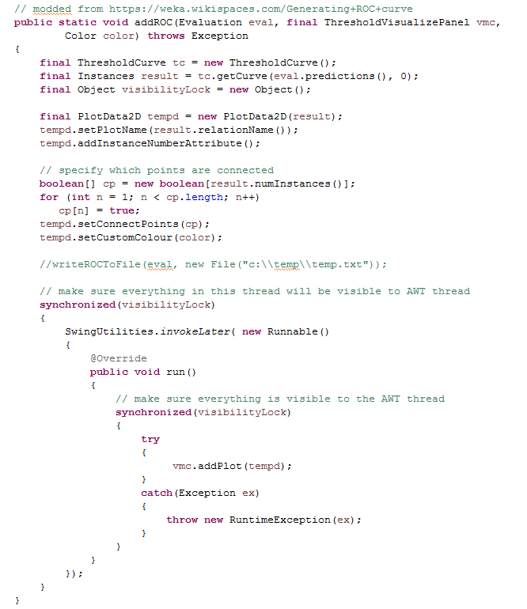
This code does the calculations of true positive and
true negative
All of the helper classes are stack confined,
but do not make visibility guarantees
Force visibility to any other thread that grabs this lock
Make sure AWT thread has full visibility
Actually write the plot; should happen on AWT thread
https://github.com/afodor/WekaExamples/blob/master/src/examples/TestClassify.java

Slide 10
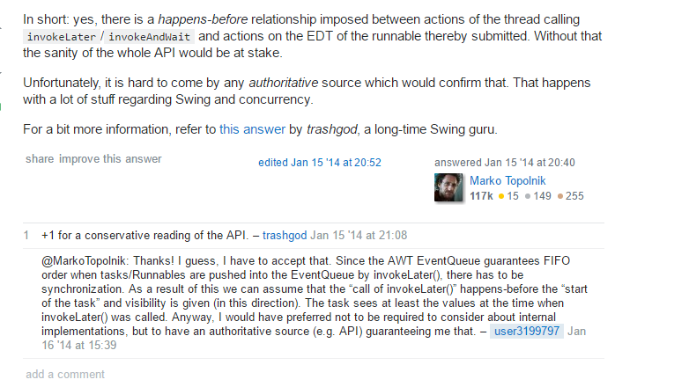
Do I need to manually force the visibility?
Probably not, but the documentation is a bit unclear, so better safe than sorry.
(It is a very small performance hit to grab the lock twice….)
http://stackoverflow.com/questions/21147240/is-happens-before-relation-given-in-case-of-invokelater-or-invokeandwait

Slide 11
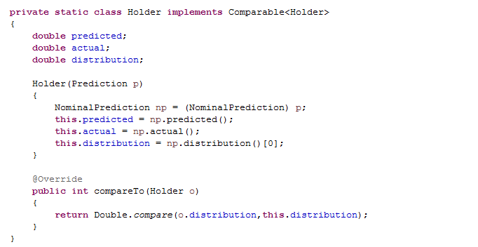
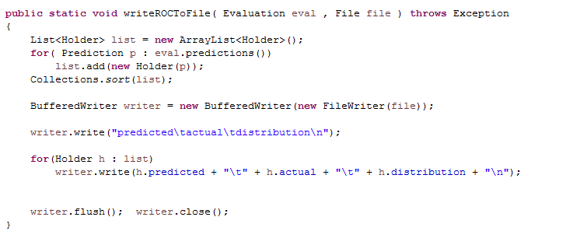
We can easily write out the ROC data to a file if we want to use an alternative visualization
or analysis platform….
https://github.com/afodor/WekaExamples/blob/master/src/examples/TestClassify.java

Slide 12
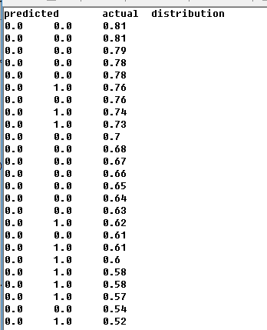
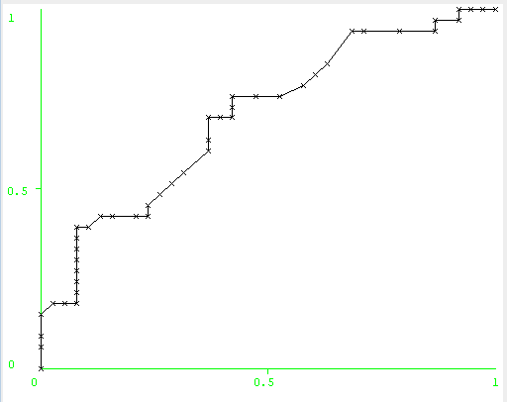
The “distribution” variable shows how much confidence the predictor has in each prediction and is
used to order the ROC curve

Slide 13
ROC curves in WEKA
Visually estimating variance via null permutations
Comparing classifiers

Slide 14
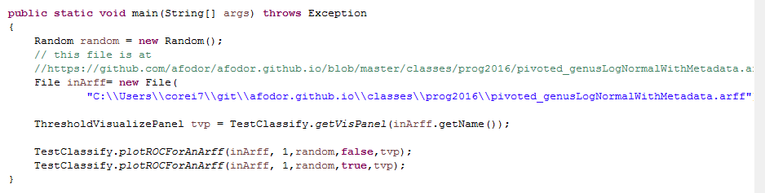
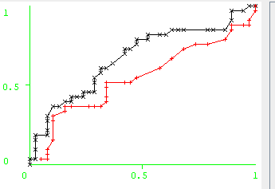
We can compare our “true” classification to
a classification with the case/control labels scrambled
https://github.com/afodor/WekaExamples/blob/master/src/examples/RunOneROCCurve.java

Slide 15
Our data gets scrambled
Our color turns red
https://github.com/afodor/WekaExamples/blob/master/src/examples/TestClassify.java

Slide 16
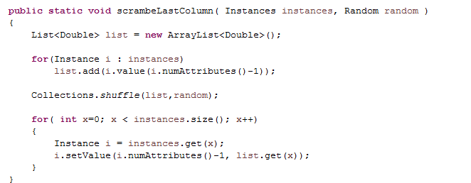
Scrambling the columns is trivial…
https://github.com/afodor/WekaExamples/blob/master/src/examples/TestClassify.java

Slide 17
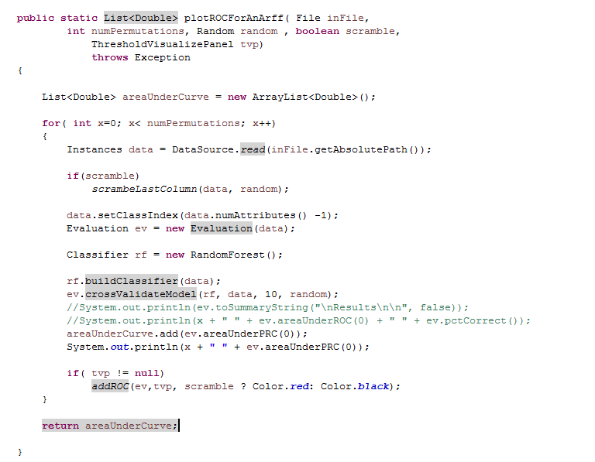
We can easily do this for multiple permutations…
https://github.com/afodor/WekaExamples/blob/master/src/examples/TestClassify.java

Slide 18
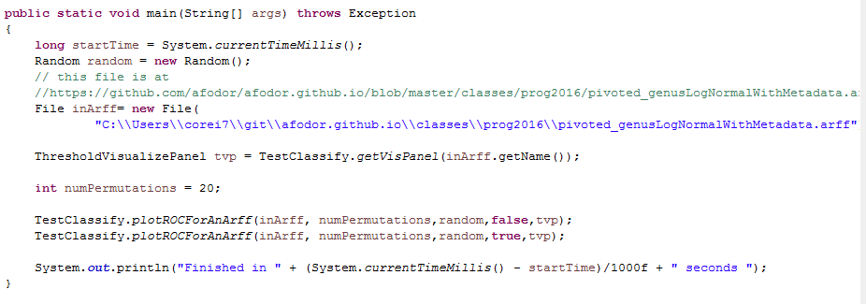
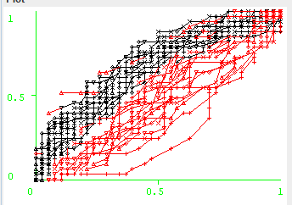
This makes a very compelling and informative visualization (here for 20 permutations)
https://github.com/afodor/WekaExamples/blob/master/src/examples/RunOneROCCurve.java

Slide 19
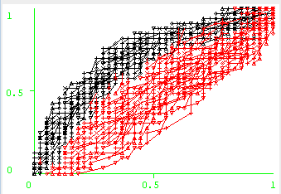
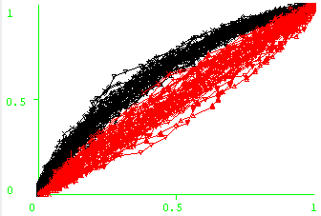
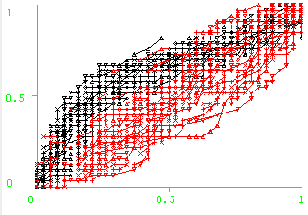
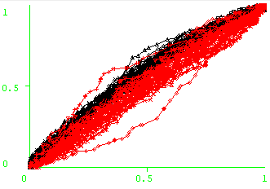
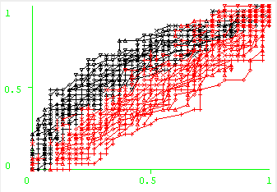
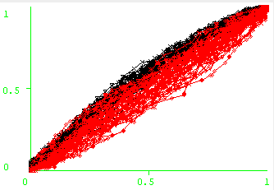
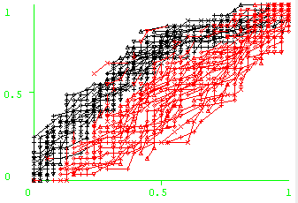
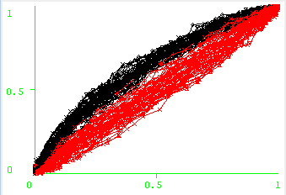
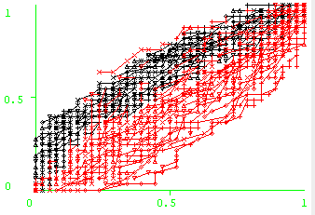
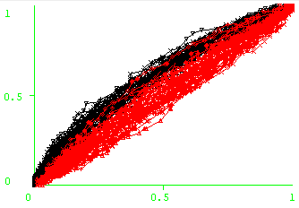
Comparison of two 16S microbiome datasets for colorectal adenomas from my lab…
2012
2015
2012
2015
phylum
family
class
genus
order

Slide 20
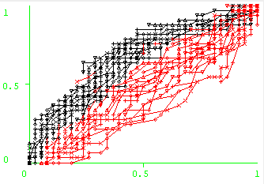

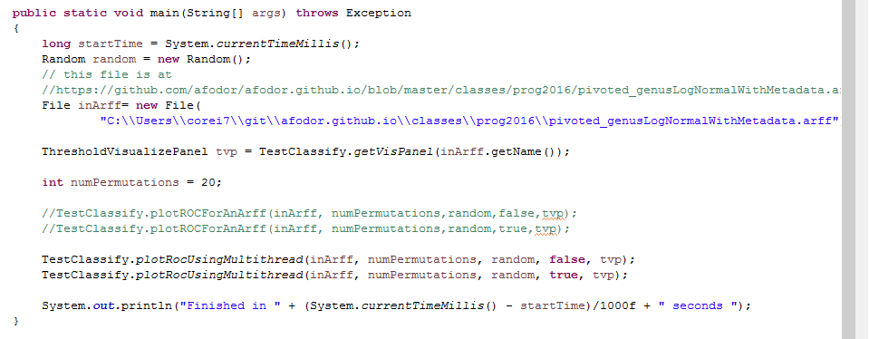
Multi-threaded application seems straight-forward…
A very robust 7.87 fold speedup on an 8 core box!
https://github.com/afodor/WekaExamples/blob/master/src/examples/RunOneROCCurve.java

Slide 21
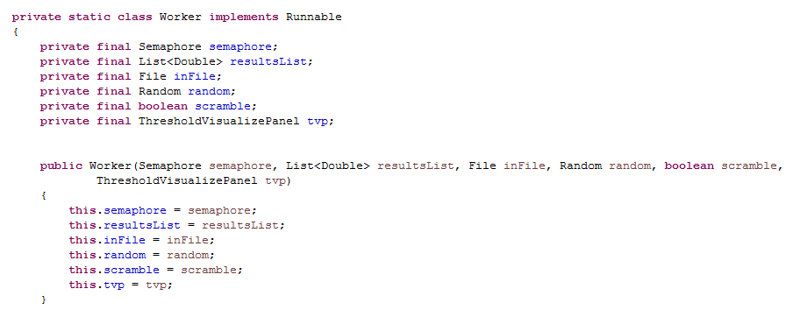
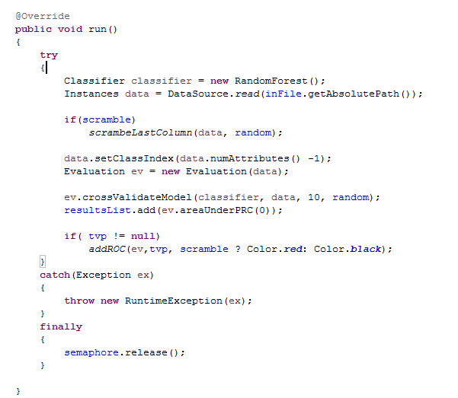
How do we make this multi-threaded? Start (as usual) by making a Worker class. Not much will be shared between workers..
Remember that everything here
is stack-confined up until the
drawing, which is confined to the
AWT thread and hence is single-
threaded!
https://github.com/afodor/WekaExamples/blob/master/src/examples/TestClassify.java

Slide 22
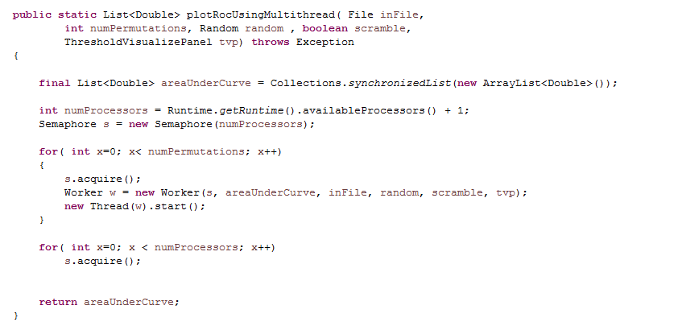
The semaphore remains a very easy to implement and flexible way to split work up between threads..
https://github.com/afodor/WekaExamples/blob/master/src/examples/TestClassify.java

Slide 23
(Just because it is bothering me….)
Once you go to multi-threaded, there is no reason for each thread to share a Random
(you lose determinism so setting an initial seed won’t allow you to exactly reproduce the results).
We still want to make sure each random has a unique seed (so we don’t want to use the system
time because two threads may be started within 10msecs of each other).
So we create a AtomicLong to see and let each thread have its own Random.
This minimizes contention on the Random and slightly simplifies the code…
(and also still guarantees reproducibility if you run the Workers one at a time single threaded)
(won’t make a measurable difference, but was bothering me….)

Slide 24

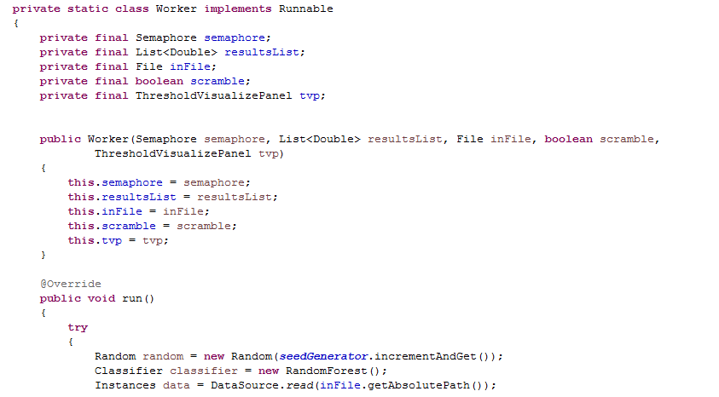
we create a AtomicLong to see and let each thread have its own Random.
…..
https://github.com/afodor/WekaExamples/blob/master/src/examples/TestClassify.java

Slide 25
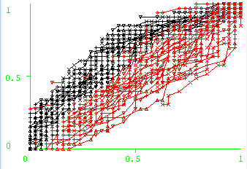
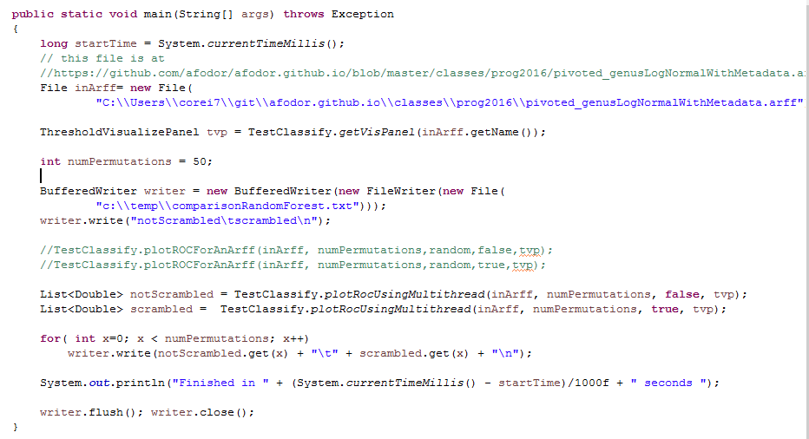

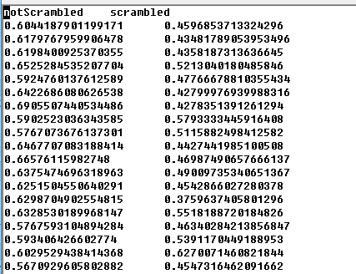
We can ask, does scrambled do worse than not scrambled to a statistically significant degree?
Increase our permutations

Slide 26
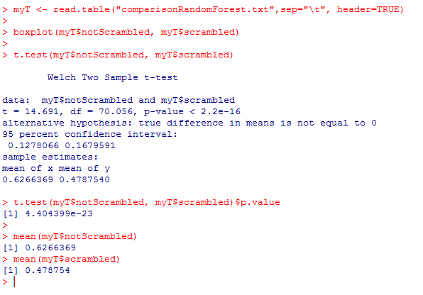
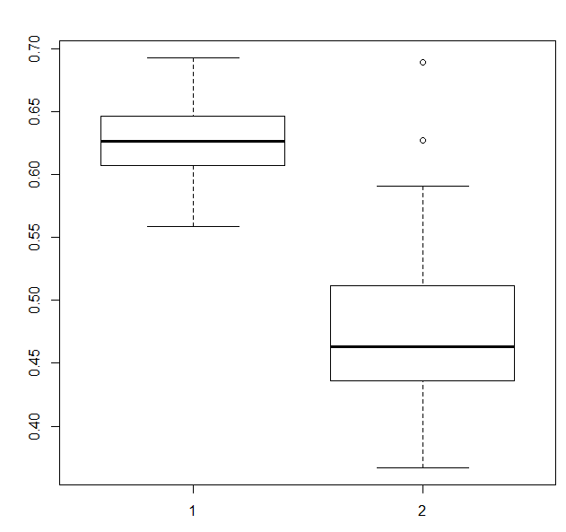
We switch to R for the visualization and the statistical test
On the hand, our predictor has modest power
(mean AUC = 0.63)
On the other hand, clearly better than shuffling
labels!

Slide 27
ROC curves in WEKA
Visually estimating variance via null permutations
Comparing classifiers

Slide 28
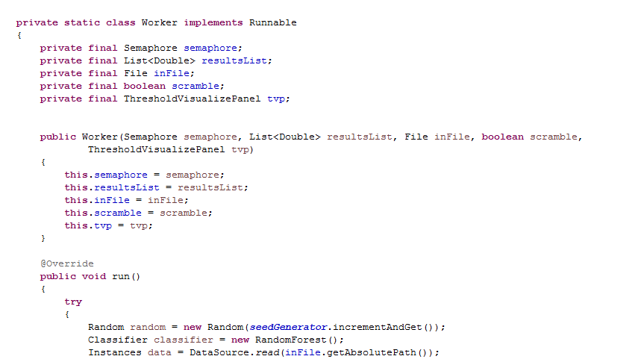
We’d like to be able to pass in a Classifier to our Worker, but we don’t want our workers to
share a Classifier object (as that would violate thread safety on mutable objects)
We can solve this problem by using Java’s ability to dynamically control which class is instantiated…

Slide 29
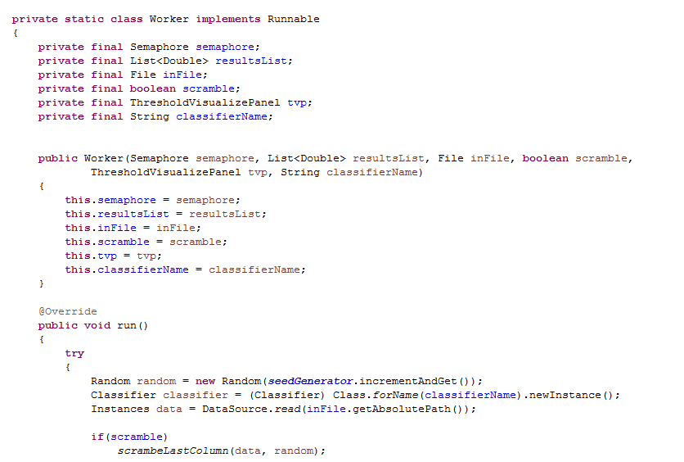
We can tell the Worker at run time which classifier to instantiate…
(This will, of course, throw a runtime Exception if classifierName does not name a valid Classifier with
a default constructor…)
https://github.com/afodor/WekaExamples/blob/master/src/examples/TestClassify.java

Slide 30
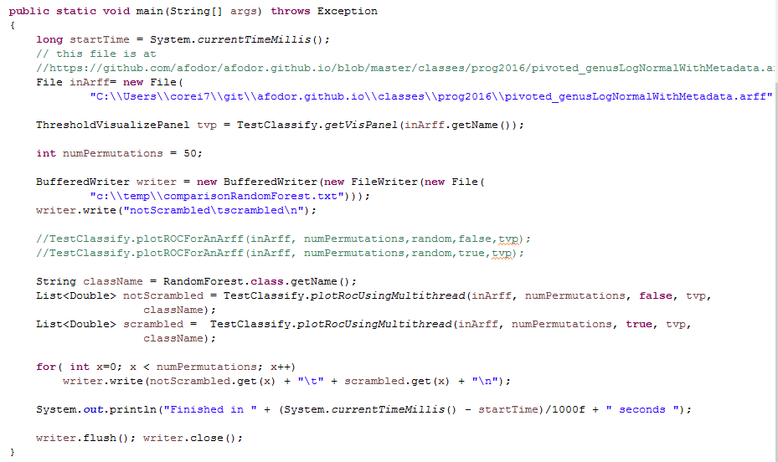
We can get the classifier name from the class itself

Slide 31
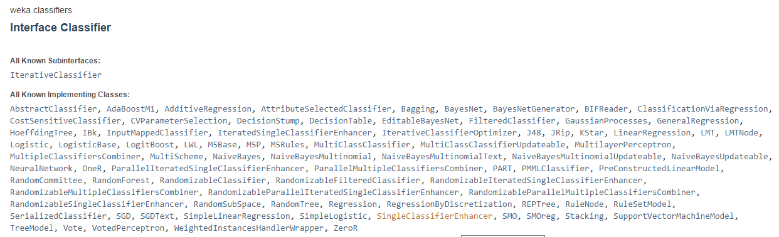
This allows us to use all of the classifiers that are implemented in Weka…
http://weka.sourceforge.net/doc.dev/weka/classifiers/Classifier.html

Slide 32
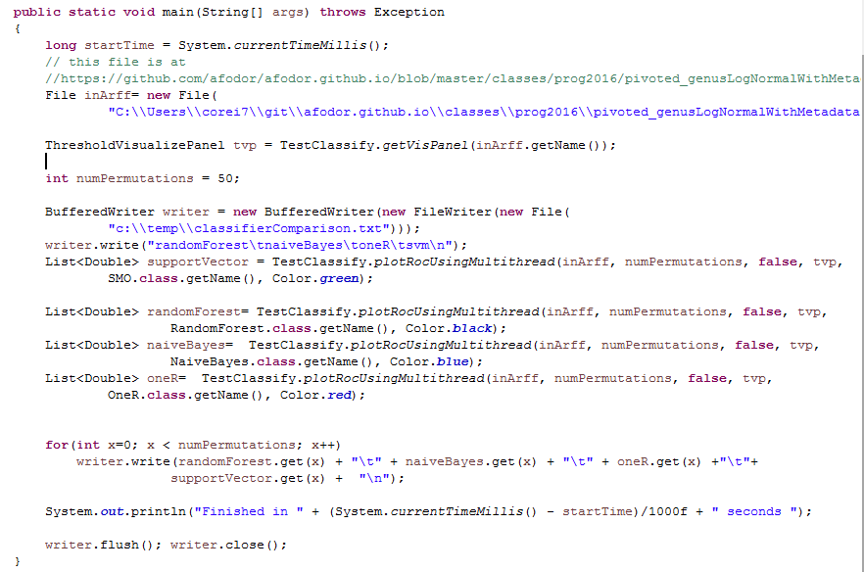
We can now directly compare classifiers (we modify the worker to pass in the color as well as the classifier)
https://github.com/afodor/WekaExamples/blob/master/src/examples/CompareClassifiers.java

Slide 33
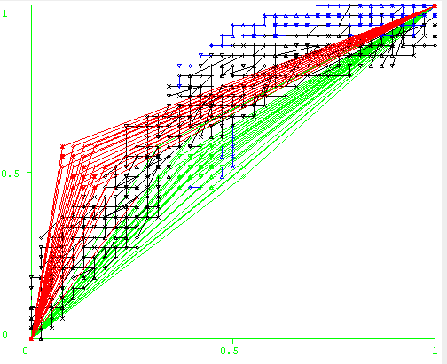
We can look at the ROC curves for a visual comparison…

Slide 34

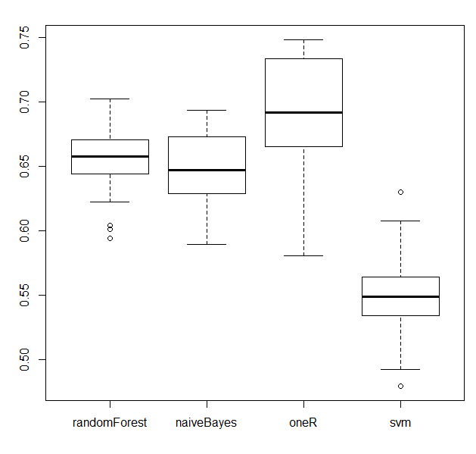
It has been noted many times in the literature, RandomForest works best for microbiome data…
Here the “OneR” algorithm does well…

Slide 35
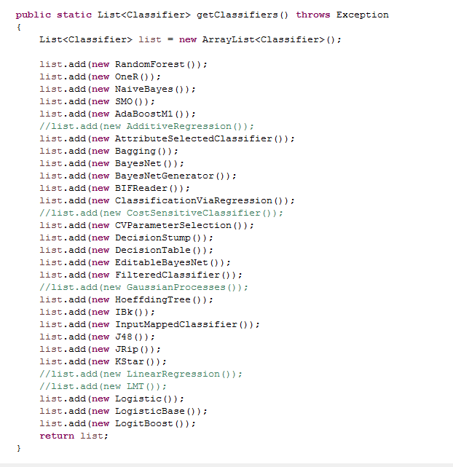
We can easily expand our classifier pool (commented out classifiers don’t work on binary data or don’t have
Default constructors/parameter sets or otherwise threw an Exception…)
(I got as far as L….)
https://github.com/afodor/WekaExamples/blob/master/src/metaMergers/RunAllClassifiersVsAllDataLocal.java

Slide 36
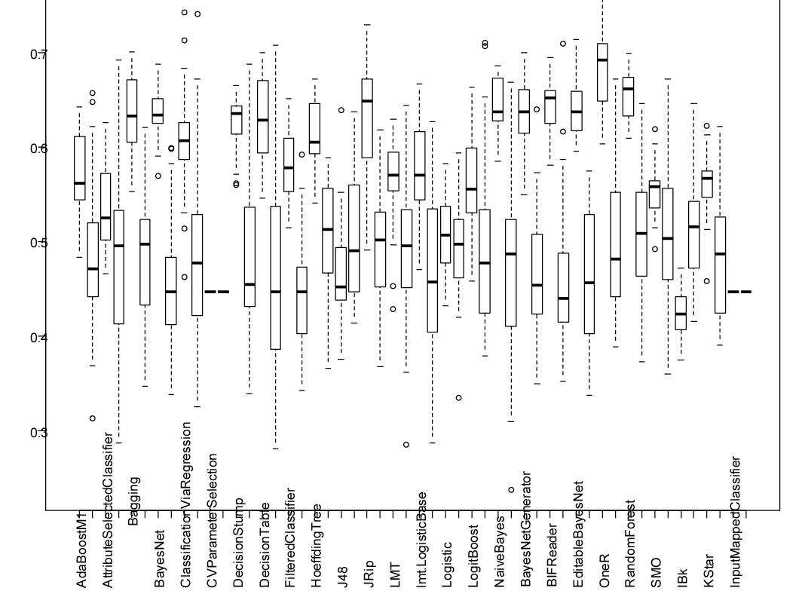
On our adenomas dataset at the genus level, OneR does well…
https://github.com/afodor/WekaExamples/blob/master/src/metaMergers/plotAllVsAll.txt

Slide 37
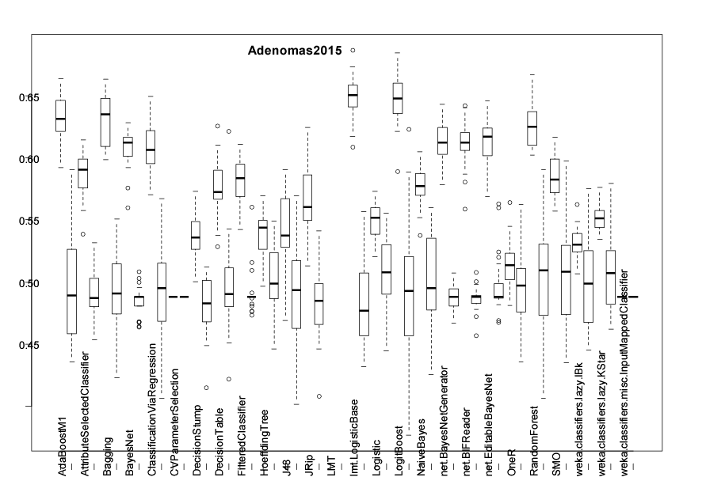
But RandomForest is more reliable across other datasets…

Slide 38


Slide 39

Models that have the words “boosting” or “Bagging” take a weighted average across many classifiers
(Random Forest does this as well).
This is often a good strategy for genomic (and metagenomics data)

