Slide 1
Amdahl's Law
Lock striping and the ConcurrentHashMap
Compare and Swap and non-blocking synchronization

Slide 2
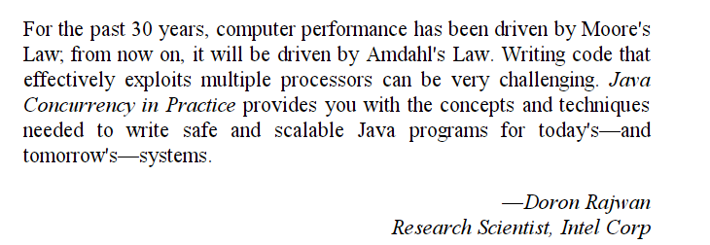
Amdahl’s law governs how efficiency scales with multiple processors…

Slide 3
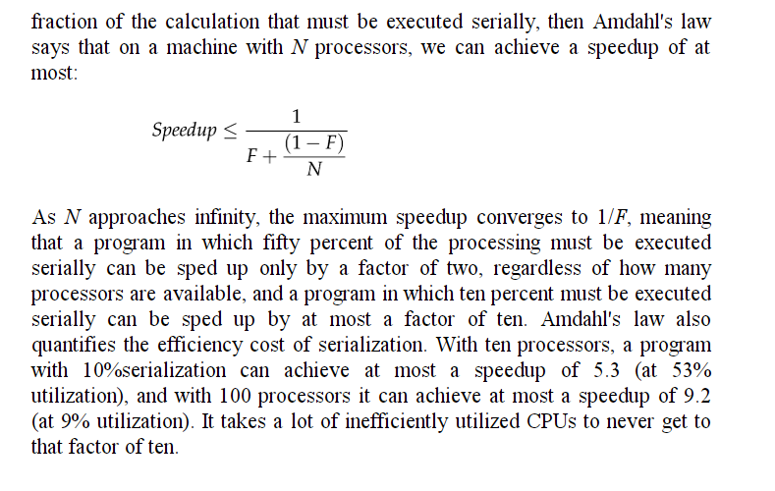
From chapter 11 of the book…
10 processors, 10% serialization (i.e. 90% parallelization) – max speedup is :
=1/ (0.1 + (0.9/10)) = 5.263158 = ~ 5.3 (which means 47% wasted utilization)
100 processors, 10% serialization – max speedup is: =1/ (0.1 + (0.9/100)) = 9.174312 (91% wasted CPU )

Slide 4
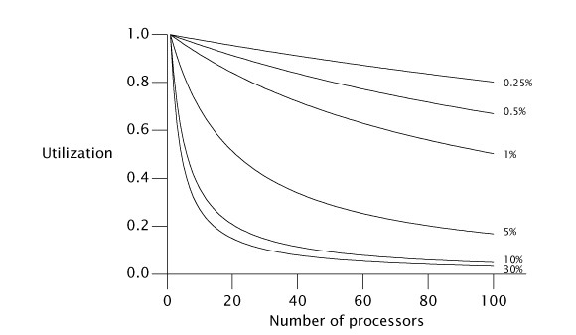
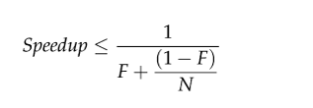
Even with 99% parallelization, it’s pretty easy to have a lot of wasted CPU time

Slide 5
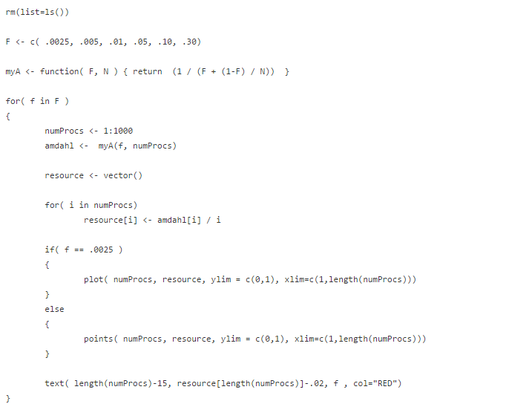
Here is a preview of R coding you can learn next semester to recreate this graph…
Amdahl’s law
Our x-axis range
Utilization = max. speedup / num processors
https://github.com/afodor/metagenomicsTools/blob/master/src/classExamples/amdahlsLaw.txt

Slide 6
For 100 processors: 99% efficiency leads to about 1/3 of the processors idle…

Slide 7
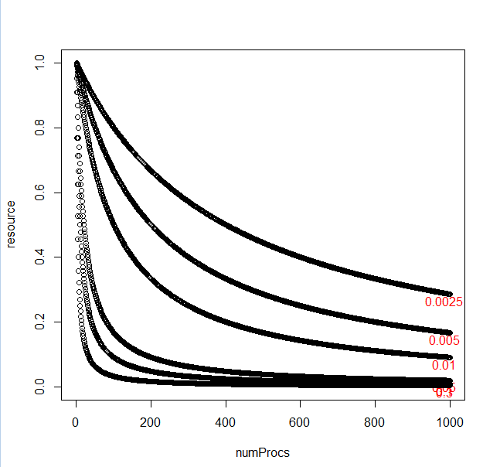
For 1,000 processors, 99% parallelization, means 85% of the processors are idle
Every synchronized (that limits parallelization), can massively reduce the efficiency of multi-core systems
Big problem for GPUs that
can have many thousands of cores…

Slide 8
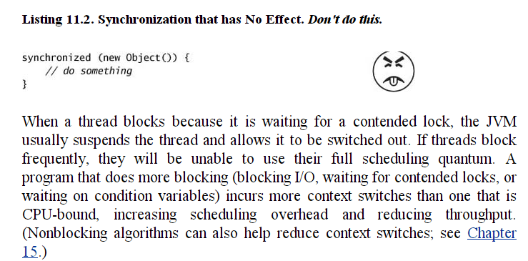
How do we minimize serialization?
Avoid excessive synchronization

Slide 9
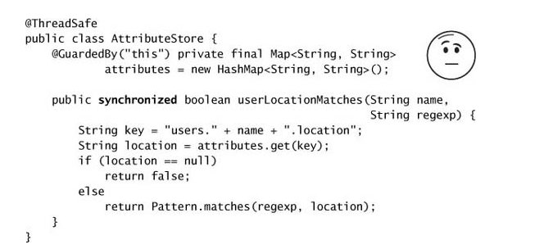
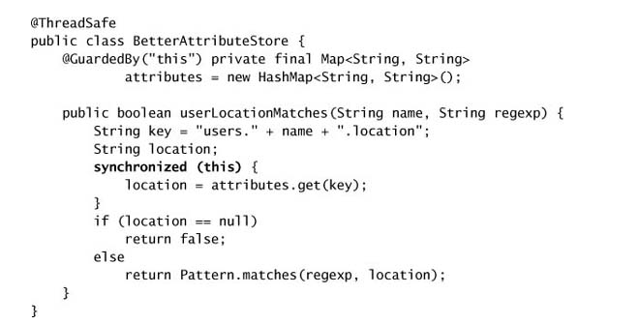
Reduce the scope of locks…
becomes

Slide 10
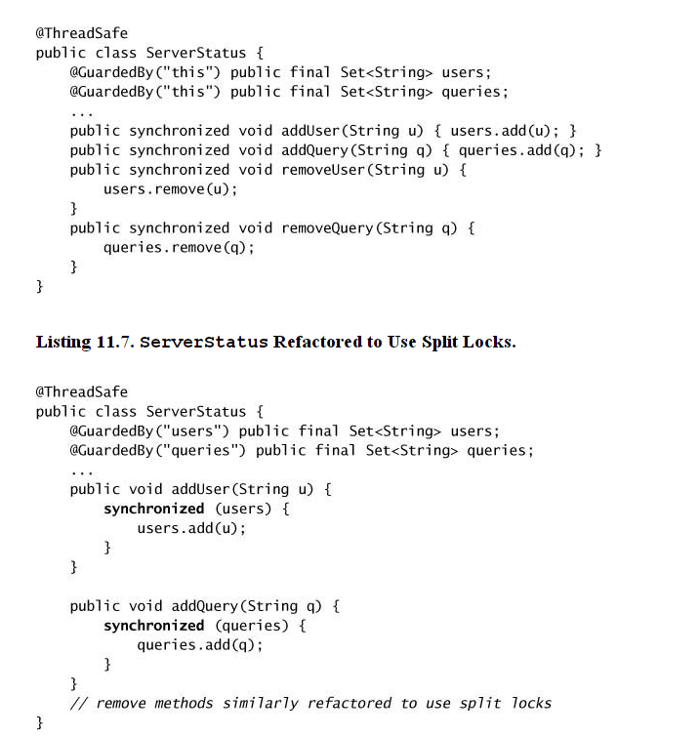
Split locks to allow for improved concurrency (but watch out for deadlock!)

Slide 11
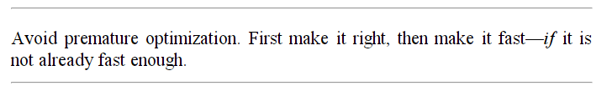
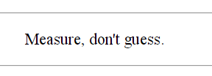
In general, you want to be measuring performance while you optimize…
“Make it work, then make it fast”

Slide 12
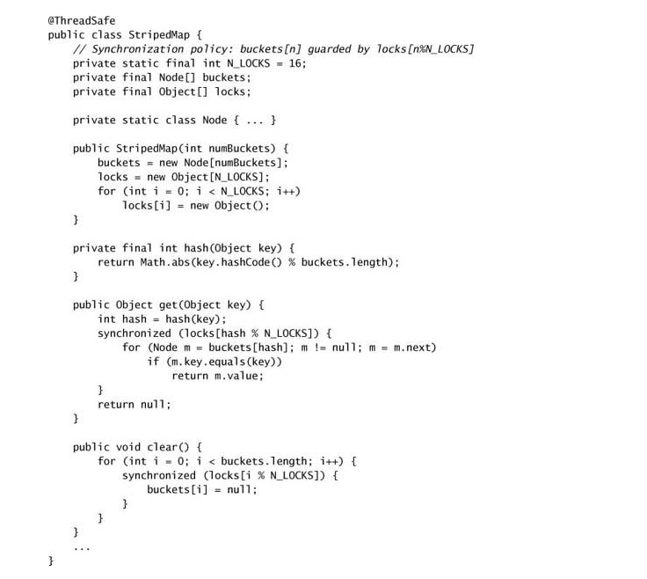
One approach (we’ve already seen) “lock striping” in (for example) the ConcurrentHashMap
bucketIDs range from { 0 ….. (numBuckets-1) }
lockIDs range from { 0 …. (numLocks-1) }
bucketID % NUM_BUCKETS yields the lock for each bucket
Map hashCode() to bucket id
Map bucketID to mapID
Another thread may write while we are trying to clear.
That’s ok because clear(), like size() is approximate

Slide 13
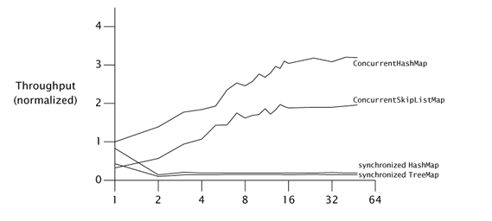
As we’ve seen the concurrent HashMap is a lot faster…
Concurrent tree map
Number of CPU’s pounding on the maps

Slide 14
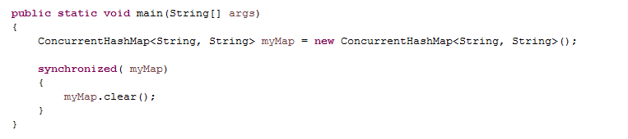
How could you ensure that a clear() actually cleared the map (that clear wasn’t approximate)
If every client that has a reference to myMap uses synchronized,
then only one thread is working at a time, and clear will be guaranteed
to clear the map…
But it would only take one thread ignoring the synchronized(myMap) lock
to push clear() back to being approximate…

Slide 15
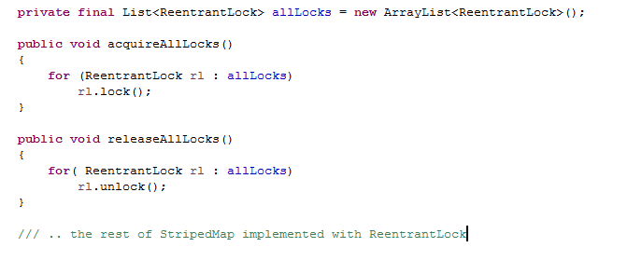
Alternatively, if you are implementing a striped map, you could ReentrantLocks…
As long as no other methods hold more than one lock,
this won’t deadlock as locks are acquired in the same order
If you forget to call this or call it when you don’t have all the locks,
your application will crash. (We could use try…catch to make it more
robust…)
A client can then call
myMap.acquireAllLocks();
myMap.clear();
myMap.releaseAllLocks();
If the client just calls
myMap.clear()
Then clear() will be approximate
and clear() will empty the map

Slide 16
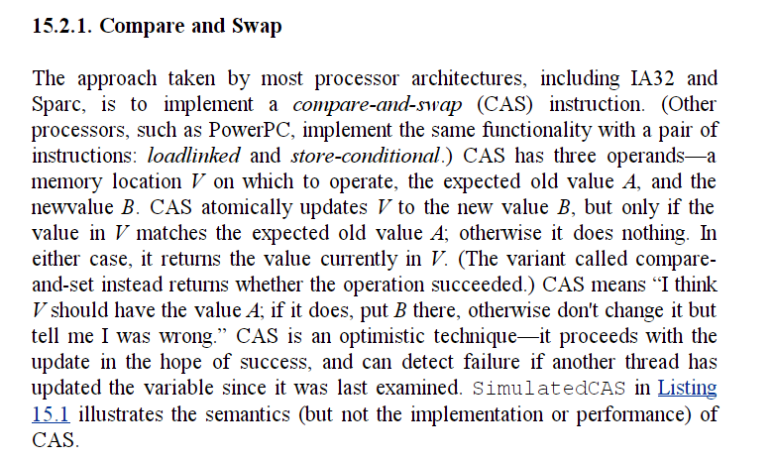
Compare and Swap takes an “optimistic” approach to multi-tasking.
Rather than locking, perform the calculation and then see if anything has changed.
If it’s changed, you can try again (or not…)
It is better to “beg forgiveness than ask permission”
Compare and Swap is implemented at the hardware level meaning it can be very fast…
Avoids explicit synchronization…

Slide 17
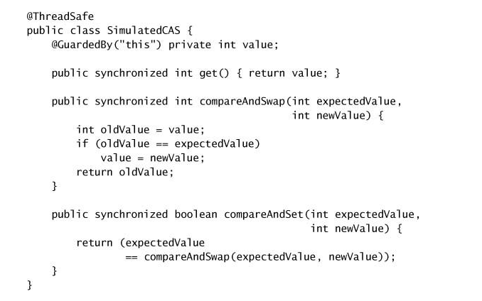
This is what compare and swap does (but not how it really works since the CPU can do this
without explicit synchronization)

Slide 18
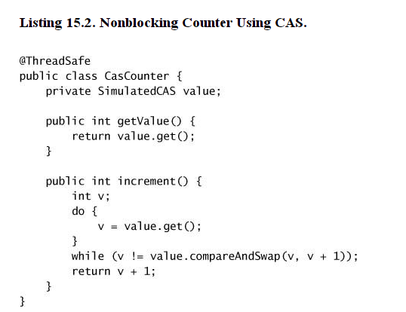
Here is a simulated atomic incrementer (like AtomicLong)
Because compareAndSwap can be implemented in hardware, this can be very fast and minimize contention

Slide 19
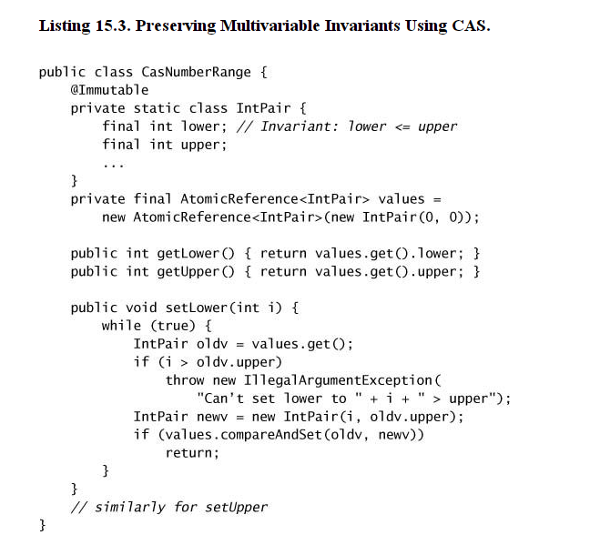
A compare and swap version of a NumberRange pair
Have to be careful can’t be out of order
in either the old or the new…
Returns true if the oldv hasn’t changed

Slide 20
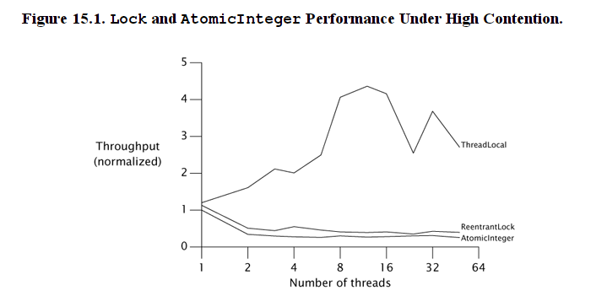
Under high contention, it doesn’t help that much to use a compare and swap….
(can’t avoid the contention)
No contention ( as a control)
Asking for permission and
Begging forgiveness is about the same

Slide 21
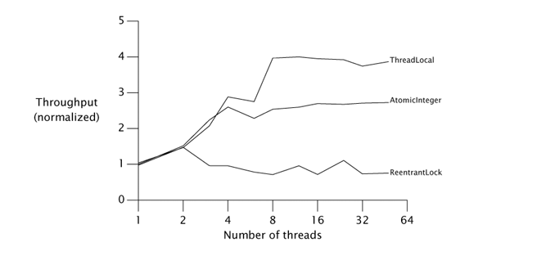
Here begging forgiveness is a better strategy.
Our optimism that another thread hasn’t messed up our results is more rewarded..

Slide 22
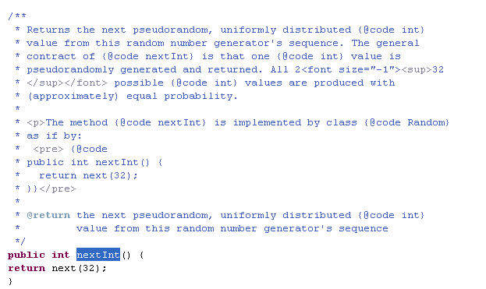
We revisit here our discussion of Random.nextInt()
(The book also does this in Chapter 15)
There is, of course, no documentation.

Slide 23
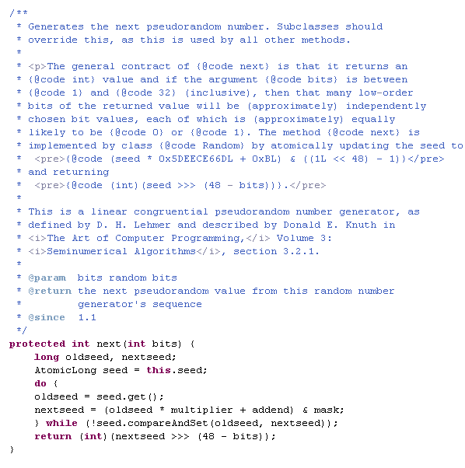
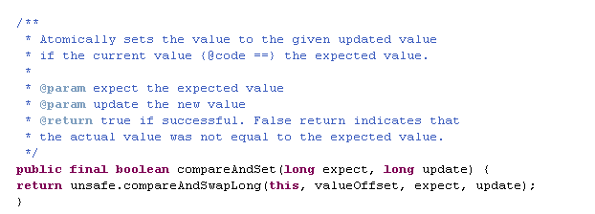
They do document that it is
atomic
If another thread has interfered,
generate the next number.
Pretty sweet…
Thread safe with minimal synchronization.
It would have been nice to more
explicitly document the thread safety!

Slide 24
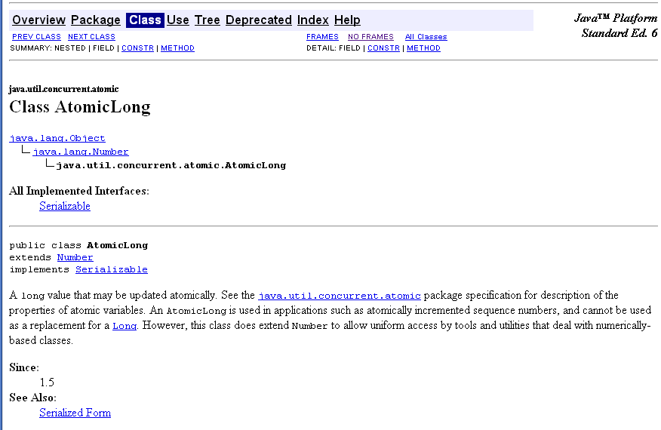
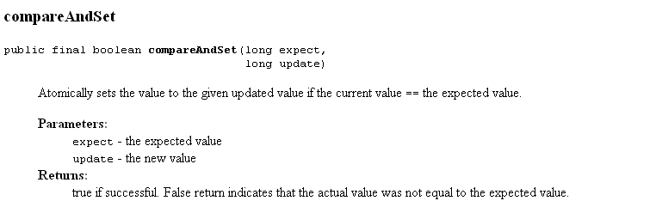

Slide 25
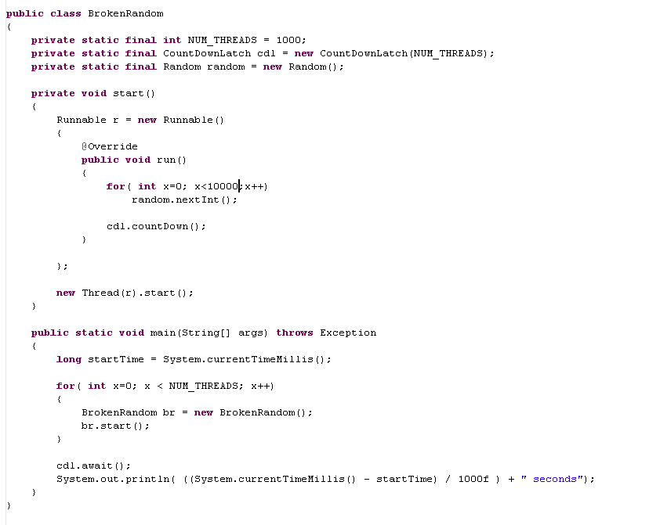
There is some (minimal) resource contention here but not too bad..
When the threads interfere with each other, they spin…
This runs in ~2 seconds

Slide 26
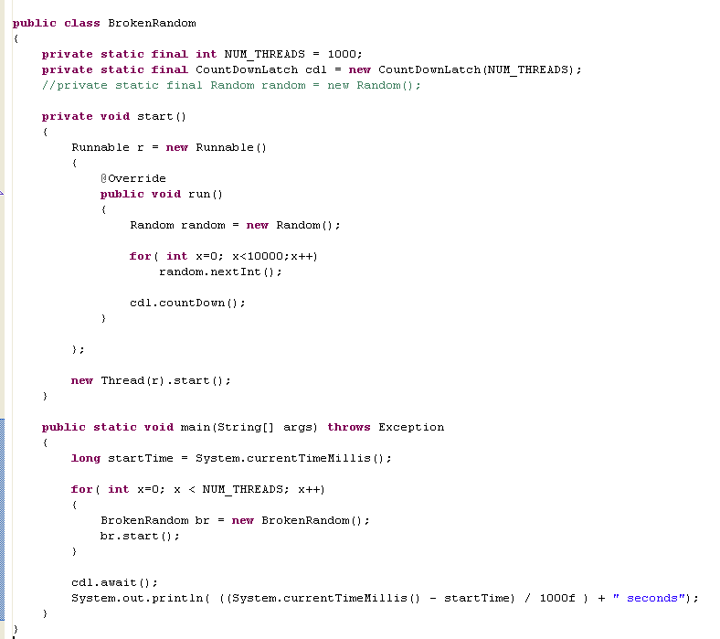
Give each thread its own random is about 0.5 seconds
(but is actually a bad idea because many of those randoms will have the same seed!)

Slide 27
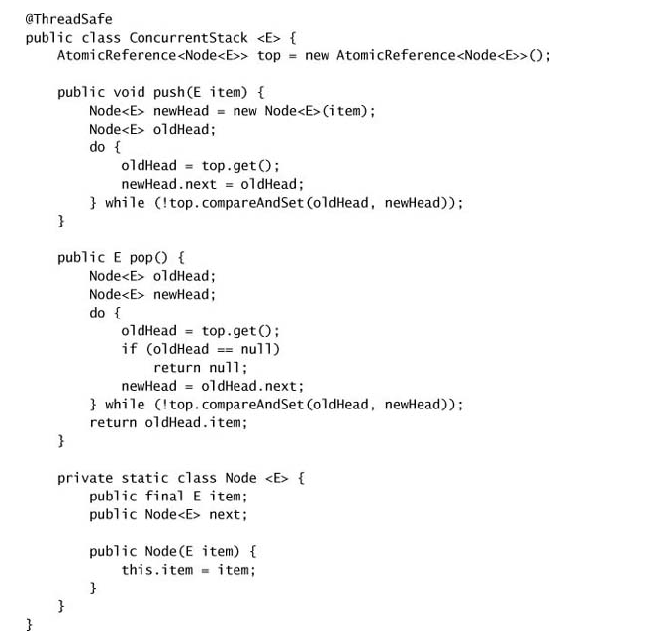
We’ve seen a concurrent HashMap; here is a Concurrent Stack…

Slide 28
Coming up:
Test code: Junit and testing architectures
(possibly) Machine learning in parallel
The Javascript approach to complexity

