Slide 1
GUI alternatives to SWING
Processing
Prefuse

Slide 2
Data visualization in an inherent part of Big Data.
There has been a lot of recent interest in developing web-based data analytics with
Javascript and libraries such as D3
Advantages of Javascript:
Once the browser is on the user’s machine, no need to install other programs
Updates to software happen instantly – no need to manage version control
AJAX can make very complex applications – gmail, google maps
HTML 5 can draw, do animations reducing needs for plug-ins (such as Flash or Java applets)
Dis-advantages of Javascript:
Language has been patched together more than designed.
Easy to get started; quite difficult to master.
Browser incompatibilies - behaviors in Mozilla, Chrome, IE, etc. are often quite different
Inherently single threaded environment (although maybe this is an advantage)
Can be slow (although this is increasingly not true; Chrome is very optimized).
Large datasets need to be reloaded over all the network with each invocation
Interacting with the browser can lead to very complex applications

Slide 3
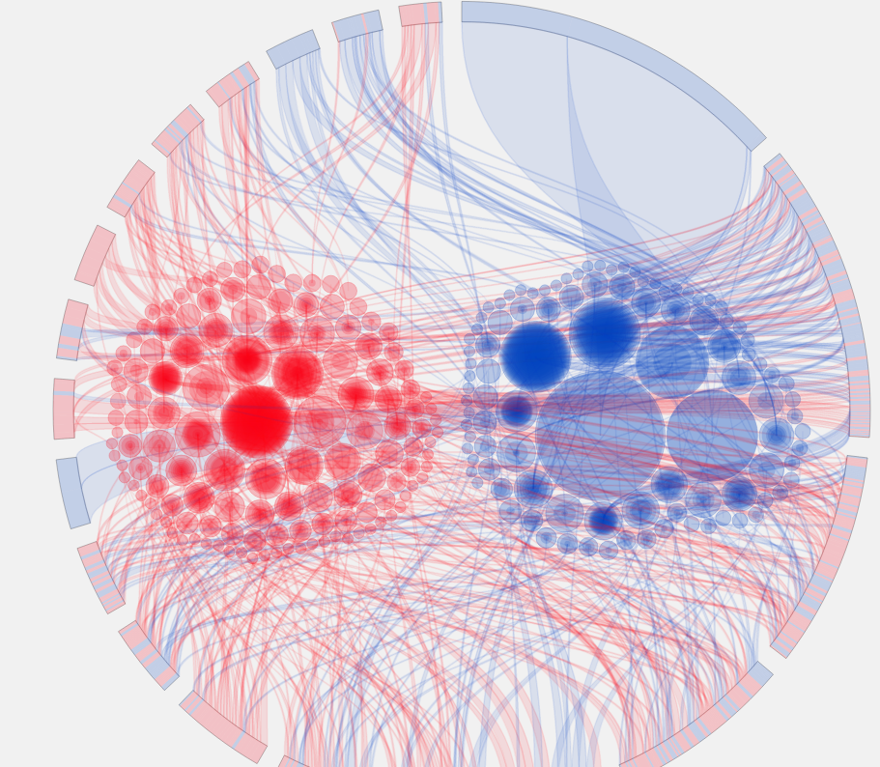
D3, a popular JavaScript library, has some really nice demos for visualization of complex, multi-factorial datasets
There has been a lot of activity in
JavaScript development,
but JavaScript is well outside the scope of
what we can realistically study this semester…
http://www.brightpointinc.com/political_influence/

Slide 4

Processing (https://processing.org/) is a very interesting project that lives in both a Java and Javascript world..
Here is a program that creates a simple bouncing ball
https://processing.org/examples/bounce.html

Slide 5
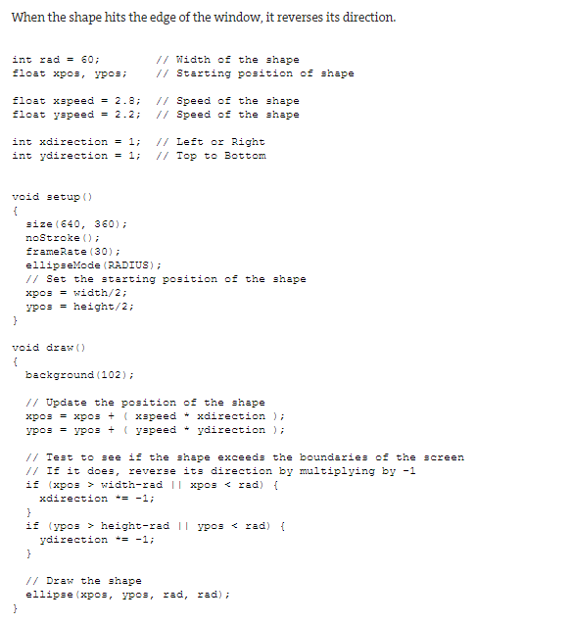
Here is the javascript code…
Setup is called within the processing framework to initialize the web app
Draw is called within the processing framework repeatedly

Slide 6
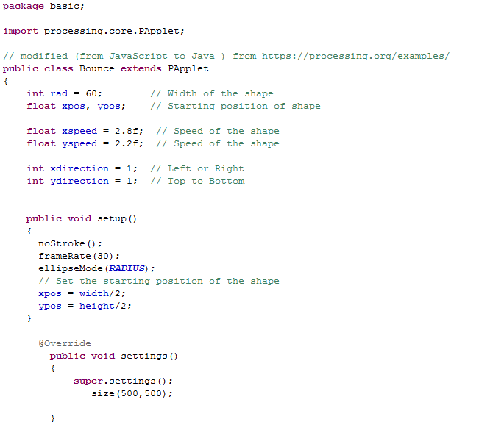
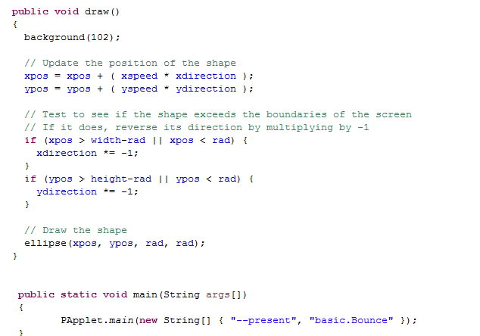
Remarkably, the language is (mostly) syntax compatible between Java and Javascript.
So the same code can be ported (almost) effortlessly to Java (this copy-paste took about 30 seconds).
https://github.com/afodor/ProcessingDemos/blob/master/src/basic/Bounce.java

Slide 7
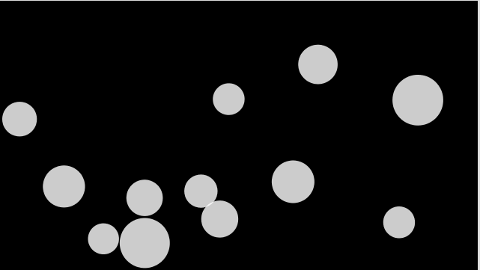
Works equally well for more complex example (this port took about 45 seconds from copy/paste)
https://processing.org/examples/bouncybubbles.html
https://github.com/afodor/ProcessingDemos/blob/master/src/basic/BouncyBubbles.java

Slide 8
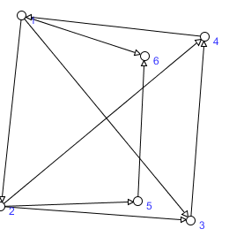
This one (spanning multiple classes) took me more like half and hour!
https://github.com/afodor/ProcessingDemos/blob/master/src/simpleForceTree/ForceTree.java
http://processingjs.nihongoresources.com/graphs/

Slide 9
Advantages of processing:
Develop in either Java or JavaScript; move (more or less) easily between the two languages
Prototype in Java (which is faster) and then once you know what you want to do deploy in JavaScript.
Disadvantages of procession:
Does not have as many built-in visualizations for mutli-dimensional data as D3 or Prefuse
(but the community seems quite active, with more stuff getting built all the time…)
Processing components cannot be easily mixed with Java Swing components.
“PAppelt” (the base class in Processing ) is no longer a Java Container/Component

Slide 10
GUI alternatives to SWING
Processing
Prefuse

Slide 11
Prefuse is an absolutely gorgeous visualization library for Java..
http://prefuse.org/
https://github.com/prefuse/Prefuse

Slide 12
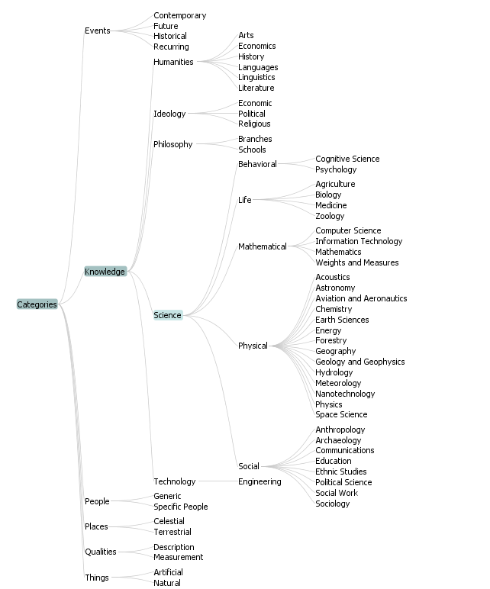
Has many of the same nice visualizations as the current D3 library
Trees with clickable nodes
prefuse.demos.TreeView within the Prefuse github repository

Slide 13
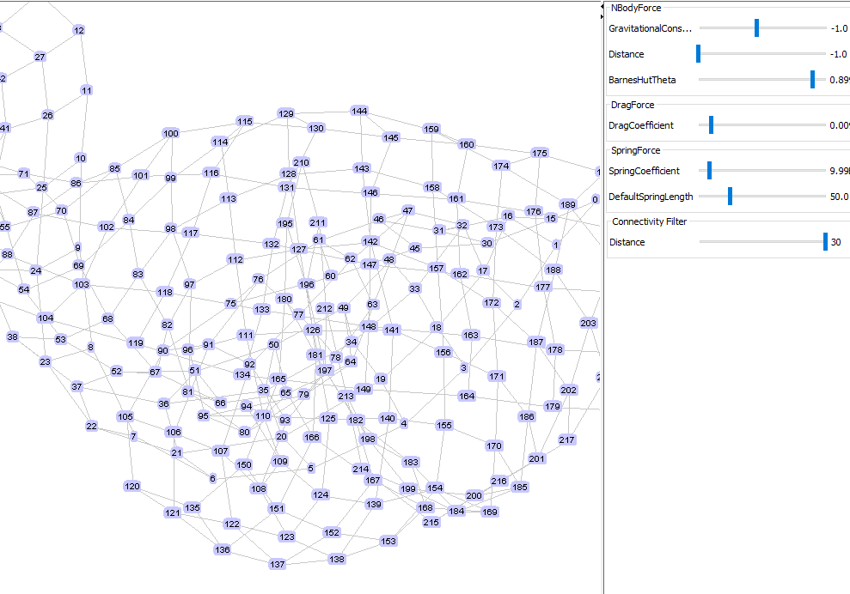
A clickable and draggable ForceTree view
prefuse.demos.GraphView within the Prefuse github repository

Slide 14
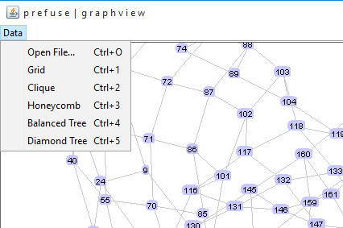
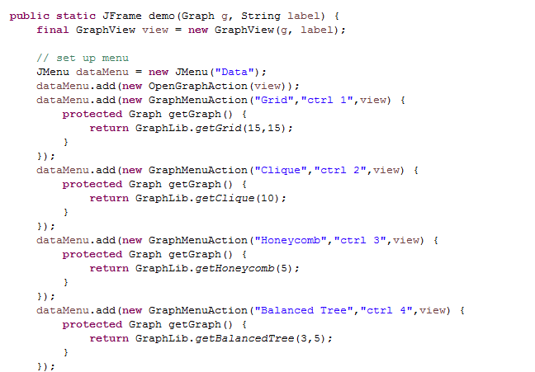
Prefuse is written in Swing using Swing controls…

Slide 15
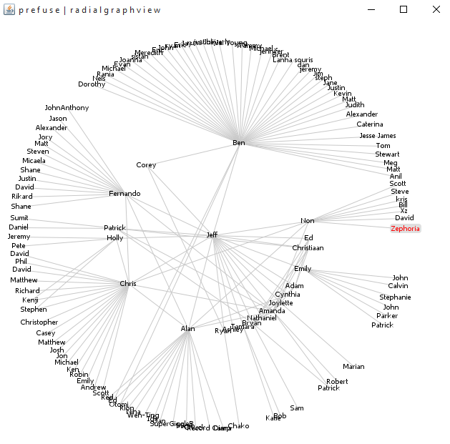
prefuse.demos.RadialGraphView within the Prefuse github repository

Slide 16
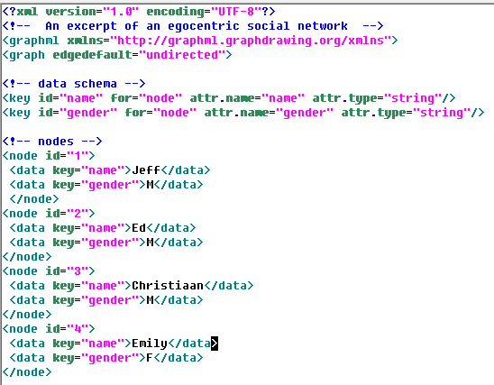
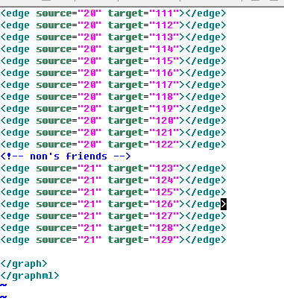
The radialGraph works on an XML file…
The top of this file…
The bottom of this file…

Slide 17
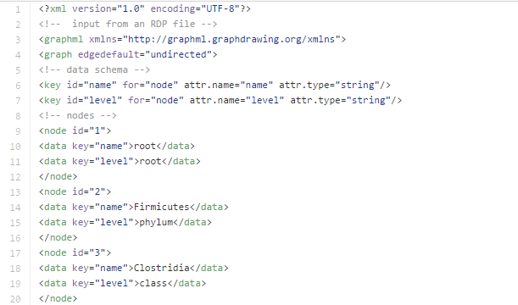
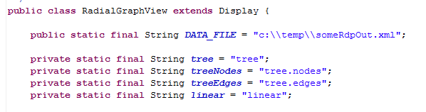
We can put our own data into this format to make our own visualizations…
https://github.com/afodor/afodor.github.io/blob/master/classes/prog2015/someRdpOut.xml
Change the Java code to point to the right file…

Slide 18
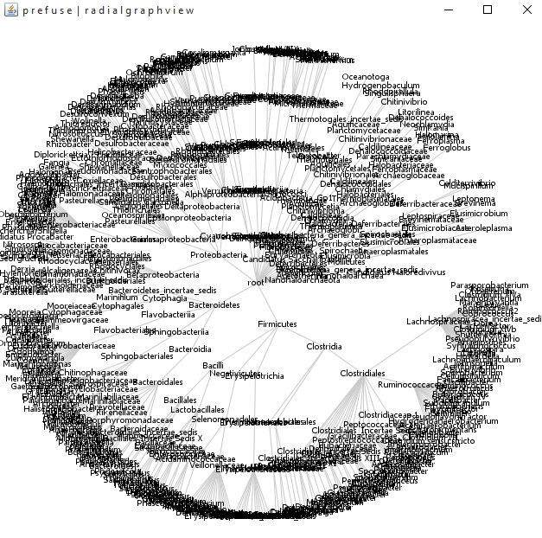
This is a visualization that represents phylogenetic levels within Bacteria
(as produced by the RDP classification algorithm on a 16S rRNA dataset)

