Slide 1
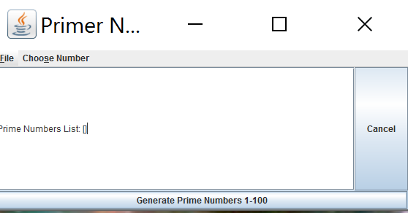
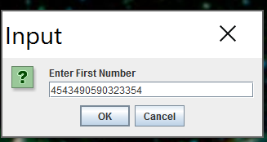
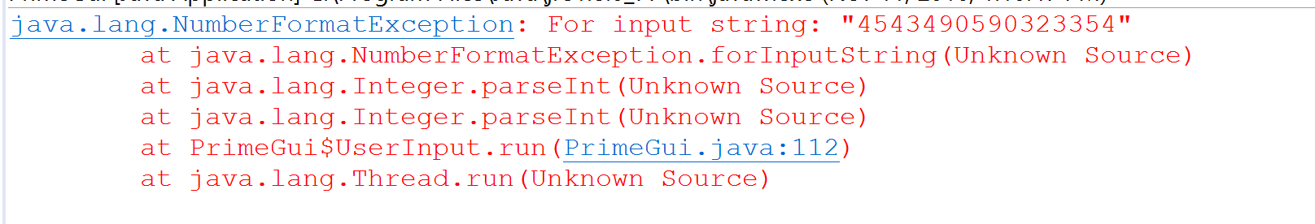
No error message with invalid integer…

Slide 2
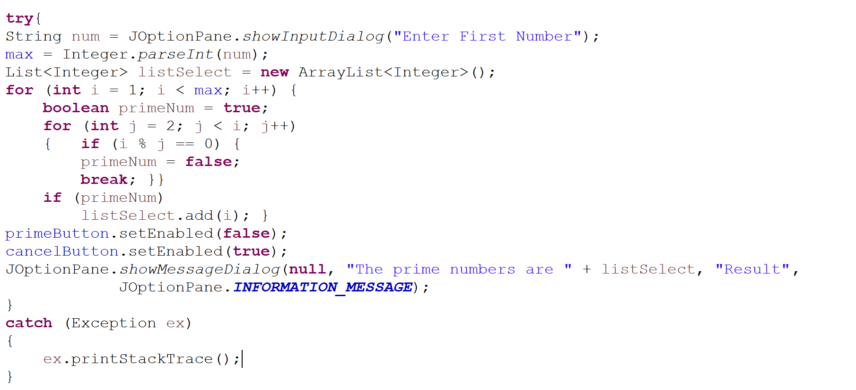
GUI applications need to give information back to the users
This line throws if not a valid integer
Error goes to the console, not the GUI

Slide 3
Results are shown in a JoptionPane message dialog….

Slide 4
Message dialogs are not always ideal for large amounts of information…
The “Ok” button is off my screen and I can’t get to it.
Application is effectively dead and has to be killed from task manager of kill -9
Consider a JScrollPane wrapped around a TextArea as an alternative (will give scroll bars…)
Also, the dialog can take a long time to render, effectively making the application look frozen

Slide 5
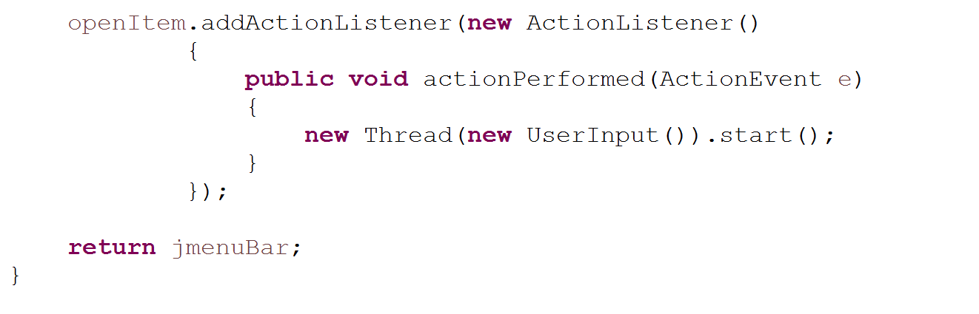
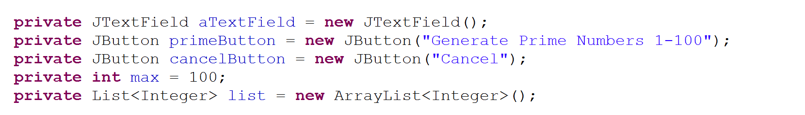
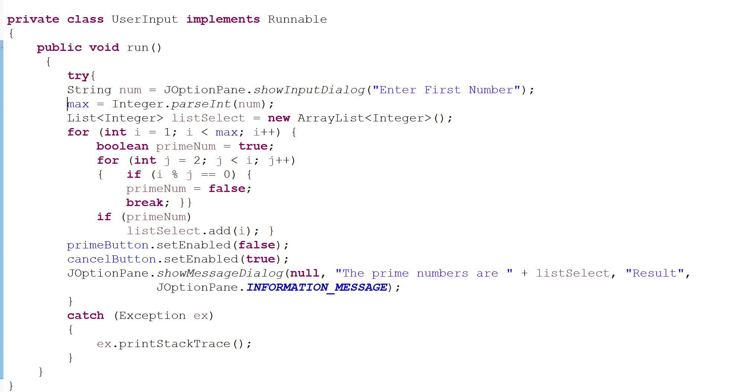
Not stack confined.
If user hits “Choose Number” again, max can change
with undefined results
These are not marked as thread safe – should be placed back on
AWT thread via SwingUtilities

Slide 6
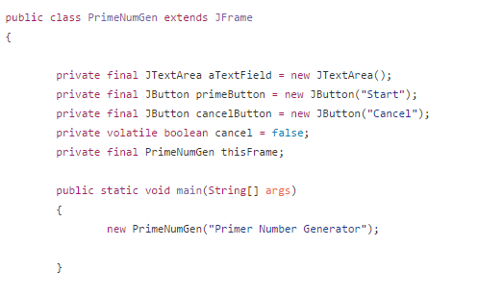
I made a version that (I think) may address some of these issues…
Volatile cancel tag
https://github.com/afodor/metagenomicsTools/blob/master/src/classExamples/gui/PrimeNumGen.java

