Slide 1
Bayesian approach to the binomial distribution with a discrete prior
The beta distribution
Bayesian approach to the binomial distribution with a continuous prior
Implementation of the beta distribution
Controversy in frequentist vs. Bayesian approach to inference

Slide 2
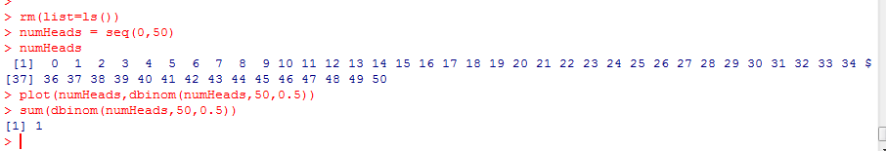
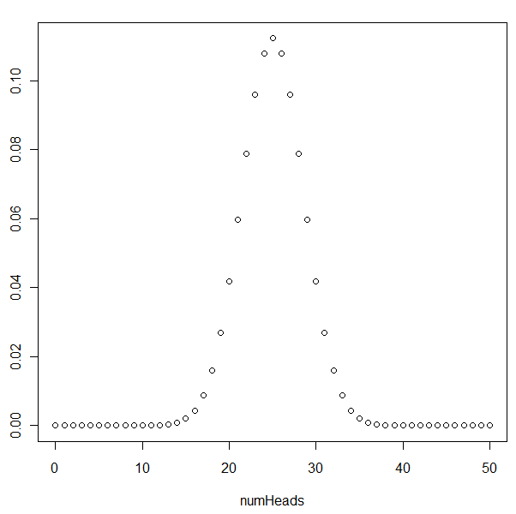
In the binomial distribution, we assume that p (hereafter ∏) is constant
and we calculate the probability for each success…
For a fair coin, p=∏ = 0.5 ; I toss the coin 50 times; k= number of heads
( )
n
k
p^{k} (1-p)^{n-k}
= n! * p^{k} (1-p)^{n-k}
k!(n-k)!
As the number of coin flips increases, this
distribution approaches the normal distribution
The sum of dbinom(1:50,50,.5) is 1.
Because when I flip a coin 50 times,
I will get between 0 and 50 heads,
So the sum(probability(allEvents)) = 1
P(numHeads | ∏ ) for every possible number of
Heads in 50 tosses
A likelihood distribution…

Slide 3
Let’s turn the problem around.
Given some set of data which we call Y_{1,}Y_{2,}Y_{3,}Y_{4,}Y_{5,}Y_{6,}….,Y_{N}
For example ( “HTTHTTH” ) where H and T are tails.
(We’ll just use “Y” for short to describe our data)
How do we calculate:
P( ∏ | Y)
This is our posterior probability distribution given some string of data…
We know….
prior
P( ∏ | Y) = p(Y| ∏ ) * p(∏)
Posterior
likelihood
Our prior’s and likelihood’s can be continuous or discrete….
We’ll see in a bit that we can use the binomial as a likelihood and the beta distribution as a prior.
But let’s consider a discrete prior….
Notes:
li

Slide 4
So let’s say that we are unsure about the true value of
∏
We are 1/3 sure that it is 0.3, 1/3 sure that it is 0.5, 1/3 sure that is 0.7.
There are 3 possible state in our Bayesian universe.
Whatever data we observe, ∏ can only ever have values of 0.3, 0.5 and 0.7
Y
prior
“H”
“T”
Marginal probs
∏₁ =0.3
1/3
1/3 * 0.3
1/3 * 0.7
1/3
1/3
1/3 * 0.5
1/3 * 0.5
X
∏ ₂ =0.5
1/3
∏ ₃ =0.7
1/3
1/3 * 0.7
1/3 * 0.3
1/3
Marginal probs
p(H) =
1/3(0.3 +
0.5 + 0.7)
= 0.5
p(T) =
1/3(0.7 +
0.5 + 0.3)
= 0.5

Slide 5
If we observe a “Head”
P( ∏ ₁ | “H”) = (1/3) * 0.3 / 0.5 = 0.2
P( ∏ ₂ | “H”) = (1/3) * 0.5 / 0.5 = 0.3333
P( ∏ ₂ | “H”) = (1/3) * 0.7 / 0.5 = 0.4667
We become more sure that the “true” probability is 0.7 and less sure that is 0.3
Y
prior
“H”
“T”
Marginal probs
∏₁ =0.3
1/3
1/3 * 0.3
1/3 * 0.7
1/3
1/3
1/3 * 0.5
1/3 * 0.5
X
∏ ₂ =0.5
1/3
∏ ₃ =0.7
1/3
1/3 * 0.7
1/3 * 0.3
1/3
Marginal probs
p(H) =
1/3(0.3 +
0.5 + 0.7)
= 0.5
p(T) =
1/3(0.7 +
0.5 + 0.3)
= 0.5

Slide 6
If we observe a “Tail”
P( ∏ ₁ | “T”) = (1/3) * 0.7 / 0.5 = 0.4667
P( ∏ ₂ | “T”) = (1/3) * 0.5 / 0.5 = 0.3333
P( ∏ ₂ | “T”) = (1/3) * 0.3 / 0.5 = 0.2
We become more sure that the “true” probability is 0.3 and less sure that is 0.7
Y
prior
“H”
“T”
Marginal probs
∏₁ =0.3
1/3
1/3 * 0.3
1/3 * 0.7
1/3
1/3
1/3 * 0.5
1/3 * 0.5
X
∏ ₂ =0.5
1/3
∏ ₃ =0.7
1/3
1/3 * 0.7
1/3 * 0.3
1/3
Marginal probs
p(H) =
1/3(0.3 +
0.5 + 0.7)
= 0.5
p(T) =
1/3(0.7 +
0.5 + 0.3)
= 0.5

Slide 7
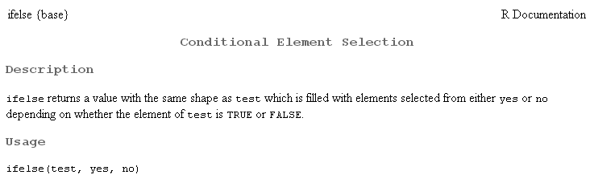
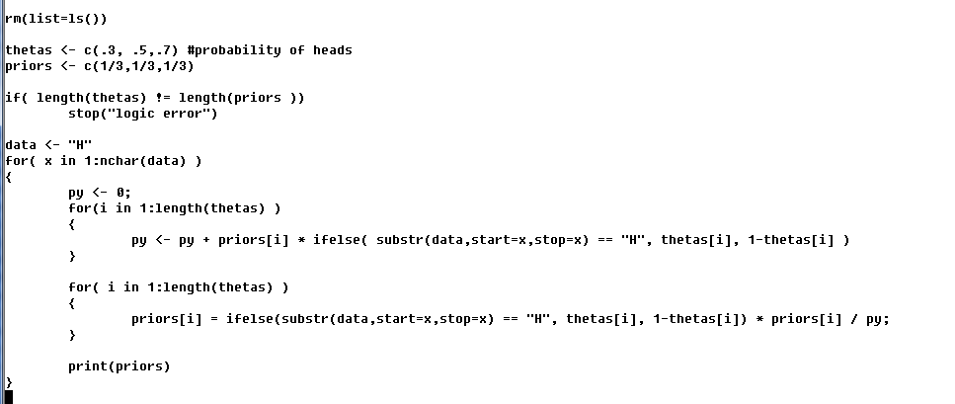

In R…. for a Head

Slide 8
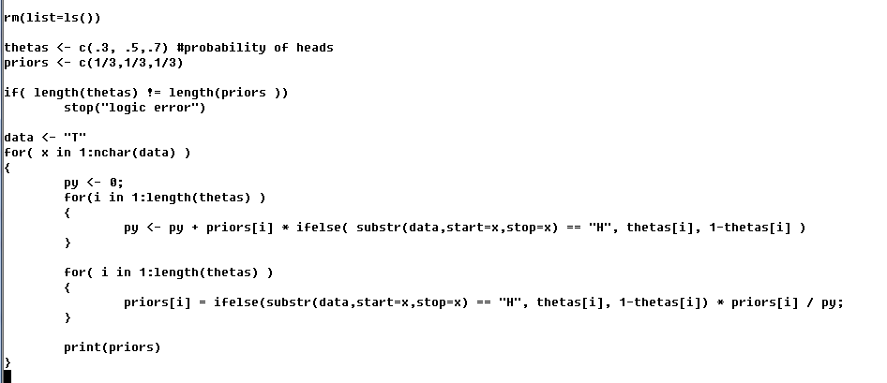

In R…. for a tail

Slide 9
Obesrving a “Head” and then a tail
P( ∏ ₁ | “HT”) = 0.2 * 0.7 /0.44651 = 0.313
P( ∏ ₂ | “HT”) = 0.333 * 0.5 / 0.44651 = 0.373
P( ∏ ₂ | “HT”) = 0.4667 * 0.3 / 0.44651= 0.313
We become more sure that the “true” probability is 0.7 and less sure that is 0.3
Y
prior
“H”
“T”
Marginal probs
∏₁ | H=0.2
0.2
0.2 * 0.3
0.2 * 0.7
0.2
1/3
0.333 * 0.5
0.333 * 0.5
∏ ₂ | H=0.333
0.3333
∏ ₃ =0.4667
1/3
0.4667 * 0.7
0.4667 * 0.3
0.4667
Marginal probs
p(H) =
0.55319
p(T) =
0.44651
Notice that we don’t return to the uniform prior. We are more certain that p(Heads) =0.5
and less certain that the coin is in either of the other states…

Slide 10
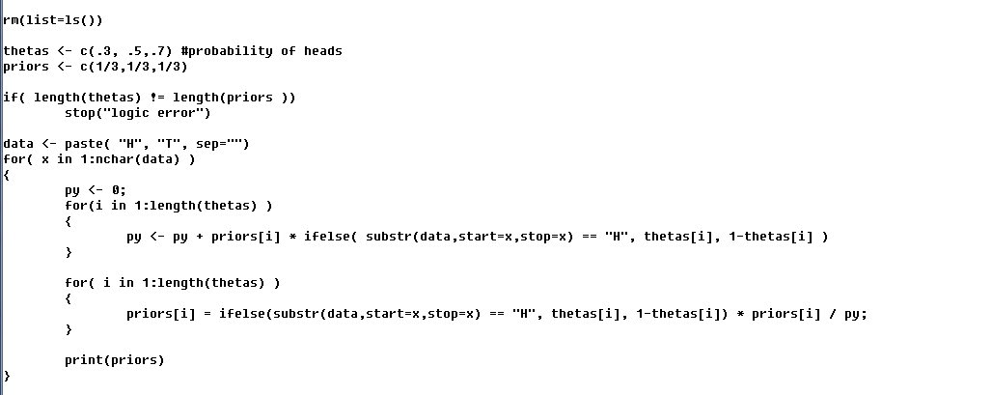

In R for (“HT”)…

Slide 11
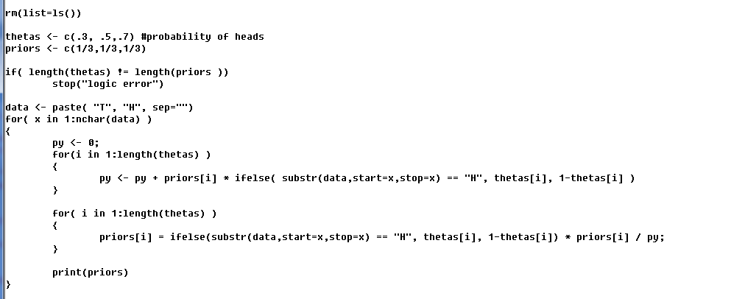

Which is the same for (“TH”) although we get there in a different way…

Slide 12
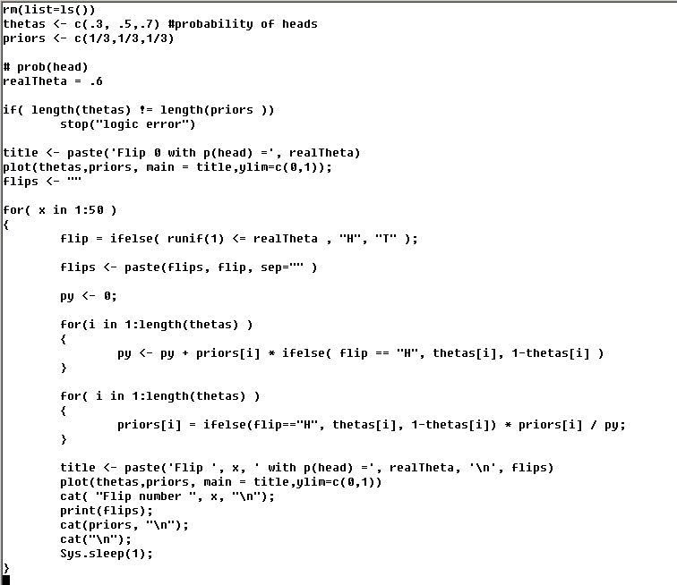
Updating one a at time for p(head) = .6
https://github.com/afodor/afodor.github.io/blob/master/classes/stats2015/discretPriors.txt

Slide 13
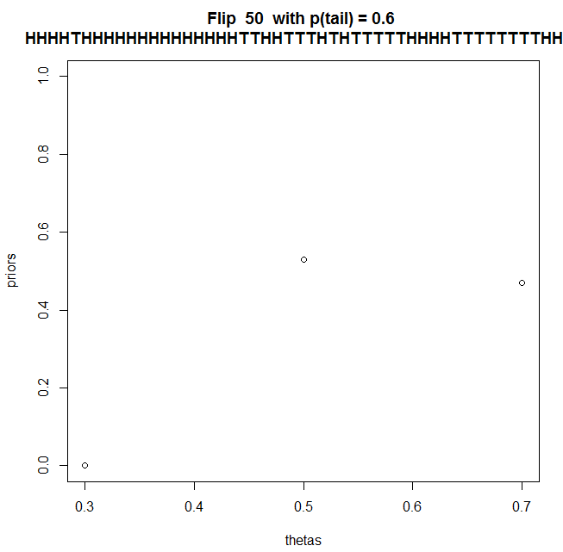

The requirement that ∏ can only ever have values of 0.3, 0.5 and 0.7 is
not really appropriate for our model…

Slide 14

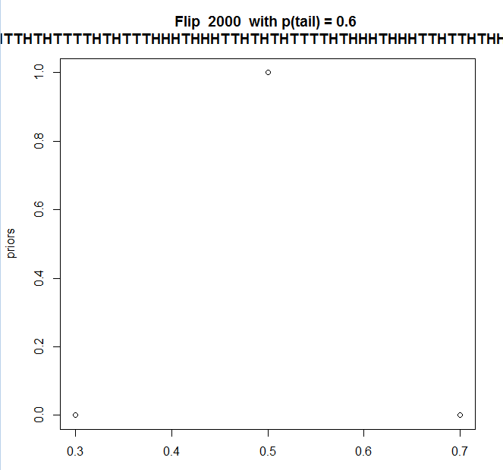
These instabilities together with chance
runs at the beginning
lead us to different results
when we run the model..
Clearly a continuous
prior is more appropriate

Slide 15
Bayesian approach to the binomial distribution with a discrete prior
The beta distribution
Bayesian approach to the binomial distribution with a continuous prior
Implementation of the beta distribution
Controversy in frequentist vs. Bayesian approach to inference

Slide 16
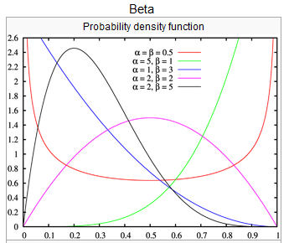
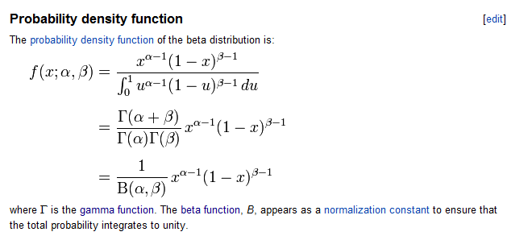
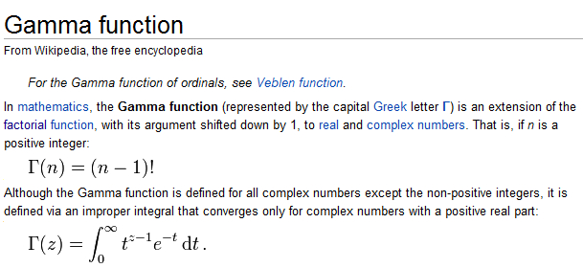
We can use the continuous beta distribution to describe my beliefs about all possible values of ∏
p(∏ | Y) can be given by the beta distribution!
http://en.wikipedia.org/wiki/Beta_distribution
When used to model the results of
the binomial distribution,
α is related to the number of successes
and β is related to the number of failures….

Slide 17
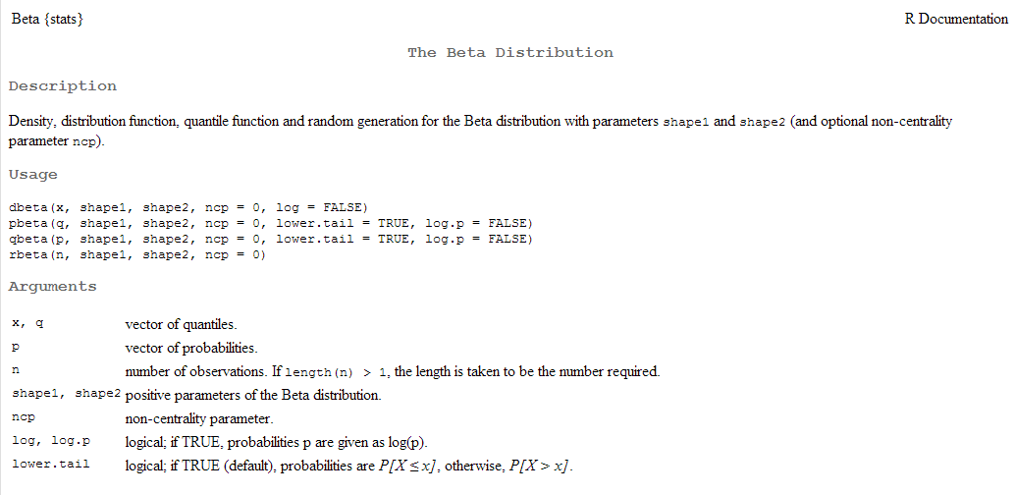
As usual in R, we have dbeta, pbeta, qbeta and rbeta..
We can think of α (shape1 in R) as (number of observed successes+1)
and β (shaple2 in R) as (number of observed failures+1)
(proof of that coming up!)

Slide 18
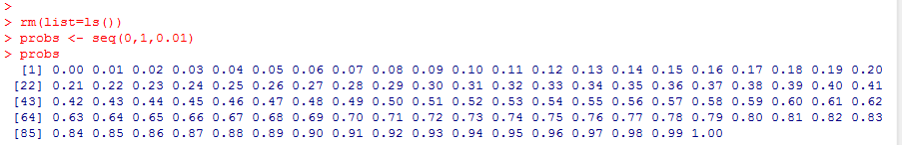
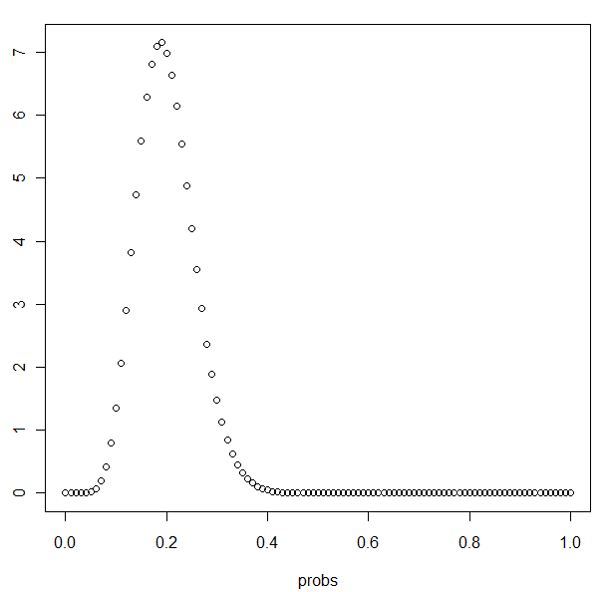
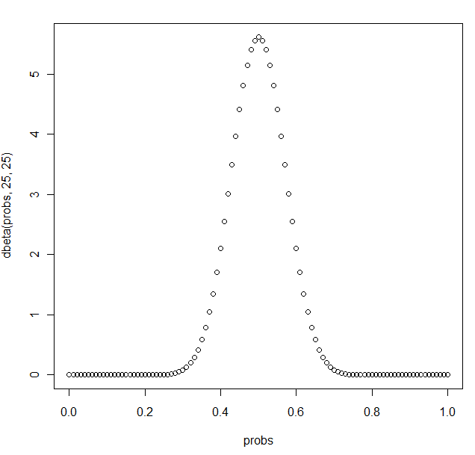

So we use α and β as the shape constants and the beta distribution gives us the
probability density of ∏. In each plot (i.e. for each set of values for α and β), we are holding
the results of the experiment constant and varying possible values of ∏ from 0 to 1)
10 heads
40 tails
25 heads
25 tails
(prob of the coin generating a head|25 heads,25tails)
(prob of the coin generating a head|10 heads,40tails)
The rule is to add 1 to the number of successes and failures

Slide 19


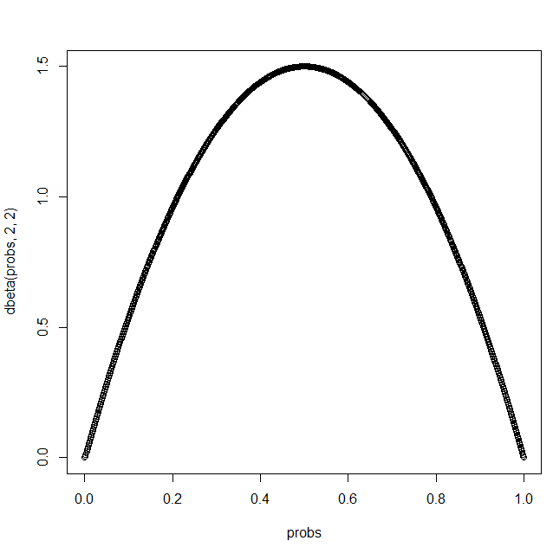
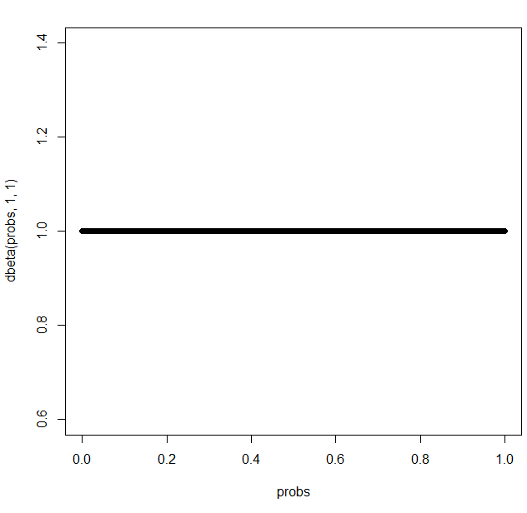
An uniformed prior.
My beliefs before I see any data
(the uniform distribution!)
After seeing one head and one tail
0 heads
0 tails
1 heads
1 tails

Slide 20

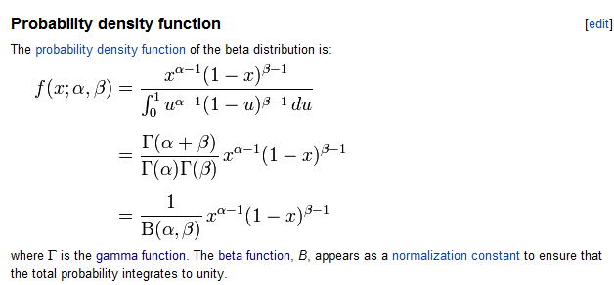
If I integrate the beta distribution from 0 to 1, the result is 1.
Conceptually, for a given result, the sum of the probabilities of all the possible values of ∏ is 1
The beta function guarantees an integral of 1 along ∏ = {0,1}

Slide 21
Bayesian approach to the binomial distribution with a discrete prior
The beta distribution
Bayesian approach to the binomial distribution with a continuous prior
Implementation of the beta distribution
Controversy in frequentist vs. Bayesian approach to inference

Slide 22
Bayes law –
Incorporating new data.
We have a prior belief about some distribution.
Say we don’t think there is ESP based on experiments with 18 people.
(Nine people guessed right; nine people guessed wrong)
Our prior probability distribution = ∏_{prior} = g(∏) = beta(10,10)
We have a new set of data (we call Y_{new}): 14 people choose right, 11 choose wrong.
We want to update our model:
For all ∏ along the range 0 to 1, we define p(∏) as the probability given by beta
p(∏ , Y_{new} ) = p(∏) * p(Y_{new} | ∏ )
p(Y_{new} , ∏ ) = p(∏ | Y_{new} ) * p(Y_{new})
p(∏ | Y_{new} ) = p(∏) * p(Y_{new} | ∏ )
p(Y_{new})
If we can calculate this along ∏ = {0,1} then p(∏ | Y_{new} ) will describe a new
distribution which is our updated belief about all values of ∏ between {0,1}
given the new data

Slide 23
For all ∏ along the range 0 to 1:
This is the prior probability.
What we believe about the probability of each value of ∏
before we see the new data.
p(∏ | Y_{new} ) = p(∏) * p(Y_{new} | ∏ )
This is the “likelihood probability”.
In this case, it comes from the binomial
p(Y_{new})
This is the “posterior” probability.
Our belief of the probability of each value of ∏
after we see the new data.
What about p(Y_{new})? This it the probability of observing our data summed across
all value of ∏.
That is:
p(Y_{new}) =

Slide 24

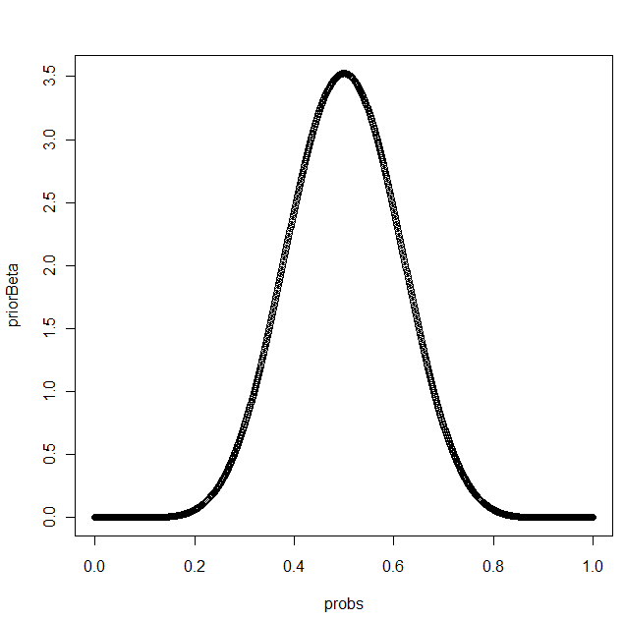
p(∏ | Y_{new} ) = p(∏) * p(Y_{new} | ∏ )
We can set any prior distribution we want, but there are good reasons to
choose a prior that is beta distributed.
a =10; b= 10 – the “shape” parameters based on our old data….
We choose as our prior – beta(10,10)
beta(10,10) =

Slide 25
p(∏ | Y_{new} ) = p(∏) * p(Y_{new} | ∏ )
a_{old} = b_{old} = 10 (Our first set of data where 9 subjects guessed right and 9 wrong)
a_{new}= 14; b_{new} = 11 – Our new data where 14 guess right and 11 guess wrong
We want to calculate our posterior distribution given our new data: p(∏ | Y_{new} )
p(∏) = beta(a_{old},b_{old}) =
(beta prior)
p(Y_{new} | ∏ ) =
(binomial likelihood)
p(∏) * p(Y_{new} | ∏ ) =
(prior * likelihood)
p(∏ | Y_{new} ) =
(Bayes law)

Slide 26
p(∏ | Y_{new} ) =
=
=
Let k’ =
k’
*
=
k’
But this integral is 1

Slide 27
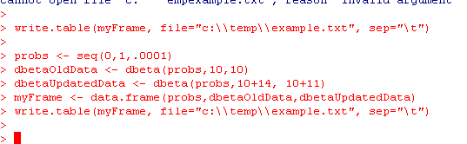
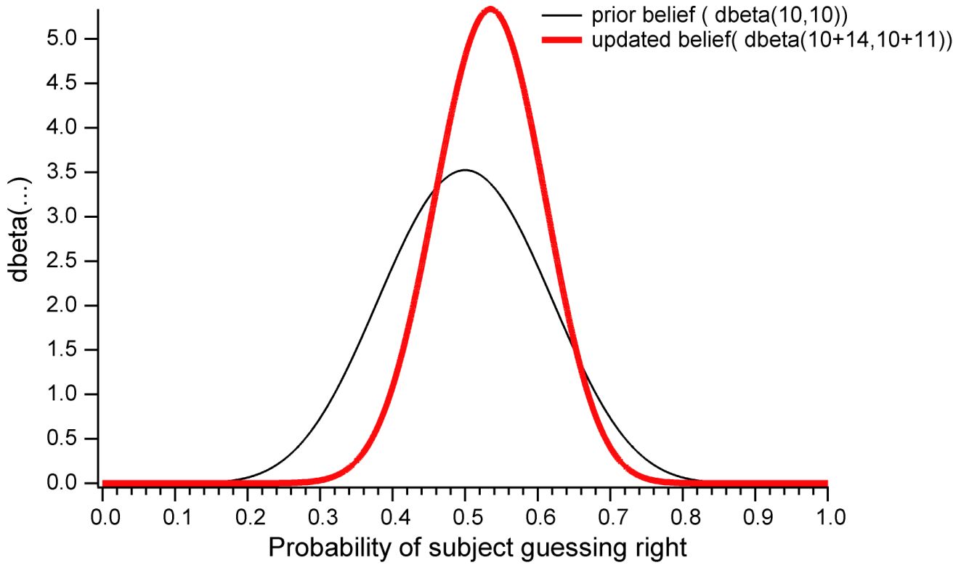
So we have this rather startling result…
p(∏ | Y_{new} ) =
To update our models, we just add the new successes to a_{old} and new failures to b_{old} and call
dbeta…
We have more data
so the variance is smaller.
There were a few more
successes, so the curve
has shifted to the right

Slide 28
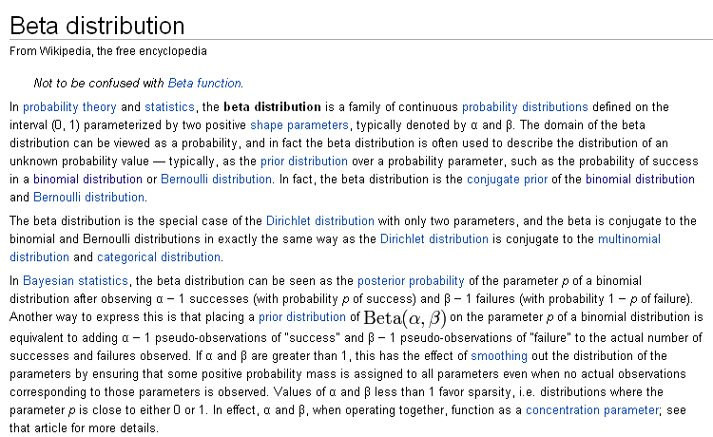
The beta distribution is the conjugate prior of the binomial distribution.
Multiplying a beta prior by a bionomial likelihood yields a beta posterior
p(∏ | Y_{new} ) = p(∏) * p(Y_{new} | ∏ )

Slide 29
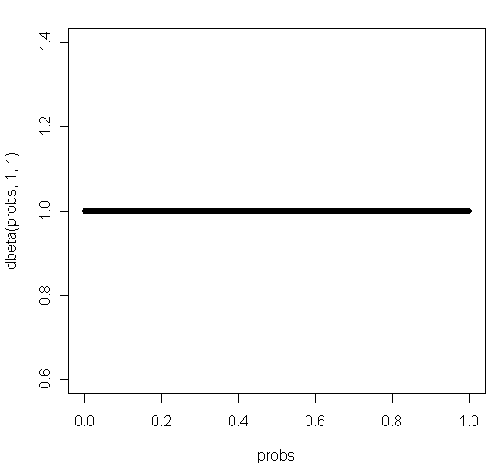

If you have no data and no beliefs, you probably want a uniform prior…
Remember the uniform distribution?
We have no expectations. The prior probability is always 1..

Slide 30
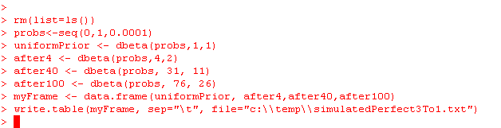
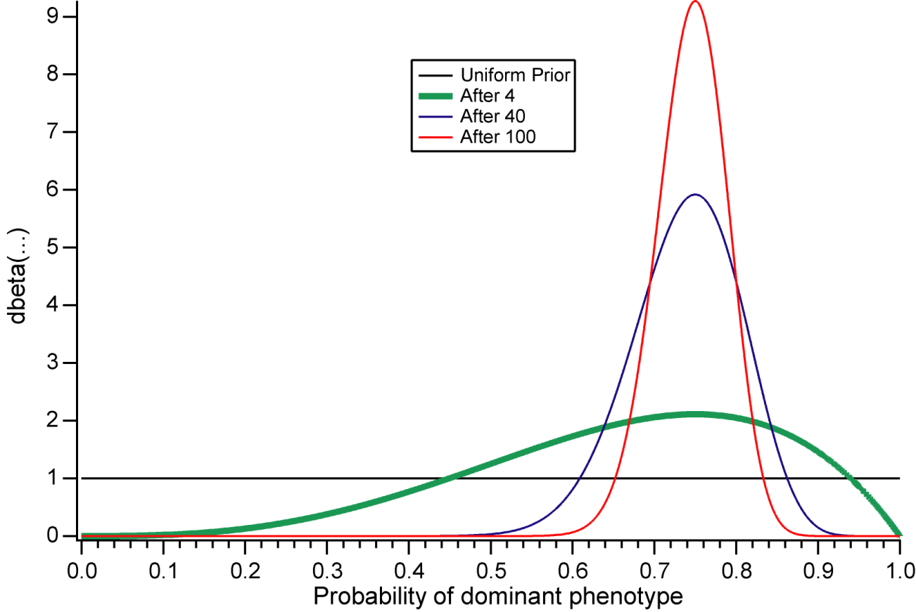
We can watch our Bayesian framework “learn” the distribution.
Consider a 3:1 Mendelian phenotype experiment (with perfect data).
Pretty sweet!

Slide 31
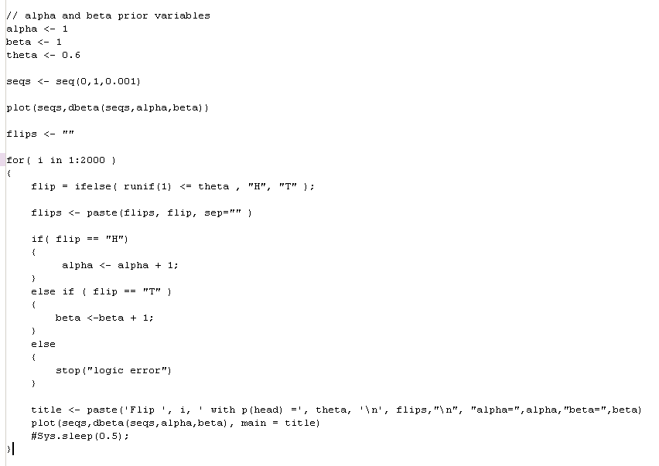
Our updating R code gets much simpler…
https://github.com/afodor/afodor.github.io/blob/master/classes/stats2015/bayesianUpdater.txt

Slide 32
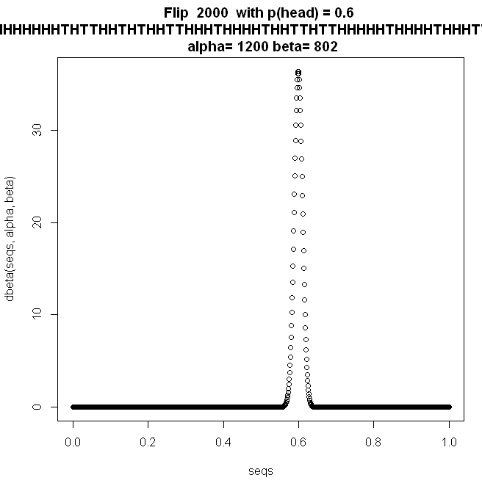
By the law of large numbers, as we get more data, the width of our beta distribution decreases

Slide 33
P(D_{loaded}|3 sixes) =
P(3 sixes| D_{loaded}) * P(D_{loaded})
The application of Bayes law always follows the same form
Posterior – our belief after seeing the data
that we have a loaded dice
Prior – our original belief that
We had a loaded die.
The likelihood
function
P(3 sixes)
The “integral”: summing over all possible
models ( p(3 sixes|fairDie) + p(3sixes|loadedDie)
This is the prior probability.
What we believe about the probability of each value of ∏
before we see the new data.
p(∏ | Y_{new} ) = p(∏) * p(Y_{new} | ∏ )
This is the “likelihood probability”.
In this case, it comes from the binomial
p(Y_{new})
The integral summing over all values of ∏
This is the “posterior” probability.
Our belief of the probability of each value of ∏
after we see the new data.

Slide 34
Bayesian approach to the binomial distribution with a discrete prior
The beta distribution
Bayesian approach to the binomial distribution with a continuous prior
Implementation of the beta distribution
Controversy in frequentist vs. Bayesian approach to inference

Slide 35
We can port the code for the beta and gamma functions from Numerical Recipes…

Slide 36
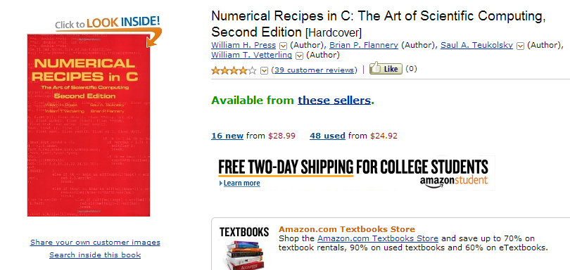

Slide 37
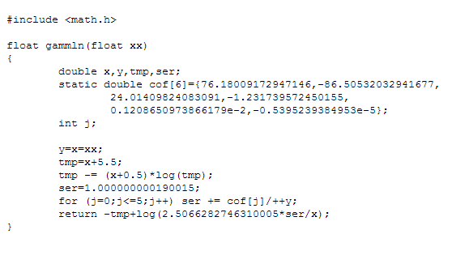
We start with the gamma function…. (or actually lngamma ())

Slide 38
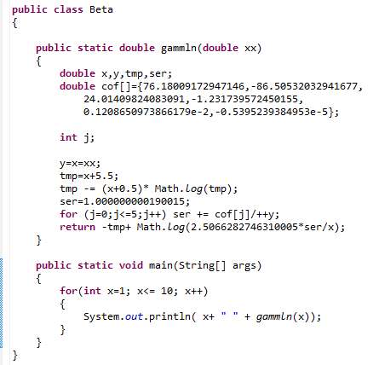
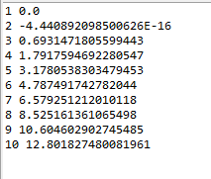

This is straight-forward to port…
Our results are within error to R…

Slide 39
Likewise, you can port over the beta distribution (which the book calls the
incomplete beta distribution described by function betai).
So you can easily have access to these distributions in the programming language of your
choice

Slide 40
Bayesian approach to the binomial distribution with a discrete prior
The beta distribution
Bayesian approach to the binomial distribution with a continuous prior
Implementation of the beta distribution
Controversy in frequentist vs. Bayesian approach to inference

Slide 41

http://www.nytimes.com/2011/01/11/science/11esp.html?_r=1&scp=1&sq=esp&st=cse

Slide 42
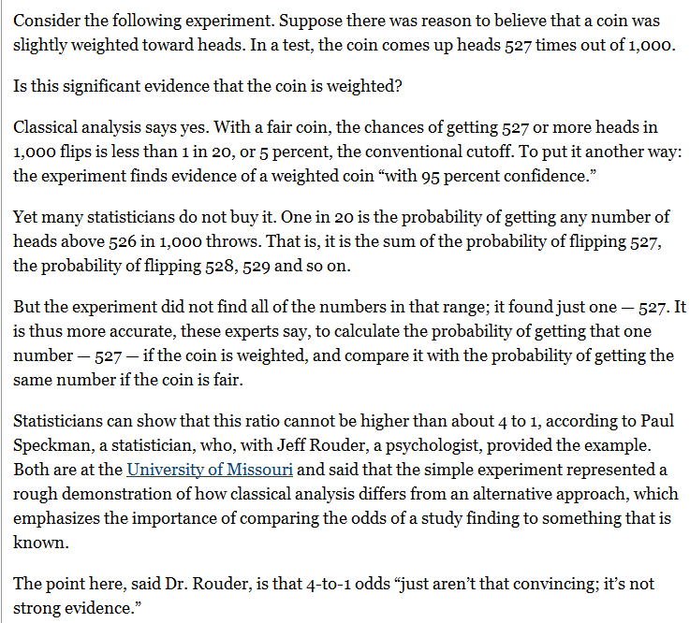



Slide 43
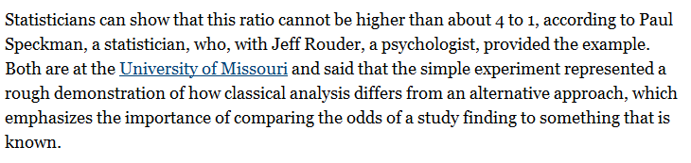
This is
p( 527 | coin is fair) / max( p ( 527 | coin is loaded ) )
p(people have ESP ) / p( people don’t) = ~ 4: 1
(you would see positive results by chance 25% of the time).
This is our first hint of a Bayesian approach to inference
My guess is that other factors (not correcting for multiple tests,
not running a two-sided test, not reporting negative results, etc)
mattered more for “ESP” than a “Bayesian” vs. “classical”
analysis, but that article gives a sense of some of the arguments

Slide 44
Coming up:
Bayesian vs. Frequentest approach to hypothesis testing for the Binomial distribution.
Numerical approximation in the Bayesian universe
The Poisson distribution and RNA-seq

