Slide 1
Deadlock

Slide 2

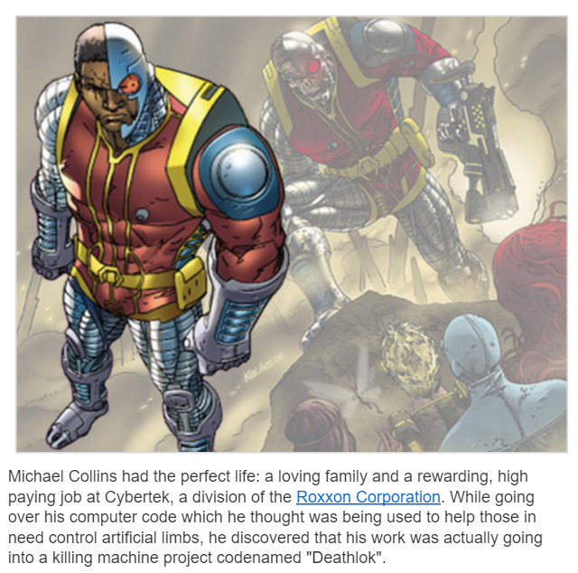

Not to be confused with Deathlok
http://marvel.com/universe/Deathlok_(Michael_Collins)

Slide 3
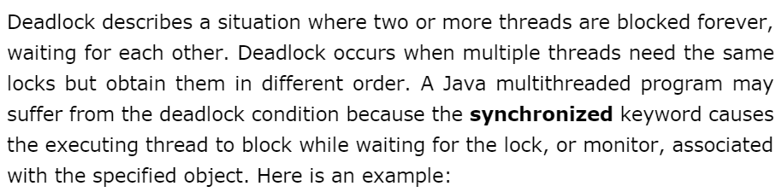
http://www.tutorialspoint.com/java/java_thread_deadlock.htm

Slide 4

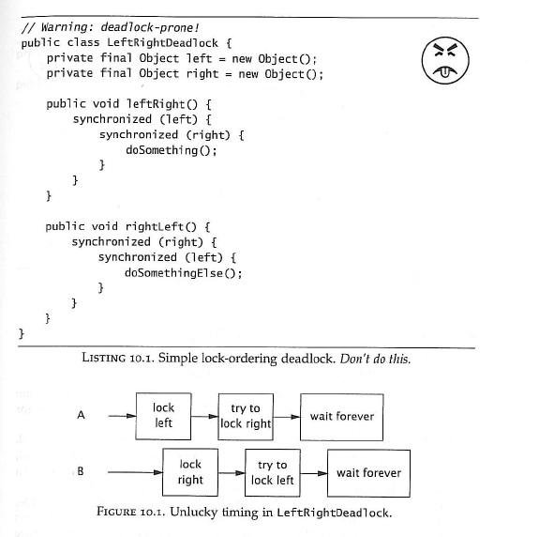
Deadlock is a vicious problem.

Slide 5
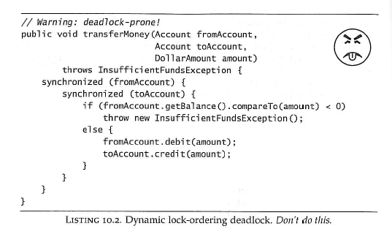
Why the frowny face? (This is a tough one…)

Slide 6
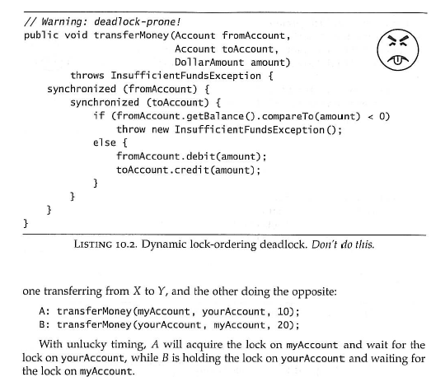
The ordering is not guaranteed!

Slide 7
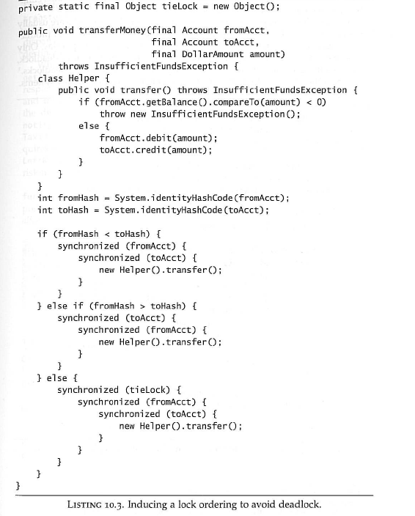
To avoid deadlock, force any two
Objects to always acquire the lock in
the same order
This will degrade to single-thread performance,
but hash collisions are rare so there is not much
of a performance penalty…

Slide 8
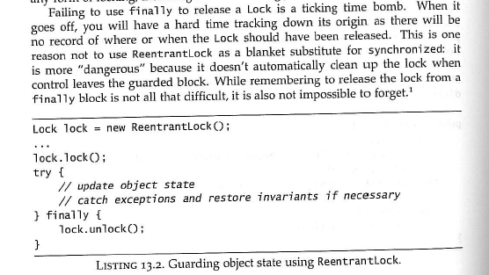
Maybe a better solution is hiding in Chapter 13….
Maybe a little more complicated to use…
It is up to you to release the lock (doesn’t happen automatically on leaving a synchronized block)

Slide 9

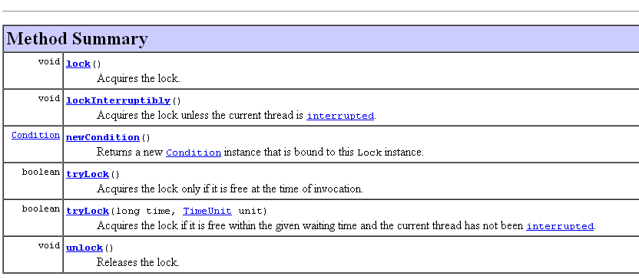
But way more flexible
Locking with synchronized can’t be interrupted
Try the lock and return if you don’t get it
Try the lock and return if you don’t get it after a time
Be careful: this will throw if you don’t have the lock
ReentrantLock is an implementation of the interface Lock

Slide 10
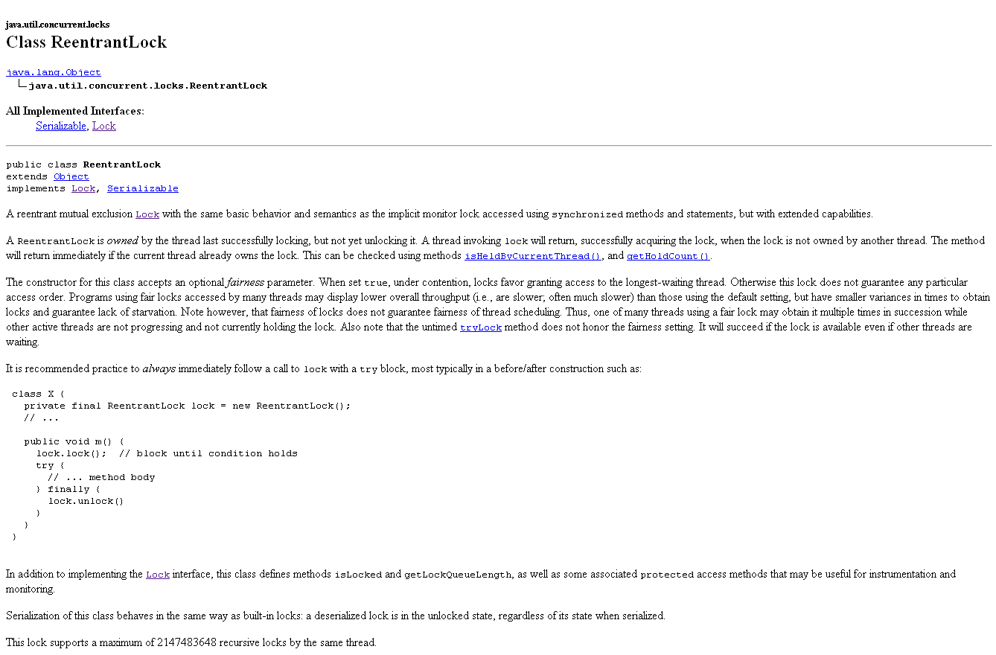

Slide 11

You get a lot of great stuff with a ReentrantLock…

Slide 12
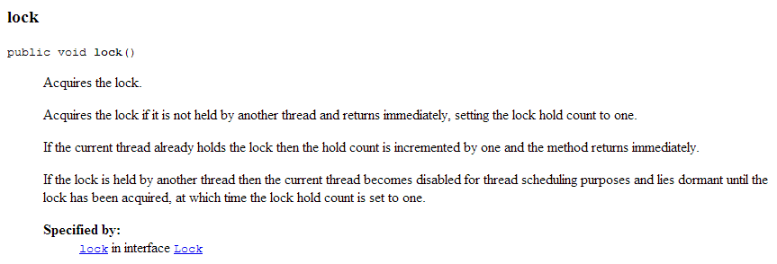
lock() works the way synchronized does…

Slide 13

When a thread is waiting for a lock, there is no way to interrupt it…
ReentrantLock offers an interruptible lock

Slide 14
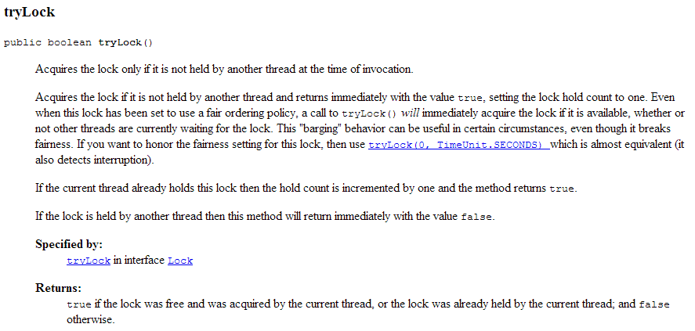
synchronized is all or nothing. Either you acquire the lock or block..
tryLock() tries for the lock but doesn’t block if the lock can’t be obtained.

Slide 15
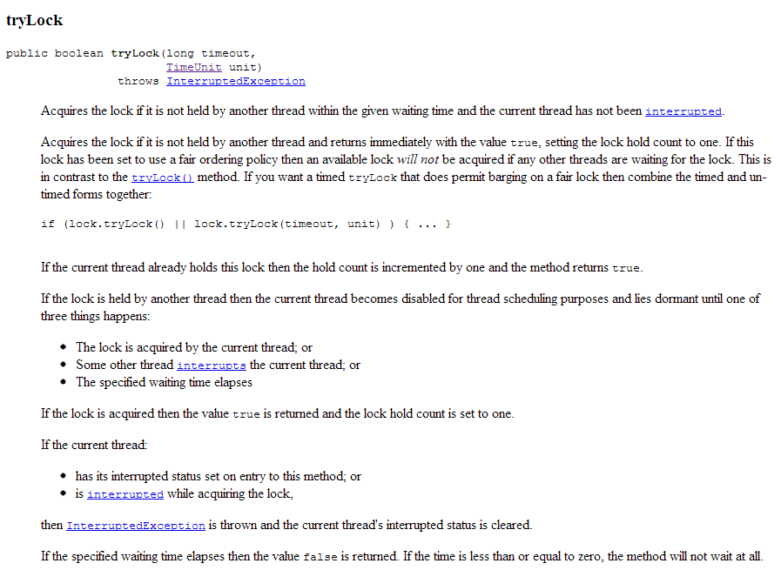
Or you can try and wait for a while…

Slide 16
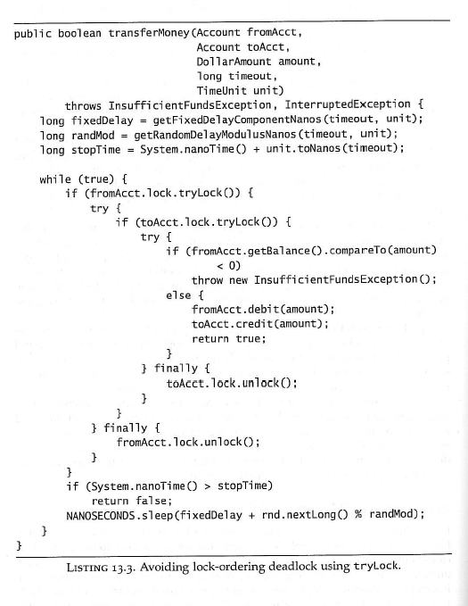
This leads to another way to prevent deadlock…
If you can’t get both locks,
release the locks and try again…
Need to be careful here;
These must be called if you got the lock
but will throw if you don’t have the lock!
stopTime guards against “livelock”.
Give up after awhile

Slide 17
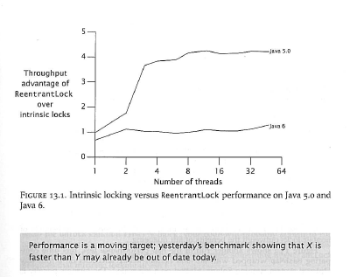
You might think ReentrantLock is slower than synchronized but…
The book argues to favor synchronized over ReentrantLock because it is simpler
(you don’t have to manage the unlock in a finally block)

Slide 18
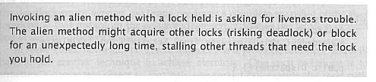
Returning to Deadlock (chapter 10)
You need to avoid “open calls”

Slide 19
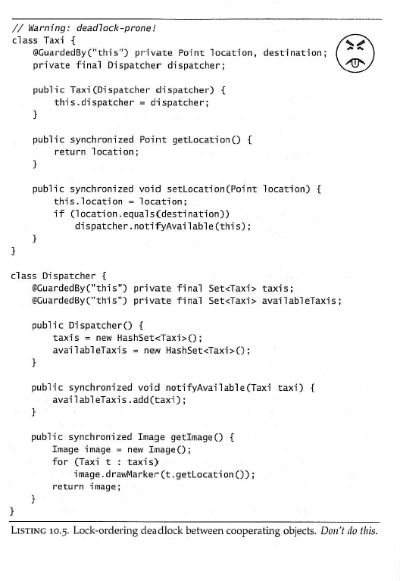
setLocation()
Locks a Taxi
notifyAvailable()
Locks the Dispatcher
getImage()
Locks the Dispatcher
getLocation()
Locks a taxi
Even after the book pointed it out, this took me awhile to see :-\

Slide 20
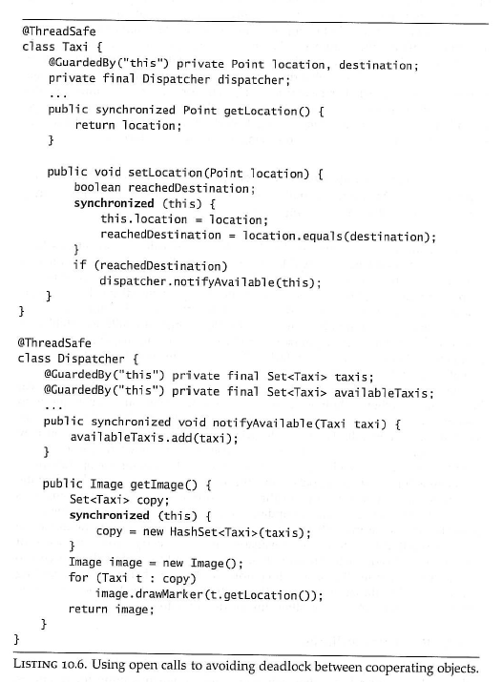
Fortunately, it is easy to avoid
these problems with open calls.
No need to hold the lock on taxi
once the destination has been checked.
We lose a little atomicity here..
(Or better yet, use thread safe
collections rather than synchronized
locks to manage your data!)

Slide 21
The easiest way to avoid deadlock.
Don’t hold more than one lock at a time.
Immutable objects don’t need to be locked!
Avoid open calls; try not to call new functions with the lock held.
If that function tries to grab another lock, the potential is there for deadlock
Methods like:
public synchronized void setVal(double newVal)
{
this.val = newVal; }
don’t make an open call and doesn’t hold a second lock
If you have to hold multiple locks, consider a ReentrantLock

