Slide 1
Zero inflated models

Slide 2
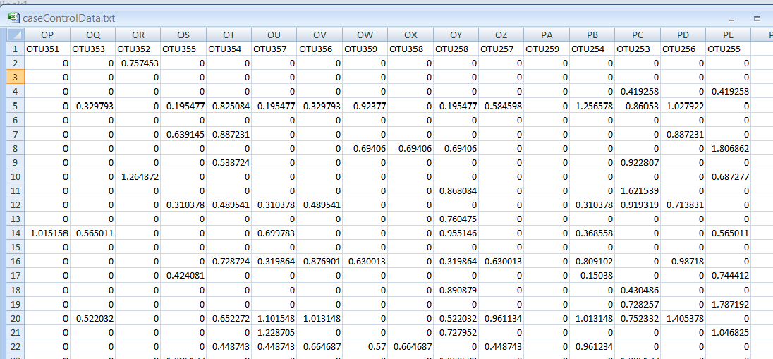
We often see lots of zeros in our sequence datasheets…
The source of all these zeros is not entirely clear…
Sequencing error, mis-classified taxa, lack of sequencing depth in some samples,
Biological diversity (we all have a few unique bugs that are not shared across many people).
http://afodor.github.io/classes/stats2015/caseControlData.txt

Slide 3
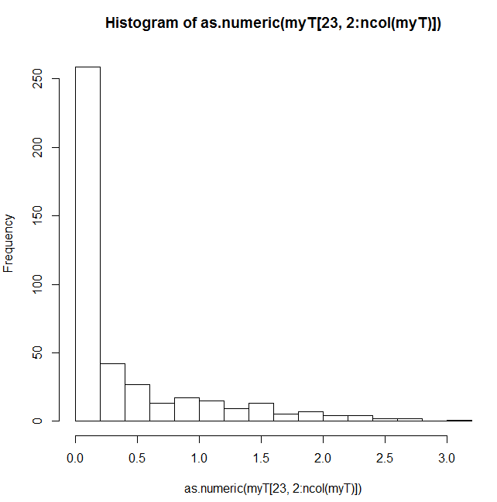
The zeros play havoc with assumptions such as normality
Today we will look at mixture models that explicitly model the over-abundance of zeros.
We follow chapter 11 in the Zuur book…

Slide 4


Mixture models that explicitly model the over-abundance of zeros
This will be binomial distributed with π = probability of a false zero
This will be either Poisson or Negative Binomial distributed
We will start with the Poisson distribution…
Prob of zero under binomial distribution
Poisson probability of a zero
Poisson probability of non-zero

Slide 5



As in all generalized linear models, we have 3 parts in the specification for a
Poisson zero inflated model
Model assumptions:
Zeros are distributed by binomial + Poisson
non-zeros distributed by Poisson
Mean and variance
(stated without proof)
(link equations)
The two link equations can share parameters
or not!
Our link equations ensure that π (which belongs to the binomial) can
only range from 0 to 1 (where the binomial is defined)
And that μ (which belongs to the Poisson) can only range >= 0
(where the Poisson is defined)
From these, we can write a (complicated) likelihood function to maximize..

Slide 6
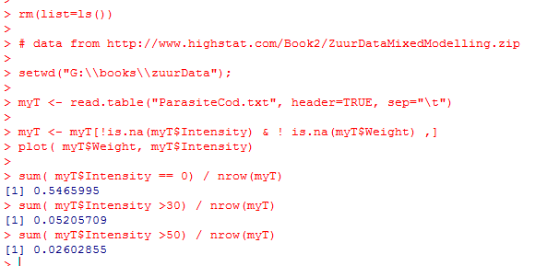
Let’s consider an example dataset…
Many zeros in this dataset (~54%) of all data
Your eye is drawn to the high intensity points,
But only ~2.6% of all data > 50

Slide 7
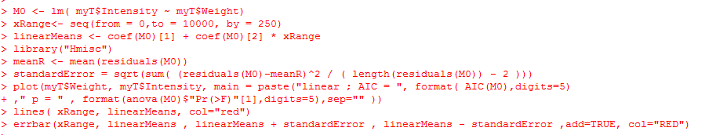
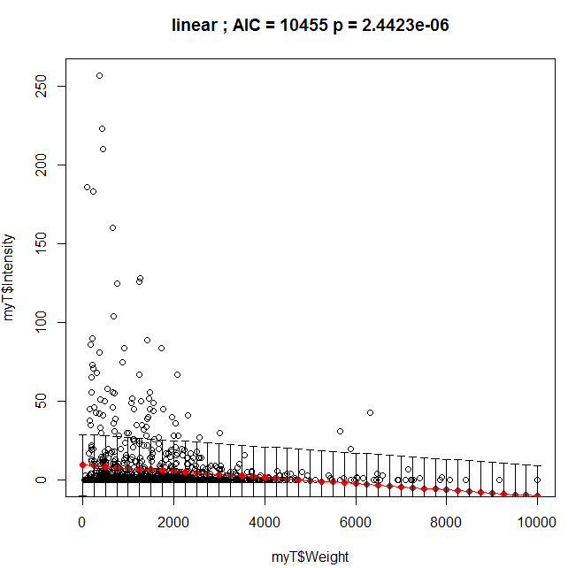
We will fit a series of models to the data… We start with a simple linear model..
Constant variance
Is problematic
Our model goes below
Zero…
https://github.com/afodor/metagenomicsTools/blob/master/src/classExamples/zeroInflatedExample.txt

Slide 8
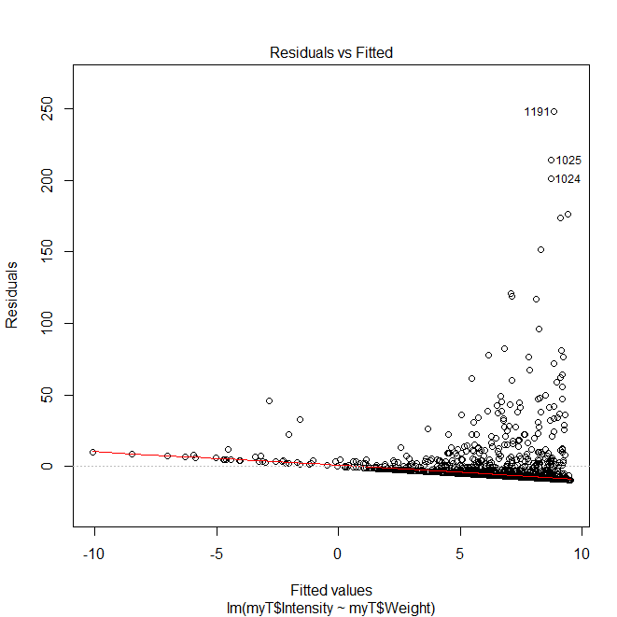
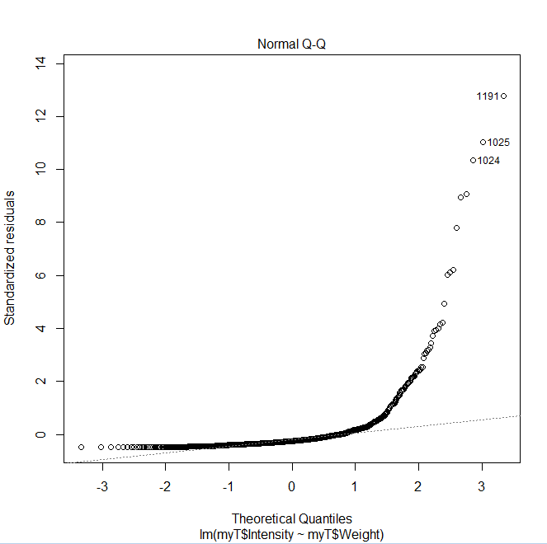
The residuals are a mess…
plot(M0)

Slide 9
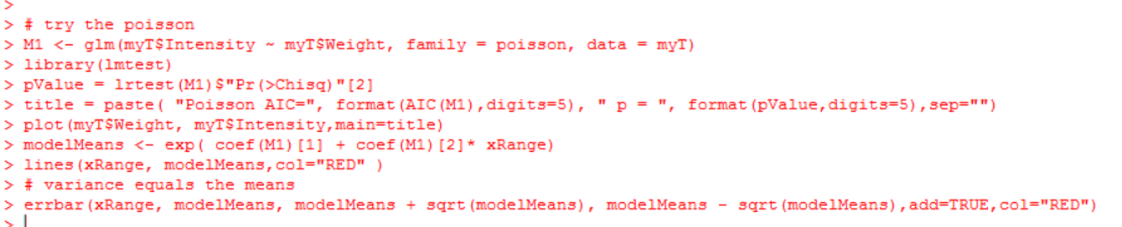
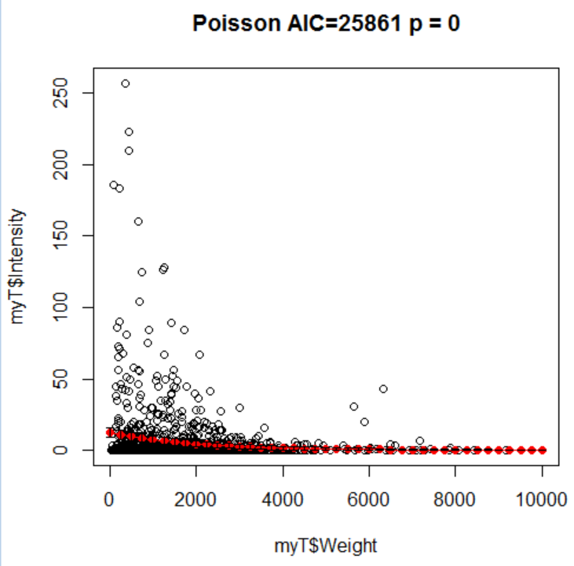
Next, we consider a Poisson model..
Fit is considerably worse than linear;
Assumption that mean==variance
seems a poor one..
Model doesn’t go below zero

Slide 10
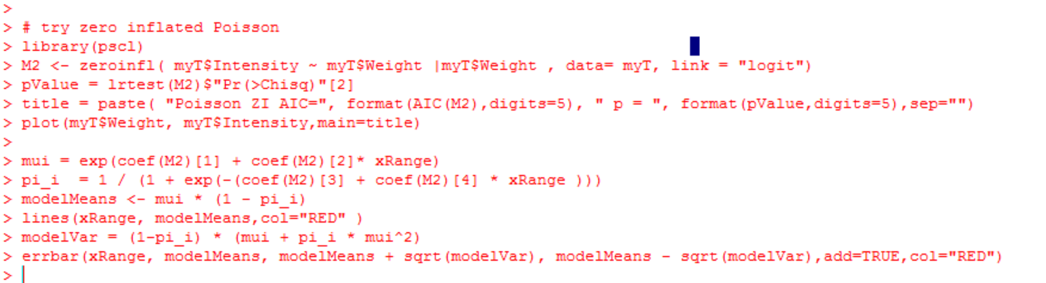
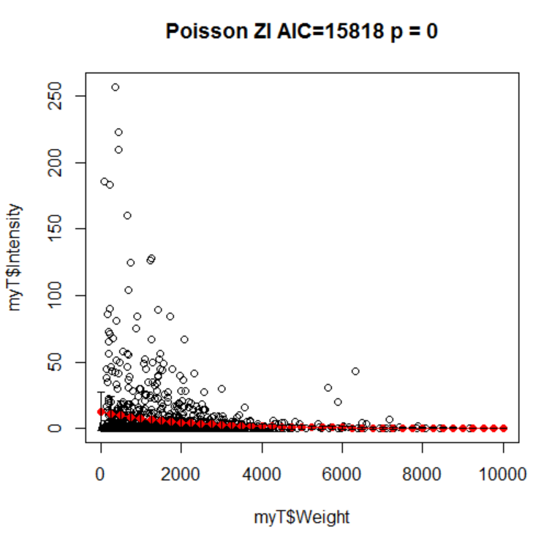
Next the zero-inflated Poisson

Slide 11
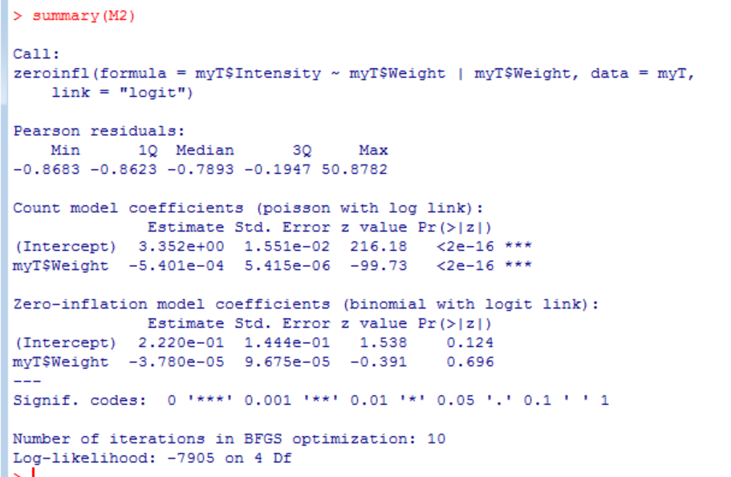

Slide 12
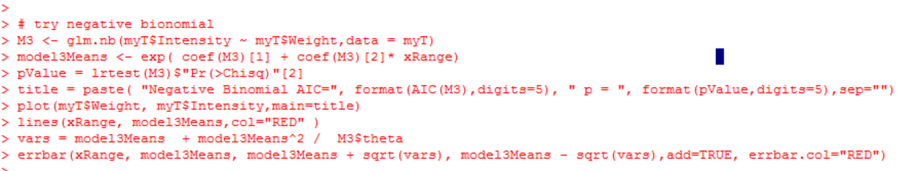
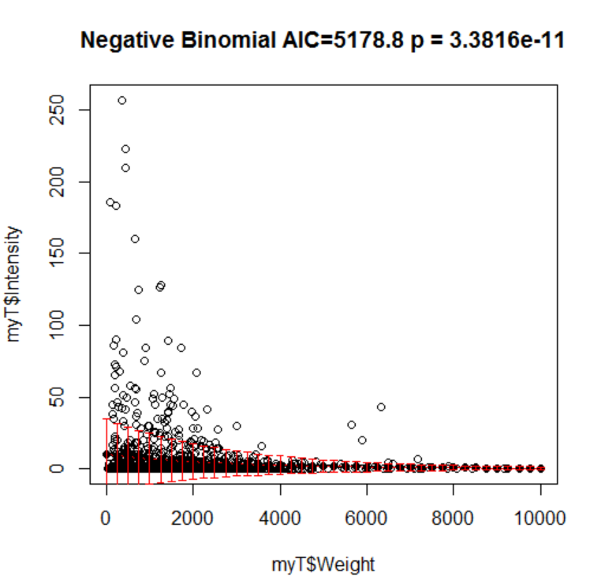
The negative binomial…

Slide 13
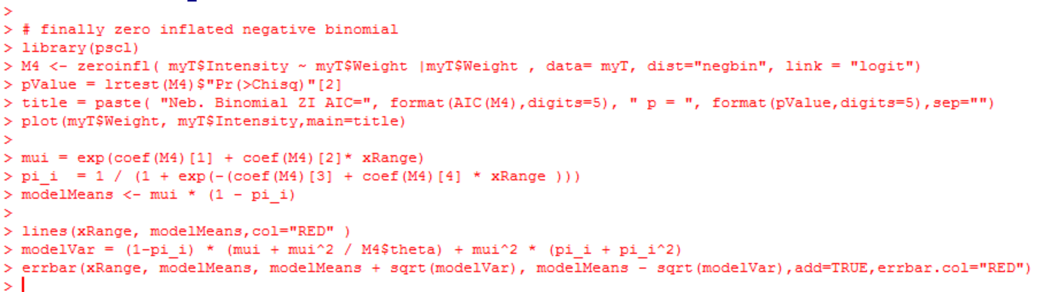
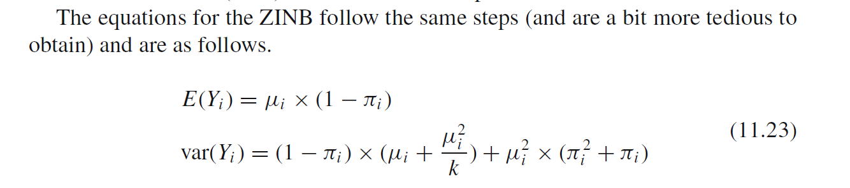
Finally, the zero inflated negative binomial…
From the Zuur book…

Slide 14
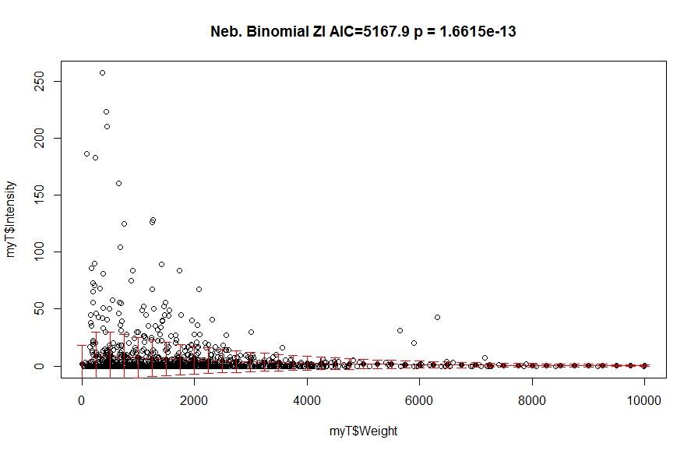

Slide 15
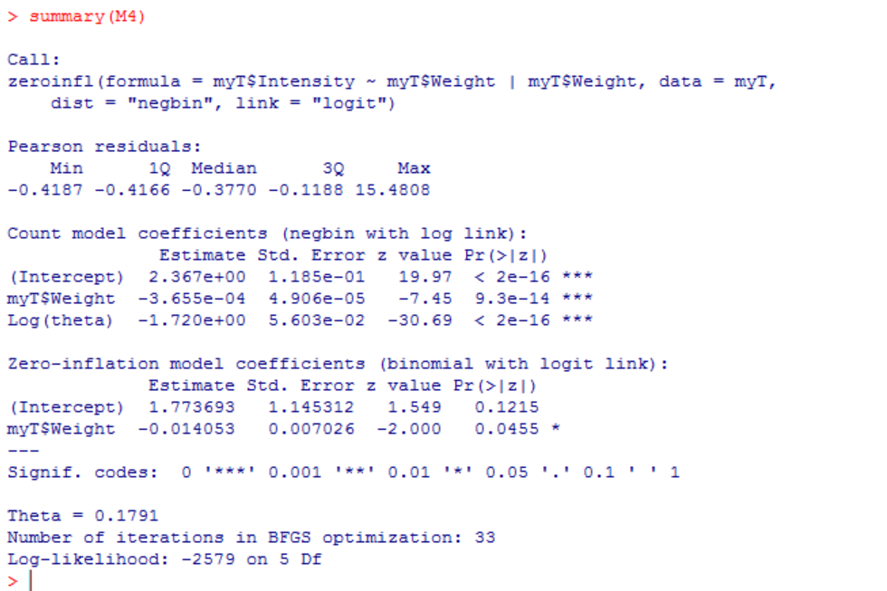

Slide 16
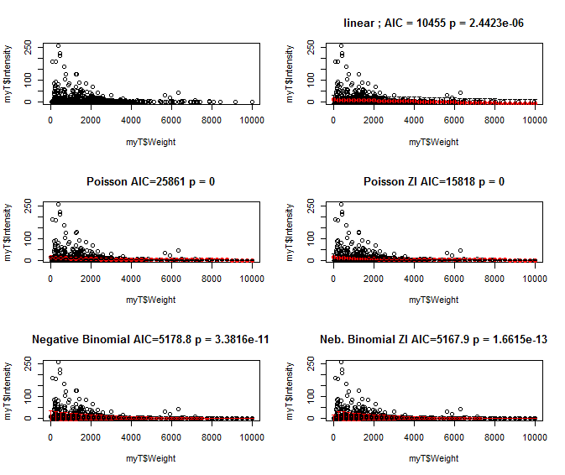
A summary view of all our models…

Slide 17
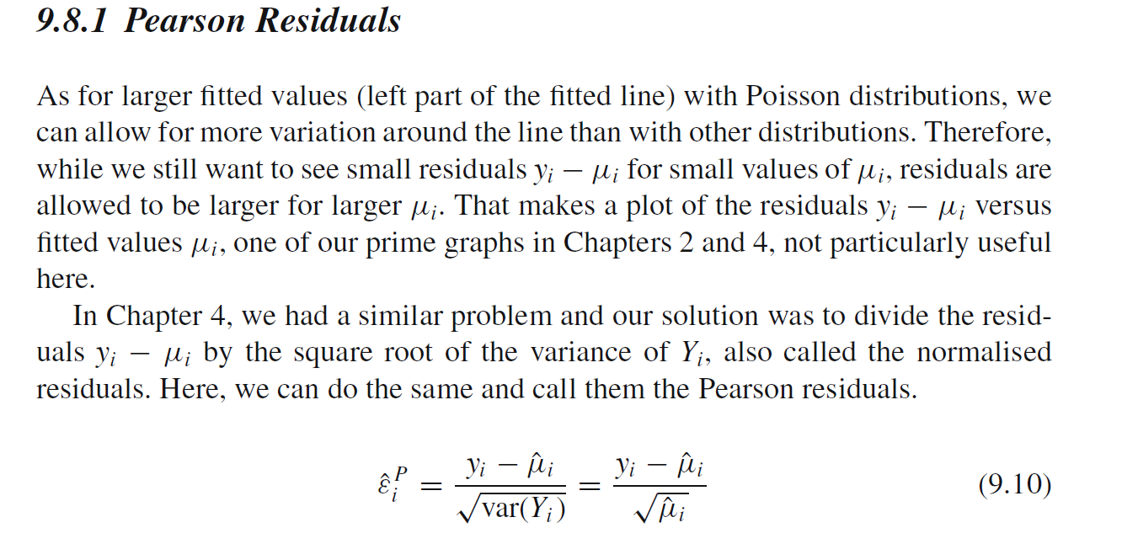
From the Zuur book; we can look at Pearson residuals vs. model or covariates

Slide 18
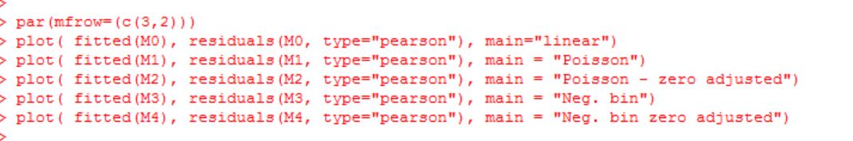
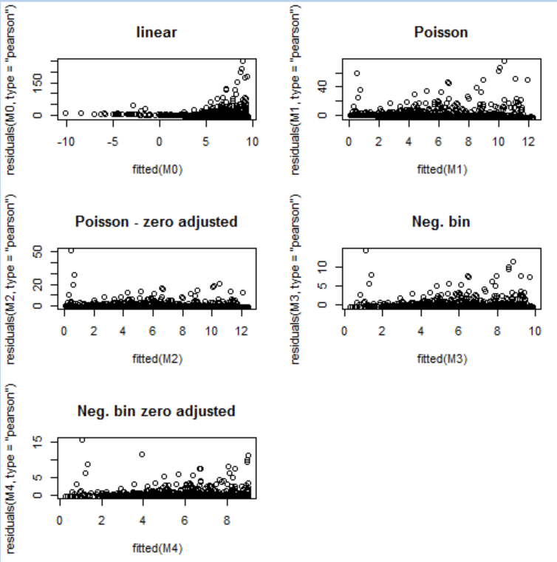
None of these models are free from patterns in their residuals..

Slide 19
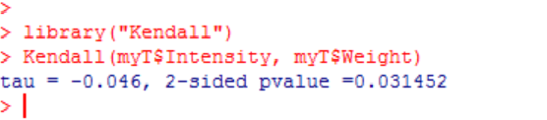
A non-parametric alternative with a (just barely) significant p-value

