Slide 1
Bayesian model of disease outbreaks

Slide 2

A journal club interlude:
A current example of MCMC “walking” methods…
(published less than a month ago…)
http://www.ploscompbiol.org/article/info%3Adoi%2F10.1371%2Fjournal.pcbi.1003457;jsessionid=1542C917D52714E6043BD1567B416164

Slide 3
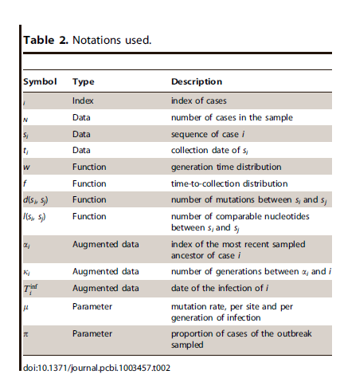
Consider a simple tree with only 4 observed cases…
i = 1,2,3,4
N = 4
1
2
4
3
Model constants:
w= f = {0.00 0.50 1.00 0.75} (see “An introduction to outbreaker 1.1-0”, p. 2)
Model variables (adjusted in Monte Carlo Markov Chain walk):
α_{i} = index of most recently sampled ancestor (so α₃ would be 2 in example above)
K_{i} = number of generations between and α_{i} i.
T_{i}^{inf} = actual date of the infection of I
µ = mutation rate
∏ = proportion observed (if ∏ = 0.8, there would be one hidden case)
So there are at least 3 * N + 3 parameters that we walk through in the MCMC

Slide 4
Each set of model variables (augmented data) represents a tree and infection history.
We are going to take MCMC walks changing these variables,
calculating likelihood. The tree we observe the most, the most probable tree,
reflects the most probable transmission path
(given the data and the assumptions of our model)
1
2
4
3
Model variables (adjusted in Monte Carlo Markov Chain walk):
α_{i} = index of most recently sampled ancestor (so α₃ would be 2 in example above)
K_{i} = number of generations between and α_{i} i.
T_{i}^{inf} = actual date of the infection of I
µ = mutation rate
∏ = proportion observed (if ∏ = 0.8, there would be one hidden case)
So there are at least 3 * N + 3 parameters that we walk through in the MCMC

Slide 5
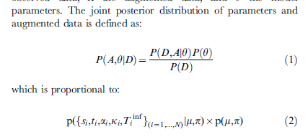
In our coin-flipping example:
P(Θ | Y_{new} ) is proportional to P(Y_{new} | Θ ) * P(Θ | Y_{old} )
Posterior
likelihood
prior
In the paper we have…
posterior
prior
likelihood
likelihood
prior
This is a little different the pure Bayesian, because there is no data in the prior!
What is “data” and what is “parameter” is more confusing than in our coin flipping example!

Slide 6
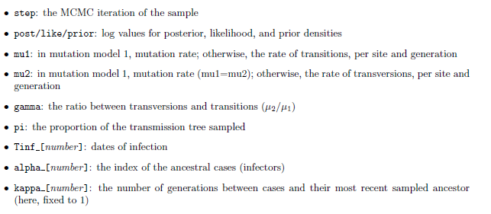
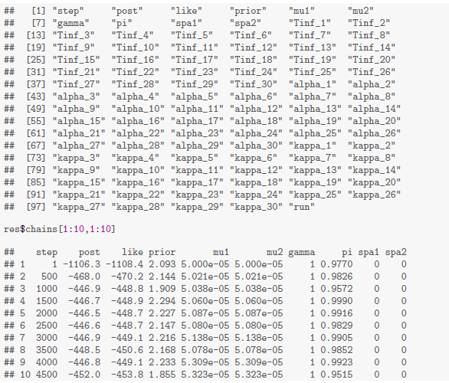
From “An introduction to outbreaker 1.1-0”
These are the variables that get updated with each walk on our chain..
µ = mutation rate = mu1 = mu2
Kappa seems to be fixed to 1
So we have u and pi for the whole dataset
and α and Tinf_ for each node

Slide 7
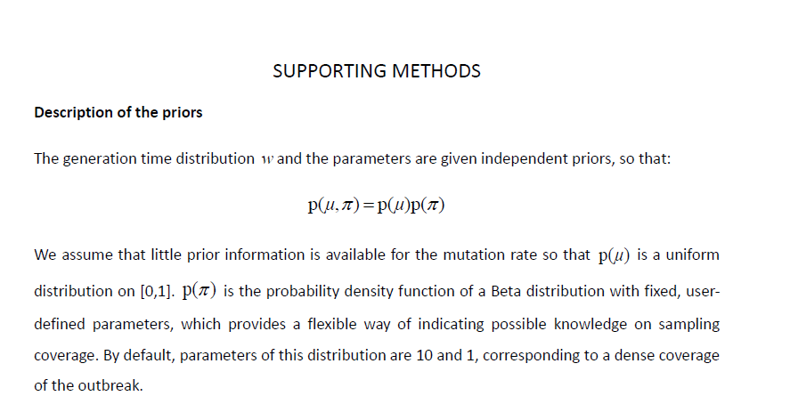
For each update, the prior probability is calculated using essentially arbitrary
distributions…
If you look at what they actually do in the code, p(μ) is set to 1
p(∏) = beta(∏,10,1)
prior = log(beta(∏,10,1) )

Slide 8
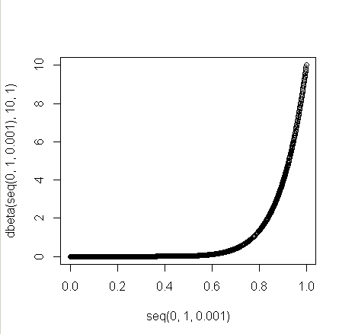
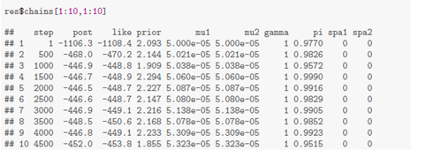



Step 500:
Step 1000:
So although they don’t say this, the prior is essentially a constant
(especially compared to the likelihood that is changing by ~600 log units..)
∏ is constrained to a very narrow range ; big limitation of this model.
The two parameters of the beta distribution are not changeable during MCMC updates.

Slide 9
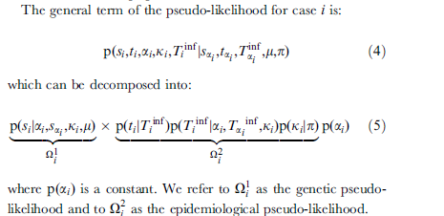
So what about the likelihood?

Slide 10
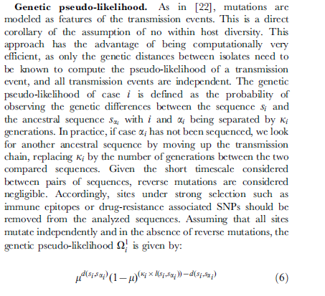
If ki is 1 (as it appears that it is by default in R), we recognize this as the
Binomial distribution without the normalizing (choose) function.
We can presumably ignore the normalizing constant since we are sampling
the posterior and we don’t need these to be true probabilities between 0 and 1…
(in previous papers, this has also been modeled by Poission distribution)
Flip a coin at each base with p(head) = µ. If it’s a head, change the base

Slide 11
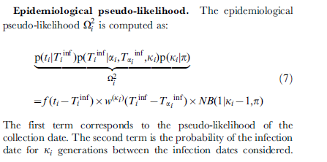
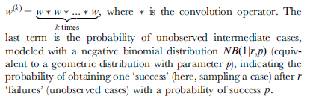
Calculate the probability that a given strain is out in the population
(the hidden variable) that you will observe it given some distribution…
The parameters for that distribution are essentially made up:
w= f = {0.00 0.50 1.00 0.75}
So there is some (made up) distribution that calculates if you have the disease,
there is some probability you will pass it on * probability it will be observed

Slide 12
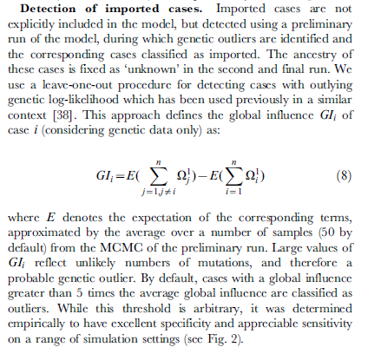

Slide 13
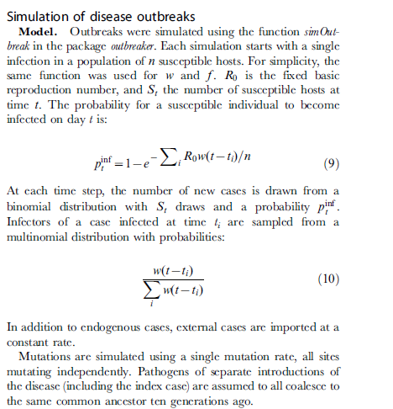
Let’s simulate a (small) outbreak and see if we can understand the way the model works

Slide 14
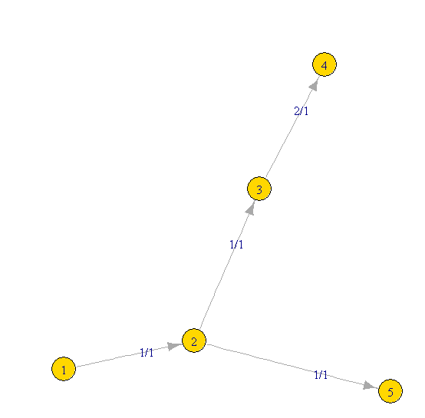


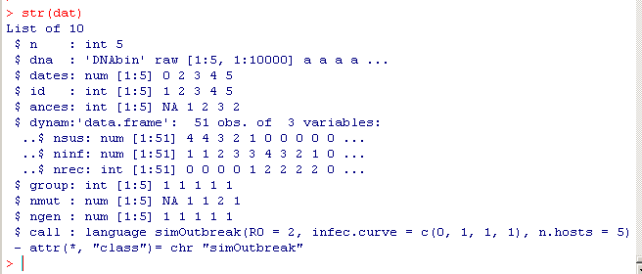
We start by typing this into R (and waiting a while for everything to download and install)
Then…

Slide 15
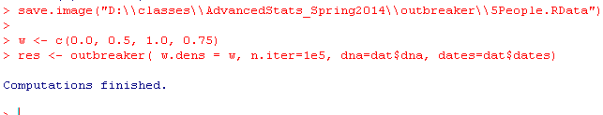
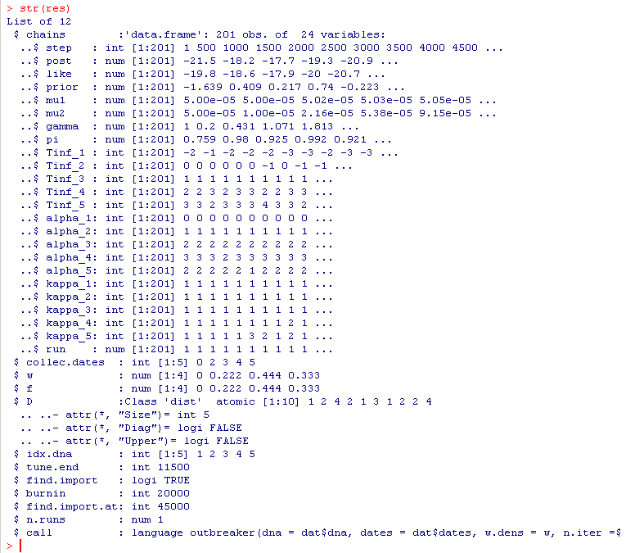
We do our walks on our simplified tree…

Slide 16

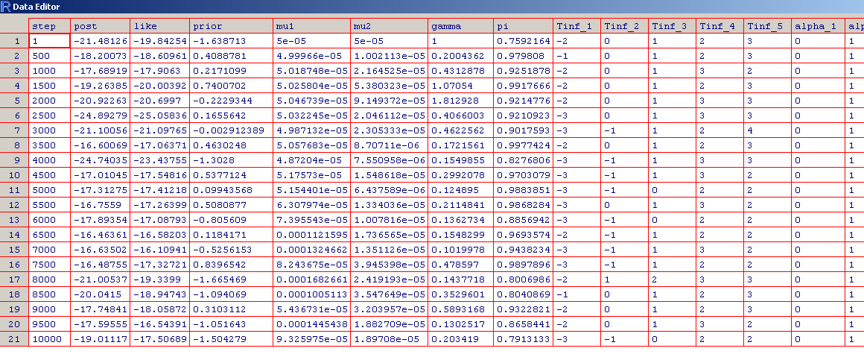

Slide 17
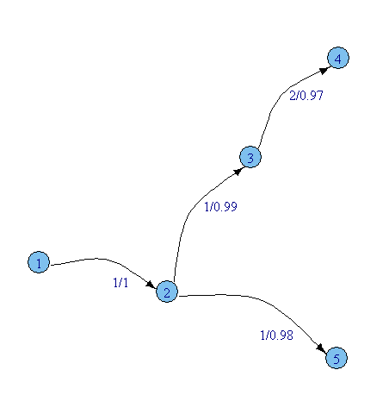
g <- transGraph(res, thres=0)
The original simulated data
The reconstructed data..

Slide 18
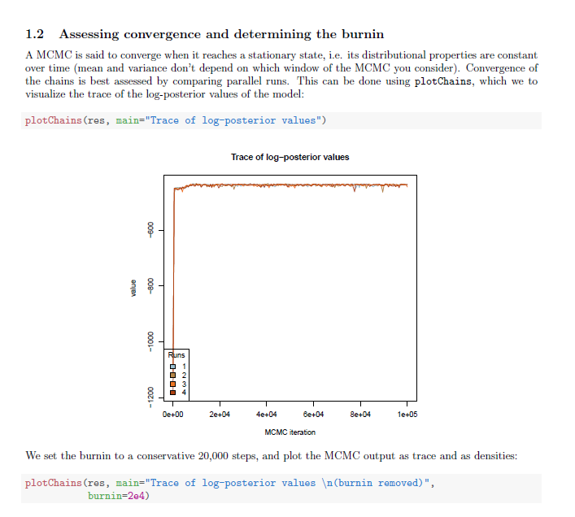

Slide 19
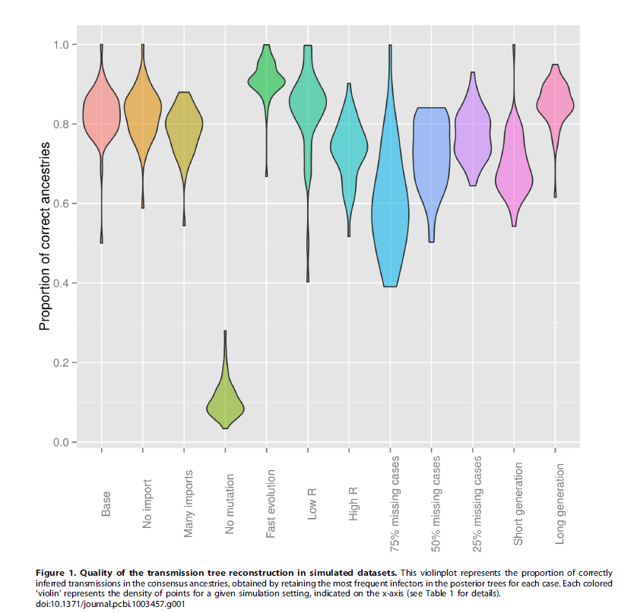

Slide 20
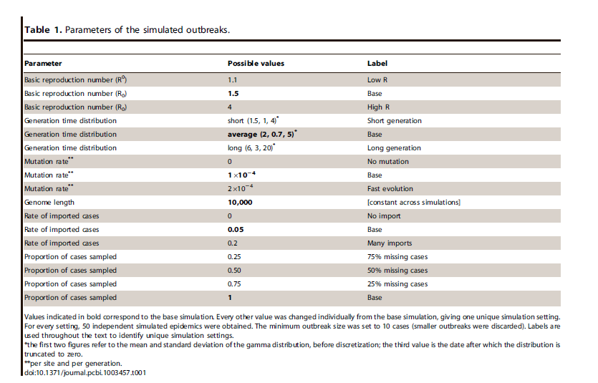

Slide 21
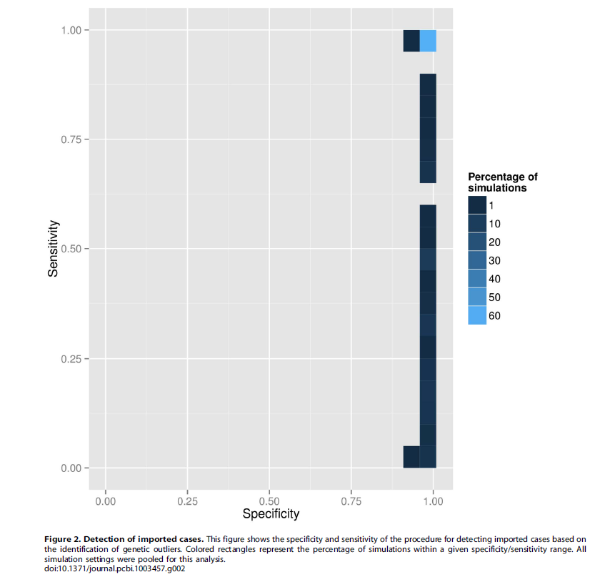

Slide 22
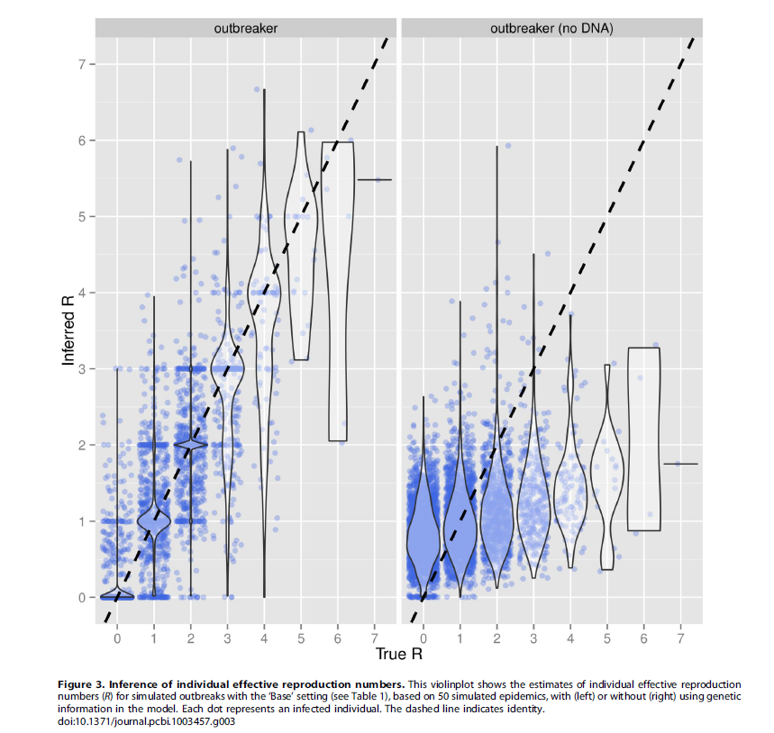
R – the # of secondary cases per infected individual

Slide 23
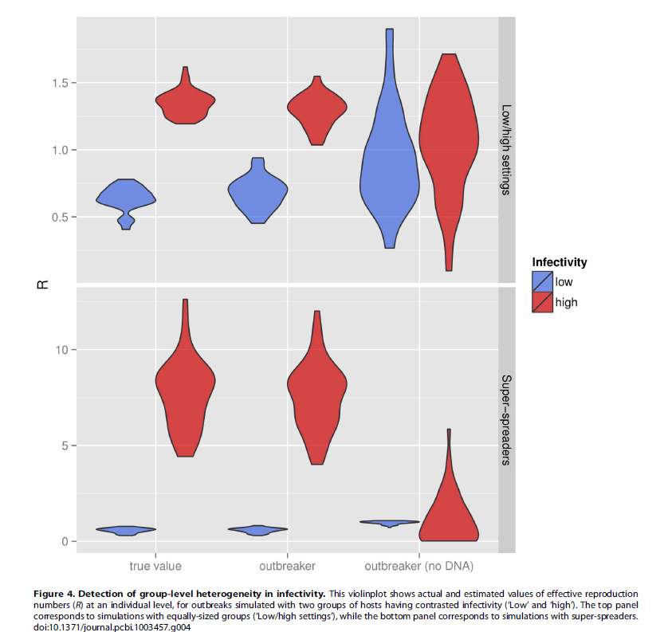

Slide 24
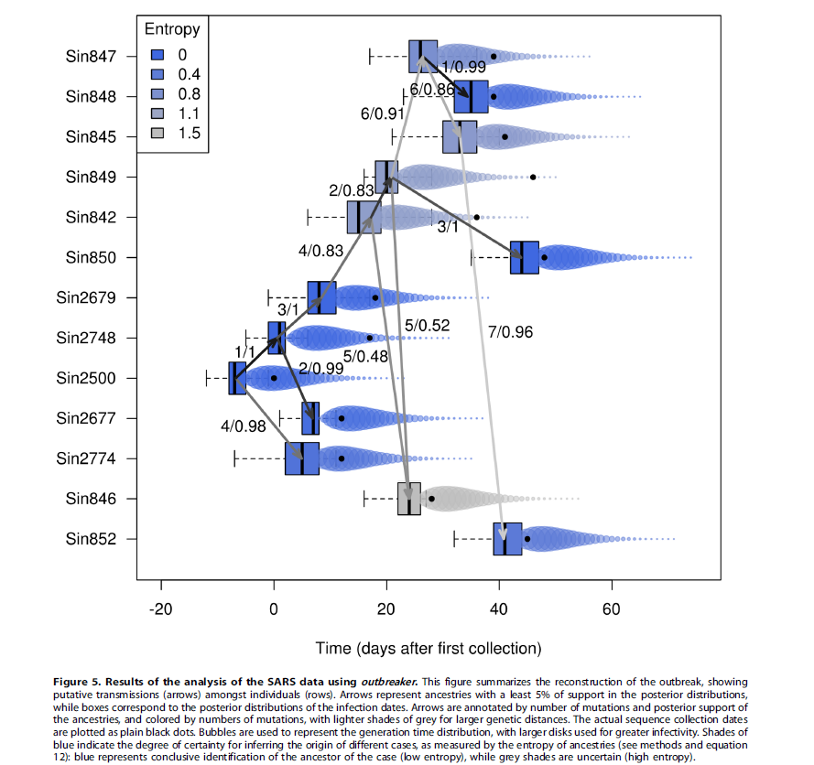

Slide 25
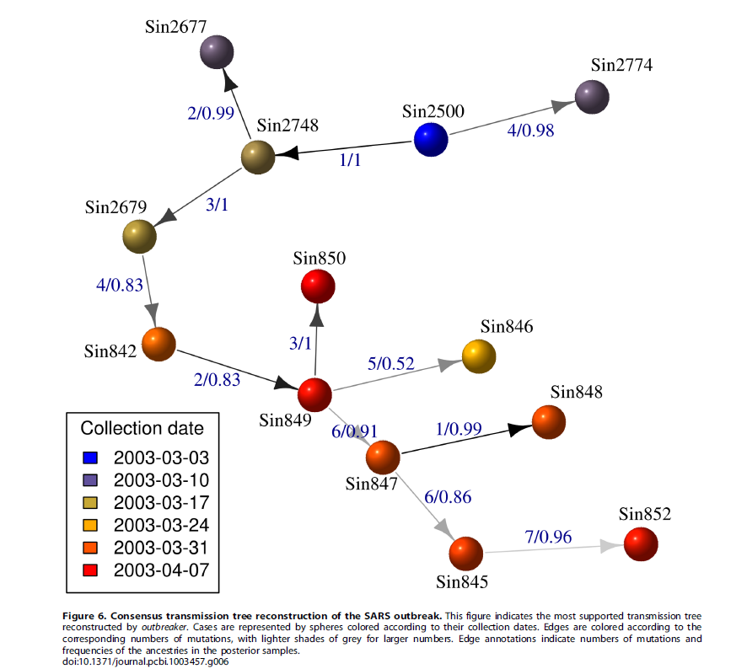
The same figure drawn in a prettier way…

Slide 26
Coming up:
We begin our review of canonical distributions:
normal, chi-square, t
which will lead us to the t-test and then linear models

