Slide 1
Host Associated Microbial Community Dynamics
Over Space and Time
Anthony Fodor
UNC Charlotte
Bioinformatics and Genomics

Slide 2
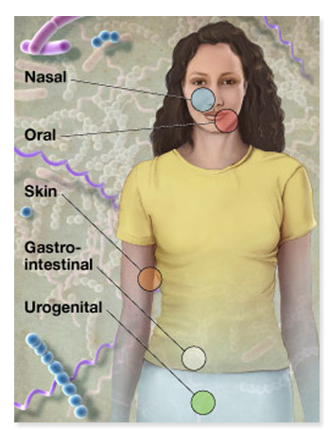

Ecosystems within our body
10 times more microbial cells than human cells
100 times more microbial genes than human genes
Both human and microbial genomes are targets
for association studies to health and disease
phenotypes
http://commonfund.nih.gov/hmp/

Slide 3

http://commonfund.nih.gov/hmp/

Slide 4
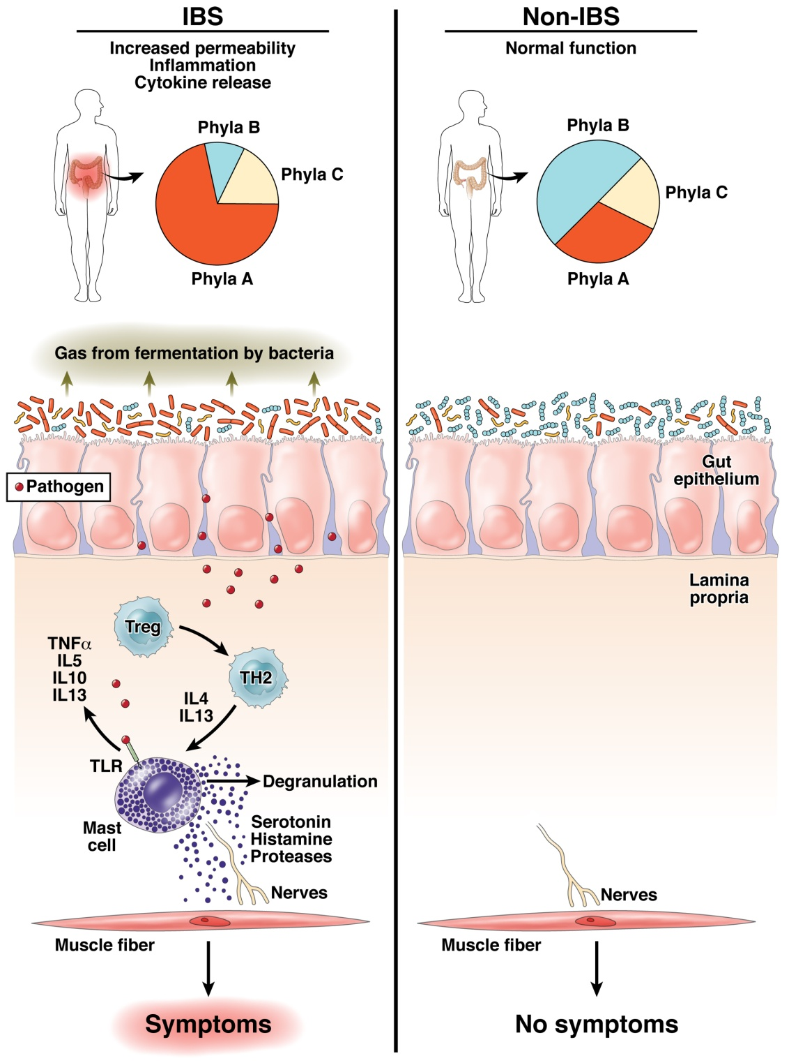
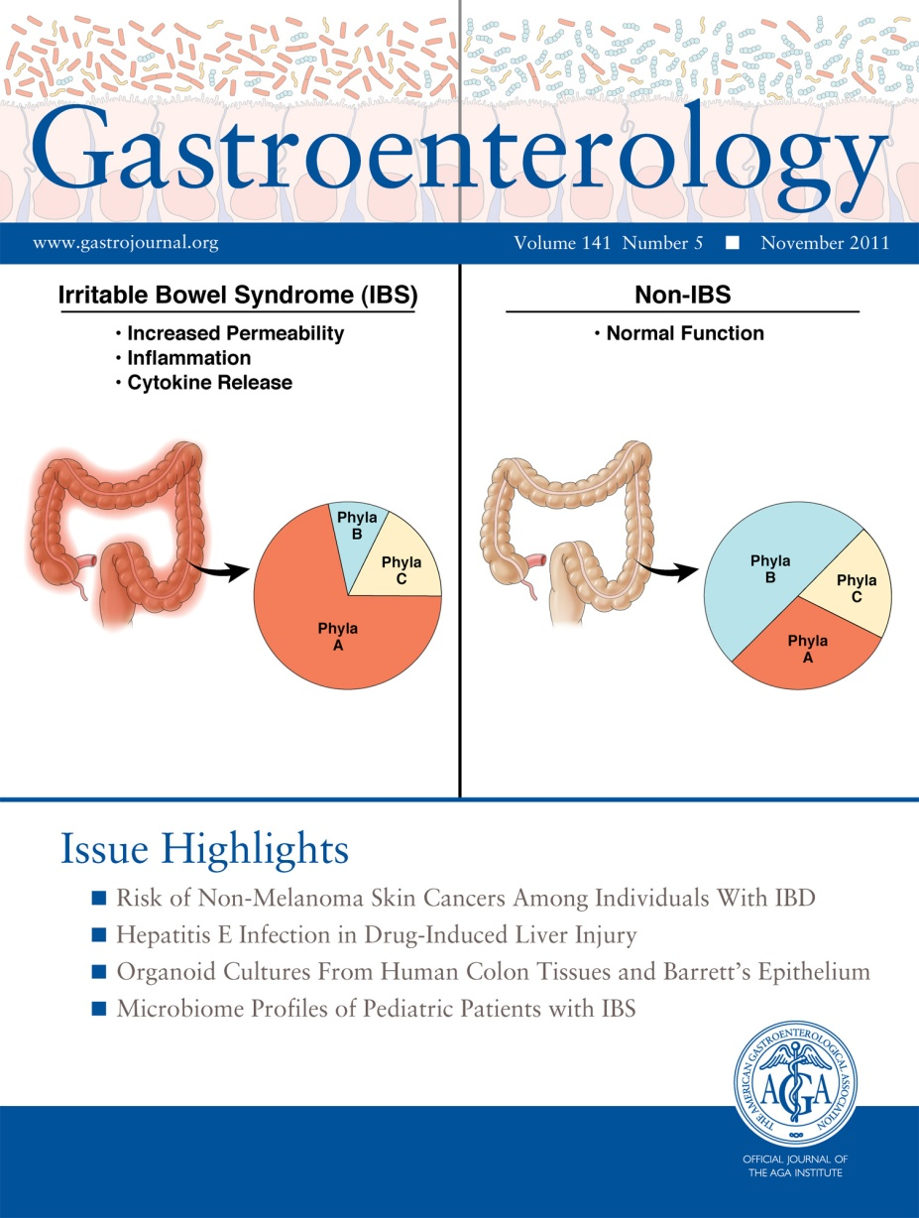
Does human variability in the microbiome impact health and disease?
Fodor & Talley. Gastroenterology. 2011

Slide 5
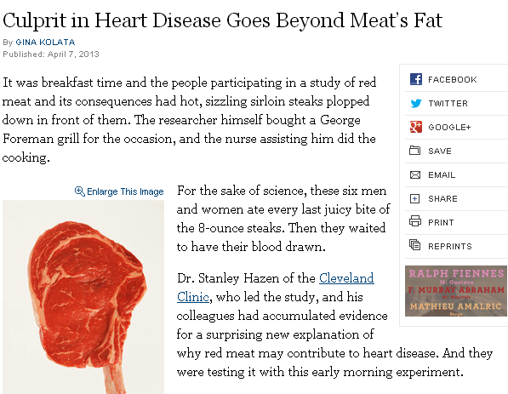
Do microbial-diet interactions cause heart disease?

Slide 6
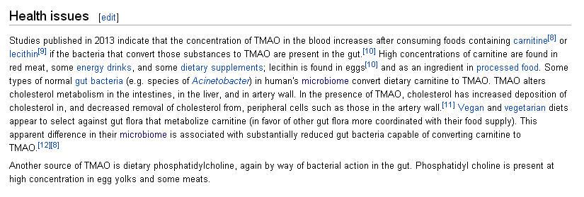
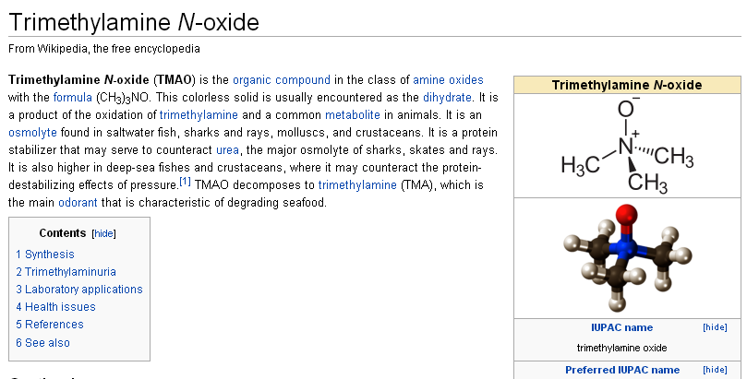

Slide 7
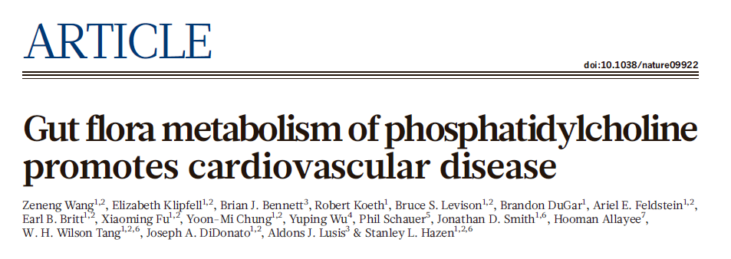
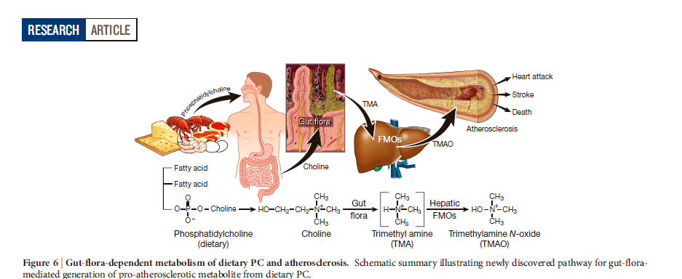

Slide 8
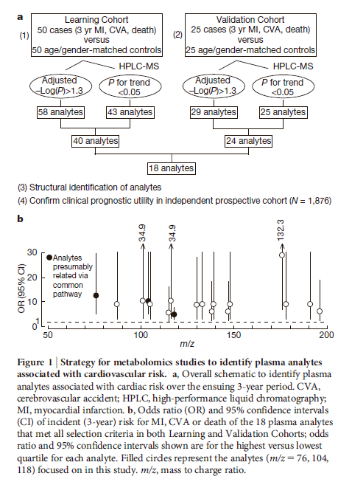
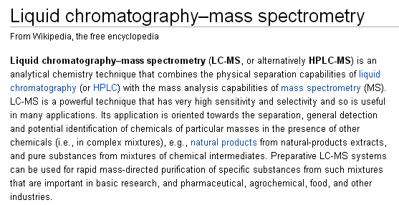

Slide 9
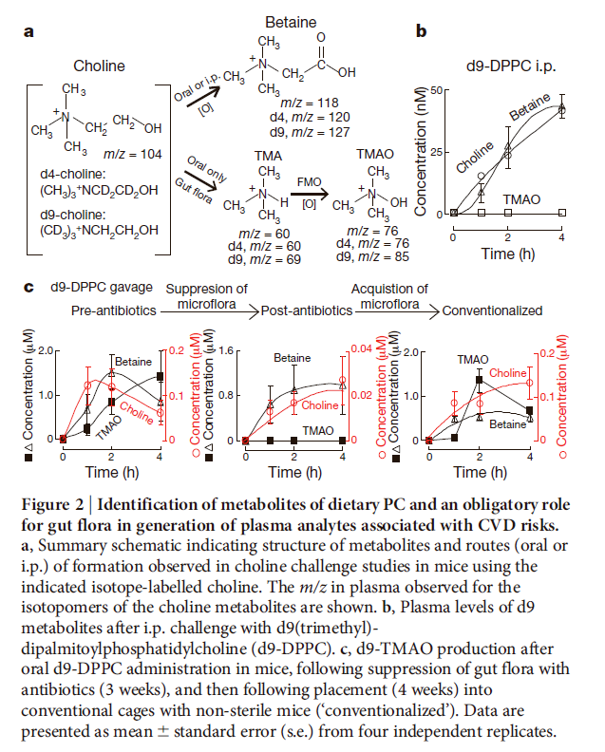

Slide 10
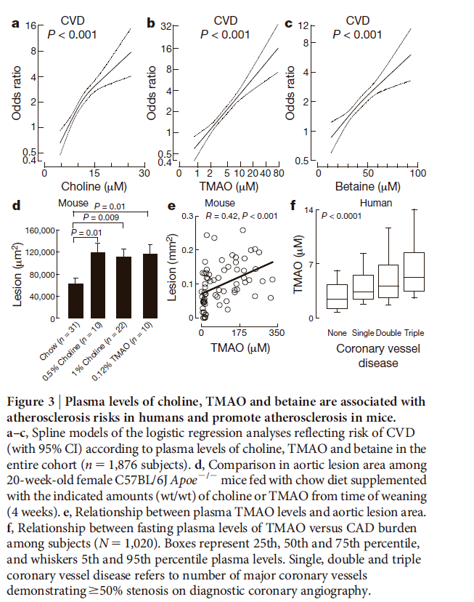

Slide 11
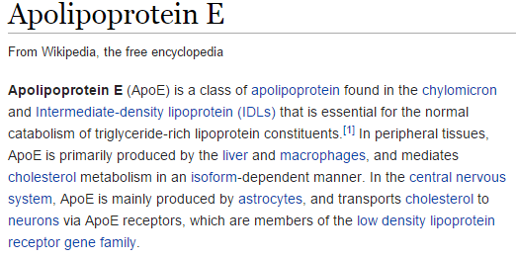
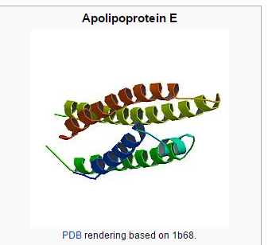
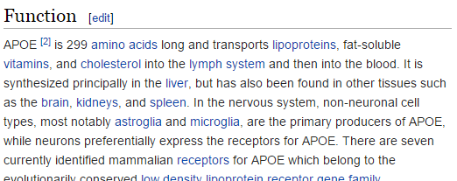

Slide 12
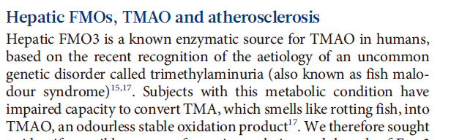
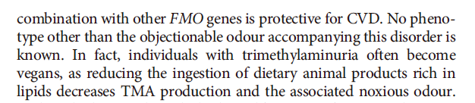
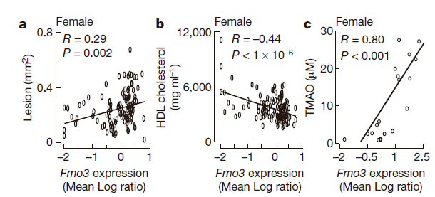
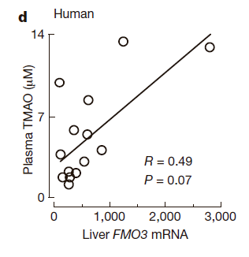
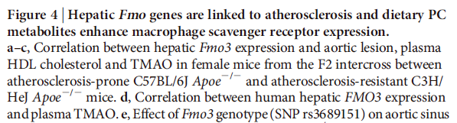

Slide 13
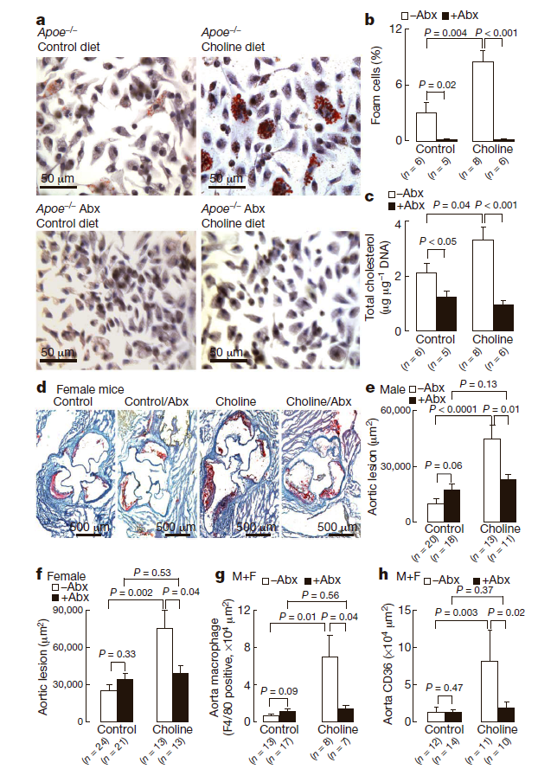

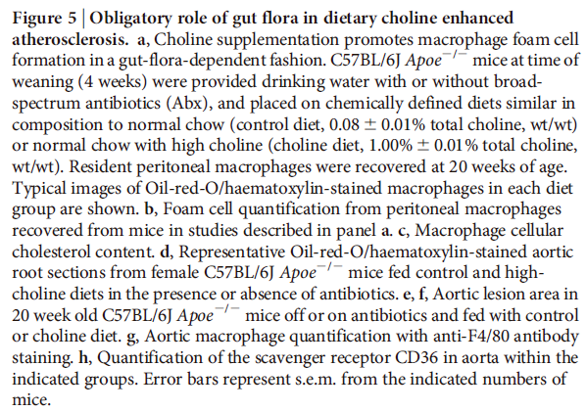

Slide 14
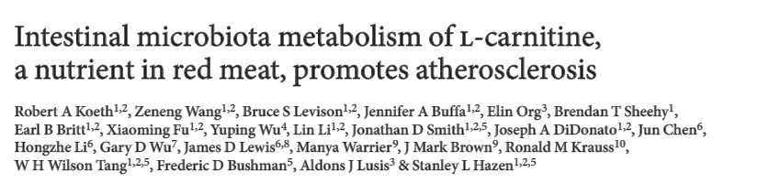
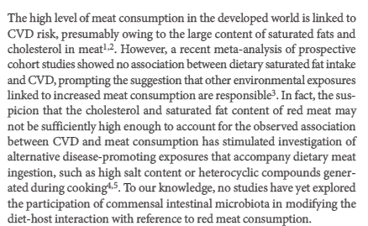


Slide 15
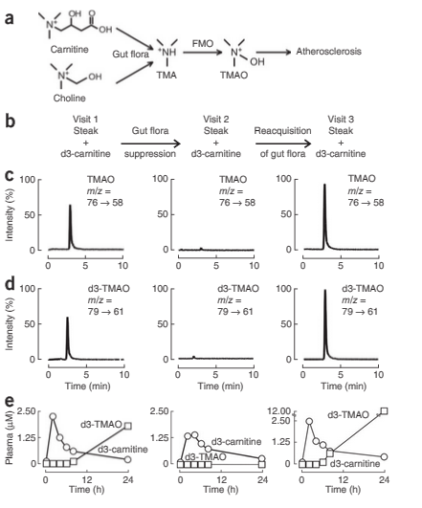
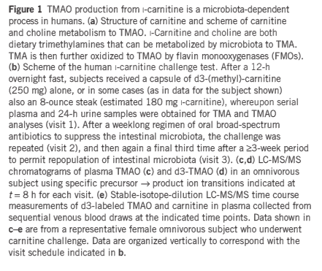

Slide 16
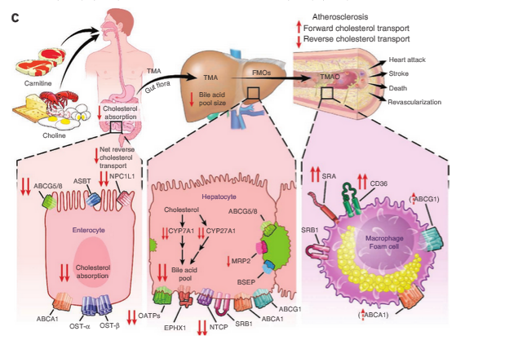

Slide 17
Is there a microbial signature associated with the development of
colorectal adenomas?
Mucosal biopsies from 33 “case” and 38 “control” patients
Tissue collected from same area in case and control
454 sequencing targeting the conserved 16S rRNA gene
~1,200,000 sequences of ~400 basepairs each
Group the sequences into 742 clusters (that are 97% identical)
http://www.nature.com/ismej/journal/v6/n10/full/ismej201243a.html
Nina Sanapareddy, Ryan M Legge, Biljana Jovov, Amber McCoy, Lauren Burcal, Felix Araujo-Perez, Thomas A Randall, Joseph Galanko, Andrew Benson, Robert S Sandler, John F Rawls, Zaid Abdo, Anthony A Fodor Temitope O Keku. ISME J. 2012

Slide 18
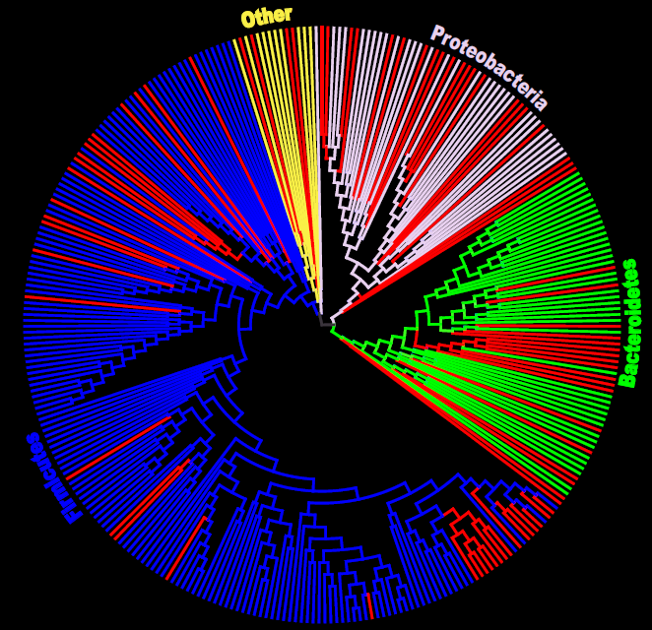
Figure 2: Maximum likelihood tree generated from the top 315 OTUs using RaxXML EPA server. Leaf nodes are labeled with the RDP call of the consensus sequence at 80%. Internal nodes are labeled with the most derived RDP classification that at least 90% of all child nodes share . Branches are colored red if the OTU was significantly different between case and control and blue if not significant (at 10% FDR).
87 taxa more abundant in case
5 taxa more abundant in control

Slide 19
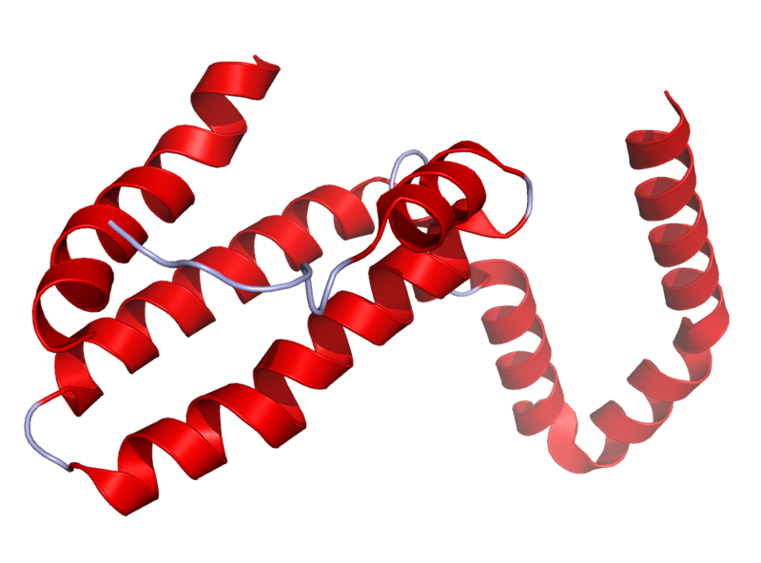
Il10^{-\-} Mouse Model
Il10 is an anti-inflammatory cytokine.
Inhibits pro inflammatory cytokines
Acts as an immunoregulator in the GI tract.
Lamblin, C., et al.,The Journal of allergy and clinical immunology, 2001.
http://en.wikipedia.org/wiki/Interleukin_10
Il10-\-
Il10^{-\-} mice are prone to inflammation with commensal tolerated by WT mice.
Knoch, B., et al.,Microbiology-Sgm, 2010
Established model for investigating disease phenotypes associated with inflammation

Slide 20
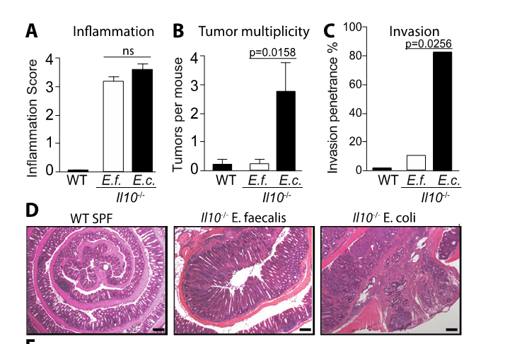
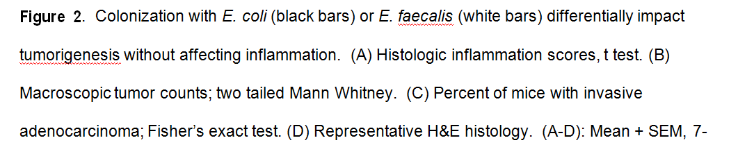
E. Coli, but not E. Faecalis, promotes tumorigensis in the IL10-/- model
http://www.sciencemag.org/content/338/6103/120.short

Slide 21
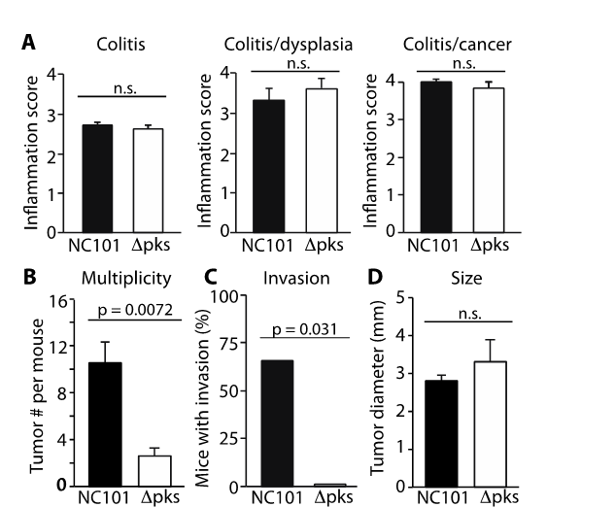
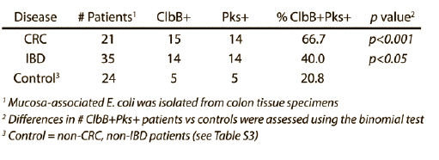
The pks island region of E. Coli (strain NC101) is associated with tumorigensis
12
12 weeks
14 weeks
18 weeks
The PKS island encodes a machinery
for synthesis of nonribosomal
peptide and polyketide compounds.
It has previously been associated with
DNA double-stranded breakage.
Figure 4. Deletion of pks reduces the tumorigenicity, but not inflammatory potential, of E. coli NC101 in AOM/Il10^{-/-} mice. (A) Histologic inflammation scores at 12, 14, 18 weeks, (B) Macroscopic tumors/mouse, (C) Histologic invasion through the muscularis propria, Fisher’s exact test. (D) Macroscopic tumor diameter
Arthur et. al, Science, 2012

