Slide 1
Compositionality and Sparseness

Slide 3
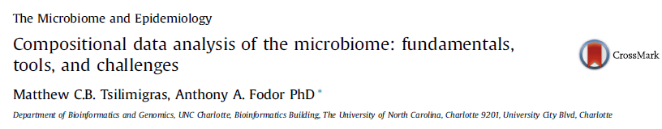
For background a recent review paper…
http://afodor.github.io/classes/stats2017/compositionalData.pdf

Slide 4
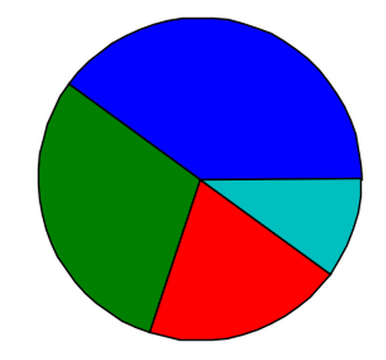

Can we fairly compare high and low biomass samples?
VS.

Slide 5
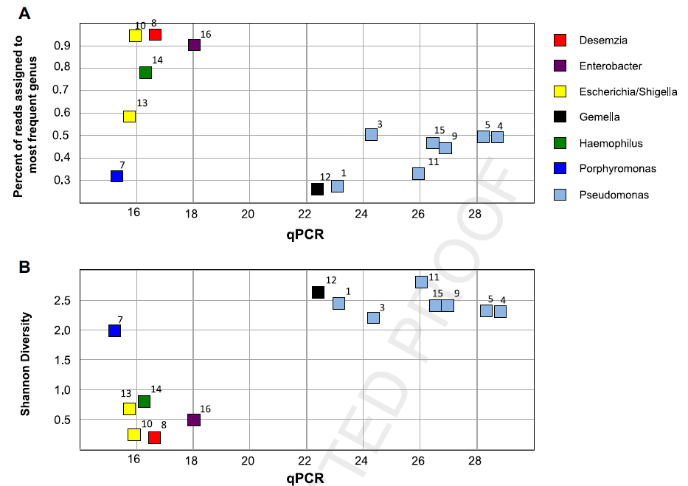
Low abundance samples are inherently challenging to survey
Less abundant
Hanna et al - Comparison of culture and molecular techniques for microbial community characterization
in infected necrotizing pancreatitis - J. Surgical Research - 2014

Slide 6
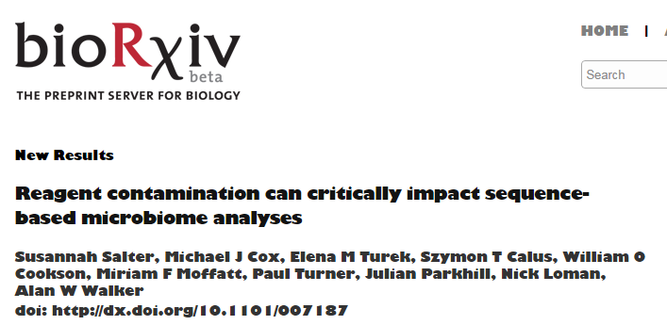
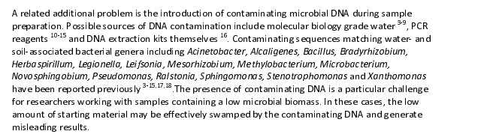
Clearly the sequencing of negative controls should be part of all of our pipelines..

Slide 7
Can we fairly compare samples with different numbers of sequences?
VS.

Slide 8
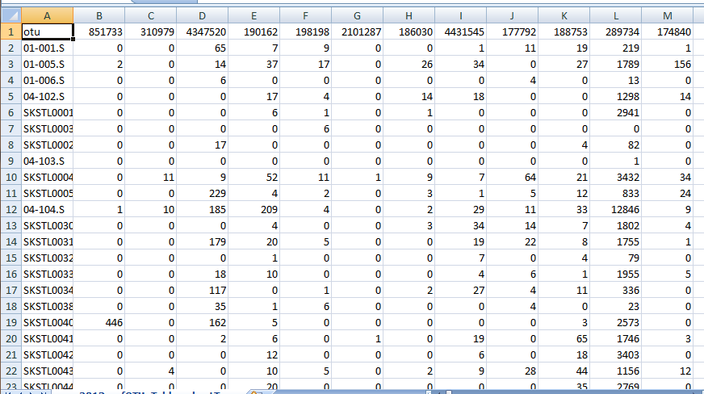
16S rRNA experiments are always compositional and often sparse
OTUs
S
A
M
P
L
E
S
Compositional – because different samples have different numbers of sequences
Sparse – because there are many zeros in the spreadsheet

Slide 9

Compositionality is a well-studied problem in statistics, but remains challenging

Slide 10


Compositionality can introduce subtle artifacts into our dataset
Relative abundance
Problems include:
Inference may report a change in A and B even though
biologically A and B have not changed.
The estimate of A and B is dependent on C. If C is
contaminant (or rRNA in a RNA-seq experiment), the values of
A and B might not be appropriate.
A and B will appear correlated, but this is a statistical artifact.

Slide 11
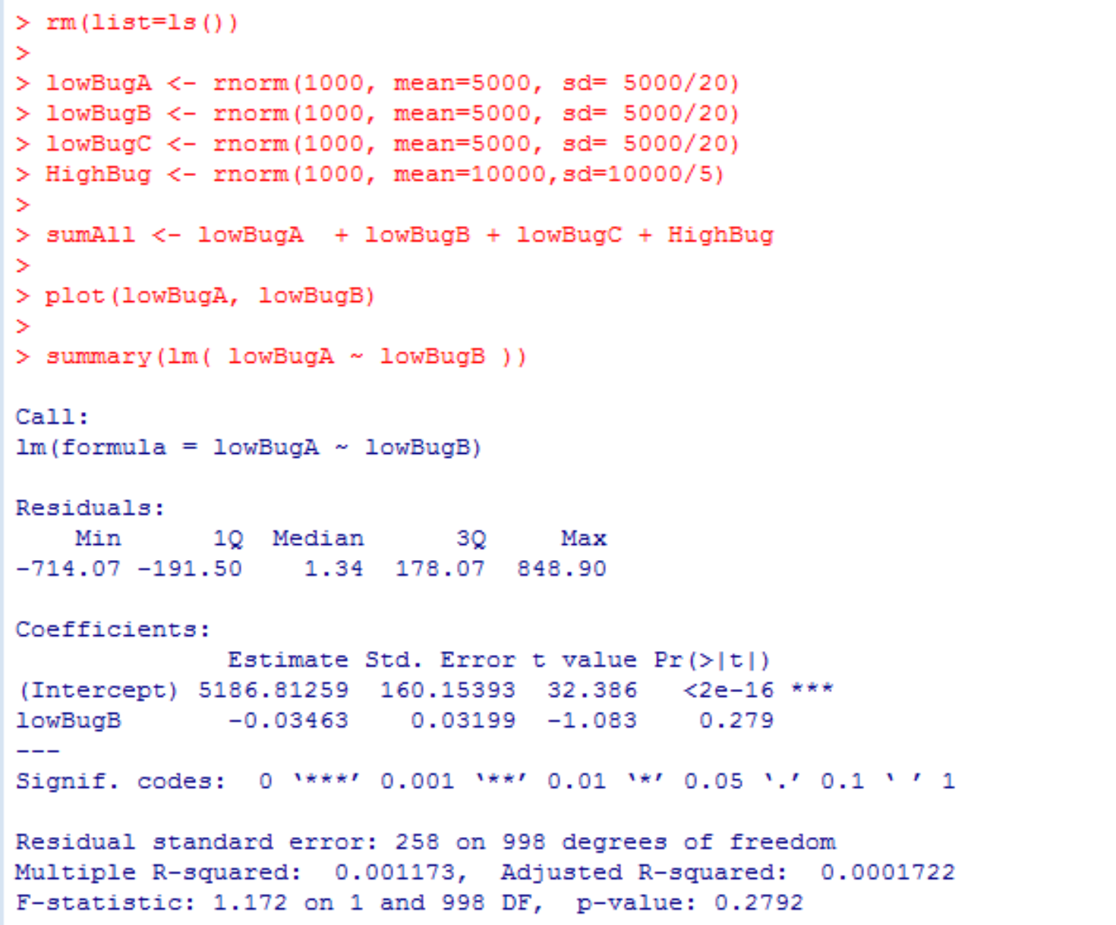
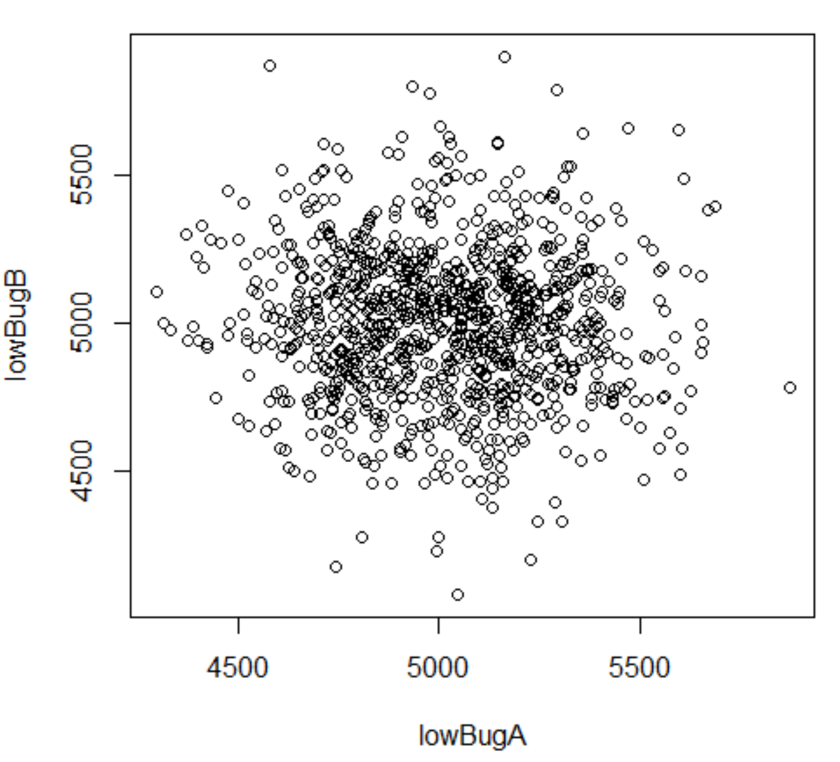
Consider a simulated data set…
Clearly A and B are independent
https://github.com/afodor/metagenomicsTools/blob/master/src/compositionality/compositionality.txt

Slide 12
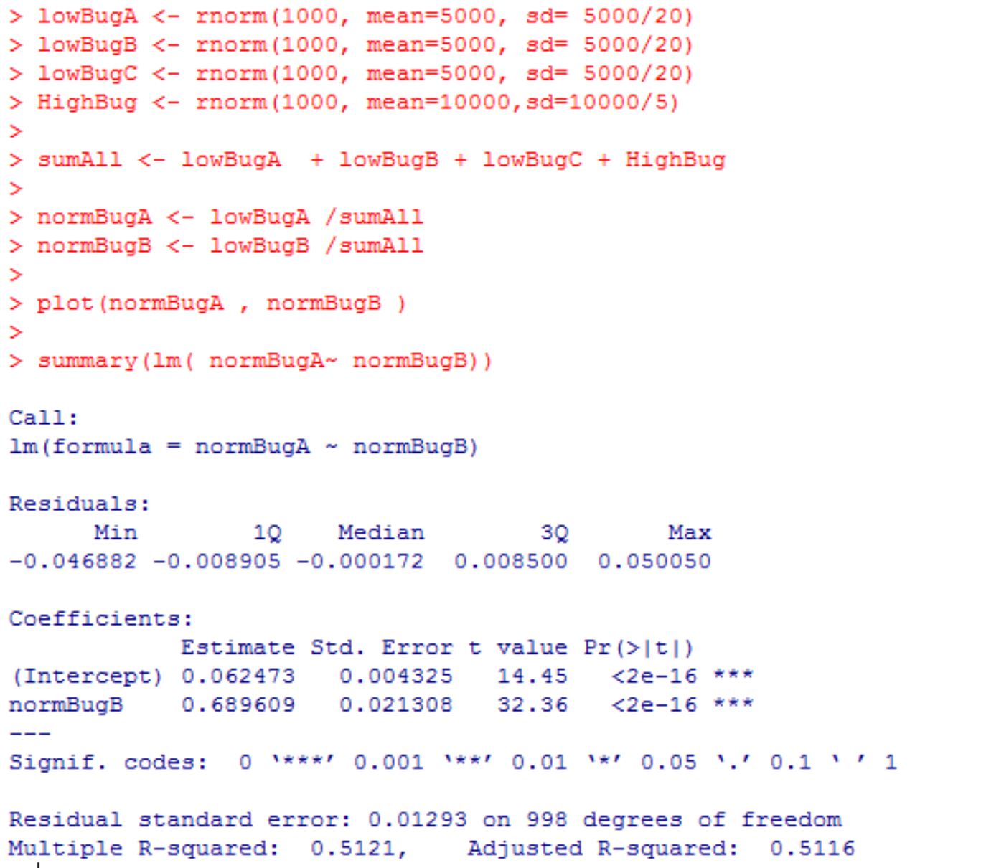
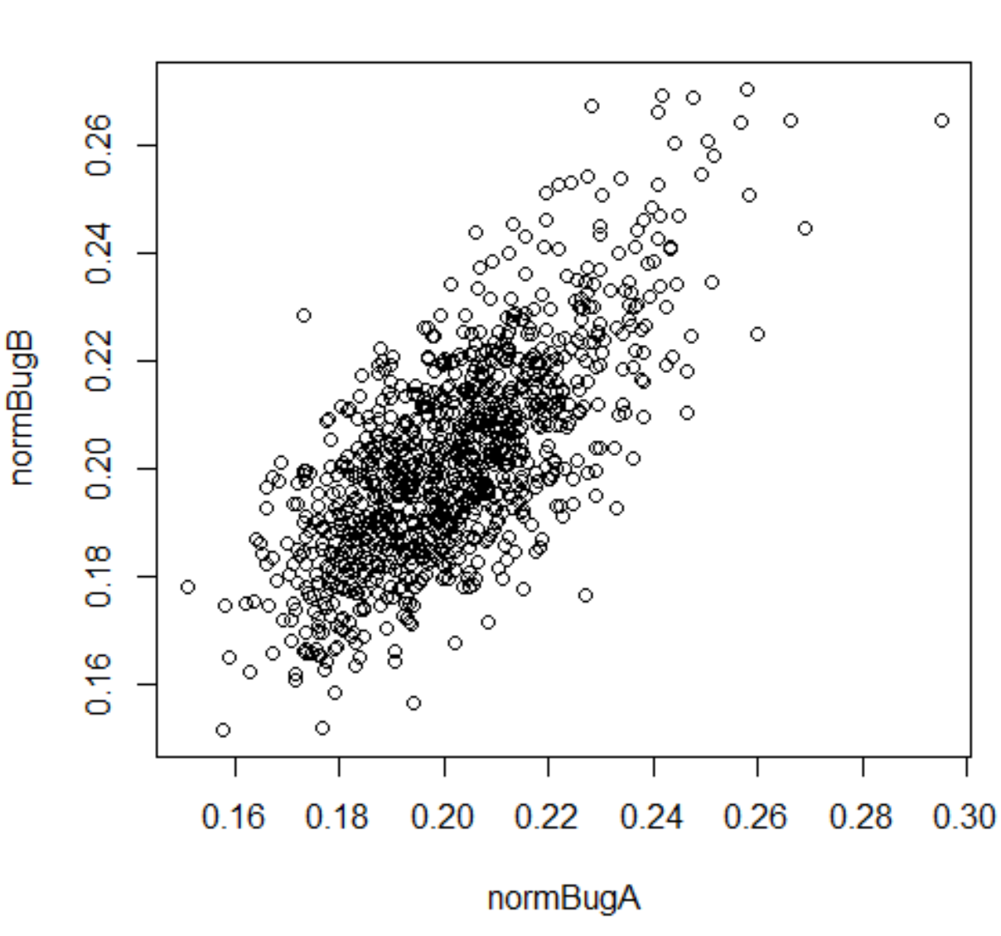
But when we switch to relative abundance space…
This looks to be a perfect correlation, but the observed correlation is entirely artefactual
induced by the normalization procedure…
https://github.com/afodor/metagenomicsTools/blob/master/src/compositionality/compositionality.txt

Slide 13
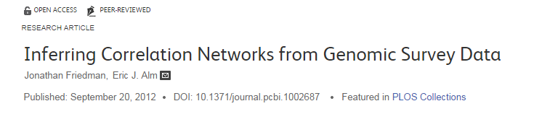
The correlation issue has been considered by multiple groups…

Slide 14
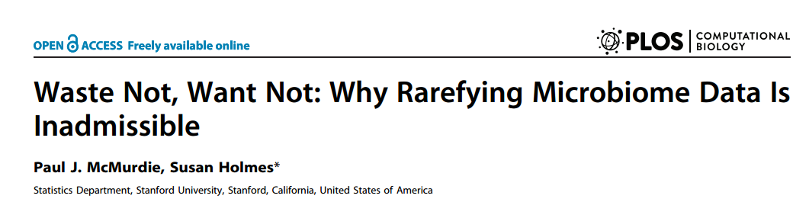

The compositional nature of 16S rRNA data has led to controversies over analysis pipelines…

Slide 15
Normalization schemes can take advantage of working in ratio space
Relative abundance
Notice that in all the above examples, the ratio of B/A is always 2
irrespective of what happens with taxa C.
10
10 / 115
10 / 1015
=
=
=
2
5
5 / 115
5 / 1015

Slide 16
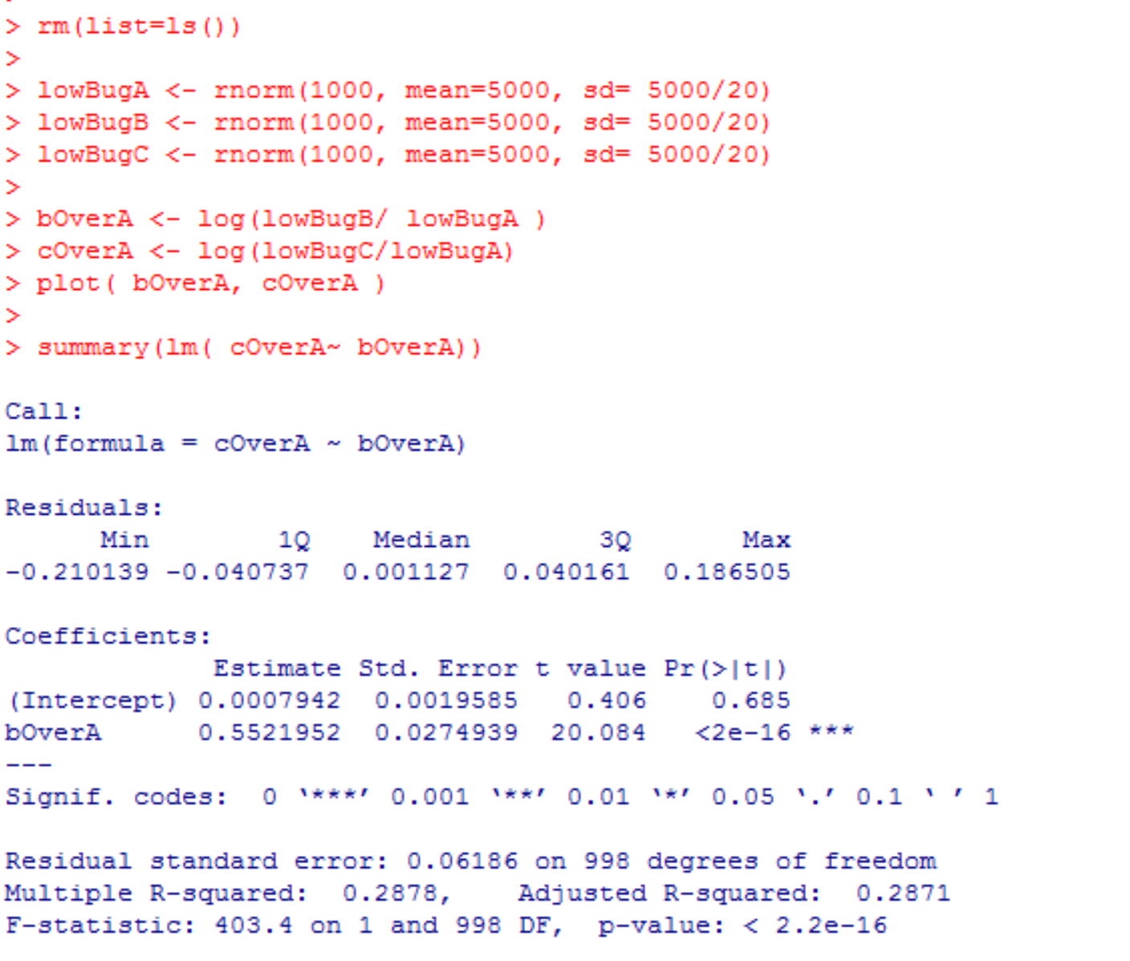
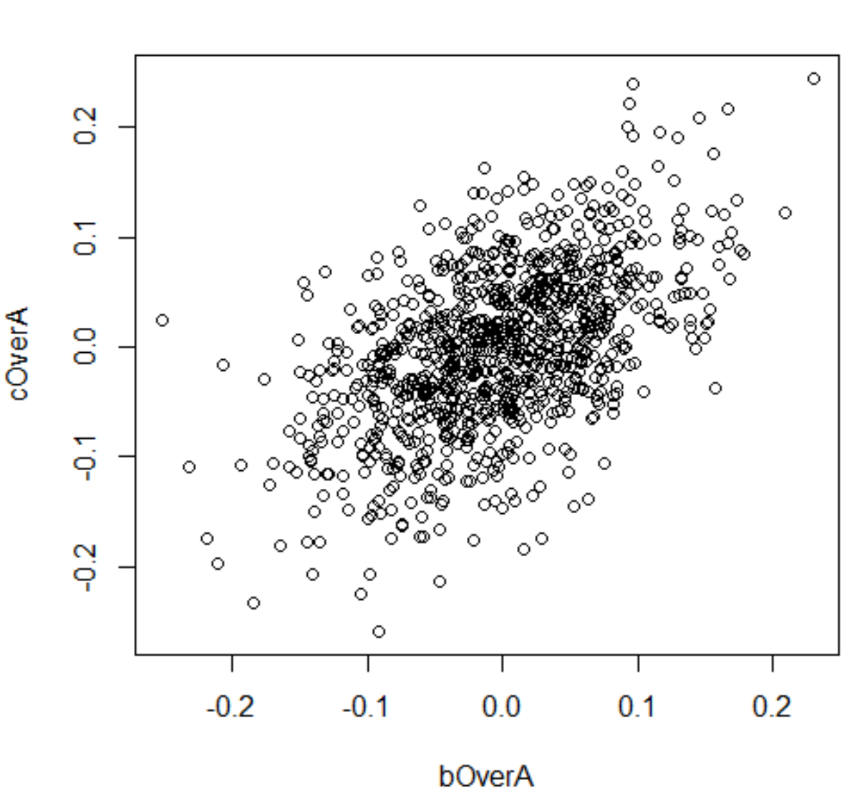
But ratio or log-ratio space does not protect you from spurious correlations…
If you plot a vector against itself, it is a perfect correlation.
Multiplying or dividing by random noise, doesn’t change the underlying association.

Slide 17
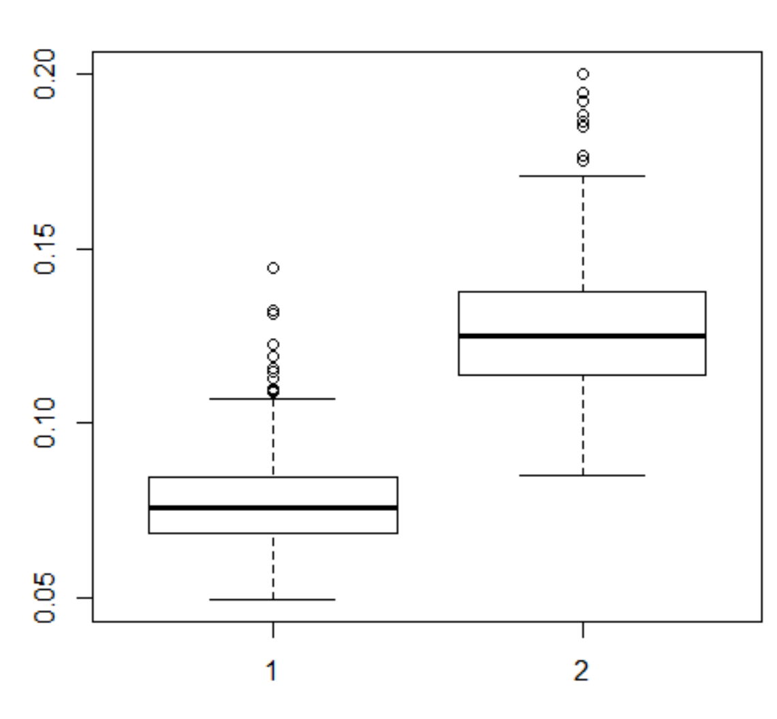
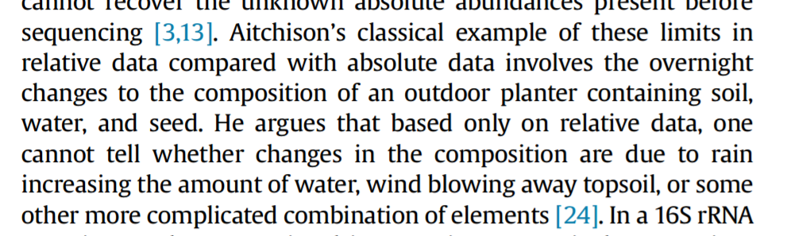
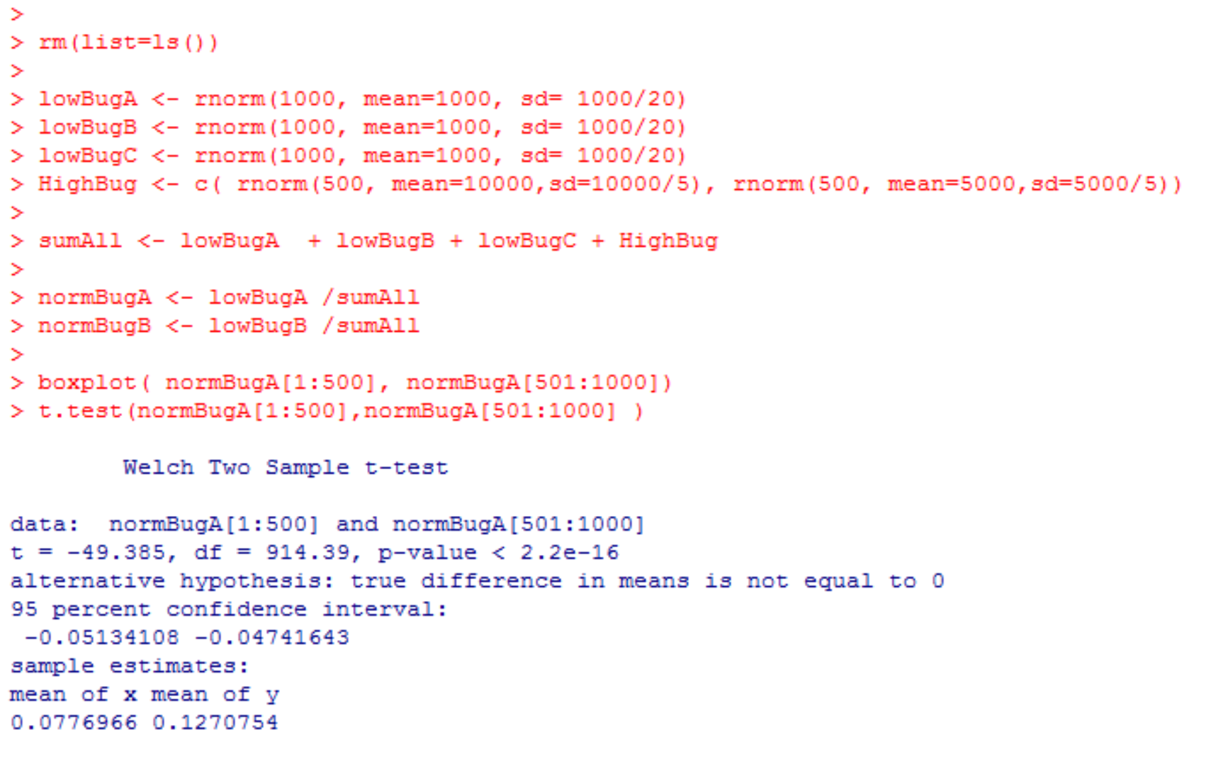
Normalization artifacts can lead to spurious inference in which we know something is changing
in our experiment but we don’t know what.
Here changes in one taxa induce spurious observed changes in another

Slide 18
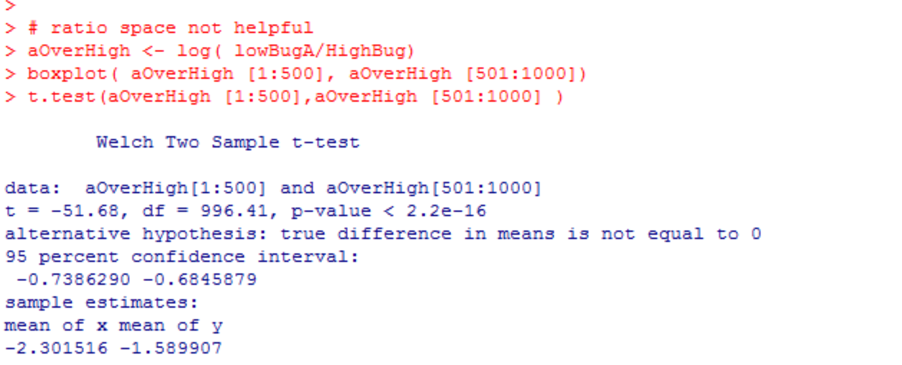
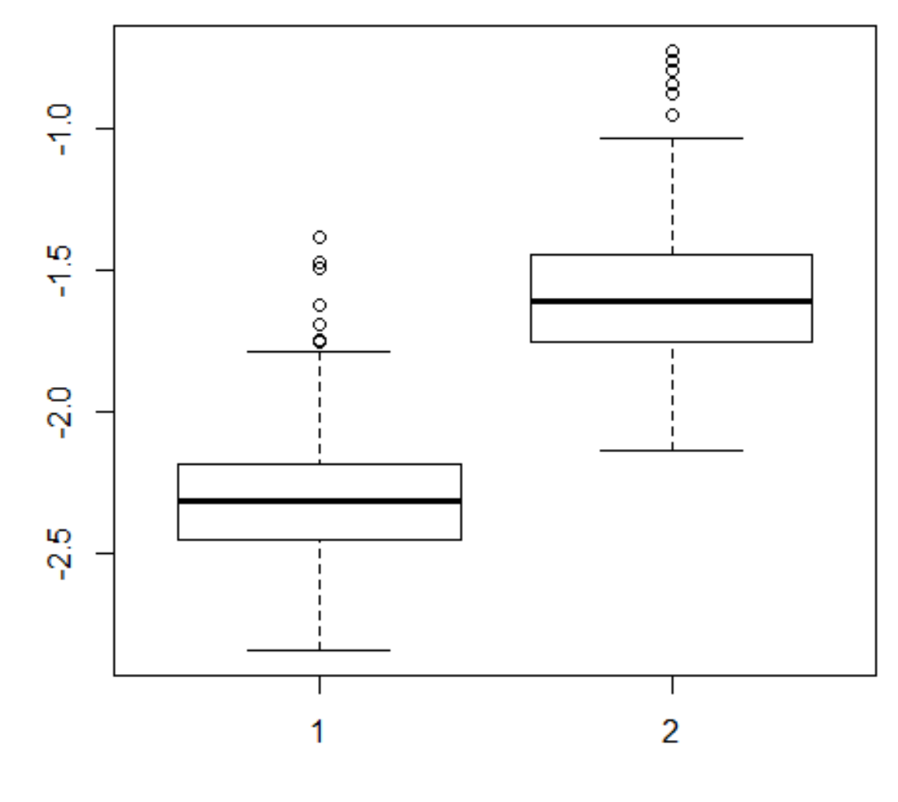
Ratio space is not necessarily helpful in resolving the problem

Slide 19
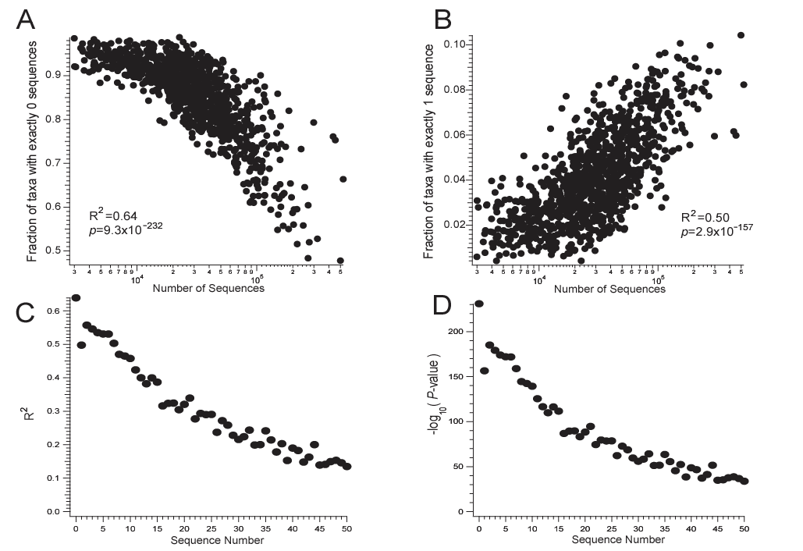
Cells in the spreadsheet with few counts are largely structured by sequencing depth
Source: Gevers et al. - The Treatment-Naive Microbiome in New-Onset Crohn’s Disease - Cell Host Microbe 2014

Slide 20
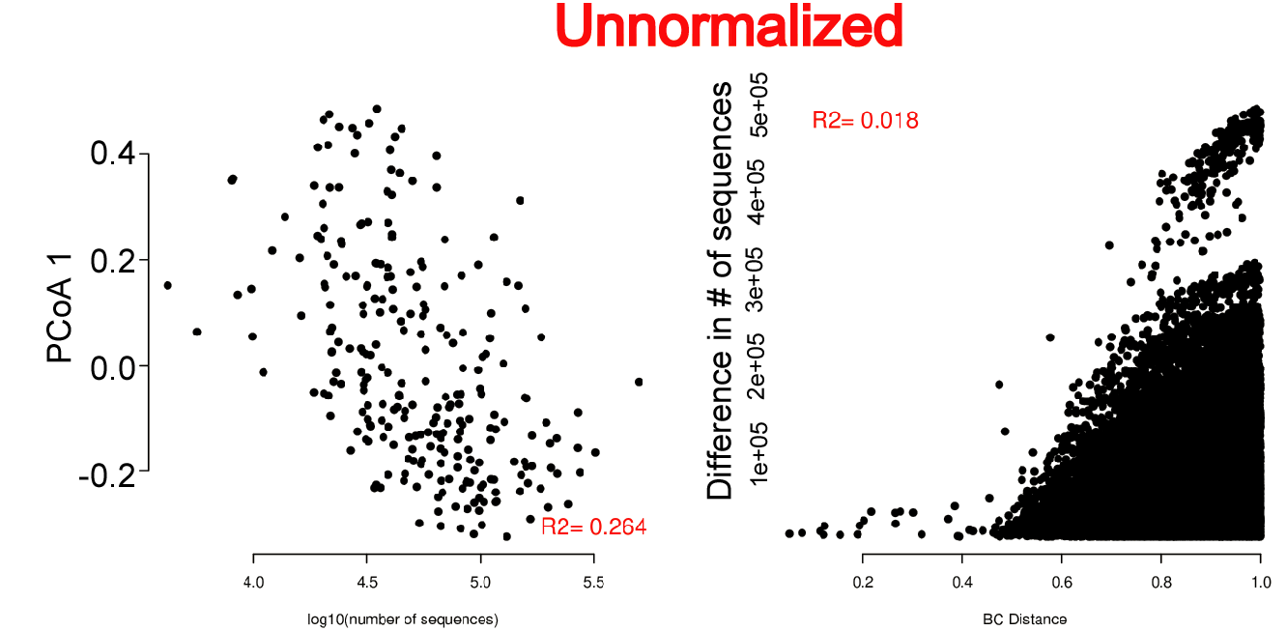
Ordination without normalization leads to dependency of sequencing depth…
Log10 (number of sequences)
Bray-Curtis distance
log

Slide 21
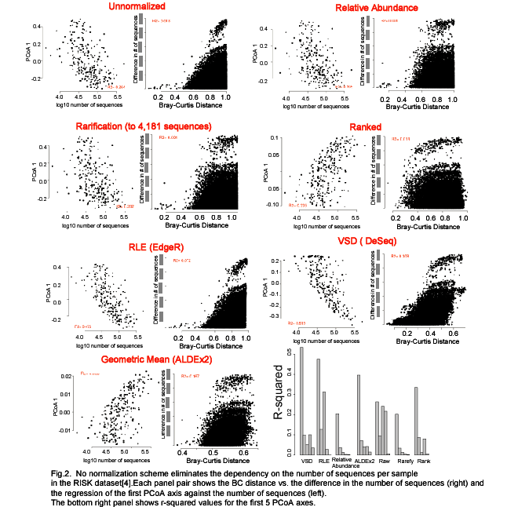
No normalization scheme eliminates the dependency of sequencing depth

Slide 22
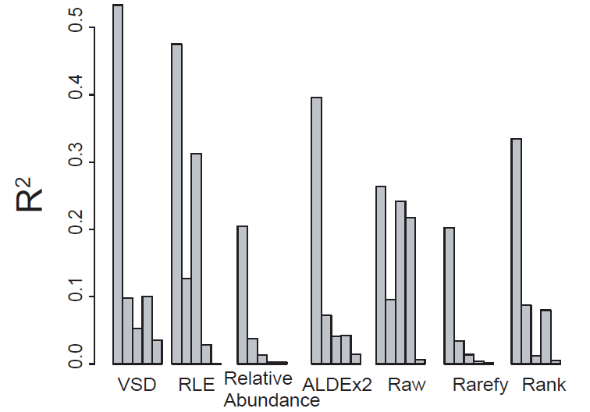
No normalization scheme eliminates compositional dependencies
Bioinformatics pipelines for 16S rRNA might consider explicitly tracking the
number of sequences per samples as a potential confounder…

Slide 23
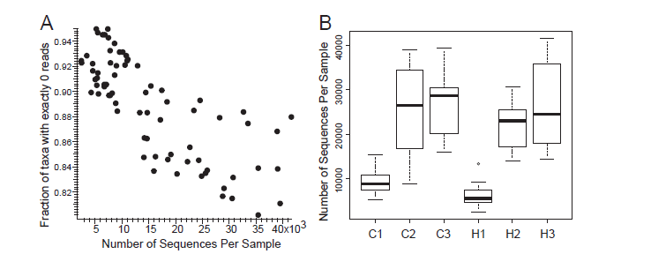

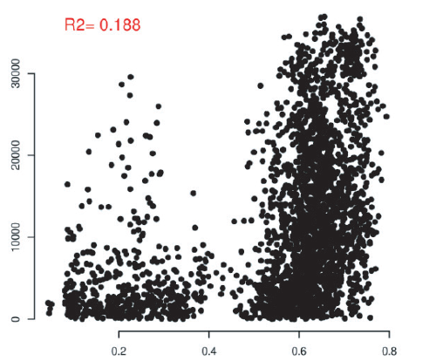
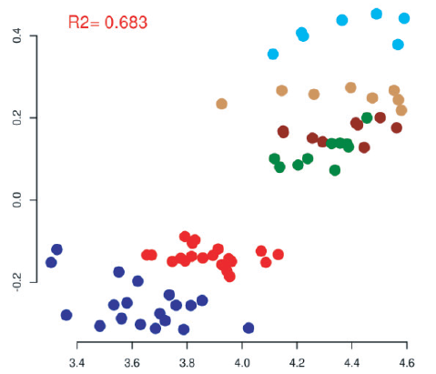
Sequencing depth can be correlated with input variables of interest…
NMDS 1
Difference in number
of sequences
Log10 (number of sequences)
Theta YC distance
Source: Baxter et al. - Structure of the gut microbiome following colonization with human feces determines colonic tumor burden - Microbiome 2014

Slide 24
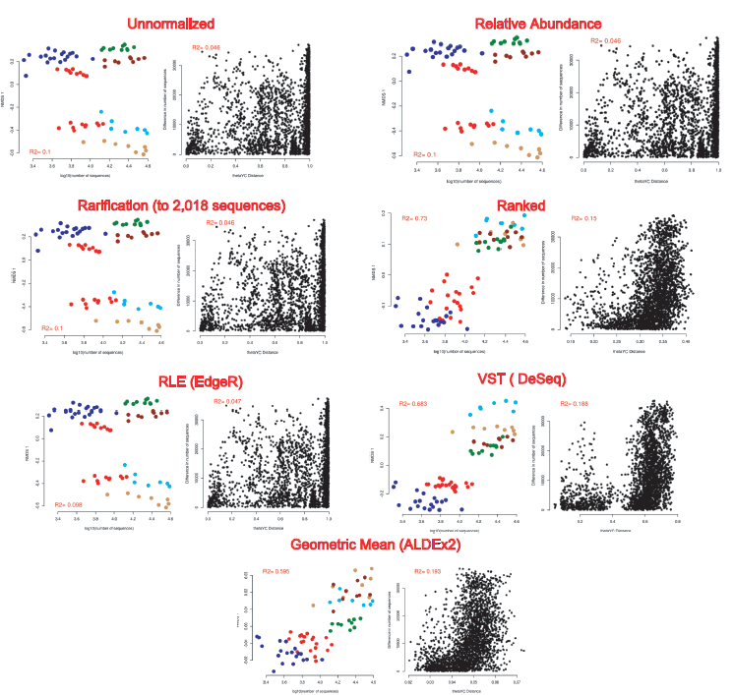
Different normalization schemes can have very different consequences for inference..
NMDS 1
Difference in number
of sequences
NMDS 1
Difference in number
of sequences
Log10 (number of sequences)
Theta YC distance
Log10 (number of sequences)
Theta YC distance
Difference in number
of sequences
NMDS 1
Difference in number
of sequences
NMDS 1
Log10 (number of sequences)
Theta YC distance
Log10 (number of sequences)
Theta YC distance
NMDS 1
Difference in number
of sequences
NMDS 1
Difference in number
of sequences
Log10 (number of sequences)
Theta YC distance
Log10 (number of sequences)
Theta YC distance
NMDS 1
Difference in number
of sequences
Log10 (number of sequences)
Theta YC distance

Slide 25
Conclusions
No normalization scheme eliminates compositional dependencies (although some do better than others!).
Bioinformatics pipelines for 16S rRNA should explicitly track number of sequences per samples as a potential confounding variable.
Just as no one statistical test is appropriate for inference, there is
likely no one normalization scheme that will be appropriate for all datasets.

Slide 26

Raad Z. Gharaibeh
University of Florida, Gainesville
(We thank Dirk Gevers for providing a parsable OTU table for the Risk data)

