Slide 1
Visualizing and building statistical models on multivariate data in R
Anthony Fodor
Bioinformatics and Genomics
UNC Charlotte
http://afodor.github.io/classes/ChapelHill2018/ch.pptx

Slide 2
I am assuming that you have installed…
Some version of R
Some text editor (sublime is a very nice choice, or e-macs or vi or r-studio)

Slide 3
Normalizing your data
PCA Ordination
Graphing everything into one big PDF ball
Some Simple Statistical Models
Some Not So Simple Statistical Models

Slide 4

If you are following along with our datasets…
We will be using the data from this paper…
https://microbiomejournal.biomedcentral.com/articles/10.1186/s40168-017-0338-7

Slide 5
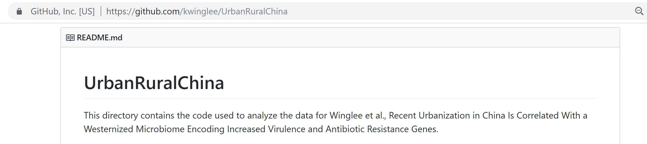
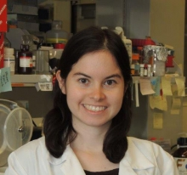
Tables and r-scripts were nicely organized by Kathryn Winglee (now of the CDC in Atlanta)
https://github.com/kwinglee/UrbanRuralChina

Slide 6
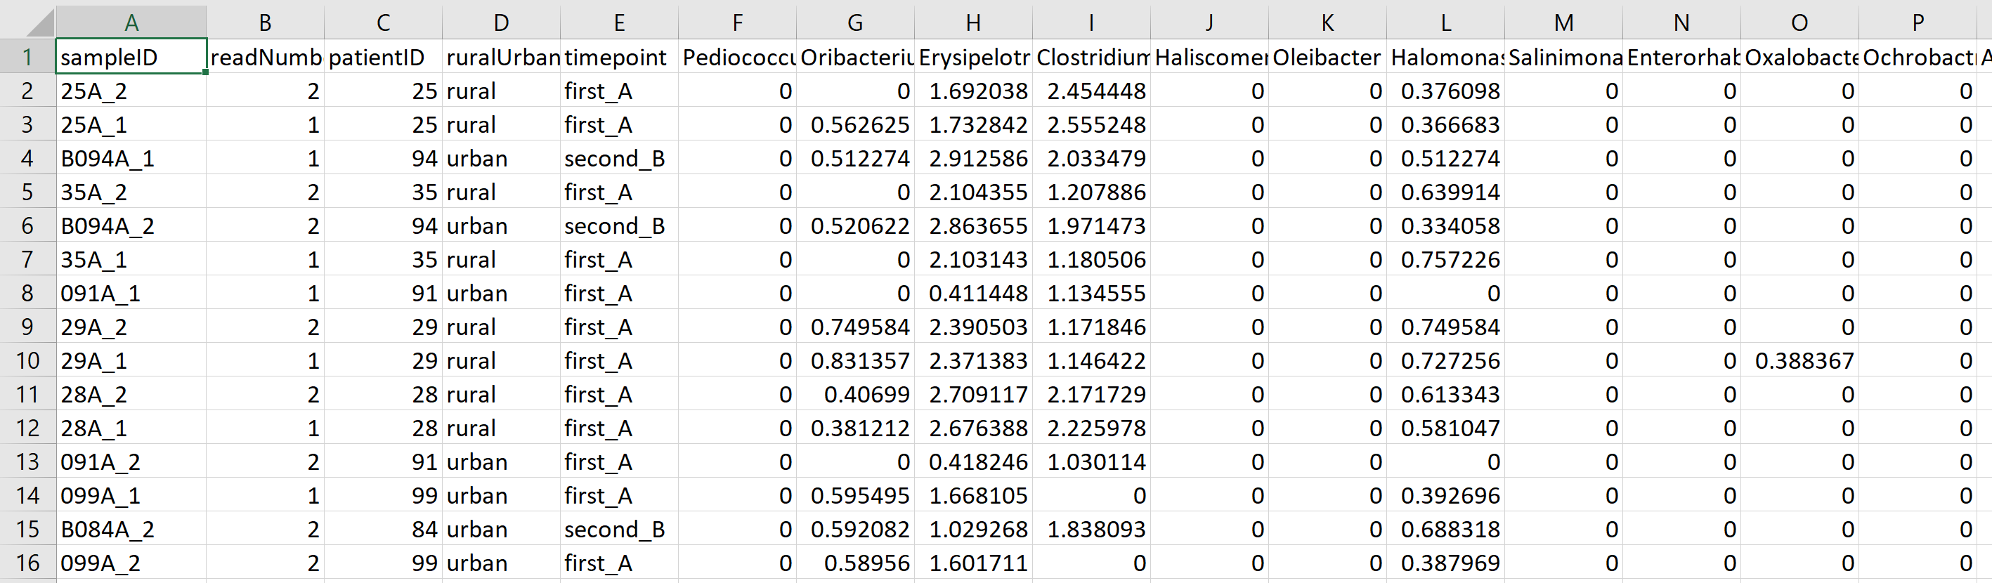
We will use this spreadsheet as our base input into R…
https://github.com/kwinglee/UrbanRuralChina/blob/master/16SrRNA/inputData/RDP/genus_taxaAsColumnsLogNorm_WithMetadata.txt

Slide 7
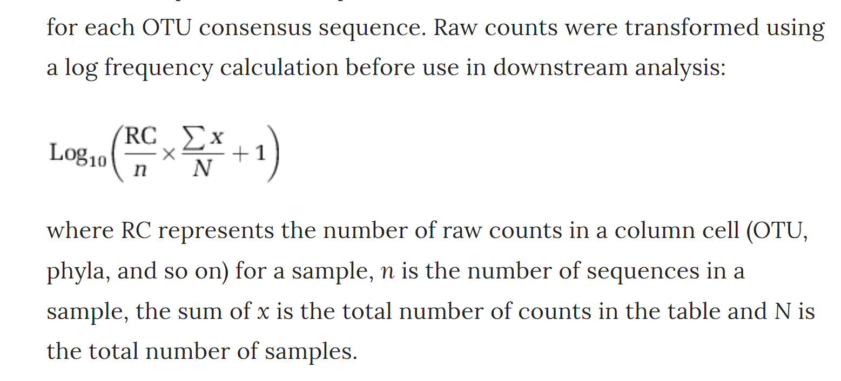
This spreadsheet has the following features:
The taxa are columns; the rows are samples
The metadata (urban vs. rural, timepoint) are in the same spreadsheet as the relative abundance
The counts are log-normalized according to the following formula
https://www.nature.com/articles/ismej2013106

Slide 8
If you have your own dataset…
We can work with you to get your data into the same format
(or to modify your R code to work with your table!)

Slide 9
Normalizing your data
PCA Ordination
Graphing everything into one big PDF ball
Some Simple Statistical Models
Some Not So Simple Statistical Models

Slide 10
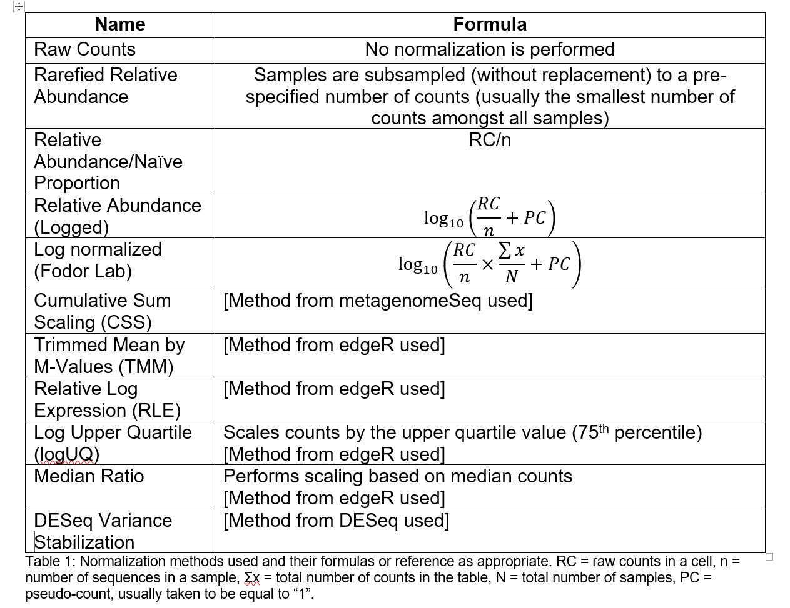
You will need to choose some normalization scheme..
(Each sequence library will be of a different depth; you need to correct for that)
The easiest (not necessarily the best) approach is to divide each cell by the total # of sequences in that sample.
This is relative abundance
Table due to :Matthew C. B. Tsilimigras (Matthew C. Brown)

Slide 11
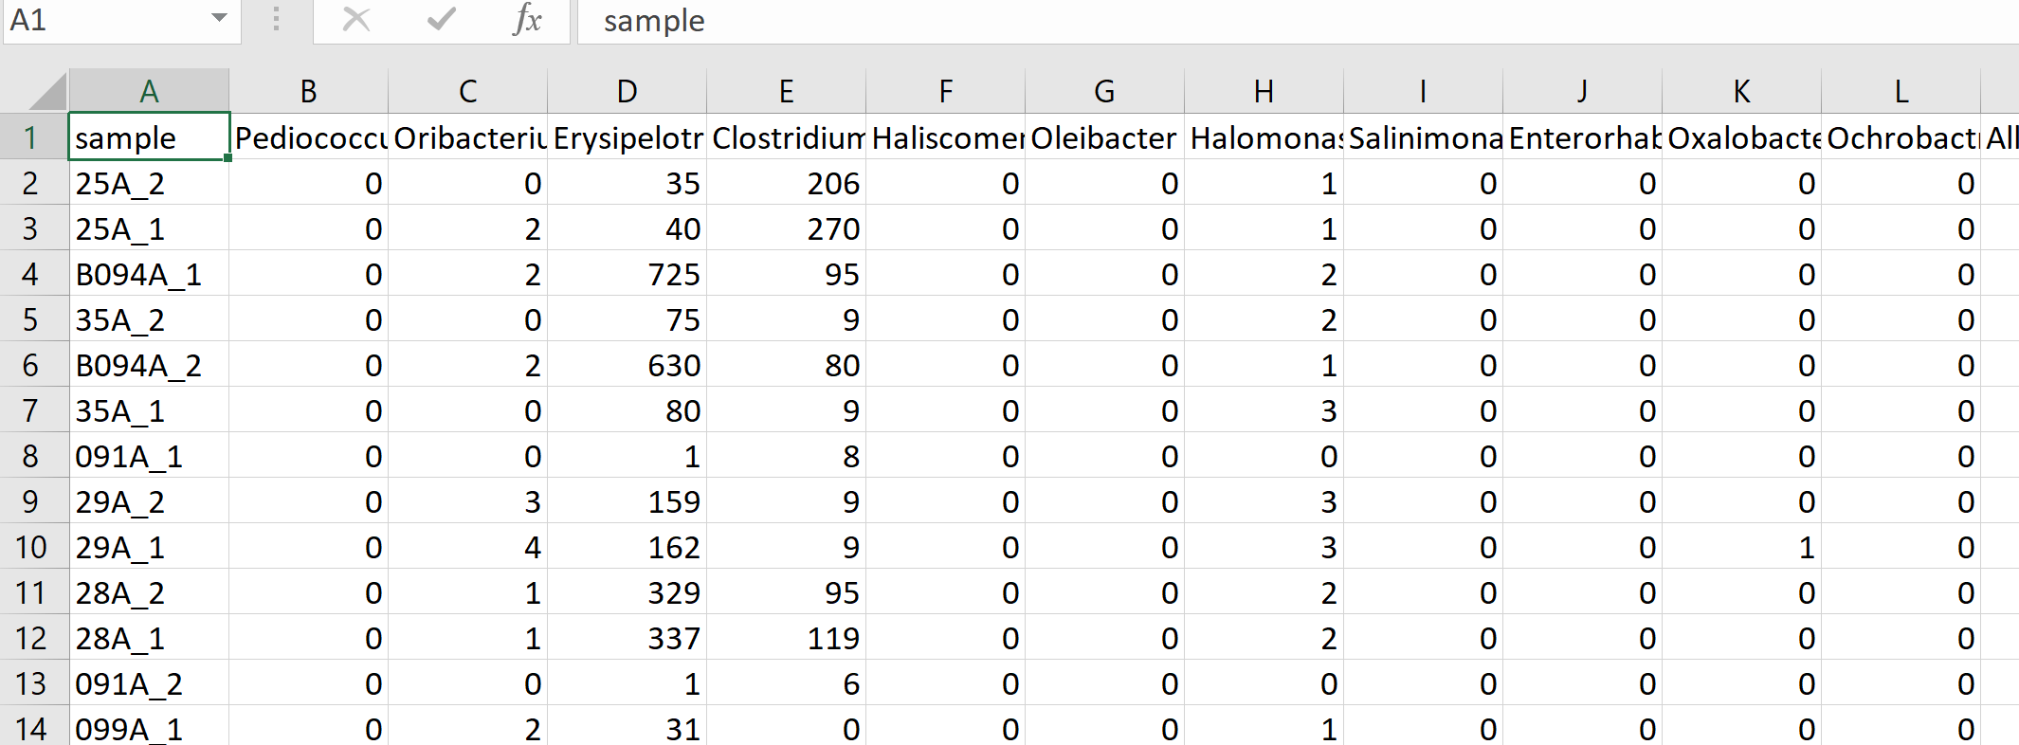
Let’s say you have a spreadsheet that is un-normalized and you want to change it to log relative abundance
https://github.com/kwinglee/UrbanRuralChina/blob/master/16SrRNA/inputData/RDP/genus_taxaAsColumns.txt

Slide 12
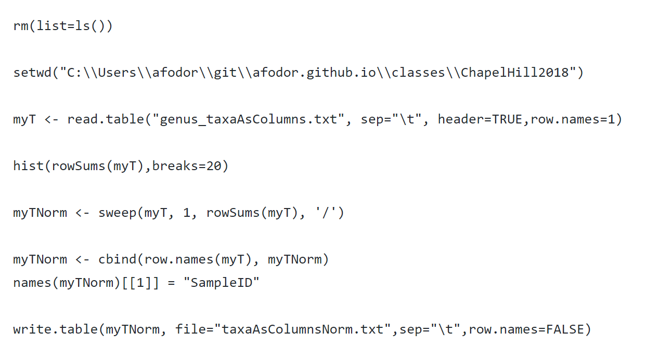
Here is a (complete) R script to convert a counts table to relative abundance and write the results to a file
https://github.com/afodor/metagenomicsTools/blob/master/src/classExamples/ch2018/quickNormalization.txt

Slide 13
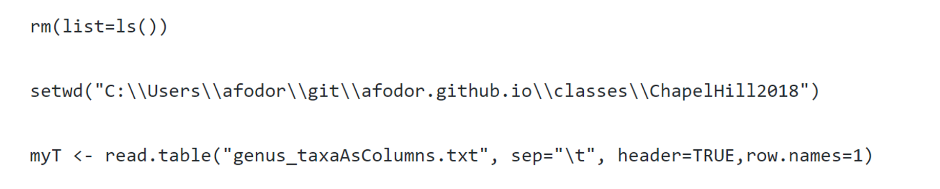
The first few lines input the file we wish to normalize

Slide 14
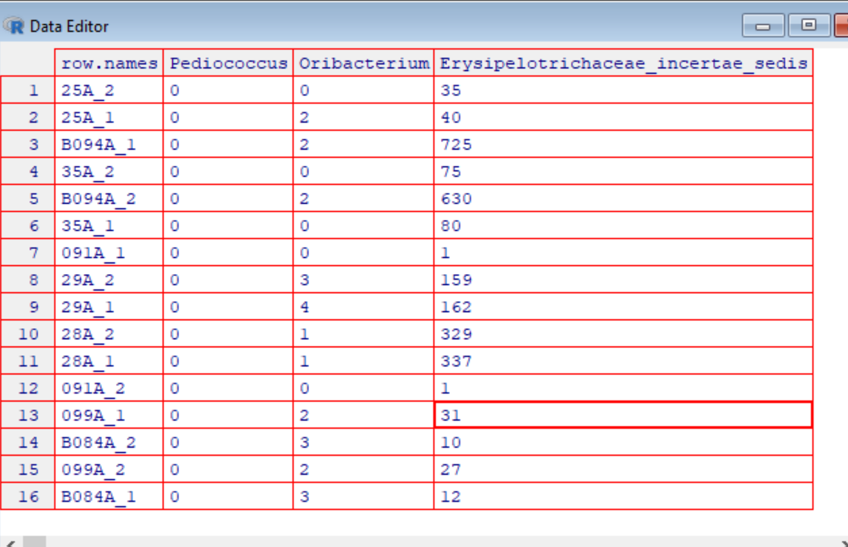
On Windows (but not necessarily in Macs or in R-studio, I get this nice view when I type
edit(myT)
Interestingly, changes I
type here don’t persist.
(I would have to type
myT <- edit(myT))
to have the changes
I type into the
spreadsheet stick.
This is because data
structures in R are
Immutable!

Slide 15
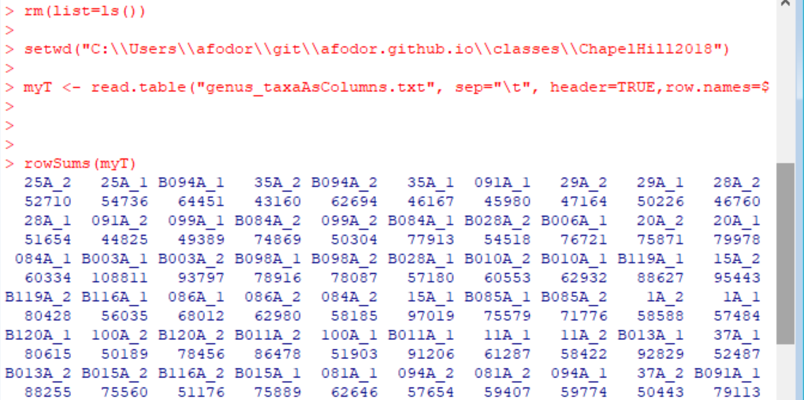
If I type
rowSums(myT)
R gives me the sequencing depth per sample

Slide 16
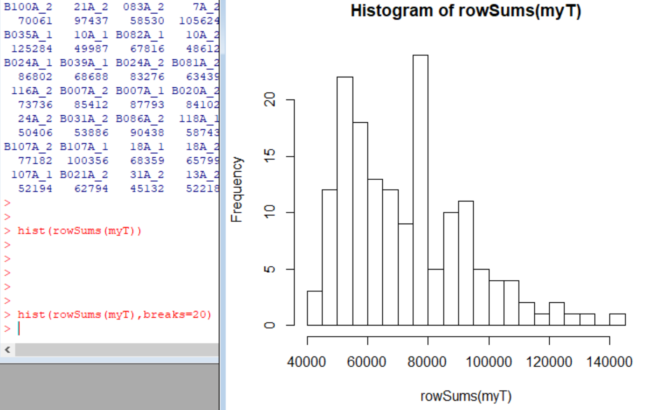
If I type
hist(rowSums(myT))
I get a nice graphic of my sequencing depth per sample. Very easy, informative QA/QC

Slide 17
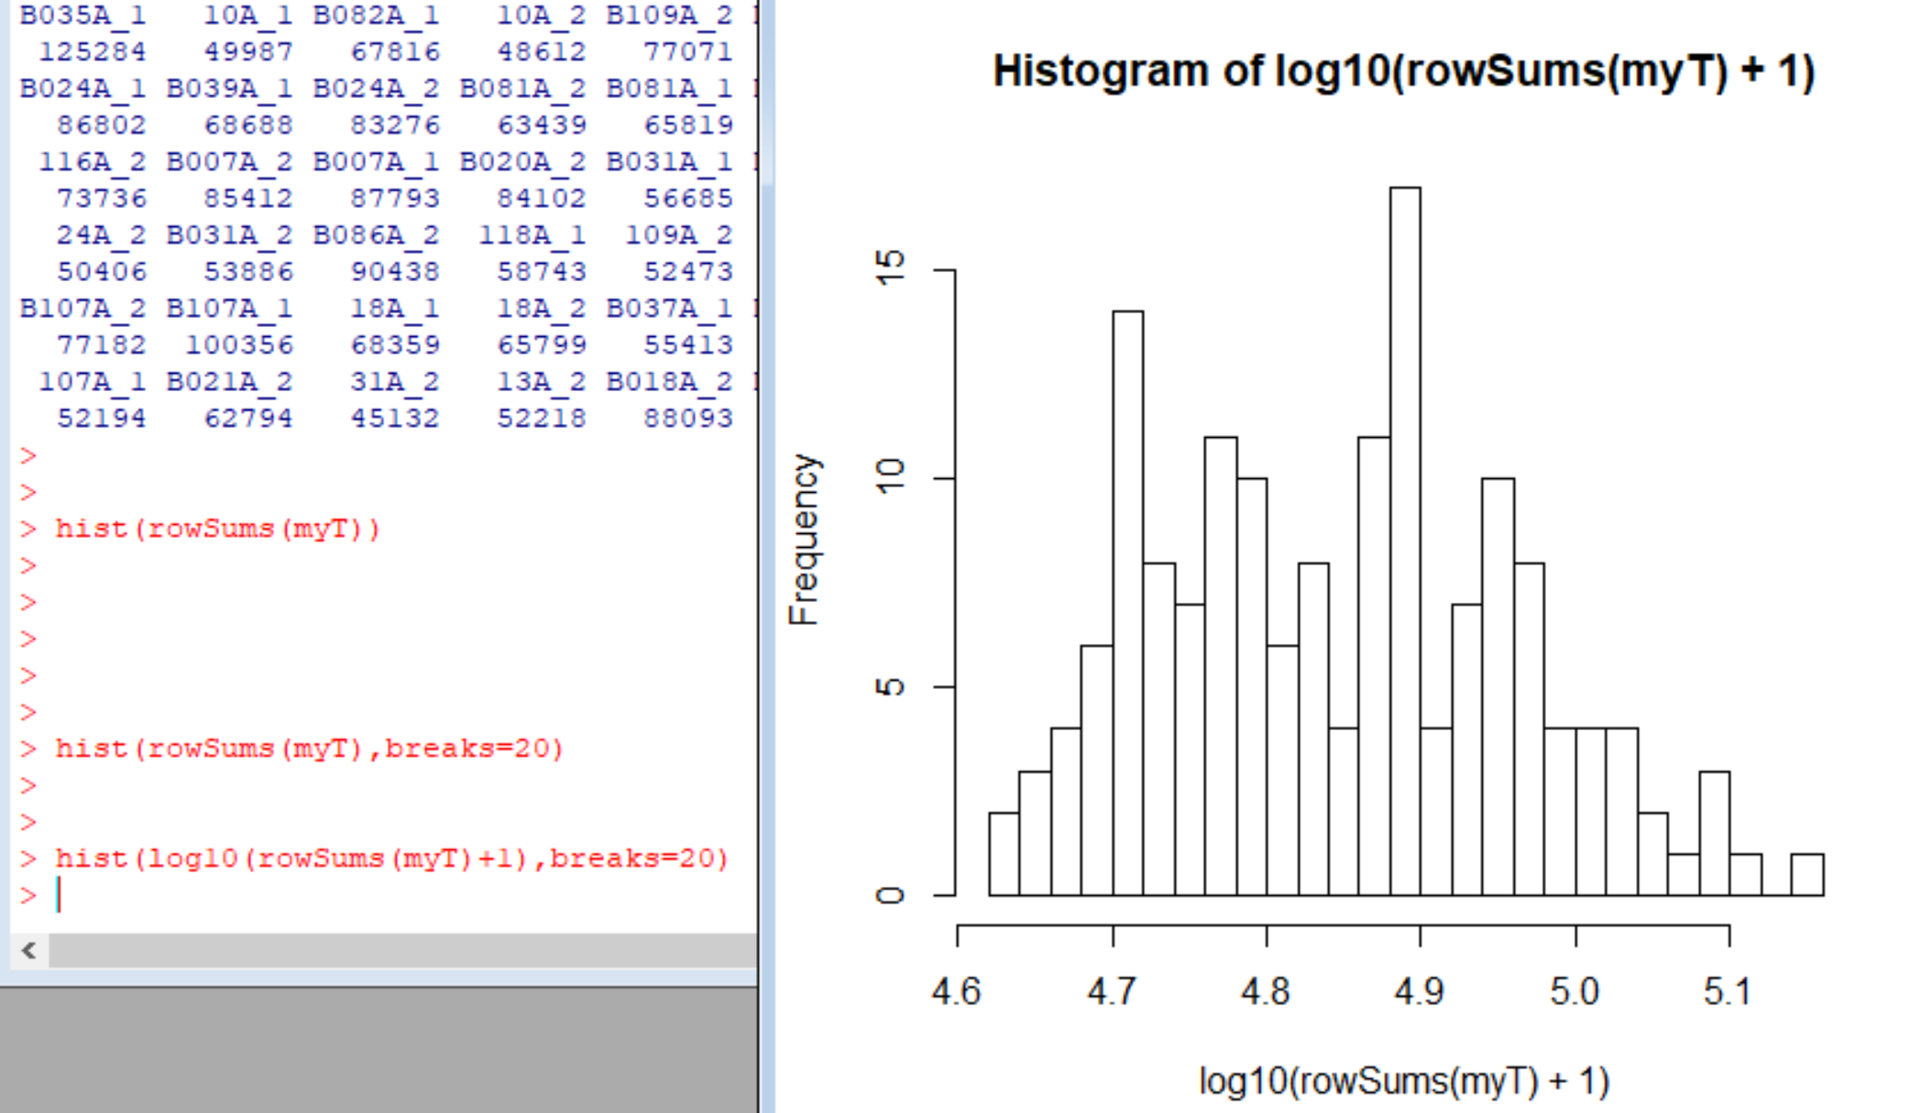
Alternatively, I can easily switch to a log scale…

Slide 18
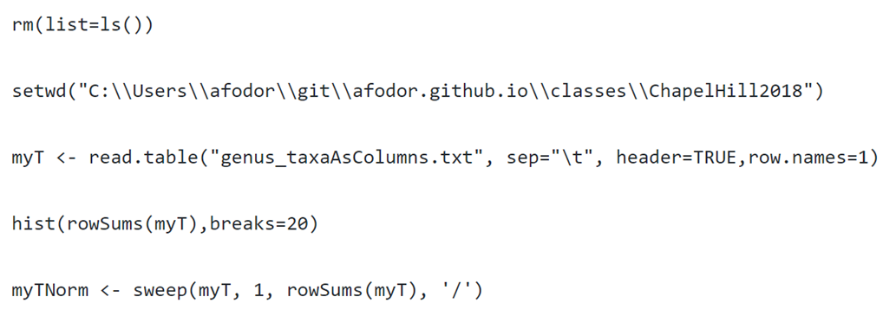
I can use the rowSums directly to switch to relative abundance

Slide 19
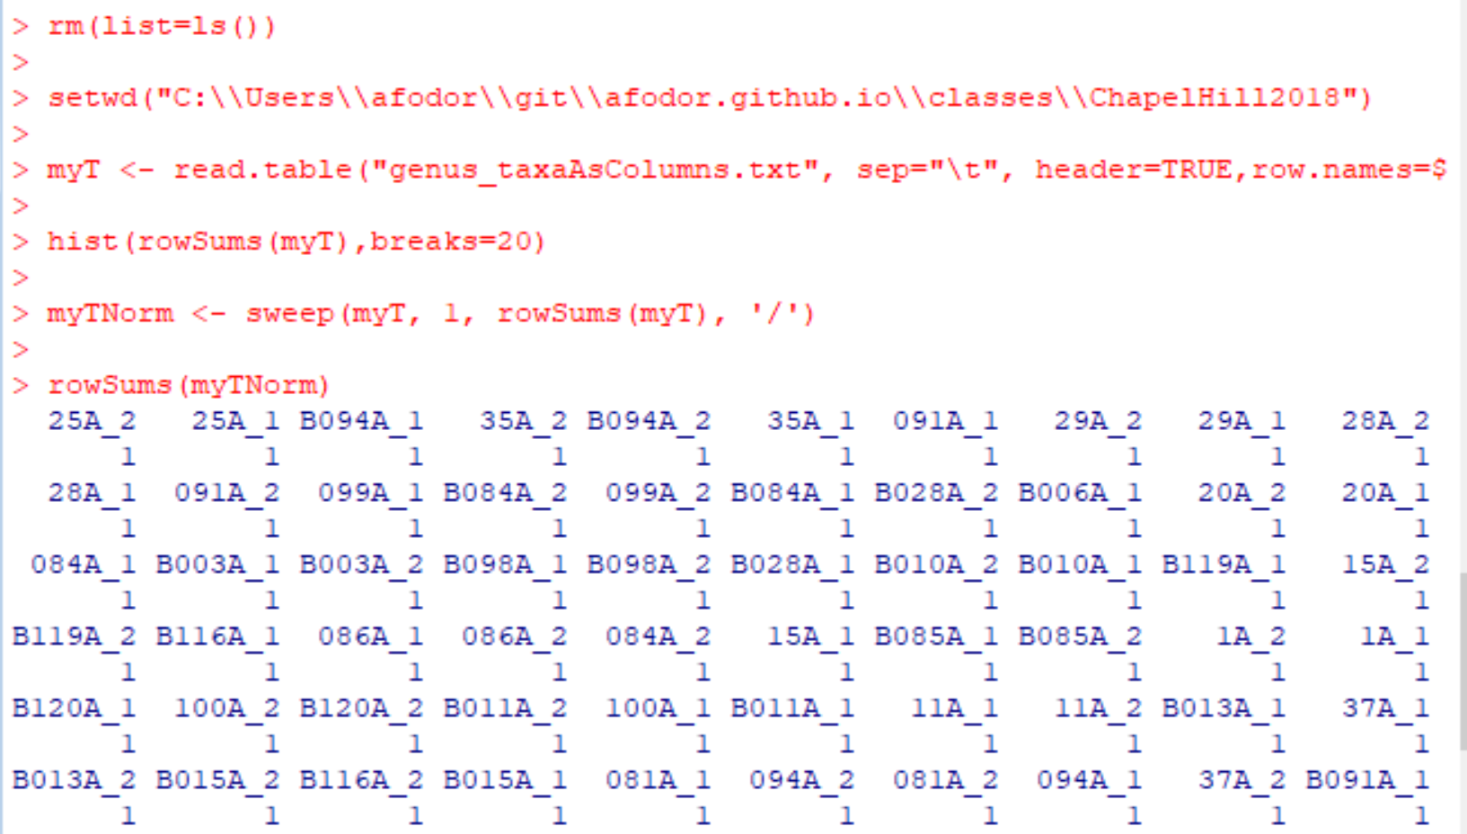
The rowSums on myTNorm should all be 1 (and they are)

Slide 20
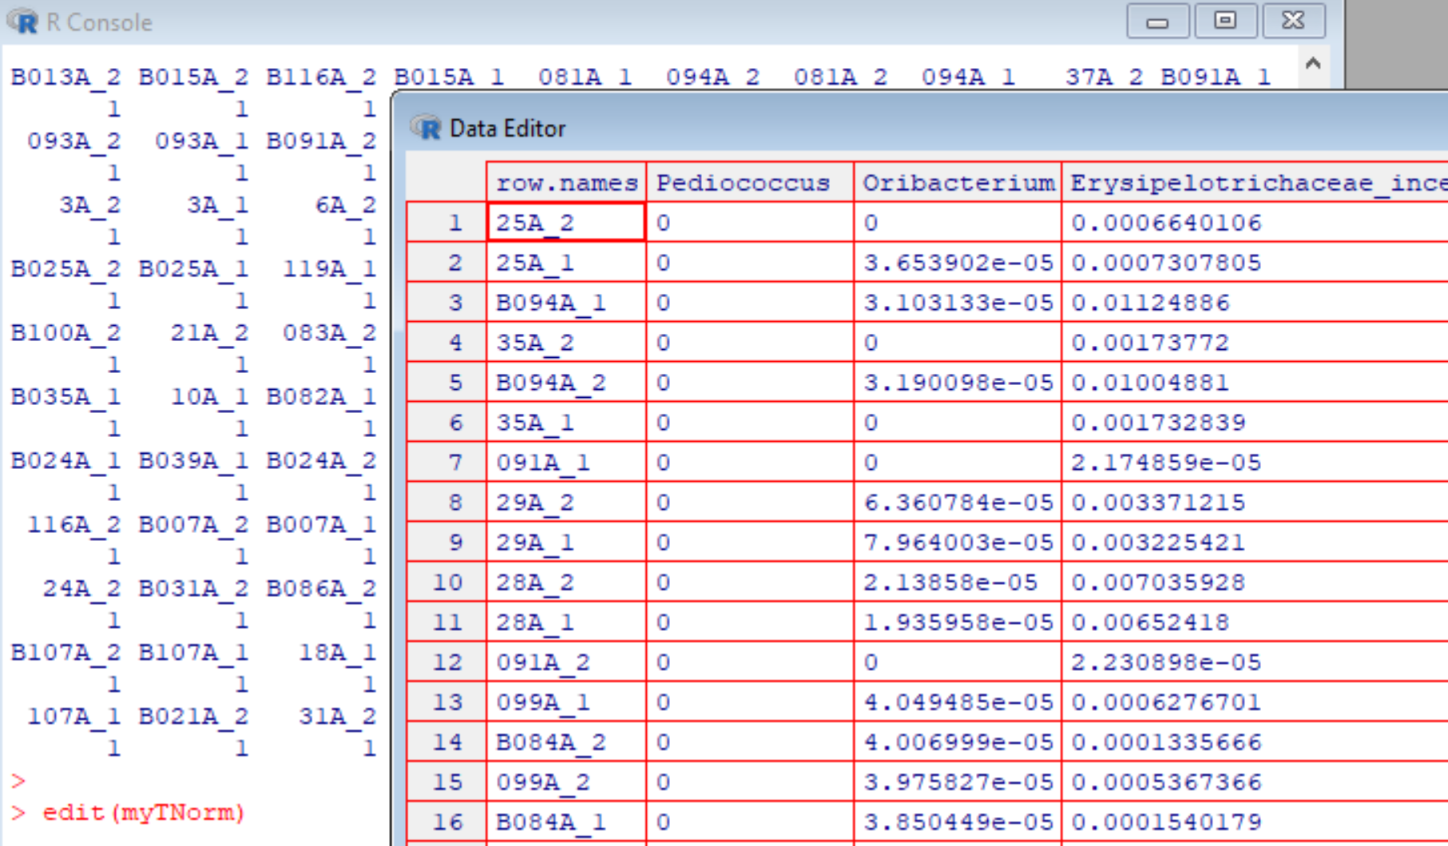
myTNorm is now in relative abundance

Slide 21
Finally, we want to be able to write our normalized file to an output file.
This is a little more involved than it seems like it should be
(learning R is mostly learning stupid R tricks…)
R by default will not give the sampleIDs a
column header.
This hacks around that default behavior

Slide 22
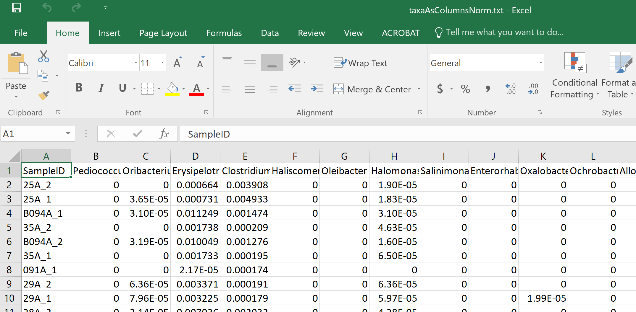
We end up with a text file in our working directory that can be imported into Excel (or wherever)

Slide 23
Normalizing your data
PCA Ordination
Graphing everything into one big PDF ball
Some Simple Statistical Models
Some Not So Simple Statistical Models

Slide 24
There are about 340 taxa in our spreadsheet.
We can’t make a 340 dimensional graph
We can use ordination to reduce the dimensionality (and complexity of our dataset)

Slide 25
We can use ordination to reduce the dimensionality of our complex data
We can go from a (20 * 340 ) spreadsheet to a ( 20* 2 ) spreadsheet.
This will allow us to better see what is going on with our data…

Slide 26
Ordination is a form of data compression
We know data compression from music and photos…
A song on a CD might be 350 MB (megabytes) big.
But we compress the song to an MP3 for our phone so that is only, maybe 6 MB big.
The compression captures what is essential about the song, but in less space.
Potentially, the more we compress, the worse the song sounds!
Our ordination attempts to capture what is essential in our ~340 taxa, but in 2 columns.
We can do this by taking advantage of duplicate information.
Imagine all the 340 taxa are highly correlated. We could remove the extra information
from those columns and still have all the important information in the spreadsheet with much less space…
( A more mathematical treatment describing the
compression is here: http://afodor.github.io/classes/stats2015/Lecture19.pptx )

Slide 27
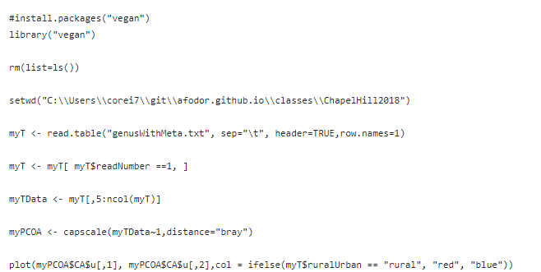
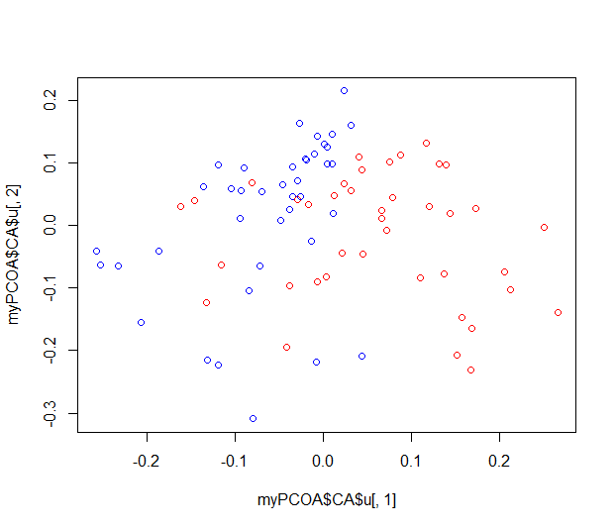
Here is a complete script for data ordination from a (in this case) log-normalized data file…
https://github.com/afodor/metagenomicsTools/blob/master/src/classExamples/ch2018/quickOrdination.txt

Slide 28
The library that will run our ordination. Uncomment this the first time
you run your program to download and install the program
https://github.com/afodor/metagenomicsTools/blob/master/src/classExamples/ch2018/quickOrdination.txt

Slide 29
This line tells R to load the “vegan” library into memory
https://github.com/afodor/metagenomicsTools/blob/master/src/classExamples/ch2018/quickOrdination.txt

Slide 30
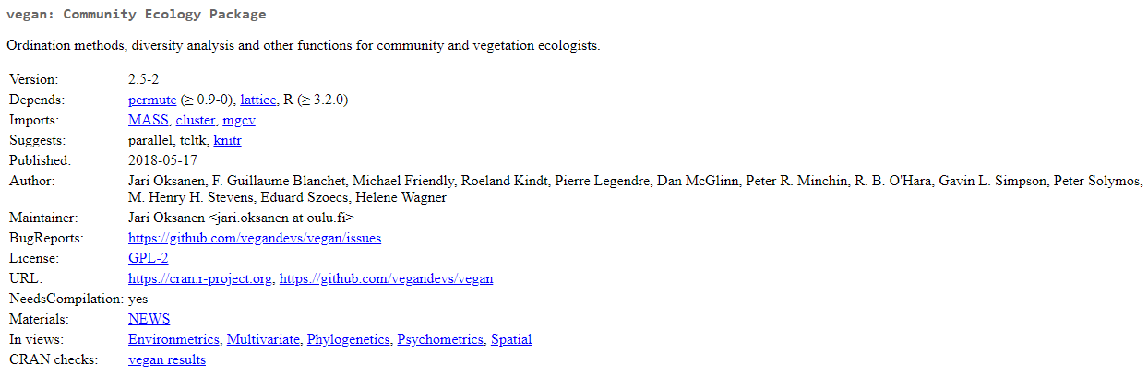
The vegan package has many useful tools for dealing with ecology count data
(like sequencing data from metagenomics)

Slide 31
As before we start R in a clean state (we would not do this if this were part of a larger suite)
https://github.com/afodor/metagenomicsTools/blob/master/src/classExamples/ch2018/quickOrdination.txt

Slide 32
And we tell R where we have the data
(this can alternatively be a URL)
https://github.com/afodor/metagenomicsTools/blob/master/src/classExamples/ch2018/quickOrdination.txt

Slide 33
As before we read our data into R
https://github.com/afodor/metagenomicsTools/blob/master/src/classExamples/ch2018/quickOrdination.txt

Slide 34
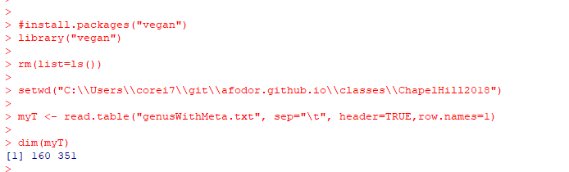
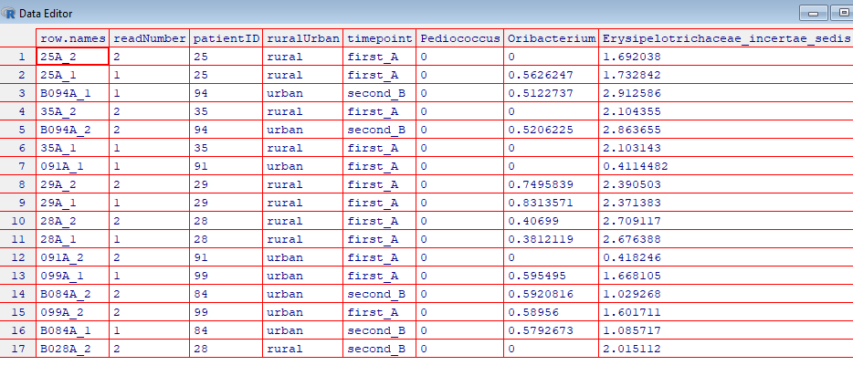
At this point in our program, our spreadsheet has 160 samples (rows) and > 340 taxa (columns)
edit( myT)
This spreadsheet
has both the forward
and backwards reads;
We want to filter out
the forward reads

Slide 35
Here we only keep the rows where the readNumber == 1
https://github.com/afodor/metagenomicsTools/blob/master/src/classExamples/ch2018/quickOrdination.txt

Slide 36
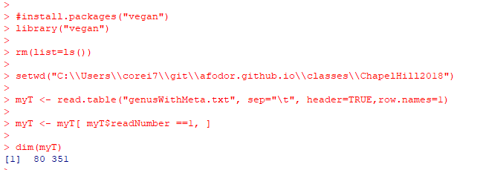
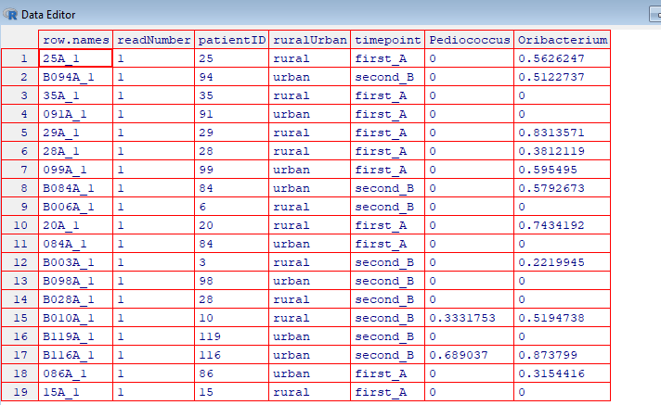
After we filter, only the rows for which the readNumber was 1 are left…
edit(myT)

Slide 37

The ability to quickly subset data tables is one of the most powerful features of R
Return columns 10-13
for one subject at one timepoint

Slide 38
Here we separate the data we want to ordinate from the first
4 columns of metadata
https://github.com/afodor/metagenomicsTools/blob/master/src/classExamples/ch2018/quickOrdination.txt

Slide 39
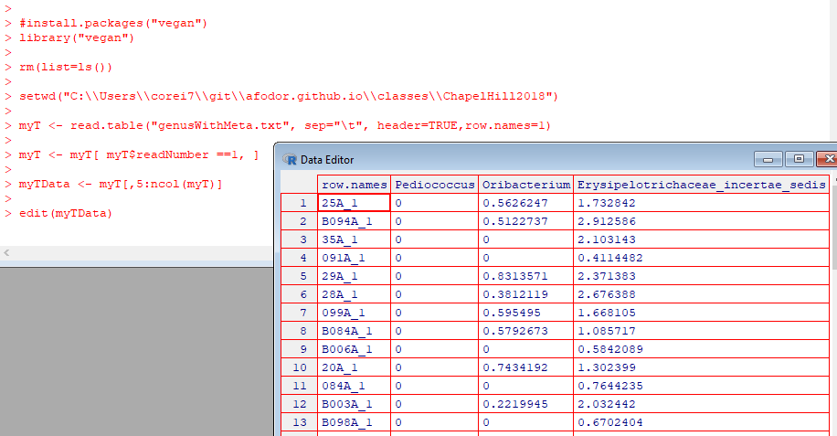
Return all
but the first 4
columns

Slide 40
Here we do the ordination/data compression
https://github.com/afodor/metagenomicsTools/blob/master/src/classExamples/ch2018/quickOrdination.txt

Slide 41
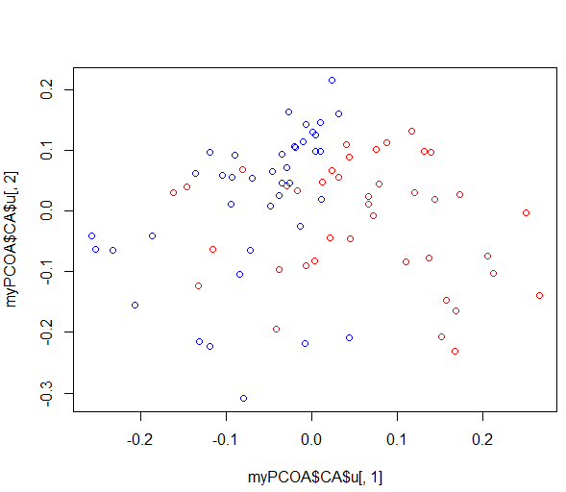
And plot the results
https://github.com/afodor/metagenomicsTools/blob/master/src/classExamples/ch2018/quickOrdination.txt

Slide 42
This graph is not quite publication ready….

Slide 43
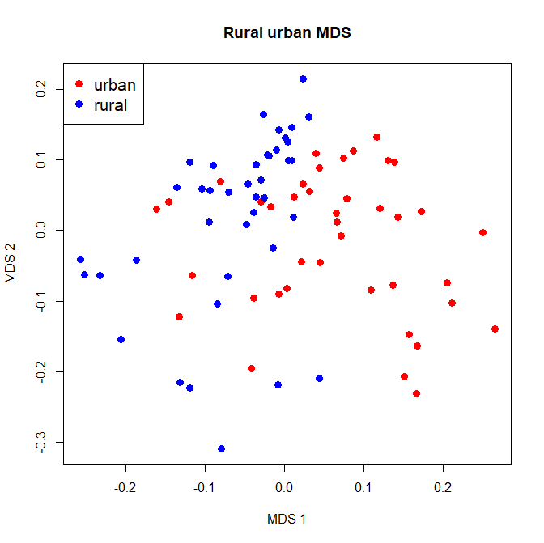
plot(myPCOA$CA$u[,1], myPCOA$CA$u[,2],col = ifelse(myT$ruralUrban == "rural", "red", "blue"),xlab="MDS 1", ylab="MDS 2", main="Rural urban MDS", pch=19,cex=1.3)
legend( "topleft", legend=c("urban", "rural"), col=c("red","blue"), pch=19,cex=1.3 )
We can pass options to our plot function to make the graph a little easier to see and a legend
Google searches help us find these commands

Slide 44
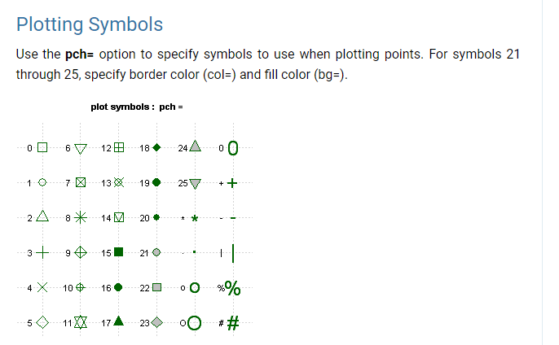
https://www.statmethods.net/advgraphs/parameters.html

Slide 45
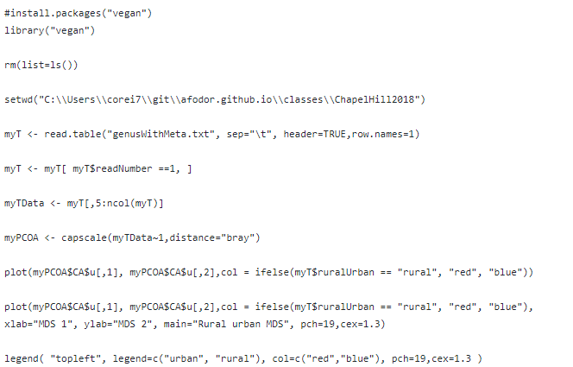
Here is our script so far…
https://github.com/afodor/metagenomicsTools/blob/master/src/classExamples/ch2018/quickOrdination.txt

Slide 46
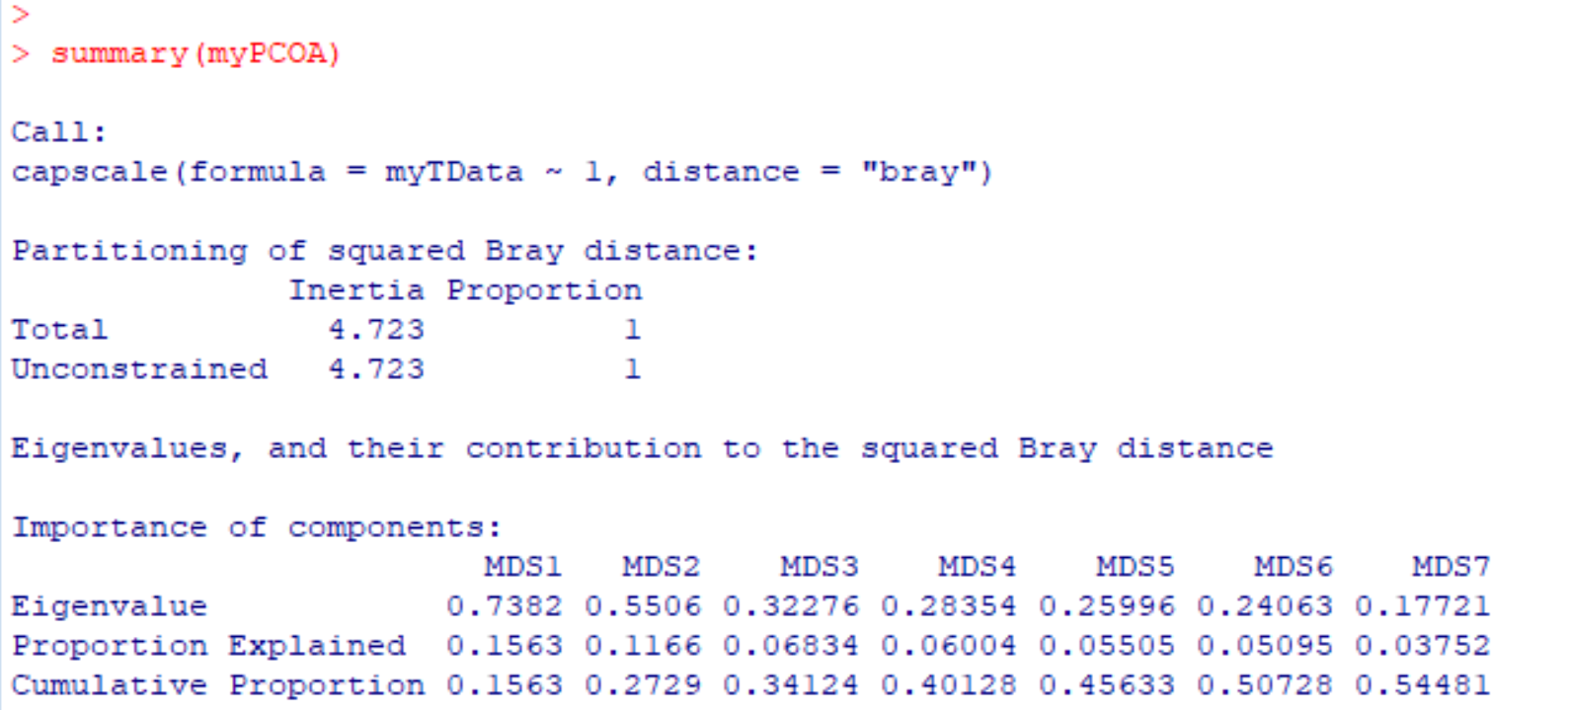
We can make one more refinement. How much duplicate information was there in the taxa?
That is, how much were the taxa correlated? How good was our compression?
We can use the “summary” command and R will yield this information…
more details at http://afodor.github.io/classes/stats2015/Lecture19.pptx

Slide 47
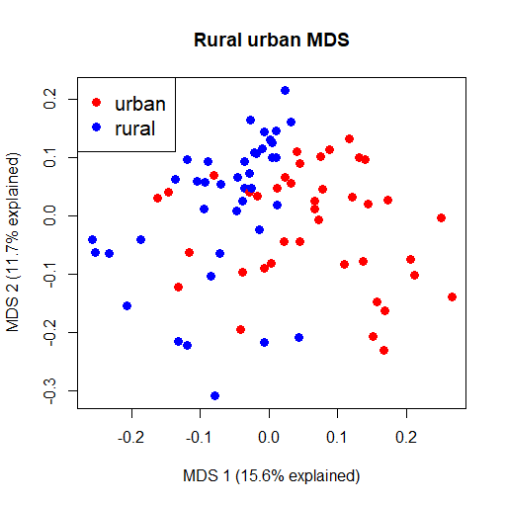
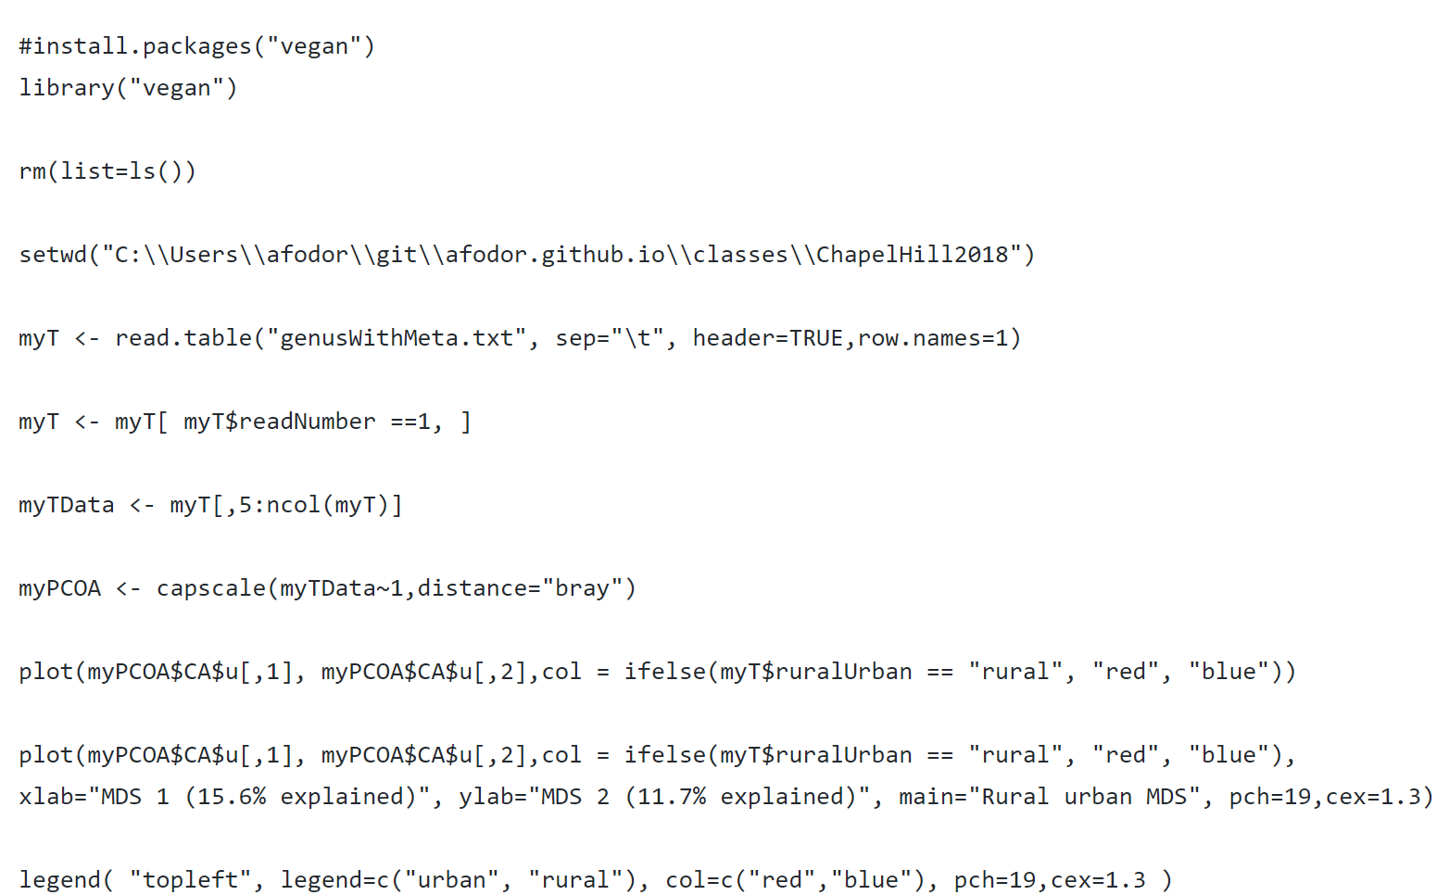
We can (in this case manually) add this to our graph script…
https://github.com/afodor/metagenomicsTools/blob/master/src/classExamples/ch2018/quickOrdination.txt

Slide 48
Normalizing your data
PCA Ordination
Graphing everything into one big PDF ball
Some Simple Statistical Models
Some Not So Simple Statistical Models

