Slide 1
BlockingQueues
A peak calling example with semaphore
CountDownLatch
Callable, Future, FutureTask
Cancellation

Slide 2
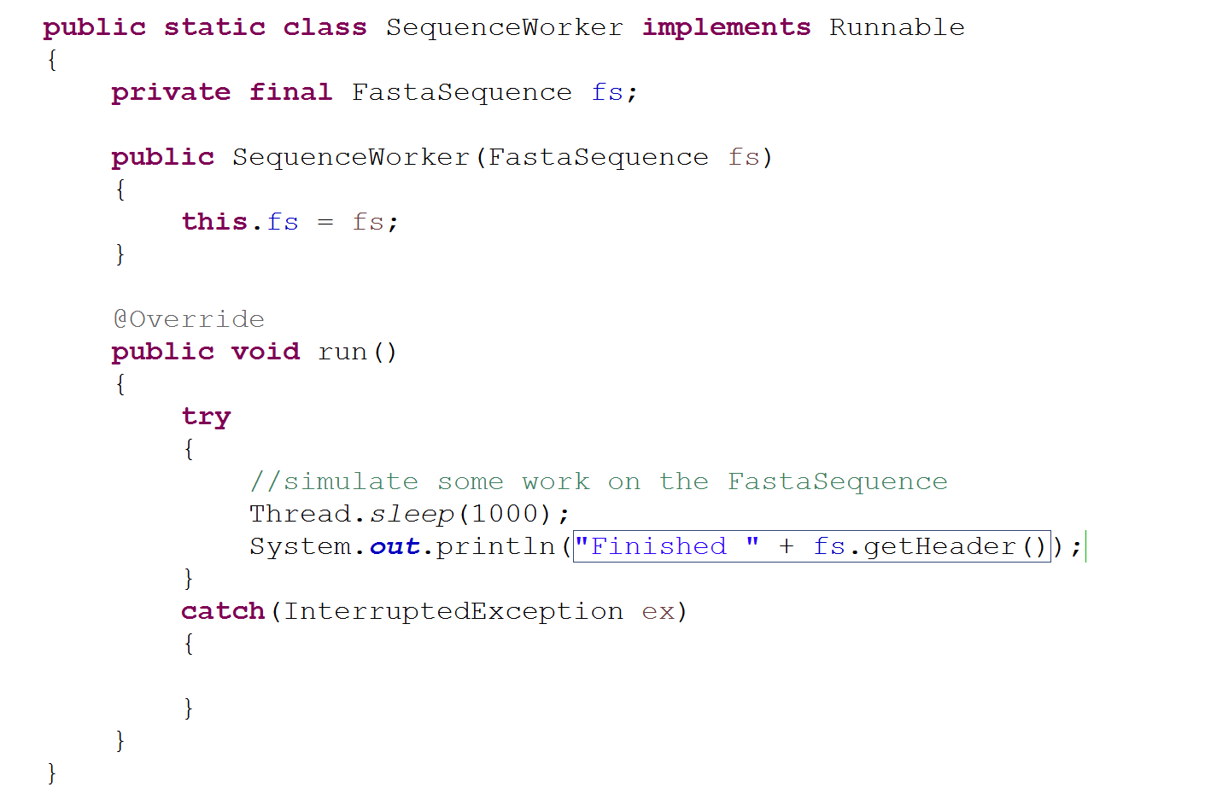
Say we have a Runnable that does some work on a FastaSequence
How do we control how many threads do work on our Fasta Sequences?

Slide 3
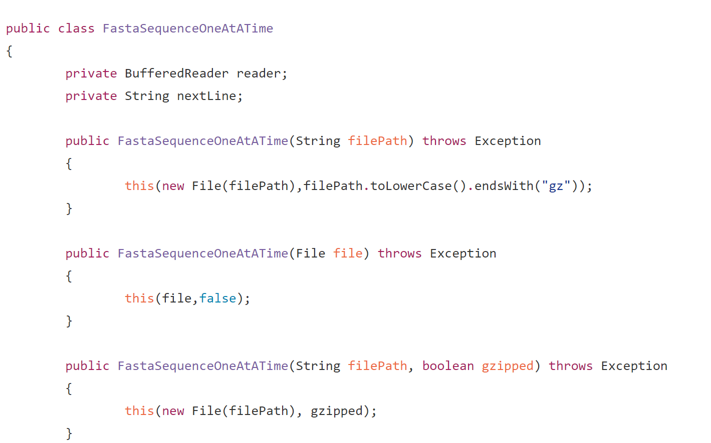
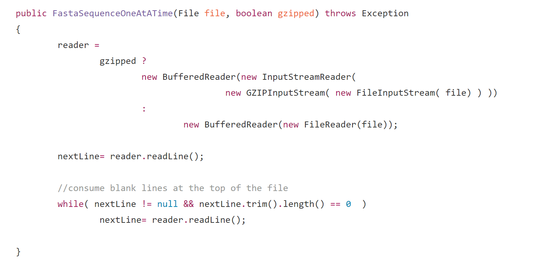
We make a class that can stream Fasta Sequences from the hard disk
https://github.com/afodor/metagenomicsTools/blob/master/src/parsers/FastaSequenceOneAtATime.java

Slide 4
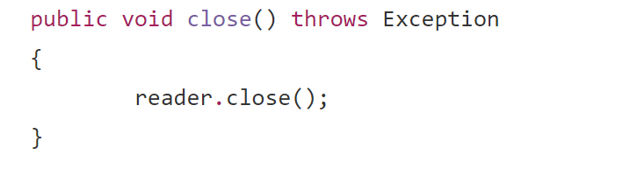
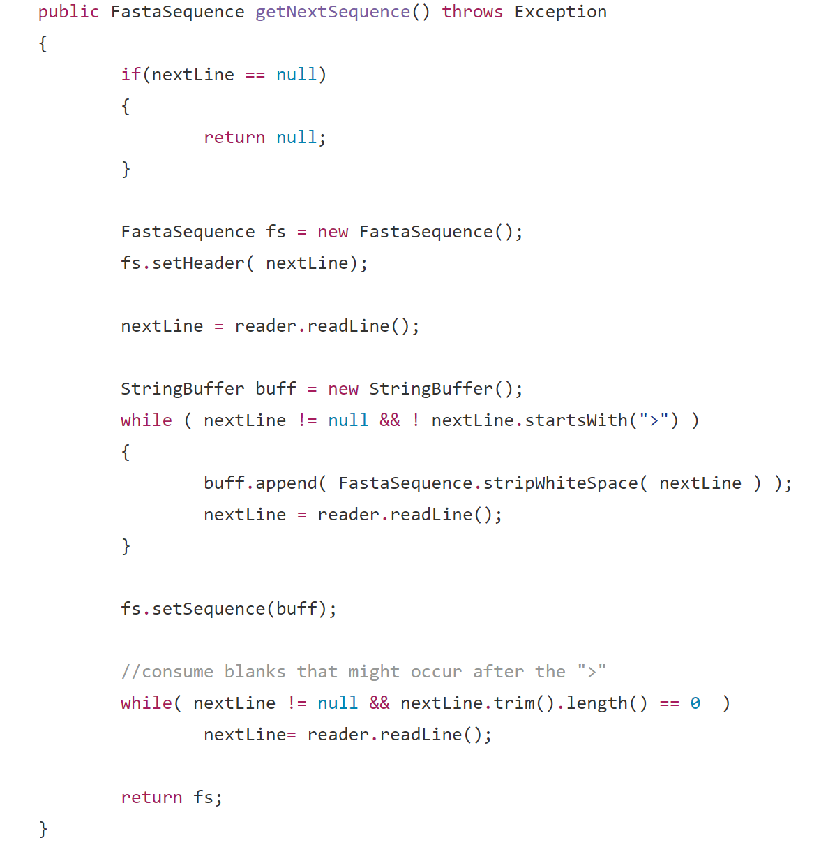
FastaSequenceOneAtATime (cont.)
https://github.com/afodor/metagenomicsTools/blob/master/src/parsers/FastaSequenceOneAtATime.java

Slide 5
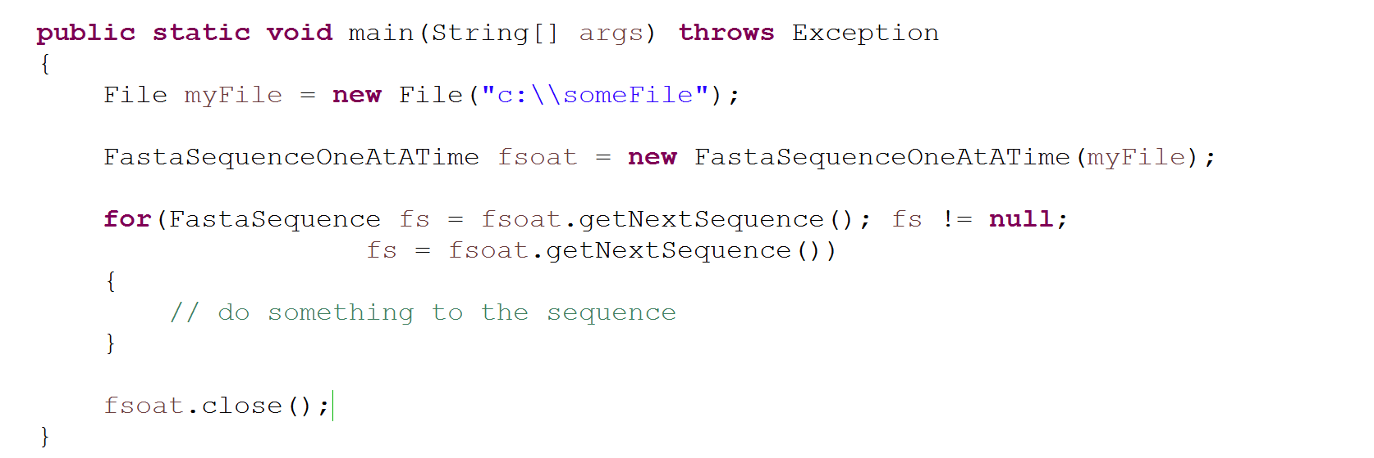
We can use our FastaSequenceOneAtATime to stream sequences (one at a time).
In this code, we do work in a single threaded way…

Slide 6
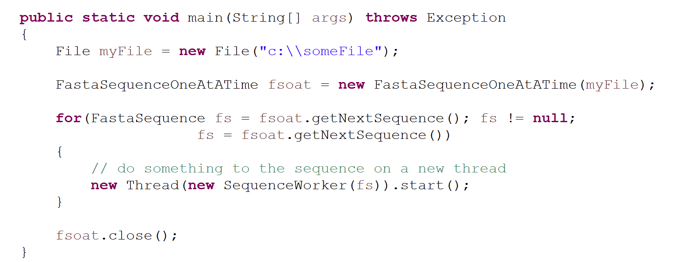
We can potentially kick off one thread per sequence,
but this has the potential to crash our system!!!
One thread will start per sequence

Slide 7
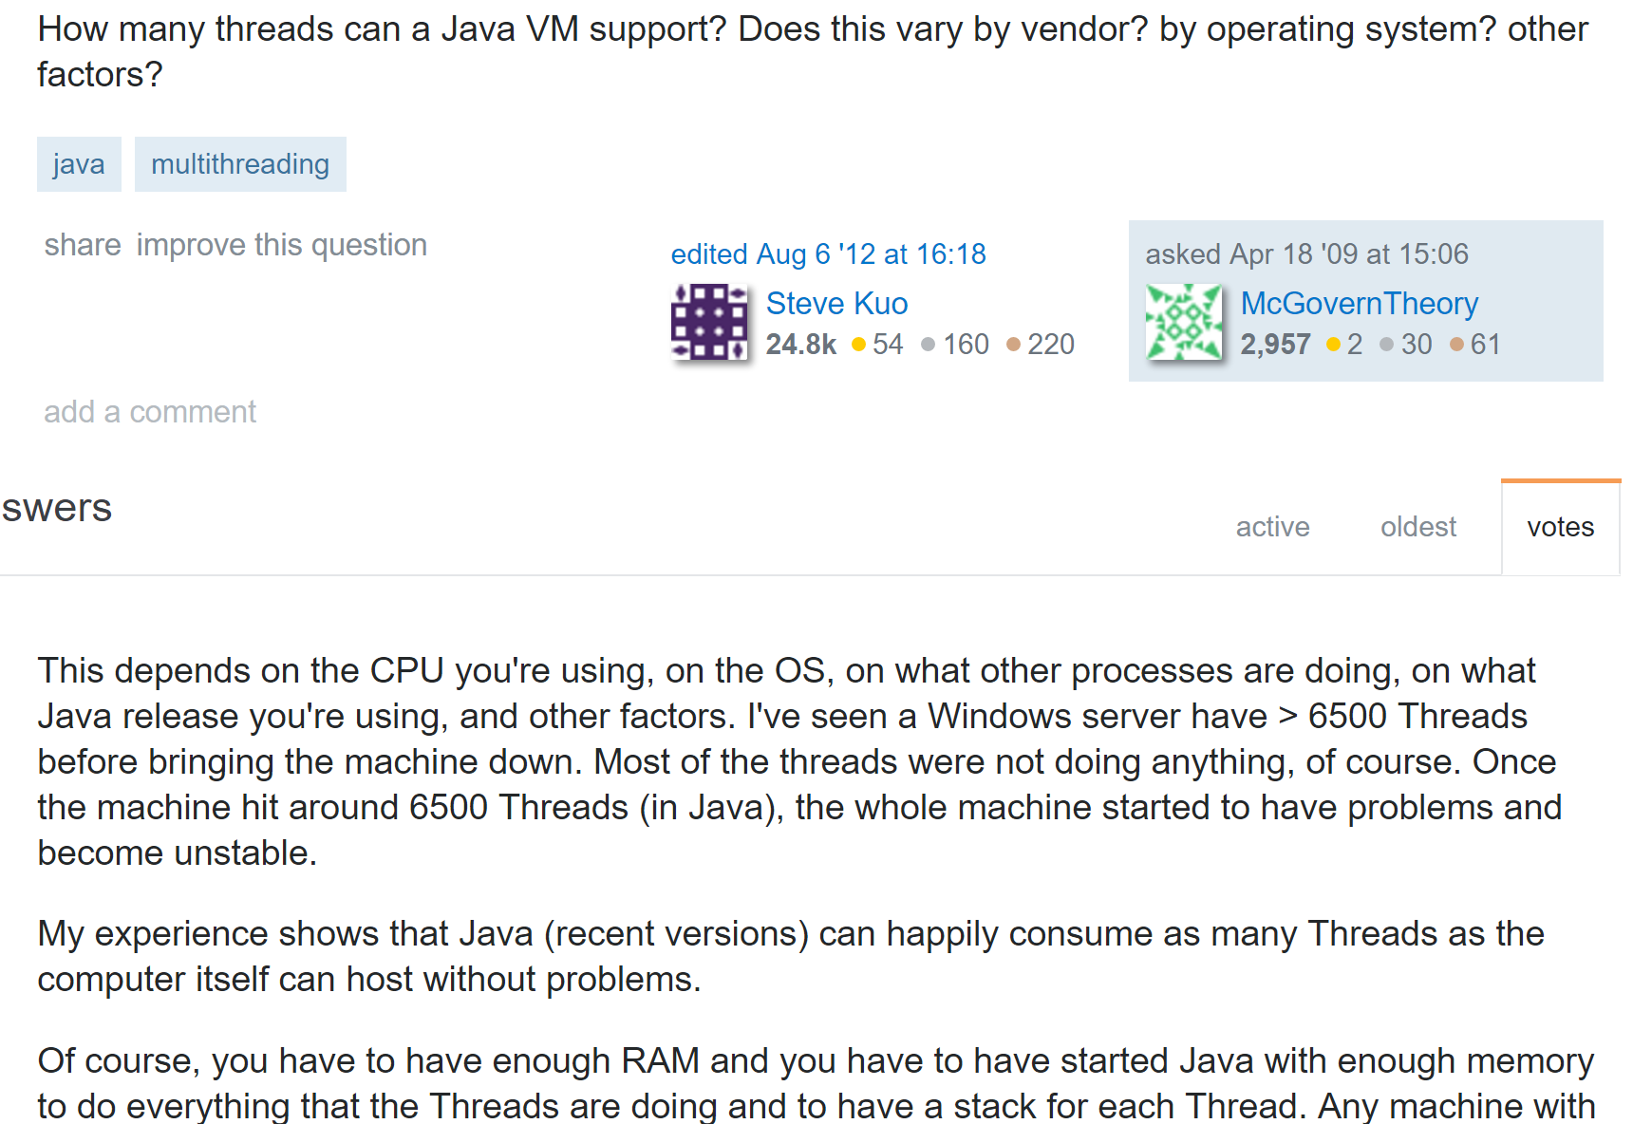
http://stackoverflow.com/questions/763579/how-many-threads-can-a-java-vm-support

Slide 8
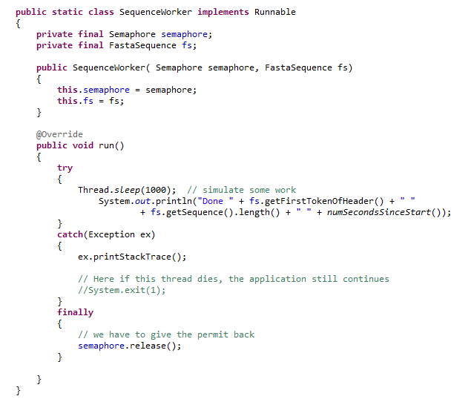
We’ve seen that one option to limit the # of threads is the Semaphore…

Slide 9
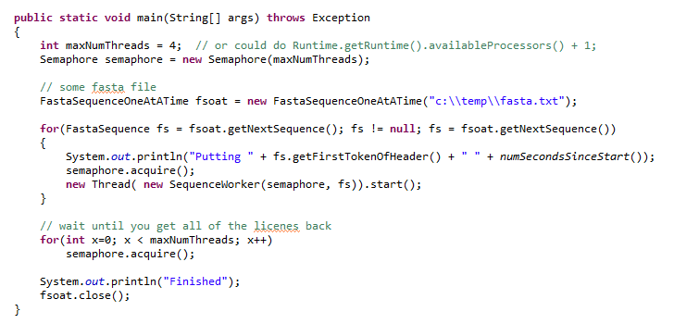
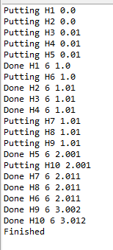
Our main method now spawns a set number of Threads at a time

Slide 10
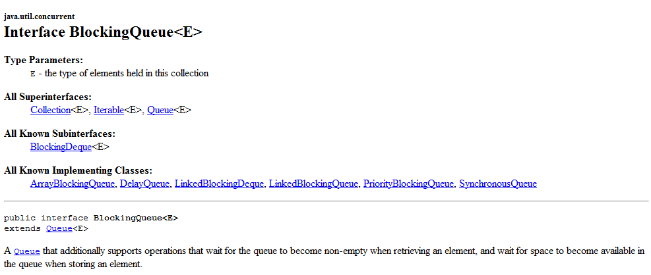
Another option to control how the work is managed is the BlockingQueue

Slide 11
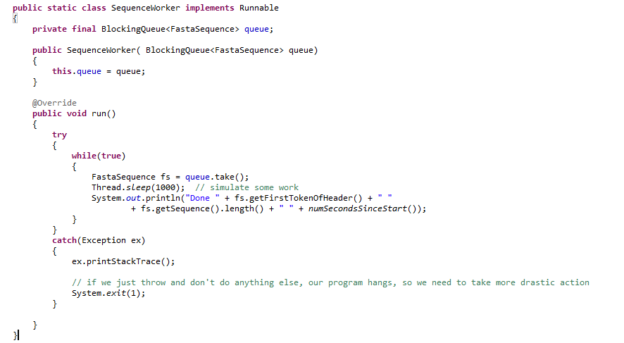
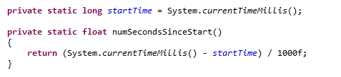
We modify our worker so that it takes a BlockingQueue instead of a FastaSequence

Slide 12
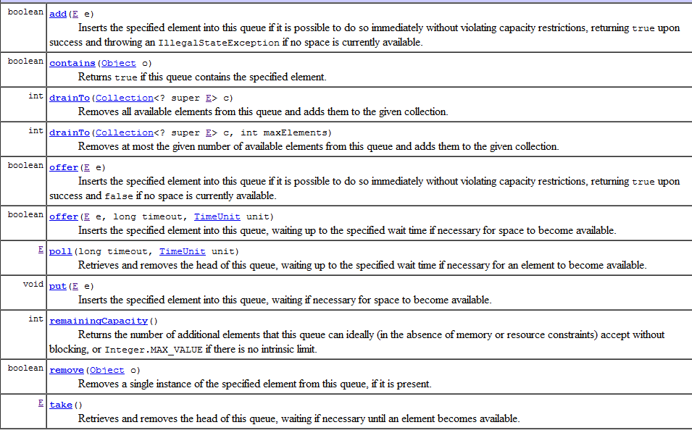

Slide 13
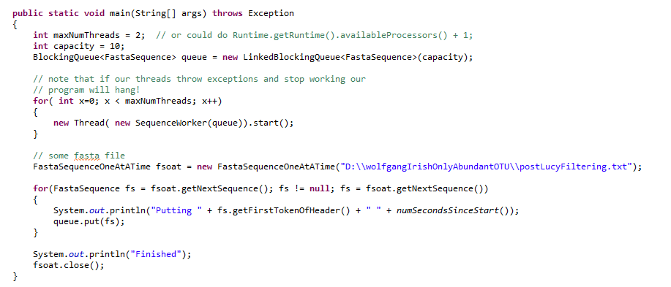
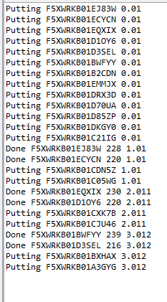
In our main method, we feed sequences one at a time into our BlockingQueue

Slide 15
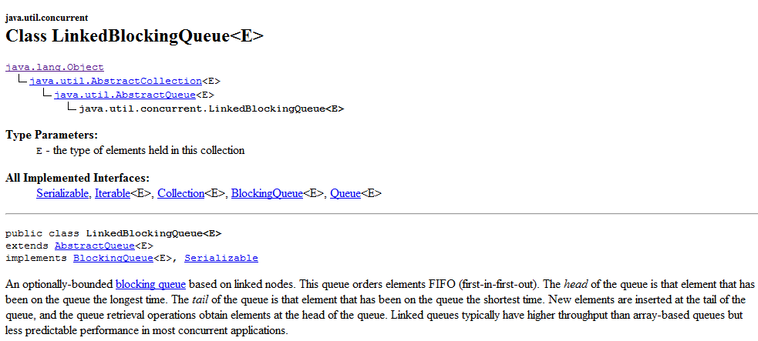
We have a number of implementations of BlockingQueue that control how the work gets
done…
We can change how the work is done by just instantiating a different BlockingQueue

Slide 16
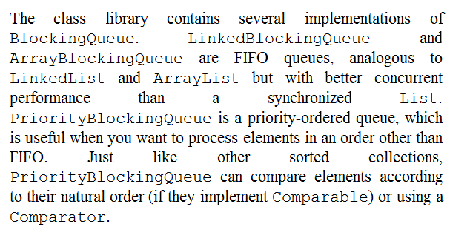
We can change how the work is done by just instantiating a different BlockingQueue

Slide 17
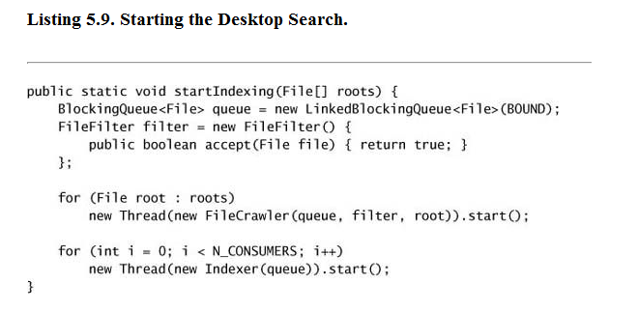
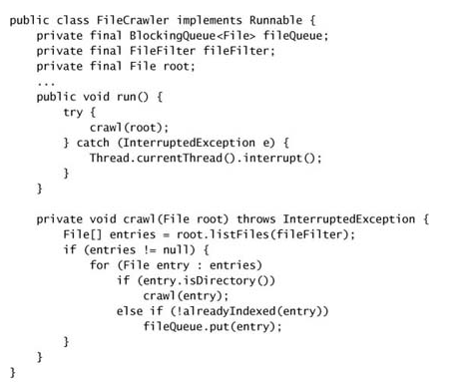
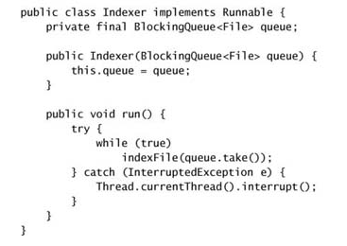
The textbook example, a search engine indexer…

Slide 18
BlockingQueues
A Peak calling example with semaphore
CountDownLatch
Callable, Future, FutureTask
Cancellation

Slide 19
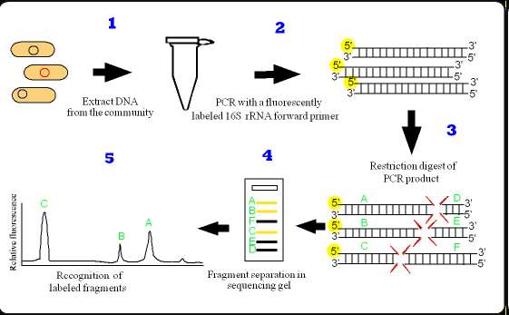
T-RFLP is a low cost “fingerprint” technique

Slide 20
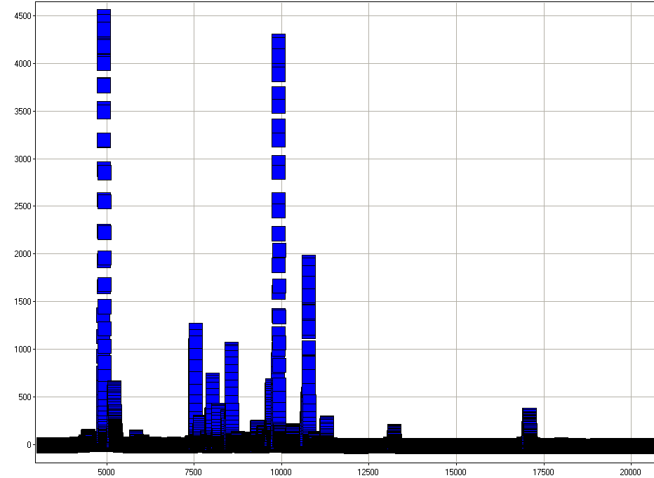
The data look like this…

Slide 21
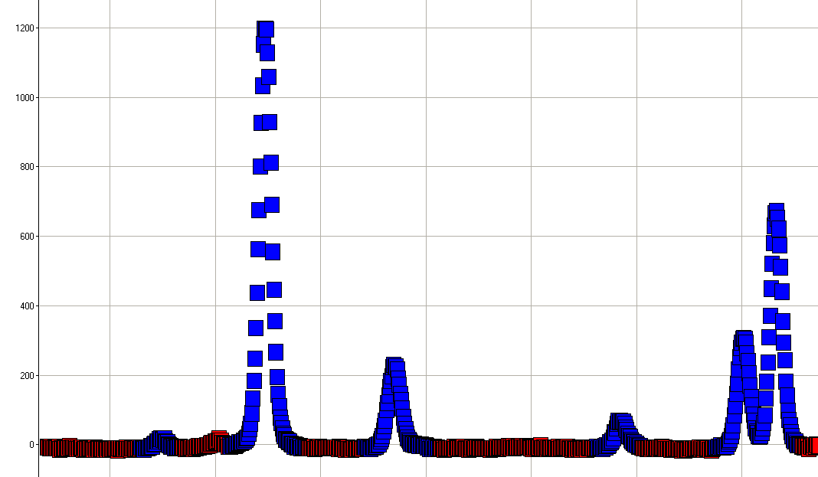
Or zoomed in it looks like this…
The coloring is done by a peak calling algorithm…

Slide 22
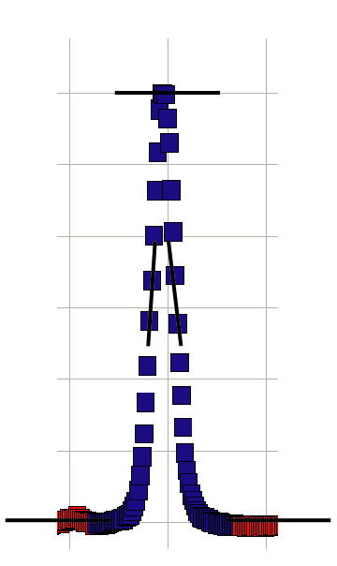
Probably more sophisticated ways to do this…
Take a moving window.
Fit a linear regression to all of the point in the window.
Look for a positive slope followed quickly by a negative slope

Slide 23
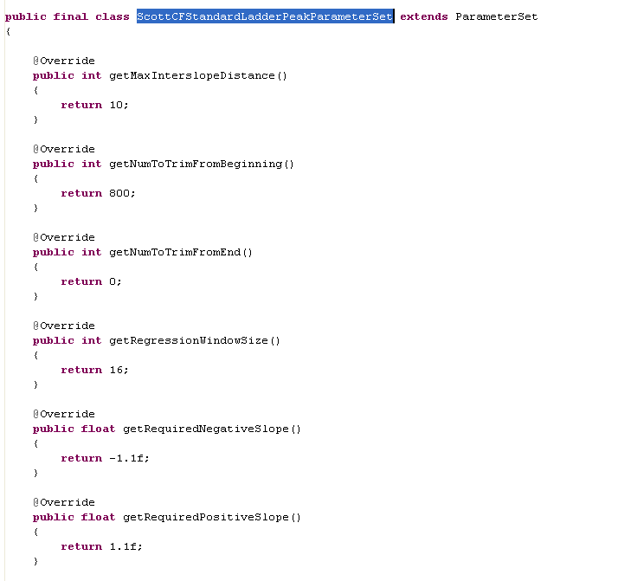
Parameters are controlled by instances of a “ParameterSet” interface.
Note that this is thread safe because it has no data!

Slide 24
I have a new CF dataset.
~12 patients. Before and after treatment.
~300 spectra with ~28,000 points each.
~8,000,000 regressions to run.
Analysis of each spectra is embarrassingly parallel.
Good candidate for multi-threaded speedup

Slide 25
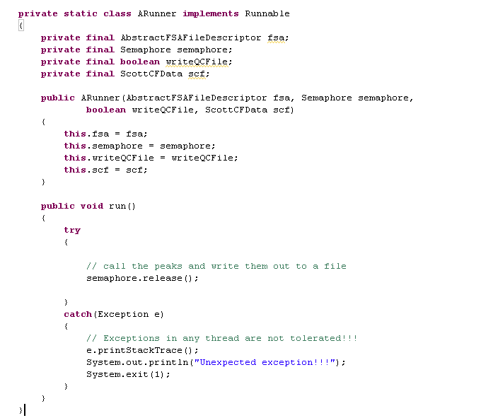
Make a worker class…
Not showing you the peak-
calling stuff here.
If you are interested let me know!
Normally this would
be in a final block
Obviously, an extreme method for error handling!
Normally, you would propagate the Exception up or
store it in a volatile Exception variable

Slide 26
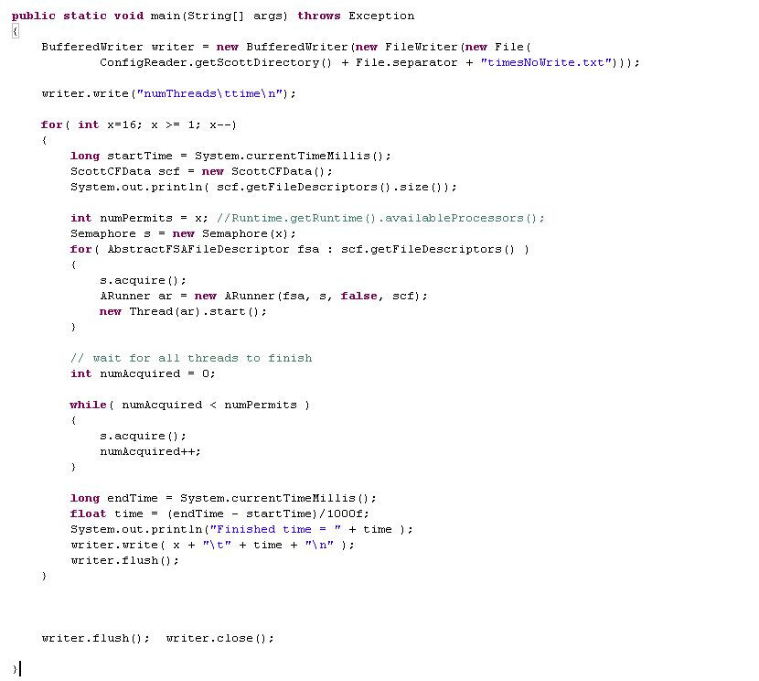
Semaphore makes this really easy to tune the work you have to do to the # of threads
in your system….
acquire a permit
This will iterate through all
the spectra (code not shown)
Semaphores provide a very simple way to make sure
that all the threads have finished!

Slide 27

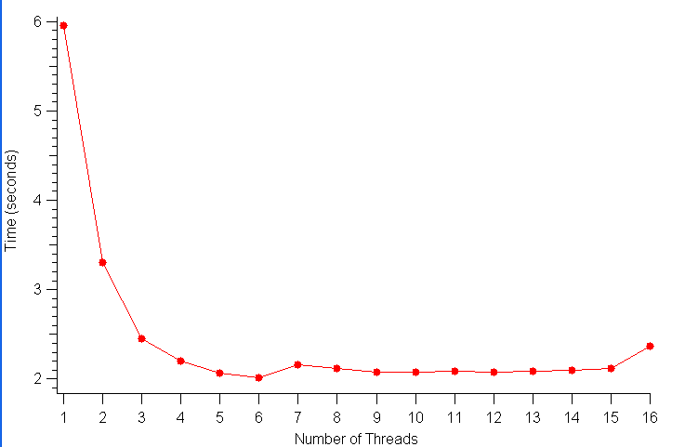
Performance on an 8-CPU Linux cluster invoking Java with default parameters.
You can actually see the CPUs click on as the program goes from 2 to 3 to 4 to 5 threads
Why maxing at 4 CPUS?
2 hypotheses:
This box is 2 CPUs * 4 cores. So communication between the CPUs could limit the concurrency.
I/O Bottlenecks…

Slide 28
Performance on a 2-CPU laptop.
A little less than a factor of 2 (but the CPU never really gets to zero on the laptop
since it is playing music and stuff…)
The book suggests Ncpu or Ncpu + 1
Interestingly, going more than the # of CPUs is a little faster!
The CPUs don’t quite get to 100% with just two threads..

Slide 29
BlockingQueues
A Peak calling example with semaphore
CountDownLatch
Callable, Future, FutureTask
Cancellation

Slide 30
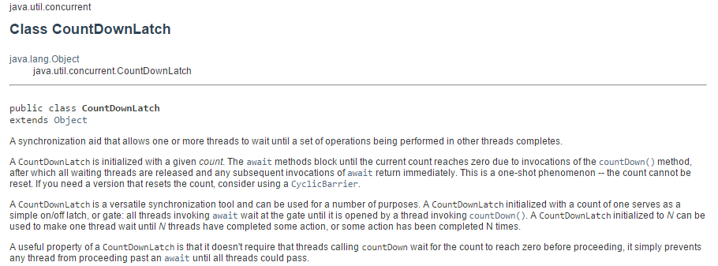
CountDownLatch is very useful (and easy to use)
new CountDownLatch( … ) is called with the number of threads.
.await() blocks until .countDown() is called the correct number of times..
If you know you want x number of threads to run and then move on when they are all
done, the CountDownLatch works nicely…

Slide 31
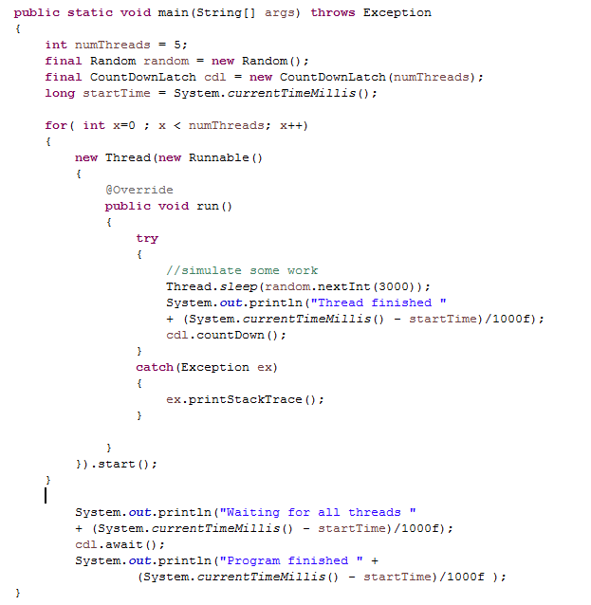
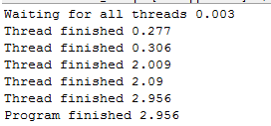
We’ve already seen examples of CountDownLatch this semester..
Very useful and easy to use way to coral your threads…

Slide 32
BlockingQueues
A Peak calling example with semaphore
CountDownLatch
Callable, Future, FutureTask
Cancellation

Slide 33
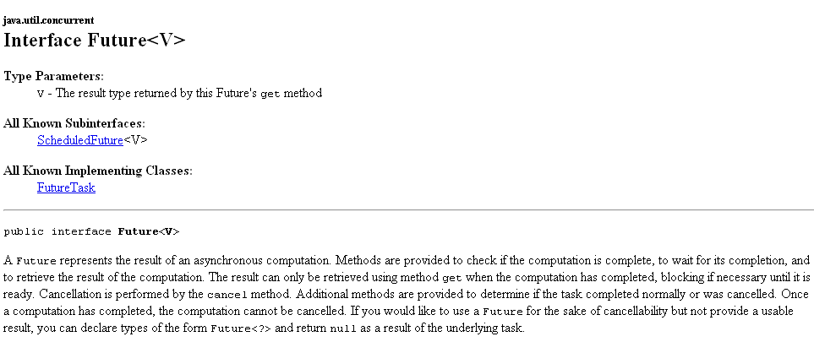
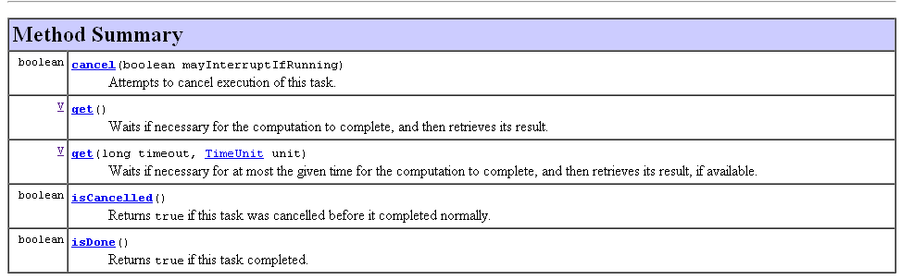
Future – Holds the results of some calculation

Slide 34
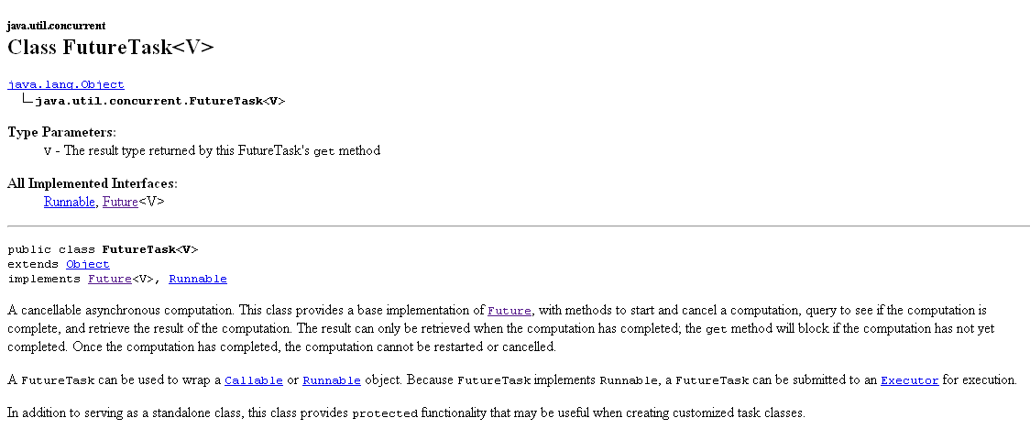
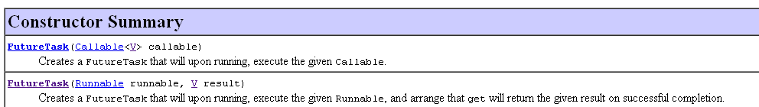
A FutureTask is an implementation of Future that we can use
When you construct, you need to pass in a Runnable or a Callable

Slide 35
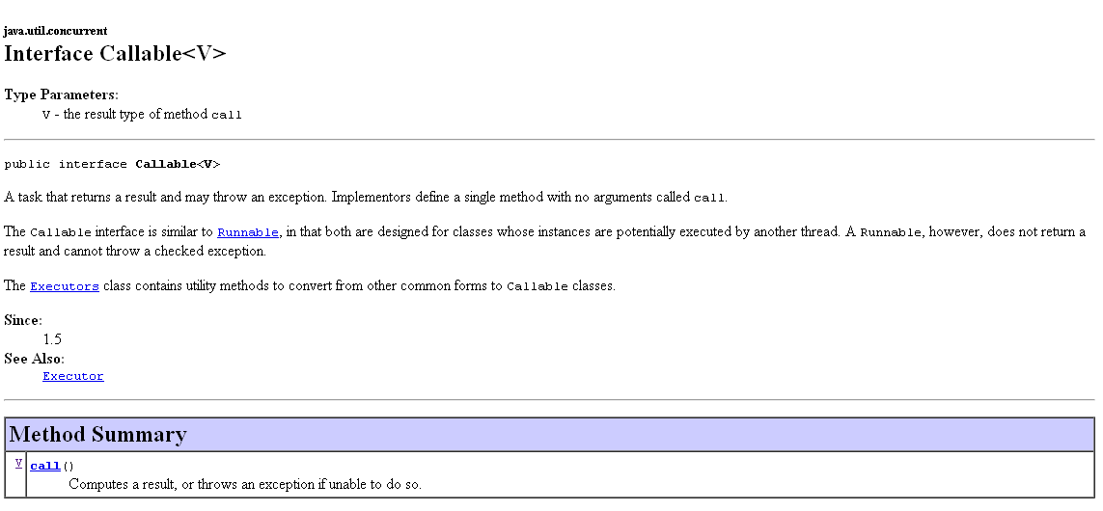
A Callable is like a Runnable, except it has a return type V
(and can throw an Exception, which is very nice)

Slide 36
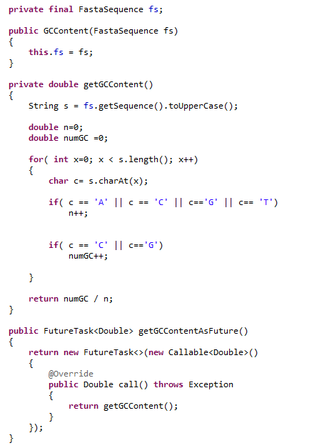
This class calculates GC content
in a background thread.
We can either getGContent()
now ( which will run in the
current thread)
Or get an object that will
allow the calculation of GC
content to run in a background
thread (but invoking
getGCContentAsFuture() will
return instantly).

Slide 37
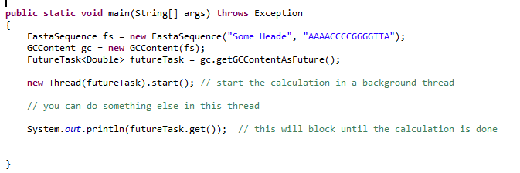
In this method, we spawn a calculation in a background thread…

Slide 38
BlockingQueues
A Peak calling example with semaphore
CountDownLatch
Callable, Future, FutureTask
Cancellation

Slide 39
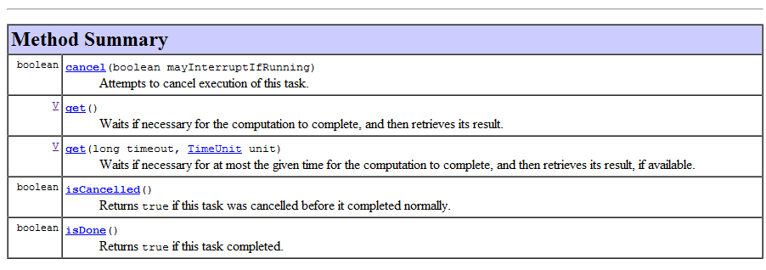
Future also supports cancellation, but this is dependent upon the co-operation of the
running threads…

Slide 40
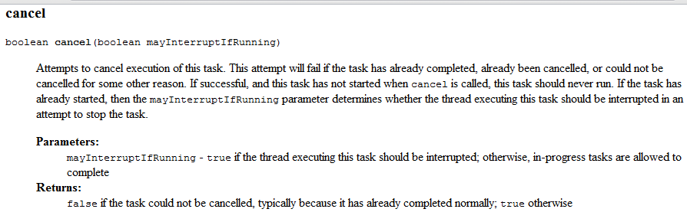
Thread.sleep and nearly all other Java blocking methods support cancellation.
If your code is working on something, it is up to you to check for cancellation
(which means checking for interruption).
More on this on Chapter 7.

Slide 41
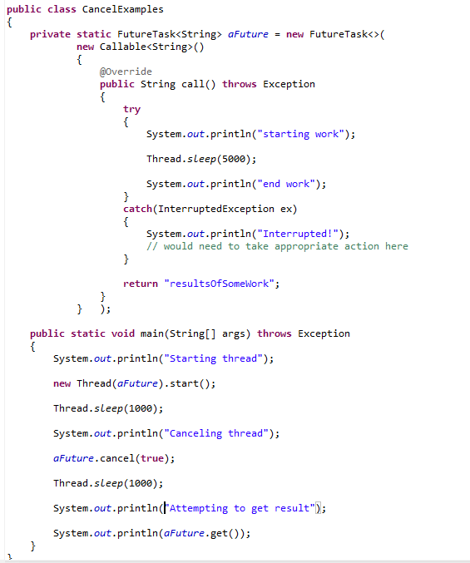
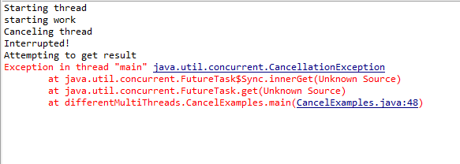
Calling cancel causes an Interruption flag to be set.
Thread.sleep(..) checks that interruption flag and
If it is set throws InterruptedException.
Calling get() after cancel, throws a CancellationException

Slide 42
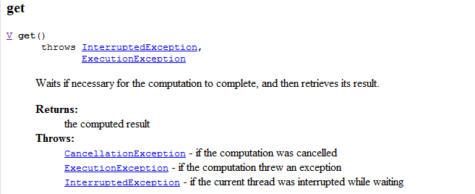

Slide 43
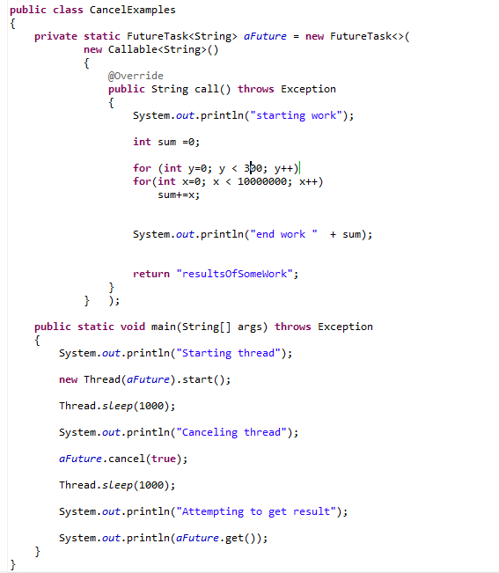
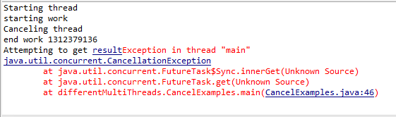
If you are not using one of Java’s blocking methods (like Thread.sleep()) that supports interruption, it is up to you to check for cancellation.
We don’t check for cancellation
Our thread continued to work after cancellation
get still throws!

Slide 44
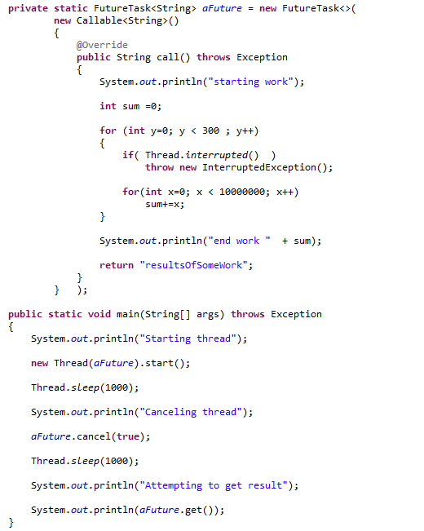
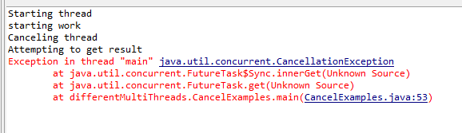
Our cancellation now works
The thread is successfully cancelled. “end work” is not reached

Slide 45
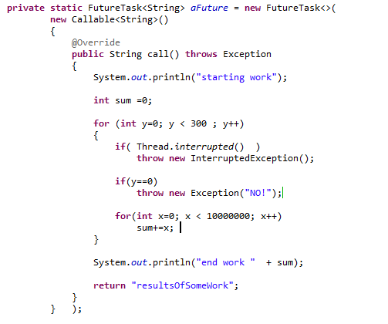


If we throw a normal
Exception (not InterruptedException)…
Then get re-throws that Exception

Slide 46
Next: Deadlock…

