Slide 1
Zero inflated models
Kendall’s tau

Slide 2
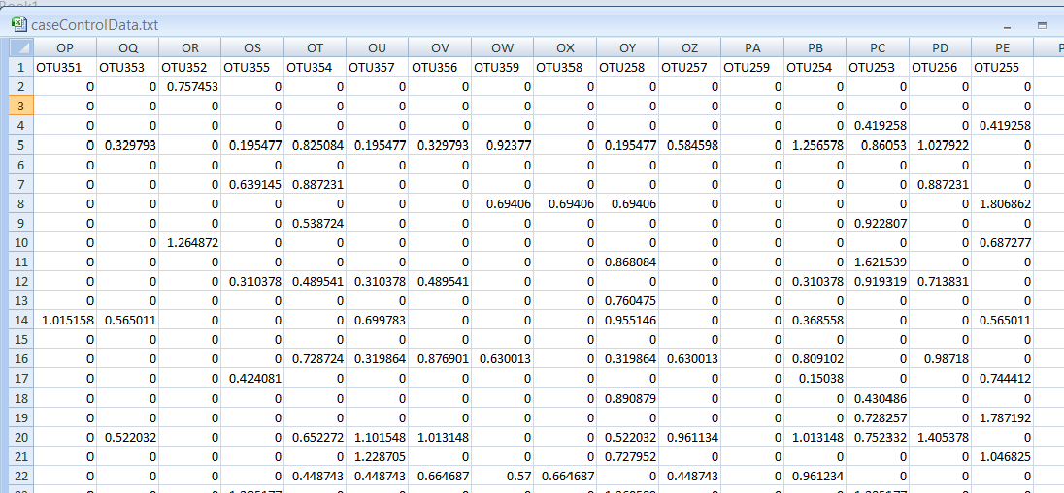
We often see lots of zeros in our sequence datasheets…
The source of all these zeros is not entirely clear…
Sequencing error, mis-classified taxa, lack of sequencing depth in some samples,
Biological diversity (we all have a few unique bugs that are not shared across many people).
http://afodor.github.io/classes/stats2015/caseControlData.txt

Slide 3
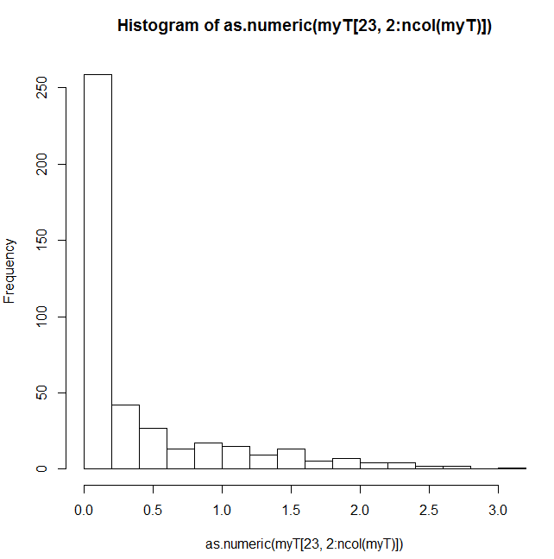
The zeros play havoc with assumptions such as normality
Today we will look at mixture models that explicitly model the over-abundance of zeros.
We follow chapter 11 in the Zuur book…

Slide 4
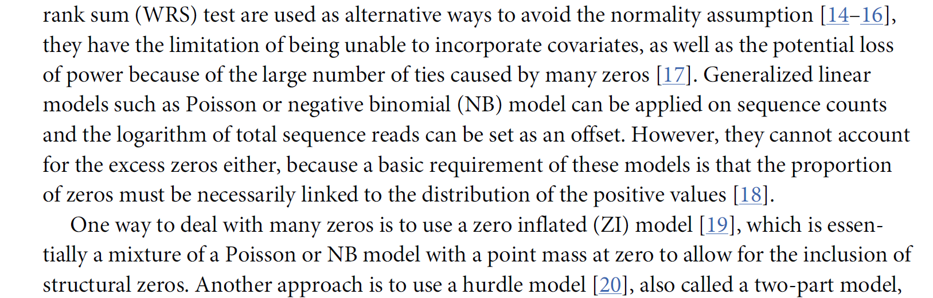
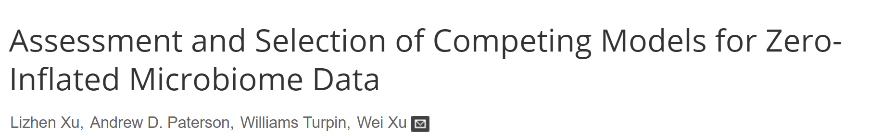
Poisson and negative binomial models have an explcit expectation of some zeros,
but the # of zeros is linked to the overall parameters of the model

Slide 5


Mixture models that explicitly model the over-abundance of zeros
This will be binomial distributed with π = probability of a false zero
This will be either Poisson or Negative Binomial distributed
We will start with the Poisson distribution…
Prob of zero under binomial distribution
Poisson probability of a zero
Poisson probability of non-zero

Slide 6



As in all generalized linear models, we have 3 parts in the specification for a
Poisson zero inflated model
Model assumptions:
Zeros are distributed by binomial + Poisson
non-zeros distributed by Poisson
Mean and variance
(stated without proof)
(link equations)
The two link equations can share parameters
or not!
Our link equations ensure that π (which belongs to the binomial) can
only range from 0 to 1 (where the binomial is defined)
And that μ (which belongs to the Poisson) can only range >= 0
(where the Poisson is defined)
From these, we can write a (complicated) likelihood function to maximize..

Slide 7
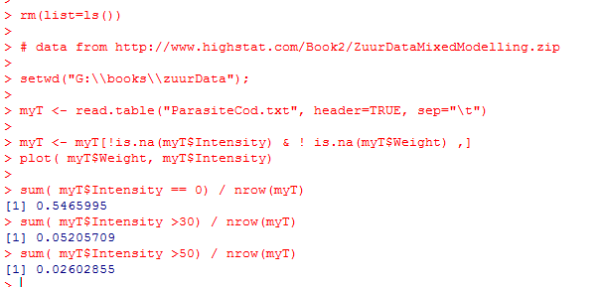
Let’s consider an example dataset…
Many zeros in this dataset (~54%) of all data
Your eye is drawn to the high intensity points,
But only ~2.6% of all data > 50

Slide 8
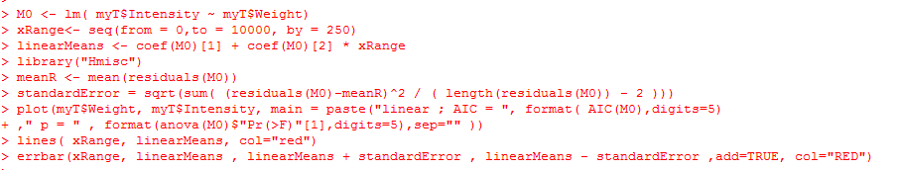
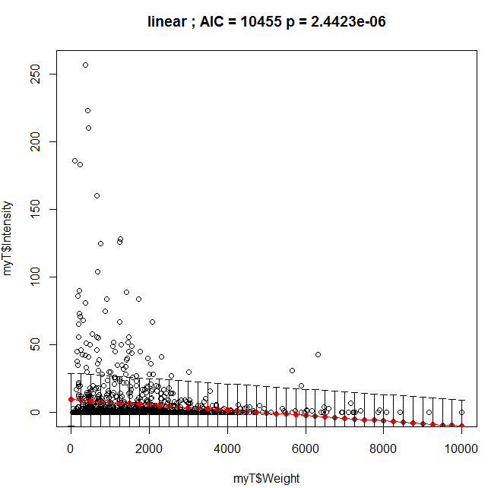
We will fit a series of models to the data… We start with a simple linear model..
Constant variance
Is problematic
Our model goes below
Zero…
https://github.com/afodor/metagenomicsTools/blob/master/src/classExamples/zeroInflatedExample.txt

Slide 9
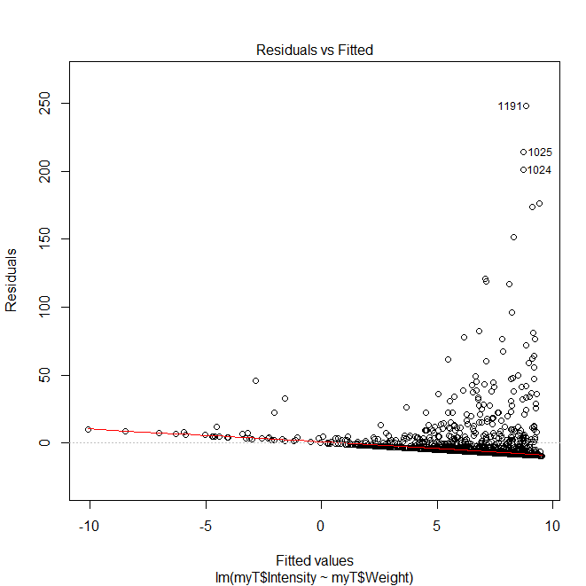
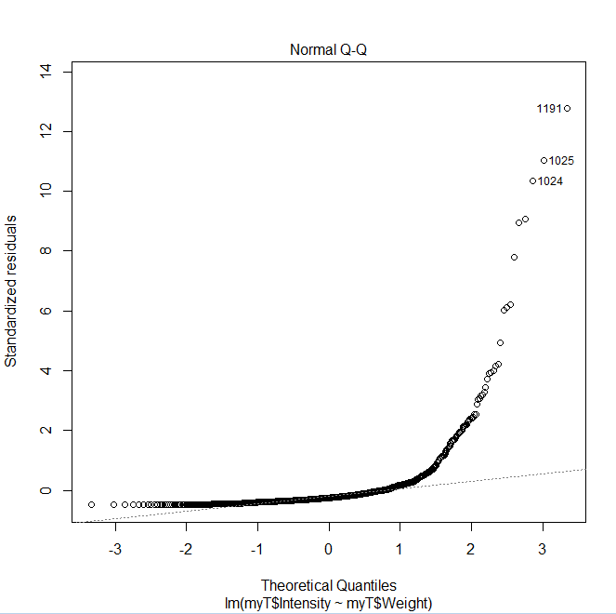
The residuals are a mess…
plot(M0)

Slide 10
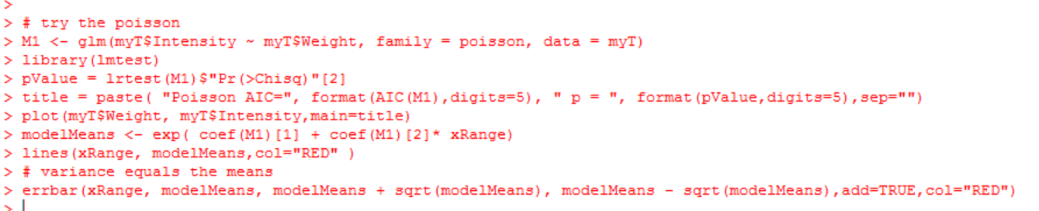
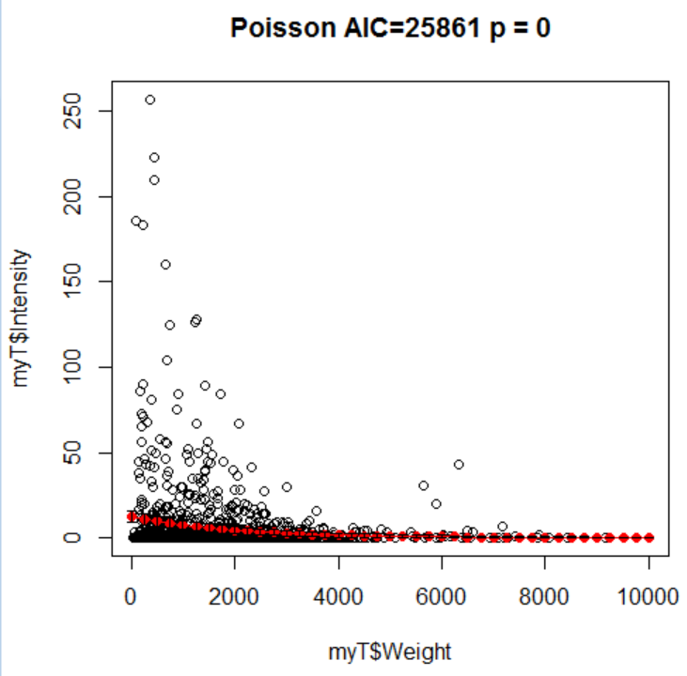
Next, we consider a Poisson model..
Fit is considerably worse than linear;
Assumption that mean==variance
seems a poor one..
Model doesn’t go below zero

Slide 11
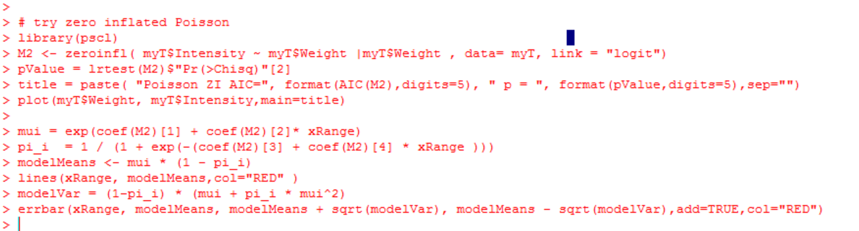
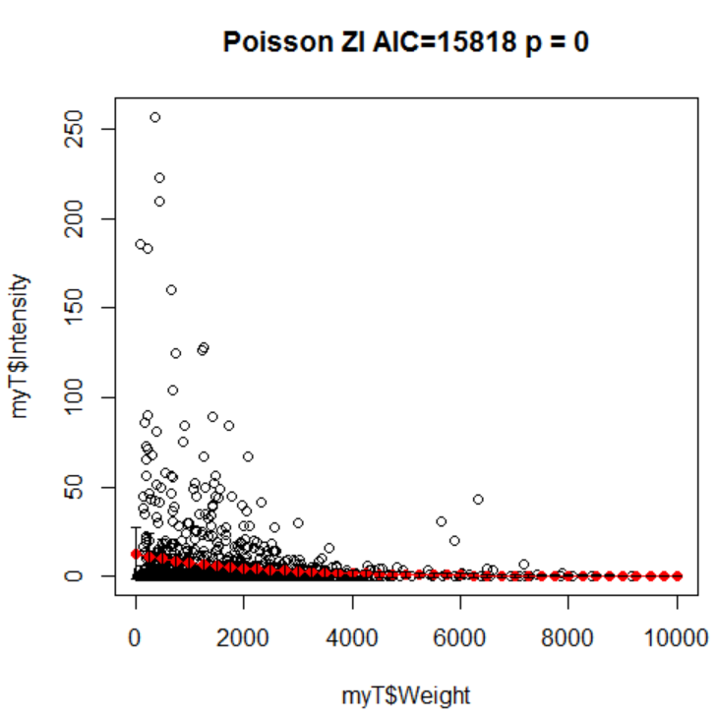
Next the zero-inflated Poisson

Slide 12
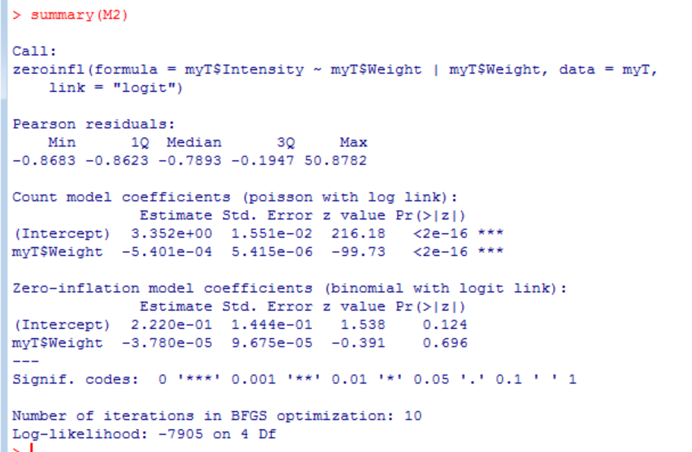

Slide 13
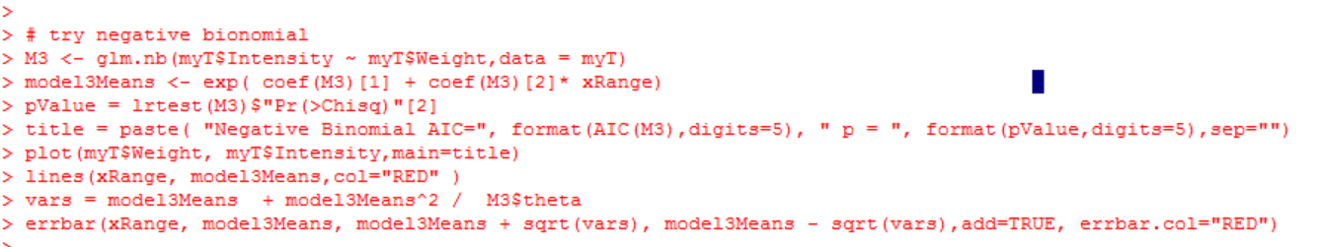
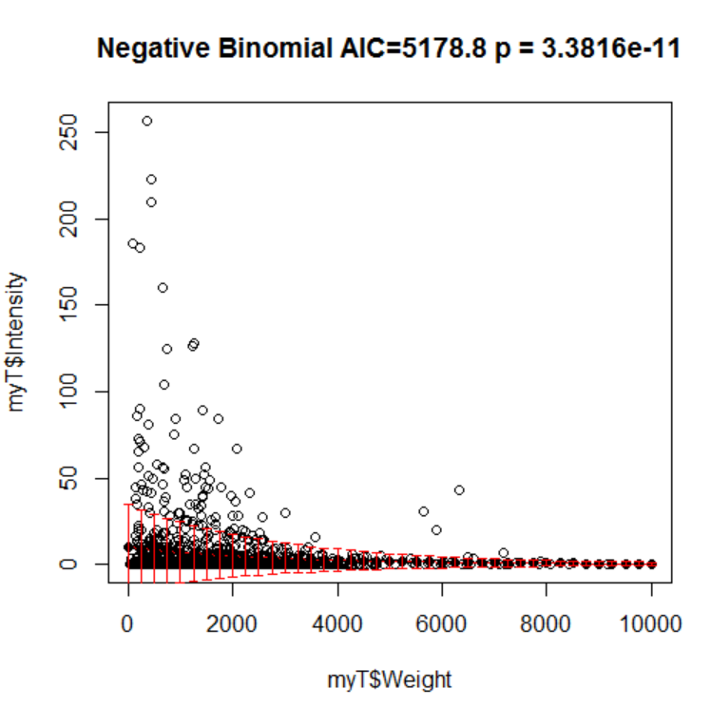
The negative binomial…

Slide 14
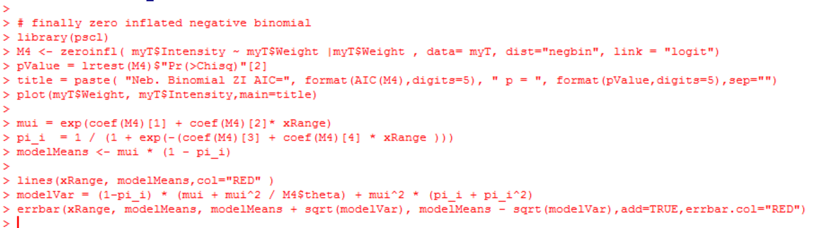
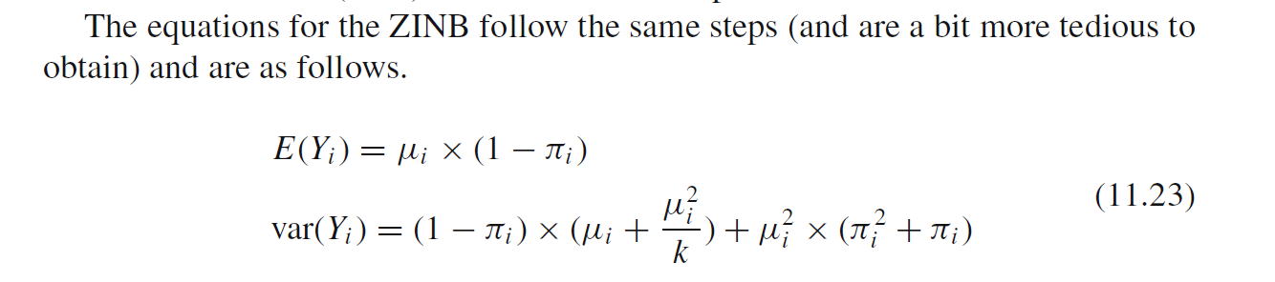
Finally, the zero inflated negative binomial…
From the Zuur book…

Slide 15
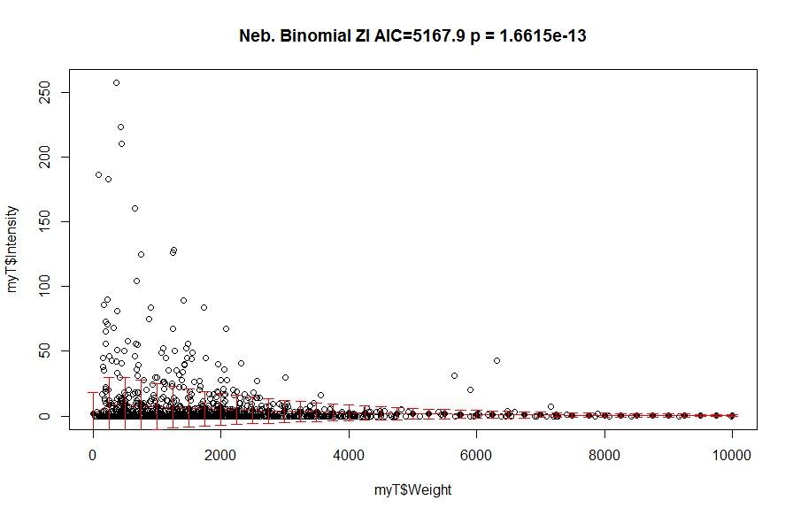

Slide 16
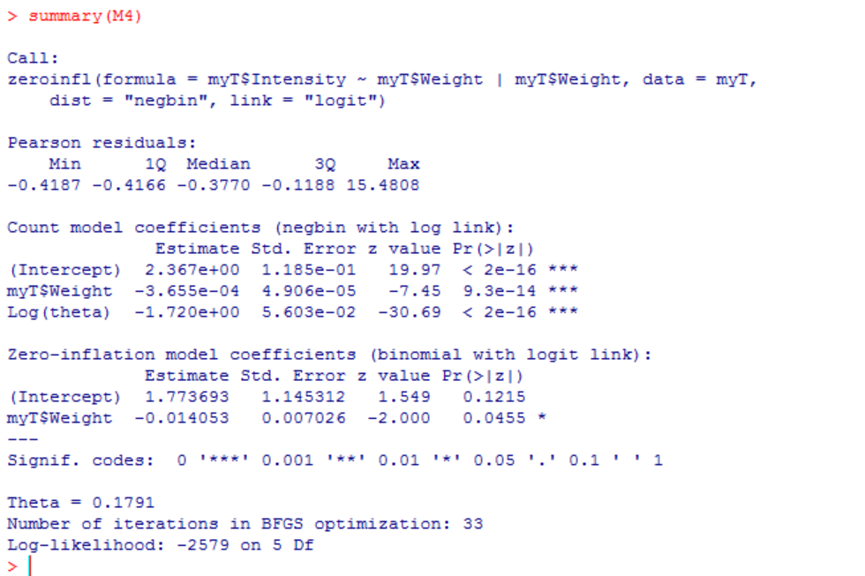

Slide 17
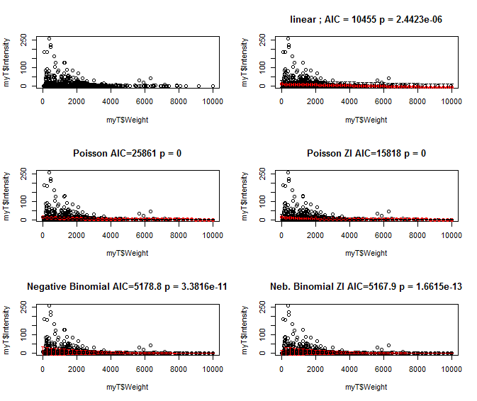
A summary view of all our models…

Slide 18
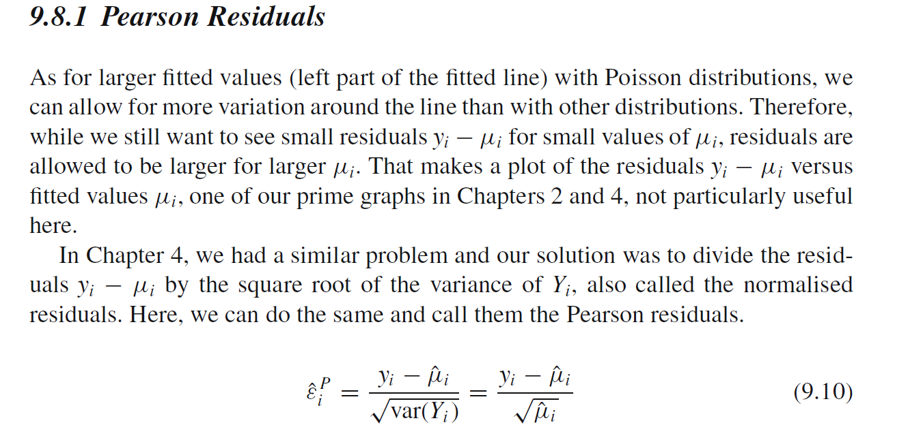
From the Zuur book; we can look at Pearson residuals vs. model or covariates

Slide 19
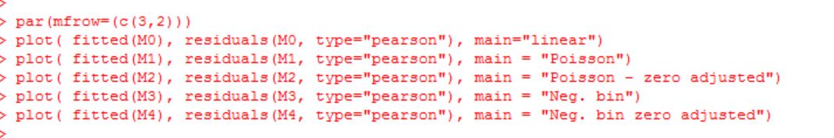
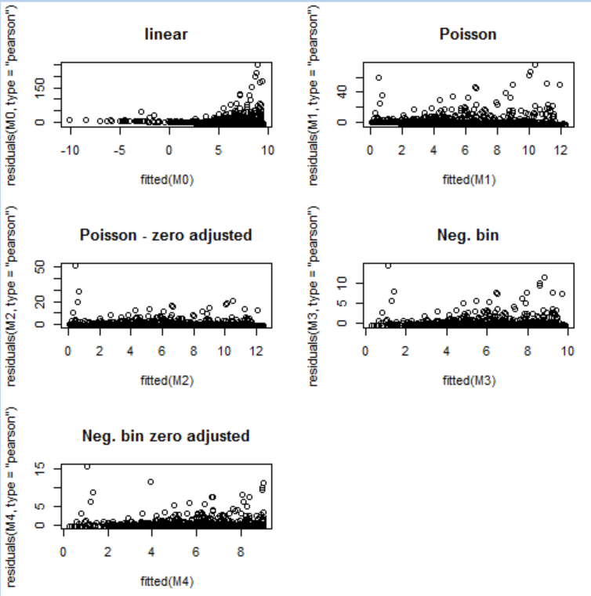
None of these models are free from patterns in their residuals..

Slide 20
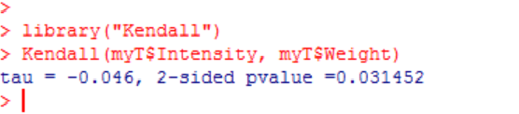
A non-parametric alternative with a (just barely) significant p-value

Slide 21
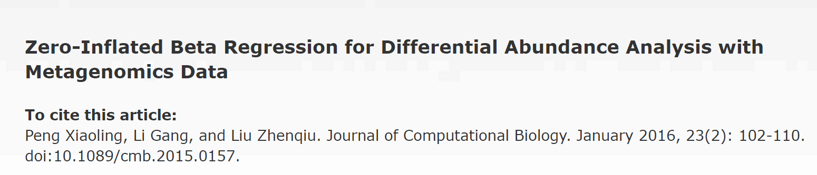
Zero inflated models are an area of very active research in genomics…

Slide 22

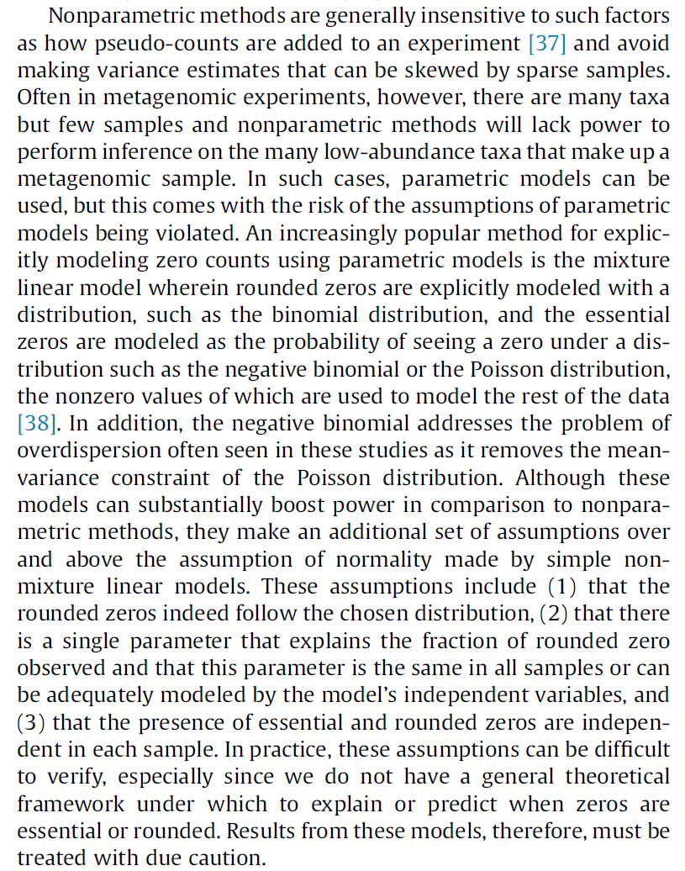
I tend to view these models with some suspicion…

Slide 23
Zero inflated models
Kendall’s tau

Slide 24
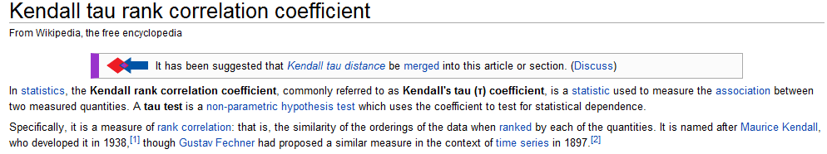
Kendall Rank Correlation – A non-parametric alternative to linear regression
http://en.wikipedia.org/wiki/Kendall_tau_rank_correlation_coefficient

Slide 25
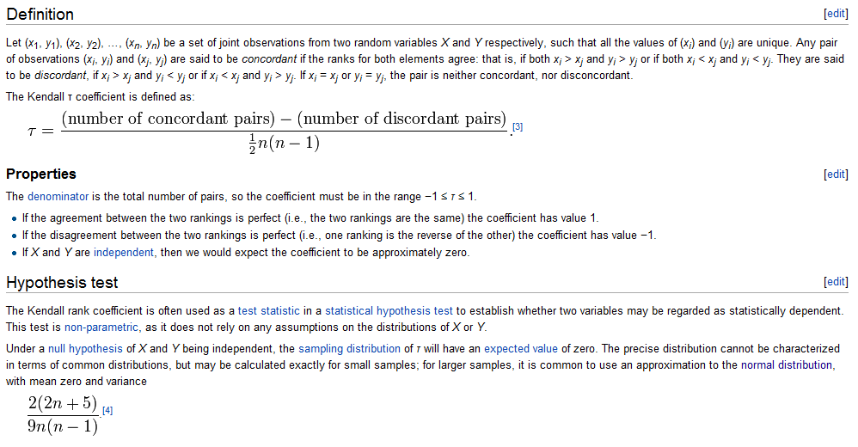
http://en.wikipedia.org/wiki/Kendall_tau_rank_correlation_coefficient

Slide 26
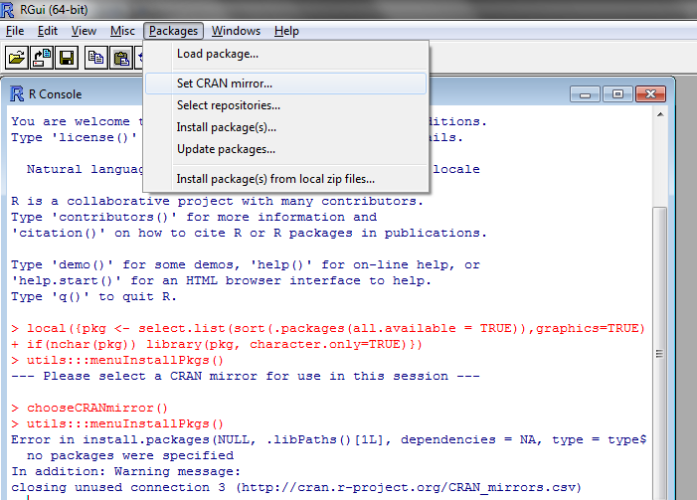
This test is not part of the main distribution in R…

Slide 27
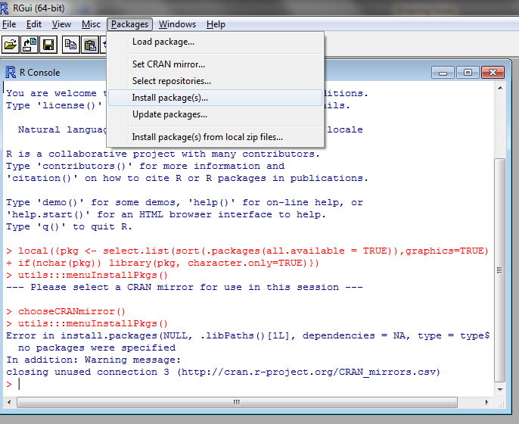

Slide 28
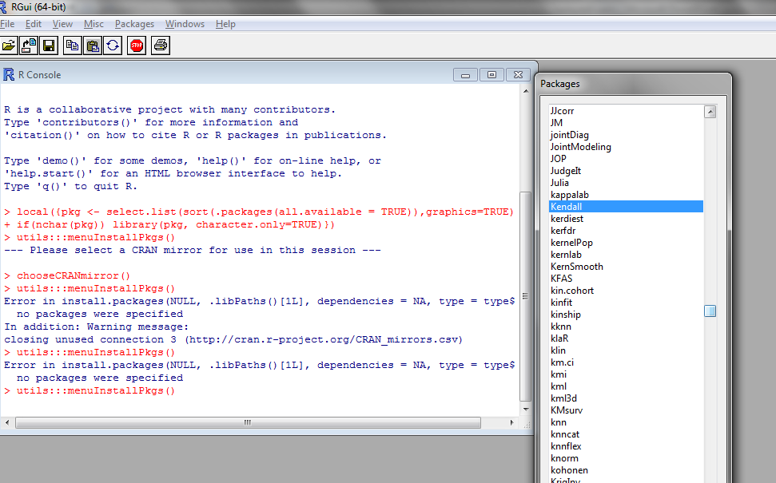
Choose Kendall and click “OK”.

Slide 29
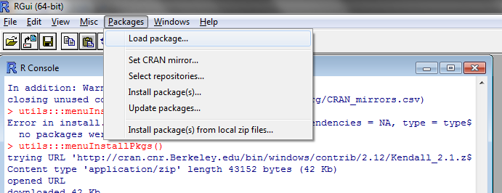
Every time you start R, you have to load the package

Slide 30
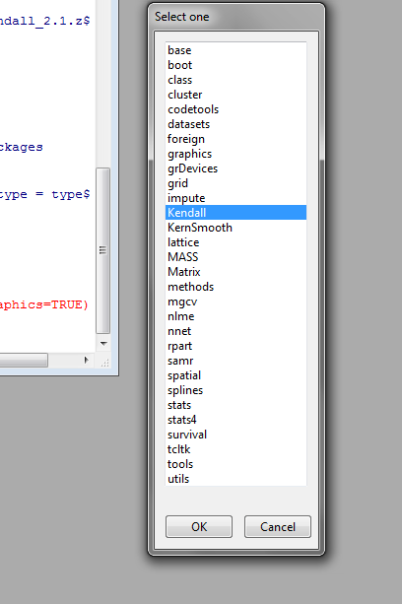

Slide 31
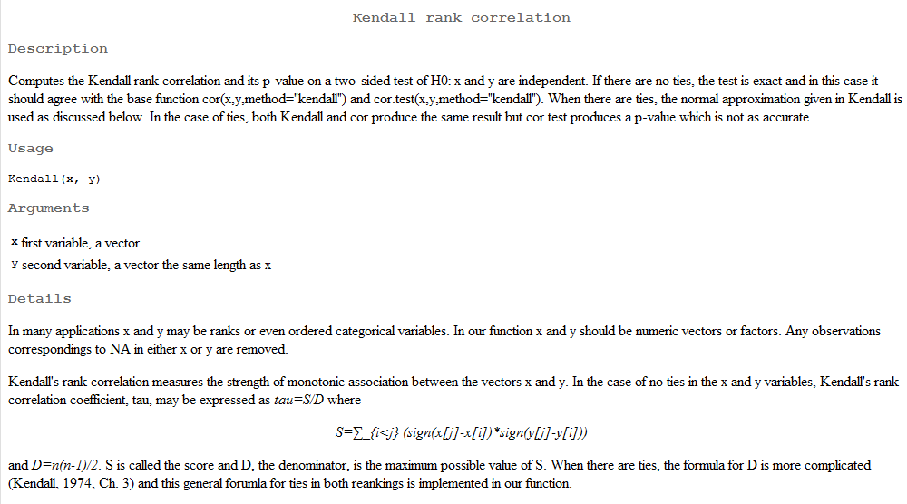
When everything is installed, “?Kendall” will yield this help file….

Slide 32
