Slide 1
Quick, superficial introduction to Support Vector Machines
A “real data” example
SVM light – An out of the box supervised classification algorithm
ROC curves

Slide 2

Yet another (very good) free text book…
http://www-bcf.usc.edu/~gareth/ISL/ISLR%20First%20Printing.pdf

Slide 3
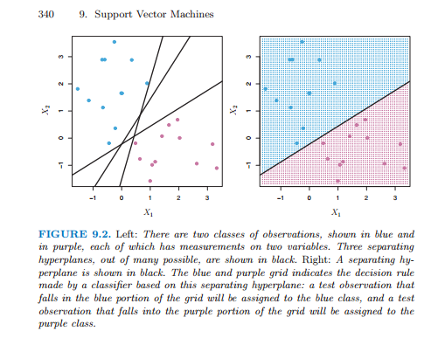
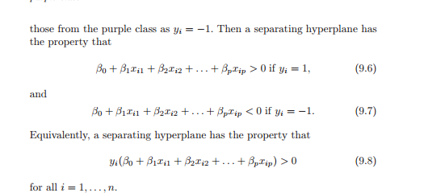
Support vector machines (Chapter 9 of this last text book!)
As before, we seek models to discriminate different cases…
There are an infinite number of lines you can draw that can separate the blue and purple dots
Our linear model is here defined in the usual way

Slide 4
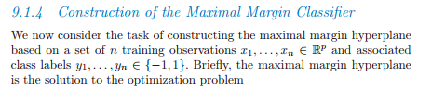
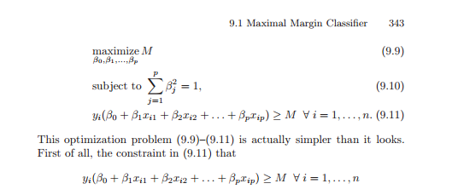
We seek the hyperplane that is the maximal distance from any of the classification points
We define a variant of our linear model
An interesting feature of this model is that the position of the hyperplane is
dependent only on the dots at the edge of the margin (as long as all of
the other dots are on the correct side).
The dots on the margin form a “support vector” for the classification

Slide 5
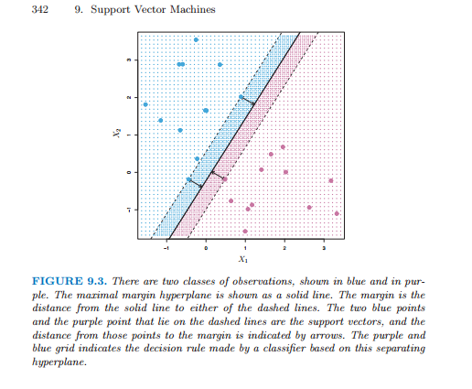
Support vector classifiers depend only on the data points that in the margin…

Slide 6
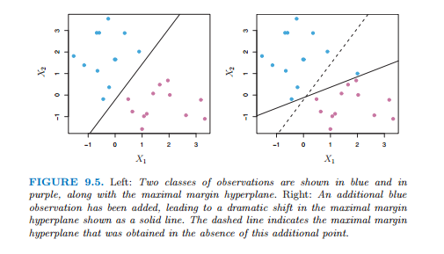
But requiring perfect separation give us a high variance model..

Slide 7
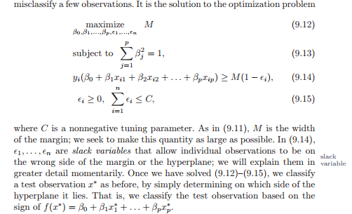
We would like to allow some error…
So we add some “slack” terms to our model.. And a tuning parameter “C” to
control how much error we can tolerate..

Slide 8
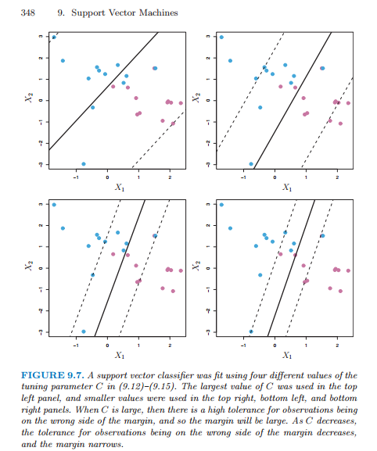
We change how much error we can tolerate with C…

Slide 9
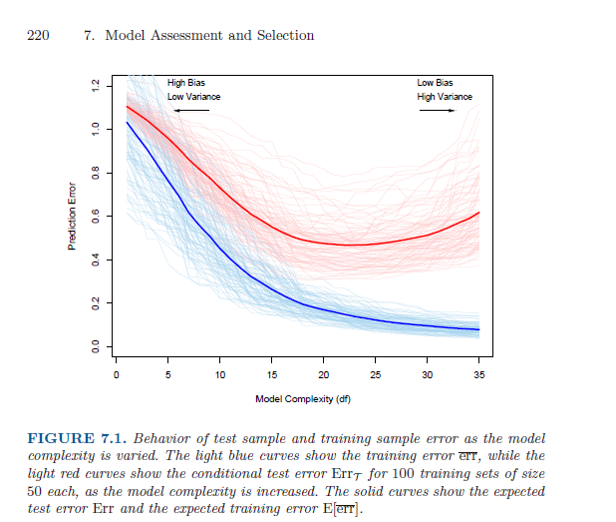
When C is high;
We take less information from outliers.
Equivalent to large number of nearest neighbors/low d.f.
When C is low…
We pay more attention to outliers
Equivalent to small # of nearest neighbors
High d.f.

Slide 10
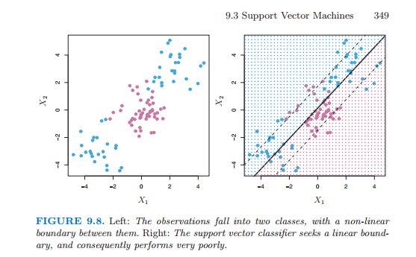
Skipping over much mathematical details…
Our boundary does not have to be linear…

Slide 11
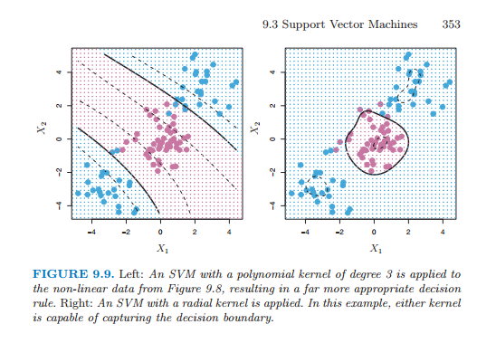
Here a non-linear “kernel” better captures the data…

Slide 12
Quick, superficial introduction to Support Vector Machines
A “real data” example
SVM light – An out of the box supervised classification algorithm
ROC curves

Slide 13


Is there a microbial signature associated with the development of
colorectal adenomas?
Mucosal biopsies from 33 “case” and 38 “control” patients
Tissue collected from same area in case and control
454 sequencing targeting the conserved 16S rRNA gene
~1,200,000 sequences of ~400 basepairs each
Group the sequences into 742 clusters (that are 97% identical)
Temitope Keku
Nina Sanapareddy
http://www.nature.com/ismej/journal/v6/n10/full/ismej201243a.html
Nina Sanapareddy, Ryan M Legge, Biljana Jovov, Amber McCoy, Lauren Burcal, Felix Araujo-Perez, Thomas A Randall, Joseph Galanko, Andrew Benson, Robert S Sandler, John F Rawls, Zaid Abdo, Anthony A Fodor Temitope O Keku. ISME J. 2012

Slide 14
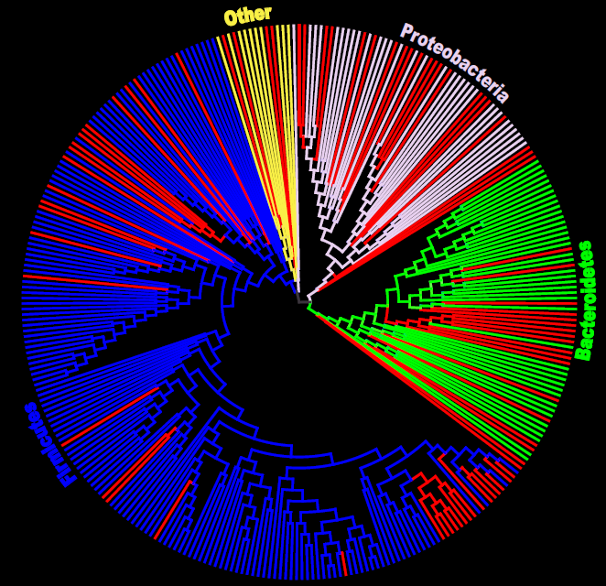
A large number of taxa are associated with colorectal adenomas
87 taxa more abundant in case
5 taxa more abundant in control

Slide 15
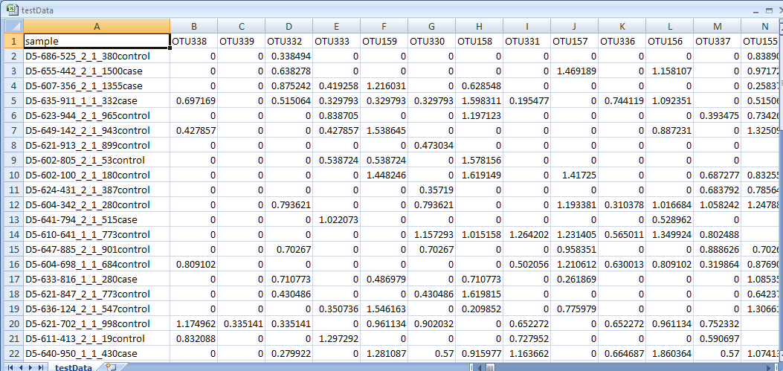
Start with this dataset…
http://bigscience.uncc.edu/fodorjournalclub2013/testData.gz/view

Slide 16
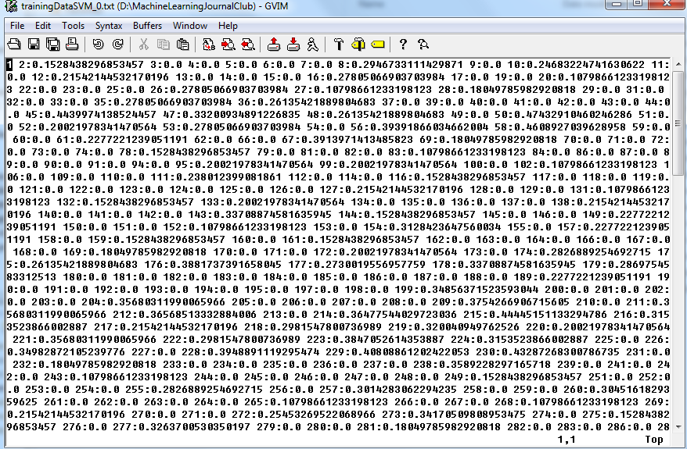
Change it to this (for input into SVM..)
Code to make this file is here..
https://github.com/afodor/metagenomicsTools/blob/master/src/machineLearningExamples/OtuWrapperToSVMLight.java

Slide 17
Quick, superficial introduction to Support Vector Machines
A “real data” example
SVM light – An out of the box supervised classification algorithm
ROC curves

Slide 18
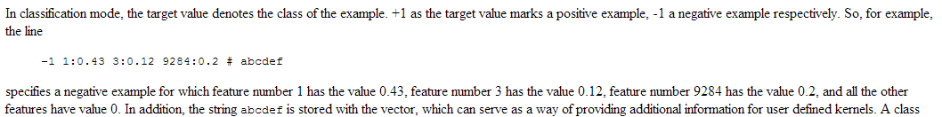
We format the input data using either 1/-1 to indicate case/control

Slide 19
I perform “leave one out classification”
For each sample:
Build the SVM on all data except that sample (using svm_learn)
classify the sample on the resulting model (using svm_classify)
This runs in less than 1 minute on my laptop (71 distinct classifications)
Code is here if you want to try it…
https://github.com/afodor/metagenomicsTools/blob/master/src/machineLearningExamples/OtuWrapperToSVMLight.java

Slide 20
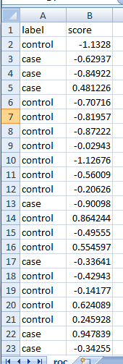
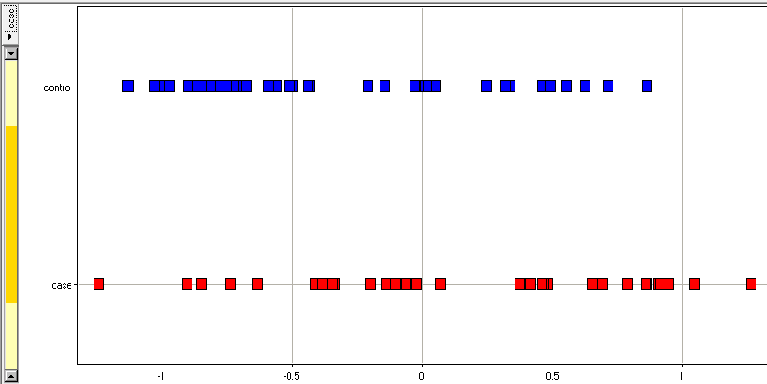
The output data looks like this…
How do we evaluate this performance?

Slide 21
Quick, superficial introduction to Support Vector Machines
A “real data” example
SVM light – An out of the box supervised classification algorithm
ROC curves

Slide 22
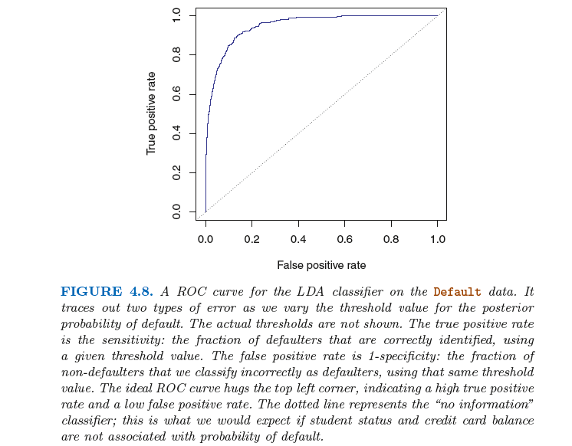

Slide 23
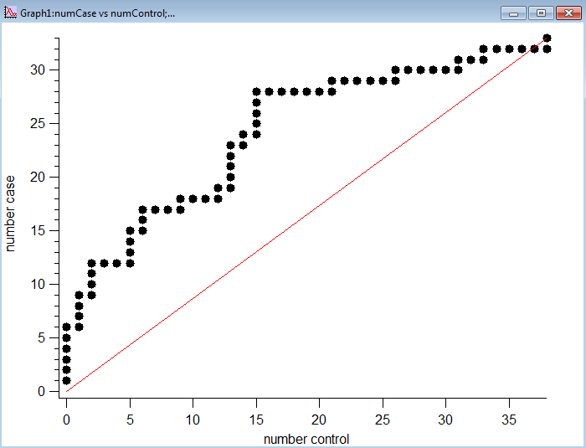
Our classification shows modest, but real, ability to classify
https://github.com/afodor/metagenomicsTools/blob/master/src/machineLearningExamples/ROC_Curve.java

Slide 24
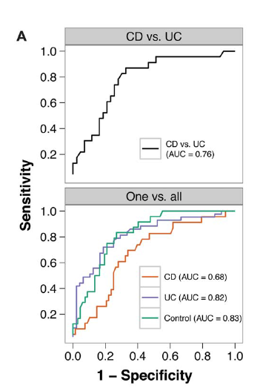

Other meta-genomic association studies have similar characteristics….

Slide 25
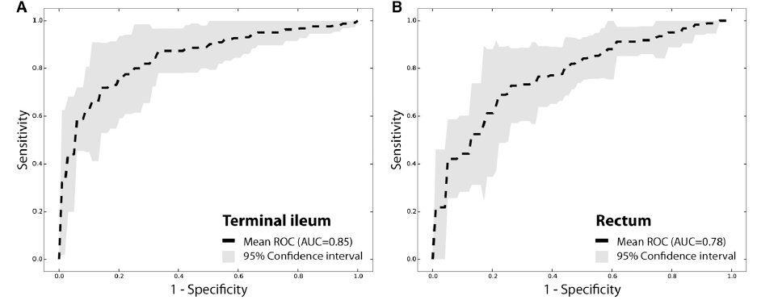
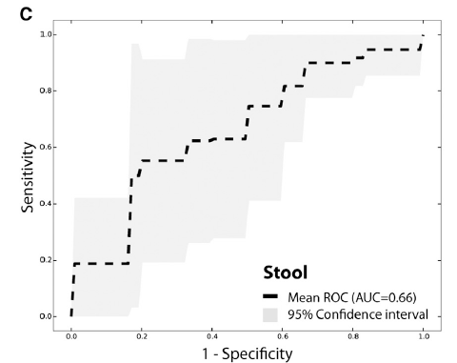

…although where you sample is undoubtedly of great importance

