Slide 1
Probability, normalized frequency and Shannon Diversity
Richness and evenness

Slide 2
A probability is a number between 0 and 1.
In bioinformatics, we have many sequence datasets, and yet many of the
language and theory of probability is applied to sequence analysis?
How is this done?

Slide 3
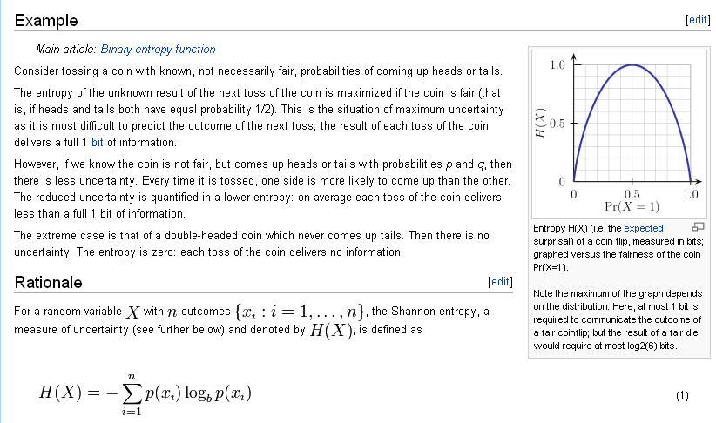
Consider information entropy:
http://en.wikipedia.org/wiki/Entropy_(information_theory)

Slide 4
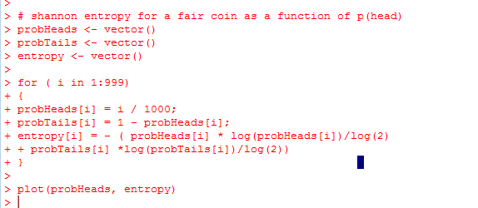
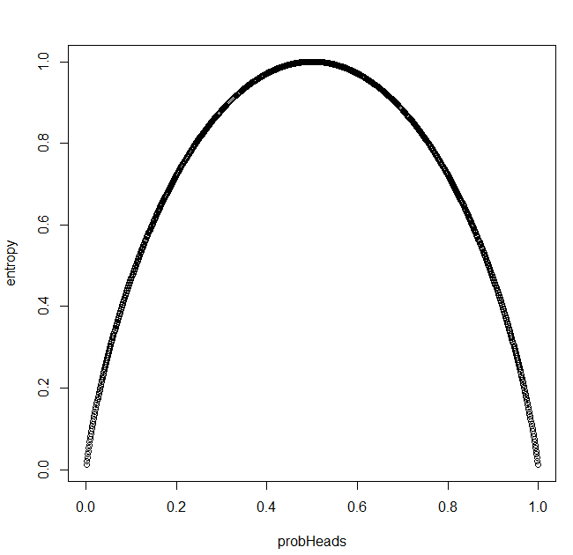

Let’s reproduce that Wiki figure in R…
Notice I’ve avoided the zeros in my code.
We define p(0) * log(0) as being 0 in
entropy calculations
(otherwise we end up with 0 * -∞ )
How many yes/no questions do you have
to answer to know what a fair coin does?
Answer: 1
Observing such a coin adds one “bit” of information
How many yes/no questions do you have to
Answer to know what a coin that always
comes up head or tails does?
Answer: 0
Observing such a coin adds no information
https://github.com/afodor/metagenomicsTools/blob/master/src/classExamples/shannonDiversity

Slide 5
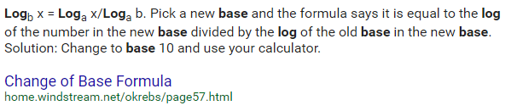
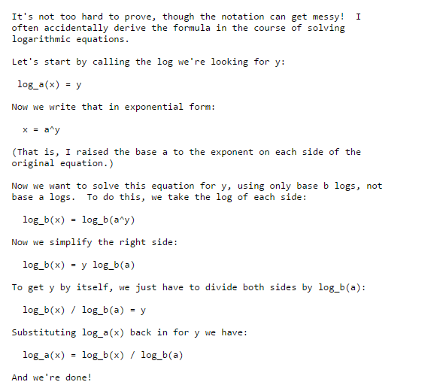
log(x)/log(2)
Gives us log base 2 of x
http://mathforum.org/library/drmath/view/70648.html

Slide 6
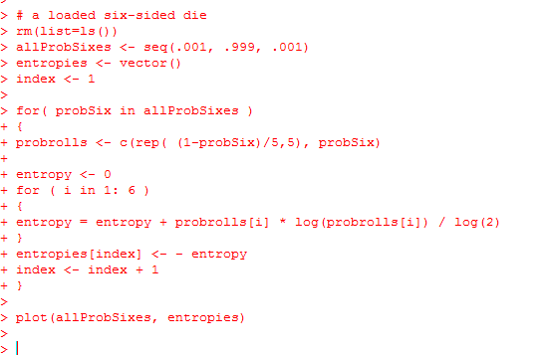
Let’s consider the loaded die from the dishonest casino
The p(6) varies from 0 to 1.
The p(1) = (1 – p(six) ) / 5
p(2) = (1 – p(six) ) / 5
p(3) = (1 – p(six) ) / 5
p(4) = (1 – p(six) ) / 5
p(5) = (1 – p(six) ) / 5
A fair dice: p(6) = 1/6
A die that always rolls a six: p(6) = 1
https://github.com/afodor/metagenomicsTools/blob/master/src/classExamples/shannonDiversity

Slide 7
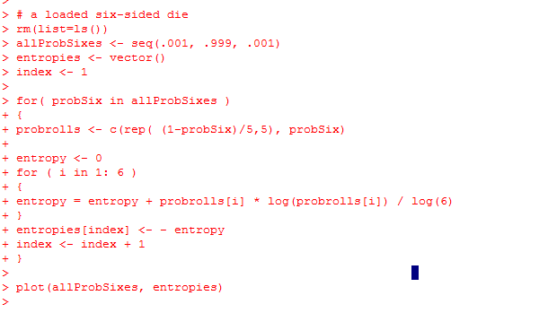
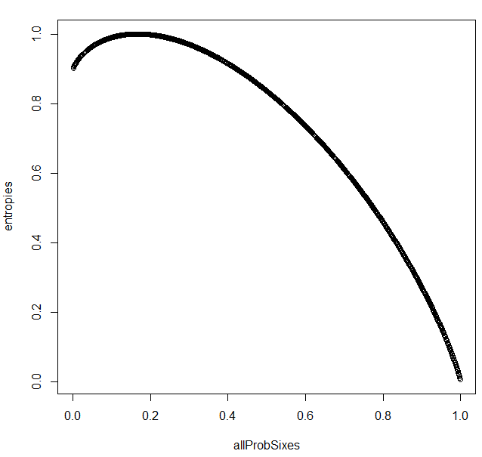
In base 6….
How many multiple choice question (where
there are six possible answers) do you have to
ask to know the outcome of a roll of a fair dice? 1
How many questions with a die that always rolls a six? 0
https://github.com/afodor/metagenomicsTools/blob/master/src/classExamples/shannonDiversity

Slide 8
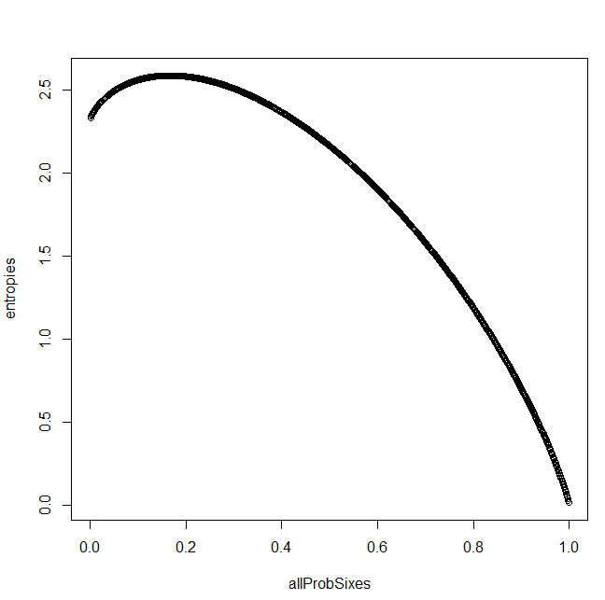
In base 2….
How many yes/no questions do you have to answer
to know the outcome of roll of a fair dice?
The answer is log₂(6) = 2.58
More intuitive for an 8-sided dice! log₂(8) = 3
As the die becomes less fair, the entropy is decreased.
We have the most information per roll when the
die is fair…

Slide 9
More intuitive for an 8-sided dice! log₂(8) = 3
The entropy for a fair 8-sided die is
- 8 * (1/8) * log₂(8) = 3
With three yes/no questions, you can always tell the outcome of the roll of a fair
8-sided die
What are the three questions?
I roll an eight-sided dice fair dice.
What are the three yes/no questions you can ask to know the outcome?
Here is (kind of) a hint:
What is the run-time for a binary search on an ordered list?
Note that 3 is the maximum entropy for an 8 sided dice.
No matter if the die is fair or not, you can always know what the result was
with 3 questions.
(Of course, if you know the die is loaded and always come up 6,
you don’t need any questions!)

Slide 10
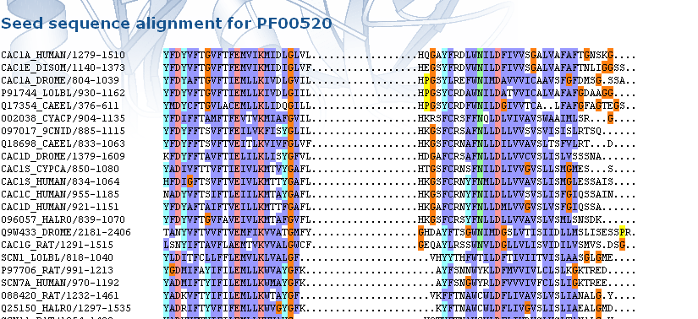
A central trick in bioinformatics….
For each column of a multiple sequence alignment……
Treat that column as the results of a 20 (for protein) or 4 ( for DNA) sided dice..
Here is the ion_trans alignment from PFAM:
For each column, make a 20 sided die…
With unknown parameters p(A), p(C), p(D)…. p(Y) such that
We will use the relative frequency of each residue in each column to estimate the p(…) for that residue for that column.
The corresponding set of vectors is sometimes called a “profile”

Slide 11
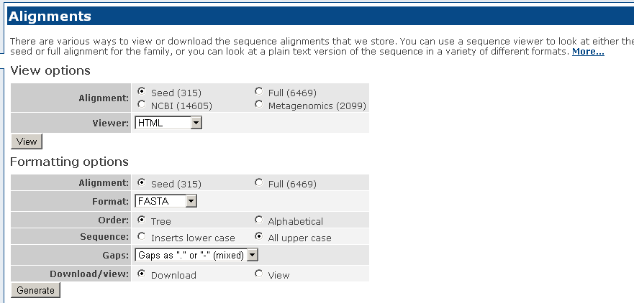
I can grab this file as FASTA from PFAM….
http://pfam.sanger.ac.uk/family/ion_trans#tabview=tab2

Slide 12
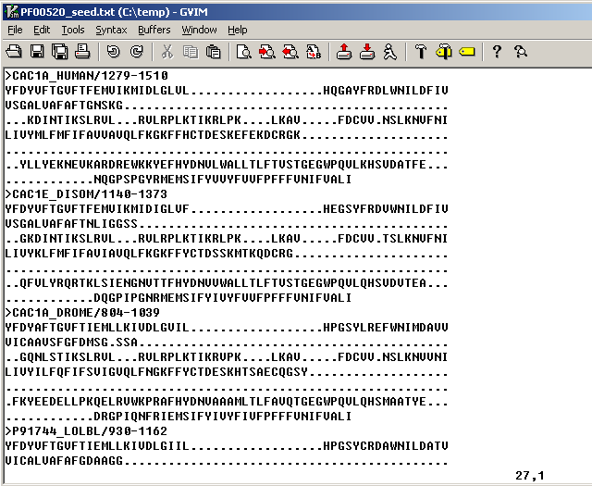
We can use sequence entropy to find the conserved columns in this alignment….

Slide 13
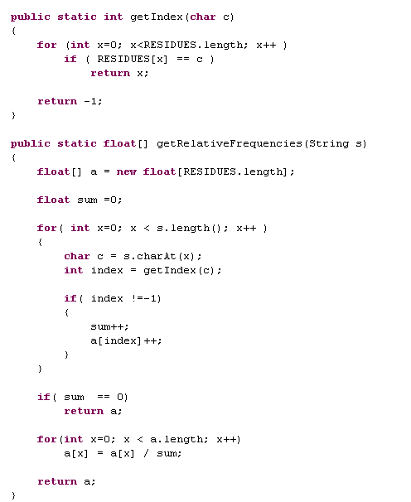
It is trivial to convert
frequencies to relative frequencies,
which we use to estimate our probabilities
parameters p(A), p(C), p(D)…. p(Y) such that

Slide 14
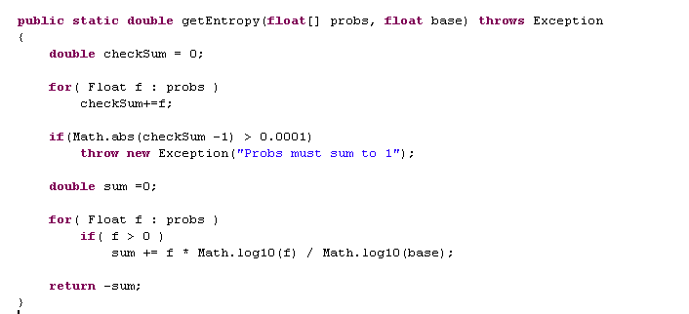
We already have this from our dice example….

Slide 15
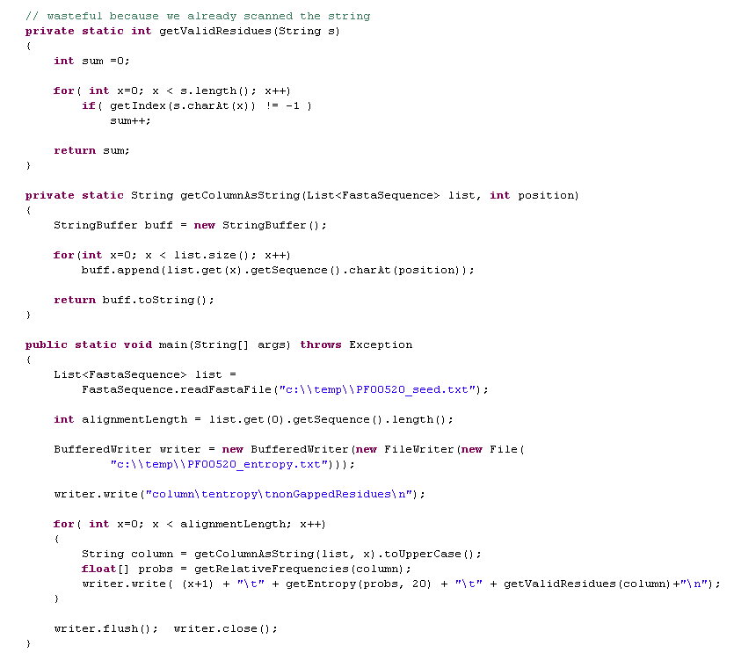
Trivial to get the entropies…
Why base 20??

Slide 16
Increasingly conserved
So these must be the really conserved, important residues in the
protein right?

Slide 17
Increasingly conserved
So these must be the really conserved, important residues in the
protein right?
Well, no. If the alignment is mostly gaps, it will seem conserved!

Slide 18
Increasingly conserved
A true probability (represented by a die or a coin) does not have a sample size
associated with it.
If I tell you a coin is fair, what I am telling you is p(heads)=0.5. It doesn’t matter how many
times it is flipped.
But probabilities derived from relative frequencies were derived from sample sizes.
Even though sample sizes are not in this equation
the effects are still there
This seems pretty obvious, but can cause real trouble!

Slide 19
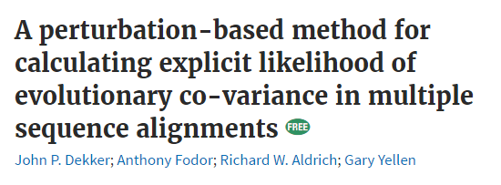
One of my first bioinformatics papers was about how not thinking about the
sample size correctly in probability estimates leads to spurious results…

Slide 20
So, of course, we have to put an additional parameter.
For example: require all columns to be at least 50% non-gapped
Increasingly conserved
Conserved residues
Conserved regions
Conserved residues: Over-represented in active sites of proteins.
Over-represented in databases of disease associated-SNPs
Very over-represented in the core of proteins.
So even this very simple application of information theory to bioinformatics has
some utility and some pitfalls that have to be dealt with

Slide 21
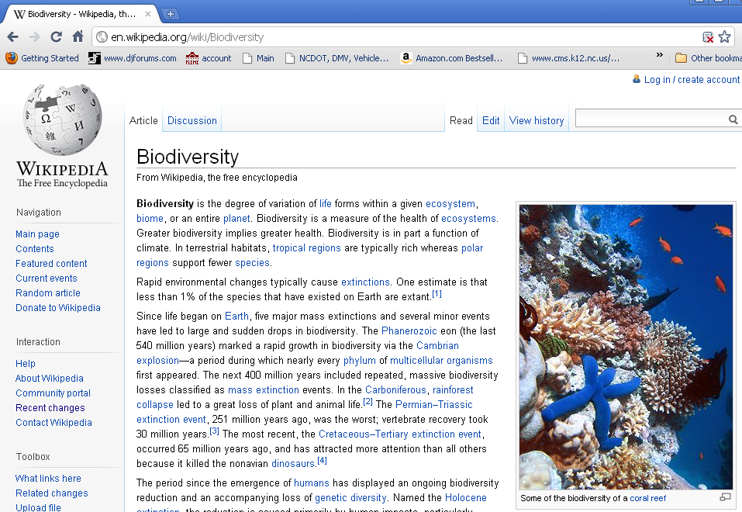
A completely different application of sequence entropy to genomics.
Diversity more in the sense of biodiversity….

Slide 22
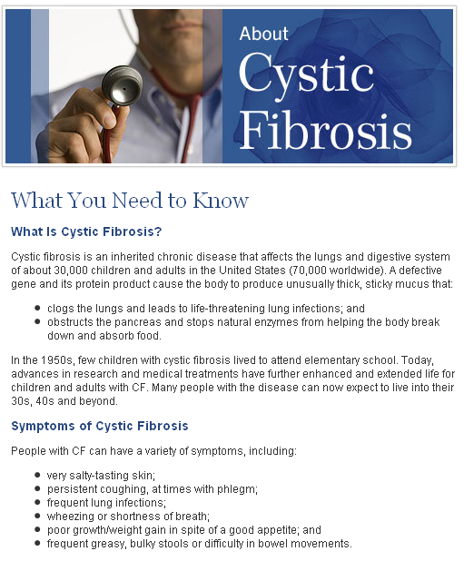
http://www.cff.org/AboutCF/

Slide 23
We’ve seen the CF studies from earlier in the semester:
Sputum samples from CF patients
23 patients total.
23 patients “exacerbation” and “end of treatment”
Antibiotics used to treat exacerbations include ceftazidime,
tobramycin, minocycline, meropenem, colomycin, clindamycin
3 patients followed through a second “exacerbation” and “end of treatment” event
For 13 patients an additional “stable” timepoint

Slide 24
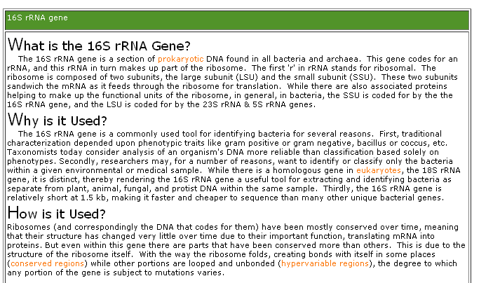
Sequencing the 16S rRNA gene

Slide 25
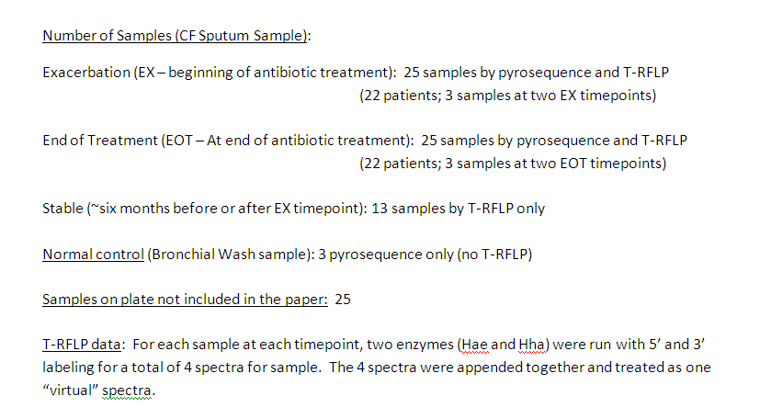
our CF patients…

Slide 26
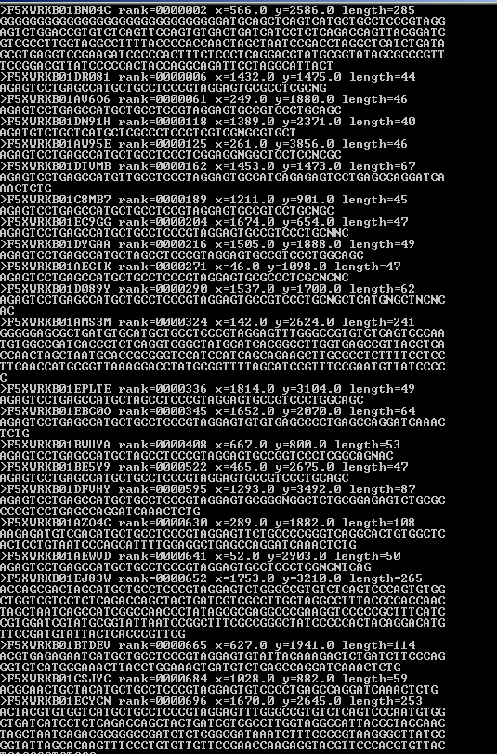
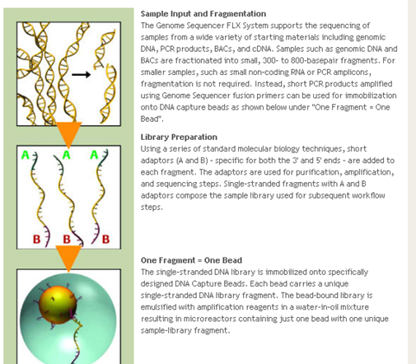

Slide 27
5’ primer –
454A sequence – barcode – 16S sequence
3’ primer –
16S sequence – 454B primer
DNA isolation
PCR using 16S rRNA primers (or whatever you are targeting)
(each sample has a different 5’ primer with a different barcode
but the same 454A and 16S sequence)
ePCR using 454A and 454B primers for sequencing
In analysis: read the barcode to know which sample you have

Slide 28
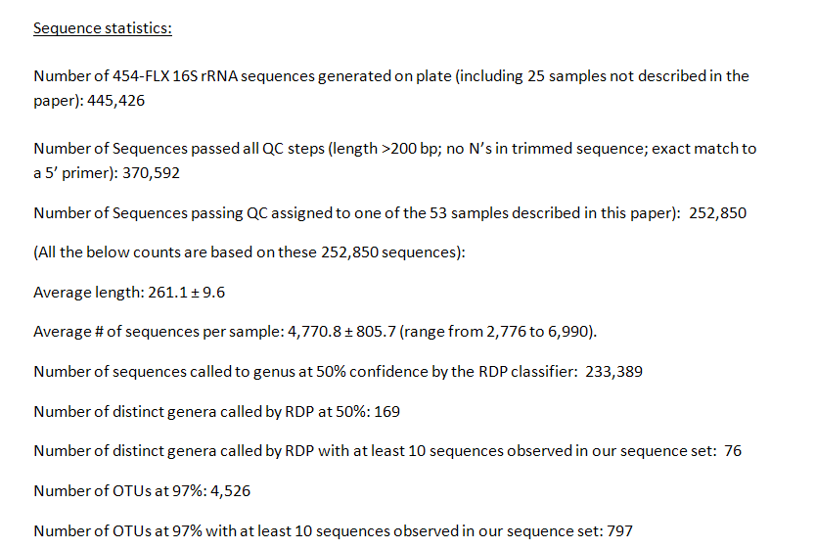

Slide 29
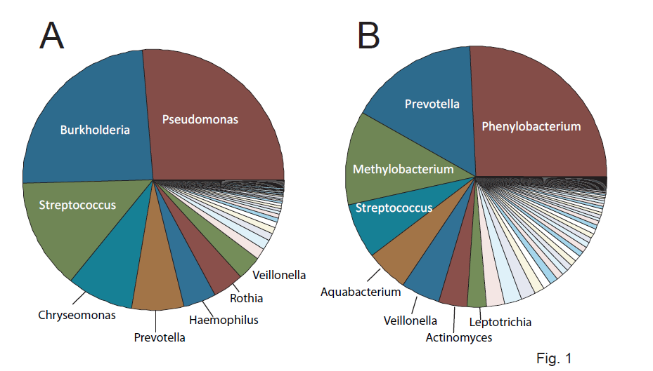
Pyrosequences assigned to each sample and then assigned to genus by the
RDP classification algorithm (which we’ve already encountered in labs…)
50 CF patients
3 normal controls

Slide 30
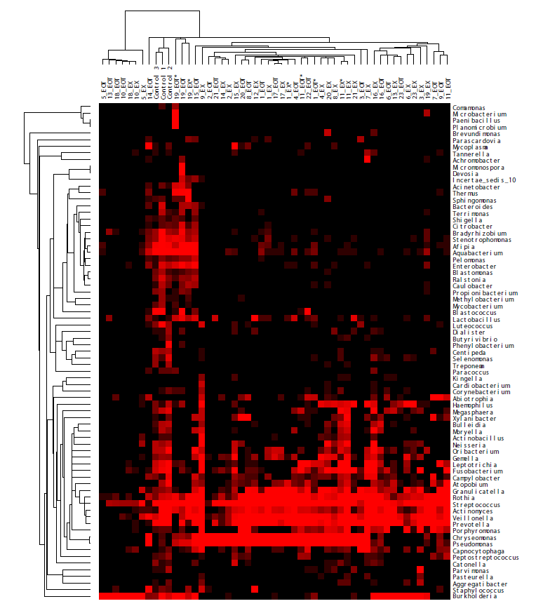
Pyrosequences assigned to each sample and then assigned to genus by the
RDP classification algorithm

Slide 31
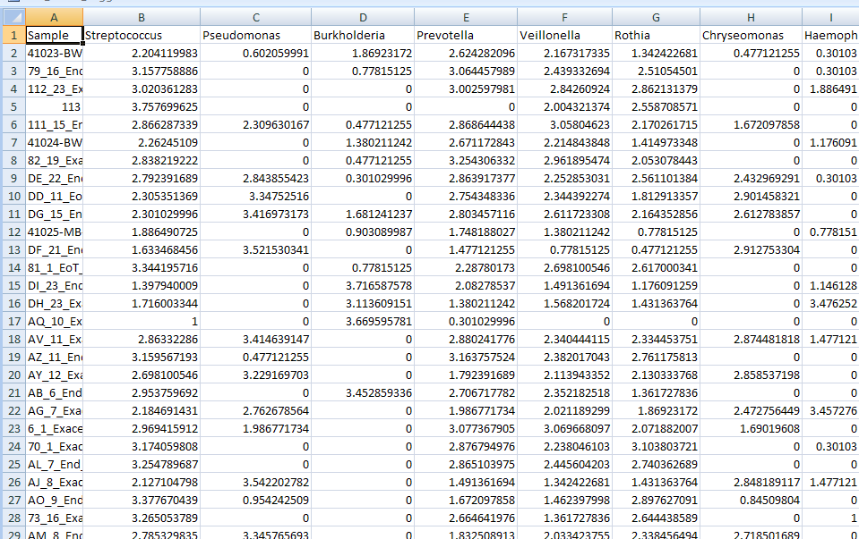
Pyrosequences assigned to each sample and then assigned to genus by the
RDP classification algorithm
169 total genra

Slide 32
We can use the same formula for diversity
For each sample, we estimate p(taxa) as
(# sequences seen in that taxa)/(total # of sequences assigned to a taxa)
We can then calculate Shannon diversity.

Slide 33
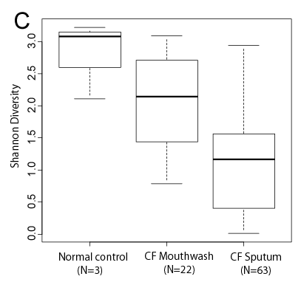
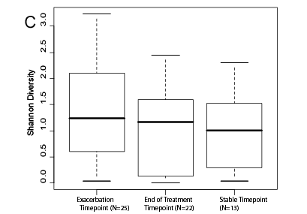
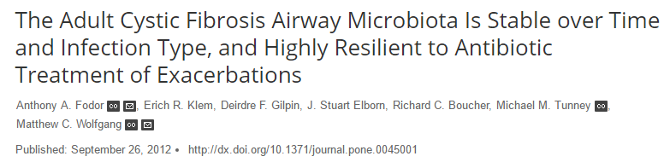
Biodiversity is the measure of the health of ecosystems…
People with CF have lower diversity…
Antibiotics seem like they are having no effect?

Slide 34
Probability, normalized frequency and Shannon Diversity
Richness and evenness

Slide 35
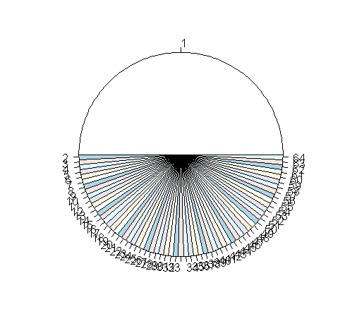
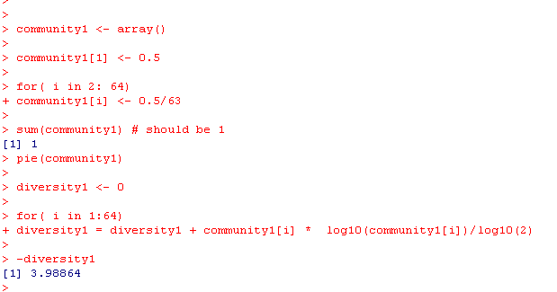
Consider two different ecosystems…
Community 1:
=-(0.5 *LOG10(0.5)/LOG10(2) + 63 * (0.5/63) *LOG10(0.5/63) /LOG10(2)) = 3.988
So 4 bits (yes/no questions) to figure out which bug you’ve got if you are
sampling from this community

Slide 36
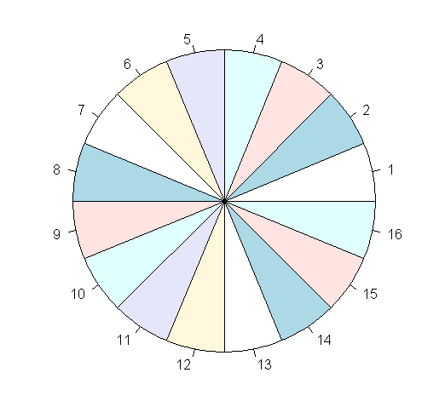
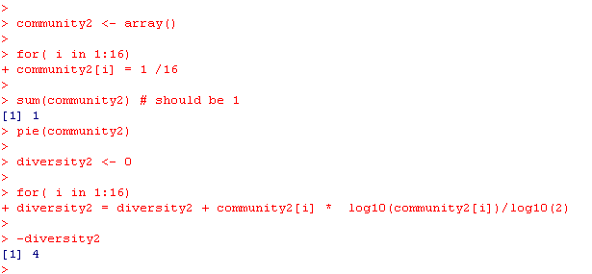
Community 2
=-16 * (1/16) *LOG10(1/16)/LOG10(2)

Slide 37
Diversity = 3.98 bits
Diversity =4 bits
Essentially the same diversity (# of yes/no questions needed to
tell the taxa from re-sampling)
But, intuitively, these are very different communities. What went wrong?
It’s not a question of sample size, as in the protein alignments,
since our simulations were based on probabilities not relative frequencies.

Slide 38
Diversity = 3.98 bits
Diversity =4 bits
The problem is that Shannon diversity isn’t really meant to directly
compare systems with such different alphabet sizes.
In community 1, there are 64 taxa.
In community 2, there are 16 taxa.
Community 1 is richer (more taxa) but less even.
Community 2 is less rich (fewer taxa) but more even.
Shannon diversity combines richness and evenness.

Slide 39
This is not a problem in protein alignments, because the richness is essentially
the same (20) for all columns.
So in this case, the Shannon diversity metric is only a measure of evenness,
which is what we want

Slide 40
Diversity = 3.98 bits
Diversity =4 bits
In bioinformatics, you must understand
the statistic you are using, how it works,
why you are using it and the nature of the
data set you are applying it to.
Failure to understand all of this usually leads to
incomplete (and sometimes incorrect analyses)

Slide 41
Let’s go back to this dataset….
What are the real differences between CF and normal?
Are antibiotics really having no effect?

Slide 42
We define two new metrics:
Shannon Evenness:
The highest possible entropy is with a perfectly even distribution
In which case we need log2(n) questions (or bits).
So if the community is perfectly even, E = 1.
If it is perfectly un-even (only one taxa observed), E=0.
Richness
the number of distinct taxa with (p>0).

Slide 43

Consider two different ecosystems…
Community 1:
=-(0.5 *LOG10(0.5)/LOG10(2) + 63 * (0.5/63) *LOG10(0.5/63) /LOG10(2)) = 3.988
So 4 bits (yes/no questions) to figure out which bug you’ve got if you are
sampling from this community
Evenness = -diversity1 / (log10(64)/log2(10) )
Richness = 64

Slide 44

Community 2
=-16 * (1/16) *LOG10(1/16)/LOG10(2)
Evenness = -diversity2 / (log10(16)/log2(2) ) = 1
Richness = 16

Slide 45
Diversity = 3.98 bits
Evenness = 0.663
Richness = 64
Diversity =4 bits
Evenness = 1
Richness = 16
In bioinformatics, you must understand
the statistic you are using, how it works,
why you are using it and the nature of the
data set you are applying it to.
Failure to understand all of this usually leads to
incomplete (and sometimes incorrect analyses)

Slide 46
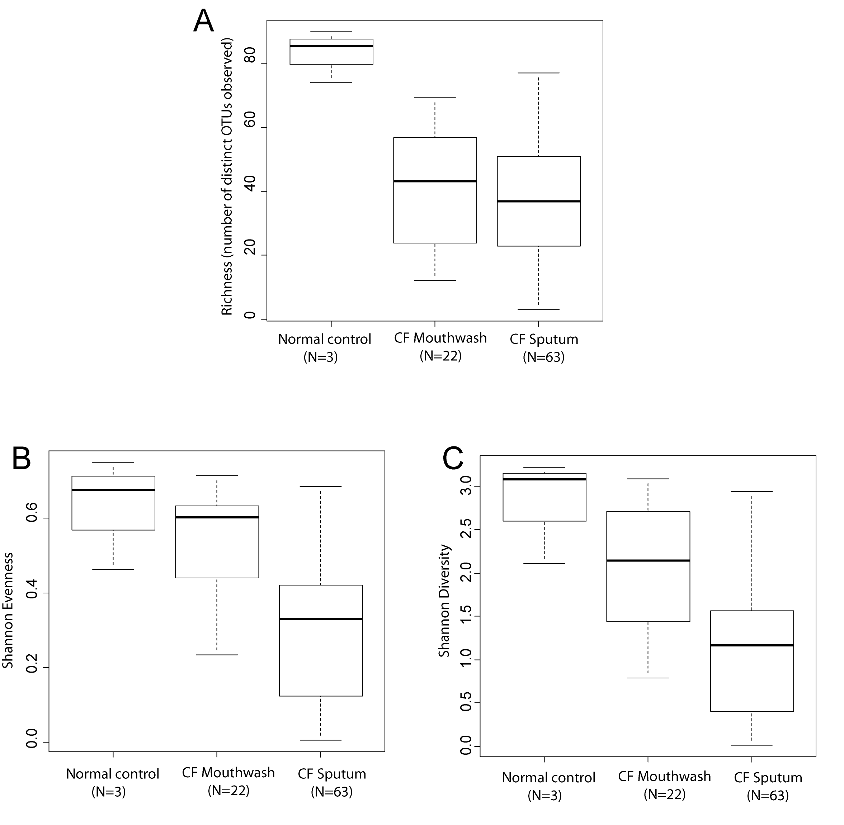
Mouthwash and sputum differ in evenness, but not richness.

Slide 47
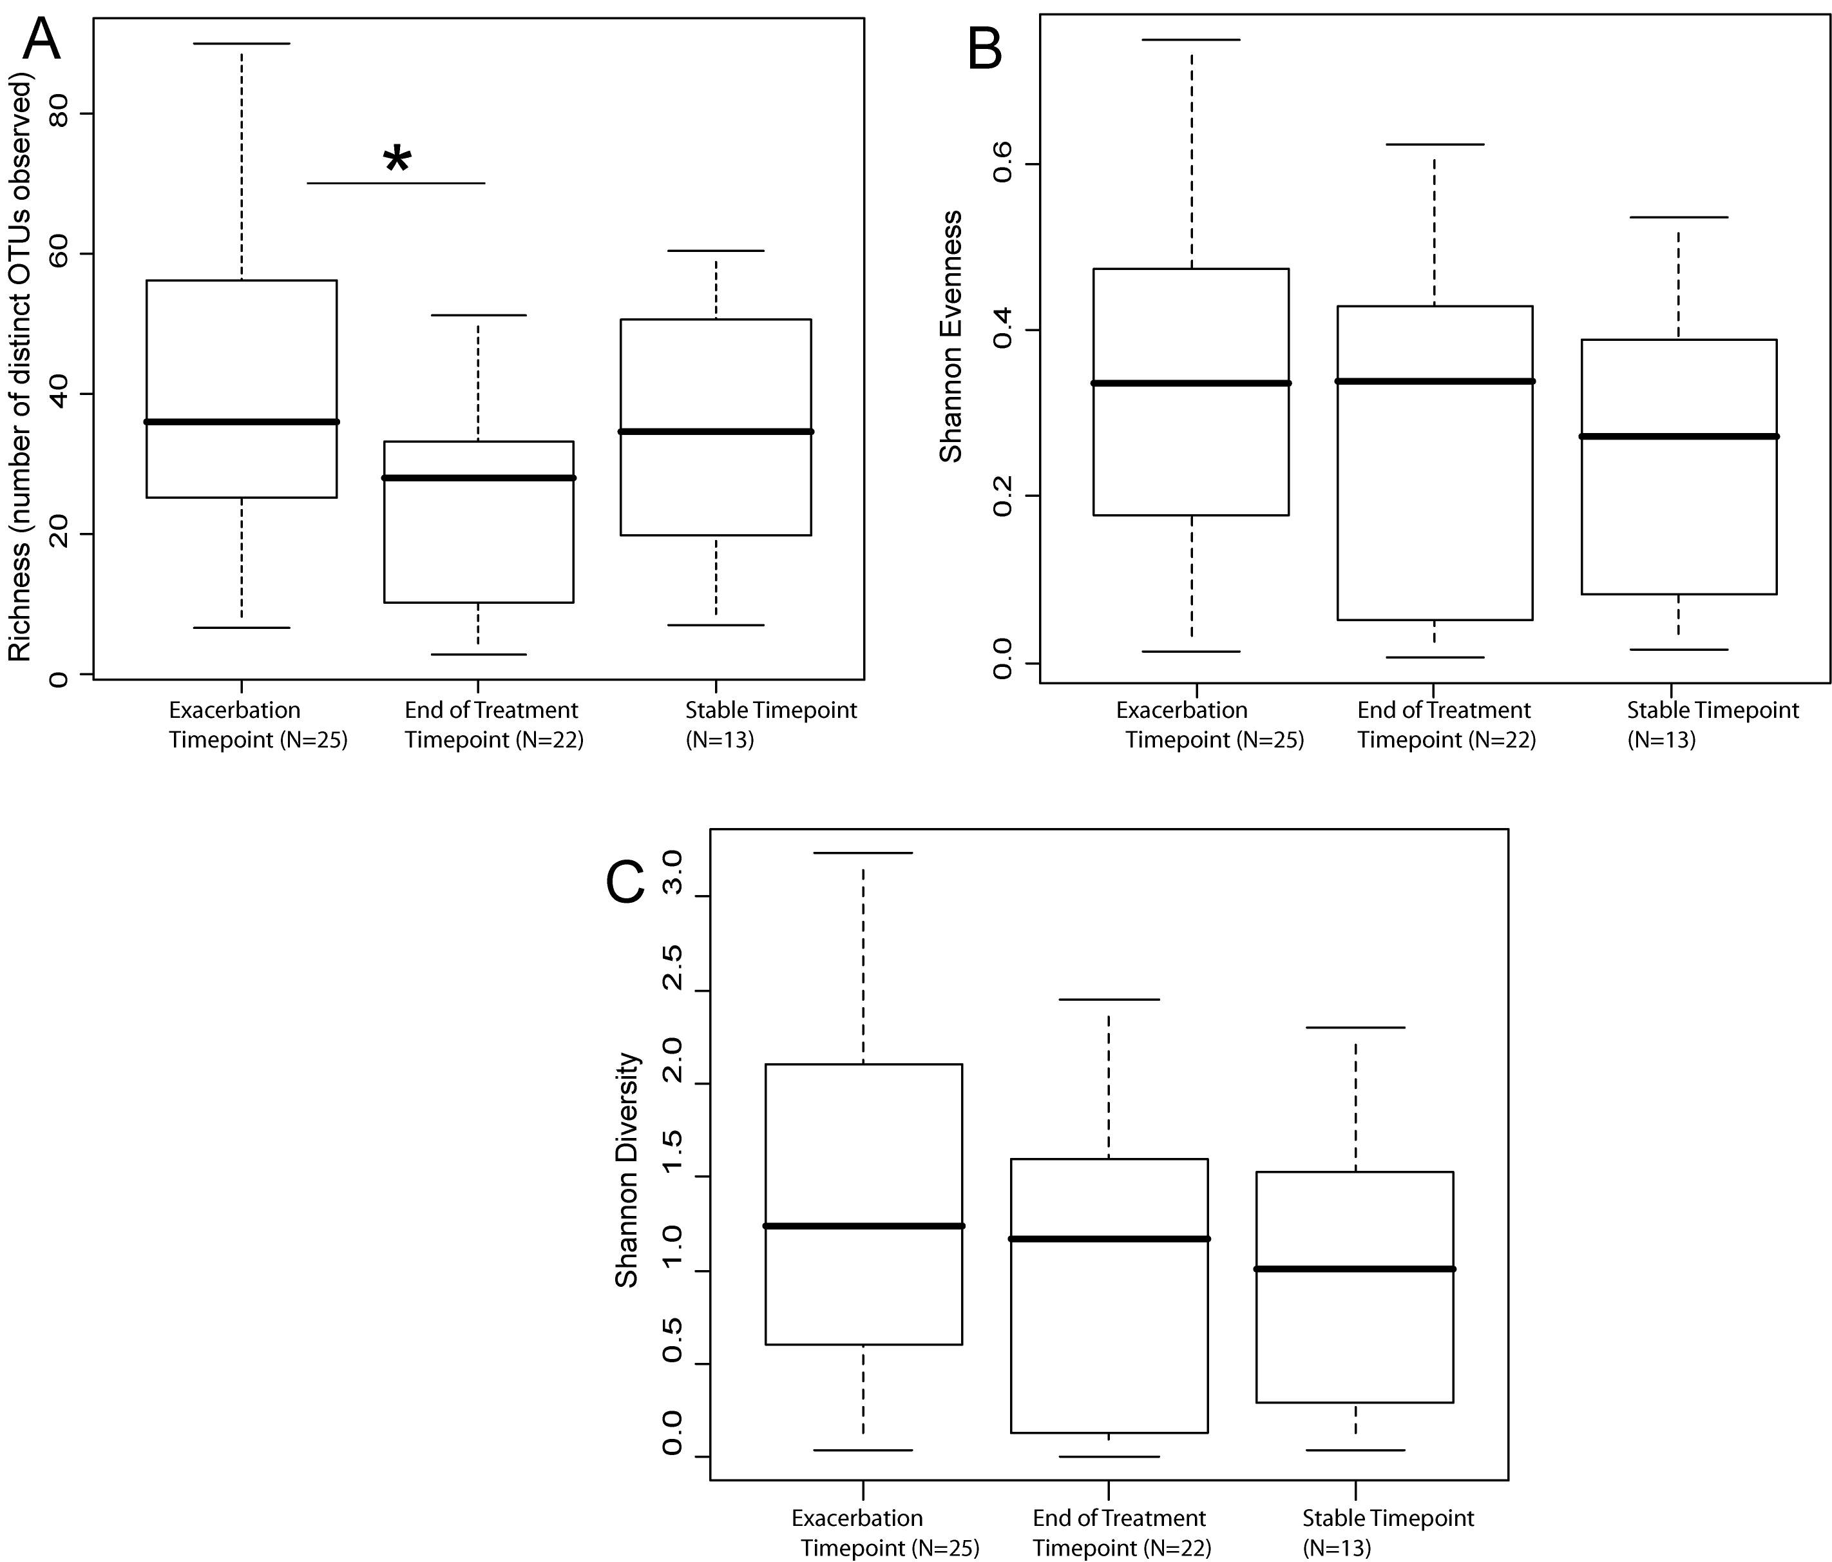
Antibiotics affect richness, but not evenness

Slide 48
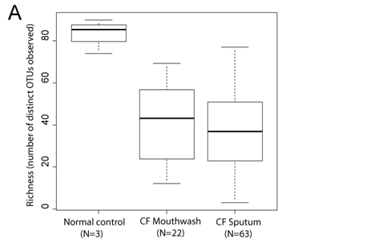
Richness a little more complicated than the Y-axis states…
There are different numbers of sequences in each sample.
Find the sample with the smallest number of sequences.
Re-sample only that number of sequences from each sample 1,000 times.
Take as richness the average. That’s what we reported in the paper…

Slide 49
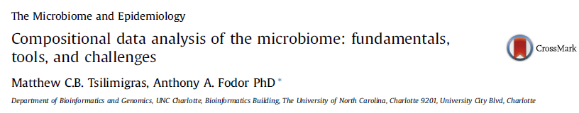
Coming up: Compositional data analysis…
For background a recent review paper…
http://afodor.github.io/classes/stats2017/compositionalData.pdf

