Slide 1
ROC curves in WEKA
Visually estimating variance via null permutations

Slide 2
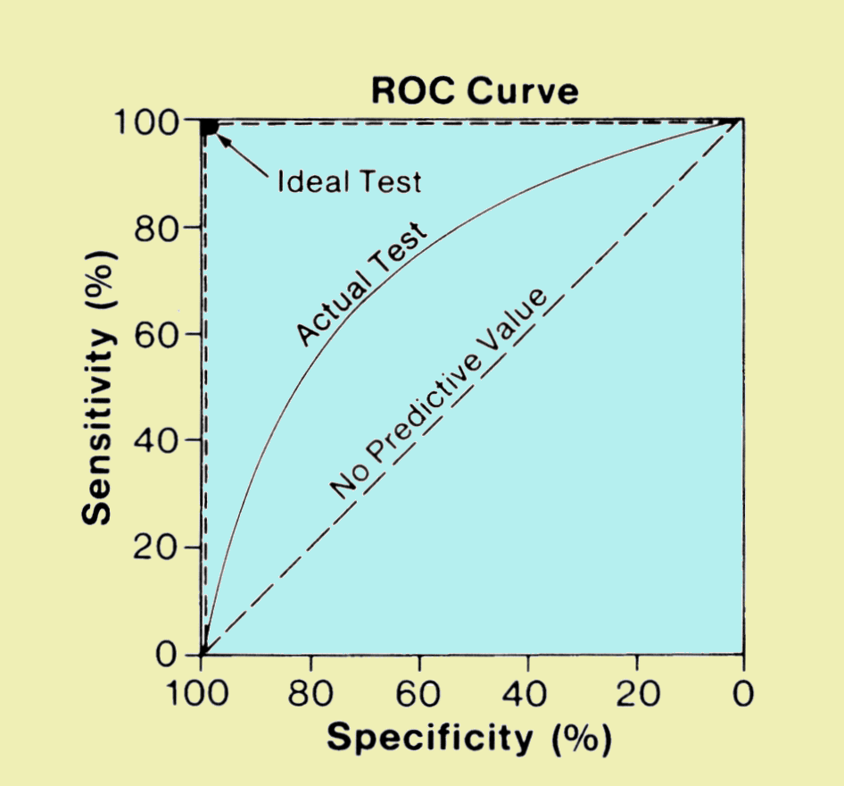
As we reviewed in lab, an ROC curve is a efficient visualization to observe classification performance
The “big data” approach to classification problems
Is a voter democratic or republican?
Voters with known affiliation
Training set
Test set
Find features
(income, zip code, gender)
that predict affiliation
Build statistical model
Make predictions on test set
Image: http://www.sprawls.org/ppmi2/IMGCHAR/1IMCHAR12.gif

Slide 3
The “big data” approach to classification problems
Is a sample case or control?
Whole-genome metagenome sequencing
on samples with known disease status
Training set
Test set
Find features
(taxa, genes)
that predict status
Build statistical model
Make predictions on test set
Image: http://www.sprawls.org/ppmi2/IMGCHAR/1IMCHAR12.gif

Slide 4
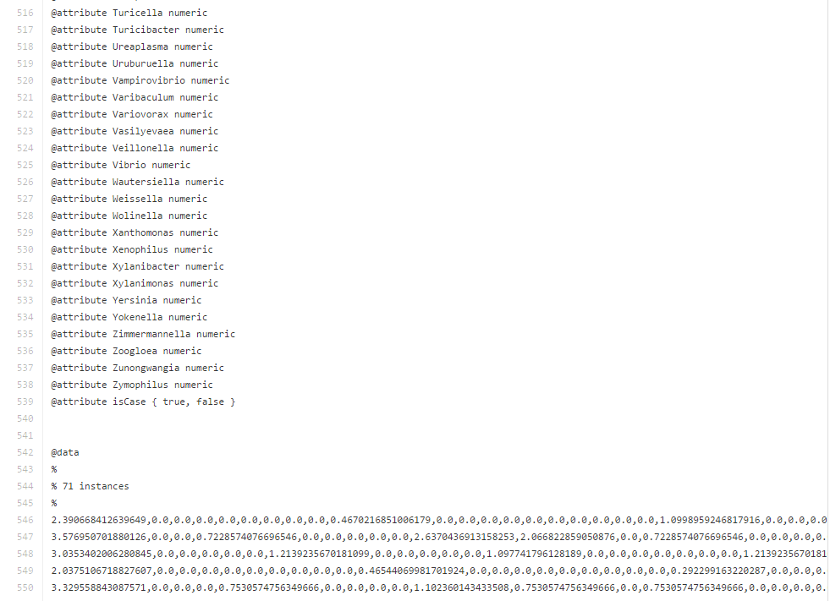
Our data file contains data from 71 patients…
https://github.com/afodor/afodor.github.io/blob/master/classes/prog2016/pivoted_genusLogNormalWithMetadata.arff
genra from PCR experiment
Patient did or did not have colorectal adenomas

Slide 5
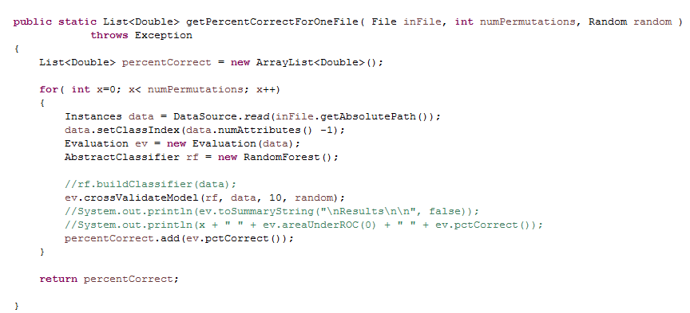
This code performs 10-fold cross validation…
https://github.com/afodor/WekaExamples/blob/master/src/examples/TestClassify.java
You will remember the 10 fold cross validation code…

Slide 6
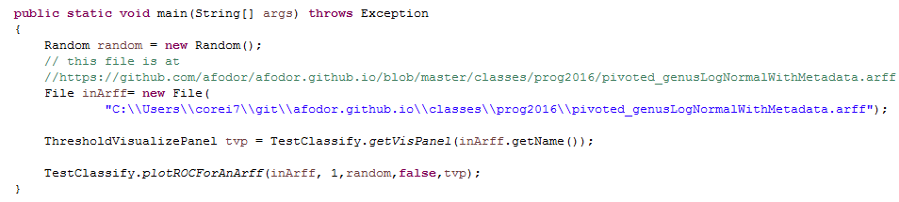
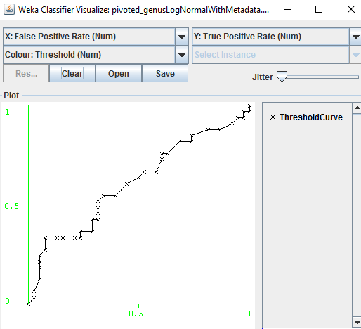
We can easily visualize the ROC code associated with this ten-fold cross validation
https://github.com/afodor/WekaExamples/blob/master/src/examples/RunOneROCCurve.java

