Slide 1
BlockingQueues
Semaphore
A bioinformatics example with semaphore
CountDownLatch
Callable, Future, FutureTask
Cancellation

Slide 2
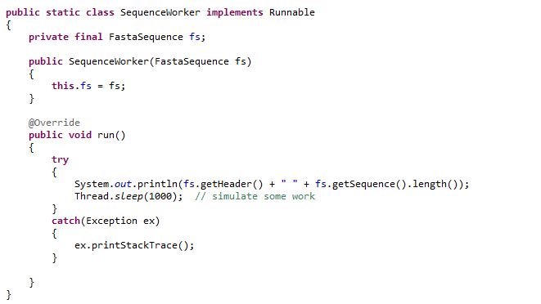
Say we have a Runnable that does some work on a FastaSequence
How do we control how many threads do work on our Fasta Sequences?

Slide 3
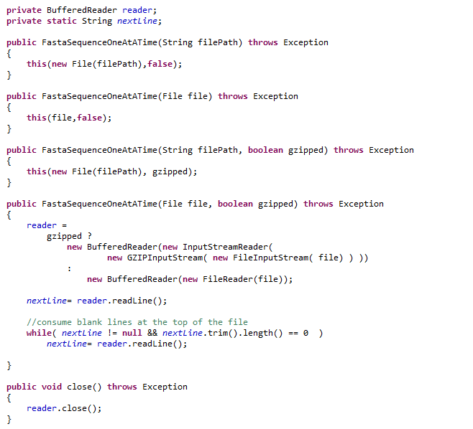
We make a class that can stream Fasta Sequences from the hard disk

Slide 4
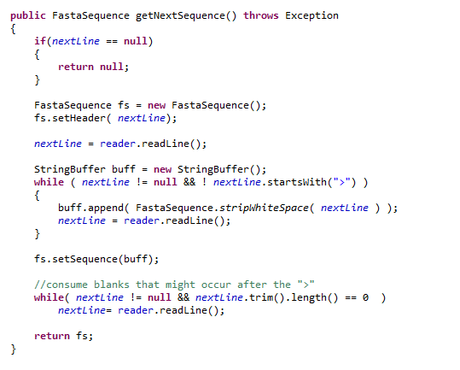
FastaSequenceOneAtATime (cont.)

Slide 5
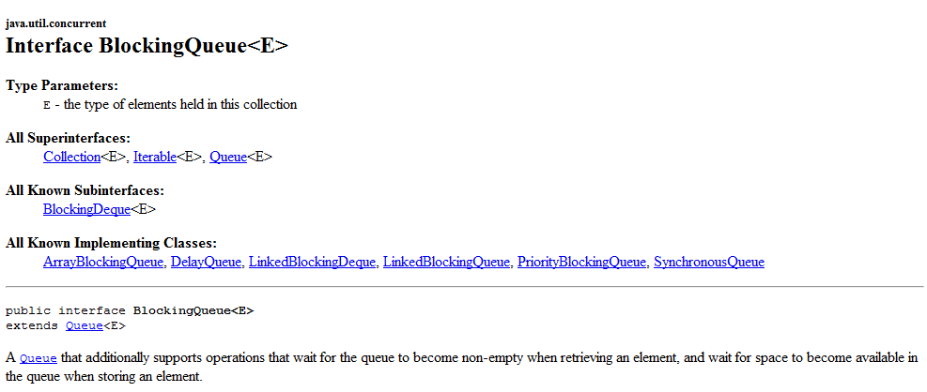
On option to control how the work is managed is the BlockingQueue

Slide 6
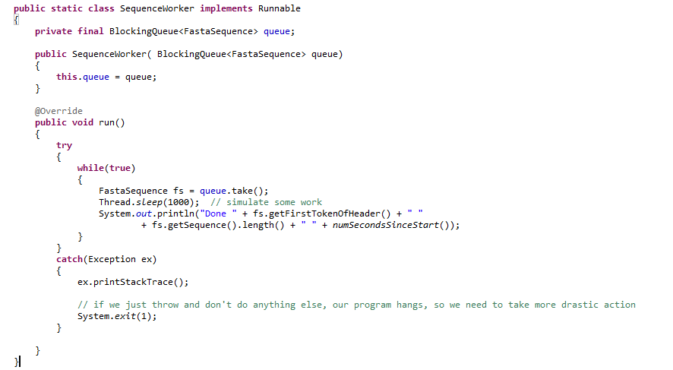
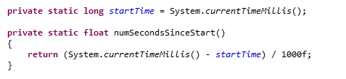
We modify our worker so that it takes a BlockingQueue instead of a FastaSequence

Slide 7
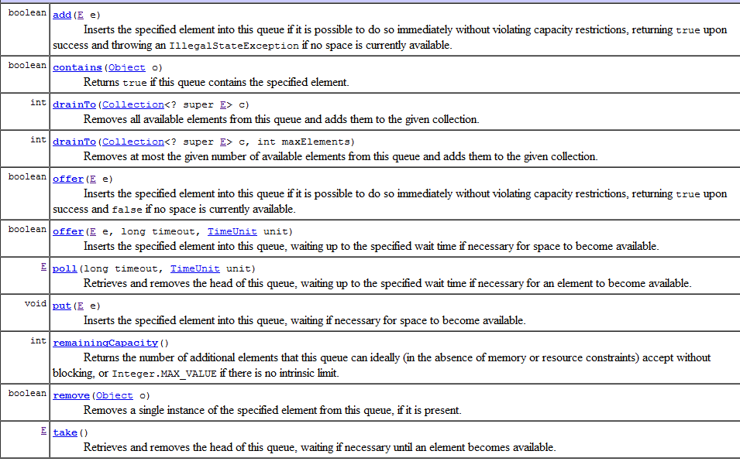

Slide 8
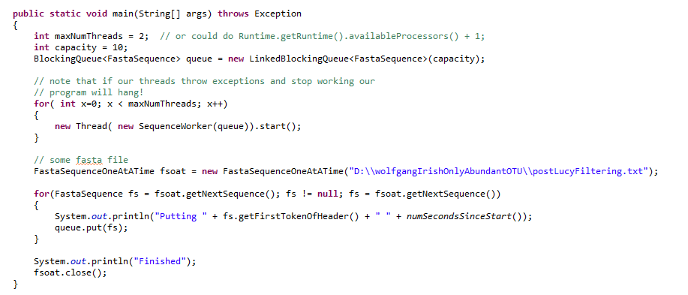
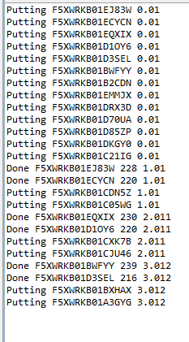
In our main method, we feed sequences one at a time into our BlockingQueue

Slide 10
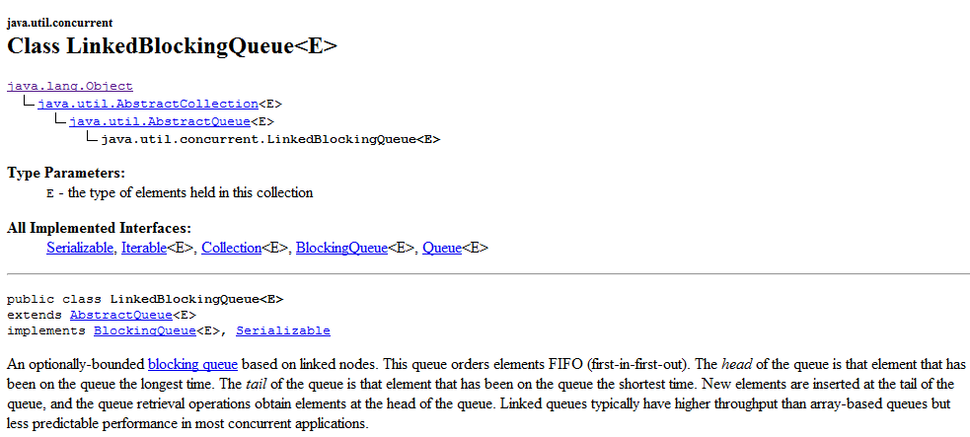
We have a number of implementations of BlockingQueue that I will let you read about
in Chapter 5
We can change how the work is done by just instantiating a different BlockingQueue

Slide 11
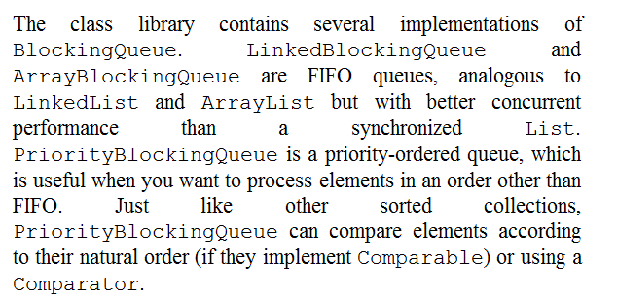
We can change how the work is done by just instantiating a different BlockingQueue

Slide 12
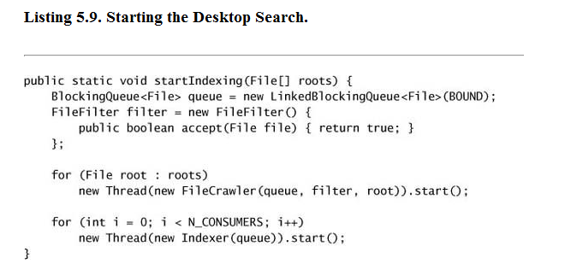
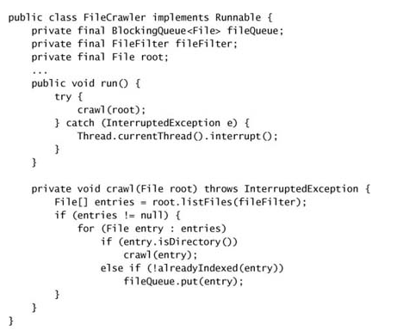
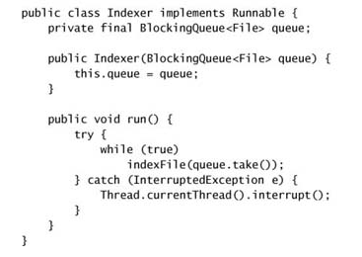
The textbook example, a search engine indexer…

Slide 13
BlockingQueues
Semaphore
A bioinformatics example with semaphore
CountDownLatch
Callable, Future, FutureTask
Cancellation

Slide 14
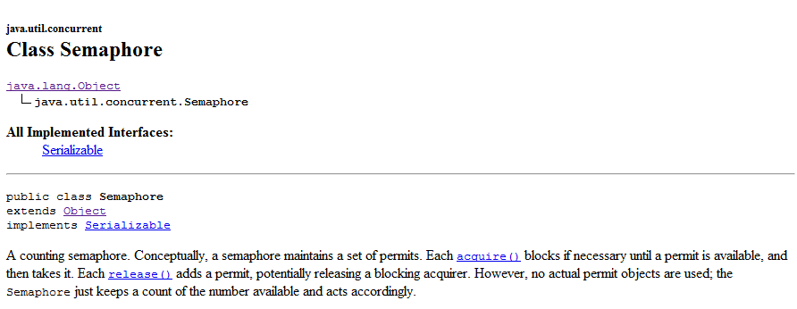

Slide 15
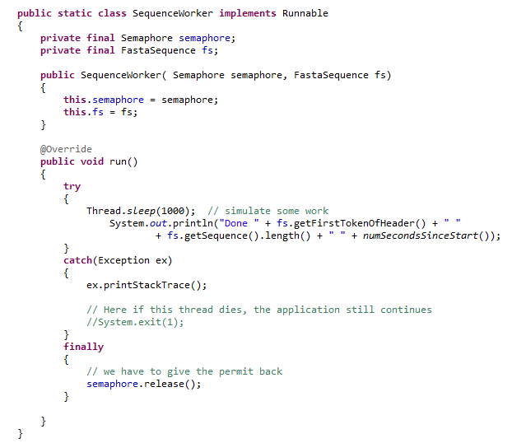
We modify our SequenceWorker to take a semaphore..

Slide 16
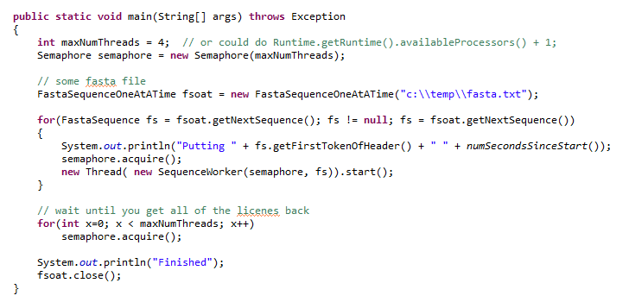
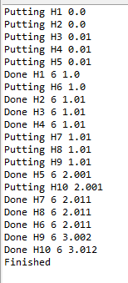
Our main method now spawns a set number of Threads at a time

Slide 17
BlockingQueues
Semaphore
A bioinformatics example with semaphore
CountDownLatch
Callable, Future, FutureTask
Cancellation

Slide 18
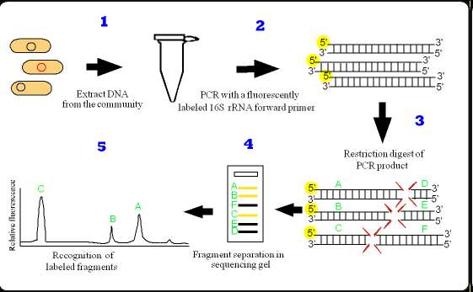
T-RFLP is a low cost “fingerprint” technique

Slide 19
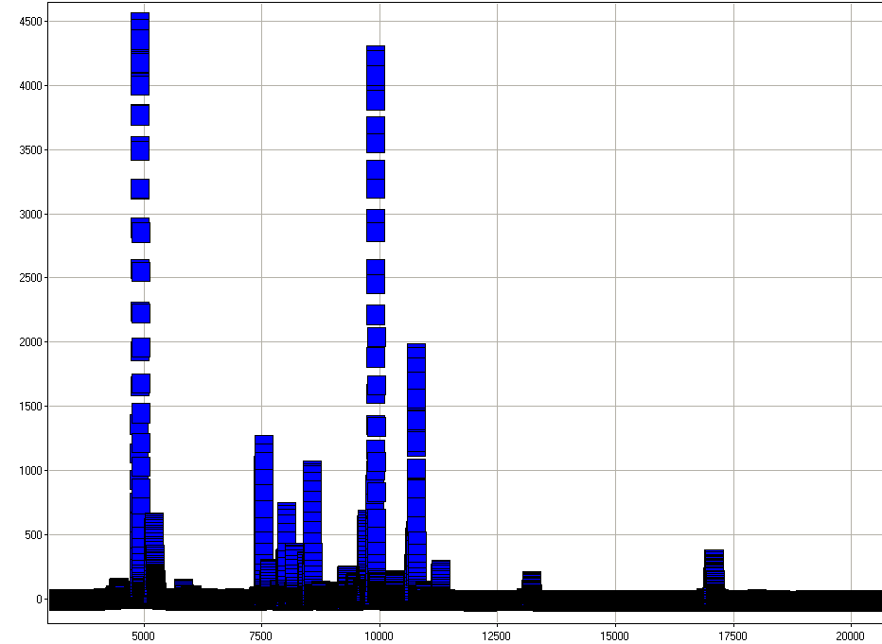
The data look like this…

Slide 20
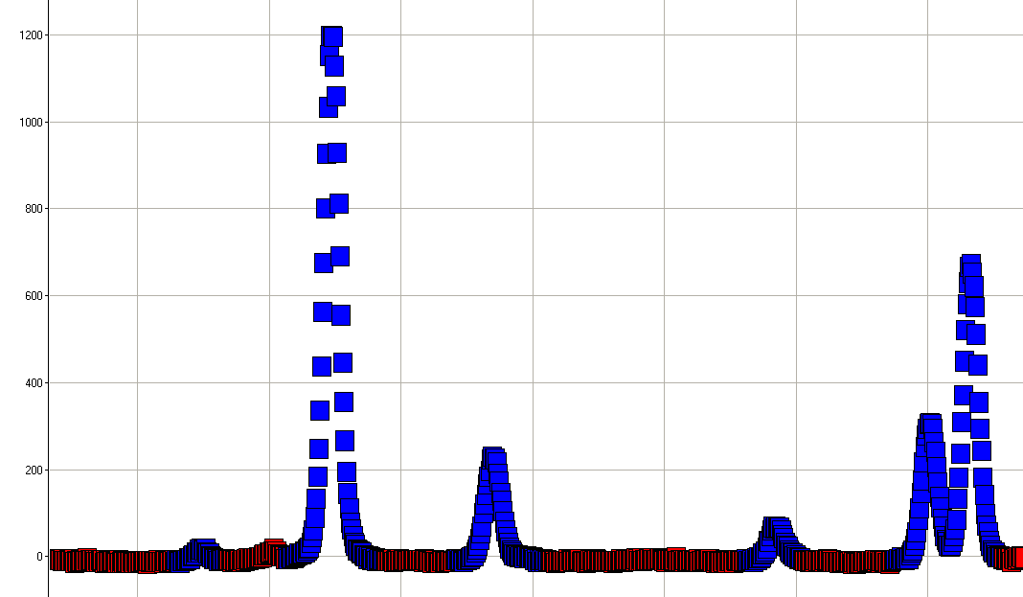
Or zoomed in it looks like this…
The coloring is done by a peak calling algorithm…

Slide 21
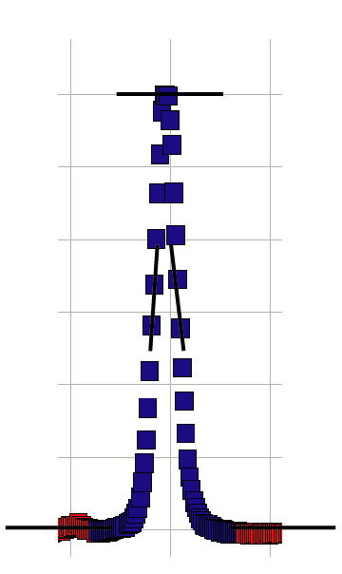
Probably more sophisticated ways to do this…
Take a moving window.
Fit a linear regression to all of the point in the window.
Look for a positive slope followed quickly by a negative slope

Slide 22
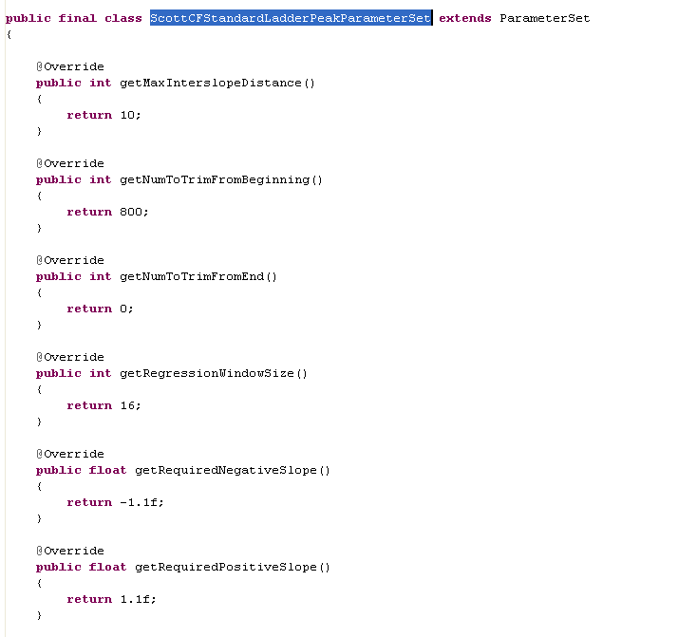
Parameters are controlled by instances of a “ParameterSet” interface.
Note that this is thread safe because it has no data!

Slide 23
I have a new CF dataset.
~12 patients. Before and after treatment.
~300 spectra with ~28,000 points each.
~8,000,000 regressions to run.
Analysis of each spectra is embarrassingly parallel.
Good candidate for multi-threaded speedup

Slide 24
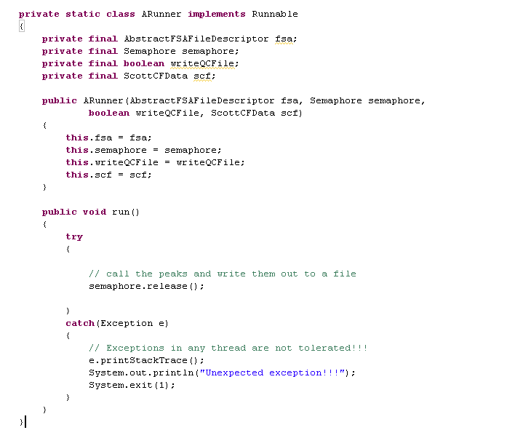
Make a worker class…
Not showing you the peak-
calling stuff here.
If you are interested let me know!
Normally this would
be in a final block
Obviously, an extreme method for error handling!
Normally, you would propagate the Exception up or
store it in a volatile Exception variable

Slide 25
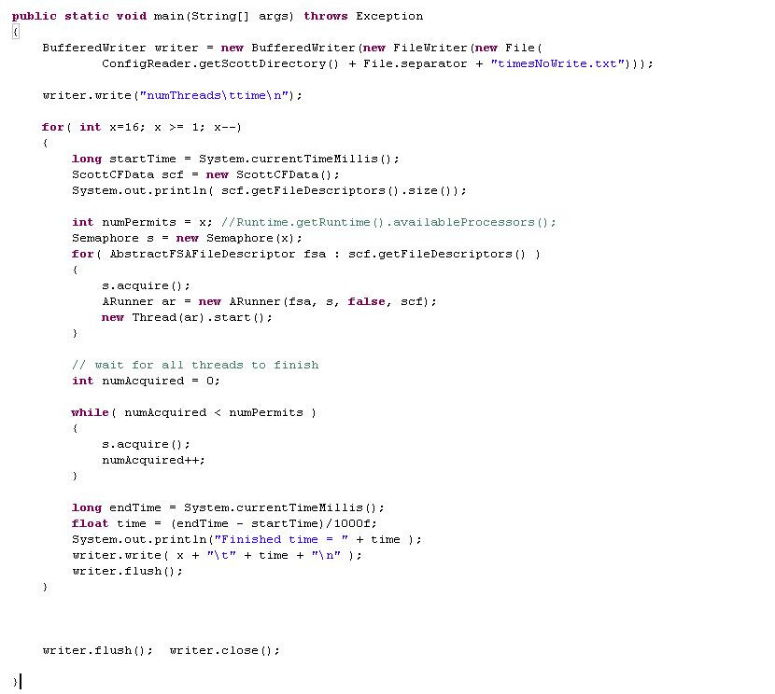
Semaphore makes this really easy to tune the work you have to do to the # of threads
in your system….
acquire a permit
This will iterate through all
the spectra (code not shown)
Semaphores provide a very simple way to make sure
that all the threads have finished!

Slide 26

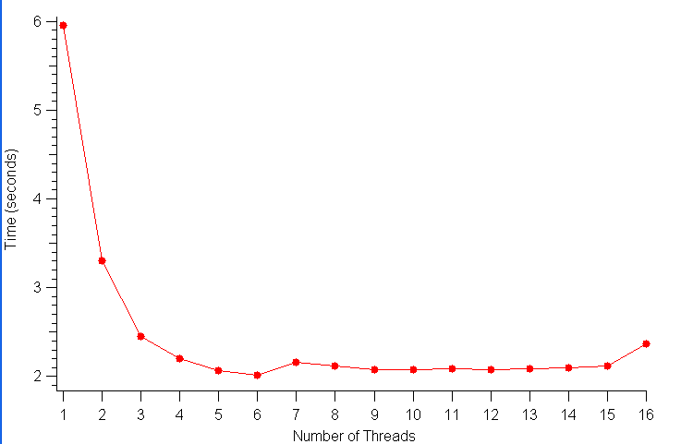
Performance on an 8-CPU Linux cluster invoking Java with default parameters.
You can actually see the CPUs click on as the program goes from 2 to 3 to 4 to 5 threads
Why maxing at 4 CPUS?
2 hypotheses:
This box is 2 CPUs * 4 cores. So communication between the CPUs could limit the concurrency.
I/O Bottlenecks…

Slide 27
Performance on a 2-CPU laptop.
A little less than a factor of 2 (but the CPU never really gets to zero on the laptop
since it is playing music and stuff…)
The book suggests Ncpu or Ncpu + 1
Interestingly, going more than the # of CPUs is a little faster!
The CPUs don’t quite get to 100% with just two threads..

Slide 28
BlockingQueues
Semaphore
A bioinformatics example with semaphore
CountDownLatch
Callable, Future, FutureTask
Cancellation

Slide 29
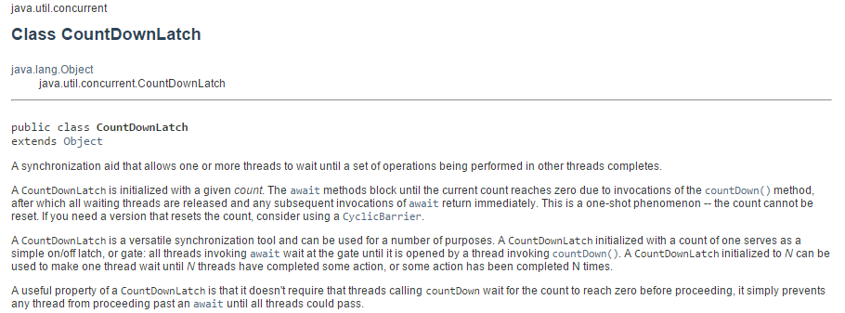
CountDownLatch is very useful (and easy to use)
new CountDownLatch( … ) is called with the number of threads.
.await() blocks until .countDown() is called the correct number of times..
If you know you want x number of threads to run and then move on when they are all
done, the CountDownLatch works nicely…

Slide 30
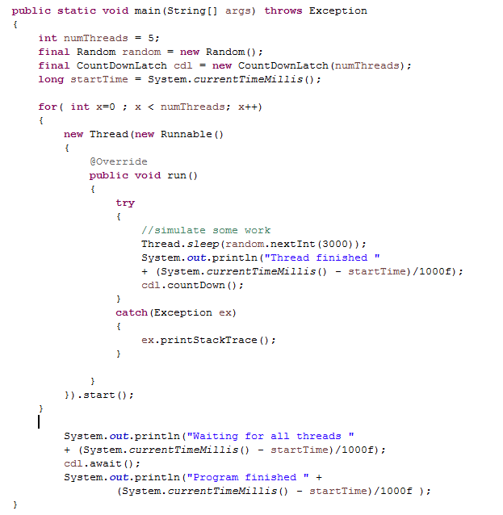
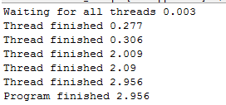
We’ve already seen examples of CountDownLatch this semester..
Very useful and easy to use way to coral your threads…

Slide 31
BlockingQueues
Semaphore
A bioinformatics example with semaphore
CountDownLatch
Callable, Future, FutureTask
Cancellation

Slide 32
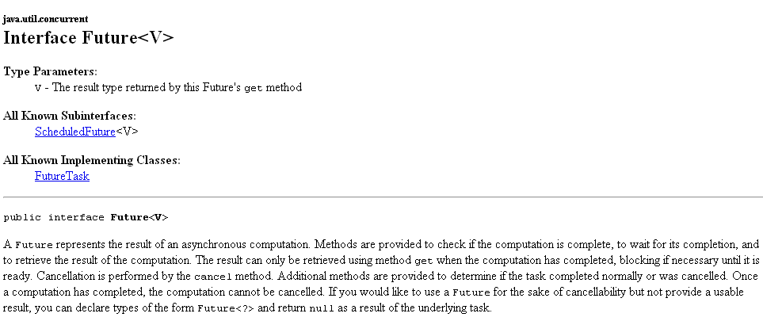
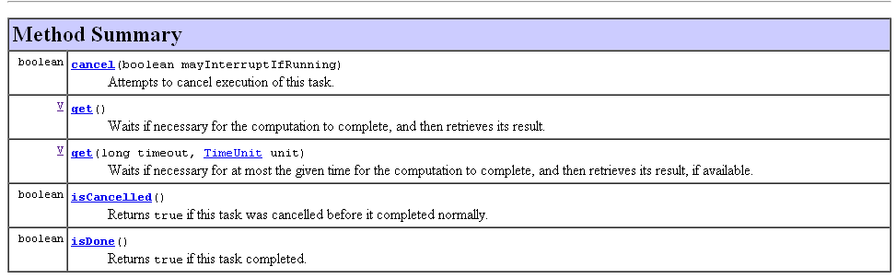
Future – Holds the results of some calculation

Slide 33
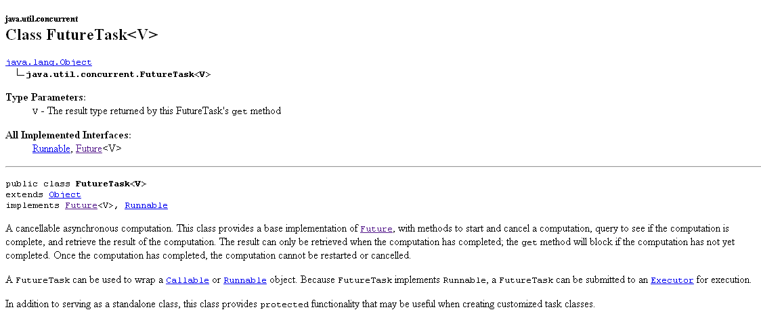
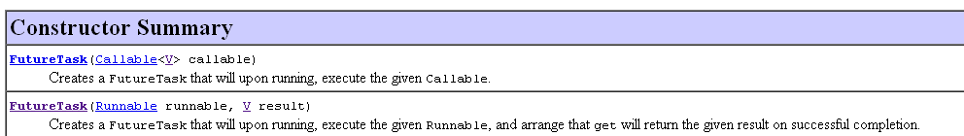
A FutureTask is an implementation of Future that we can use
When you construct, you need to pass in a Runnable or a Callable

Slide 34
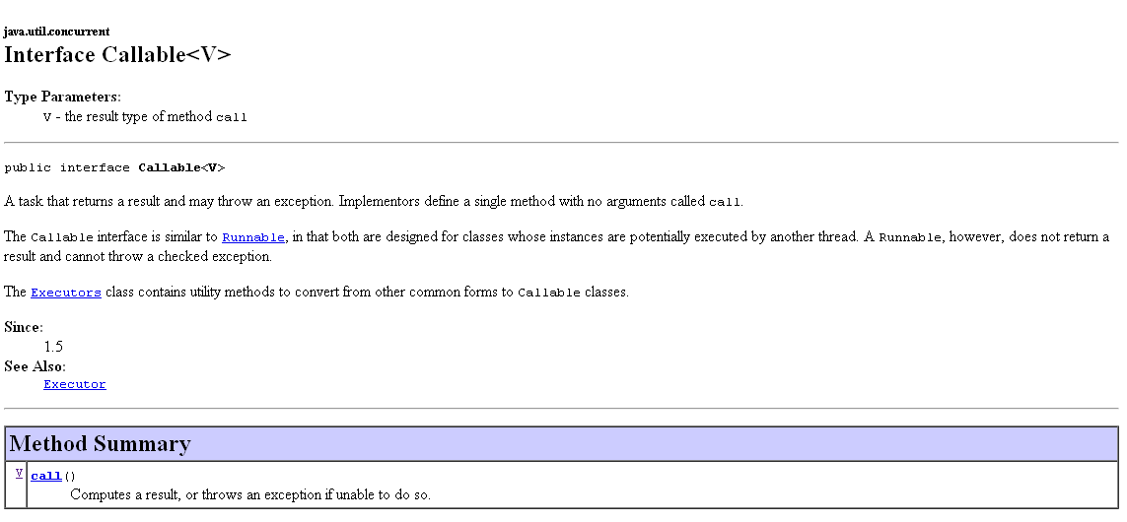
A Callable is like a Runnable, except it has a return type V
(and can throw an Exception, which is very nice)

Slide 35
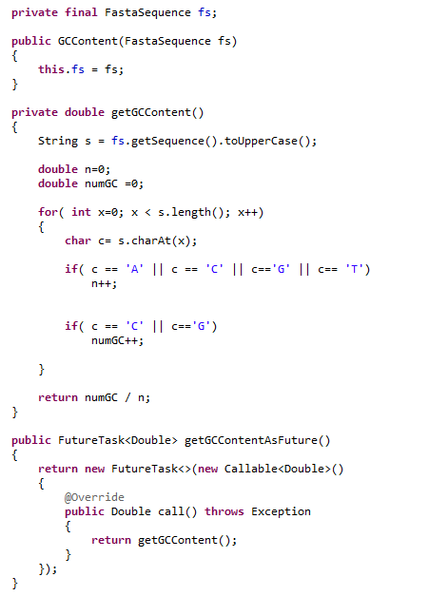
This class calculates GC content
in a background thread

Slide 36
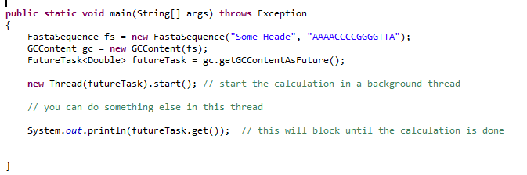
In this method, we spawn a calculation in a background thread…

Slide 37
BlockingQueues
Semaphore
A bioinformatics example with semaphore
Callable, Future, FutureTask
Cancellation

Slide 38
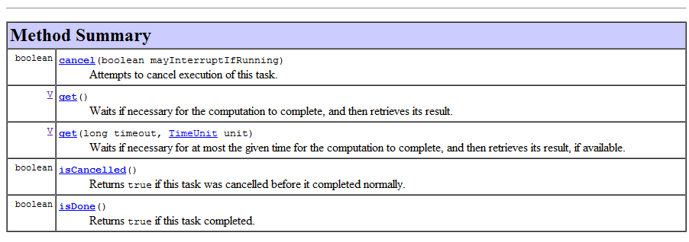
Future also supports cancellation, but this is dependent upon the co-operation of the
running threads…

Slide 39
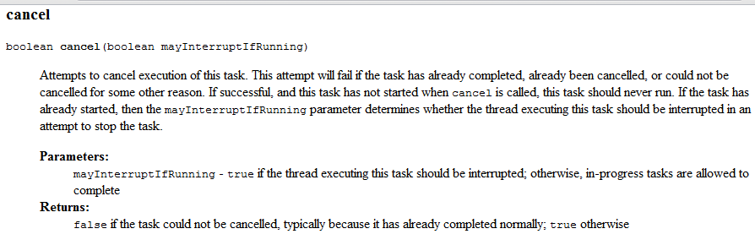
Thread.sleep and nearly all other Java blocking methods support cancellation.
If your code is working on something, it is up to you to check for cancellation
(which means checking for interruption).
More on this on Chapter 7.

Slide 40
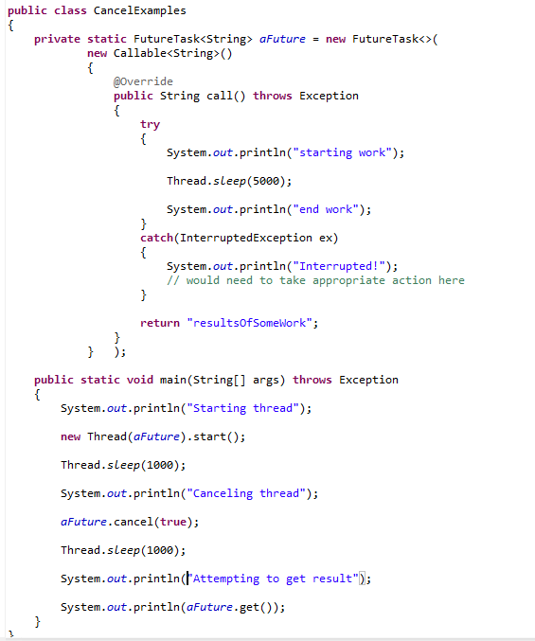
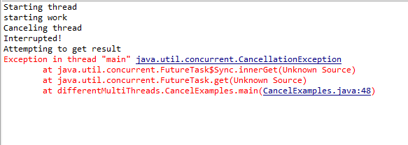
Calling cancel causes an Interruption flag to be set.
Thread.sleep(..) checks that interruption flag and
If it is set throws InterruptedException.
Calling get() after cancel, throws a CancellationException

Slide 41
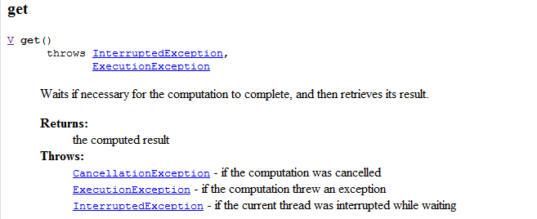

Slide 42
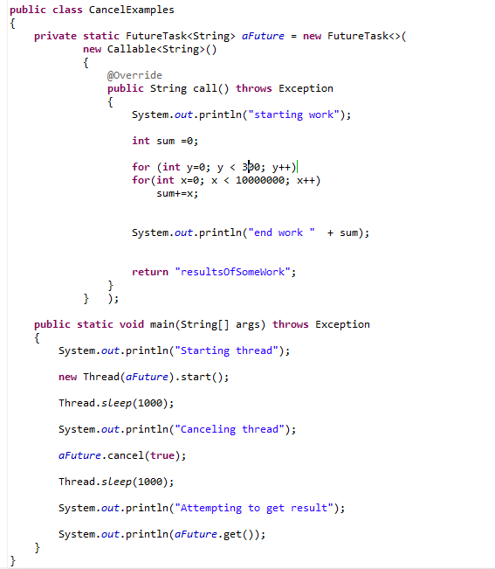
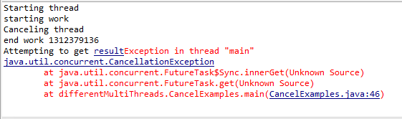
If you are not using one of Java’s blocking methods (like Thread.sleep()) that supports interruption, it is up to you to check for cancellation.
We don’t check for cancellation
Our thread continued to work after cancellation
get still throws!

Slide 43
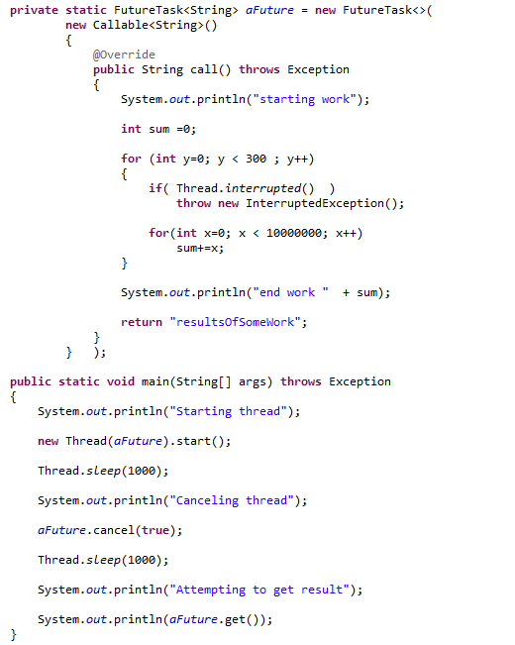
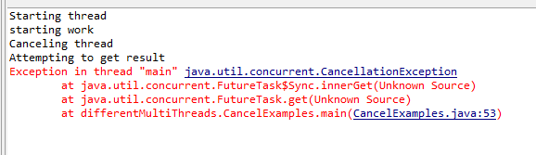
Our cancellation now works
The thread is successfully cancelled. “end work” is not reached

Slide 44
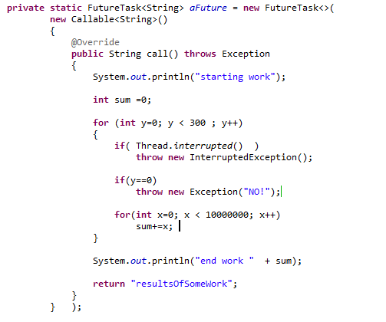
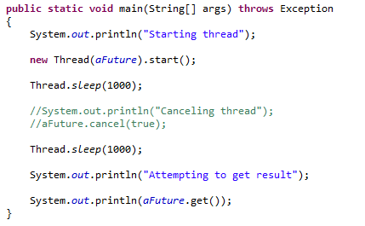
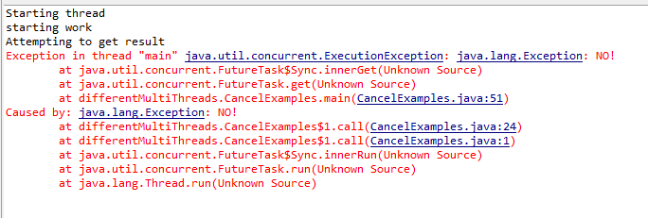
If we throw a normal
Exception (not InterruptedException)…
Then get re-throws that Exception

