Slide 1
One last example…

Slide 2
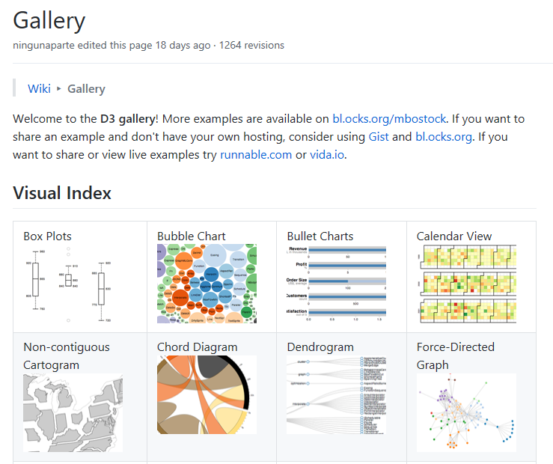
The D3 library has lots of nice visualization examples to show off what javascript can do in the browser…
https://github.com/d3/d3/wiki/gallery

Slide 3
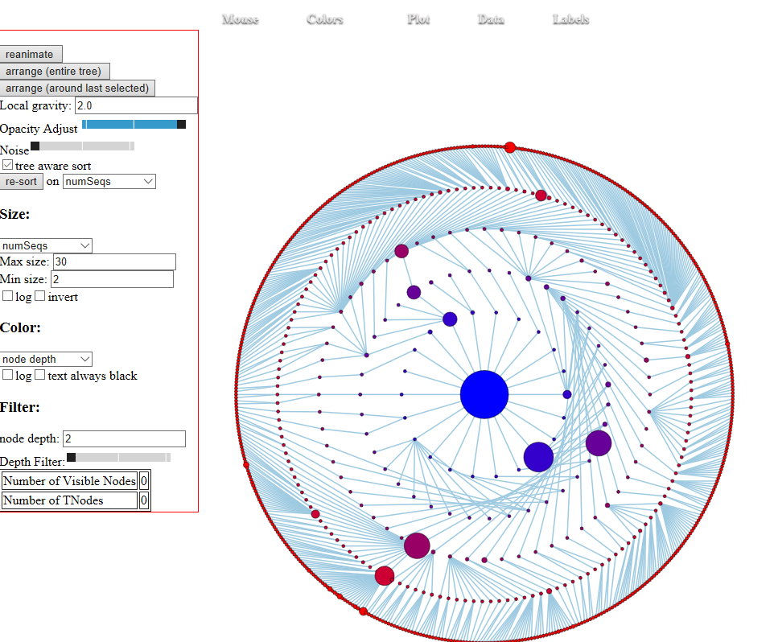
My (forever unfinished) attempt to visualize 16S experimental data in javascript with D3
http://afodor.github.io/ForceTree.html?FileToOpen=ismeJRDP_CaseControl.json

Slide 4
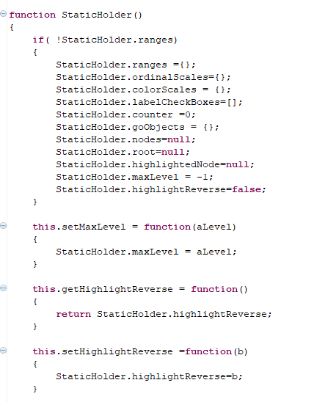
To solve scoping issues, I have a StaticHolder function/object
Every time you “new” this you get an object with functions that
point to a common object (called StaticHolder) that holds all the
Static data…
One of many, many different ways you allow common access
without “polluting” the global scope
(many other methods for achieving the same objective can be found
in the Javascript Ninja book…)
http://afodor.github.io/d3ForceTree.js
And so on….

Slide 5
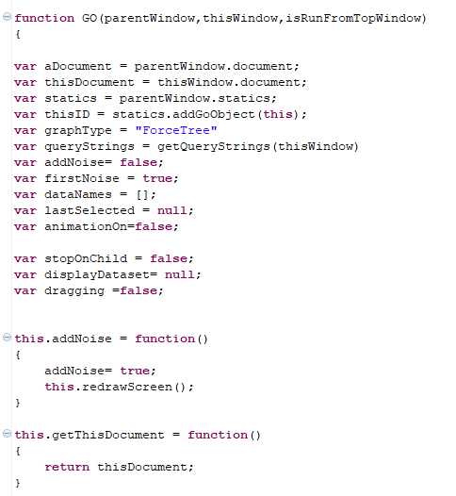
The (poorly named) function GO(…) will add the graphics to a browser window…
Unlike the “statics” object, the “GO” object uses
closures for encapsulation.
The functions in “GO” will each have access to their
own copy of the data…
http://afodor.github.io/d3ForceTree.js

Slide 6
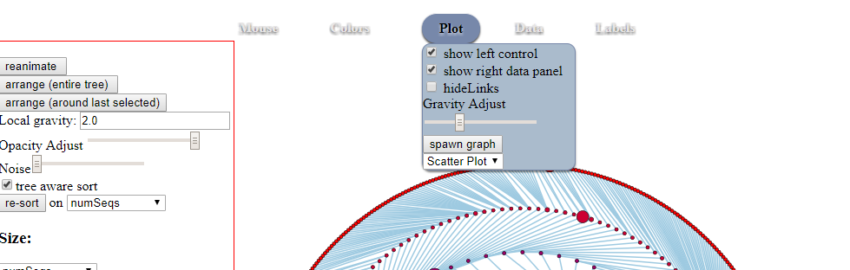
This allows (at least in theory) for multiple graphs each with their own state…

Slide 7
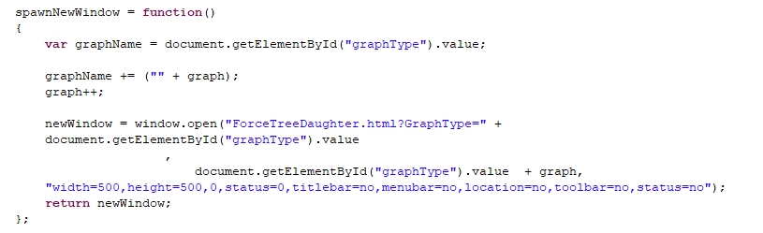
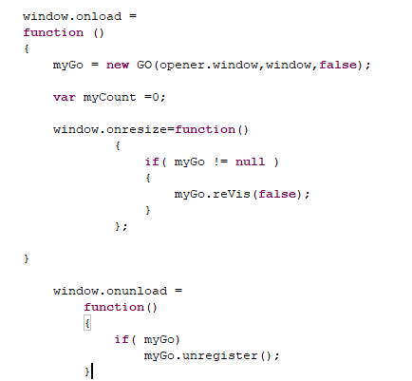
ForceTree.html
ForceTree.html
ForceTreeDaughter.html

Slide 8
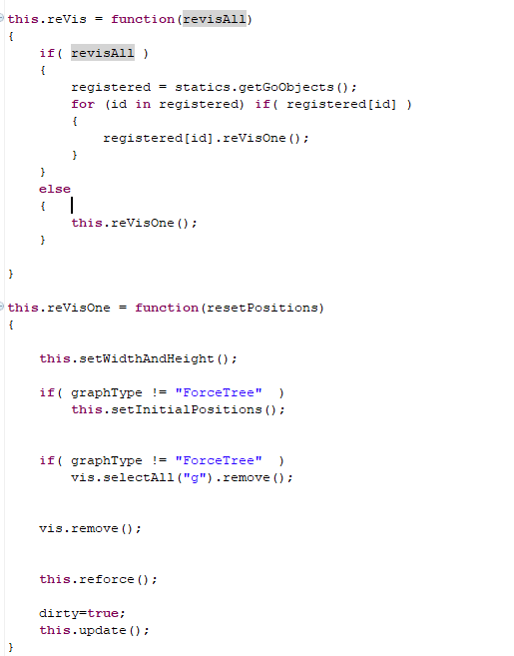
The appropriate functions in “GO” take care of their own window
The data in this “GO” object access by closures

Slide 9
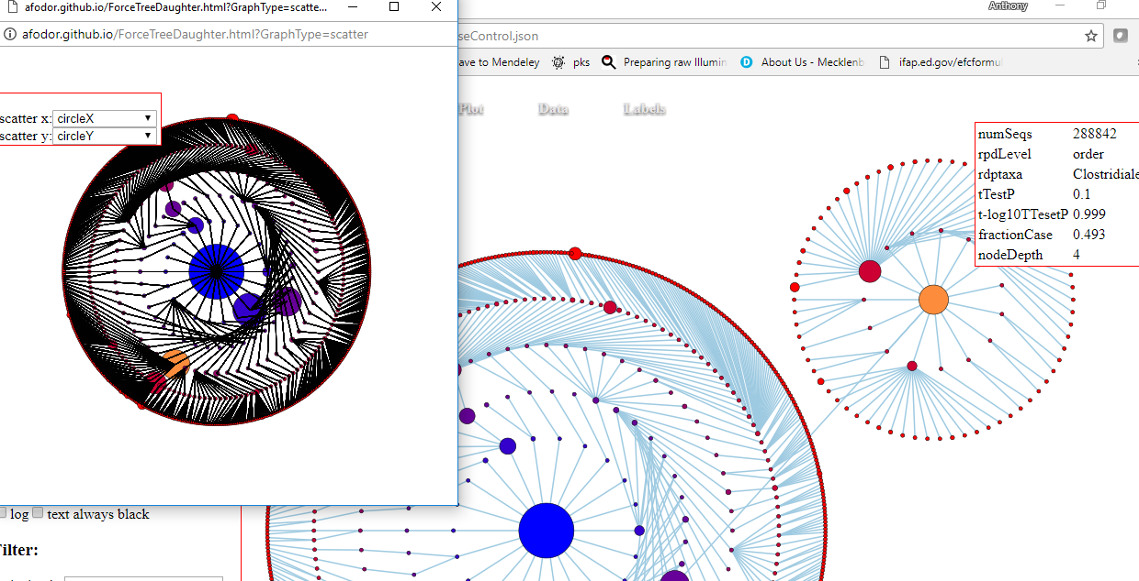
Not working particularly well, but the idea was to allow for multiple views of the same data…….

