Slide 1
Matrix form of Linear Regression
The F distribution
ANOVA approach to Linear Regression
ANOVA approach to t-test (One way ANOVA with two levels)

Slide 2
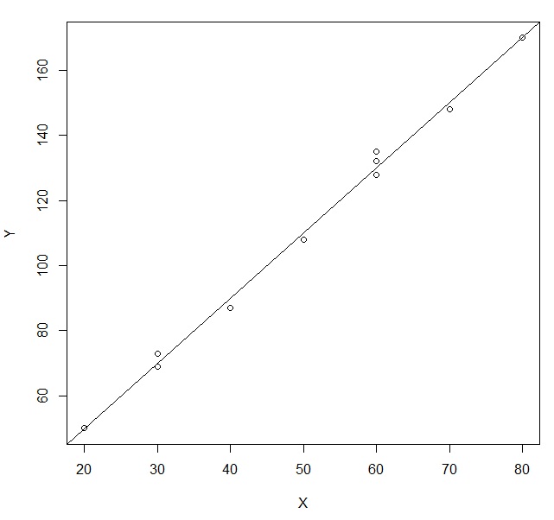
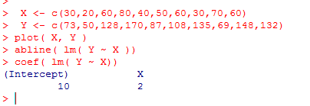
X <- c(30,20,60,80,40,50,60,30,70,60)
Y <- c(73,50,128,170,87,108,135,69,148,132)
Y = B₀ + B₁X + e
B₀
+
B₁
+
=
Linear least square fit finds B0 and B1 to guarantee that
is a minimum

Slide 3
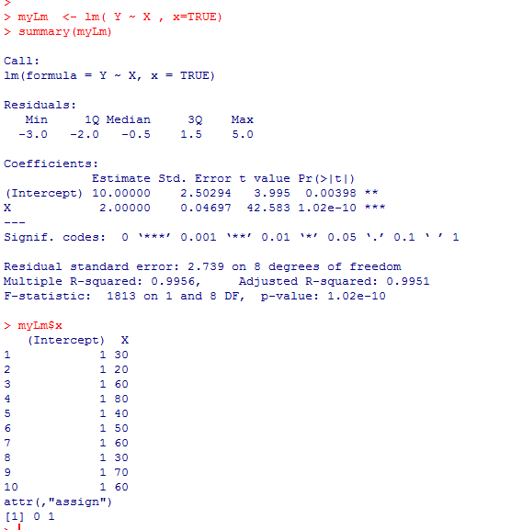
By setting “x=true”, we can keep R’s version of the
matrices used to find the parameters

Slide 4
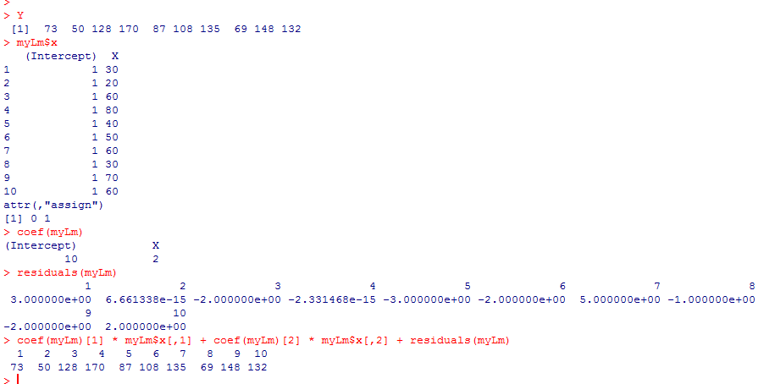
We can get R to give us all of the pieces used in the fit…
Y = B₀ + B₁X + e

Slide 5
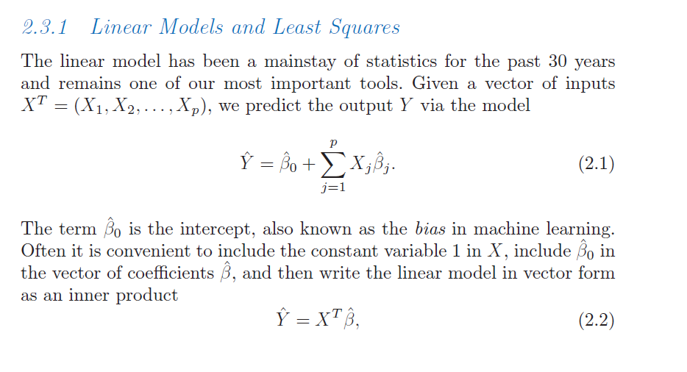
We can make this even more concise…
Hastie et al: The elements of Statistical Learning
http://www-stat.stanford.edu/~tibs/ElemStatLearn/download.html

Slide 6
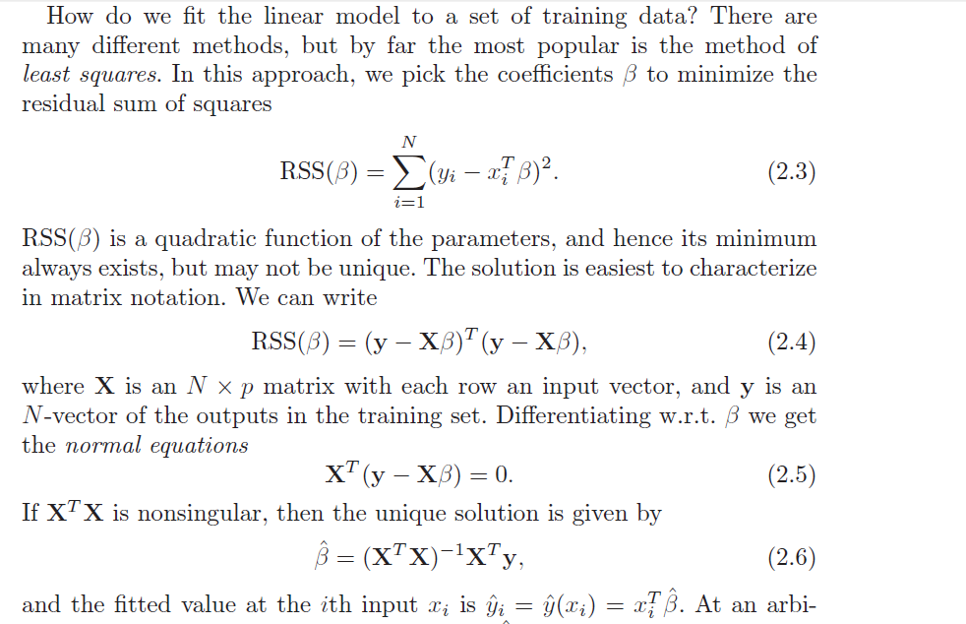

Slide 7
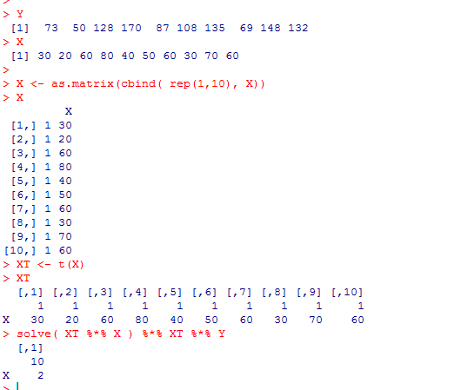
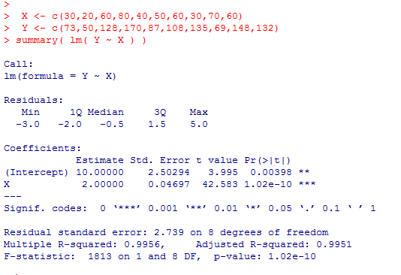

So we can find least square parameters easily with a few line of matrix manipulation

Slide 8
Matrix form of Linear Regression
The F distribution
ANOVA approach to Linear Regression
ANOVA approach to t-test (One way ANOVA with two levels)

Slide 9
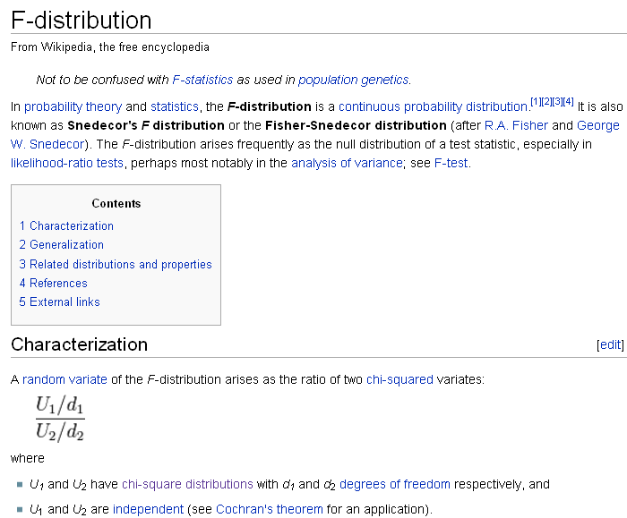

Slide 10
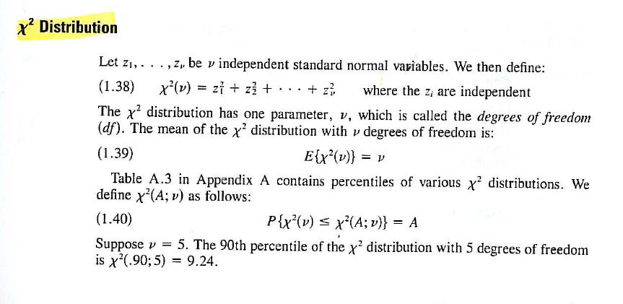
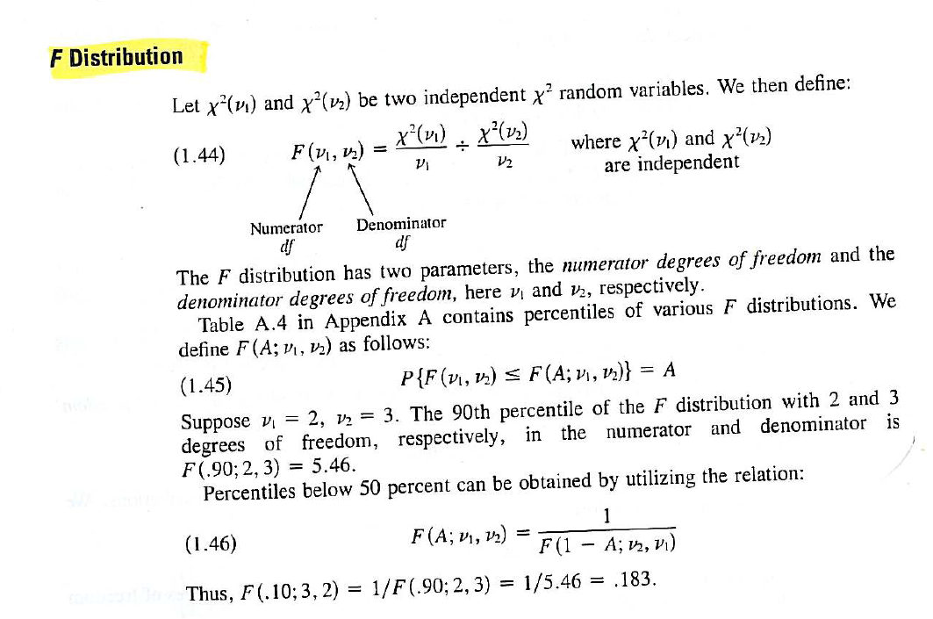
The F distribution is built on the Chi-square distribution…
Neter et al - Applied Linear Statistical Models

Slide 11
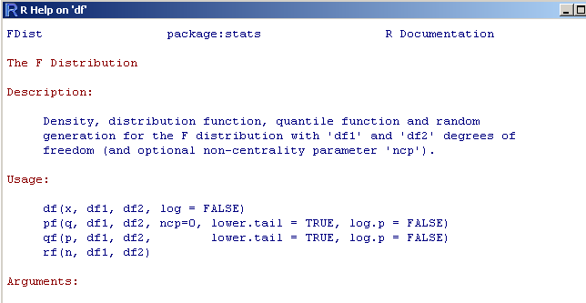
As usual df, pf, qf, rf….

Slide 12
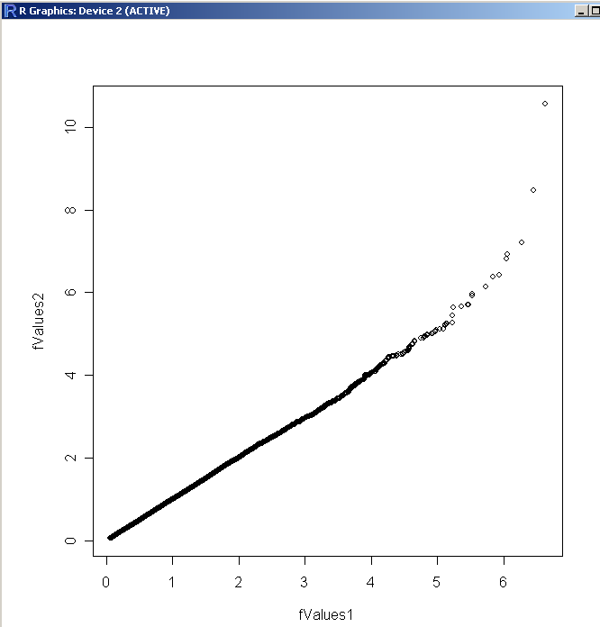
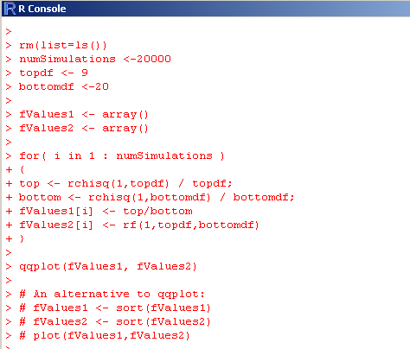
You can guess how to use these methods without looking at the documentation…
Here is a demonstration that the definition of F is correct…

Slide 13
Matrix form of Linear Regression
The F distribution
ANOVA approach to Linear Regression
ANOVA approach to t-test (One way ANOVA with two levels)

Slide 14
We have
Y = B₀ + B₁X + e
We want to know if B1 is significantly different than 0.
In the previous lecture, we saw how to do this with the t-distribution.
That’s what R gives us when we type summary()

Slide 15


Alternatively, we can compare the error of the full model:
Y = B₀ + B₁X + e
8 d.f. associated with this model (there are 2 parameters with 10 data points)
How much error would we have if B1 is equal to 0 in the reduced model?
Y = B₀ + e
The value of B₀ that minimizes the error is just the mean.
So the sum squared error is
There are 9 d.f. associated with this model (there is 1 parameter with n=10)

Slide 16

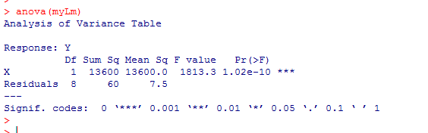
Our ANOVA statistic is:
(reduced error – full error)/ (reduced DF – full DF)
(Full error)/ (full DF)
( 13660 – 60 ) / (9-8 )
(13600) / 1
=
=
1813.3
(60)/ (8)
7.5
If the parameter didn’t make much of a difference,
the full and reduced error would be similar….
In this case, the extra parameter makes a huge difference
We say, this is F distributed with df = (1,8)
This is what R does when we type ANOVA (lm)
Zeros out the parameters and asks whether
the error changes by a significant amount

Slide 17
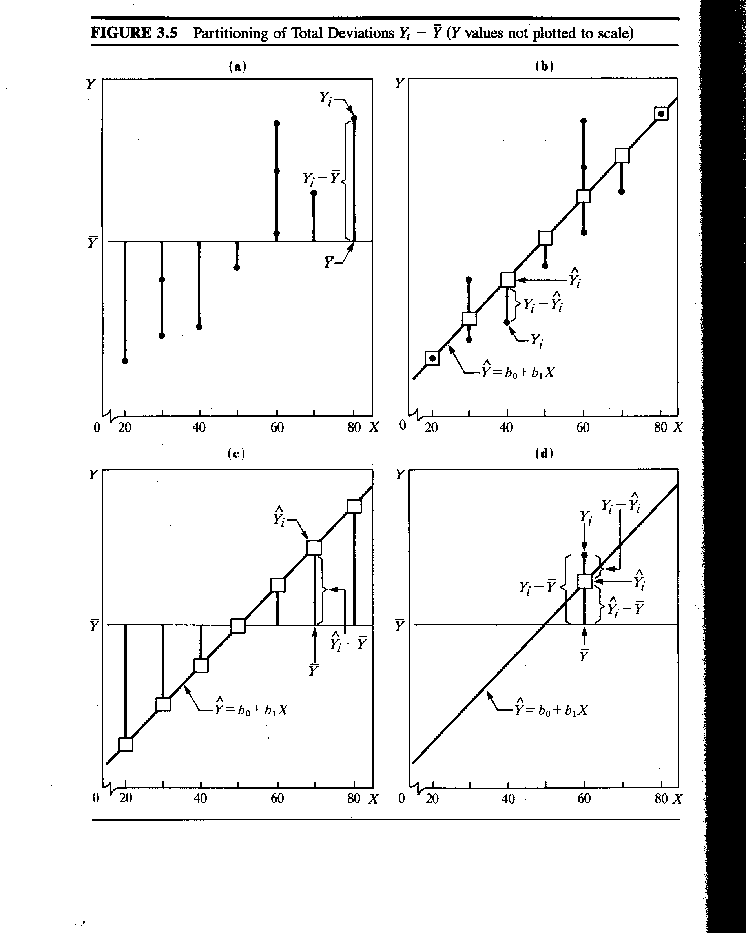
Visually
Neter et al - Applied Linear Statistical Models

Slide 18
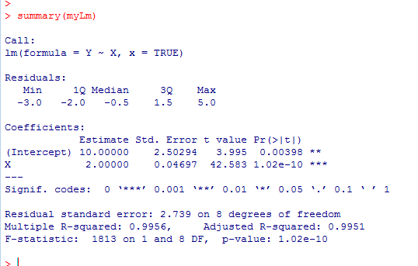
We can define R² as:
Total sum squared ( SSTO )
Regression sum squared (SSR)
=
R² measures how much variance your
model captures

Slide 19
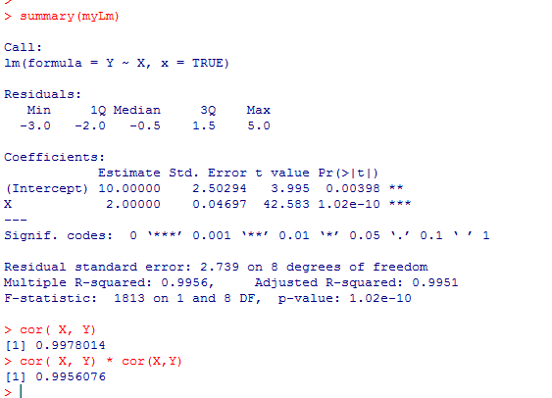
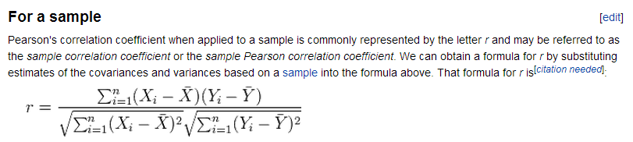
R is the Pearson Correlation co-efficient (which is likely familiar to all of you!)
R²
R
> r <- sum(( X- mean(X)) * (Y - mean(Y)))
/ ( sqrt(sum((X-mean(X)) * (X-mean(X)) )) * sqrt(sum((Y-mean(Y)) * (Y-mean(Y)) )))
> r * r
[1] 0.9956076
R²
http://en.wikipedia.org/wiki/Pearson_product-moment_correlation_coefficient

Slide 20
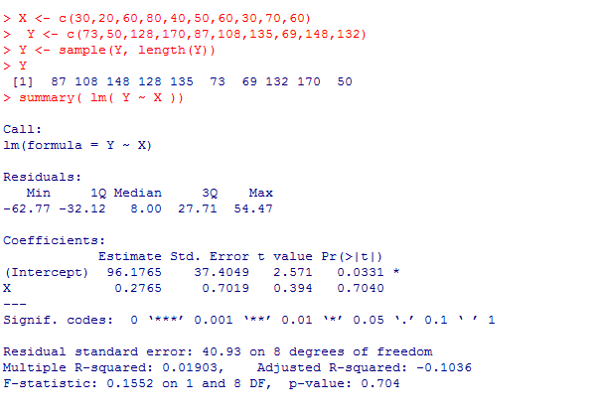
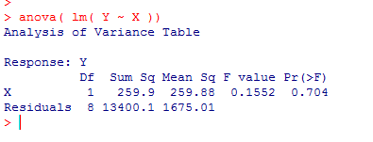

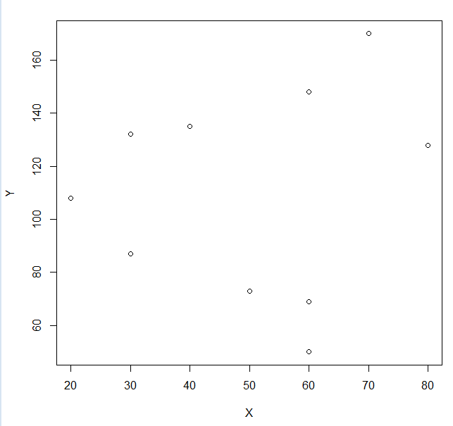



Note that if we scramble the Y data, the significance of the relationship is lost
The residuals for the reduced model haven’t changed:
However, the full model now doesn’t explain very much
(reduced-full) / full = ((13660-13400.12) / 1 ) / (13400.12/8) =
F-statistic = 0.1552;

Slide 21
In summary, R fits the linear model and gives us a great deal of information on the fit
Stats on the residuals
T derived errors on
B₀ and B₁
B₀
B₁
R²
P-value from F test
Sqrt( sum( residuals)) / model df
= sqrt( 60 / 8 ) =
ANOVA F statistic

Slide 22
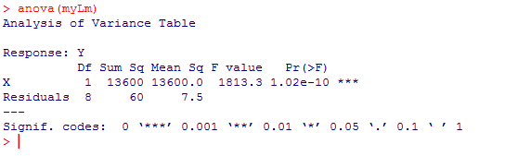
ANOVA() tells R to zero out each (non-intercept) parameter and evaluate significance that way
Divided by D.F. (in this case 1 since there
is one parameter different between reduced and full)
P-value from F-test
Divided by D.F. (in this case 8 since we estimate two
parameters from 10 data points)

Slide 23
Matrix form of Linear Regression
The F distribution
ANOVA approach to Linear Regression
ANOVA approach to t-test (One way ANOVA with two levels)

Slide 24
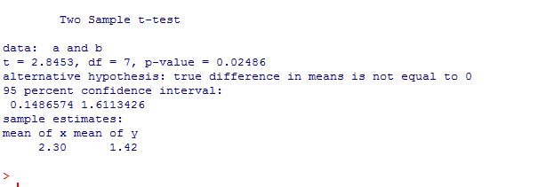
Previously: We saw the two sample t-test.
So consider two samples (weight of mice on Drug A vs. Drug B)
Consider the equal variance version of the t-test
rm(list=ls())
a <- c(2.1,3.2,2.0,1.9)
b <- c(1.8,1.3,1.7,1.2,1.1)
t.test(a,b, var.equal=TRUE)
(In the ANOVA version of the t-test, the samples must have equal variance!)

Slide 25
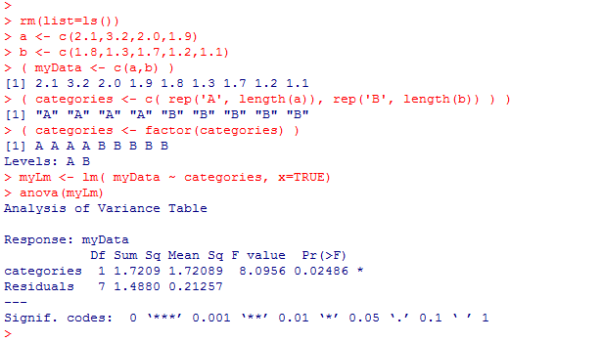
We can make an alternative version of this test cast as an ANOVA
rm(list=ls())
a <- c(2.1,3.2,2.0,1.9)
b <- c(1.8,1.3,1.7,1.2,1.1)
( myData <- c(a,b) )
( categories <- c( rep('A', length(a)), rep('B', length(b)) ) )
( categories <- factor(categories) )
myLm <- lm( myData ~ categories, x=TRUE)
anova(myLm)
We tell R that we have a categorical variable
This is a ONE-way
ANOVA (with 2 levels)
One factor (two levels)

Slide 26
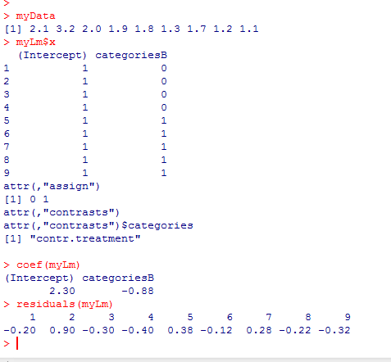

The full model has sum squared residual of 1.488 with 7 d.f.
=
B₀
+
B₁
+

Slide 27

The reduced model (B1=0) has sum squared residual 3.208889 with 8 d.f.
=
B₀
+
The errors will be minimized when
B₀ = mean of data

Slide 28
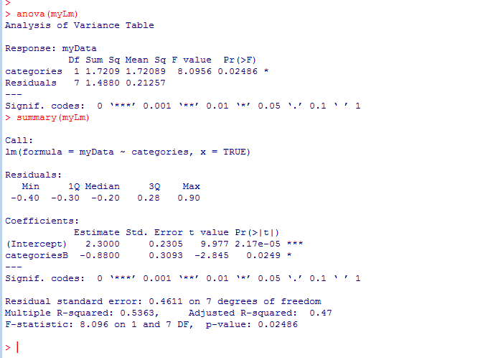
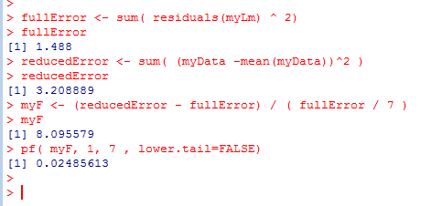
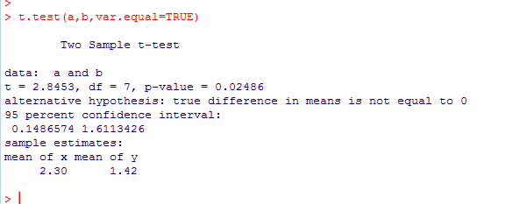
Our ANOVA statistic is f=:
(reduced error – full error)/ (reduced DF – full DF)
(Full error)/ (full DF)
( ( 3.208889 - 1.488 ) / 1 ) / (1.488 /7 )
So t.test, anova and summary all yield identical results..

Slide 29
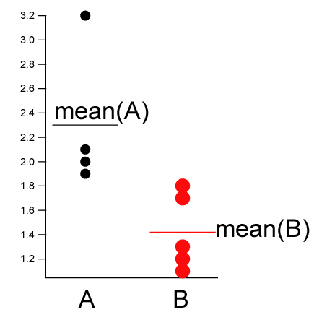
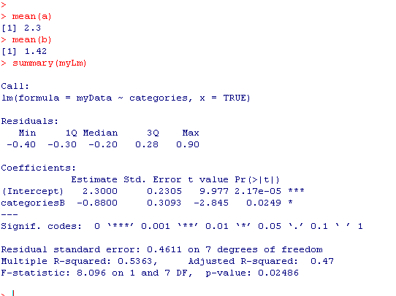
“Full model” ; 7 degrees of freedom (n=9 – 2 parameters).
The mean of A and B are modeled as distinct
The mean of A
The difference between the mean of
A and the mean of B.
The null hypothesis is that this is zero
(i.e. that mean(A) == mean(B))
A is the “background” ; B is compared to A.
We can switch that with relevel

Slide 30
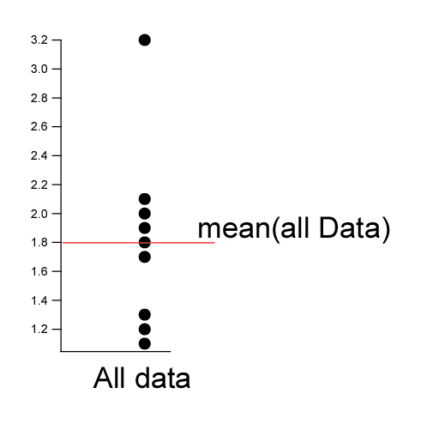
“Reduced model” ; 8 degrees of freedom (n=9 – 1 parameters).
There is only one grand mean.
The ANOVA asks does the full model explain significantly more of the data than does
the reduced model?
The null hypothesis is that the data is explained best by one mean

Slide 31
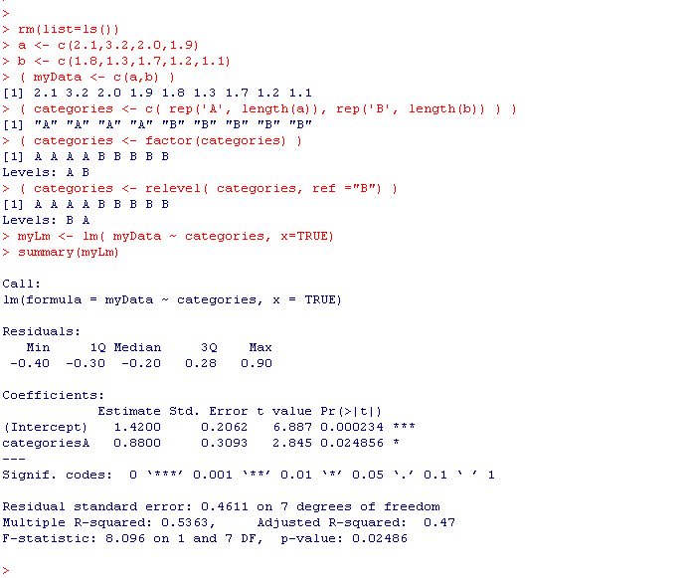
In the previous slide, A is the “background” ; B is compared to A.
We can switch that with relevel ; now “B” is the background
The mean of A
The mean of B
The difference between the mean of
B and the mean of A.
The null hypothesis is that this is zero
(i.e. that mean(A) == mean(B))
For the 2 level ANOVA it doesn’t matter which is “background”; we get the same p-value

Slide 32
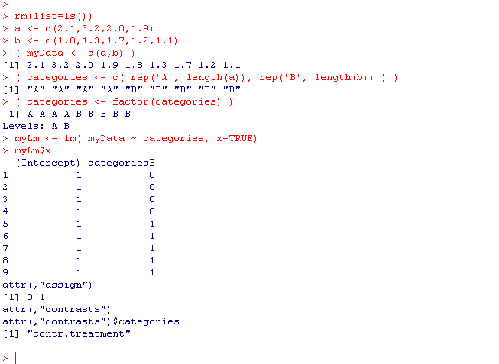
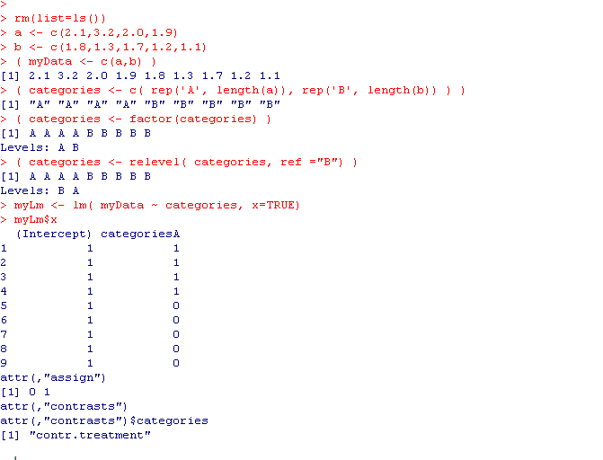
With “A” as the background….
=
B₀
+
B₁
+
With “B” as the background….
=
B₀
+
B₁
+
For the 2 level case, these models produce identical inference (it doesn’t matter which is background);
This gets more complicated as we move to multiple levels.

Slide 33
With “A” as the background….
=
B₀
+
B₁
+
Extra credit:
Prove in general for the above model that
B₀ = mean(A) and B₁ = mean(B)- mean(A)

Slide 34
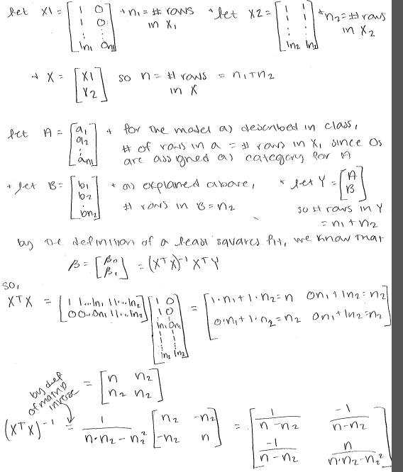
Proof! From Brittany Smith
and then…

Slide 35
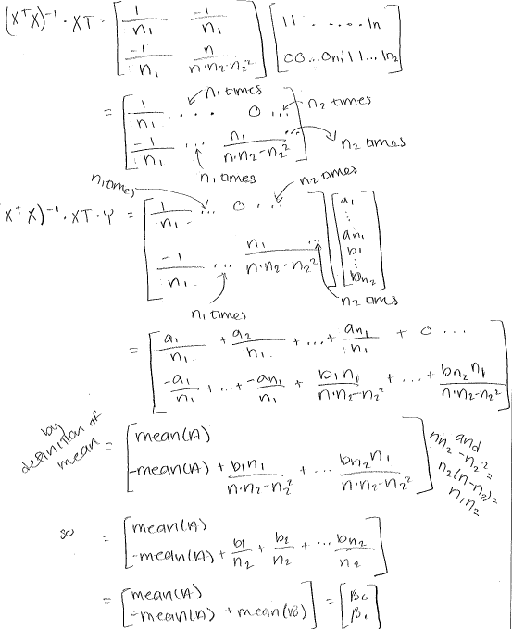

Slide 36
Next: Towards multivariate models.
One WAY-Anova with multiple levels.
Combining regression and t-test (Analysis of covariance)
Multiple ANOVAs and regressions (with interaction terms)
Using Principle Component Analysis (PCA) to attack multi-dimensional data

