Slide 1
Visualizing and building statistical models on multi-variate data in R
Anthony Fodor
Bioinformatics and Genomics
UNC Charlotte

Slide 2

If you are following along with our datasets…
We will be using the data from this paper…
https://microbiomejournal.biomedcentral.com/articles/10.1186/s40168-017-0338-7

Slide 3
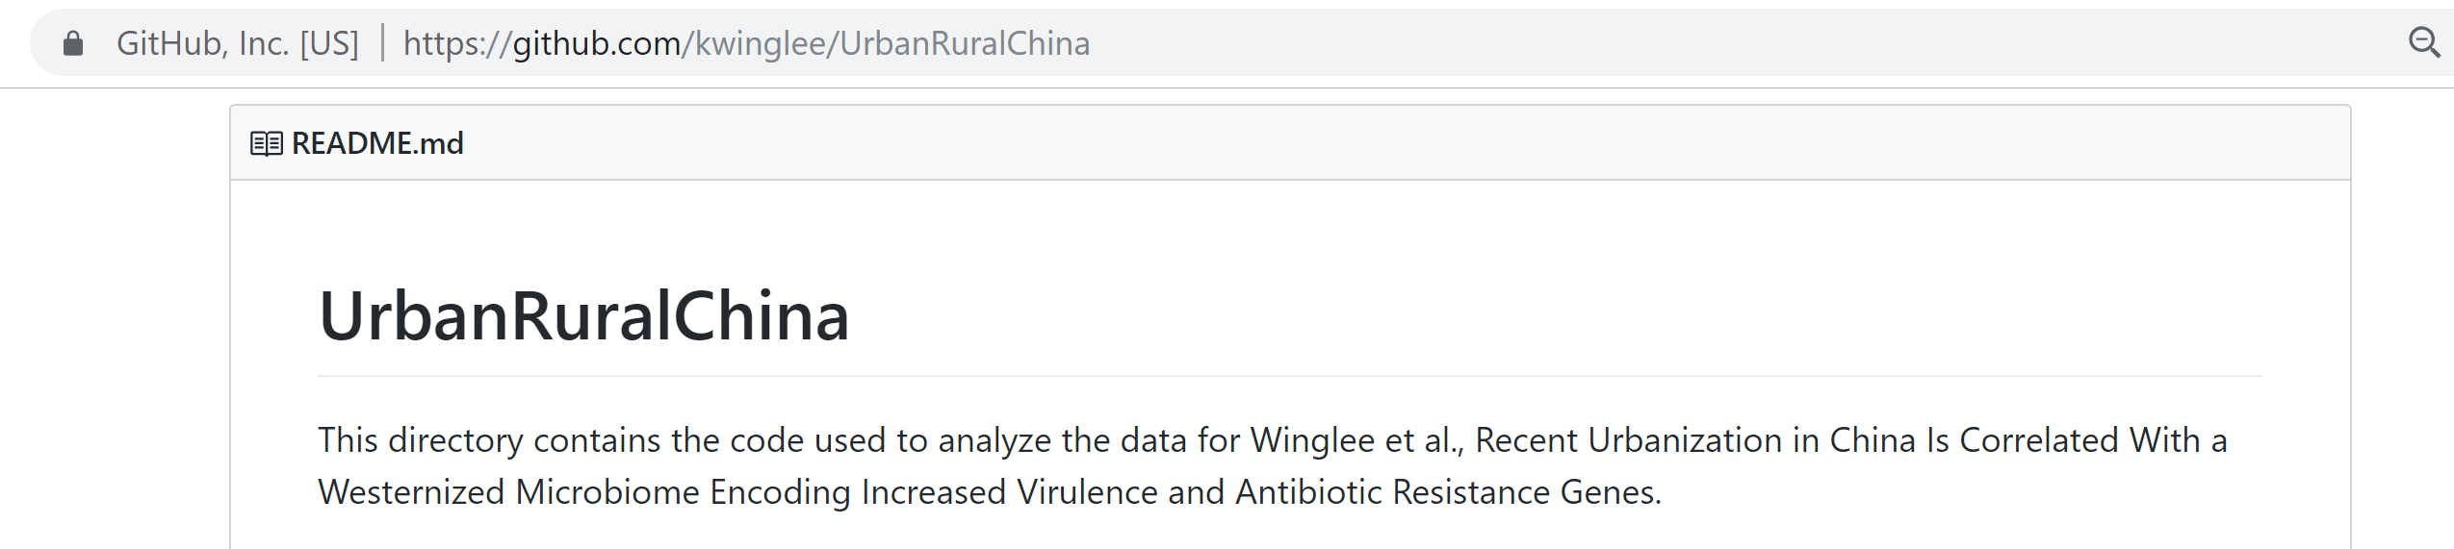

Tables and r-scripts were nicely organized by Kathryn Winglee (now of the CDC in Atlanta)
https://github.com/kwinglee/UrbanRuralChina

Slide 4
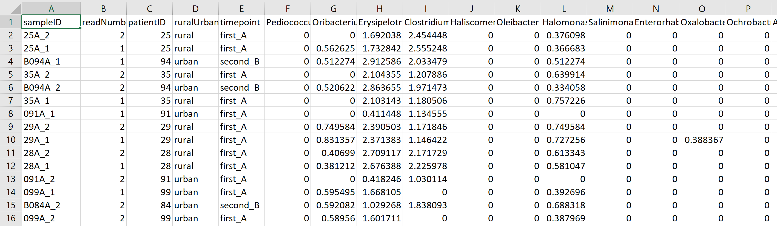
We will use this spreadsheet as our base input into R…
https://github.com/kwinglee/UrbanRuralChina/blob/master/16SrRNA/inputData/RDP/genus_taxaAsColumnsLogNorm_WithMetadata.txt

Slide 5
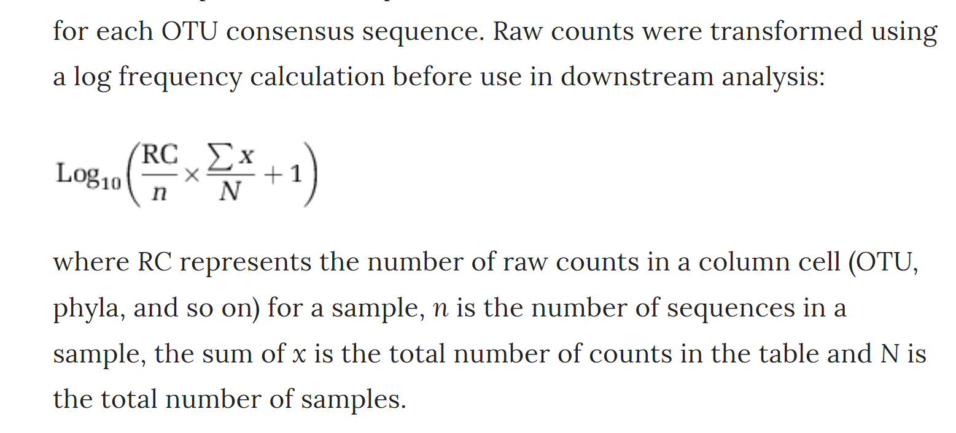
This spreadsheet has the following features:
The taxa are columns; the rows are samples
The metadata (urban vs. rural, timepoint) are in the same spreadsheet as the relative abundance
The counts are log-normalized according to the following formula
https://www.nature.com/articles/ismej2013106

Slide 6
If you have your own dataset…

