Slide 1
Visualizing and building statistical models on multivariate data in R
Anthony Fodor
Bioinformatics and Genomics
UNC Charlotte
http://afodor.github.io/classes/ChapelHill2018/ch.pptx

Slide 2
I am assuming that you have installed…
Some version of R
Some text editor (sublime is a very nice choice, or e-macs or vi or r-studio)

Slide 3
Normalizing your data
PCA Ordination
Graphing everything into one big PDF ball
Some Simple Statistical Models
Some Not So Simple Statistical Models

Slide 4

If you are following along with our datasets…
We will be using the data from this paper…
https://microbiomejournal.biomedcentral.com/articles/10.1186/s40168-017-0338-7

Slide 5
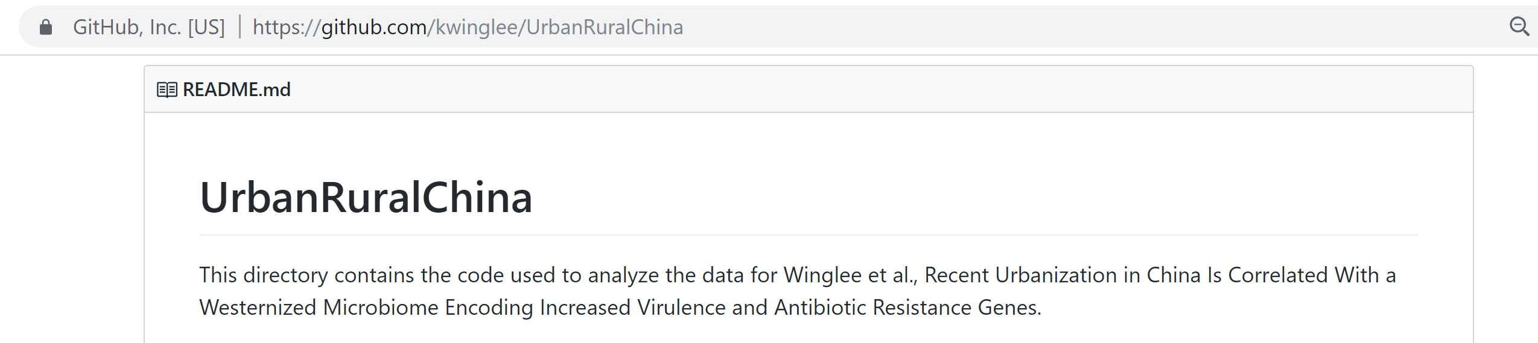
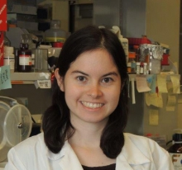
Tables and r-scripts were nicely organized by Kathryn Winglee (now of the CDC in Atlanta)
https://github.com/kwinglee/UrbanRuralChina

Slide 6
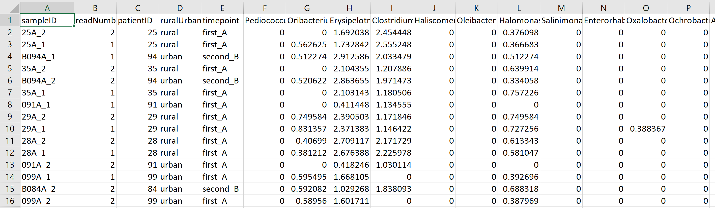
We will use this spreadsheet as our base input into R…
https://github.com/kwinglee/UrbanRuralChina/blob/master/16SrRNA/inputData/RDP/genus_taxaAsColumnsLogNorm_WithMetadata.txt

Slide 7
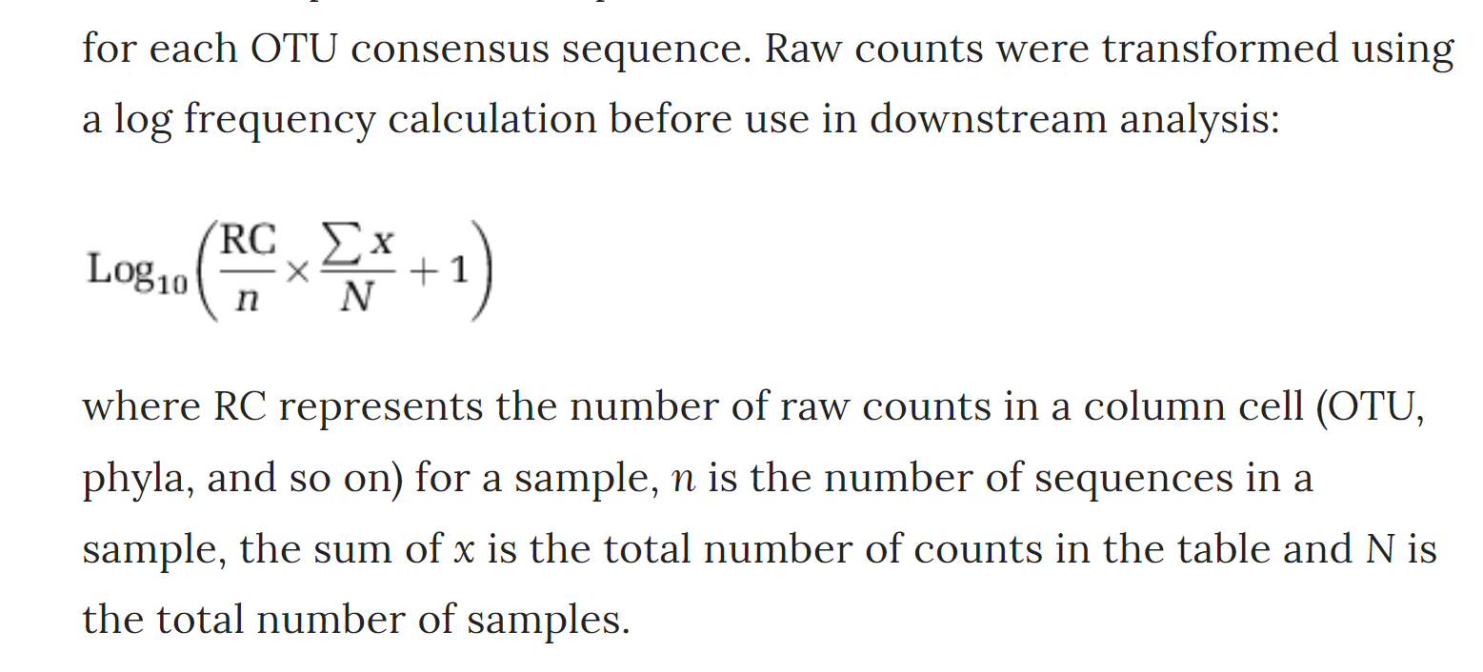
This spreadsheet has the following features:
The taxa are columns; the rows are samples
The metadata (urban vs. rural, timepoint) are in the same spreadsheet as the relative abundance
The counts are log-normalized according to the following formula
https://www.nature.com/articles/ismej2013106

Slide 8
If you have your own dataset…
We can work with you to get your data into the same format
(or to modify your R code to work with your table!)

Slide 9
Normalizing your data
PCA Ordination
Graphing everything into one big PDF ball
Some Simple Statistical Models
Some Not So Simple Statistical Models

Slide 10
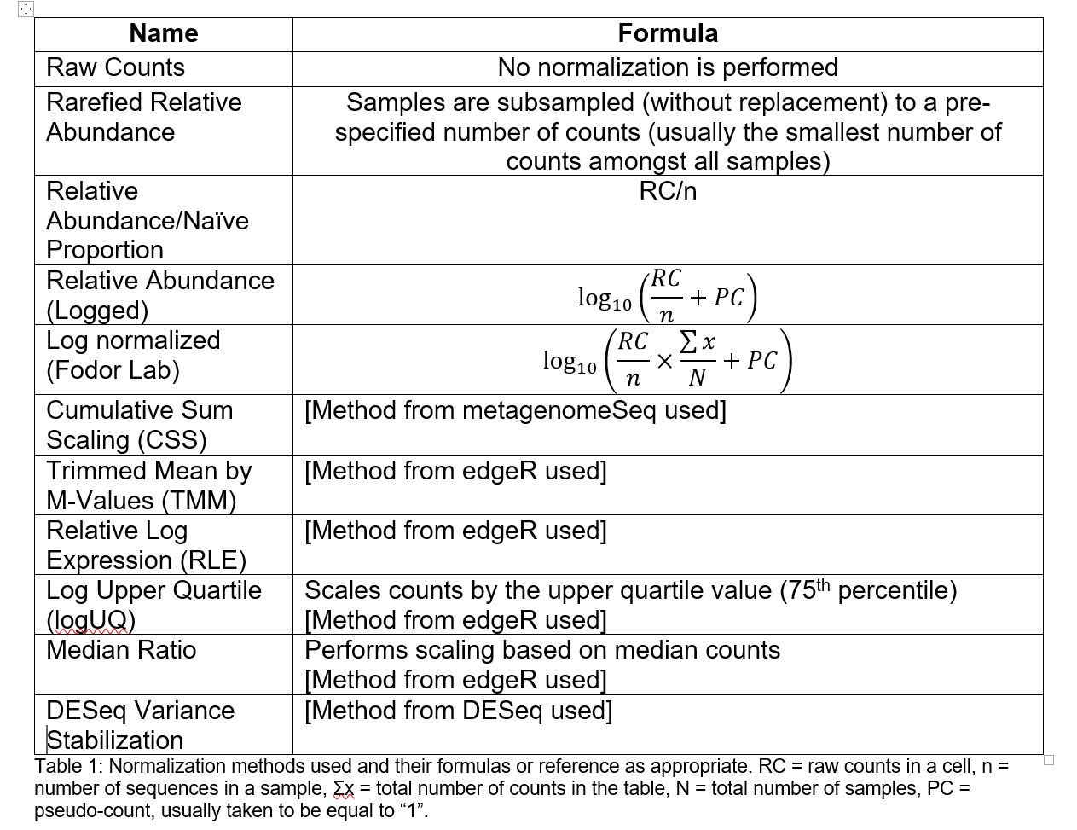
You will need to choose some normalization scheme..
(Each sequence library will be of a different depth; you need to correct for that)
The easiest (not necessarily the best) approach is to divide each cell by the total # of sequences in that sample.
This is relative abundance
Table due to :Matthew C. B. Tsilimigras (Matthew C. Brown)

Slide 11
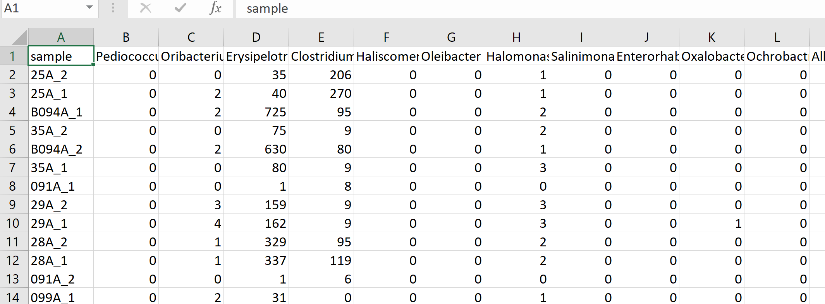
Let’s say you have a spreadsheet that is un-normalized and you want to change it to log relative abundance
https://github.com/kwinglee/UrbanRuralChina/blob/master/16SrRNA/inputData/RDP/genus_taxaAsColumns.txt

Slide 12
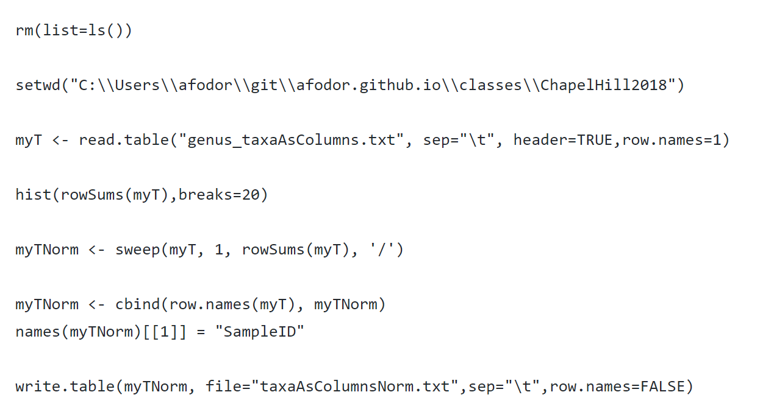
Here is a (complete) R script to convert a counts table to relative abundance and write the results to a file
https://github.com/afodor/metagenomicsTools/blob/master/src/classExamples/ch2018/quickNormalization.txt

Slide 13
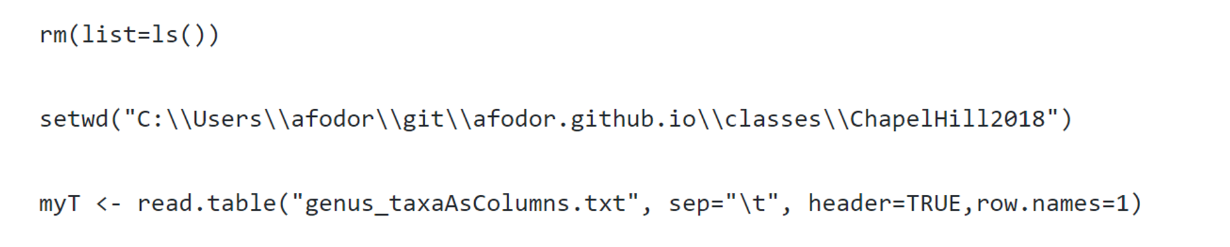
The first few lines input the file we wish to normalize

Slide 14
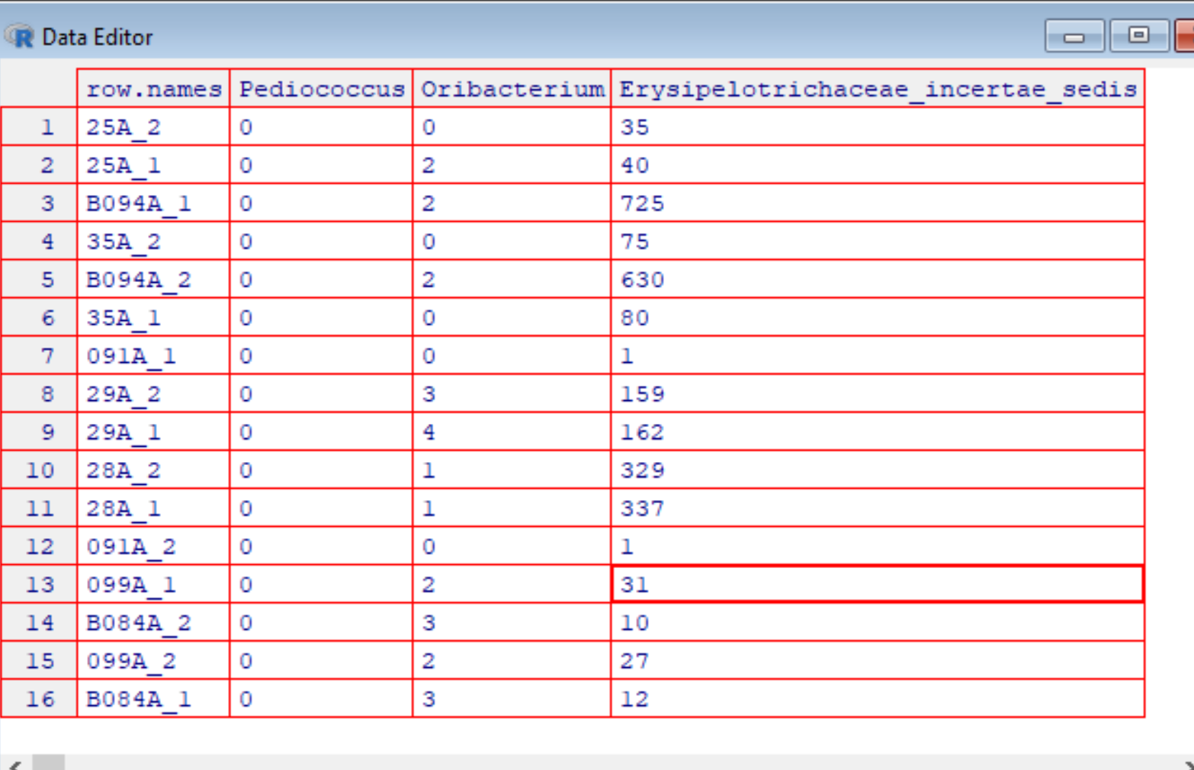
On Windows (but not necessarily in Macs or in R-studio, I get this nice view when I type
edit(myT)
Interestingly, changes I
type here don’t persist.
(I would have to type
myT <- edit(myT))
to have the changes
I type into the
spreadsheet stick.
This is because data
structures in R are
Immutable!

Slide 15
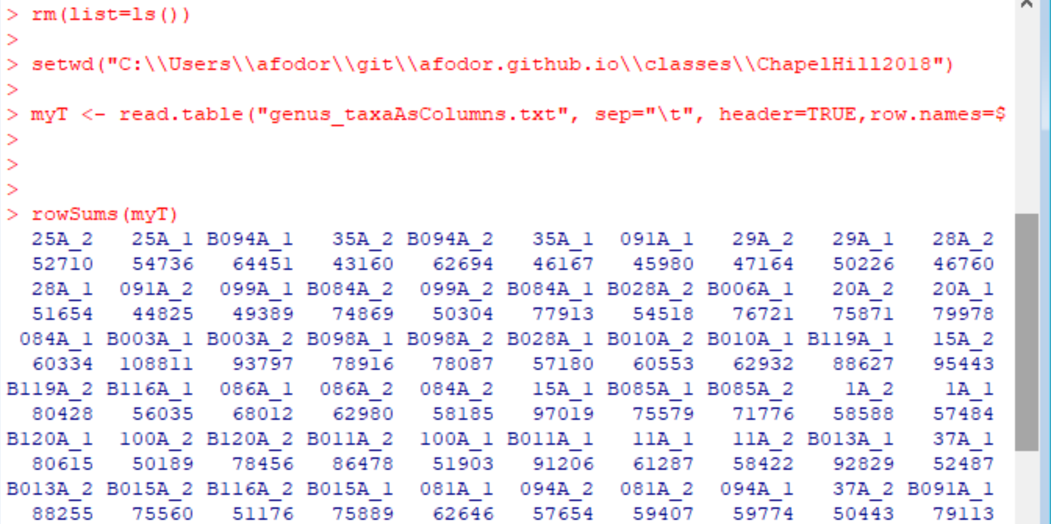
If I type
rowSums(myT)
R gives me the sequencing depth per sample

Slide 16
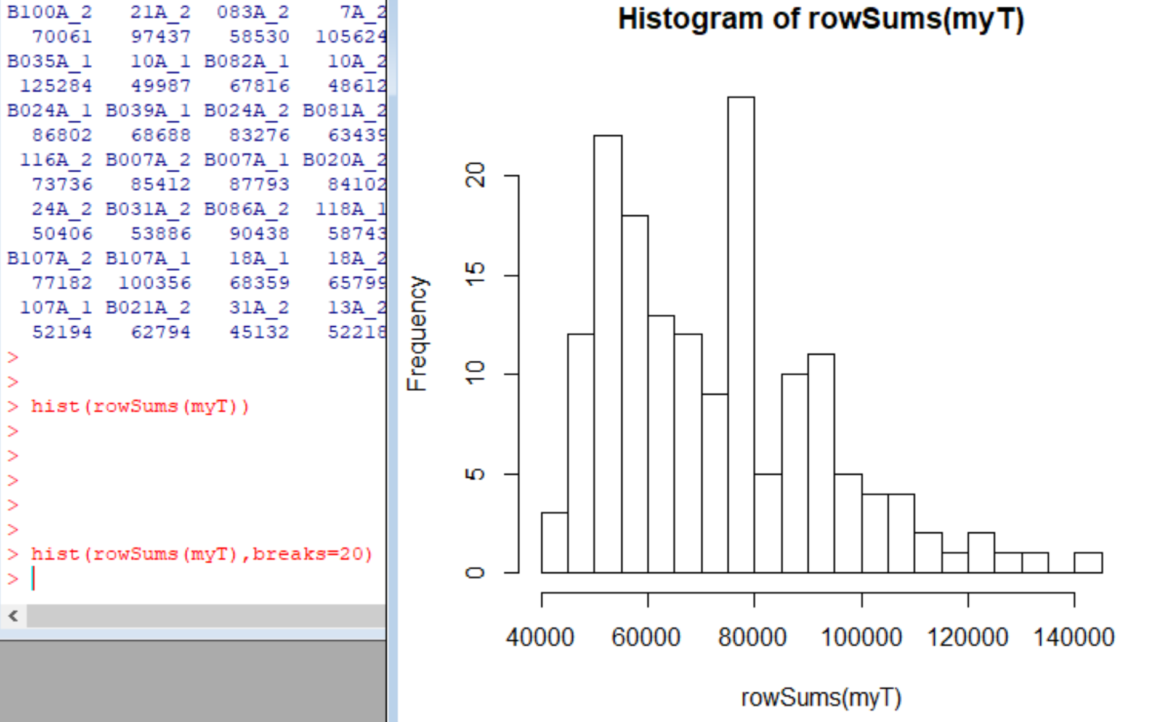
If I type
hist(rowSums(myT))
I get a nice graphic of my sequencing depth per sample. Very easy, informative QA/QC

Slide 17
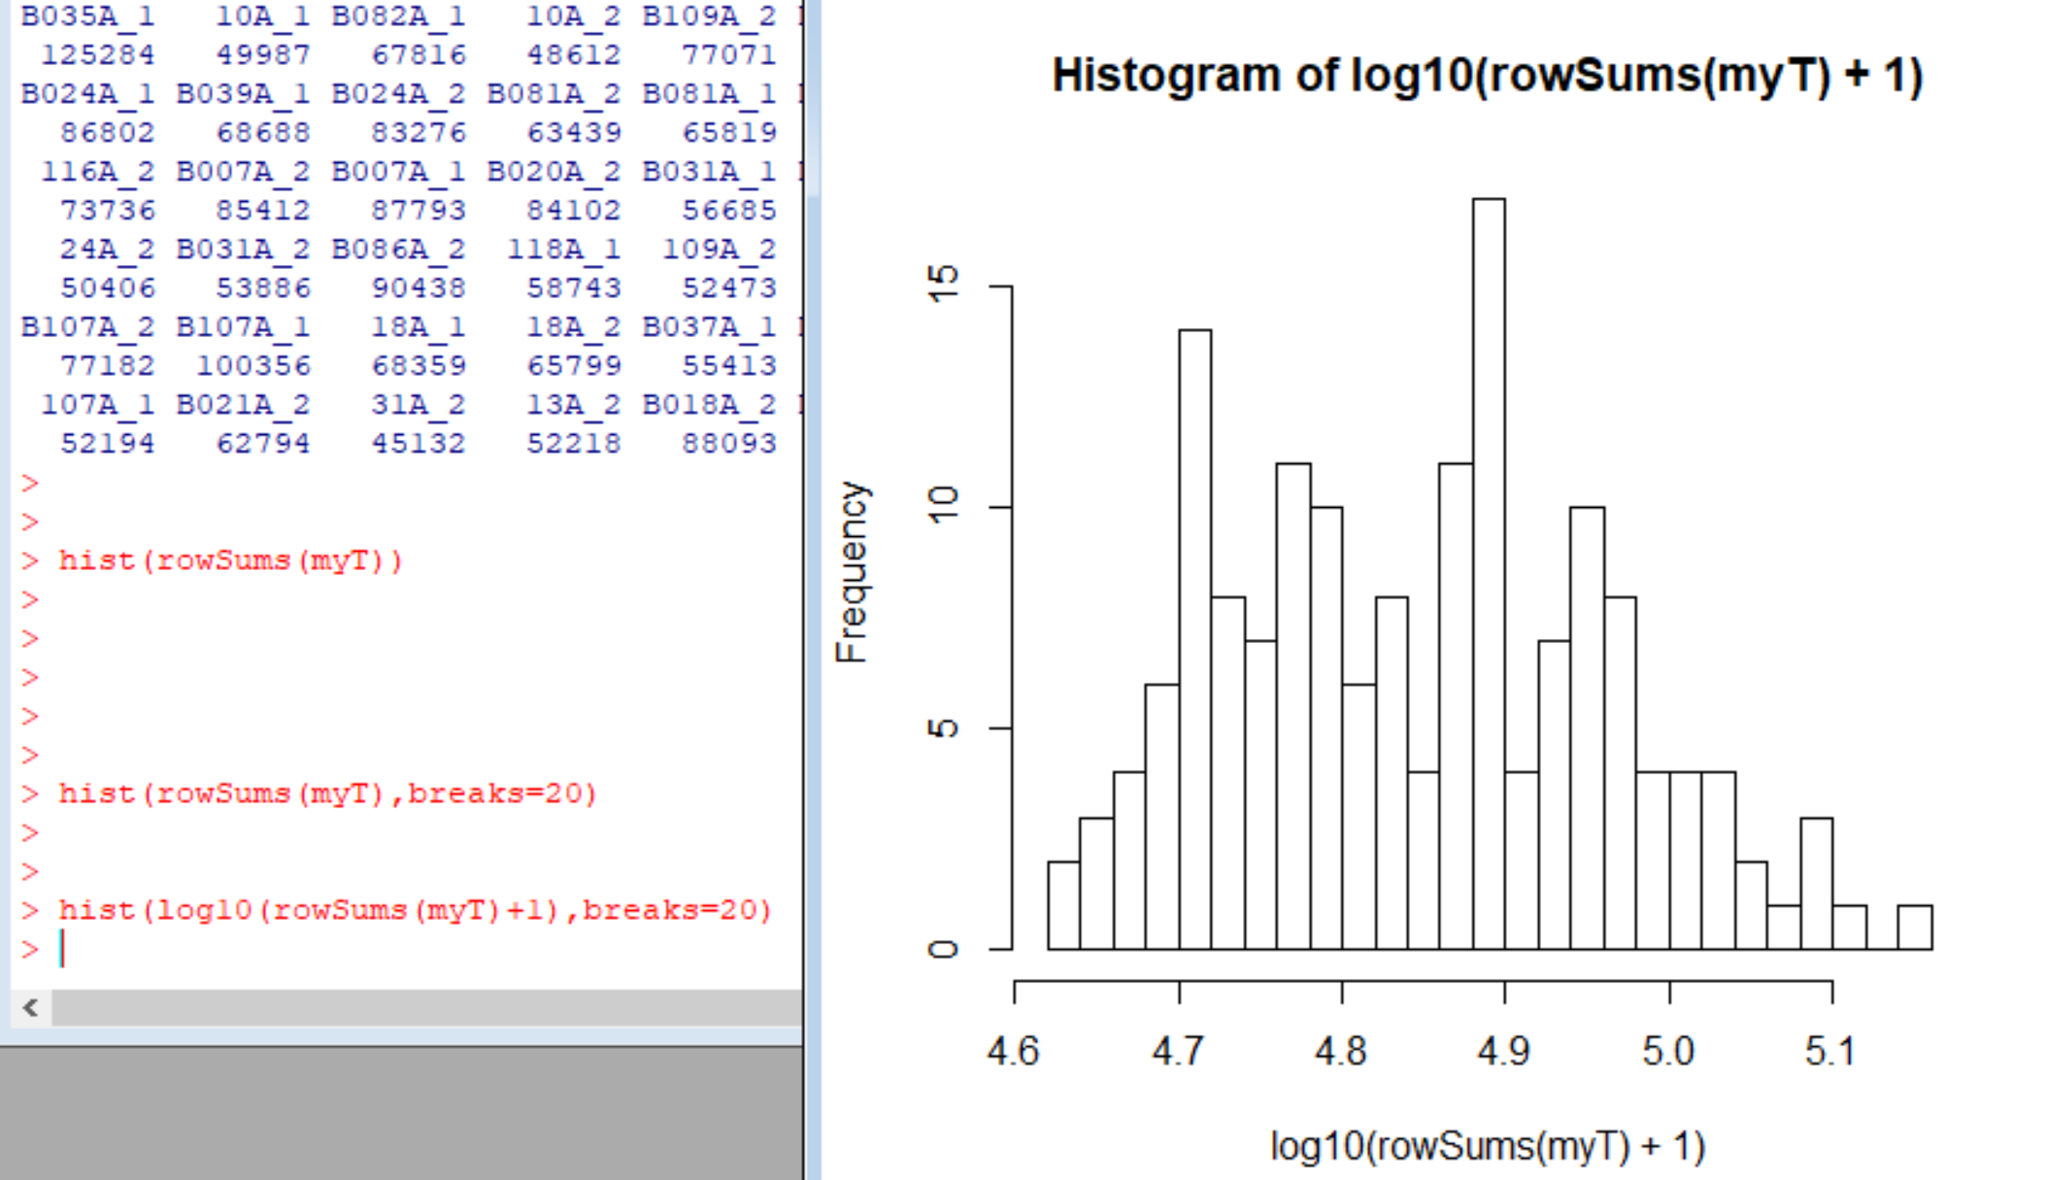
Alternatively, I can easily switch to a log scale…

Slide 18
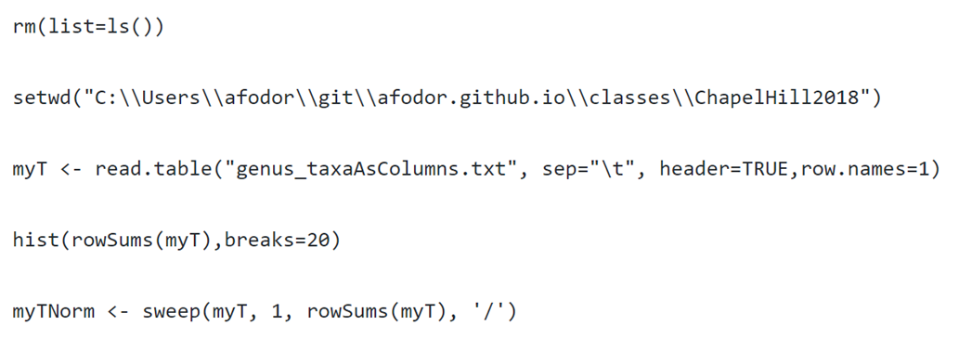
I can use the rowSums directly to switch to relative abundance

Slide 19
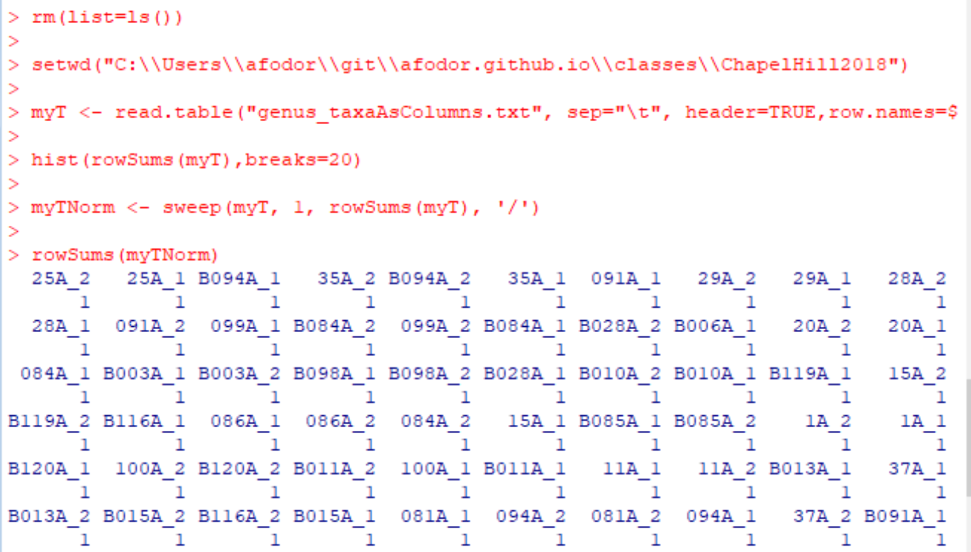
The rowSums on myTNorm should all be 1 (and they are)

Slide 20
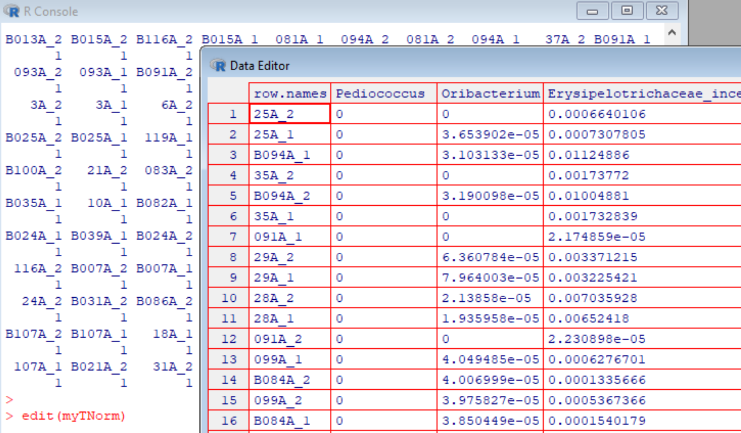
myTNorm is now in relative abundance

Slide 21
Finally, we want to be able to write our normalized file to an output file.
This is a little more involved than it seems like it should be
(learning R is mostly learning stupid R tricks…)
R by default will not give the sampleIDs a
column header.
This hacks around that default behavior

Slide 22
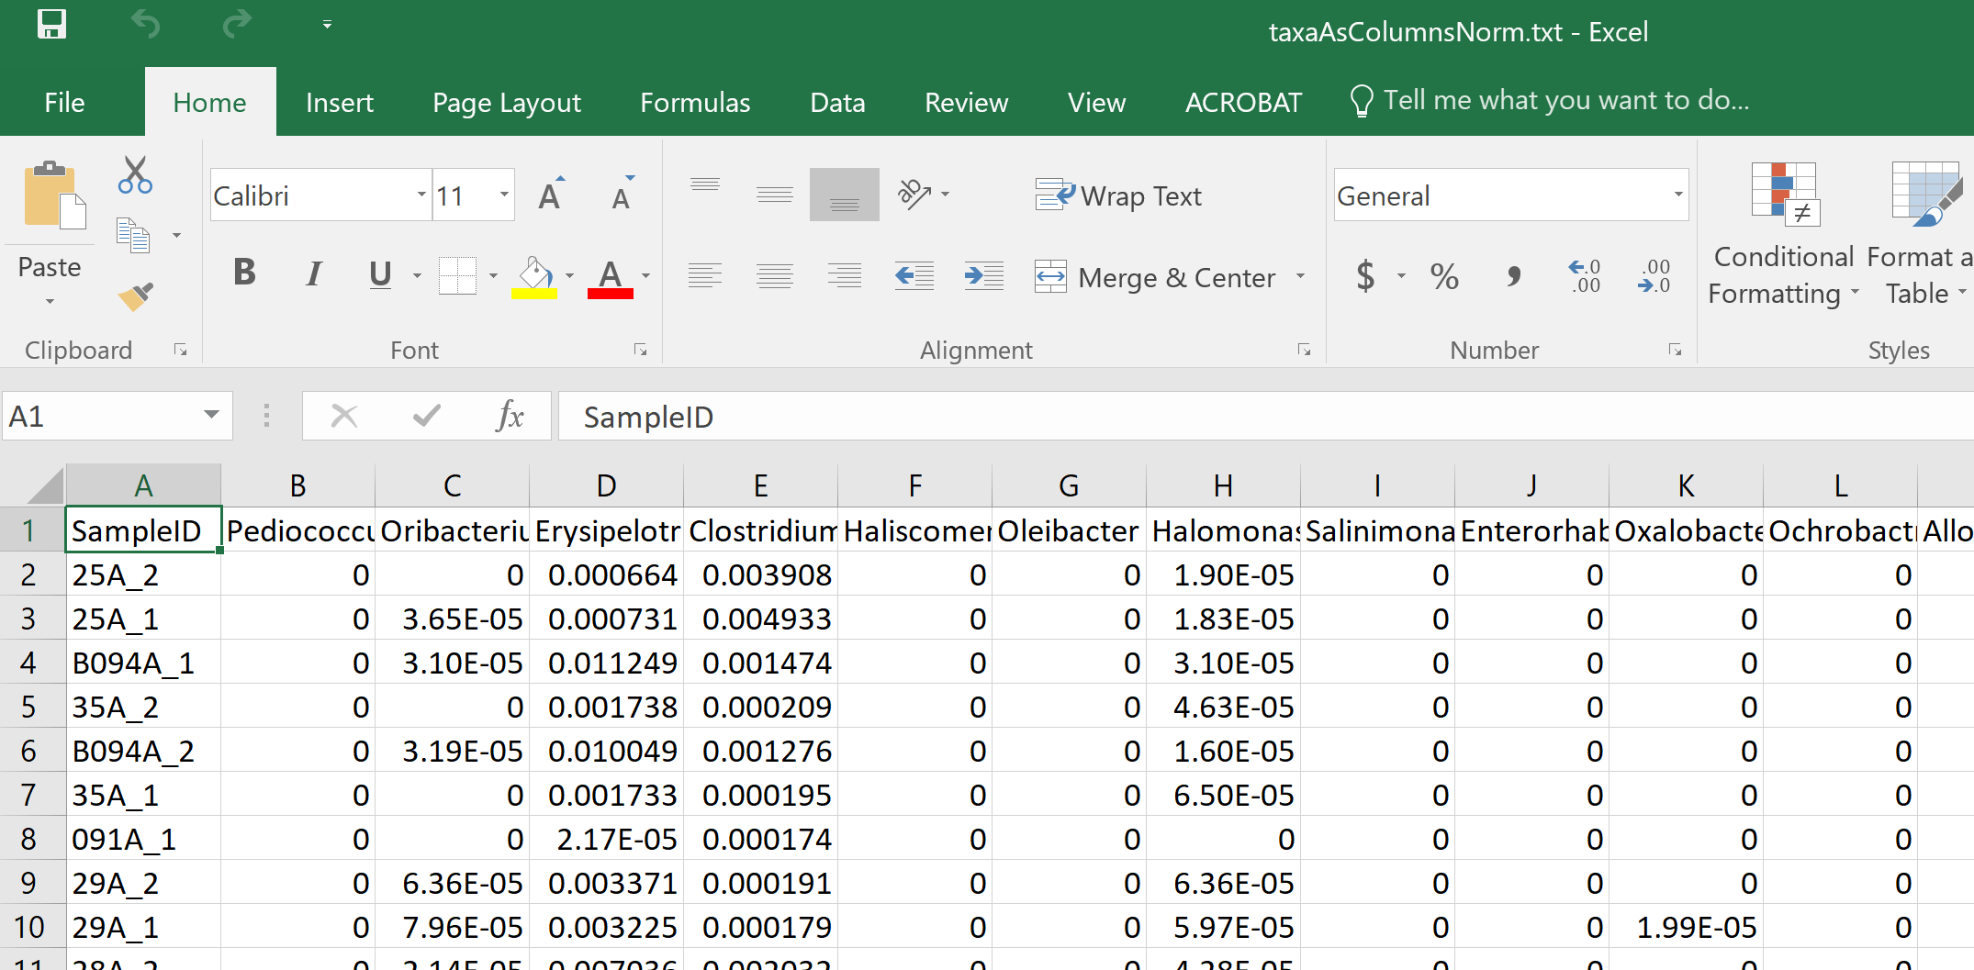
We end up with a text file in our working directory that can be imported into Excel (or wherever)

Slide 23
Normalizing your data
PCA Ordination
Graphing everything into one big PDF ball
Some Simple Statistical Models
Some Not So Simple Statistical Models

