Slide 1
Last time:
mean and variance of an empirical distribution
Initial commands in R
Everything in R is a vector ;
elements of a vector all share a common data type

Slide 2
Reading for the next week:
Vassar stats book: Chapter 5 – Chapter 6
(basic concepts of probability through binomial distribution)
(or equivalent in your favorite canonical stats book)
Art of R programming:
Chapter 2 ( Vectors), Chapter 4 (Lists)
(or equivalent chapters here: http://heather.cs.ucdavis.edu/~matloff/132/NSPpart.pdf)

Slide 3
Lists in R
R is not a high-performance language
GC content from Java to R
The Uniform distribution
Mean and SD on discrete theoretical distributions
The law of large numbers

Slide 4
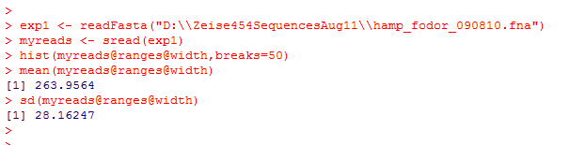
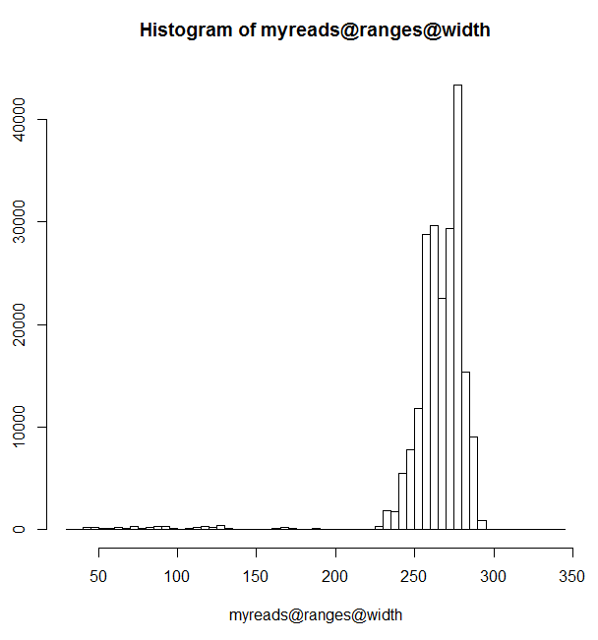
Last time, we used the very nice readFasta function from BioConductor

Slide 5
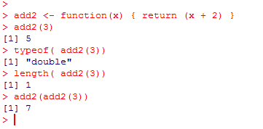
We can make our own functions in R…
Here we return a vector of type double and length 1

Slide 6
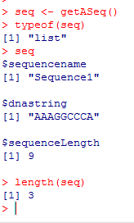
Vectors in R can only hold one data type.
Lists, on the other hand, can hold multiple data types.
Lists can be thought of vectors of vectors (or recursive vectors)
Here we have a function that returns a List describing a DNA sequence
getASeq <- function()
{
aSeq <- list()
aSeq$sequencename <- "Sequence1";
aSeq$dnastring <- "AAAGGCCCA";
aSeq$sequenceLength <- nchar(aSeq$dnastring)
return (aSeq)
}
seq is a list with 3 elements:
1: sequenceName (== “Sequence1”)
2: dnastring (== “AAAGGCCCA”)
3: sequenceLength (== 9)
This is completely different from data structures in Java and will take some getting used to!

Slide 7
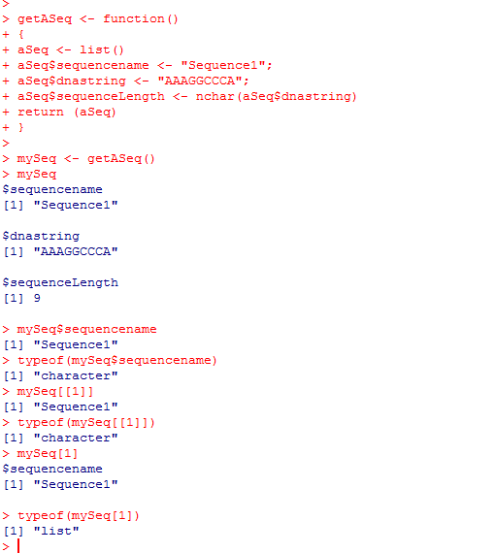
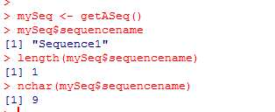
The elements in a list can be referred to either by their name or by their index
Element 1 in our list – a character vector of length 1

Slide 8
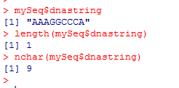
The elements in a list can be referred to either by their name or by their index
Element 2 in our list – a character vector of length 1

Slide 9
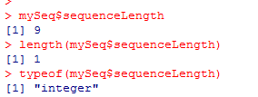
The elements in a list can be referred to either by their name or by their index
Element 3 in our list – a integer vector of length 1

Slide 10
The elements in a list can be referred to either by their name or by their index
This is equivalent to mySeq$sequencename
Note that [[]] and [] are different operators!

Slide 11
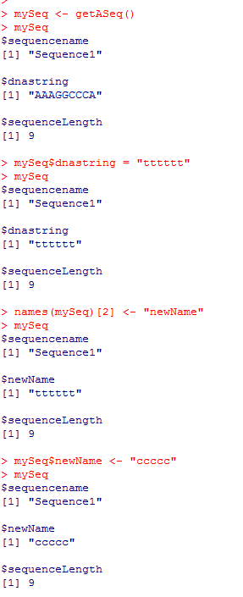
We can read and write the names associated with our list dynamically…
getASeq <- function()
{
aSeq <- list()
aSeq$sequencename <- "Sequence1";
aSeq$dnastring <- "AAAGGCCCA";
aSeq$sequenceLength <- nchar(aSeq$dnastring)
return (aSeq)
}
Give this 2nd element of this list a new name

Slide 12
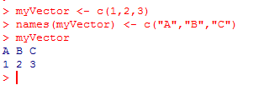
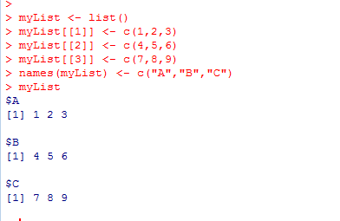
Name tricks work for vectors as well ….
(which makes sense because a List is just a vector of vectors !)
(note the [[ ]] operator )

Slide 13
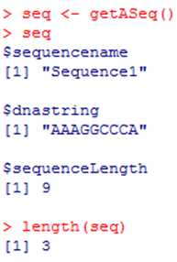
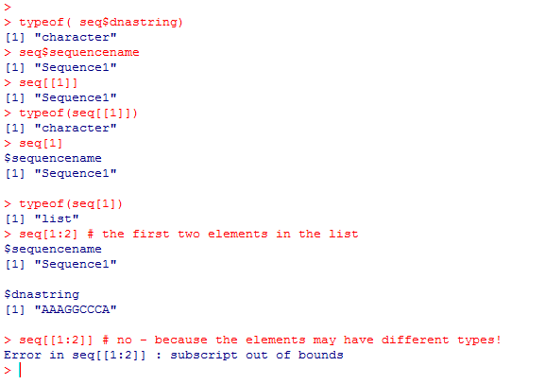
Beware the [] vs. [[]] differences !!!
getASeq <- function()
{
aSeq <- list()
aSeq$sequencename <- "Sequence1";
aSeq$dnastring <- "AAAGGCCCA";
aSeq$sequenceLength <- nchar(aSeq$dnastring)
return (aSeq)
}
Return as type “character”
Return as type “character”
Return as a sub list of type “list”
The [] operator returns a sub-list
The [[]] operator returns
the requested item cast to type

Slide 14
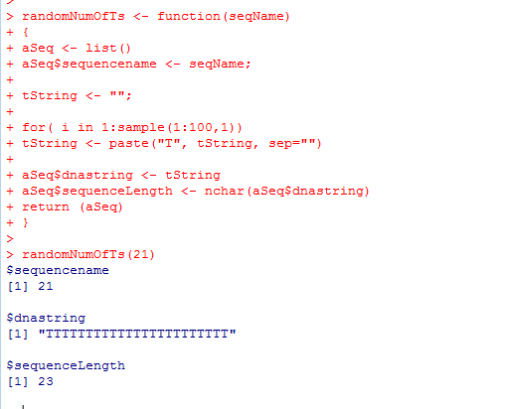
Here is a very inefficient function that returns a sequence with a number of T’s between 1 and 100
randomNumOfTs <- function(seqName)
{
aSeq <- list()
aSeq$sequencename <- seqName;
tString <- "";
for( i in 1:sample(1:100,1))
tString <- paste("T", tString, sep="")
aSeq$dnastring <- tString
aSeq$sequenceLength <- nchar(aSeq$dnastring)
return (aSeq)
}

Slide 15
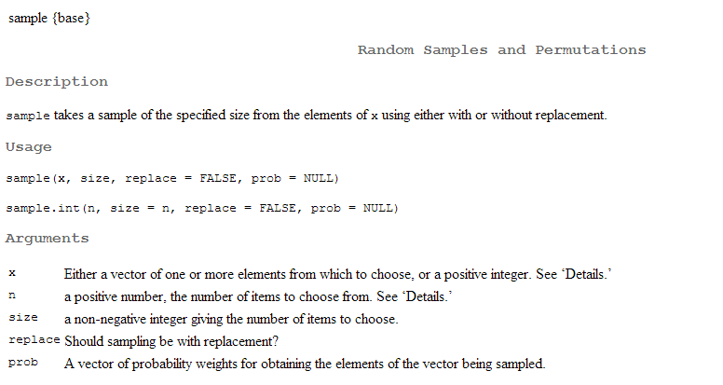
?sample

Slide 16
Here is a (failed) attempt to implement a function to make a vector holding a set of these sequences…
getRandomCollection <- function(numToGet)
{
returnVector <- vector();
if(numToGet >= 1 )
{
for( i in 1:numToGet)
{
returnVector[i] <- randomNumOfTs( paste("Seq", i,sep=""));
}
}
return (returnVector);
}
paste return a Character vector concatenating its arguments (equivalent of “Seq” + i in Java )

Slide 17
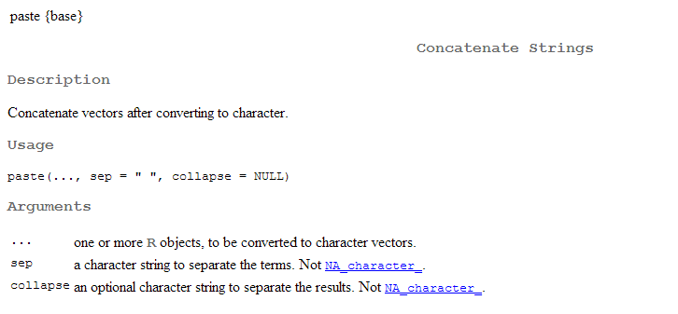
?paste

Slide 18
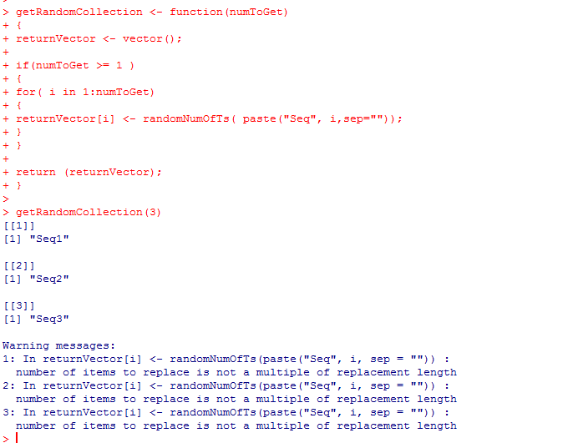
(Our first failed attempt….)

Slide 19
What went wrong???
This is a single element of the vector…
This is a list of length 3
R didn’t understand that we wanted the entire
list placed in each element of the vector..
It tried to copy just the first element…
A seriously annoying error message you will see all the time…

Slide 20
Our second (failed) attempt to implement a function to hold our sequences
getRandomCollection <- function(numToGet)
{
returnList <- list();
if(numToGet >= 1 )
{
for( i in 1:numToGet)
{
returnList[i] <- randomNumOfTs( paste("Seq", i,sep=""));
}
}
return (returnList);
}

Slide 21
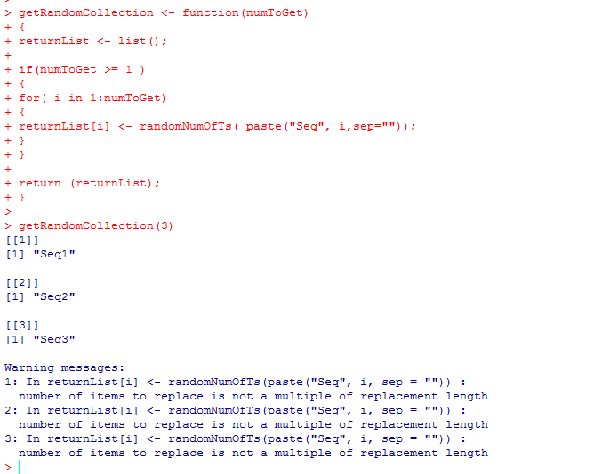
This is not any better….

Slide 22
What went wrong?
This is a new sublist with element i;
My intuition here would be a set of empty lists,
but that is not what R does!

Slide 23
Here (finally) is solution that does what we want….
getRandomCollection <- function(numToGet)
{
returnList <- list();
if(numToGet >= 1 )
{
for( i in 1:numToGet)
{
returnList[[i]] <- randomNumOfTs( paste("Seq", i,sep=""));
}
}
return (returnList);
}
Access each element in the underlying list..

Slide 24
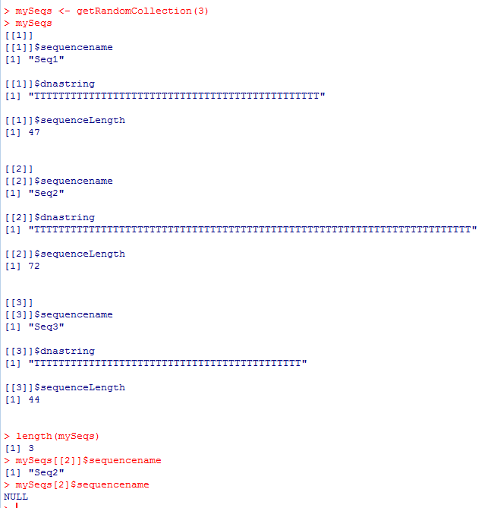
Using the [[]] operator gets the list I put in
Using the [] operator gets a new list containing the list I put in
(that new list does not have a type $sequenceName at the top level )

Slide 25

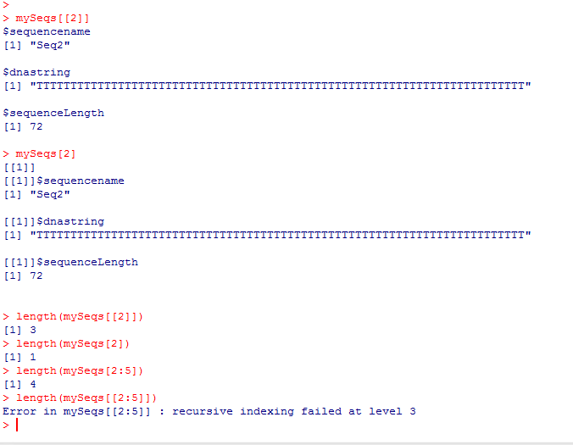
Again: [] vs. [[]] is confusing….
The list we put in (length=3)
A new list containing the list we put in (length=1)
The list we put in (length=3)
A list containing the list we put in (length=1)
Ok. A list containing sequences 2-5
R can’t interpret this
A not helpful error message!

Slide 26
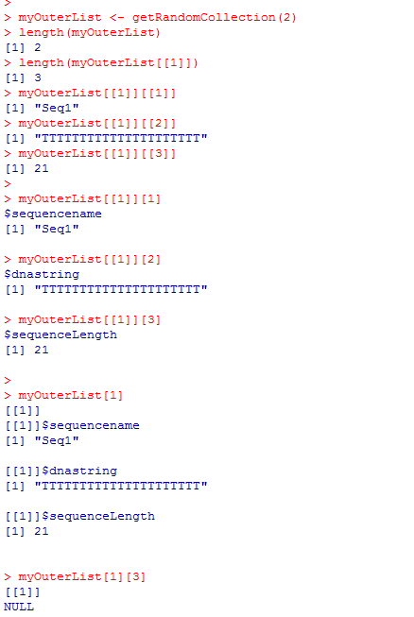
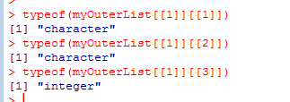
Again: [] vs. [[]] is confusing….
Our two sequence “objects”
The first sequence
The three elements of the first sequence as vectors…

Slide 27
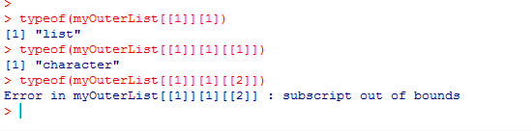
The three elements of the first sequences as lists
each containing a single vector

Slide 28
The first sequence as a new list of length 1
containing the original list that has the three vectors!

Slide 29
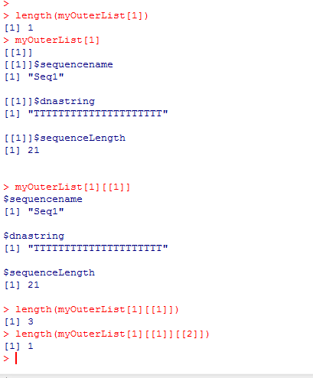

The first sequence as a new list of length 1
containing the original list that has the three vectors!

Slide 30
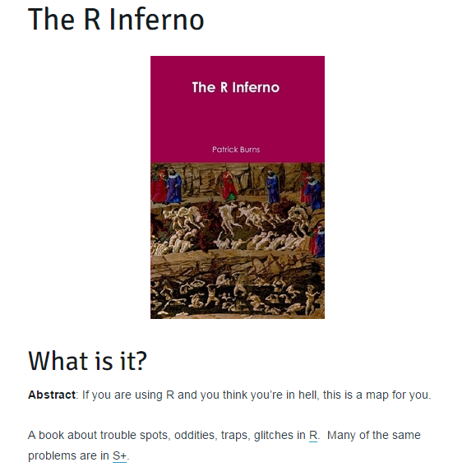
These examples do not reflect good design decisions in R!
http://www.burns-stat.com/documents/books/the-r-inferno/
(we won’t be covering this book this semester, but it is certainly worth a look…)

Slide 31
Lists in R
R is not a high-performance language
GC content from Java to R
Theoretical distributions
The Uniform distribution
Mean and SD on discrete theoretical distributions
The law of large numbers

Slide 32
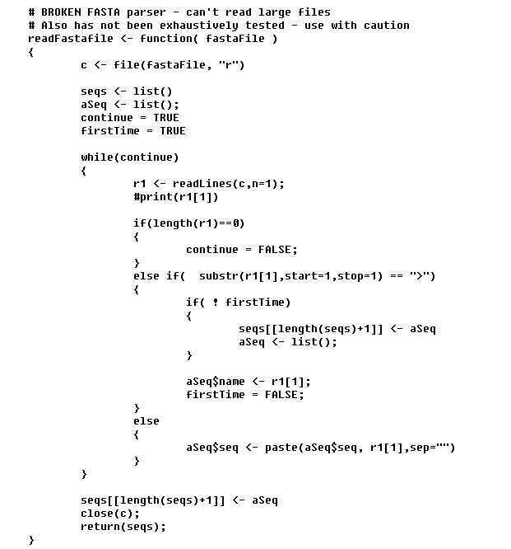
A (slow) Fasta parser…
Open up an input stream for reading
Read one line
Read the first character
Add our new sequence
to the end of the list
Append each line of the sequence
Any ideas why this would be unusably slow?

Slide 33
By default, every R function makes a copy of the input data structures.
This line:
seqs[[length(seqs)+1]] <- aSeq
makes a copy of the entire list and then adds one to the end…
Equivalent to Java’s “CopyOnWriteArrayList”
You can try and work around this, pre-allocate the list, etc, etc.
But a better solution is to write the parser is some other language and
import into R as a native method…

Slide 34
Lists in R
R is not a high-performance language
GC content from Java to R
Theoretical distributions
The Uniform distribution
Mean and SD on discrete theoretical distributions
The law of large numbers

Slide 35
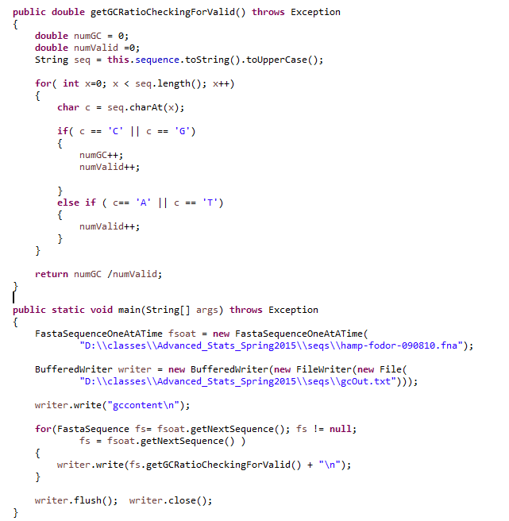
Here is some Java code to check GC ratio and dump the results to a file…
https://github.com/afodor/metagenomicsTools/blob/master/src/parsers/FastaSequence.java

Slide 36
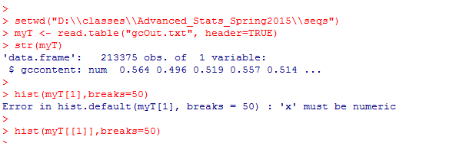
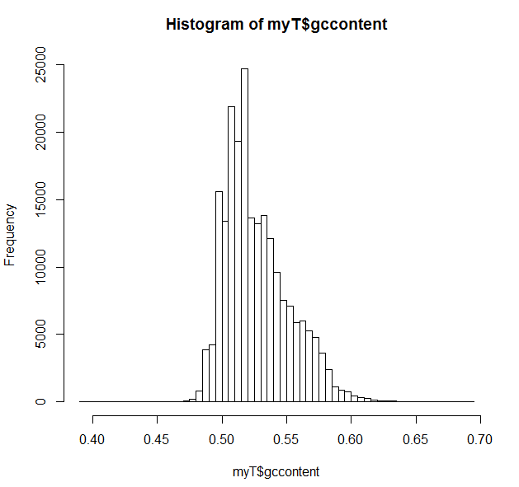
To make the histogram…

Slide 37
To make the histogram…
If we use setwd, only have to type the directory once…
read.table is a command we will see a lot of
We don’t know what data.frame is, but
it is probably some kind of vector…
No; this returns a new list of length 1!
If you don’t know what [] you will be
saying to the computer, what do you mean
it’s not numeric
This works!
Alternatively: hist(myT$gccontent,breaks=50)

Slide 38
Lists in R
R is not a high-performance language
GC content from Java to R
The Uniform distribution
Mean and SD on discrete theoretical distributions
The law of large numbers

Slide 39
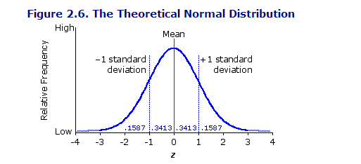
A theoretical distribution is a mathematical description of what we expect to see in
a series of observations…
The most famous distribution is the normal distribution;
Likely familiar from your previous stats. Class
We will get there soon…
http://vassarstats.net/textbook/

Slide 40
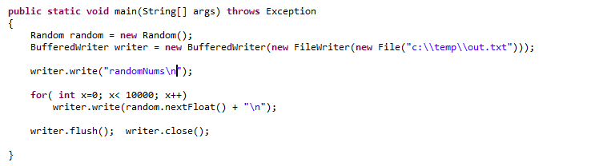
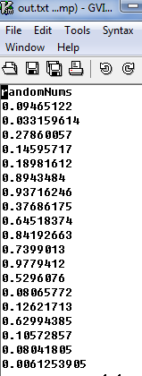
But we will start with the Uniform distribution.
The Uniform distribution is what is sampled when you call on Java’s Random number generator
When we call random.nextFloat() we are sampling the Uniform distribution from an interval of 0 and 1

Slide 41
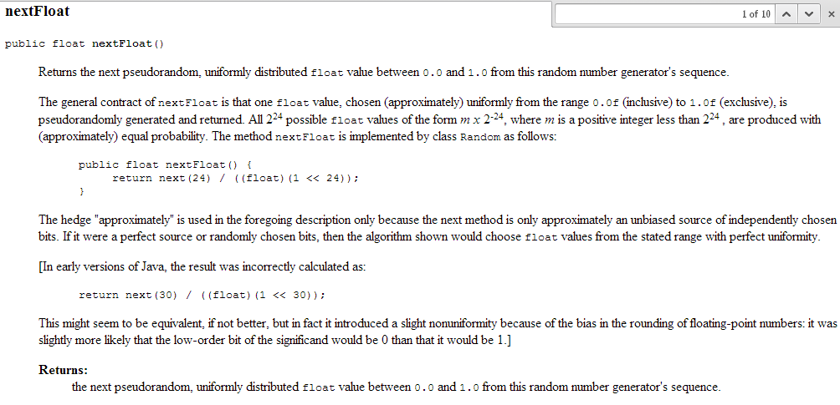
When we call random.nextFloat() we are sampling the Uniform distribution from an interval of 0 and 1

Slide 42
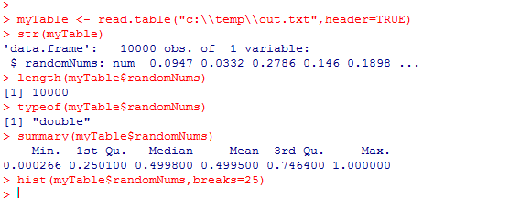
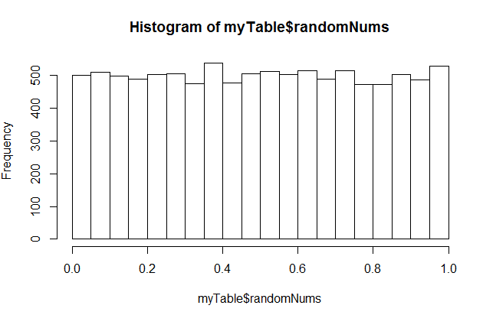
We can use R to investigate the results of calling nextFloat()
myTable – reads our file and returns
a DataFrame.
A DataFrame in R is a set of vectors
(like a spreadsheet).
In this case, we only have one vector
of type double.
str() asks R for the structure of an Object
The uniform distribution means that any value between
0 and 1 is equally likely

Slide 43
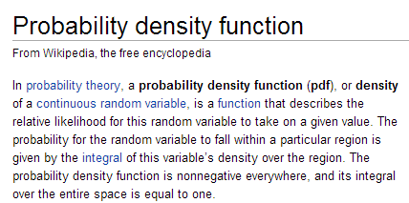
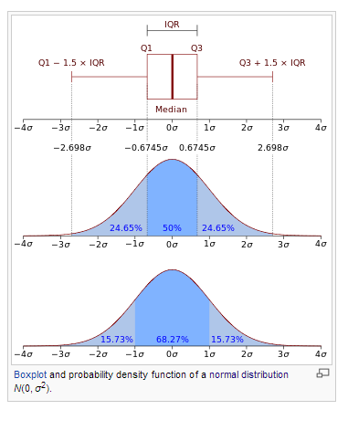
We can define a probability density function (pdf) for the uniform distribution.
Chapter 3 of “Doing Bayesian analysis” by Kruschke has a nice description of pdf’s
A PDF is a “sponge” with an area set to 1;
The shape of the the “sponge” tells you
the probability of seeing different values

Slide 44
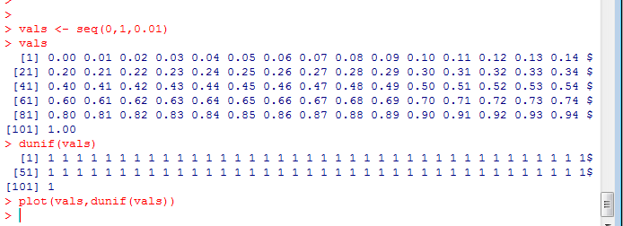
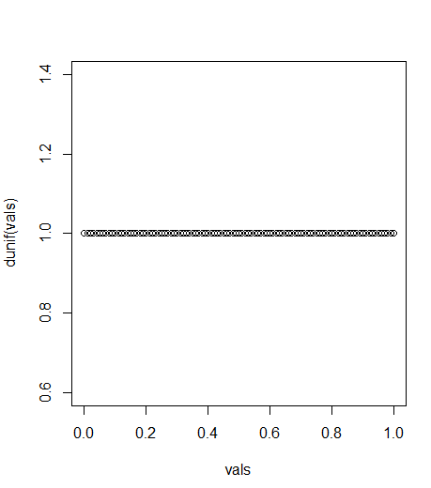
The Uniform distribution has a very boring probability density function..
Again, we sample uniformly between 0 and 1

Slide 45
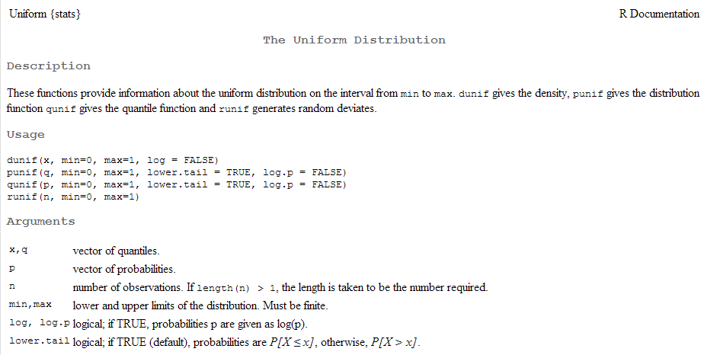
Here we made use of dunif(…)
Given a vector x, return the probability density of that vector from the Uniform distribution.
(dunif is vector in/vector out)

Slide 46
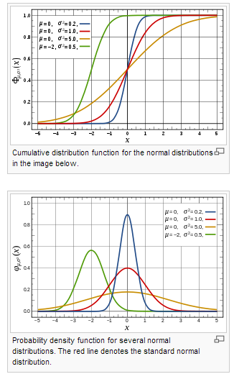
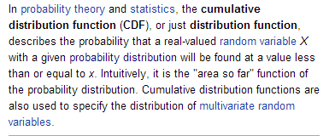
We can also define a cumulative distribution function.
http://en.wikipedia.org/wiki/Cumulative_distribution_function

Slide 47
This is given by punif..

Slide 48
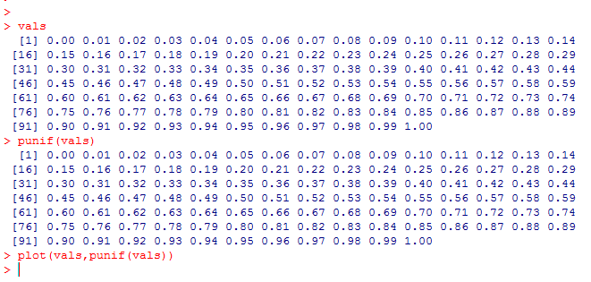
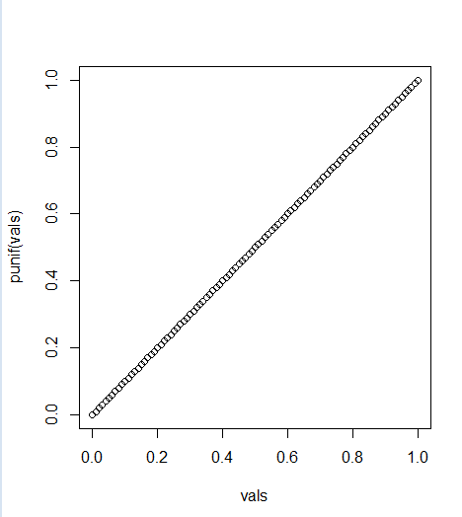
punif gives the cumulative uniform distribution
20% of the time, I expect to see 0.2 or less
50% of the time, I expect to see 0.5 or less.
70% of the time, I expect to see 0.7 or less..

Slide 49
Uniform distributions are pretty boring but…
A statistical test repeated many times in cases in which null
hypotheses are always true will yield a uniform distribution
of p-values between 0 and 1.
UNLESS the assumptions of the test are not valid.
This will make more sense as the semester progresses!

Slide 50
So what does this have to do with bioinformatics or microarrays.
Consider a microarray with 25,000 genes.
Let’s say you are comparing cancer cells to non-cancer cells
(with n=3 in each condition).
This is like performing 25,000 experiments at once.
For each gene, we form a null hypothesis of no change.
If we know there really is no change (for example, the same DNA
is applied to all of the microarrays), then all of these null
hypotheses are true. If we apply a statistical test (say the t-test)
25,000 times the resulting distribution should be uniform…

Slide 51
This is one of the papers that came out of an independent
Project from the first time I taught this course (Tim Tickle was
one of 4 students)

Slide 52
here is the same graph of actual vs. expected p-values
This is a way of measuring how good the assumptions of
our statistical tests are in case where we know there should be
no differences between samples..

Slide 53
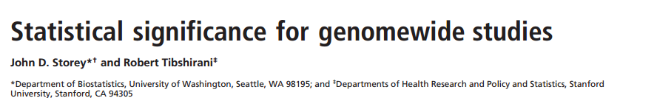
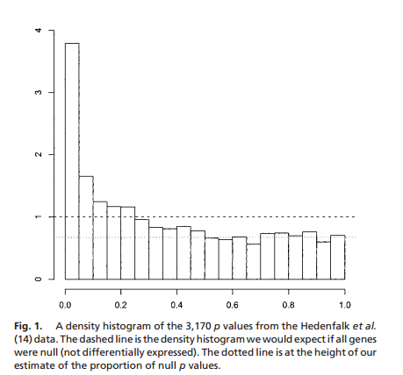
Comparison to the uniform-distribution can be used to perform inference.
If there was no difference between case and control, p-values should be uniform.
If they are smaller than uniform, the experiment showed differences…
Basis for Storey q-values
(more on false discovery rate later
The dashed lines is the uniform distribution

Slide 54
For Bayesian statistics, the uniform distribution is often an appropriate prior
when you have no expectations about what you expect in the data…
(More on this later)

Slide 55
Lists in R
R is not a high-performance language
GC content from Java to R
The Uniform distribution
Mean and SD on discrete theoretical distributions
The law of large numbers

Slide 56
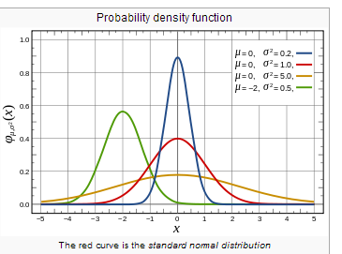
We are used to thinking about mean and standard deviation as the parameters on the normal distribution
However mean and variance can be defined on any discrete or continuous probability distribution

Slide 57
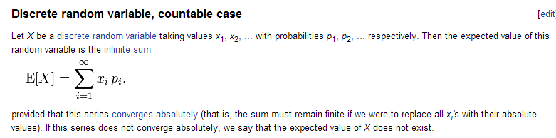
Consider a fair die with
p(1) = 1/6
p(2) = 1/6
p(3) = 1/6
p(4) = 1/6
p(5) = 1/6
p(6) = 1/6
P(7 or greater) =0
This is a discrete probability distribution.
The prob(1..6) = 1
The mean, or expected value is defined as
1/6 * 1 + 1/6 *2 + 1/6 * 3 + 1/6*4 + 1/6 *5 + 1/6 * 6 = 3.5
http://en.wikipedia.org/wiki/Expected_value

Slide 58
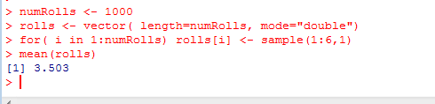
Expected value (mean) for a fair die:
1/6 * 1 + 1/6 *2 + 1/6 * 3 + 1/6*4 + 1/6 *5 + 1/6 * 6 = 3.5
We can confirm the correctness of this calculation with simulated data in R:
We pre-allocate to avoid concatenation
The mean is within error of the expected value

Slide 59
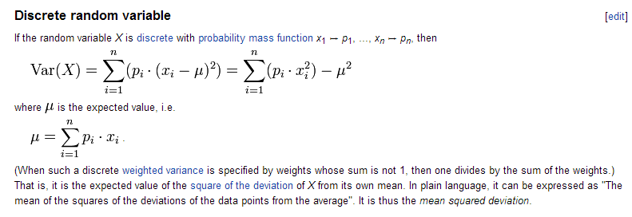

We can likewise define variance for any distribution..
For our fair die:
(1/6) ( 1 – 3.5)^2 + (1/6) ( 2 – 3.5)^2 +
(1/6) ( 3 – 3.5)^2 +
(1/6) ( 4 – 3.5)^2 +
(1/6) ( 5 – 3.5)^2 +
(1/6) ( 6 – 3.5)^2 =2.916
http://en.wikipedia.org/wiki/Variance

Slide 60



We can ask: How many rolls of the dice do we need to reliably see the expected
mean and variance?
The more rolls we have,
the closer we get to the
expected values for mean
and values

Slide 61

An example of the law of large numbers
If you gamble for enough time, you will lose money…

Slide 62
Concepts for this lecture:
R concepts…
Lists are “recursive vectors” ;
allows collections of different data types
(read the List chapter in your textbook!)
Difference between the [] and [[]] operators for Lists
Lists of lists…
Statistical concepts…
Probability density functions (pdfs)
Mean and standard deviation of distributions.
The uniform distribution: dunif, punif in R..
The law of large numbers.

Slide 63
Reading for the next week:
Vassar stats book: Chapter 5 – Chapter 6
(basic concepts of probability through binomial)
(or equivalent in your favorite canonical stats book)
Art of R programming:
Chapter 2 ( Vectors), Chapter 4 (Lists)
(or equivalent chapters here: http://heather.cs.ucdavis.edu/~matloff/132/NSPpart.pdf)

