Slide 1
Monitor Pattern
Read only Collection views
Synchronized Collections views
Concurrent HashMap
The Vehicle Tracker Example

Slide 2
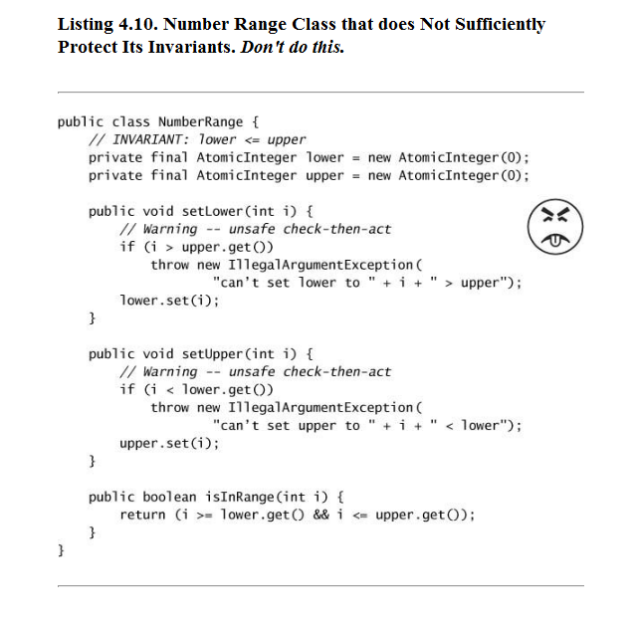
Why the frowny face?

Slide 3
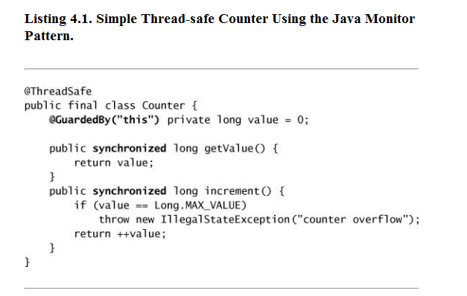
Java monitor pattern –
guard all state with “this”

Slide 4
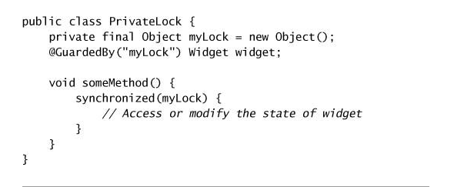
Using a private lock guarantees that you control all access…
(this is an alternative to the monitor pattern)

Slide 5
Monitor Pattern
Read only Collection views
Synchronized Collections views
Concurrent HashMap
The Vehicle Tracker Example

Slide 6
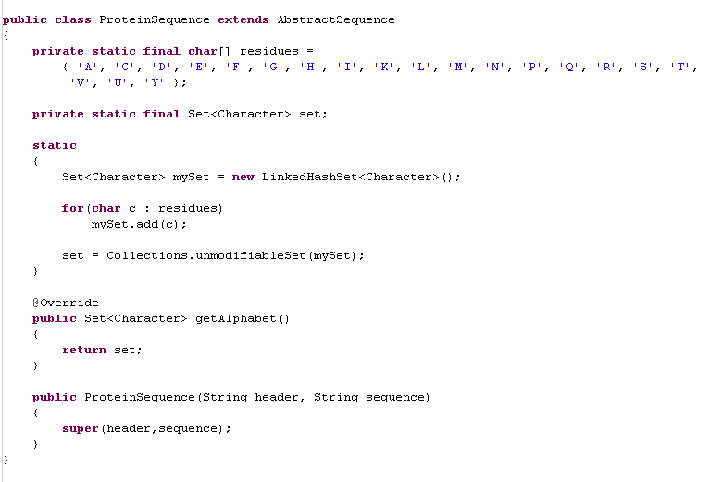
We’ve seen the “read only” view of an underlying collection is useful..
Immutability is a key tool in thread safety…
We extend AbstractSequence
Our static initializer to set up
our cached alphabet

Slide 7
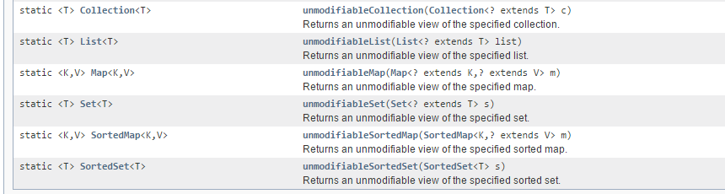
This is the “decorator” pattern. We wrap the collection is functions that throw an
Exception if the underlying class is modified…
https://docs.oracle.com/javase/7/docs/api/java/util/Collections.html
thows Exception()
UnmodifiableCollection
Get()
Set()
underlyingCollection

Slide 8
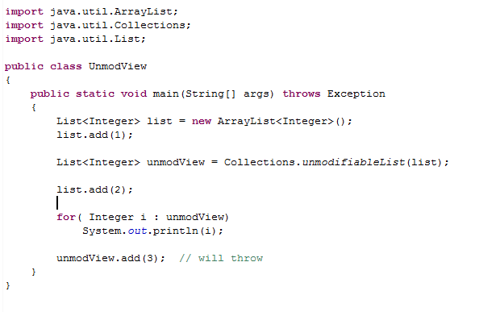
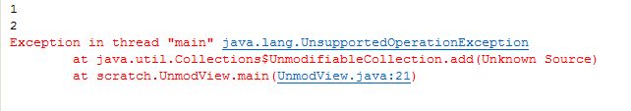
Will print out 1 and then 2

Slide 9
Read only Collection views
Synchronized Collections views
Concurrent Collections
The Vehicle Tracker Example

Slide 10
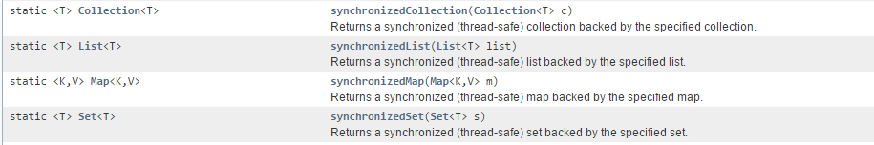
Alternatively (or in addition) we can create a synchronized collection.
Only one thread at a time can use this collection…
synchronizedCollection
Get()
Set()
synchronized(this)
synchronized(this)
underlyingCollection

Slide 11
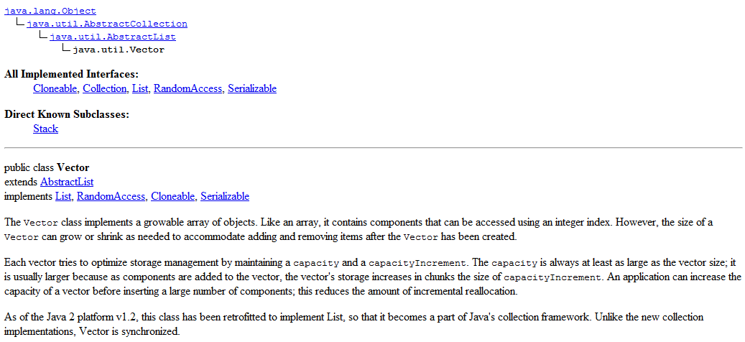
Vector is a synchronized list using the monitor pattern
(Vector is an equivalent to Collections.synchronizedList( myList ) )

Slide 12
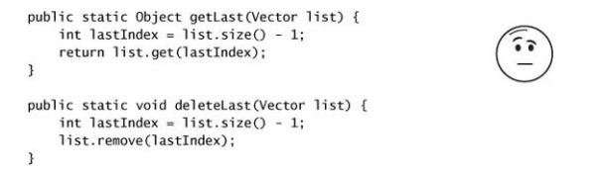
Why the so-so face?

Slide 13
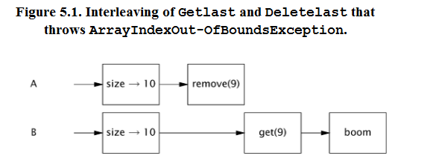
This is thread safe, but might not be what the user expects.
Thread safe: the underlying data will not be corrupted!
But may throw an Exception that the user isn’t expecting!

Slide 14
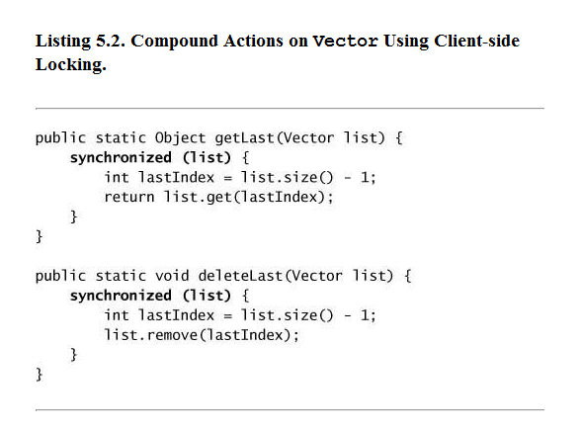
One solution (utilizing the monitor pattern).
Make getting the last element atomic (so that what is the “last” element can’t be
changed by different threads…)

Slide 15
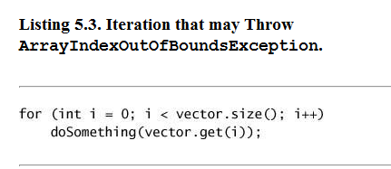
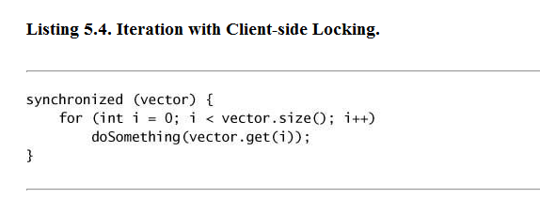
You have to be careful when iterating…
This will throw if the vector changes
between calling .size() and calling .get()
Again, this is threadsafe (the underlying data won’t get corrupted)
But the user may get an exception they are not expecting
The monitor pattern offers a solution (but could be very slow if the vector
Is big and/or doSomething is slow; no concurrency while the lock is held!)

Slide 16
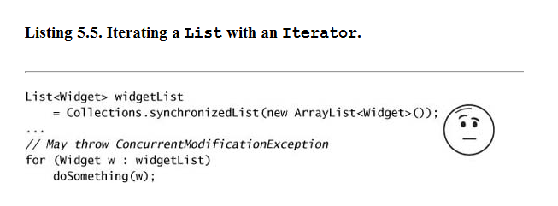
You have to be careful when iterating…
This is equivalent to a for loop that calls .size
(even though it doesn’t look like it!)

Slide 17
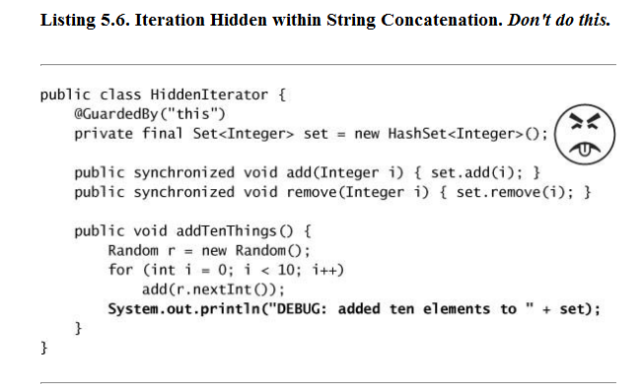
Why the frowny face?

Slide 18
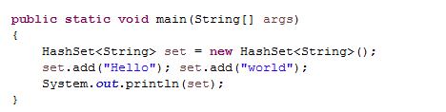

Why the frowny face?
Same problem. set.toString() iterates the set

Slide 19

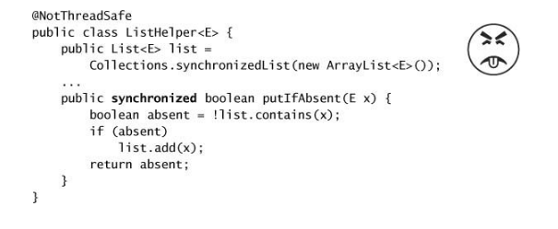
Botched attempt to use the monitor pattern..
Here is an attempt to add “put if absent” to a synchronized list
What’s wrong here?

Slide 20
Botched attempt to use the monitor pattern..
Here is an attempt to add “put if absent” to a synchronized list
This locks
ListHelper
These lock “list”
The wrong object is locked!!

Slide 21
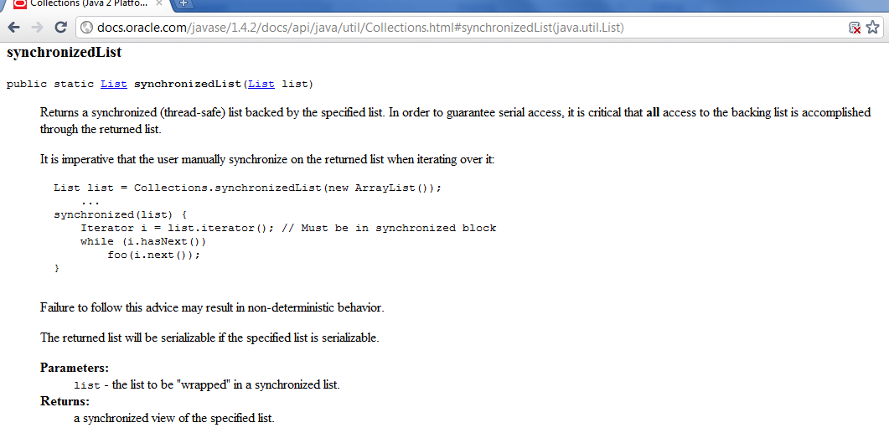
Every access to the returned list needs to respect the monitor pattern
and call synchronized(list)

Slide 22
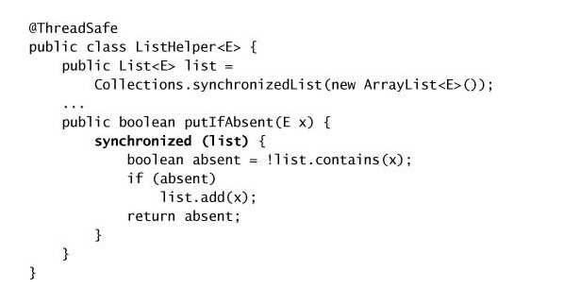
Why does this one work?

Slide 23
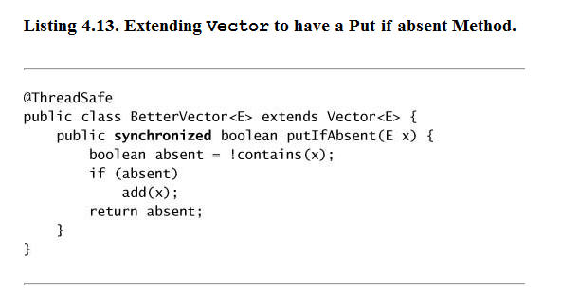
Why does this one work?

Slide 24
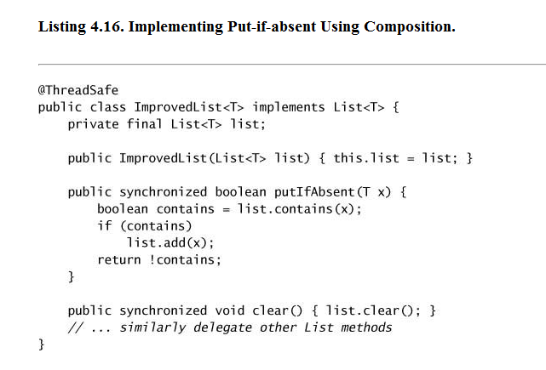
Composition (hasA) as an alternative to inheritance (isA)

Slide 25
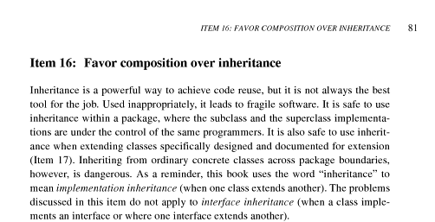
We follow Bloch here, “favor composition over inheritance…”

Slide 26
Read only Collection views
Synchronized Collections views
Concurrent Collections
The Vehicle Tracker Example

Slide 27
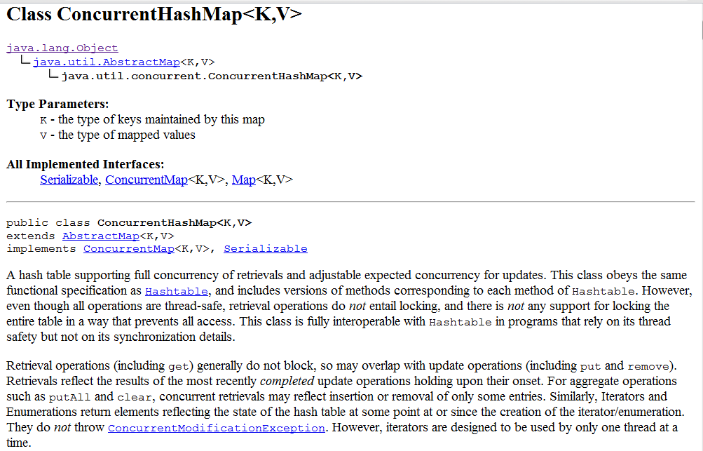
ConcurrentHashMap is a thread-safe HashMap

Slide 28
size() and isEmpty() are only approximate on concurrent collections
Concurrent collections do not lock on this.
If you grab a lock on the ConcurrentHashMap, that doesn’t stop another thread from
writing at the same time, because these classes do not use the monitor pattern

Slide 29
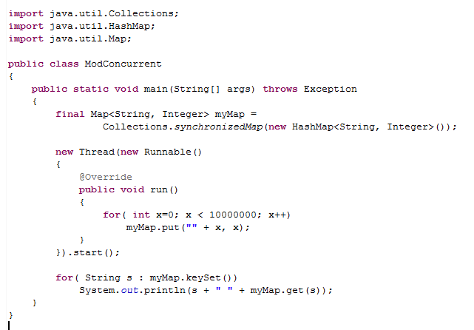
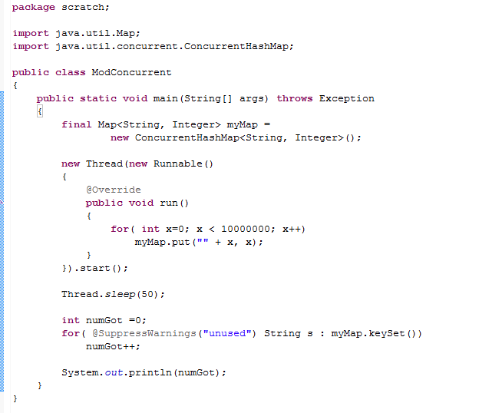
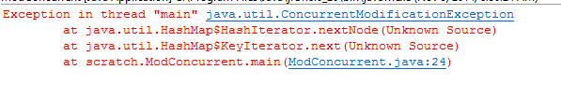
Concurrent collections do not throw ConcurrentModification Exceptions
Every time you run this, you will get a
different answer…
The state of the iterator is not rigorously
defined, but it won’t throw an Exception
Iteration gives you a view of the map
at some point in time which may change

Slide 30
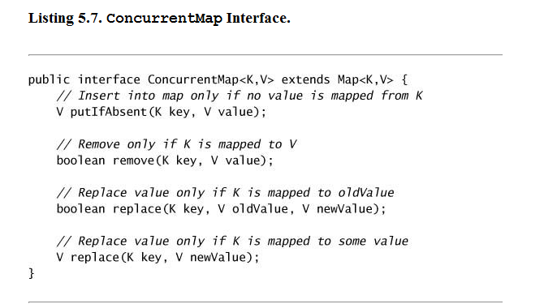
Many useful thread-safe functions are provided for you…

Slide 31
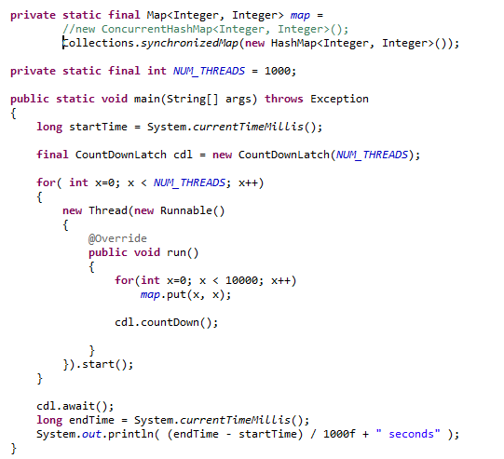
Putting lots of data into the Synchronized HashMap
block until countDown() is called NUM_THREADS time
(still pretty fast…..)

Slide 32
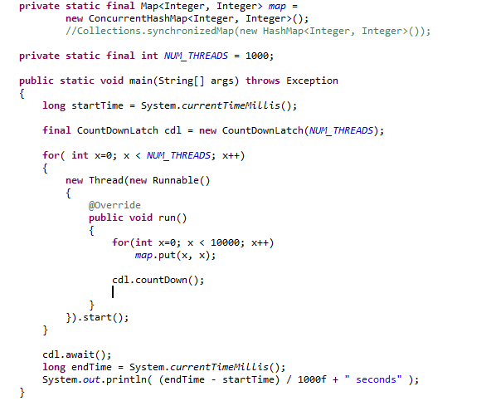

The concurrent hash map
Significantly faster “for free”

Slide 33
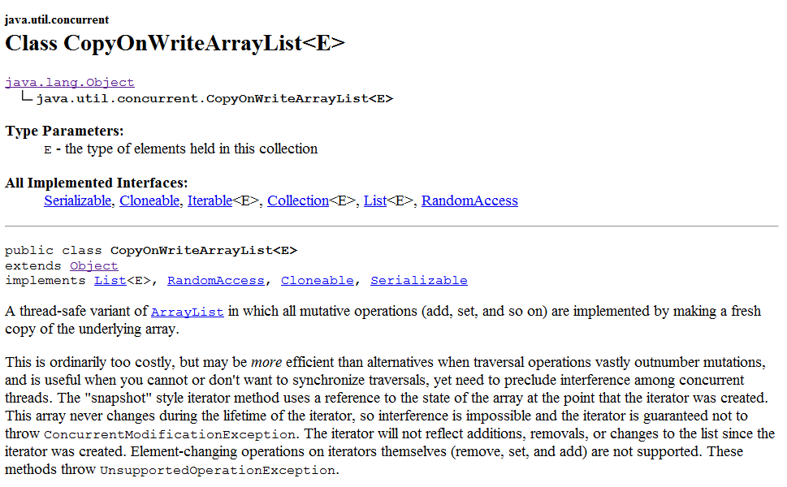

Slide 34
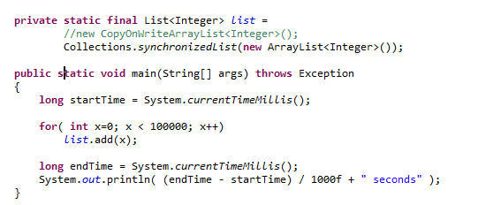
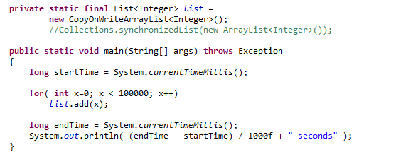
The CopyOnWriteArrayList – concurrency not so much for free

Slide 35
Thread safety through copying data….
Internal array #1
CopyOnWriteArrayList
Thread A calls “add”
Copy of internal arrays # is started
Thread B calls
get and gets an
element
from array #1
Time
Internal array #2 is created
CopyOnWriteArrayList
Internal array #2
Garbage collected
Internal array #1
Thread C calls
get and gets an element
from array #2

Slide 36
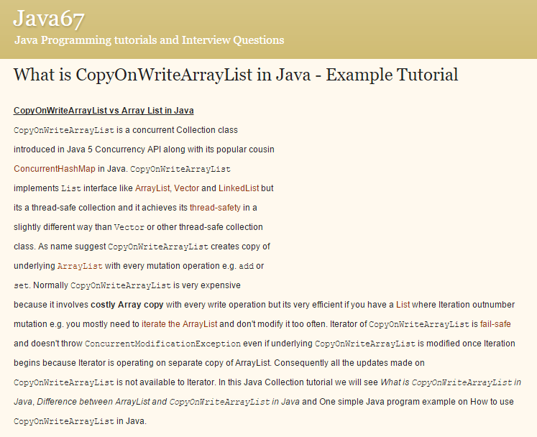
http://java67.blogspot.com/2012/09/what-is-copyonwritearraylist-in-java-example-vs-arraylist.html

Slide 37
Read only Collection views
Synchronized Collections views
Concurrent Collections
The Vehicle Tracker Example

Slide 38
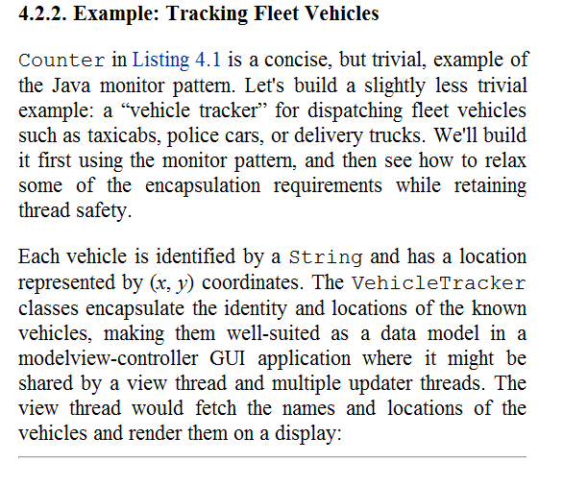
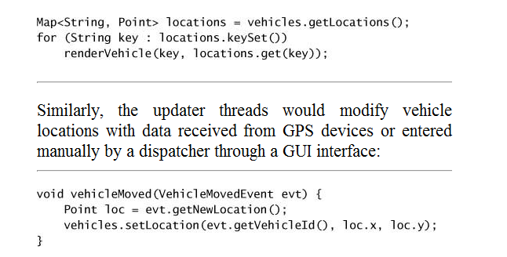
The “Vehicle tracking” example

Slide 39
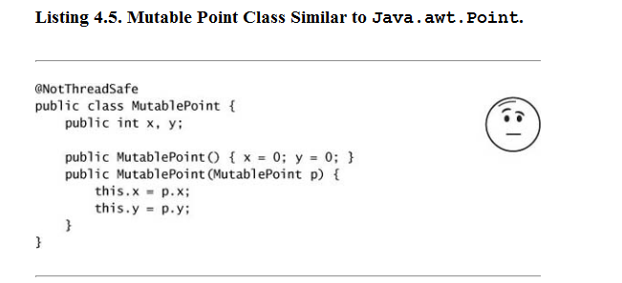
Solution #1: Thread safety through copying.
Define a mutable point…

Slide 40
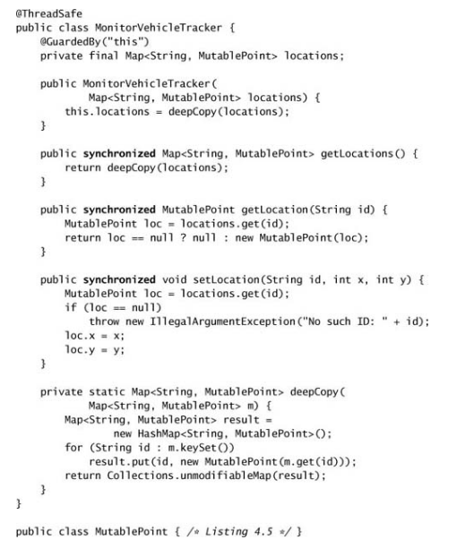
Assumes location doesn’t change
during object construction!
Thread safety via deep copies.
Once the constructor has fired,
no other thread can impact
locations.
User can think they are
changing the underlying data,
but calls to change mutablePoint don’t
make changes any other user can see

Slide 41
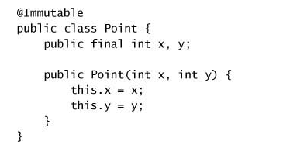
Solution #2: Make points immutable – achieve thread safety through delegation

Slide 42
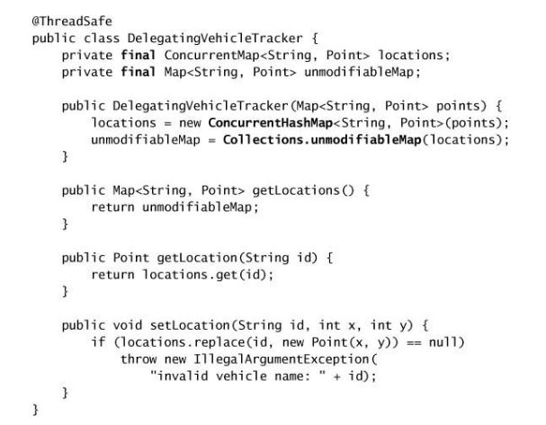
This will give a “real-time” view.
Updates written by thread A are seen by Thread B
Assumes points doesn’t change
during object construction!
Delegate thread
safety to the
ConcurrentHashMap
Use the decorator
pattern twice!

