Slide 1
One Way ANOVA with multiple levels
Combining ANOVA and regression

Slide 2
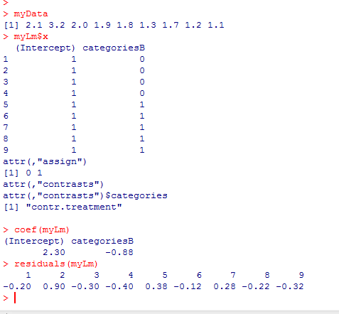

Previously we used a one way ANOVA to do a test with one factor and two levels..
The full model has sum squared residual of 1.488 with 7 d.f.
=
B₀
+
B₁
+

Slide 3

The reduced model (B1=0) has sum squared residual 3.208889 with 8 d.f.
=
B₀
+
The errors will be minimized when
B₀ = mean of data

Slide 4
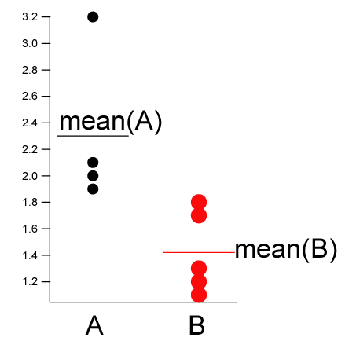
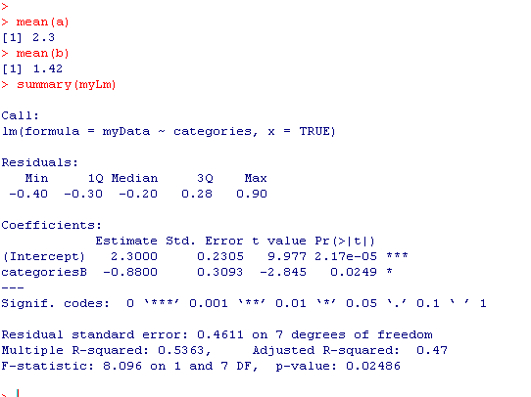
“Full model” ; 7 degrees of freedom (n=9 – 2 parameters).
The mean of A and B are modeled as distinct
The mean of A
The difference between the mean of
A and the mean of B.
The null hypothesis is that this is zero
(i.e. that mean(A) == mean(B))
A is the “background” ; B is compared to A.
We can switch that with relevel

Slide 5
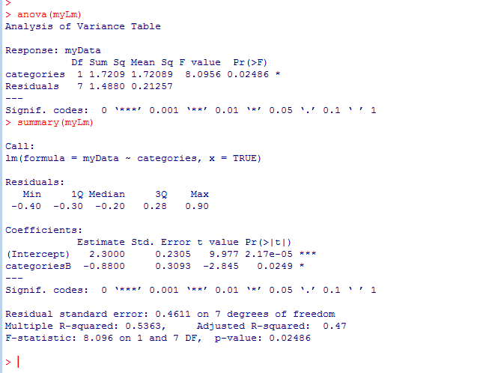
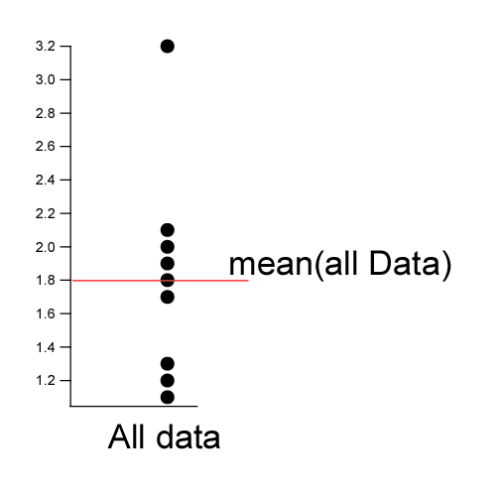
“Reduced model” ; 8 degrees of freedom (n=9 – 1 parameters).
There is only one grand mean.
The ANOVA asks does the full model explain significantly more of the data than does
the reduced model?
The null hypothesis is that the data is explained best by one mean

Slide 6
It is straight-forward to extend this to multiple levels.
Consider a measurements (e.g. weight) for three genotypes
A/A A/a a/a
4.3
2.3
4.5
5.6
4.2
3.9
2.8
2.7
2.3
1.9
1.3
1.2
1.8
2.1
1.6
0.9
1.1
1.2
2.1
0.5
0.9
AA <- c(4.3,2.3,4.5,5.6,4.2,3.9,2.8)
Aa <- c(2.7,2.3,1.9,1.3,1.2,1.8,2.1)
aa <- c(1.6,0.9,1.1,1.2,2.1,0.5,0.9)
myData <- c(AA,Aa,aa)
genotypes <- c( rep("AA",length(AA)), rep("Aa",length(Aa)), rep("aa",length(aa)))
genotypes <- factor(genotypes)
myLm <- lm( myData ~ genotypes, x=TRUE)
anova(myLm)
myLm$x

Slide 7
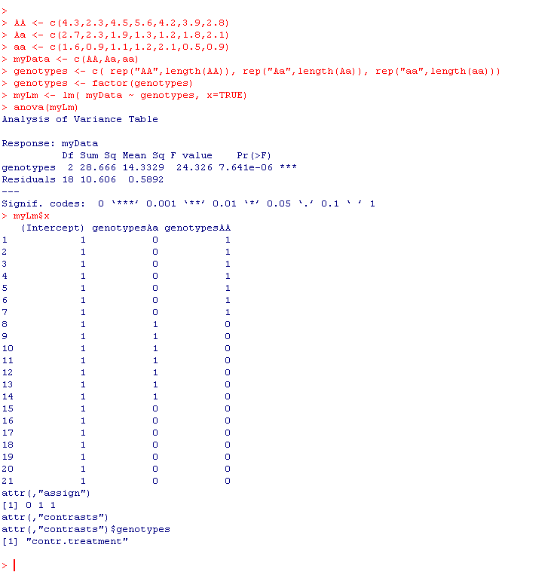


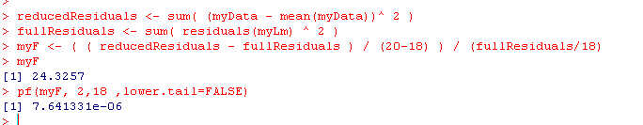
Full model:
weight = intercept + Aa + AA + E
(aa is background)
Residuals for full model is 10.6057
With 18 d.f. (n=21 – 3 parameters)
Reduced model:
weight = mean + E
20 D.F. (n=21 – 1 parameter)

Slide 8
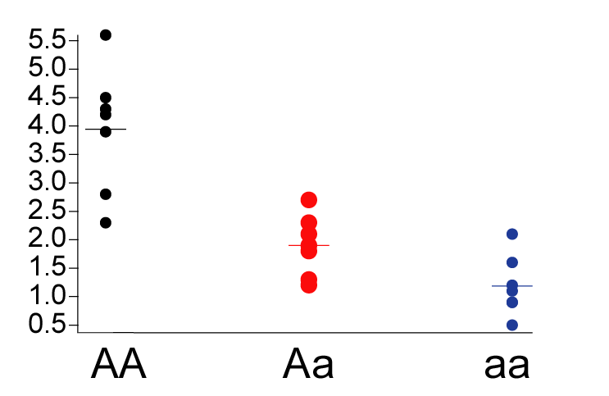
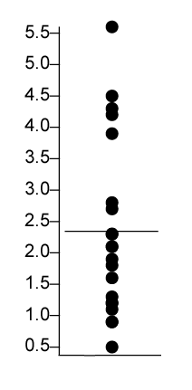
Full model: With three means
weight = intercept + Aa + AA + E
Reduced model: With one means
weight = B0 + e
ANOVA test: do we reduce the error by a significant amount by adding
the additional parameters?

Slide 9
This p-value tests the null hypothesis
that µ_{AA} = µ_{Aa} = µ_{aa}
It doesn’t tell us which of these
individual means are different.
So it evaluates that genotype makes a difference
But doesn’t tell us if, for example, µ_{AA} = µ_{aa}
These are “dummy variables” –
No two rows are non-zero

Slide 10
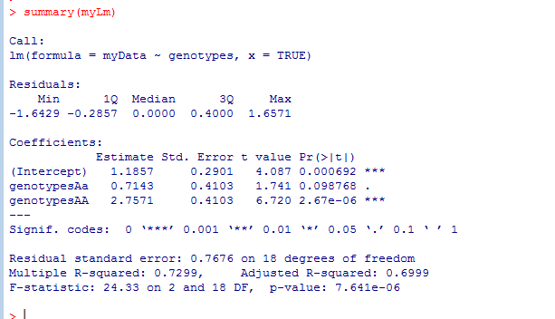
If we type summary, R will perform every comparison with respect to the chosen background
Here R chose “aa” as the background and compares everything to aa

Slide 11
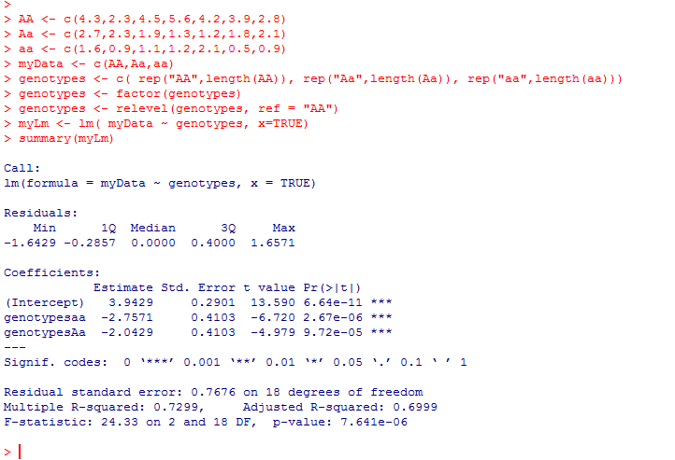
We can change which genotype is considered by using relevel
Here we use relevel to force all comparisons to AA

Slide 12
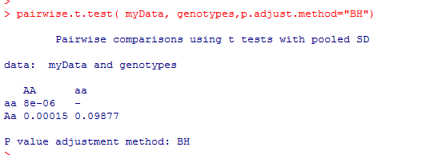
Alternatively, you can ask R to do every possible t-test…
(and correct for multiple comparisons!)

Slide 13
This problem could be considered as a quantitative problem (a regression).
Define gene “dose” (does of the “a” allele):
AA = 0
Aa = 1
aa =0
Then this view of the data……
Becomes…

Slide 14
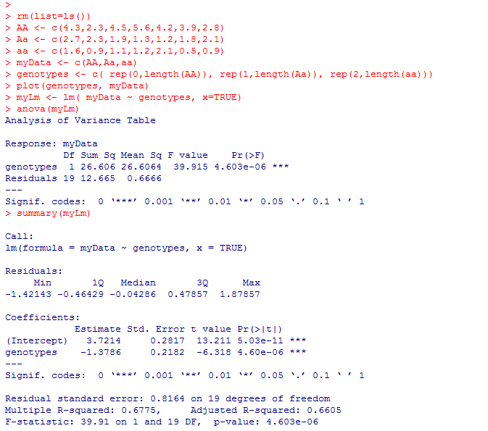
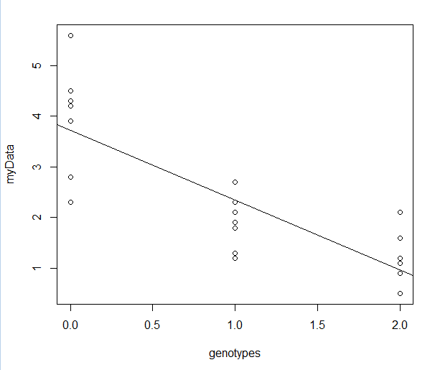

The linear regression view!

Slide 15
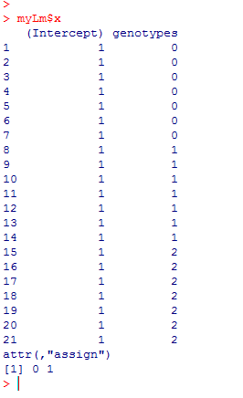

We’ve gained one degree of freedom as now our model has just two parameters
Y = B0 + B1*genotype + error
However, the Matrix form of our equation has not changed:
We can still use the ANOVA to determine the significance of both parameters

Slide 16
One Way ANOVA with multiple levels
Combining ANOVA and regression

Slide 17
The really interesting thing about linear models, is no matter how complicated they
get, the solution remains the same..
We can make models arbitrarily complex and the statistics will work
(whether they still have any meaningful biology is another question!

Slide 18
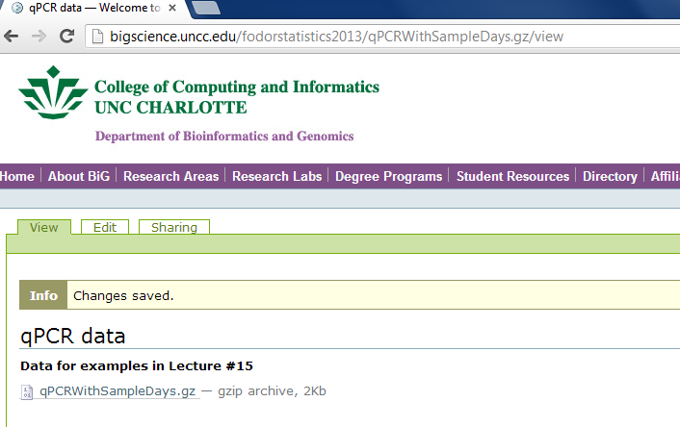
As an example of this, we will analyze a qPCR data set..
You can grab the data here:
http://afodor.github.io/classes/stats2015/qPCRWithSampleDays.txt

Slide 19
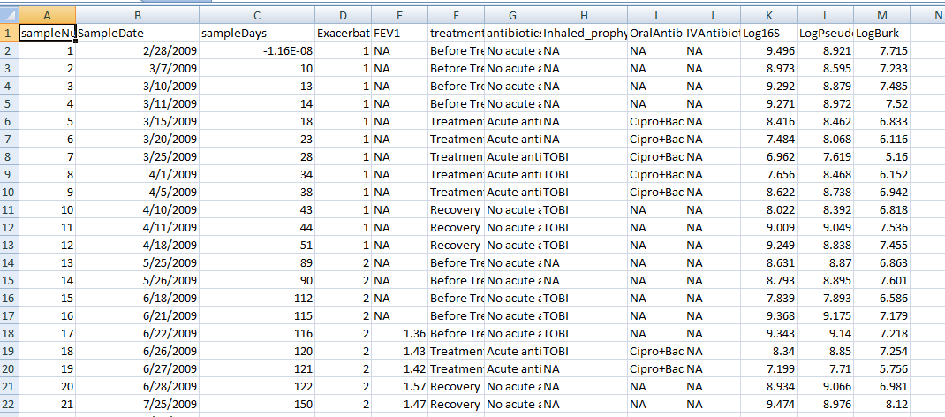
http://afodor.github.io/classes/stats2015/qPCRWithSampleDays.txt

Slide 20

This dataset is described in this paper (which can be downloaded from campus)
http://jcm.asm.org/content/53/1/237.short

Slide 21
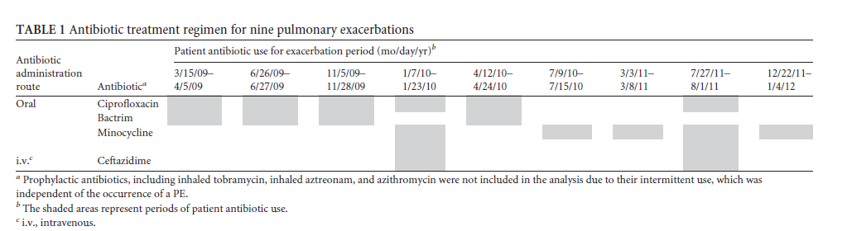
The data are from a single Cystic Fibrosis patient exposed to an antibiotic regime…

Slide 22
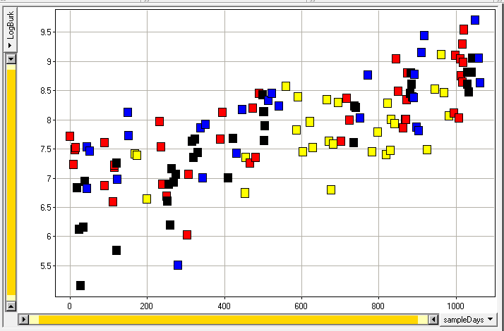

How does the 16S signal change with time (the x-axis) and with
antibiotic treatment (the colors?)
We will build and evaluate a series of linear models…

Slide 23
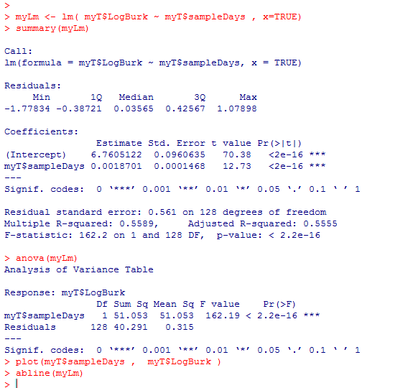
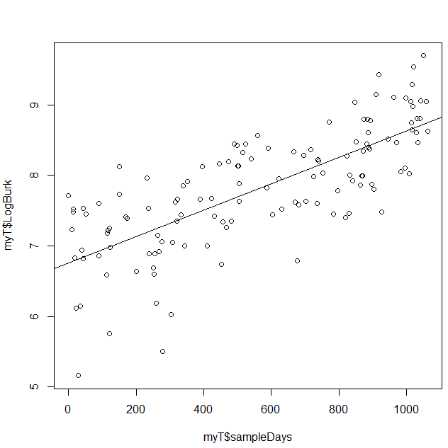
First we look only at time (ignoring antibiotic treatment)
logBurk = B0 + B1 * times + error
Time explains more than half the variance and we reject the zero slope hypothesis easily

Slide 24
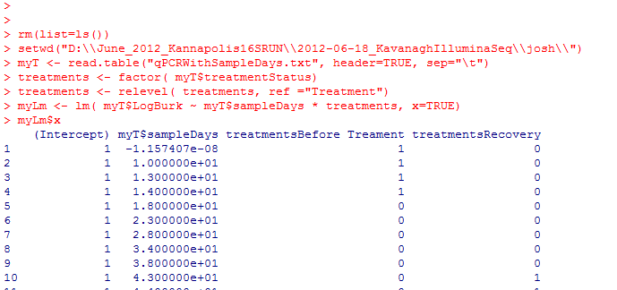
We start with the full model (including interaction terms!)
This is a small amount of typing in R but produces a highly complex model.
logBurk = B0 + B1 * sampleDays + B2 * “BeforeTreatment” + B3 * “Recovery” + B4 * “stable”
+ B5 * “BeforeTreatment*sampleDays” + B6 * “Recovery*sampleDays”
+ B7 * “stable*sampleDays”

Slide 25
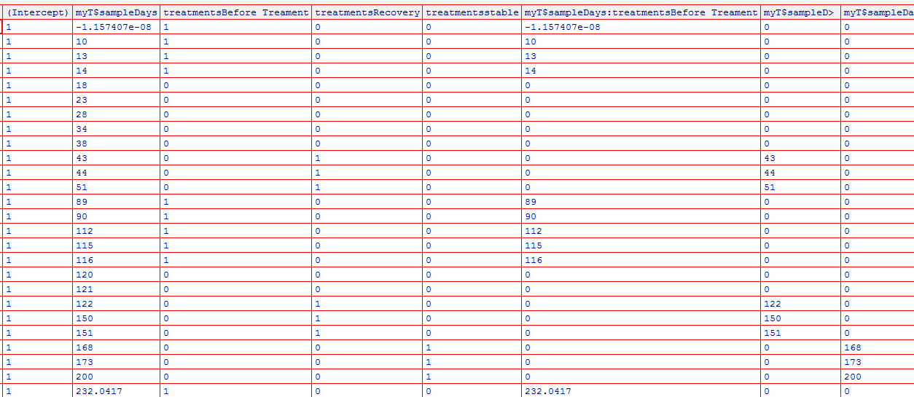
At the matrix level…
myLm <- lm ( myT$LogBurk ~ myT$sampleDays * treatments, x=TRUE)
edit(myLm$x)
B0
Intercept
B2
B3
B4
B5
B6
B7
B1
Time
beforeTreatment
Recovery
Treatment
beforeTreatment
*study days
Recovery
*study days
Treatment
*study days
“Dummy variables” controlling intercept values
“Dummy variables” controlling slope values
Dummy variables have no two rows with a non-zero value

Slide 26
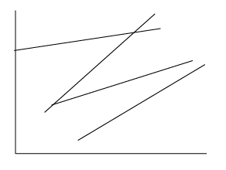
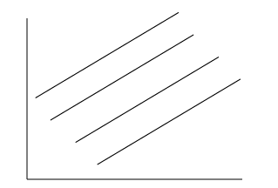
Do we need all of these parameters?
logBurk = B0 + B1 * sampleDays + B2 * “BeforeTreatment” + B3 * “Recovery” + B4 * “stable”
+ B5 * “BeforeTreatment*sampleDays” + B6 * “Recovery*sampleDays”
+ B7 * “stable*sampleDays”
Can we get rid of the interaction terms?
Full model (allows slopes to vary with antibiotic treatments)
Reduced model (one slope for all data)

Slide 27
Our first model comparison:
The full model:
myT$LogBurk ~ myT$sampleDays * treatments
The reduced model:
myT$LogBurk ~ myT$sampleDays + treatments
In the reduced model, B5-B7 are set to zero.
That is, there is no interaction between treatment and time.
That is, all the data can be fit with a single slope.

Slide 28

At the matrix level… the full model
myLm <- lm ( myT$LogBurk ~ myT$sampleDays * treatments, x=TRUE)
edit(myLm$x)
B0
Intercept
B2
B3
B4
B5
B6
B7
B1
Time
beforeTreatment
Recovery
Treatment
beforeTreatment
*study days
Recovery
*study days
Treatment
*study days
“Dummy variables” controlling intercept values
“Dummy variables” controlling slope values
Error is 33.8603 on 122 degrees of freedom
(n=130 – 8 parameters)

Slide 29
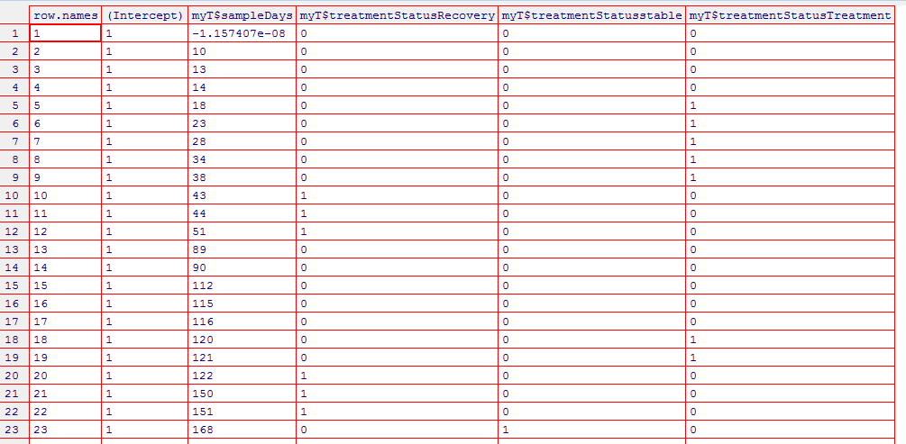

The reduced model:
B0
Intercept
B2
B3
B4
B1
Time
beforeTreatment
Recovery
Treatment
Error is 35.97212 with 125 d.f. (n=130 -5 parameters)

Slide 30
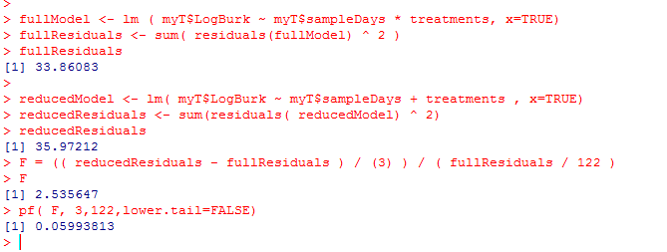
Full model:
Error is 33.8603 on 122 degrees of freedom
(n=130 – 8 parameters)
Reduced Model:
Error is 35.97212 with 125 d.f. (n=130 -5 parameters)
F = ( (35.97212 - 33.8603 ) / ( 125-122 ) ) / (33.8603/122) = 2.536324

Slide 31
At a p=0.05 threshold, the extra parameters for slope don’t reduce a significant amount of variance…
This is consistent with
“eyeballing” the data.
The 4 colors don’t seem
to have dramatically
different slopes…

Slide 32
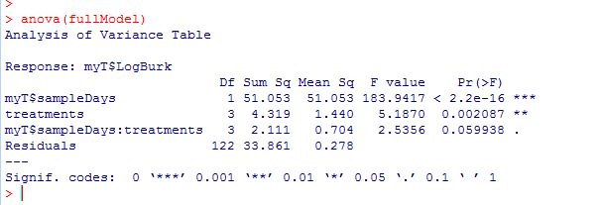
R can do a lot of this work for us (with much less typing!)
Equivalently…
Zeroing out the interaction terms leads to a non-significant difference.
(Zeroing out the other terms does make a difference!)

Slide 33
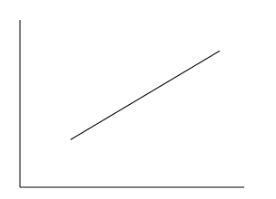
We seek the simplest model that can explain our data.
So our new “full model” drops the interaction terms.
Our new “full model”:
logBurk = B0 + B1 * sampleDays + B2 * “BeforeTreatment” + B3 * “Recovery” + B4 * “stable”
A five parameter model. There is only one slope (B1).
The intercept can be modulated by treatment.
We compare this to a “reduced model”
logBurk = B0 + B1 * sampleDays
Does treatment make a difference?
Full model (one slope; four intercepts)
Full model (one slope; one intercept)

Slide 34
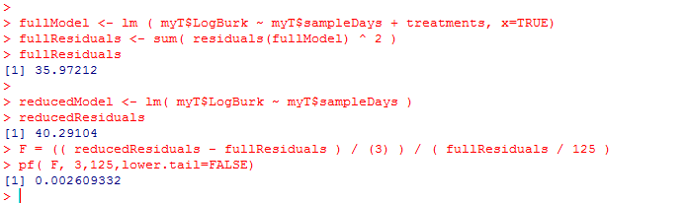

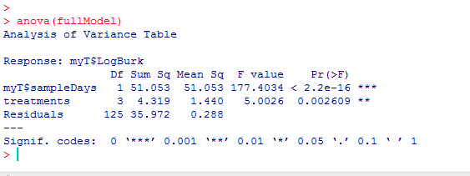
The intercepts do make a significant difference in the amount of variance explained!
Or (with less typing)
So the treatment makes a difference! So we don’t proceed to the reduced model

Slide 35

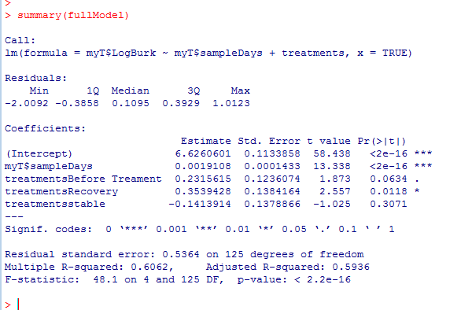
But which treatments are different?
Treatment is our baseline.
The intercept for “treatment” is 6.62; this is different than 0
The slope is not 0
Recovery is significantly
higher than treatment;
the bug grows back when
the antibiotic is stopped.

Slide 36
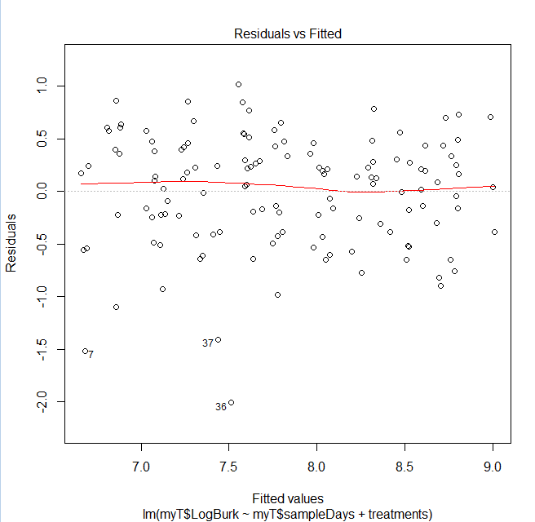
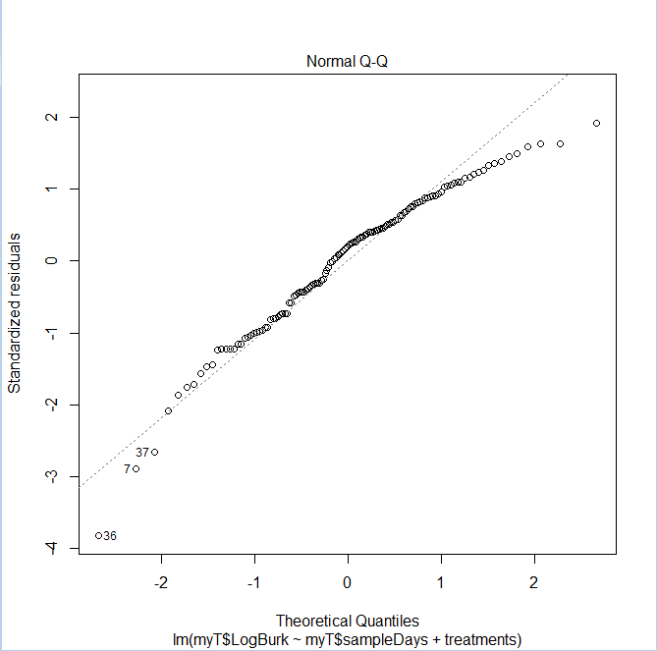
How well do we fit the assumption of normality?
plot(fullModel)
There is minimal systematic bias in the residuals…

Slide 37
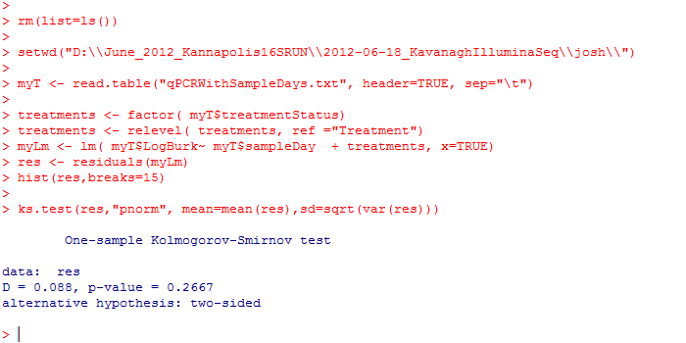
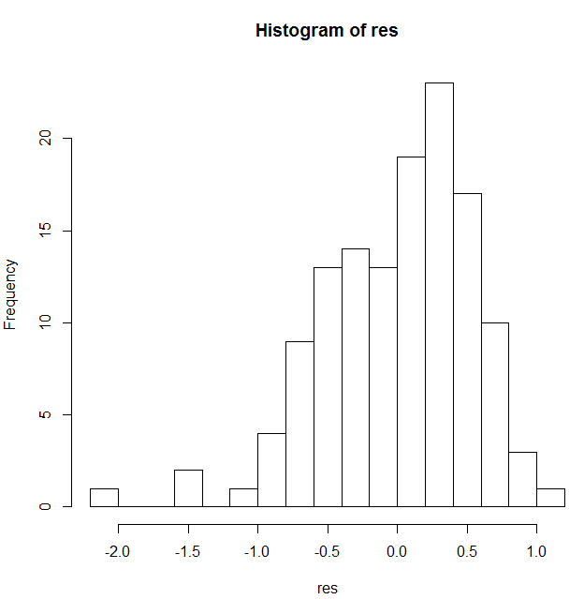
With the ks.test, we fail to reject a hypothesis that the residuals are not normally distributed
The assumption of normality seems reasonable in this case…

Slide 38
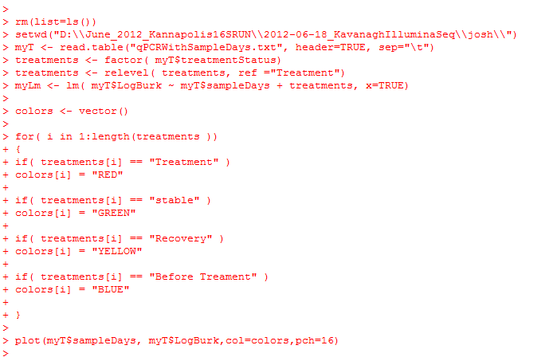
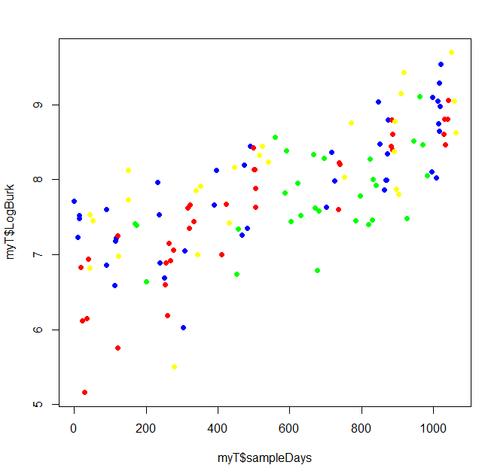
Making a graph of our model.. We start with just the data…

Slide 39
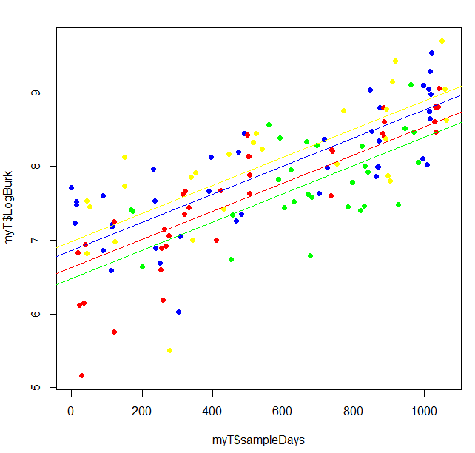
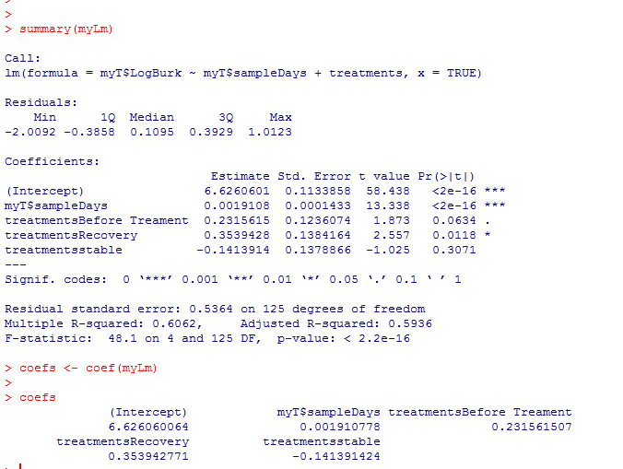
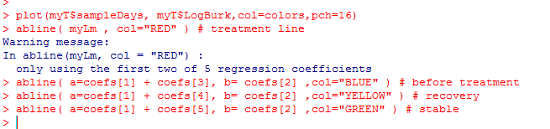
Adding in the model to our graph

Slide 40
Next:
Polynomial linear equations
Multiple regression and ANOVA
PCA

