Slide 1
Ordination to visualize complex data
Gene by gene hypothesis testing with false discovery rate correction
Assumptions of statistical models (and how much do they matter?)

Slide 2
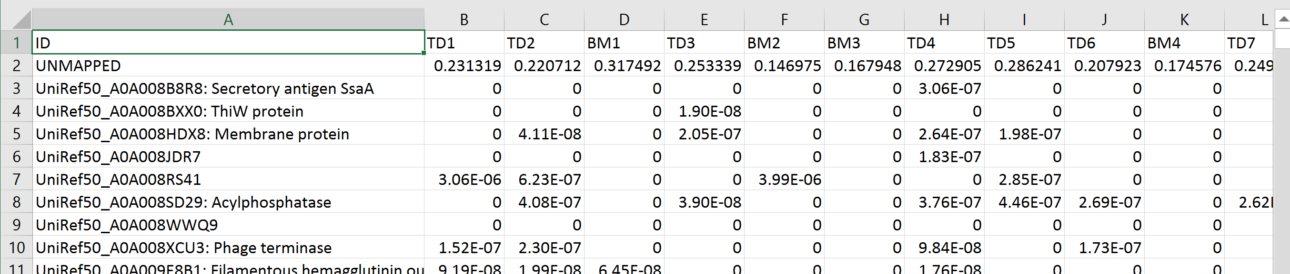
From the workshop on the first day, we end up with a large spreadsheet ( ~ 100 MB uncompressed)
We can (just barely) open this in Excel…
We have 20 samples corresponding to samples
We have 651,705 rows, correspond to different gene families
How do we make sense of such a complex dataset?

Slide 3
We can use ordination to reduce the dimensionality of our complex data
We can go from a (21 * 651,705 ) spreadsheet to a ( 21 * 2 ) spreadsheet.
This will allow us to see what is going on with our data…

Slide 4
Ordination is a form of data compression
We know data compression from music and photos…
A song on a CD might be 350 MB (megabytes) big.
But we compress the song to an MP3 for our phone so that is only, maybe 6 MB big.
The compression captures what is essential about the song, but in less space.
Potentially, the more we compress, the worse the song sounds!
Our ordination attempts to capture what is essential in our 651,705 rows, but in 2 rows.
We can do this by taking advantage of duplicate information.
Imagine all the 651,705 rows are highly correlated. We could remove the extra information
from those rows and still have all the important information in the spreadsheet with much less space…
( A more mathematical treatment describing the
compression is here: http://afodor.github.io/classes/stats2015/Lecture19.pptx )

Slide 5
How do we do this in practice?
First we have to clean up the spreadsheet a little…
It is easier to work with the data in R if we don’t try and read in all the names of the families
(R gets cranky about memory, especially on Windows!)

Slide 6
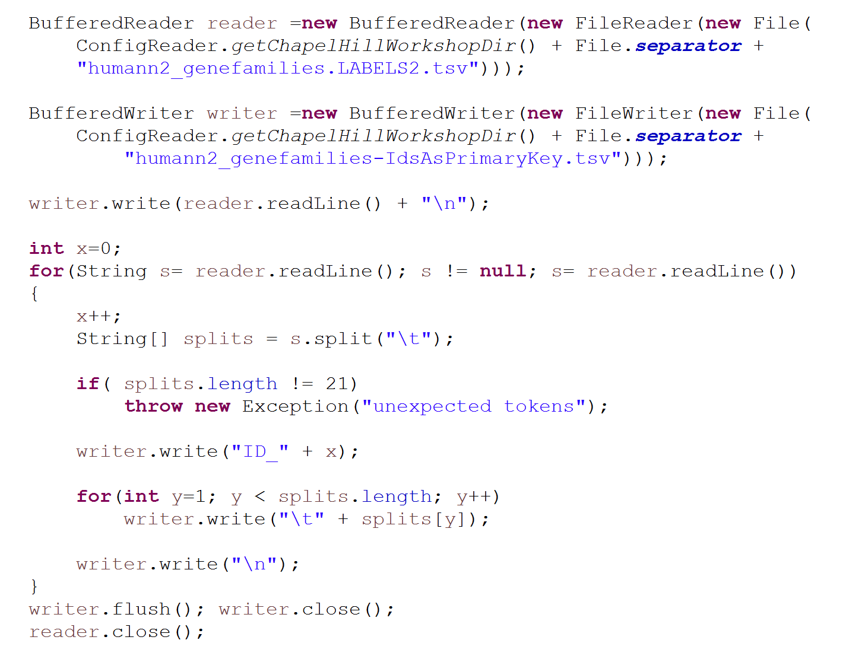
A little Java code replaces each complex name with a simple identifier…
(you could also have R just ignore them, but inevitably in doing this work, you want to either know a language like Java, Python or Perl or work with someone who does…)
Make sure each row has exactly 21 entries
Give each gene family a unique name
https://github.com/afodor/metagenomicsTools/blob/master/src/chapelHillWorkshop/PreprocessGeneFamilies.java

Slide 7
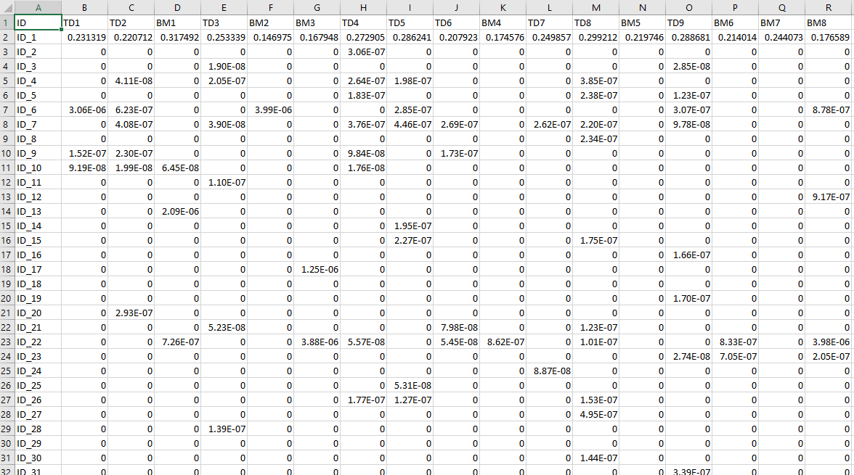
We end up with a slightly less cumbersome spreadsheet… still (21 * 651,705 )
https://github.com/afodor/ChapelHillWorkshop/blob/master/humann2_genefamilies-IdsAsPrimaryKey.tsv.gz?raw=true
Smaller unzipped version: https://github.com/afodor/ChapelHillWorkshop/blob/master/humann2_genefamilies.LABELS2OnlyAbundantSubSampled.txt

Slide 8
We can read this into R with a few lines of code…
rm(list=ls())
setwd("C:\\ChapelHillWorkshop")
library("vegan")
inFileName <- "humann2_genefamilies-IdsAsPrimaryKey.tsv"
myT <-read.table(inFileName,header=TRUE,sep="\t",row.names=1,
colClasses=c("character", rep("numeric", 20)))
myT <- t(myT)
myMDS <- capscale(myT~1,distance="bray")
plot( myMDS$CA$u[,1], myMDS$CA$u[,2] ,
col = ifelse ( substr( row.names(myT), 1,2) == "BM" , "RED" ,"BLUE"))
https://github.com/afodor/metagenomicsTools/blob/master/src/chapelHillWorkshop/quickMDS

Slide 9
We can read this into R with a few lines of code…
rm(list=ls())
setwd("C:\\ChapelHillWorkshop")
library("vegan")
inFileName <- "humann2_genefamilies-IdsAsPrimaryKey.tsv"
myT <-read.table(inFileName,header=TRUE,sep="\t",row.names=1,
colClasses=c("character", rep("numeric", 20)))
myT <- t(myT)
myMDS <- capscale(myT~1,distance="bray")
plot( myMDS$CA$u[,1], myMDS$CA$u[,2] ,
col = ifelse ( substr( row.names(myT), 1,2) == "BM" , "RED" ,"BLUE"))
We start our R session with nothing in memory
Where all our files are;
Note the double-back slash for windows paths
The first row are sample names…
Our spreadsheet has a row of strings, then numbers
A tab separated file
Transpose the spreadsheet so genes are columns
Perform the ordination
Plot the first two MDS axes, coloring by tissue type
https://github.com/afodor/metagenomicsTools/blob/master/src/chapelHillWorkshop/quickMDS

Slide 10
As an exercise (right now)…
(1) Download the data from
https://github.com/afodor/ChapelHillWorkshop/blob/master/humann2_genefamilies-IdsAsPrimaryKey.tsv.gz?raw=true
(2) Unzip it (you can install cygwin https://www.cygwin.com/ on windows
and then use gzip – d from the command line)
(3) Copy the R code from the previous slide (you can copy it directly from the previous slides or find the
appropriate code here: https://github.com/afodor/metagenomicsTools/blob/master/src/chapelHillWorkshop/quickMDS)
(4) Change the working directory to where you have the file installed ( watch out for double-back slashes on windows)
(5) Run then code (you can paste the code right into R). Wait a minute or two. Did you see the graph?

Slide 11
We end up with a basic graph…

Slide 12
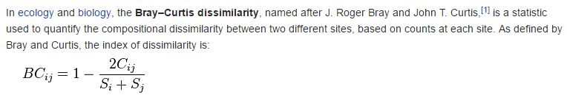
We used the Bray-Curtis distance metric…
https://en.wikipedia.org/wiki/Bray%E2%80%93Curtis_dissimilarity
This works mathematically, but isn’t really in the spirit of the statistic (since we don’t have taxa).
We can change the distance metric (used to calculate the distance/correlation between the samples )
to a different option..
If we dig into the documentation ( by typing ?capscale in R or using Google ) we get a list of
different distance metrics we can use…
Let’s switch to the default (“Euclidian”) by changing this line in R…
myMDS <- capscale(myT~1)
We now use the default Eucliadian distance
(You can use a text editor or just hit the up-arrow in R till you get to this line of code, change it, and then
re-run the plot line)
Do the two different tissue types still separate?

Slide 13
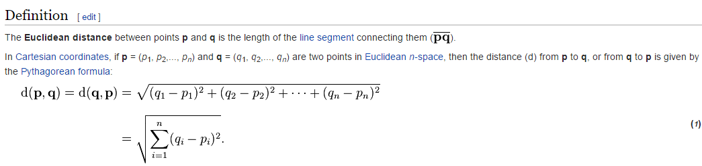
https://en.wikipedia.org/wiki/Euclidean_distance

Slide 14
We can make our graph much prettier with appropriate options…
plot( myMDS$CA$u[,1], myMDS$CA$u[,2] ,
col = ifelse ( substr( row.names(myT), 1,2) == "BM" , "RED" , "BLUE" ) ,
cex = 2.0, pch=19, xlab = "MDS 1", ylab = "MDS 2")
Symbol size
Symbol type

Slide 15
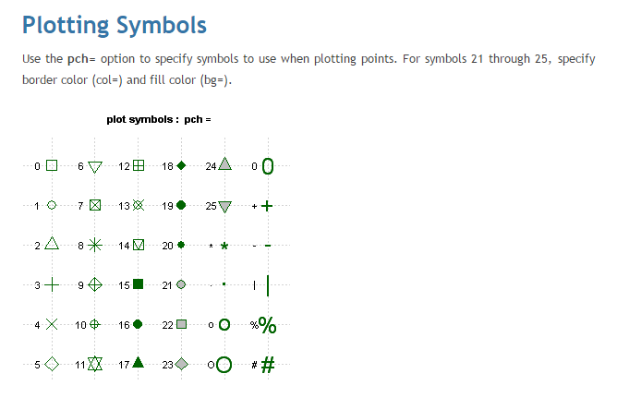
We have lots of options for our pch symbols…
http://www.statmethods.net/advgraphs/parameters.html

Slide 16
Maybe we want different symbols for our two body sites…
plot( myMDS$CA$u[,1], myMDS$CA$u[,2] ,
col = ifelse ( substr( row.names(myT), 1,2) == "BM" , "RED" , "BLUE" ) ,
cex = 2.0, pch=ifelse ( substr( row.names(myT), 1,2) == "BM" , 15, 19),
xlab = "MDS 1", ylab = "MDS 2")

Slide 17
As an exercise (now), change the x and y-axis labels.
Change the colors of the two different body sites..
Change the symbols used to plot the two sites..

Slide 18
If we want, we can simply dump out the resulting ordination into a file…
write.table(myMDS$CA$u, sep="\t", file="mds.txt",col.names=NA)
write.table(myMDS$CA$eig,file="eigenValues_.txt",sep="\t", col.names=NA)

Slide 19
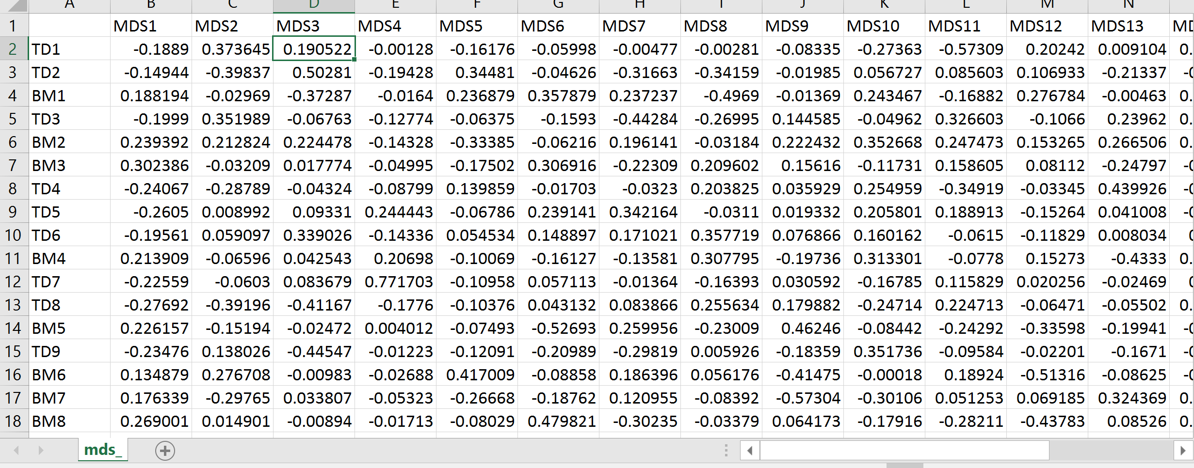
One file gives us the co-ordinates in our new ordination space.
Each new MDS axis is orthogonal (uncorrelated)

Slide 20
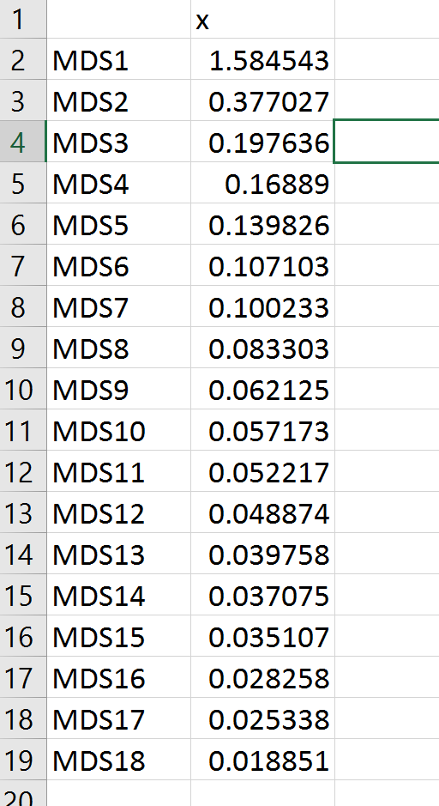
The other file tells us how much of the original data can we capture with each axis.
That is, how well did the data compress?
That is, how heavily correlated was the original data?

Slide 21
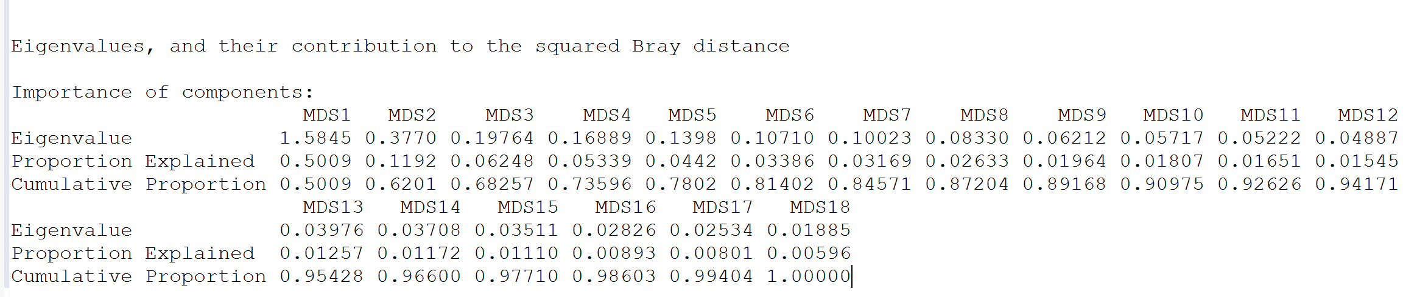
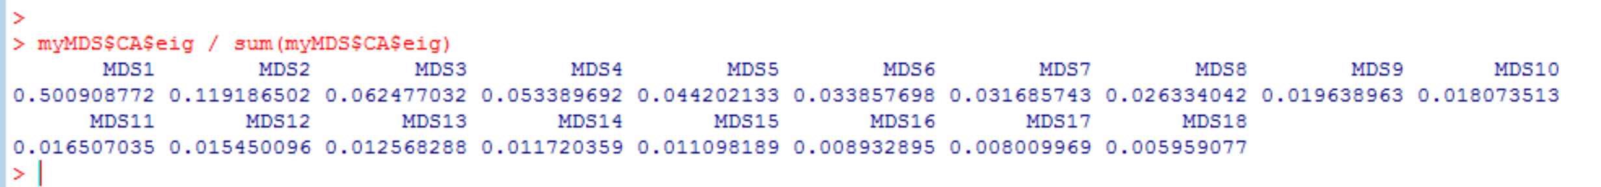
We can get the percent variance explained from R in a number of ways…
summary(myMDS)
or, alternatively….
The first two axes together capture ~62% of the data that was present in all 651,705 genes!
Lots of highly correlated genes in the original spreadsheet!

Slide 22
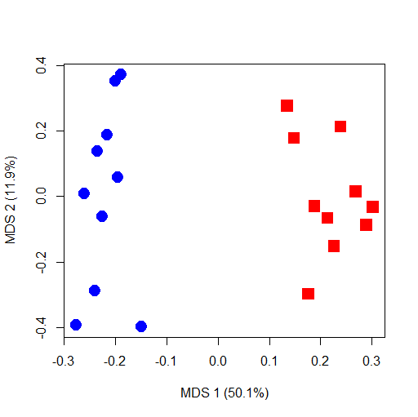
Often this information is put directly in the axes legends
plot( myMDS$CA$u[,1], myMDS$CA$u[,2] ,
col = ifelse ( substr( row.names(myT), 1,2) == "BM" , "RED" , "BLUE" ) ,
cex = 2.0, pch=ifelse ( substr( row.names(myT), 1,2) == "BM" , 15, 19),
xlab = paste("MDS 1 (", format( 100 * myMDS$CA$eig[1] / sum(myMDS$CA$eig),digits=3), "%)", sep=""),
ylab = paste("MDS 2 (", format( 100 * myMDS$CA$eig[2] / sum(myMDS$CA$eig),digits=3), "%)", sep=""))

Slide 23
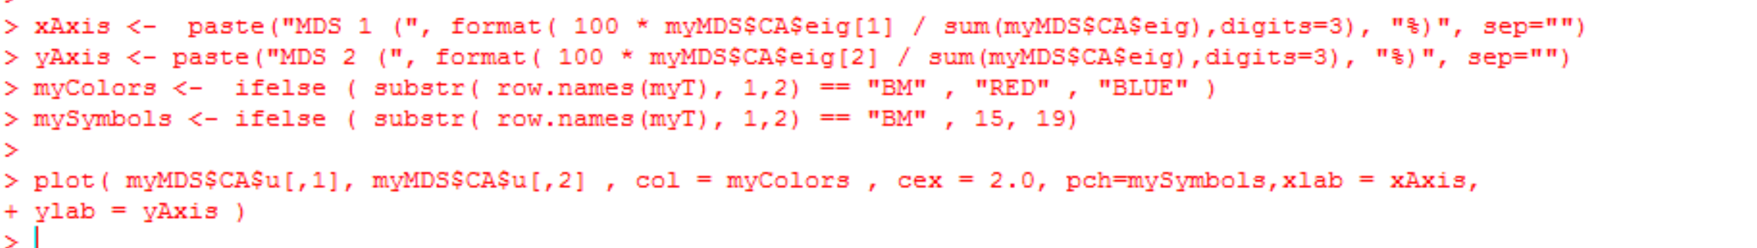
Maybe that one line of R code is too hard to read?
We can break it up into shorter pieces..
https://github.com/afodor/metagenomicsTools/blob/master/src/chapelHillWorkshop/quickMDS

Slide 24

Using ordination on metagenomics data is not without controversy…
This paper argues that different distance metrics make different assumptions about mean-variance
relationships, and hence you can think you are looking at a difference in means between two groups but
really it is a difference in variance…
This is interesting (and worthy of study) but in practice reviewers are unlikely to give you too much trouble…
These authors recommend approaching datasets taxa by taxa (or gene by gene), which is what we will turn to next..

Slide 25
Ordination to visualize complex data
Gene by gene hypothesis testing with false discovery rate correction
Assumptions of statistical models (and how much do they matter?)

Slide 26
If we return to our original spreadsheet, instead of asking questions about how BM vs. TD changes
in ordination space, we can evaluate each row of the spreadsheet directly.
For each row, we can form a null hypothesis that the TD and BM samples are drawn from the same distribution.
That will give us 651,705 null hypotheses to evaluate.
We will need to correct for multiple hypothesis testing

Slide 27
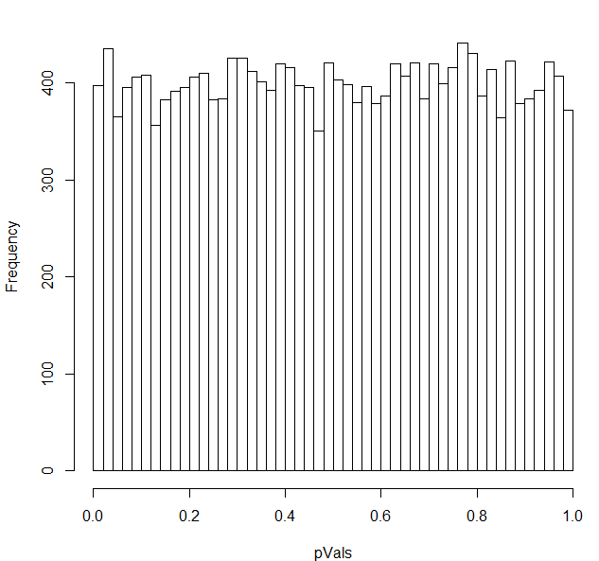

Not correcting for multiple hypothesis testing yields spurious results
You have 20,000 genes in an rna-seq experiment.
You have two conditions (A) and (B).
You run them through DeSeq (or any other stats package).
If the null hypothesis is always true (no difference between A and B),
the p-values will be uniformly distributed…
We can model this pretty simply:

Slide 28
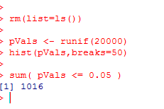
If we use a simple threshold of significance of 0.05, we would
expect about 1,000 genes to be called significant even if the null
hypothesis were always true..
There are 1,016 genes that have p-values <0.05
in this case where the p-values are uniform

Slide 29
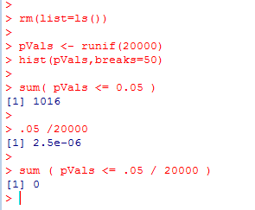

One alternative:
Use as a p-value threshold Bonferroni correction.
The desired threshold / number of tests.
In this case 0.05 / 20000 = 2.5e-06
None of our p-vals reach this threshold..
At this threshold, there is a 5% chance of any false positives

Slide 30
Bonferroni correction is sometimes considered too conservative for genomics experiments.
At small sample sizes, you might have few genes with p-values smaller than the
Bonferroni thresholds.
A less conservative alternative, false discovery rate.
At a 5% false discovery rate, we expect 5% of our hits to be false positives.
This is less conservative than Bonferroni correction, where there is a 5% chance
that any of our hits are false positives.

Slide 31
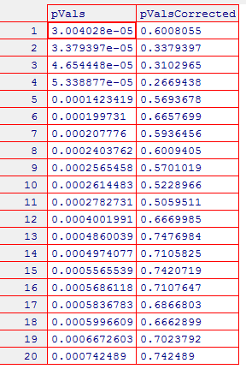
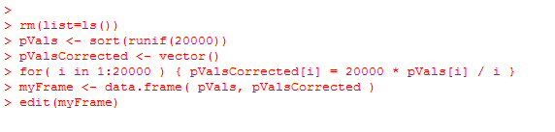
One straight-forward approach to finding genes at a given false-discovery rate
Benjamini and Hochberg FDR
1. Rank all the p-values (smallest first). The rank of each value = K
2. Calculate N * p / k
where N = the # of hypotheses that you are testing
p = the “raw” (uncorrected) p-value.
3. Start at the top of the list. Go down to N * p / k > threshold
(e.g. 0.10 for 10% FDR).
N * p = # of expected false positives at a given p-value
k = # of genes actually observed at that p-value

Slide 32
Note that for the first hit (smallest p-value),
Bonferroni correction is the same as BH FDR.
(Since if k=1,
N * p / K = N * p
which is the same as multiplying the p-value by the number of hypotheses to
do the correction)

Slide 33
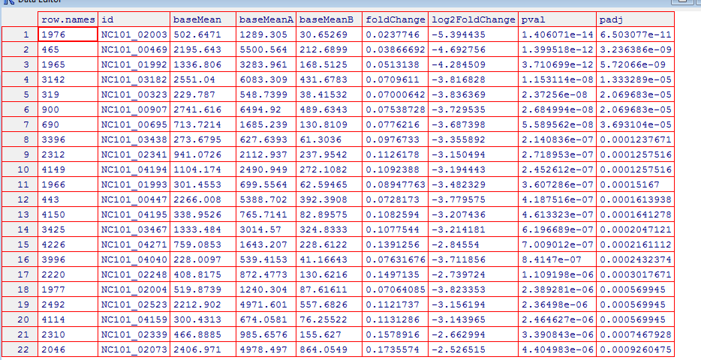
Here are example results from DeSeq (a popular RNA-seq analysis tool)…
FDR adjusted
p-values..
Raw p-values

Slide 34
If we have 651,705 tests to correct for, we will adversely impact our power.
Also, a lot of our genes have mostly zeros. We don’t want to waste our power on rows that
only have one or two non-zeros. We can’t do meaningful inference on those rows.
We can use R to examine and filter out the rare genes…
rm(list=ls())
setwd("C:\\ChapelHillWorkshop")
library("vegan")
inFileName <- "humann2_genefamilies-IdsAsPrimaryKey.tsv"
myT <-read.table(inFileName,header=TRUE,sep="\t",row.names=1,
+ colClasses=c("character", rep("numeric", 20)))
sums <- apply(myT,1,sum)
logSums <- log10( sums + 0.000001)
hist(logSums[2:length(logSums)],breaks=30)

Slide 35
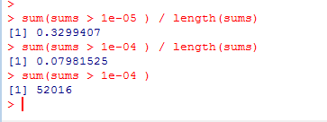
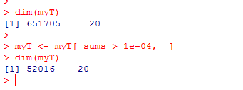
Setting a cutoff of a row-sum of 1e-04 yields a manageable number of 52,016 null hypotheses
One line of r-code quickly removes the low abundance genes and leaves us with 52,016 rows..

Slide 36
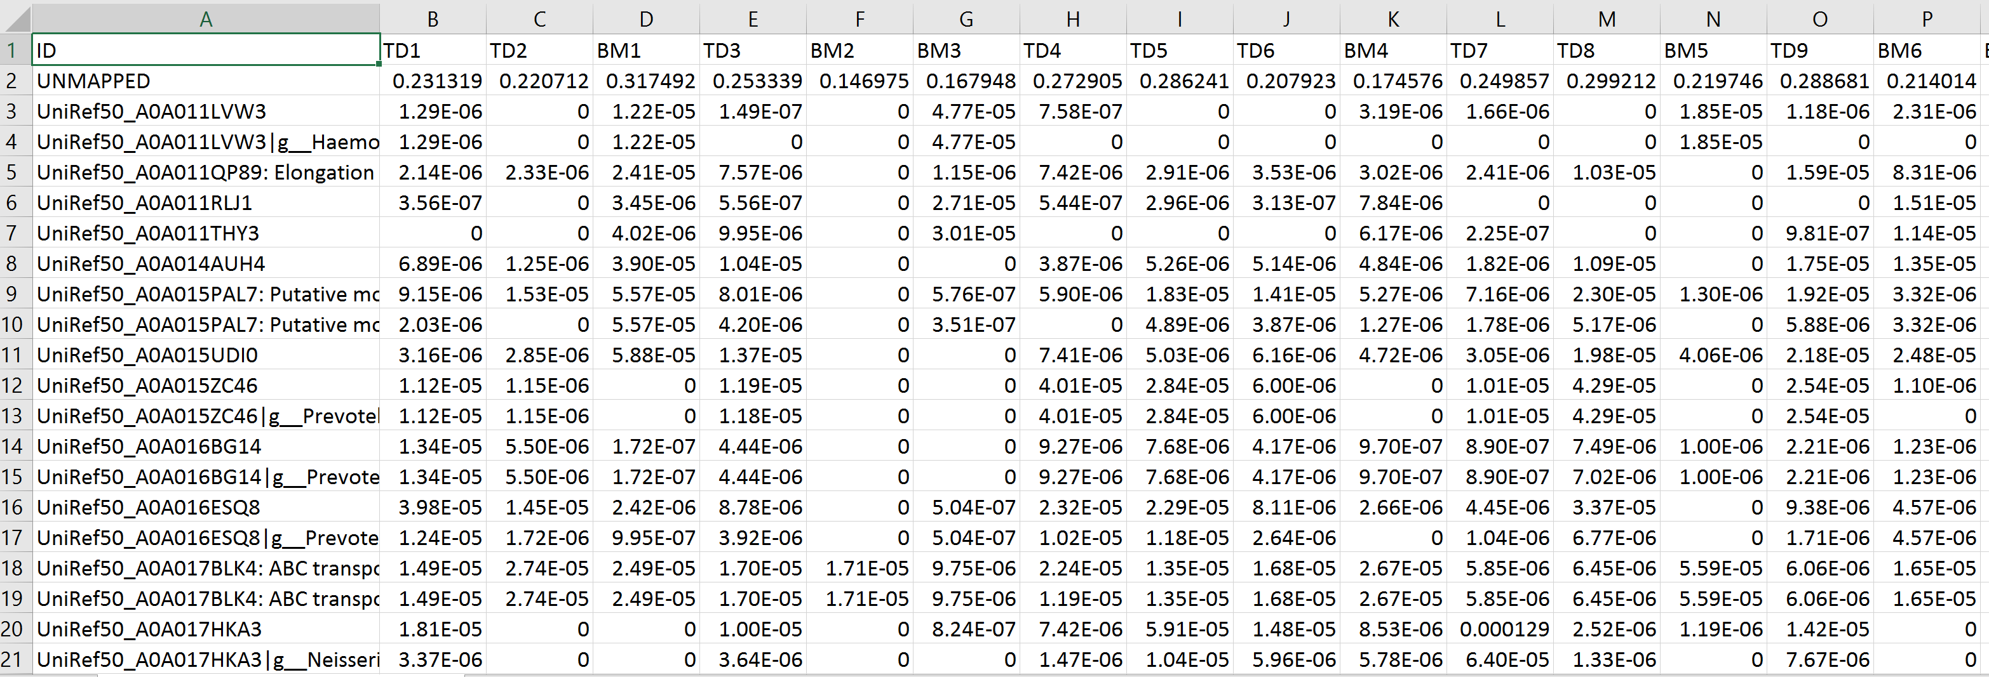
We will instead filter out rare genes in the Java layer
(code not shown but is here:
https://github.com/afodor/metagenomicsTools/blob/master/src/chapelHillWorkshop/RowSums.java )
To end up with a spreadsheet that has genes with sum > 1e-04 with the names attached
(since we won’t be using ordination to compress away each row in the following examples…)
20 columns
52,016 rows
This file is here:
https://github.com/afodor/ChapelHillWorkshop/blob/master/humann2_genefamilies.LABELS2OnlyAbundant.txt.gz

Slide 37
With a modest amount of coding we can run a t-test on every row of our spreadsheet and collect the results…
rm(list=ls())
setwd("C:\\ChapelHillWorkshop")
library("vegan")
inFileName <- "humann2_genefamilies.LABELS2OnlyAbundant.txt"
myT <-read.table(inFileName,header=TRUE,sep="\t",quote="",row.names=1,
colClasses=c("character", rep("numeric", 20)))
pValues <- vector(length=nrow(myT))
pValuesWilcoxon <- vector(length=nrow(myT))
names <- vector(length=nrow(myT))
meanTD <- vector(length=nrow(myT))
meanBM <- vector(length=nrow(myT))
isTD <- grepl("TD", names(myT))
pdf("topHits.pdf")
Set up data structures to hold our results
Set up an output file to capture our visualization
https://github.com/afodor/metagenomicsTools/blob/master/src/chapelHillWorkshop/quick_TTest

Slide 38
With a modest amount of coding we can run a t-test on every row of our spreadsheet and collect the results…
for( i in 1:nrow(myT))
{
bug <- as.numeric(myT[i,])
pValues[i] <- t.test( bug[ isTD ] ,bug[ ! isTD ] )$p.value
pValuesWilcoxon[i] <- wilcox.test( bug[ isTD ] ,bug[ ! isTD ] )$p.value
meanTD[i] <- mean(bug[ isTD ])
meanBM[i] <- mean(bug[ ! isTD ])
names[i] <- row.names(myT)[i]
if( pValues[i] < 1e-07 )
{
graphMain <- paste( "p=" , format(pValues[i],digits=3), "wilcoxon_p=" ,
format(pValuesWilcoxon[i],digits=3))
boxplot( bug ~ isTD, ylab = names[i],main = graphMain , xlab="is TD")
myFrame <- data.frame( bug, isTD)
stripchart(bug ~ isTD, data = myFrame,vertical = TRUE, pch = 21, add=TRUE )
}
}
We walk through every row in the spreadsheet
run our statistical tests and capture the results
This will write about 100 plots to a PDF
https://github.com/afodor/metagenomicsTools/blob/master/src/chapelHillWorkshop/quick_TTest

Slide 39
Finally write our results to a spreadsheet (including FDR adjustment )
myFrame <- data.frame(names,meanTD ,meanBM ,pValuesWilcoxon, pValues)
myFrame <- myFrame [order(myFrame$pValues),]
myFrame$adjustedP <- p.adjust( myFrame$pValues, method = "BH" )
write.table(myFrame, file="pValuesFromTTest.txt", sep="\t",row.names=FALSE)
dev.off()
Best hits first!
Add BH correction
Dump to file
This is important; you won’t be able to open the PDF without closing it from R
(which is what this line does)
https://github.com/afodor/metagenomicsTools/blob/master/src/chapelHillWorkshop/quick_TTest

Slide 40
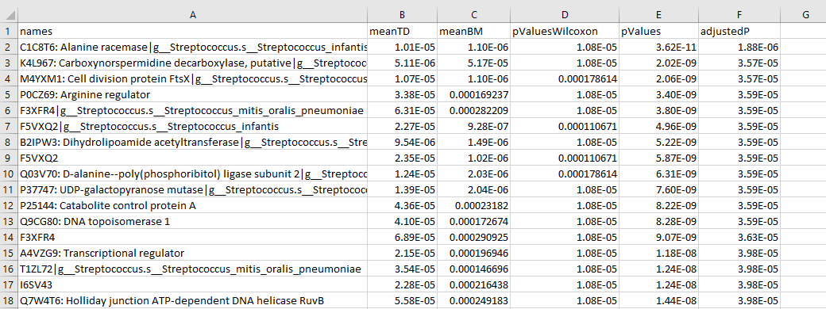
We end up with a nice, ordered list of all our hits…
Even after correction, these hits are highly significant!
(This is because comparing two tissues reliably produces some of the biggest difference in microbiome research)

Slide 41
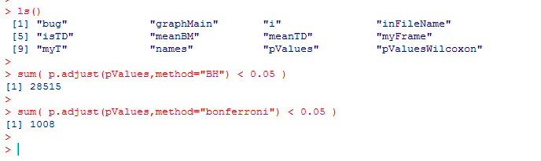
How many genes are significant at a 5% false discovery rate?
We can have R tell us really quickly…
Even using “stringent” Bonferroni correction, there are many many hits
As an exercise:
Run this code in R:
https://github.com/afodor/metagenomicsTools/blob/master/src/chapelHillWorkshop/quick_TTest
The file the code depends on is here:
https://github.com/afodor/ChapelHillWorkshop/blob/master/humann2_genefamilies.LABELS2OnlyAbundant.txt.gz
How many genes are significantly different under BH and Bonferroni correction for the non-parametric
Wilcoxon test (with pvalues held in pValuesWilcoxon)

Slide 42
One of my favorite visualizations is to plot the distribution of all pValues
hist(pValues,breaks=30)
hist(pValuesWilcoxon,breaks=30)
This emphasizes how enormous the differences between the tissue types are…

Slide 43
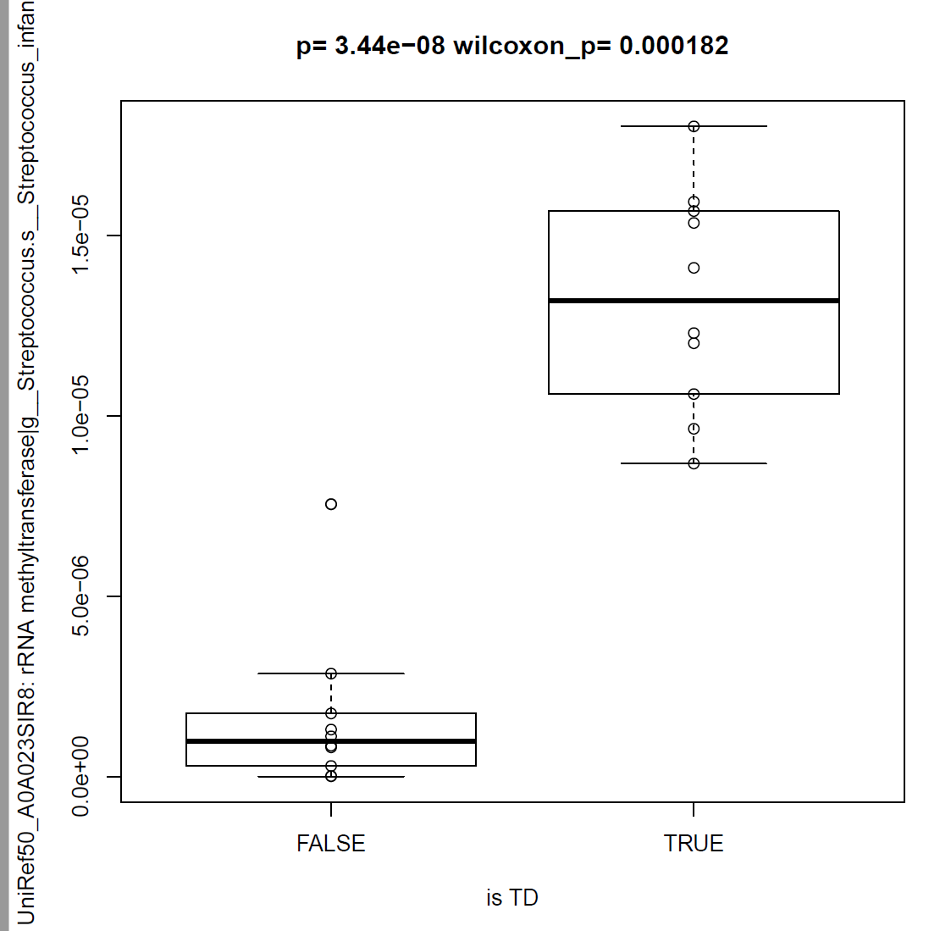
The pdf file that we generated (topHits.pdf) gives us a more detailed view of each gene…

Slide 44
Let’s switch to a more challenging dataset where the differences are much more subtle…

Slide 45


Is there a microbial signature associated with the development of
colorectal adenomas?
Mucosal biopsies from 33 “case” and 38 “control” patients
Tissue collected from same area in case and control
454 sequencing targeting the conserved 16S rRNA gene
~1,200,000 sequences of ~400 basepairs each
Group the sequences into 742 clusters (that are 97% identical)
Temitope Keku
Nina Sanapareddy
http://www.nature.com/ismej/journal/v6/n10/full/ismej201243a.html
Nina Sanapareddy, Ryan M Legge, Biljana Jovov, Amber McCoy, Lauren Burcal, Felix Araujo-Perez, Thomas A Randall, Joseph Galanko, Andrew Benson, Robert S Sandler, John F Rawls, Zaid Abdo, Anthony A Fodor Temitope O Keku. ISME J. 2012

Slide 46
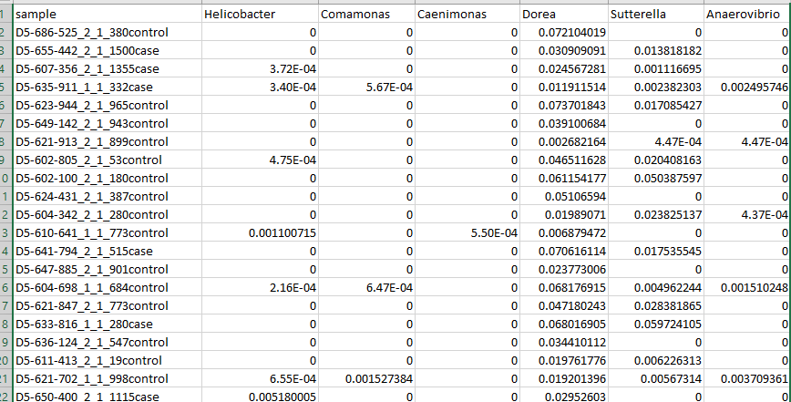
A version of the dataset is here.. (note this is a different taxonomic scheme than the published data…)
92 genera
71 samples
https://github.com/afodor/metagenomicsTools/blob/master/src/gamlssDemo/genusPivotedTaxaAsColumnsNormCaseContol.txt

Slide 47
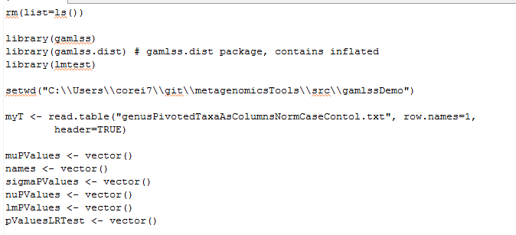
Just as in the previous dataset, for each genus we can form a null hypothesis of no association with case/control
We set up much as before….
Here we will use a one-way ANOVA
(equivalent to a t-test with assumption of equal variance)
We’ll talk about all those other tests in a bit!
https://github.com/afodor/metagenomicsTools/blob/master/src/gamlssDemo/quickFit.txt

Slide 48
Here we are taxa are in columns, but the same idea. Walk through, build a model for each taxa
pdf("genus.pdf")
par(mfrow=c(3,2))
for( i in 2:ncol(myT))
{
myFrame <- data.frame( bug = myT[,i], logBug = log10(myT[,i] + + 0.00001),
isCase = grepl("case",row.names(myT)))
myLm <- lm( myFrame$logBug ~ myFrame$isCase )
index <- i -1
lmPValues[index] <- anova(myLm)$"Pr(>F)"[1]
names[index] <- names( myT)[i]
if( lmPValues[index] < 0.05)
{
graphMain <- paste( "p=" , format(lmPValues[index],digits=3))
boxplot( as.numeric(myFrame$logBug) ~ myFrame$isCase,
ylab = paste("log10(",names[index],")",sep=""),main = graphMain , xlab="is Case")
stripchart(logBug ~ isCase, data = myFrame,vertical = TRUE, pch = 21, add=TRUE )
}
}
dev.off()
Six graphs per page
A linear model:
taxa = case/control + error
Use ANOVA to test the hypothesis that the case/control
parameter is == 0
Capture hits at an (uncorrected) threshold
Don’t forget to turn off the pdf output stream!
https://github.com/afodor/metagenomicsTools/blob/master/src/gamlssDemo/quickFit.txt

Slide 49
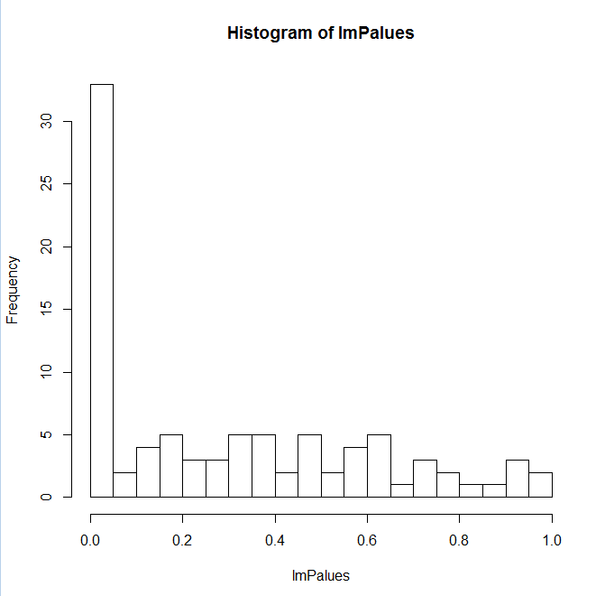

If we look at all the p-values, there is strong evidence of a signature associated with disease
hist(lmPValues,breaks=30)
We show 32 taxa significant at a 10% FDR in this pipeline

Slide 50
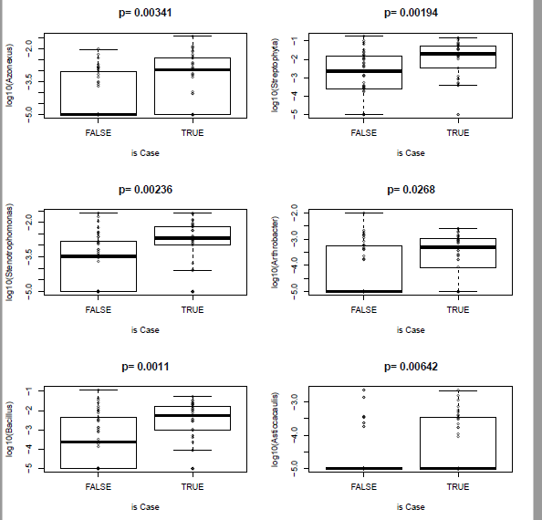
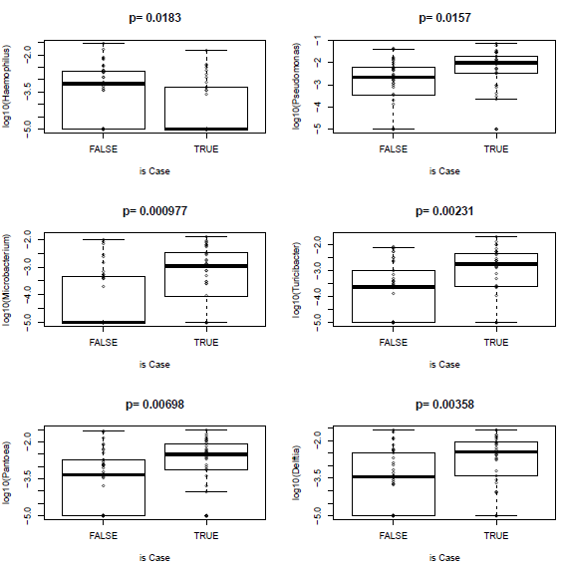
Our bugs seem to be higher in case than control

Slide 51
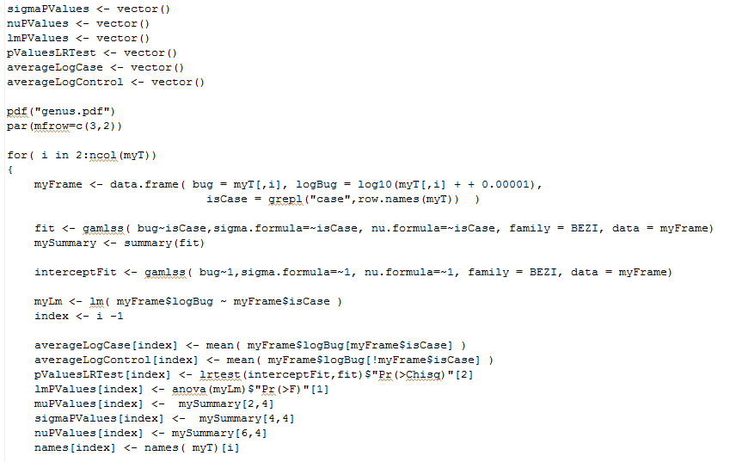
We can keep track of which bug is higher in case and which in control….
https://github.com/afodor/metagenomicsTools/blob/master/src/gamlssDemo/quickFit.txt

Slide 52
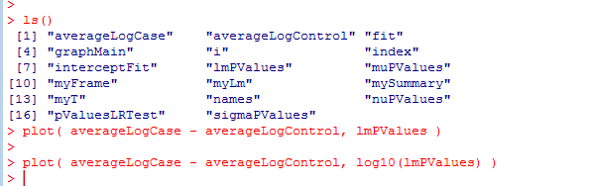
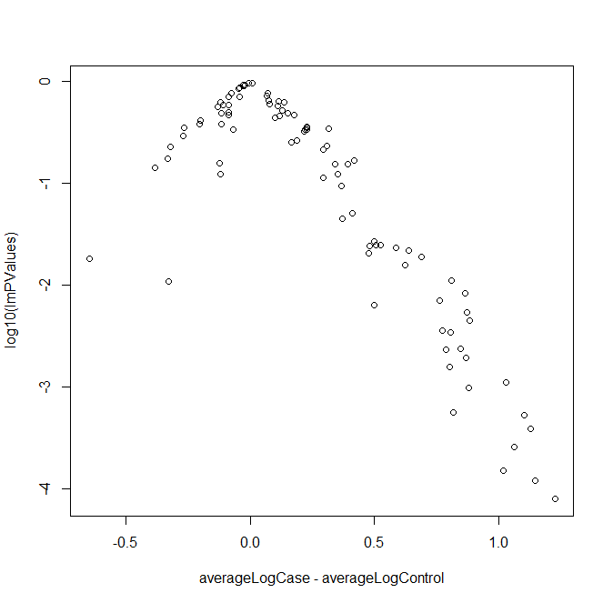
This allows us to make a volcano plot at the end of the run….
Nearly all the significant hits are higher in case!

Slide 53
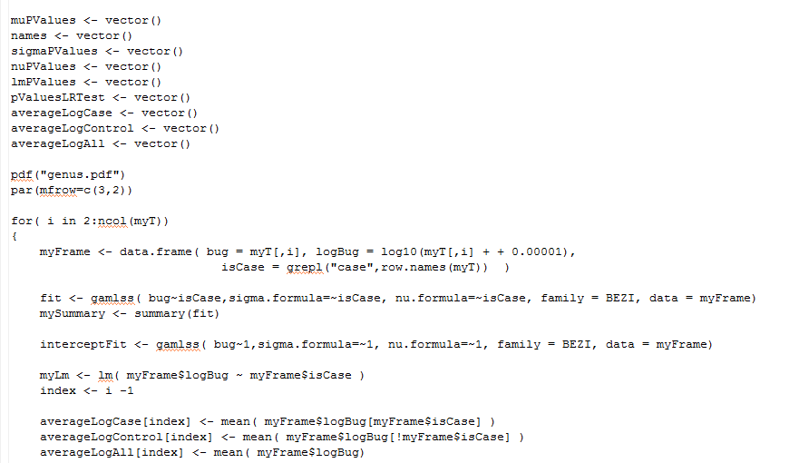
We can also keep track of the overall averages….
https://github.com/afodor/metagenomicsTools/blob/master/src/gamlssDemo/quickFit.txt

Slide 54
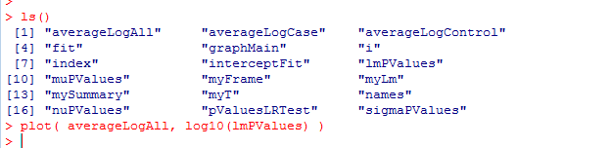
We can then ask are the changes associated with disease in high or low abundance organisms?
Most of the changes are in very low-abundance
organisms (representing < .1% of the reads)

Slide 55
Ordination to visualize complex data
Gene by gene hypothesis testing with false discovery rate correction
Assumptions of statistical models (and how much do they matter?)

Slide 56
Our linear model makes assumptions of equal variance, normality
We can ask how well these assumptions are met…

Slide 57
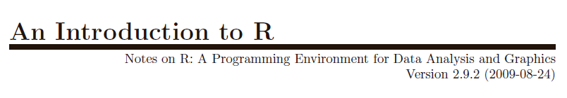
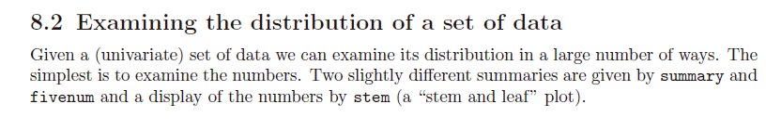
http://cran.r-project.org/doc/manuals/R-intro.pdf

Slide 58

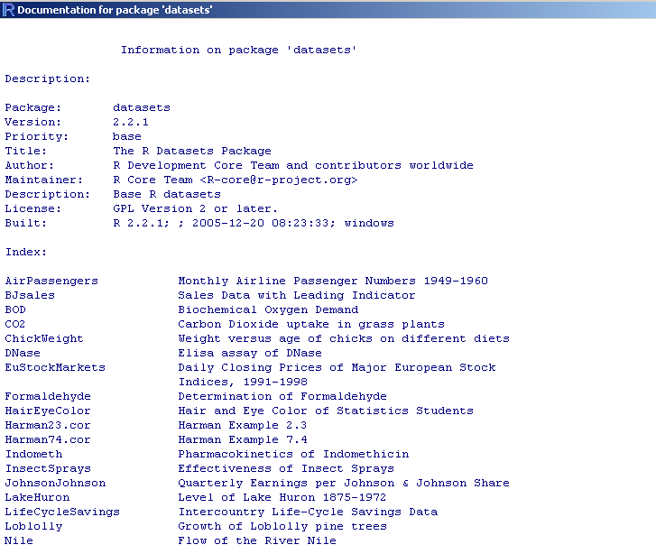
R has built in practice datasets to play with….

Slide 59

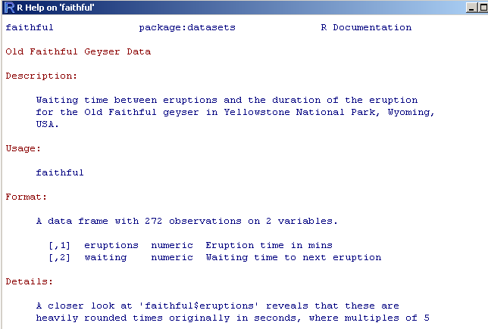

Slide 60
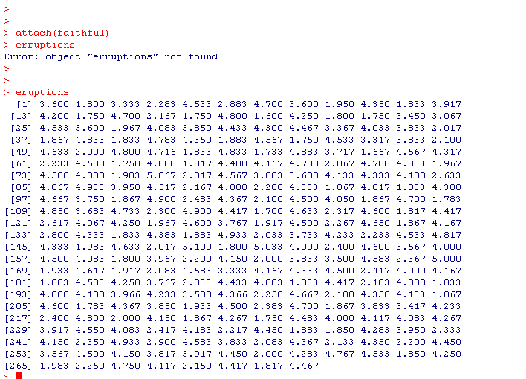

Slide 61
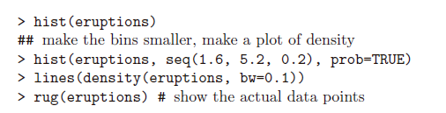
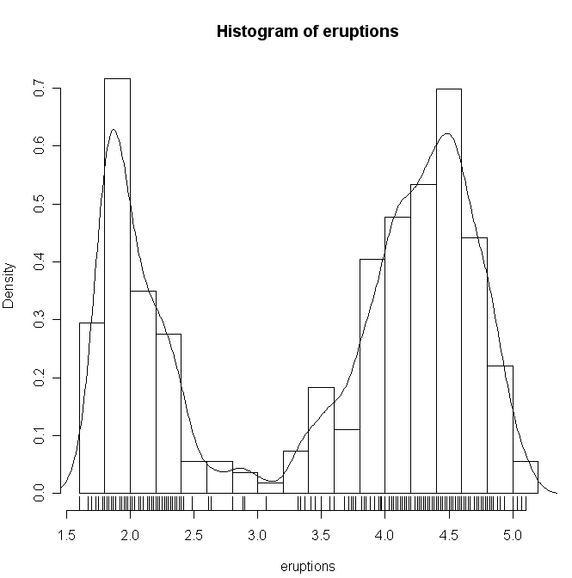
R has lots and lots of way to see if a distribution is normal….
Scales the y-axis in probability space
Show the raw data on the histogram
Obviously this is not normal…
(An introduction to R; section 8.3)

Slide 62
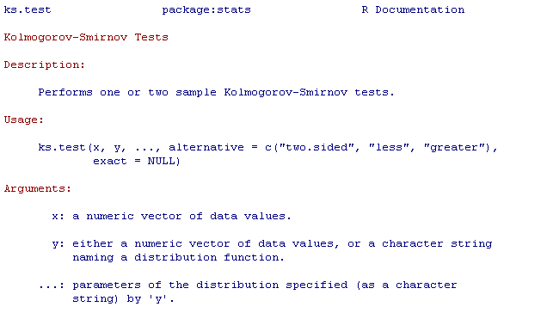
We can use of any number of statistical tests to test for normality….
?ks.test

Slide 63
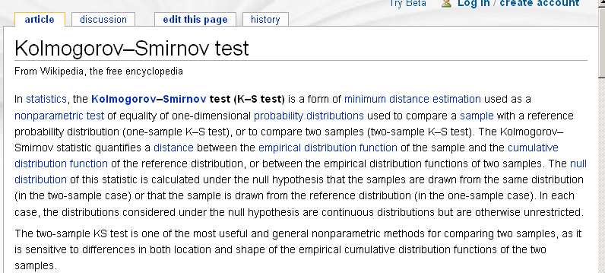

Slide 64
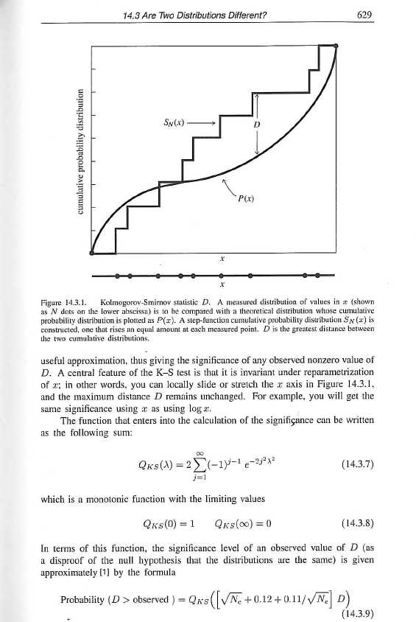
From the numerical recipes in C++ book…

Slide 65
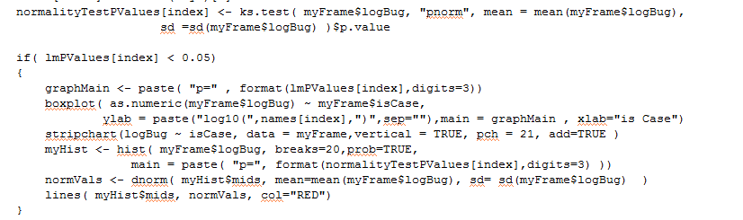
We can ask whether our transformed data is normally distributed and visualize how well the normal
distribution matches our data
Collect the result of our normality test
We can comment this out with a # to write graphs for all the taxa
Make a histogram
of our data
How well does the normal distribution fit our data??
https://github.com/afodor/metagenomicsTools/blob/master/src/gamlssDemo/quickFit.txt

Slide 66
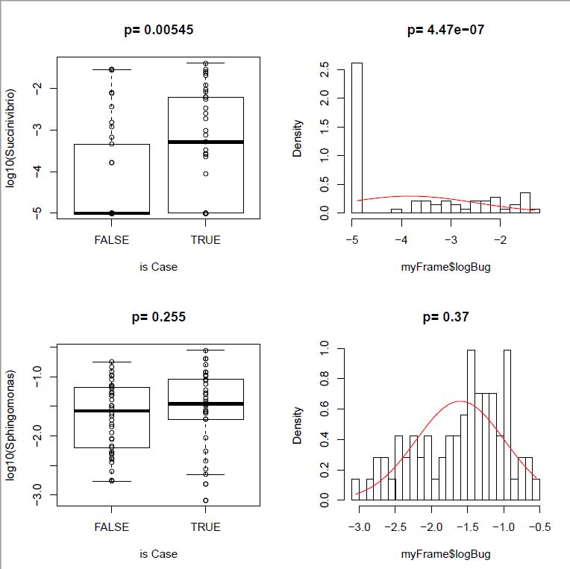
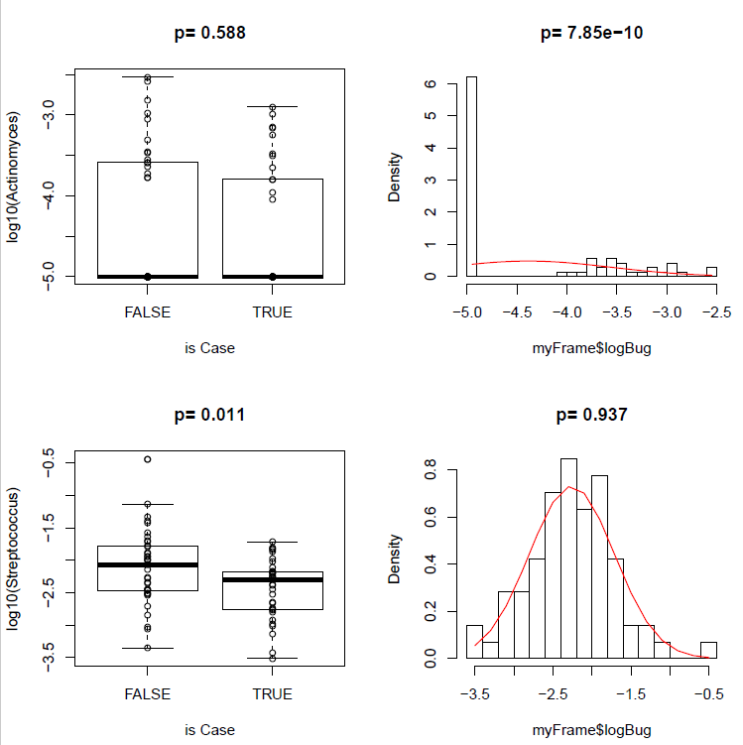
What we find is that for more abundant bugs, the normal distribution is not so far off…
But for low abundance taxa, the normal distribution can’t deal with the zeros…

Slide 67
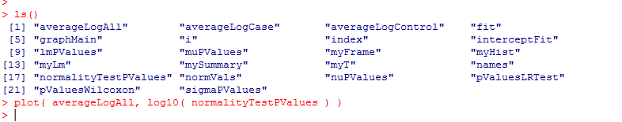
Clearly, the normality assumption fails for low abundance taxa
Most of our hits were in the -3 to -4
log abundance, so normality assumption
is not as bad as lower abundances.

Slide 68
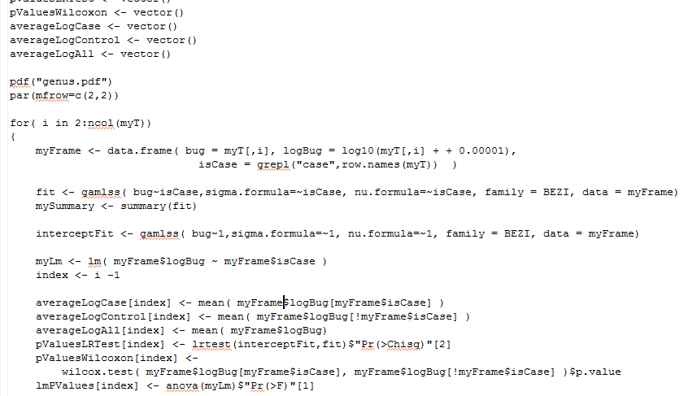
We can add the non-parametric Wilcoxon test to our set of analyses

Slide 69
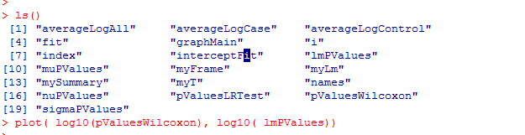
Despite our flagrant violation of normality assumptions, our results appear to be robust to parametric assumptions

Slide 70



There is a good deal of current interest in the literature in explicitly modeling the zeros
(these are often called “zero inflated models”)
This one is called the zero inflated beta distribution
3 parameter model
One parameter to absorb the zeros
Two parameters to fit the rest of the data

Slide 71

R makes it possible to fit such models to our microbiome data….
We capture the p-values from each of our parameters
Fitting is pretty simple; we say how we want to model each parameter.
In this case, each of the three parameters is aware of the
case/control label

Slide 72

For each taxa, R will perform inference for us for all three parameters

Slide 73


As usual, we can capture the p-values for all of our taxa…
We find that the parameter that measures zeros is well correlated with our standard linear models..
So (In this case) our conclusions appear to be robust to the modeling approach we take…
Running multiple statistical models is a good defense against reviewer crabbiness!

Slide 74
Learning more…

Slide 75


Ese
Essential for learning all the weirdness of R (does not try and teach stats!)

Slide 76



Helpful books on mixed linear models
http://link.springer.com/
This book is more mathematical and very thorough;
a good reference
This book is more accessible and covers a broader
range of topics (including zero-inflated models)

Slide 77



http://www.amazon.com/gp/offer-listing/025608338X/ref=sr_1_5_olp?ie=UTF8&qid=1357529565&sr=8-5&keywords=applied+linear+statistical+models&condition=used

Slide 78

Either edition of this book is fine, but new or used is going to be around $40.
It really is an outstanding book (but dense!). It is worth the investment of time and money

Slide 79

This is a great book, but is insanely over-priced!
If you think you will be implementing Bayesian stats in your pipelines, it might be worth having

Slide 80

Doing Bayesian Data Analysis: A Tutorial with R and BUG. John K. Kruschke. More approachable, but also not quite as clear or concise as the Bolstad book. Very nice chapters on Monte Carlo approaches to Bayesian analysis, but a bit heavy on the Bayesian proselytizing for my taste. Also quite expensive. Overall, though, a very engaging text. If you get the Google electronic edition, make sure that your device(s) can show the scanned versions (which are DRM’ed ) as the equations in the default view are illegible.
Be sure to read sample
chapters on the device
of your choice to make
sure formatting is ok
before purchasing…

Slide 81

Recommended:
It’s about $30-$40 and will make your life easier, but is not strictly required.
More useful as a reference than as a tutorial…

Slide 82

On-line resources:
Vassar stats book
http://vassarstats.net/textbook/
You will need at least one book that covers canonical statistics.
Start with this one (it is free) and then if it is not working for you, consider alternatives…

Slide 83


Legal download:
http://www-stat.stanford.edu/~tibs/ElemStatLearn/printings/ESLII_print10.pdf

Slide 84

A less mathematical treatment of the same material….
http://www-bcf.usc.edu/~gareth/ISL/

