Slide 1
Microbial communities in Health and Disease
Dr. Anthony Fodor
Associate Professor
Department of Bioinformatics
The University of North Carolina at Charlotte

Slide 2
What is metagenomics?

Slide 3
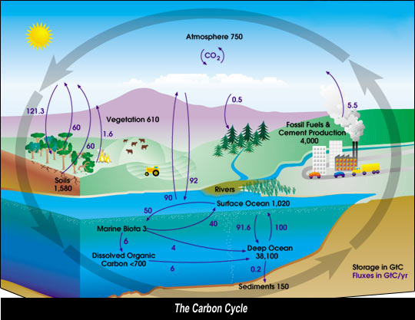
Microbes run the world!
Microbes control much
of the energy and nutrient
flux on the planet.
http://www.global-greenhouse-warming.com/images/CarboncCycleDiagram.jpg

Slide 4
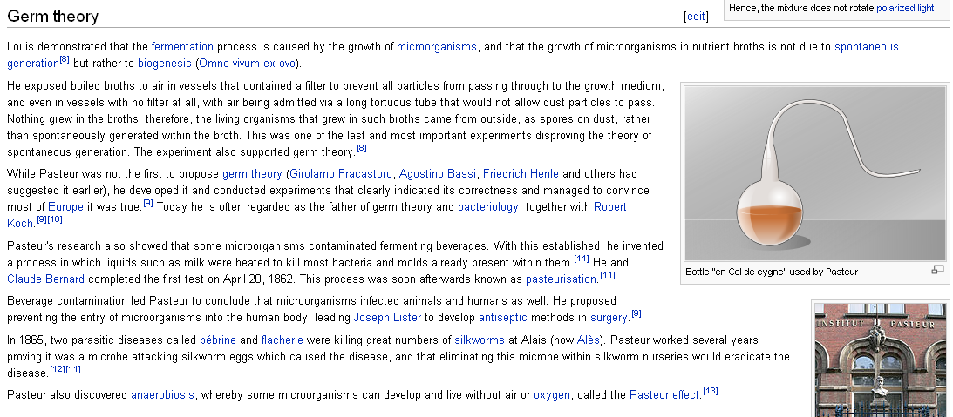
In the 19th century, Pasteur (and others) demonstrated some of the
properties of microbes…
Famous demonstration that microbial life is not “spontaneously generated”

Slide 5
In pure culture, you are looking at one genome at a time.
When you sample microbes in their native environment,
you are looking at many microbes at a time.
Many genomes in a single experiment
Metagenomics

Slide 6
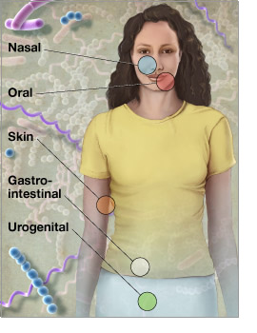
Microbes run the world!
There are 10 times more microbial
cells in our body than human cells!
Microbes within our bodies contribute
to many important phenotypes
including obesity, immune system
development and Crohn’s disease
http://www.genome.gov/images/feature_images/nr_hmp.jpg

Slide 7
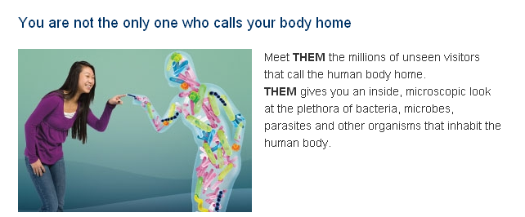
Microbial communities are complex
http://www.discoveryplace.org/museum/exhibit/15/THEM
There are 100 times more microbial genes in the human body than human genes
We still don’t know how many different kinds of microbes are in the human body

Slide 8
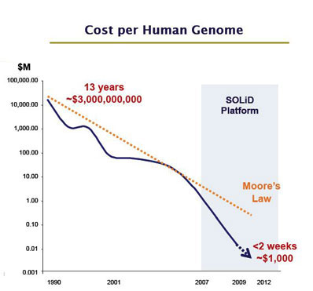
Progress in describing complex communities is driven by new technology
The technology that
will soon allow us to
sequence a human genome
for $1,000 will allow
us to sequence a microbial
genome for a few dollars
http://images.forbes.com/media/2010/06/03/0603_chart-cost-human-genome_398x371.jpg

Slide 9
A bug that causes cancer

Slide 10
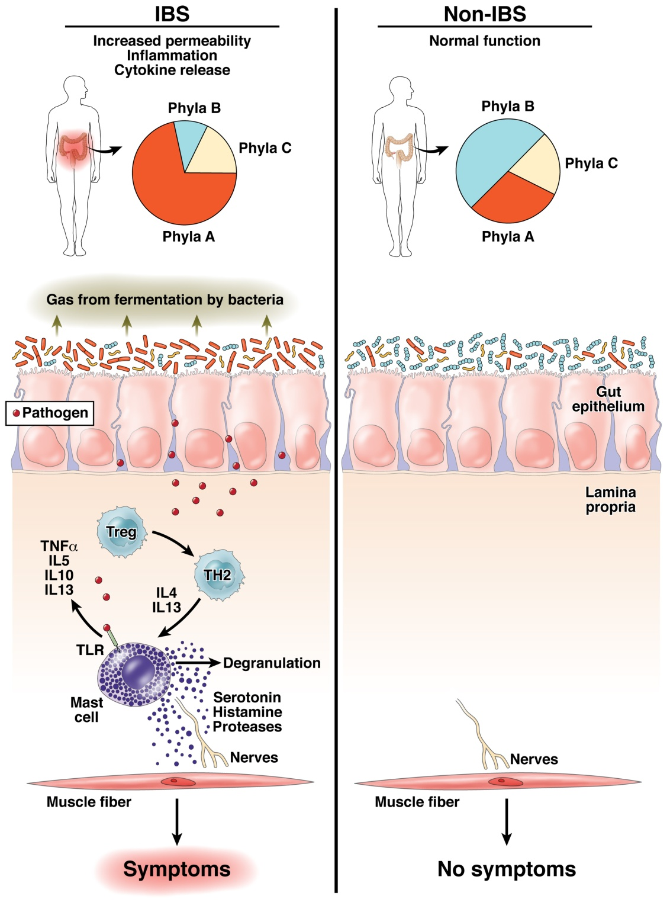
The “dysbiosis” hypothesis linking risk for inflammation related diseases to the microbiome
Fodor & Talley. Gastroenterology. 2011

Slide 11
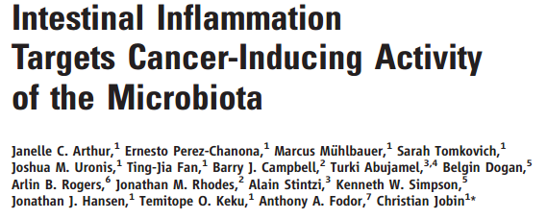
2012

Slide 12
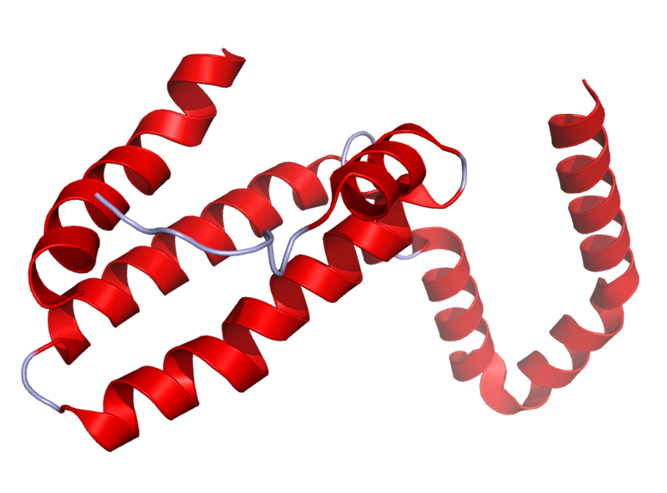
Il10^{-\-} Mouse Model
Il10 is an anti-inflammatory cytokine.
Inhibits pro inflammatory cytokines
Acts as an immunoregulator in the GI tract.
Lamblin, C., et al.,The Journal of allergy and clinical immunology, 2001.
http://en.wikipedia.org/wiki/Interleukin_10
Il10-\-
Il10^{-\-} mice are prone to inflammation with commensal tolerated by WT mice.
Knoch, B., et al.,Microbiology-Sgm, 2010
Established model for investigating disease phenotypes associated with inflammation

Slide 13
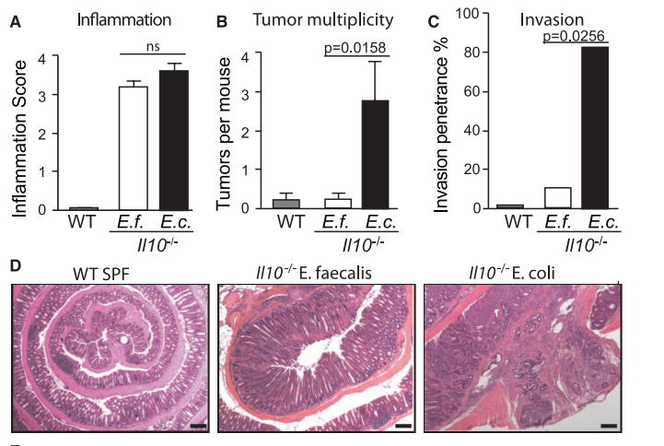
Some bugs, but not others, can cause inflammation to progress to cancer…
2012
Arthur et al, Science, 2012

Slide 14
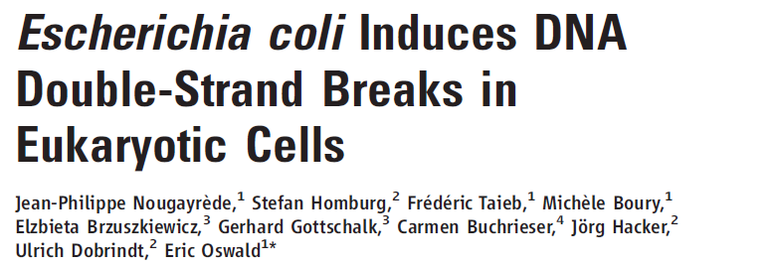
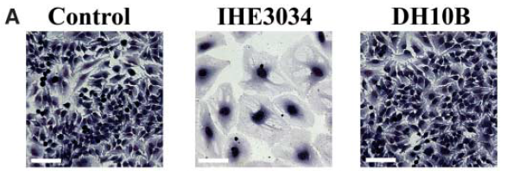
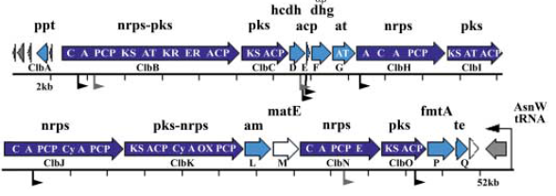
2006
Clinical E. coli isolates
change cell morphology
This activity is dependent
on the PKS island,
that encodes machinery
for polyketide and
non-ribosomal polypeptide
synthesis

Slide 15
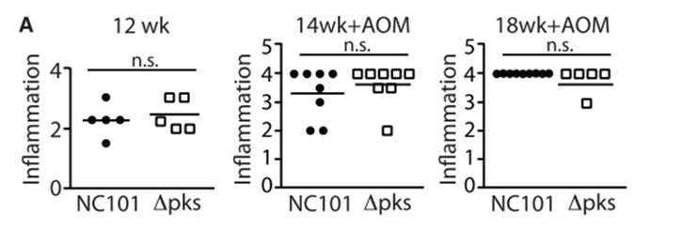
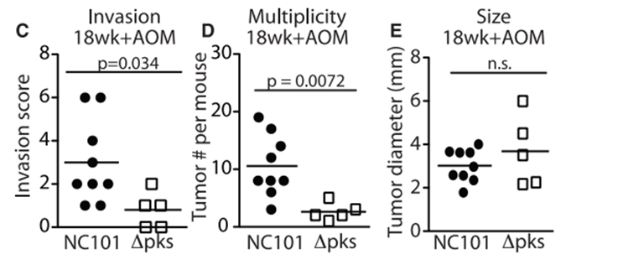
Remarkably, the PKS island appears essential in promoting progress to CRC
2006
2012

Slide 16
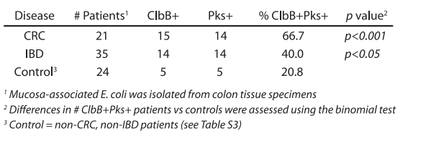
The presence of PKS is associated with cancers in multiple human cohorts
2006
2012

Slide 17
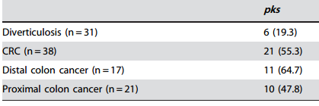
The presence of PKS is associated with cancers in multiple human cohorts
2006
2012
Buc et al - High Prevalence of Mucosa-Associated E. coli Producing
Cyclomodulin and Genotoxin in Colon Cancer (2013)
2013

Slide 18
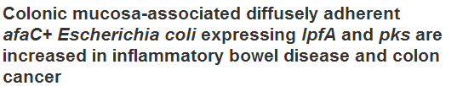

The presence of PKS is associated with cancers in multiple human cohorts
2006
2012
Buc et al - High Prevalence of Mucosa-Associated E. coli Producing
Cyclomodulin and Genotoxin in Colon Cancer (2013)
2013

Slide 19
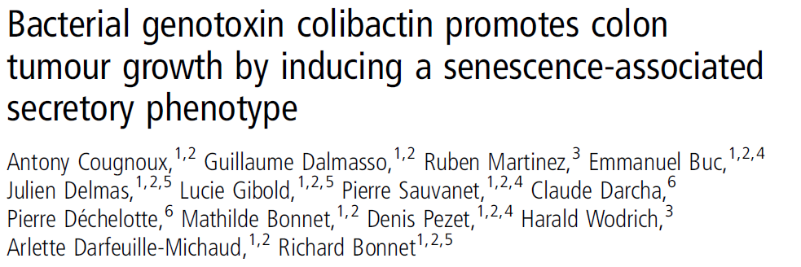
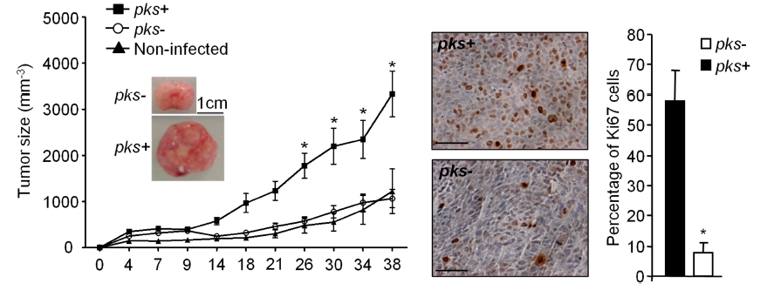
This oncogenic potential of PKS appears to be reproducible
in a HCT116 cell/ nude mouse system
2006
2012
2013
2014

Slide 20
Chinese bugs are becoming more like U.S. bugs!

Slide 21
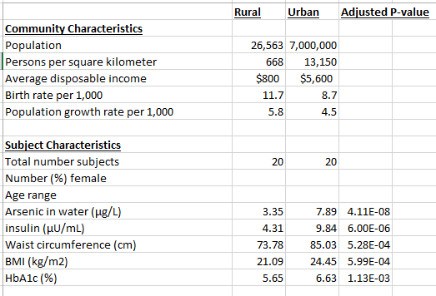
Life in neighboring regions in Hunan province is very different for rural and urban populations

Slide 22
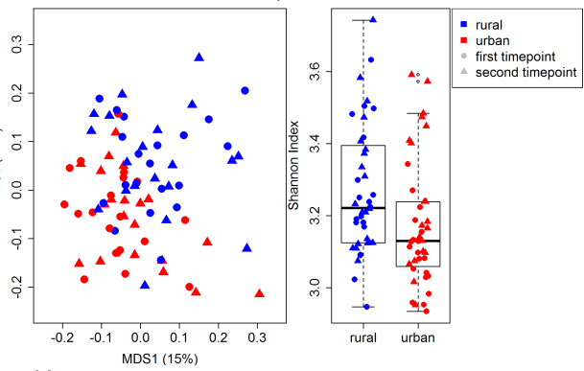
To the list of differences, we can add differences in the microbiotia

Slide 23
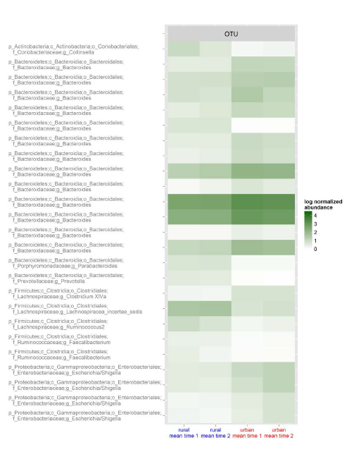
Among the bugs that are higher in rural China is E. Coli (that we think causes colorectal cancer!)

Slide 24
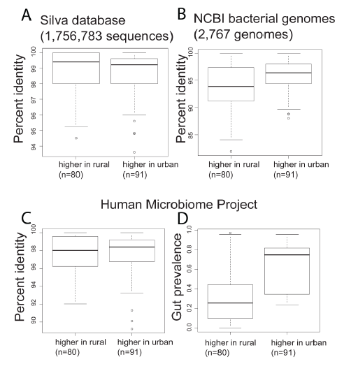
Bugs in rural China are less like U.S. bugs (and are not as well studied)

Slide 25
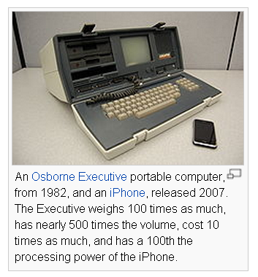
Computer then and now…
What will microbiology look like when we
can carry around whole-genome microbiome
samplers in our hand?
Will there be an iPhone sequencing app?
If you can sequence them in real time,
microbes are no longer invisible…
http://en.wikipedia.org/wiki/Moore's_law

Slide 26
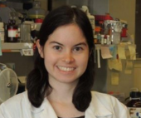


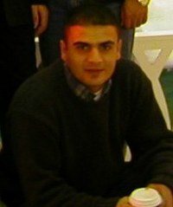
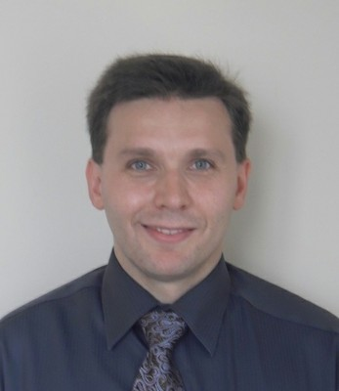
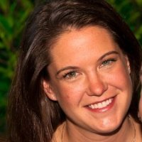
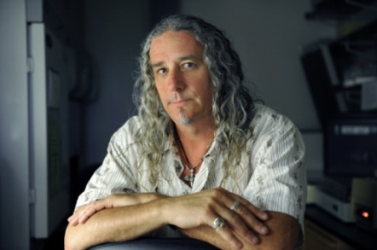
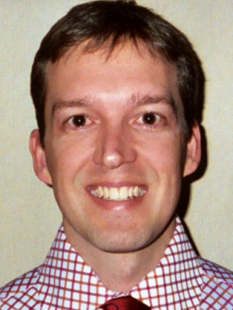

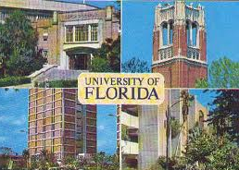


Acknowledgements
UNC-Chapel Hill
Janelle Arthur
Annie Green Howard
Marcus Muhlbauer
Penny Gordon-Larsen
UNC-Charlotte
Ra’ad Gharaibeh
Jon McCafferty
Kathryn Winglee
UF- Gainesville
Christian Jobin
Kathryn Winglee
Annie Green Howard
Penny Gordon-Larsen
Raad Gharaibeh
Jon McCafferty
Marcus Muhlbauer
Janelle Arthur
Christian Jobin

