Slide 1
Introduction to our mouse dataset for lab..
Estimating mean and variances for the negative binomial fit

Slide 2
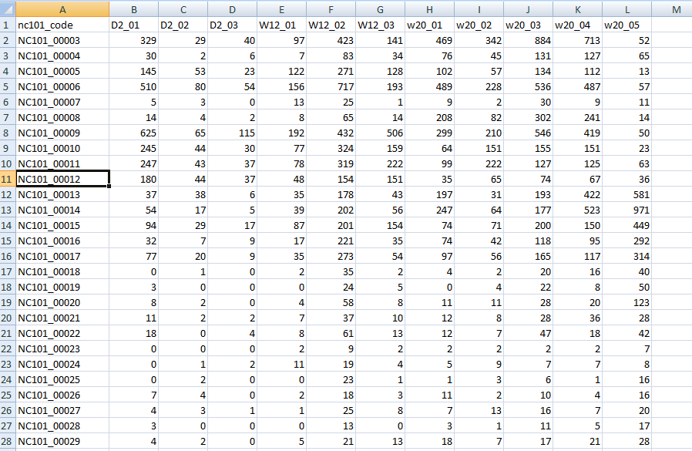
The dataset is at github…
http://afodor.github.io/classes/stats2015/longitdunalRNASeqData.zip
File = nc101_scaff_dataCounts.txt

Slide 3
The dataset is at github…
Week 2
Week 12
Week 20
File = nc101_scaff_dataCounts.txt

Slide 4
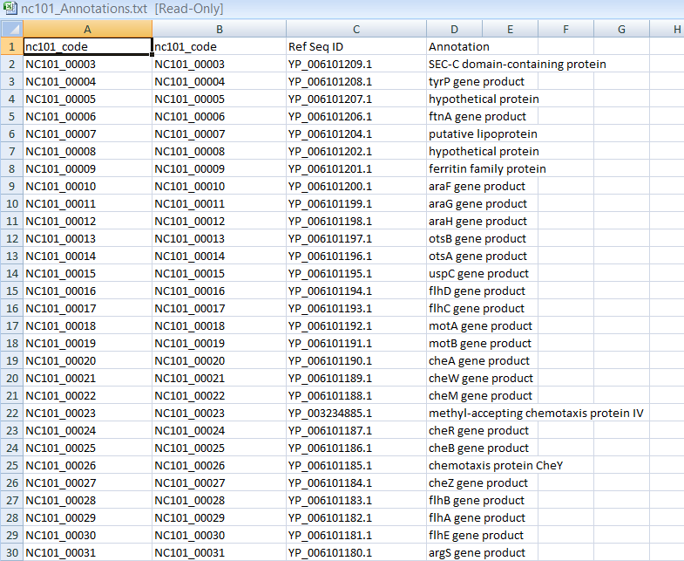
In case you care what these genes are…
File = nc101_Annotations.txt

Slide 5
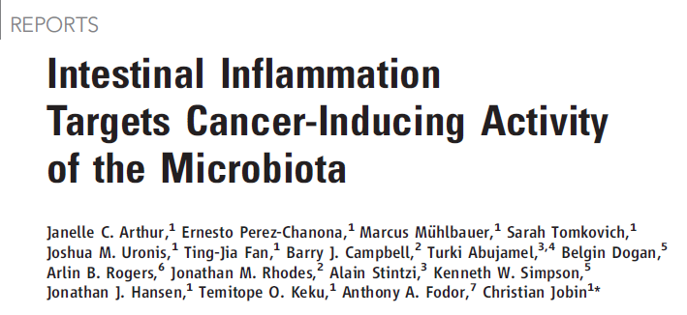

Two papers that describe this experimental system….
http://www.sciencemag.org/content/338/6103/120.full.pdf
Proofs are here: http://afodor.github.io/classes/stats2015/proofs_NatureCommunications.pdf
(since UNCC doesn’t have access to this journal!!)

Slide 6
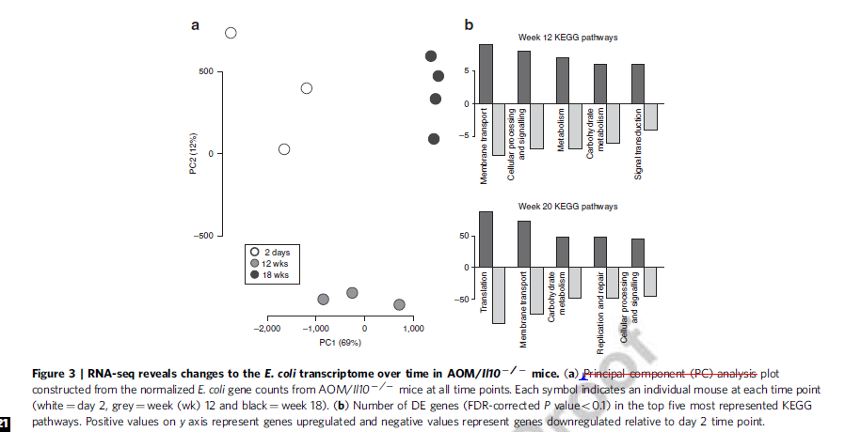
Fig.3 in the 2nd paper is the dataset you have…

Slide 7
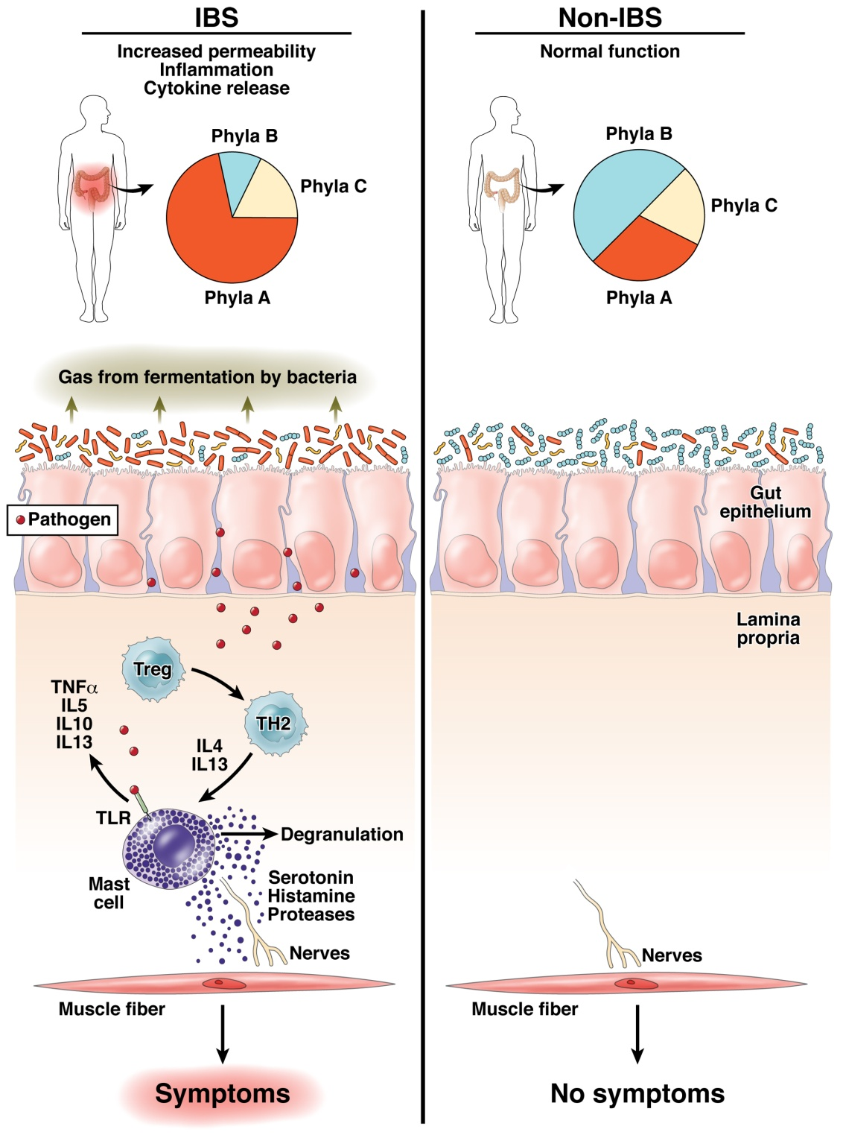
The “dysbiosis” hypothesis linking risk for inflammation related diseases to the microbiome
Fodor & Talley. Gastroenterology. 2011

Slide 8
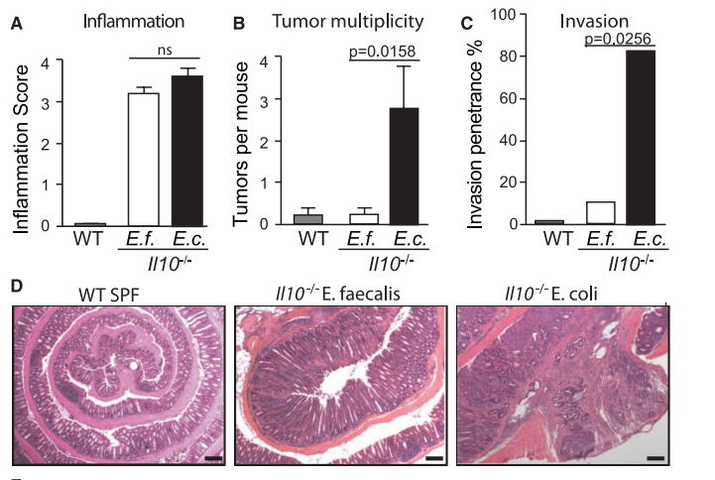
Some bugs, but not others, can cause inflammation to progress to cancer…
Arthur et al, Science, 2012

Slide 9
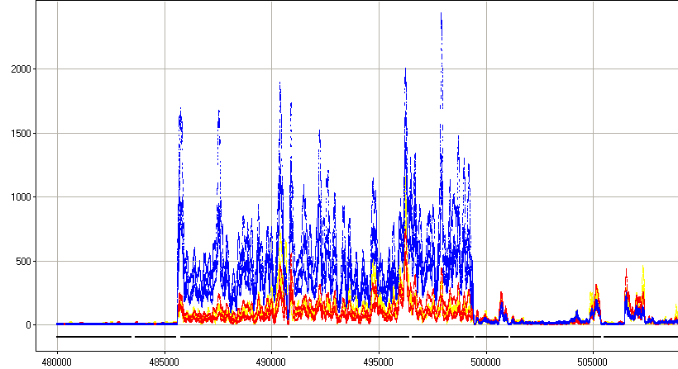



rna-seq shows us gene expression of host-associated E. Coli
Sterile mice
Inoculate with E. Coli
RNA from fecal samples characterized
by RNA-seq on the Illumina platform
2 days
12 weeks (inflammation)
18 weeks (cancer)
Normalized Read Count
Position along the genome
30S ribosomal protein
50S ribosomal protein
preprotein translocase subunit
DNA-directed RNA polymerase subunit

Slide 10
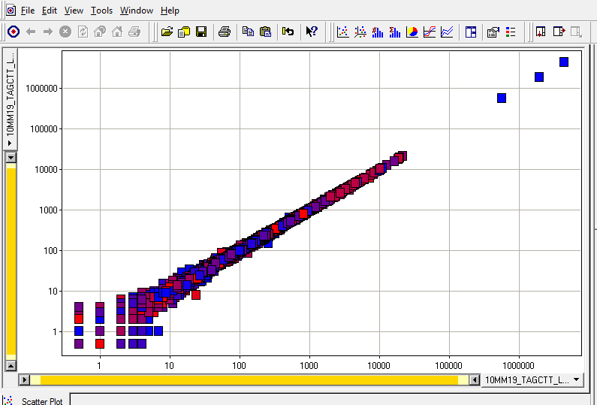
Features of the dataset:
Paired ends are nearly exactly the same
rRNA
unmapped
In your spreadsheet for the homework, we simply merged the paired ends…

Slide 11
One potential problem with this dataset.
Most of the sequences were 16S and 23S rRNA
(Bacteria do not have a poly-A tail on their mRNA )
(We used a bead capture method to remove the rRNA signature with limited success)
rRNA
unmapped

Slide 12
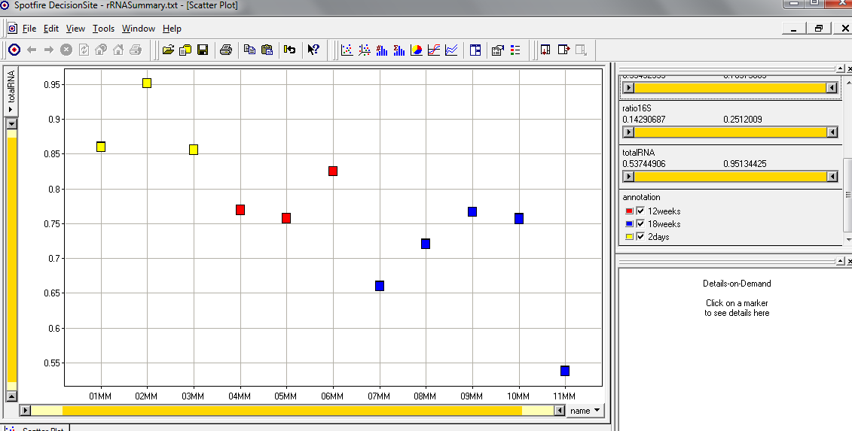
The fraction of 16S rRNA was correlated with time!
(The ribosomal machinery changes with the state of the bug?)
A potentially confounding variable…
16s rRNA reads + 23s rRNA reads
Sample names
In your spreadsheet, we removed the 16S and 23S rRNA sequences
and we will do normalization on the resulting counts…

Slide 13
Introduction to our mouse dataset for lab..
Two approaches to column normalization
Estimating mean and variances for the negative binomial fit

Slide 14
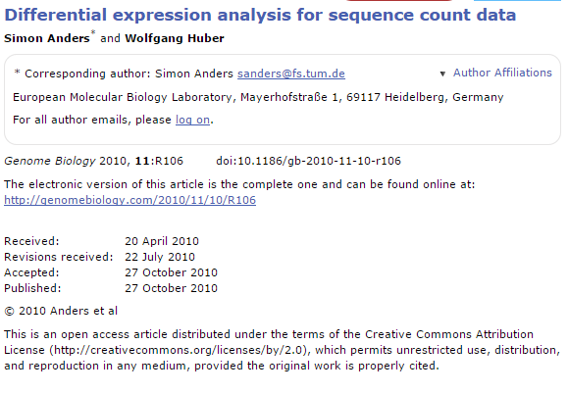
In lab Wed, we will fit the Poisson distribution to this mouse/E. Coli dataset.
We will see that this is a poor model..
In the following weeks lab, we will use a better model based on the negative binomial distribution.
To fit the negative binomial distribution to our dataset, we need to have a strategy to:
(i) deal with the fact that different samples have different numbers of sequences
(ii) choose a strategy to estimate mean and variance for each gene.
(iii) use those means and variances to produce p-values from the negative binomial
distribution
We follow the logic and equations in this paper:

Slide 15
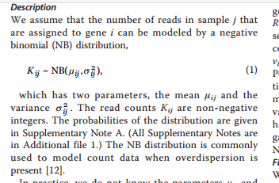
i is an index for samples (columns in our spreadsheet)
J is an index for genes (rows in our spreasheet)
K_{ij} is the # of counts in each cell

Slide 16
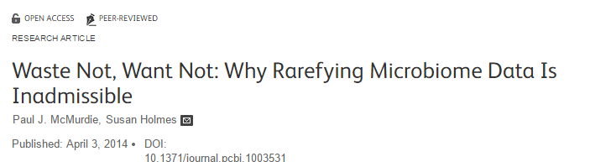
Our first step; normalization….
Each sample in our spreadsheet has a different number of sequences.
We need to correct for this (so that we don’t just reflect in our p-values
that there were more sequences in one sample).
This is a highly controversial and complex question that we will
touch on repeatedly over the semester…

Slide 17
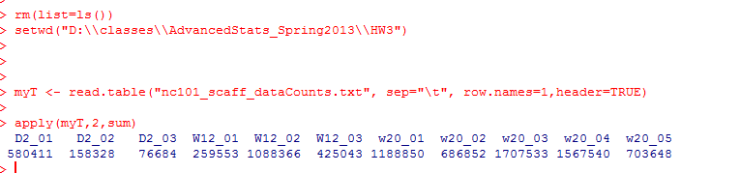
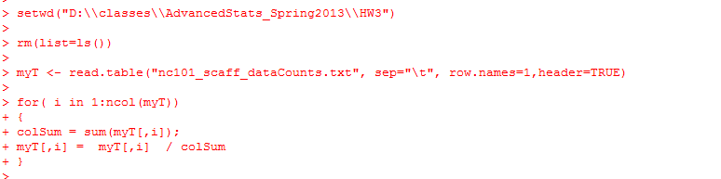
These few lines of code give us the # of sequences in each sample….
“apply” sum to the columns of myT
(if the 2nd parameter were 1, it would be applied to the rows)
One simple normalization scheme is to divide each cell by the sum in the column.
This converts each gene to relative abundance…

Slide 18
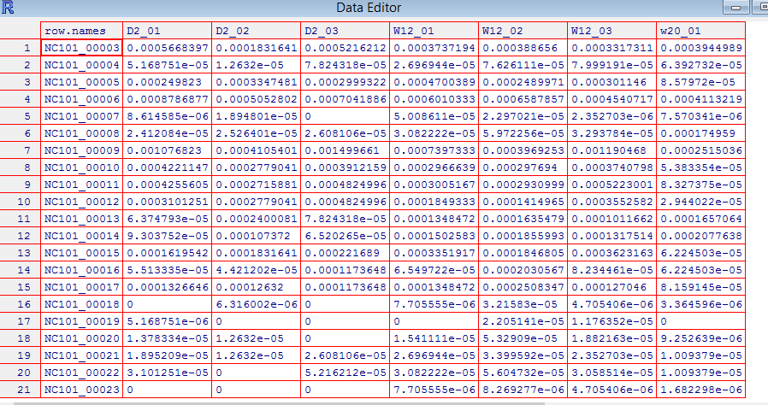

After normalization, the sum of each column is 1…

Slide 19
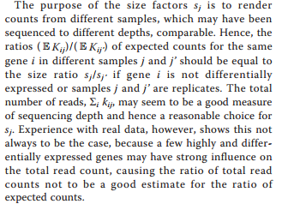
Many people have problems with relative abundance normalization, including the dseq authors
They are concerned that outliers may cause problems…
There is also the compositionality problem (which we talk about more later…)

Slide 20
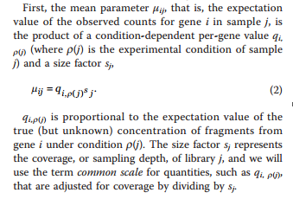
More formally…
q is the true fraction of gene expression under condition p(j)
(in our spreadsheet, p(j) gives us the time 2 weeks, 12, or 20 weeks)
S_{j} is the scaling factor – a normalization factor that will be different for different samples

Slide 21
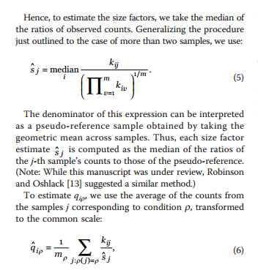
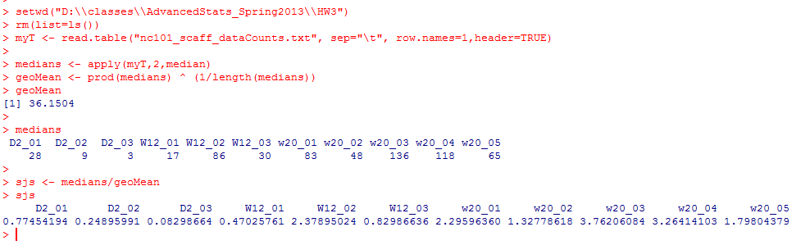
To estimate S_{j}, we take the median of each column

Slide 22
q_{ip}
will be our estimate of expression, normalized by scaling factor
The times (the p(…) ) in our spreadsheet can be defined by columns…

Slide 23
rm(list=ls())
twoWeeks <- 1:3
twelveWeeks <- 4:7
twentyWeeks <- 7:10
myT <- read.table("nc101_scaff_dataCounts.txt", sep="\t", row.names=1,header=TRUE)
myT <- myT + 1
twoWeeks <- 1:3
twelveWeeks <- 4:7
twentyWeeks <- 7:10
medians <- apply(myT,2,median)
geoMean <- prod(medians) ^ (1/length(medians))
sjs <- medians/geoMean
getQsVals <- function( myT, sjs, range )
{
qs <- vector(length=nrow(myT))
for( i in 1:nrow(myT) )
{
sum = 0;
for ( j in range)
{
sum = sum + myT[i,j] / sjs[j]
qs[i] = sum / length(range);
}
}
return(qs)
}
qsForTwoWeeks <- getQsVals(myT,sjs, twoWeeks)

Slide 24
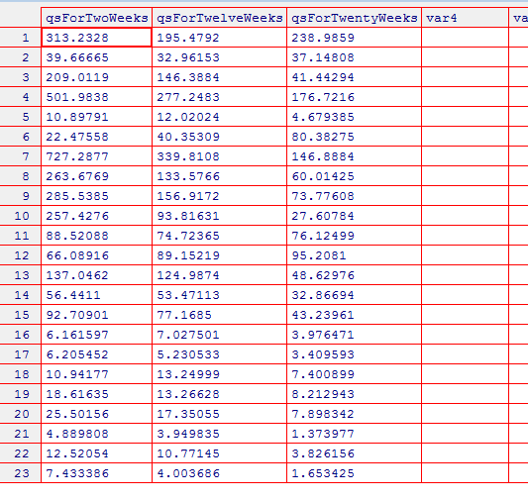
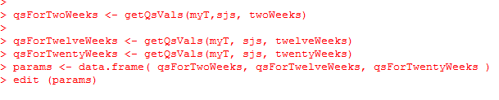

Slide 25
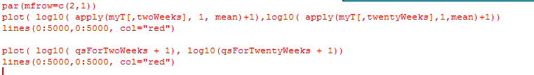
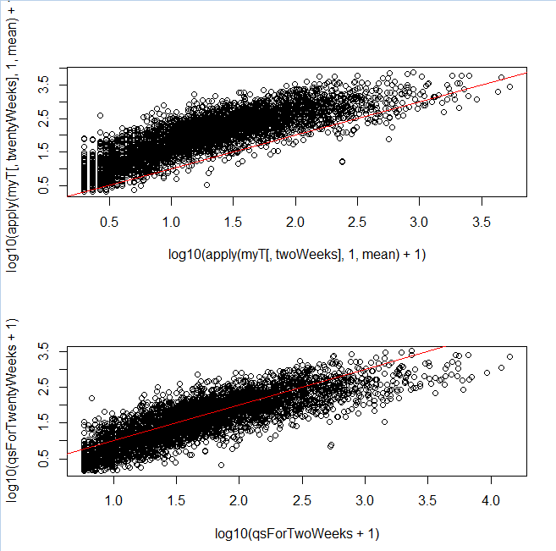
Our normalization makes the different samples more directly comparable…
Without normalization
You can see a local
regression might
have done better!
With normalization

Slide 26
What about the variance?
You might think the variance within a condition would just be something like…
varTwoWeeks <- apply( myT[,twoWeeks], 1, var )
varTwelveWeeks <- apply( myT[,twelveWeeks], 1, var )
varTwentyWeeks <- apply( myT[,twentyWeeks], 1, var )
That is just canonical variance defined within each category
There are going to be numerous reasons why this will not be the variance used in DeSeq

Slide 27
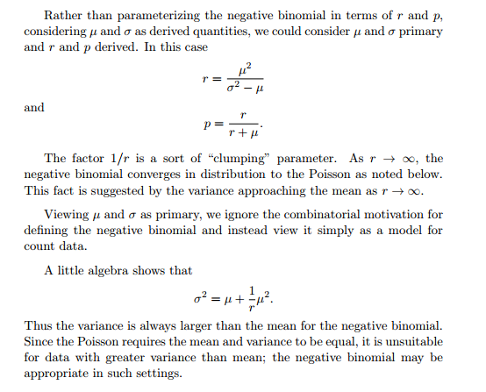
One problem is that the negative binomial distribution is not defined when the variance <= mean!
So if we are going to use the negative binomial, we have to define
the variance as the mean plus something…
http://www.johndcook.com/negative_binomial.pdf

Slide 28

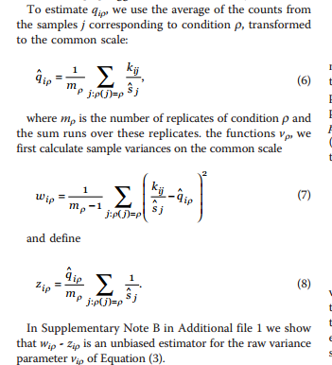
So if we are going to use the negative binomial, we have to define
the variance as the mean plus something…
We state without proof an equation
for the “raw variance”
The proof is given in supplementary
materials (where, to be honest,
I have struggled with it…)

Slide 29
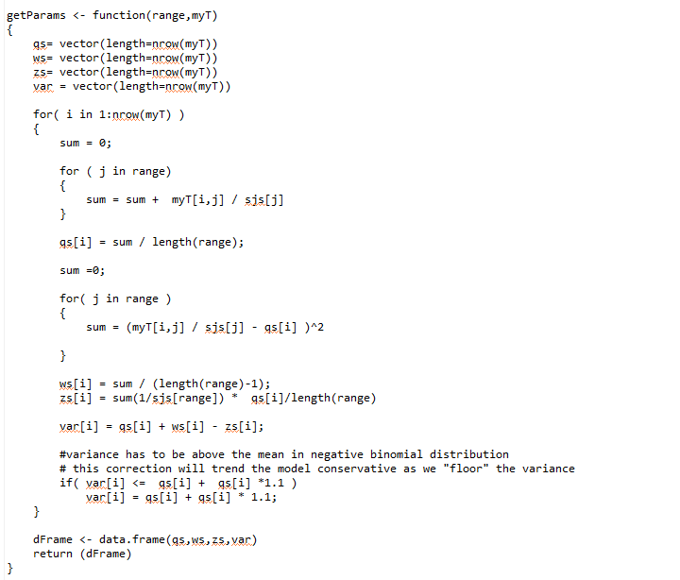

Here is a function that yields the means and variances
for a range of columns
We force the shotgun noise to be > 0
(or it will produce NAN’s in our
negative binomial distribution!)

Slide 30
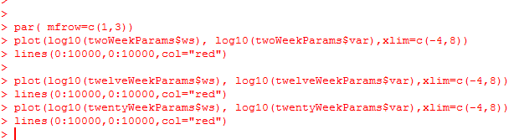
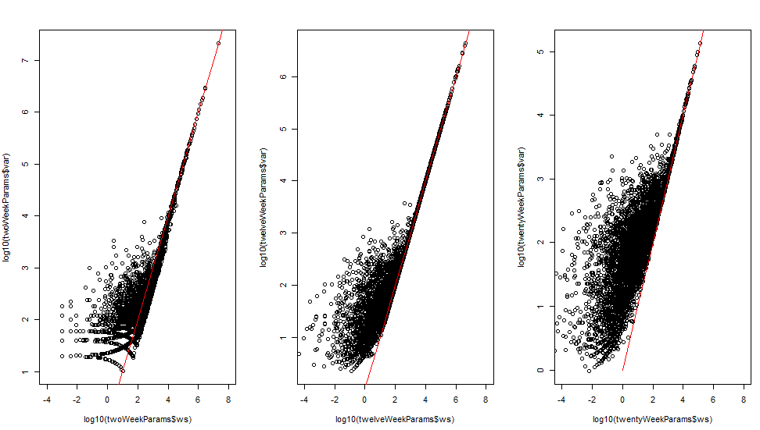
We see the adjusted variance approaches the canonical variance as the
variance increases….

Slide 31
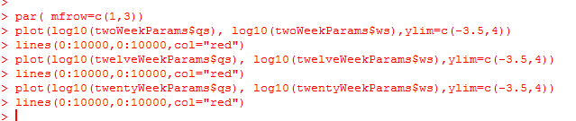
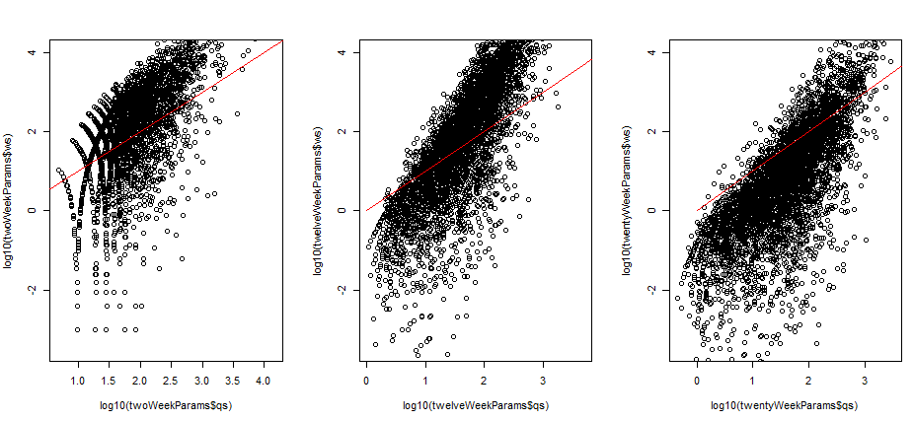
The canonical variance is often well below the mean….

Slide 32
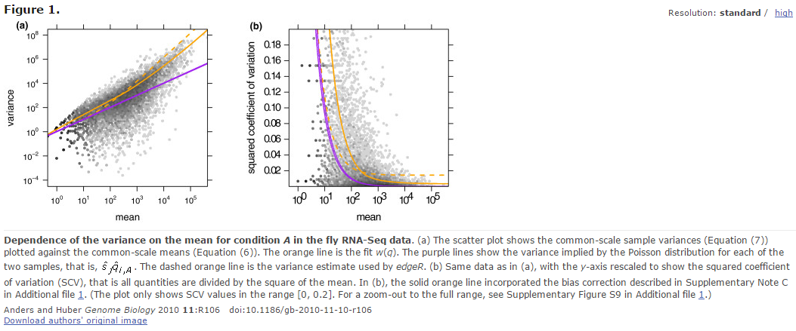
We see the canonical variance is also often below the mean in the dataset
analyzed in the DeSeq paqer

Slide 33
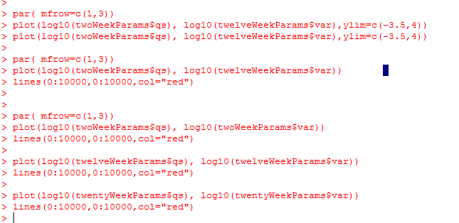
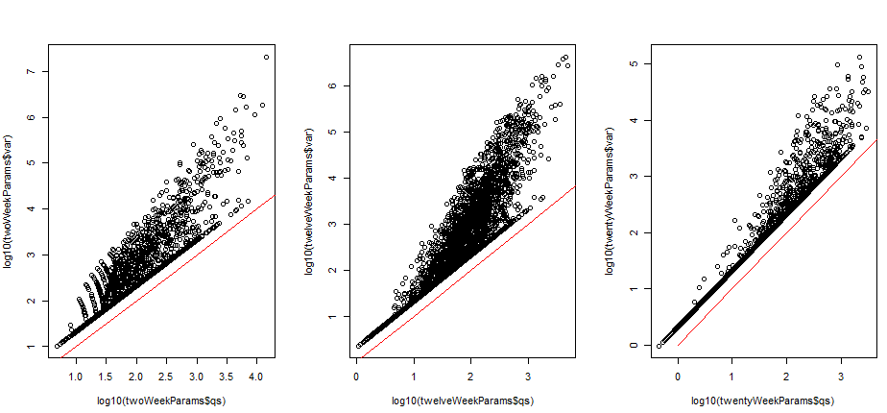
But our adjusted variance is above the mean (because we forced it to be!)

Slide 34
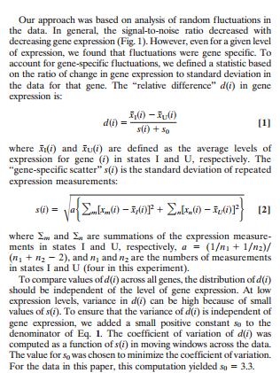
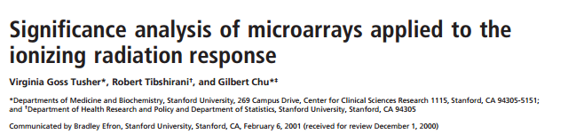
This procedure belongs in a long history of adding small constants to the variance…
(which often seems poorly justified by theory…)
Adding an arbitrary damper to the variance
(9,951 citations)

Slide 35
Adding an arbitrary damper to the variance

Slide 36
Next time:
Now that we have the mean and the variance, how do we use the
negative binomial distribution to calculate p-values?
Also, although all the math we have just done is in the paper, that is not how
DeSeq actually calculates the variances!!
Why not? How does variance get calculated?

