Slide 1
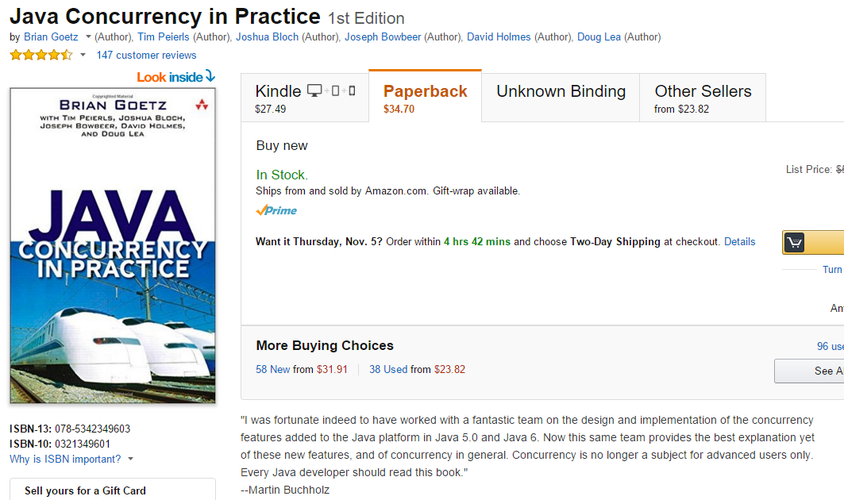
We switch to our last textbook for the semester.
Java Concurrency in Practice…

Slide 2
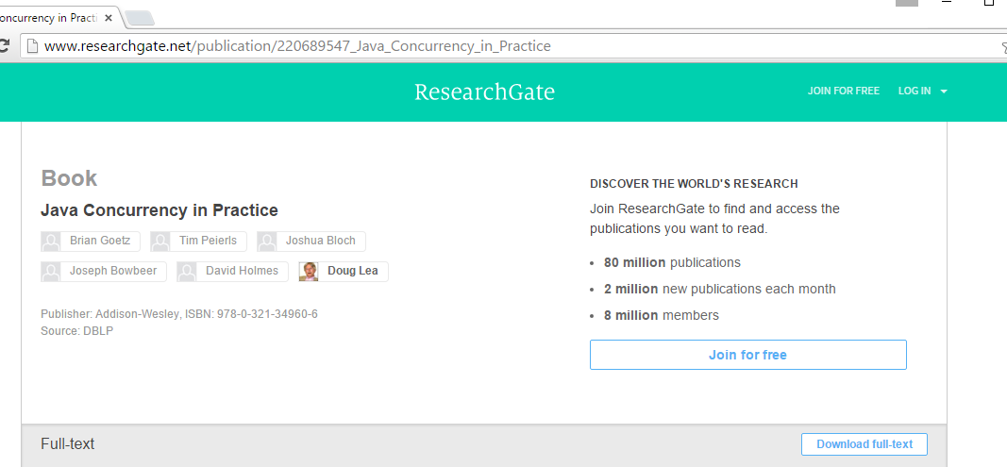
A legal PDF for the book seems to be available…
http://www.researchgate.net/publication/220689547_Java_Concurrency_in_Practice

Slide 3
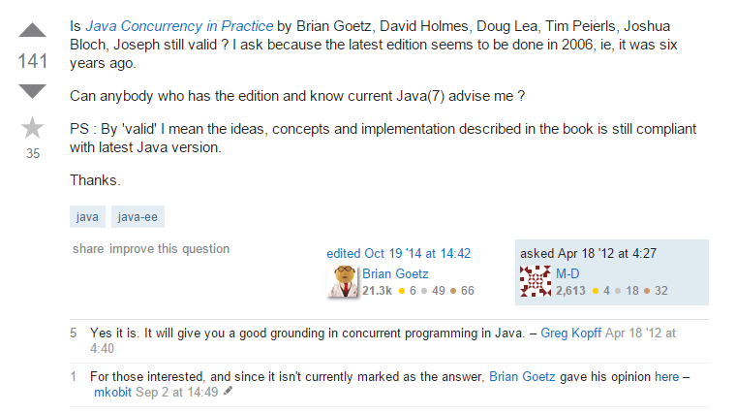
The book doesn’t cover the latest and greatest in Java technology
(this class in general doesn’t cover the latest technology…)
but I think is a very useful introduction to theory…
http://stackoverflow.com/questions/10202768/is-java-concurrency-in-practice-still-valid/10214606#10214606

Slide 4

Java – Concurrency in Practice – Textbook Review – Chapter #1

Slide 5
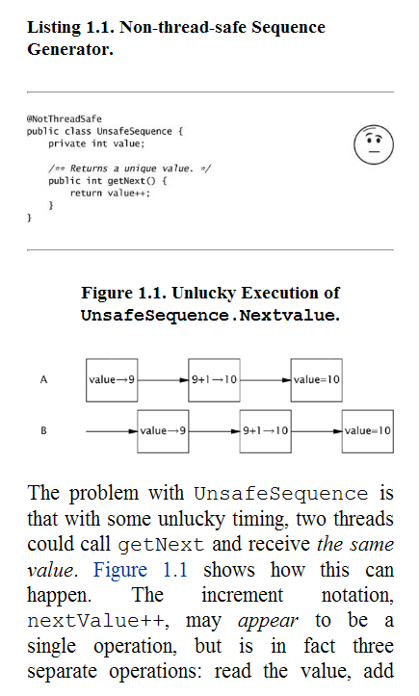

Risks of threads..
Threads have many benefits and are a
requirement of modern operating systems
But it is not hard to write incorrect code…

Slide 6
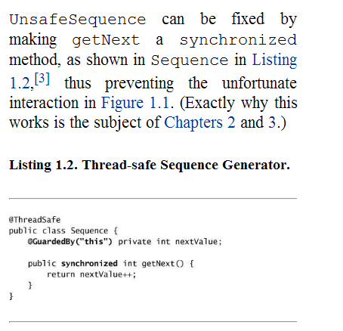
We can fix this by adding a “synchronized” but then it is no longer a multi-threaded program.
In this case, because we expect this method to execute quickly, this might be acceptable..
Adding synchronized influences liveliness vs. correctness.

Slide 7

Java – Concurrency in Practice – Textbook Review – Chapter #2

Slide 8
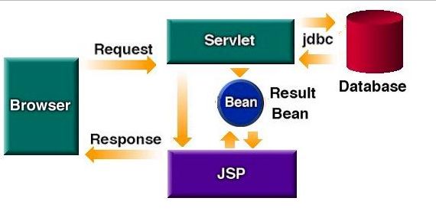
Servlets are inherently multi-threaded (and hence make up many examples for the book)
http://www.kirkdorffer.com/jspspecs/images/scenario2.jpg

Slide 9
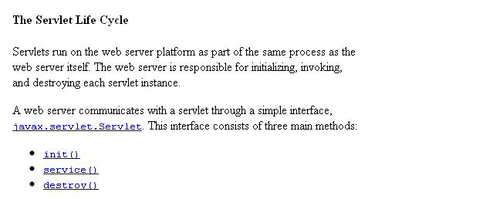
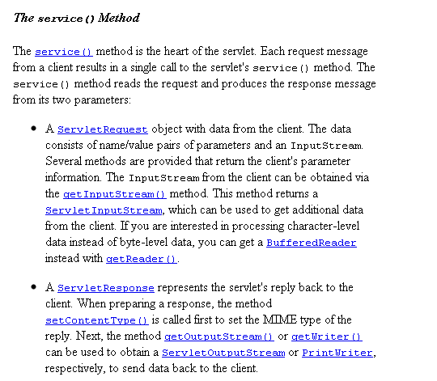

http://java.sun.com/developer/onlineTraining/Servlets/Fundamentals/

Slide 10
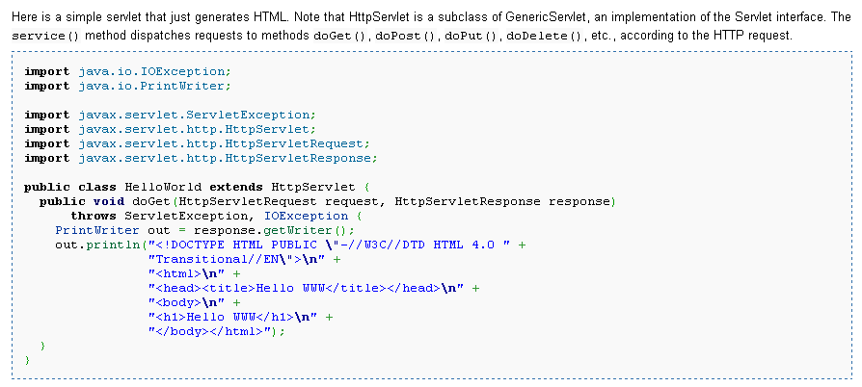
Is this servlet thread-safe?
http://en.wikipedia.org/wiki/Java_Servlet

Slide 11
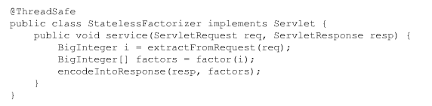
Is this thread safe? why or why not?

Slide 12


Slide 13
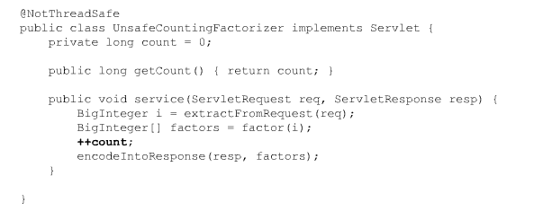
Is this thread safe? why or why not?

Slide 14
In this case, one instance of the servlet is instantiated and sits in memory waiting for
requests..
Multiple clients hit service at the same time…
++count is really
count = count + 1
The assignment and the increment can happen at different times.
The results are undefined…

Slide 15
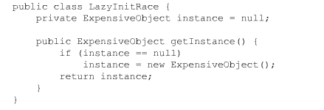
Lazy (or just in time) initialization.
Is this thread-safe? Why or why not?

Slide 16
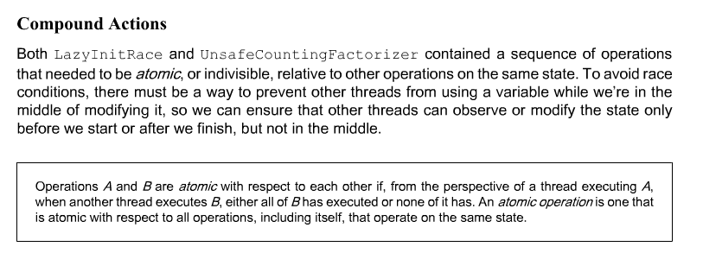

Slide 17
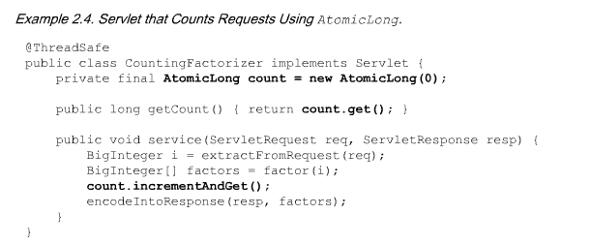
One solution. Atomic variables. Make sure both compound actions happen
at the same time!

Slide 18
For 32 bit data types ( short,int,boolean,char,float) there is some degree of
atomicity.
int x;
x = x + 1
Both the increment and the assignment will happen atomically
(but they are separate operations which is why our HashMap example breaks…

Slide 19
For 32 bit data types ( short,int,boolean,char,float) there is some degree of
atomicity.
int x;
x = x + 1
Both the increment and the assignment will happen atomically
(but they are separate operations which is why our HashMap example breaks…
For 64-bit operations, there is no such guarantee
long x;
x = x + 1
Even the increment operator might break as there are multiple operations
to move all 64 bits..
So even:
y = x
might break if x and y are long or double
(I haven’t been able to figure out if this is true on a 64 bit platform!)
But we don’t want to write code that will fail on 32 bit platforms (at least for now)

Slide 20
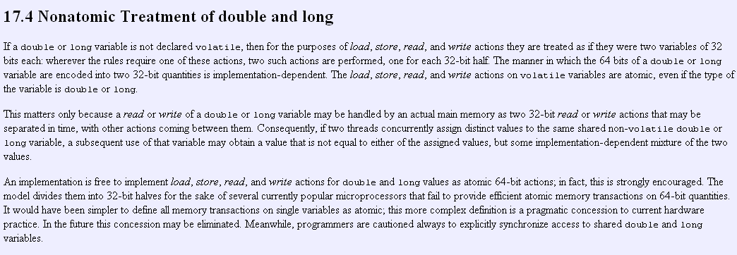
http://java.sun.com/docs/books/jls/second_edition/html/memory.doc.html
On my JVM (XXX on 32 bit XP), long assignment is usually (but not always) atomic…

Slide 21

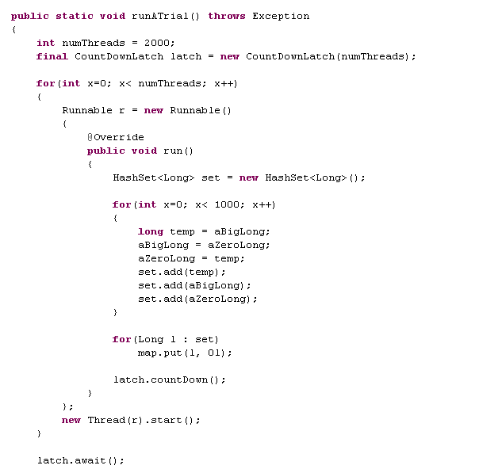
This can lead to some nearly impossible to replicate bugs
I ran this several thousand times. It broke (i.e. there were 3 distinct values in the hashMap)
only twice. Really vicious bug!

Slide 22
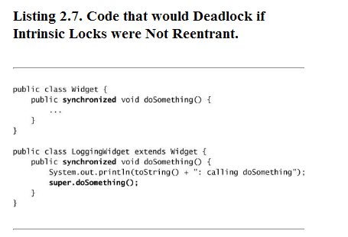
If you have a lock on an object, you can enter another method that has the lock on the
same object; this is called reentrancy

Slide 23
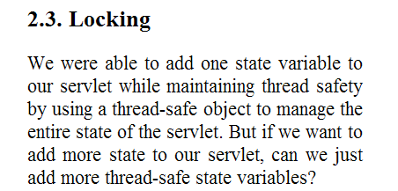
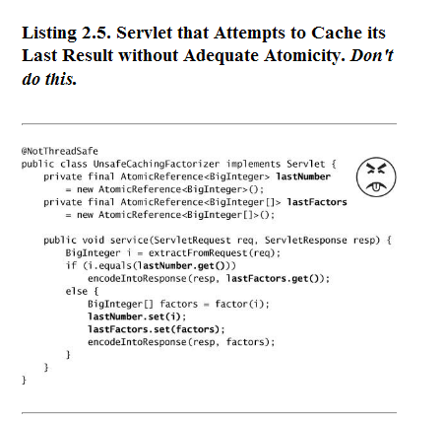

Slide 24
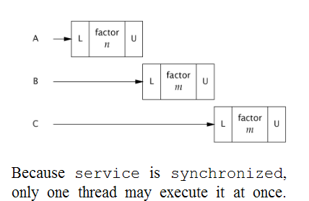
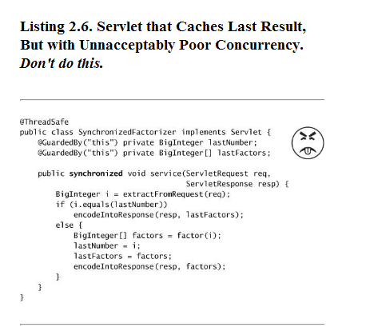
Again, we can avoid the
dangers of threading by
making our program single-threaded,
but then we lose all the benefits of
threading!

Slide 25
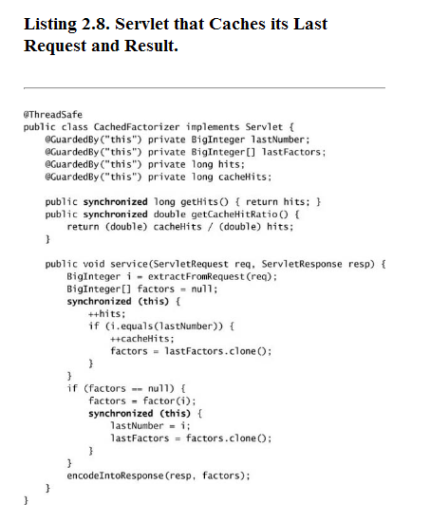
You can increase performance
by only locking the regions of the code
that need to be locked
A more refined performance vs.
correctness trade-off

Slide 26
Next time..
Labs + we will continue to work our way through the
Java concurrency textbook…
(into Chapters 3 and 4)

