Slide 1
Besaran dan Sebaran Penggunaan Narkoba
Ignatius Praptoraharjo

Slide 2
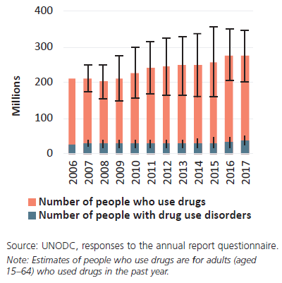
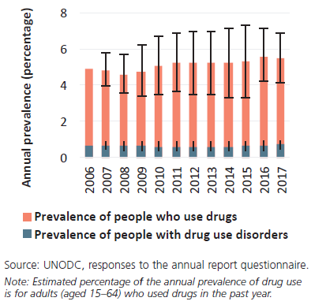
Besaran Pengguna Napza
Global trends in the estimated number
of people who use drugs and those
with drug use disorders, 2006–2017
Global trends in the estimated
prevalence of drug use and drug use
disorders, 2006–2017
Notes:
Opioids most harmful
Hep C stands out vs HIV

Slide 3
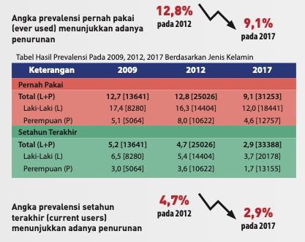
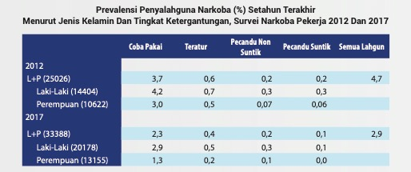
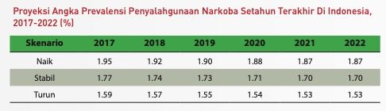
Survei BNN 2017

Slide 4
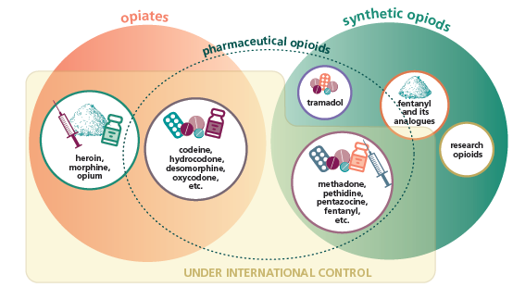
OPIODS
SOURCE: UNODC, WDR 2019

Slide 5
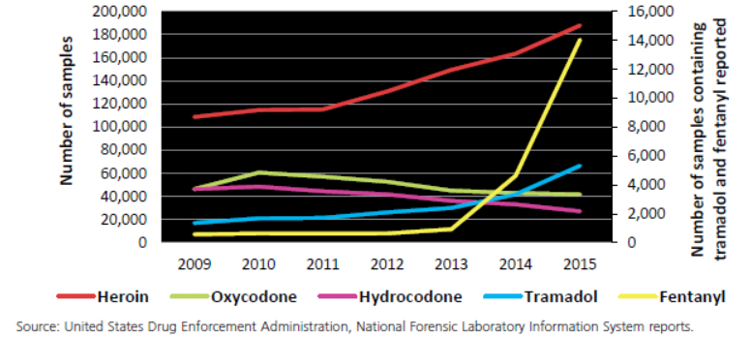
Heroin and Opioid Sintetik

Slide 6
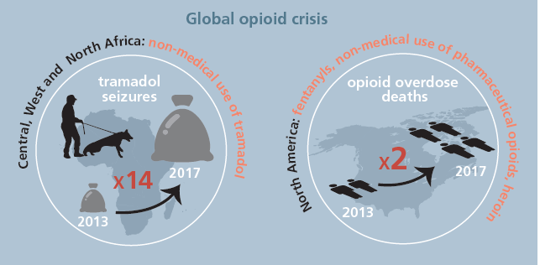
SOURCE: UNODC, WDR 2019

Slide 7
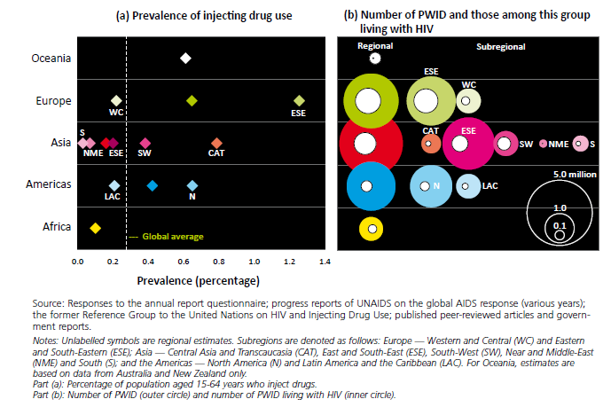
12 juta orang memakai narkoba dengan cara disuntik

Slide 8
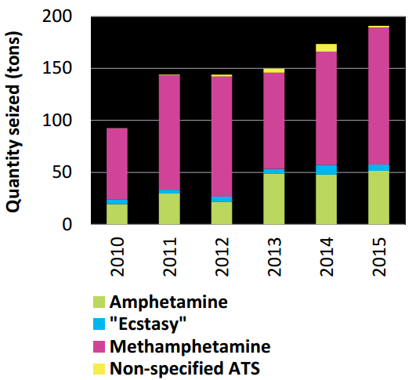
Amphetamine-type stimulants (ATS)
Jumlah tangkapan ATS di dunia
Total ATS seizures: highest ever
Amphetamine and methamphetamine constitute considerable share of burden of disease, rank second only after opioids
Users of amphetamines increased, reaching 37 million globally
Methamphetamine seizures up, East and South-East Asia overtaking North America
“Ecstasy” seizures stable but greater variety of products on the market

Slide 9
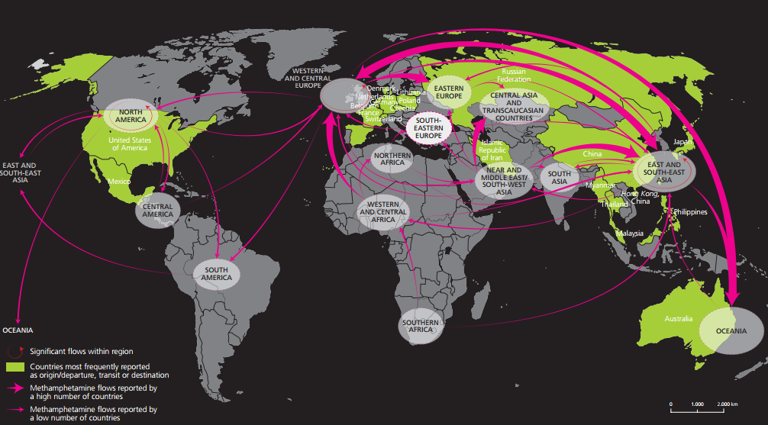
Methamphetamine: interregional trafficking flows
Expanding market in East/South-East Asia, Oceania, concerns about growing use in North America, South-West Asia and parts of Europe. Rising treatment demand in some regions.

Slide 10
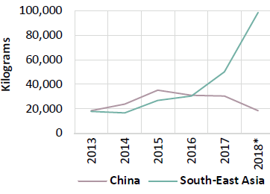
Quantity of methamphetamine seized in China and South-East Asia, 2013–2018

Slide 11
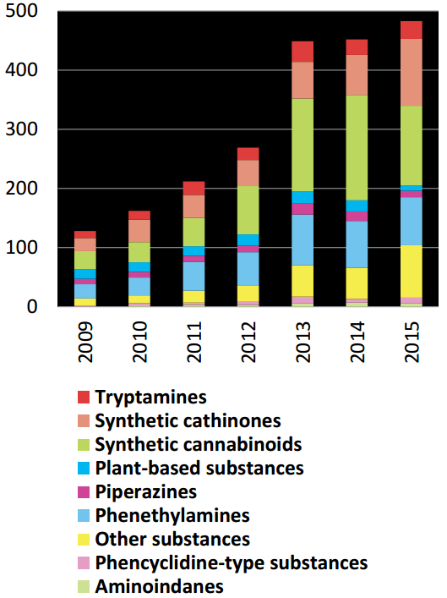
NPS - New psychoactive substances
No. of different NPS reported each year
Between 2009-2016, 739 different NPS reported
In 2015 alone, almost 500 NPS were on the market worldwide
Core group of about 80 persistent NPS
Innovation continues but at slower pace
NPS with stimulant properties expand in number
Recent emergence of NPS mimicking medicines (fentanyl analogues, benzodiazepine derivatives) with high potential to cause harm
UNODC, early warning advisory on new psychoactive substances.

Slide 12
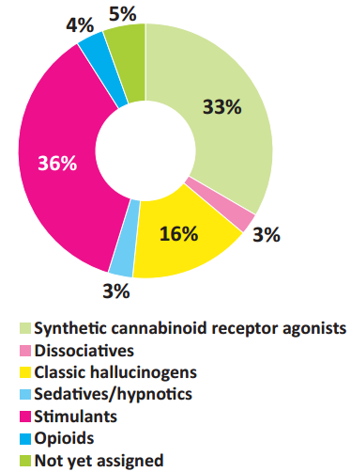
Penggunaan NPS
Proportion of NPS by effect
Overall size of market for NPS still relatively small
Many NPS users unaware of content of NPS products and dosage of substances contained
Injecting use of NPS with stimulant effect among high-risk groups further aggravating health risks (e.g. HIV)
Easy availability and low price make them highly attractive for some groups
Identification of NPS in the laboratory still a challenge due to their high number
Source: UNODC, early warning advisory on new psychoactive substances. Based on the analysis of 717 NPS. Note: The analysis of the pharmacological effects comprises NPS registered up to December 2016. Plant-based substances were excluded from the analysis as they usually contain a large number of different substances some of which may not have been known and whose effects and interactions are not fully understood.

Slide 13
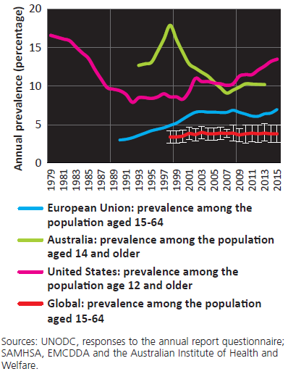
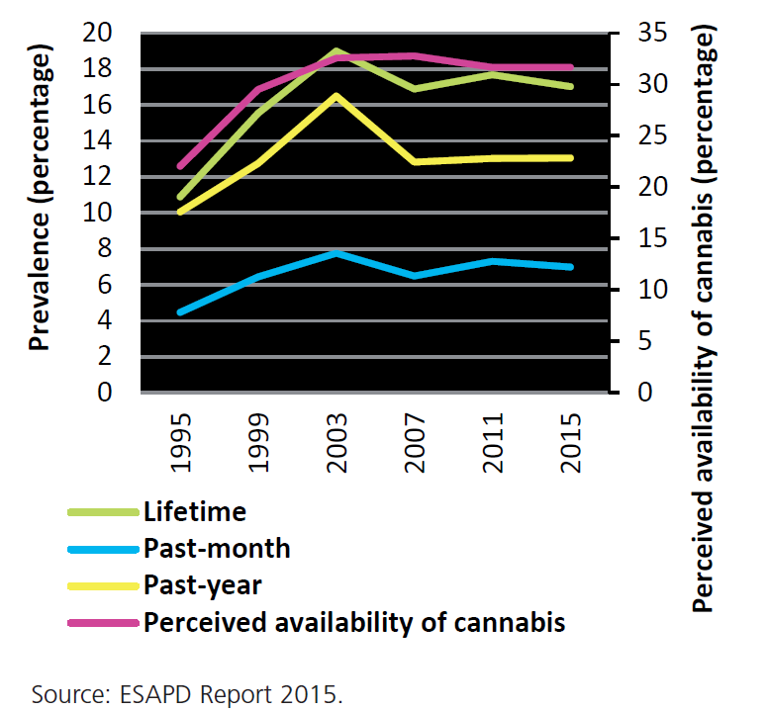
Penggunaan Ganja
Annual cannabis prevalence: United States, European Union, Australia, global level
Cannabis prevalence among
15-16 year-old, Europe

Slide 14
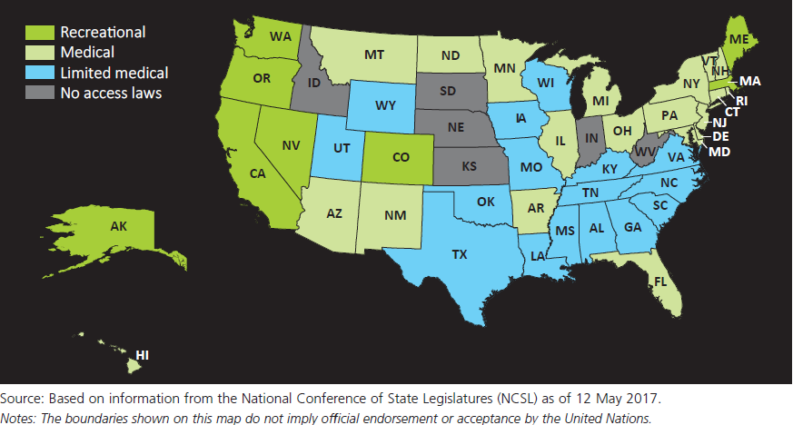
Penggunaan Ganja Rekreasional dan Medik di AS
Jurisdictions in the United States allowing recreational use, medical use of cannabis and with no access to cannabis, May 2017

Slide 15
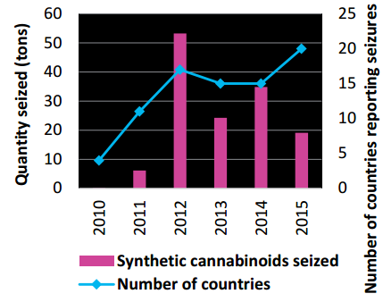
Kanabis Sintetik : Bukan sekedar kanabis
Synthetic cannabinoids seizures worldwide
Some synthetic cannabinoids are much more potent and toxic than THC
Intoxications, including hospitalisations and fatalities, reported
Many new substances in many different compositions
In addition to herbal material also used as liquid, blotter, powder, tablet
Problematic use in prisons and by vulnerable population groups (e.g. homeless)
Use among some user groups declining (e.g. US 12 graders)
Source: UNODC, responses to annual report questionnaire, 2010-2015. Note: Contains seizures in the form of herbal material, as well as powder and liquids.

Slide 16
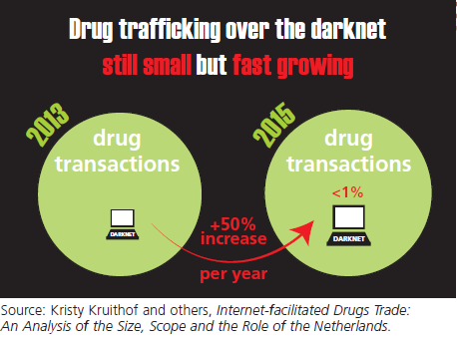
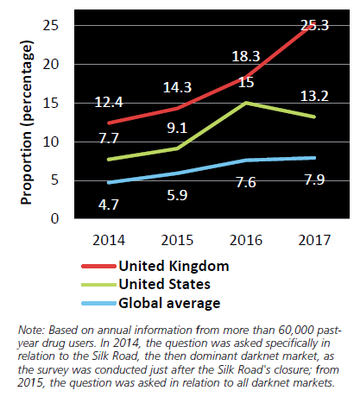
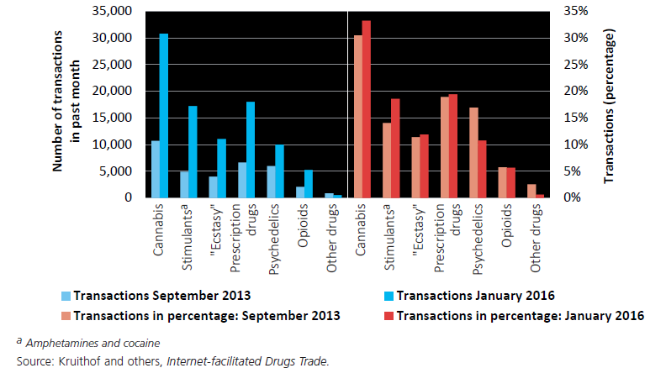
Narkoba di Internet
Annual drug users obtaining drugs over the darknet in the past 12 months
Number of transactions and their market share on the darknet

Slide 17
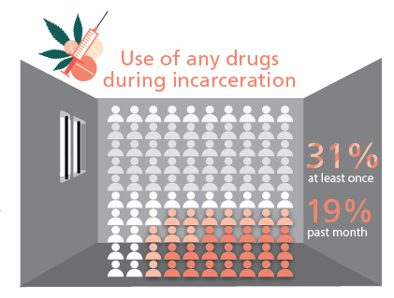
PENJARA DAN NARKOBA
SOURCE: UNODC, WDR 2019
SOURCE: PPH, IBBS 2017

Slide 18
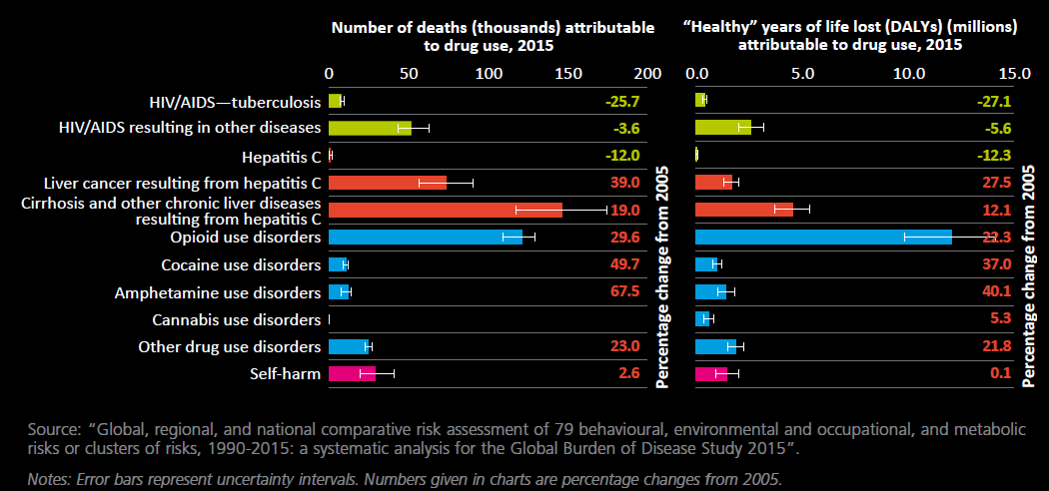
Dampak kesehatan: Kematian yang diakibatkan oleh narkoba 2015

Slide 19
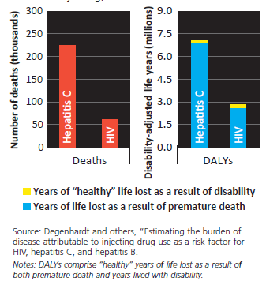
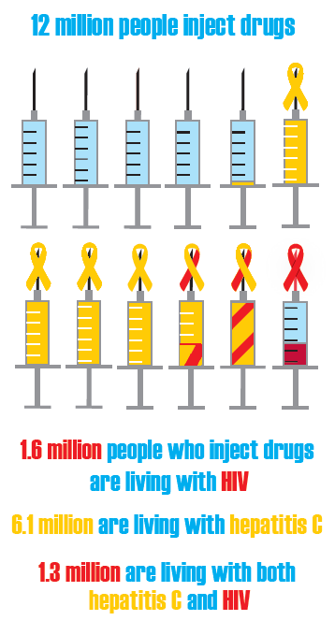
Dampak kesehatan: Hepatitis ternyata merupakan dampak yang terbesar dari menyuntik narkoba

Slide 20
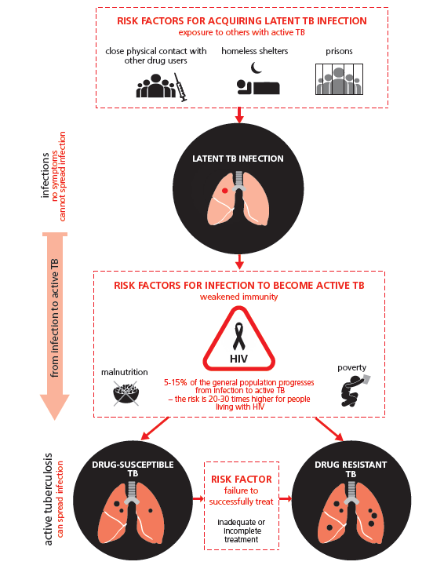
TB dan Penggunaan Narkoba
High-risk factors for acquiring and progressing to active tuberculosis (TB) among people who use drugs.
8% in people who inject drugs vs 0.2% in the general population
Frequent co-morbidity in drug users
More barriers to access prevention and treatment for TB

Slide 21
Hasil Tes Biologis Pengguna Sabu berdasarkan Kota

Slide 22
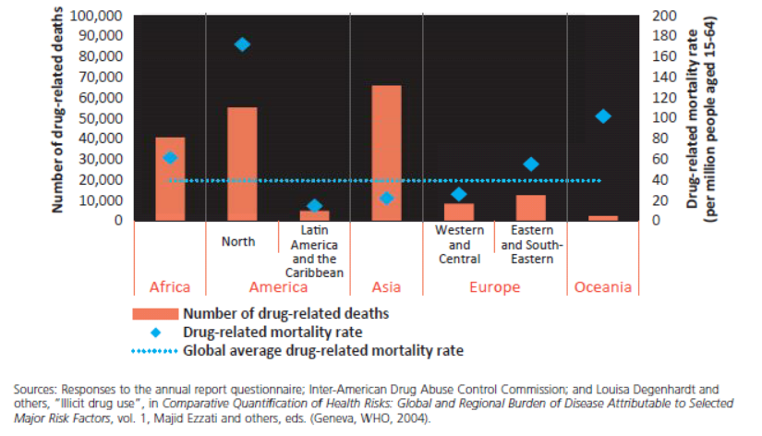
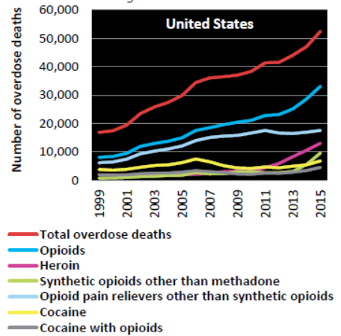
Paling tidak 190,000 kematian diakibatkan oleh narkoba
Kebanyakan karena OD, dan kebanyakan karena opioid

Slide 23
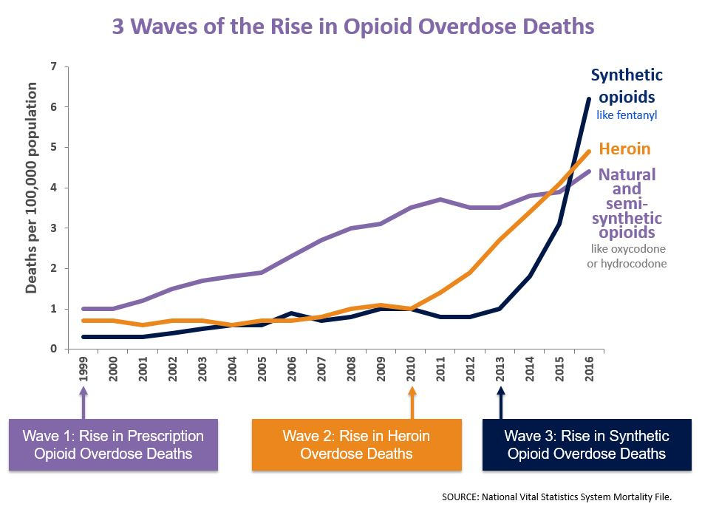

Slide 24
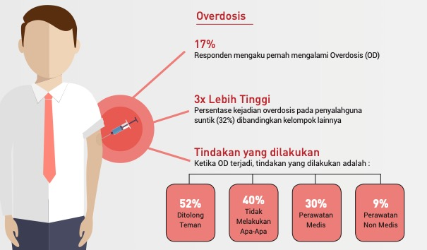
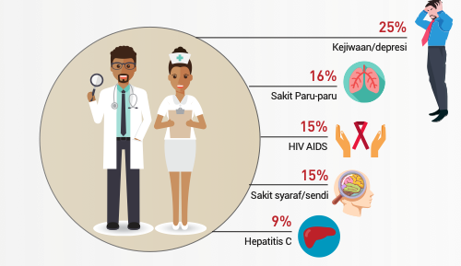
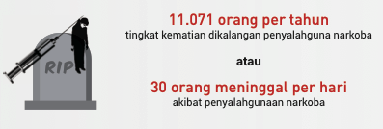
Survei BNN 2017: DAMPAK KESEHATAN

Slide 25
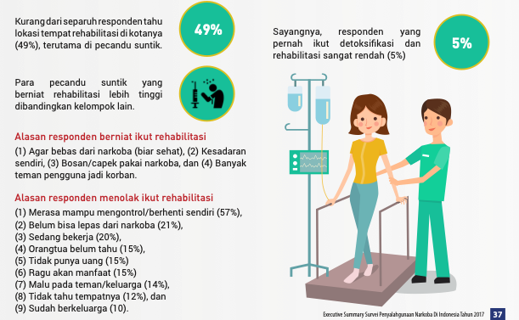
SURVEI BNN 2017: REHABILITASI

Slide 26
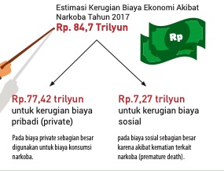
SURVEI BNN 2017: ESTIMASI BIAYA KERUGIAN

