Slide 1
Clinical Heterogeneity and Adaptive Decoding for Cross-Subject MI-EEG in Acute Stroke
Systematic Experimental Validation on XWStroke Dataset
LIU Yuehan
18 May 2026

Slide 2
01
Background
02
Research Status
CONTENTS
03
Preliminary Results
04
Future Directions

Slide 3
01
BACKGROUND

Slide 4

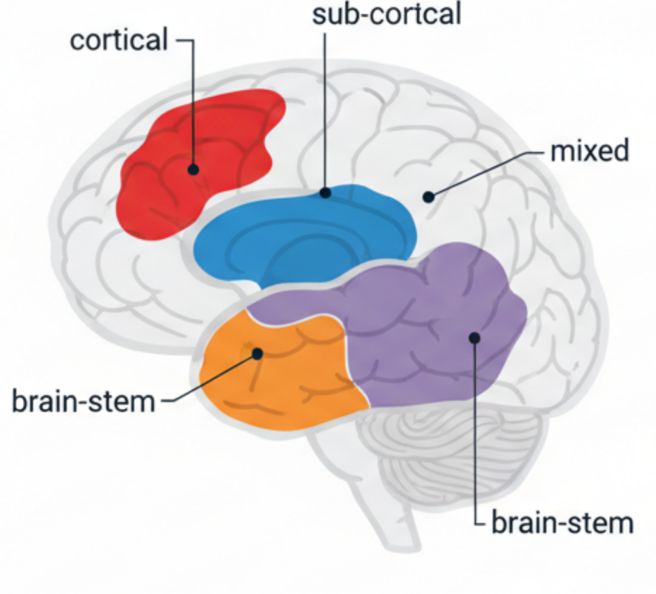


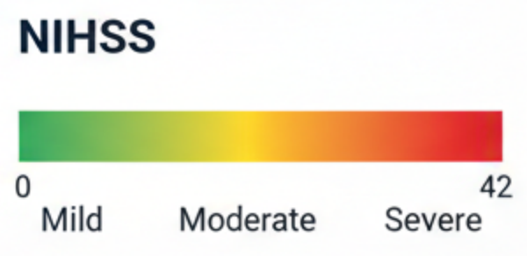
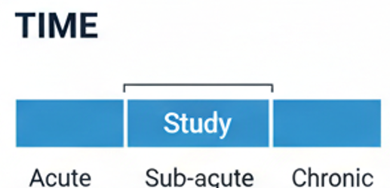
Stroke Heterogeneity
Heterogeneity Variables：
Type,
Leision Location,
Paralysis Side,
Severity,
Period
Core Contribution:
systematic introduction of stroke clinical variables into cross-subject MI-EEG decoding
Clinically Adaptive Strategie

Slide 5
XW Stroke Dataset
N=50 acute stroke patients (1–30 days post-stroke)
32 EEG + 2 EOG channels, 500 Hz sampling, 4-second epochs
13 artifact-affected subjects identified
Dimension | Category | N=50
Artifact | Yes | 13 (26%)
 | No | 37 (74%)
Paralysis Side | Left | 28 (56%)
 | Right | 22 (44%)
NIHSS | Light (1–3) | 28 (56%)
 | Medium (4–7) | 16 (32%)
 | Severe (≥8) | 6 (12%)
Lesion Location | Subcortical | 29 (58%)
 | Brainstem | 16 (32%)
 | Cortical | 3 (6%)

Slide 6
02
RESEARCH
STATUS

Slide 7
Core Method on XW Dataset (6 only)
Paper | Data Scope | Reported Results | Publish
Bun24 | Full 50 | SACAN 94.44% | DASA 2024 (Conference)
Bun25 | Full 50 | 80/20 standard evaluation 99.52%, LOSO 97.43% | Computers, Materials & Continua
Kav24b | Full 50 | Dipole 91.03%, MNE 89.07%, Beamforming 87.17% | Bioengineering
Wan26h | 24-patient subset | XW Stroke cross-subject 66.56% | Arxiv(Apr.2026)
Liu25c | 30-patient subset | Decoding accuracy above 60% for each ROI, with manifold and NIHSS correlation analysis | IEEE TNSRE
Lv25 | 14-patient subset | KNN 75.00% ± 7.94%, LDA and SVM lower | JNER

Slide 8
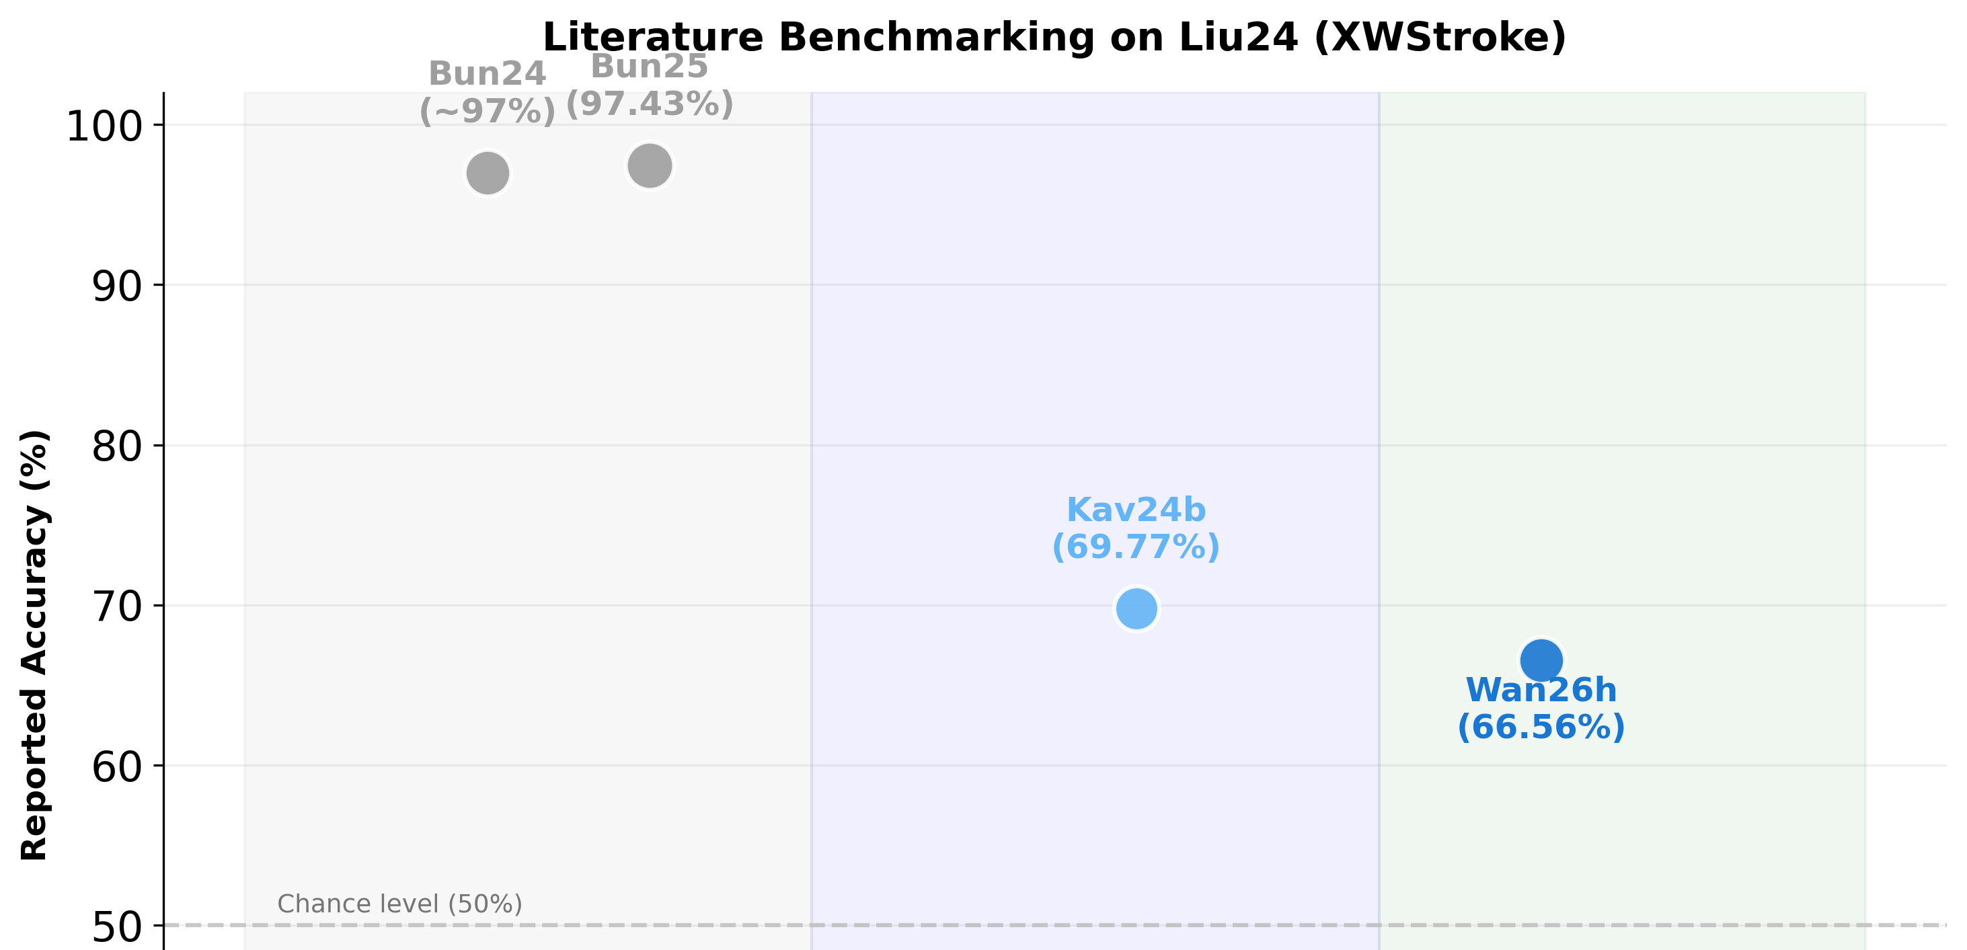
Core Method on XW Dataset (LOSO)

Slide 9
Core Method on XW Dataset

Slide 10
03
PRELIMINARY
RESULTS

Slide 11
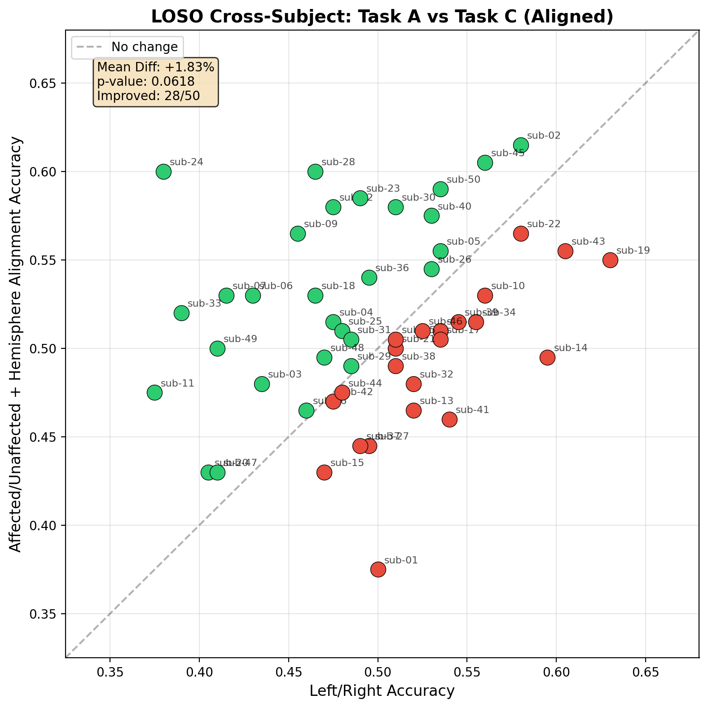
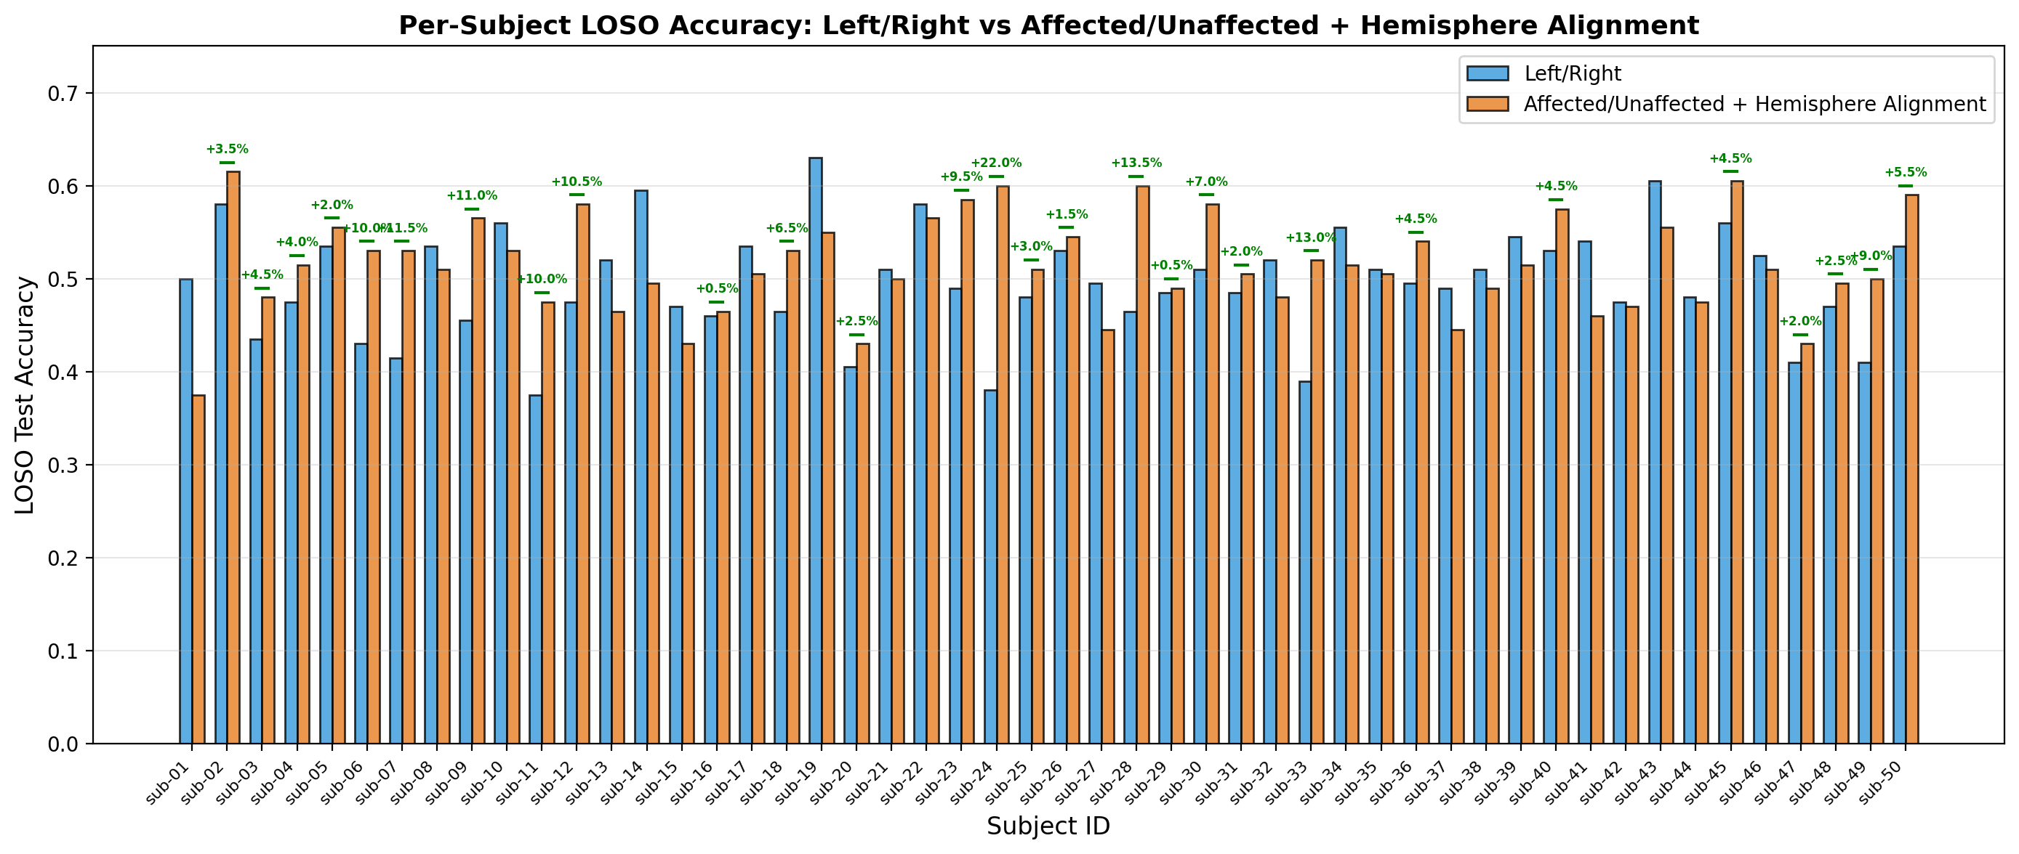
Affected Label Convert: Full-Cohort Baseline
Passive Paradigm:
avg performance: +1.83%
p-value: 0.0618 > 0.05
improved subjects: 28/50

Slide 12
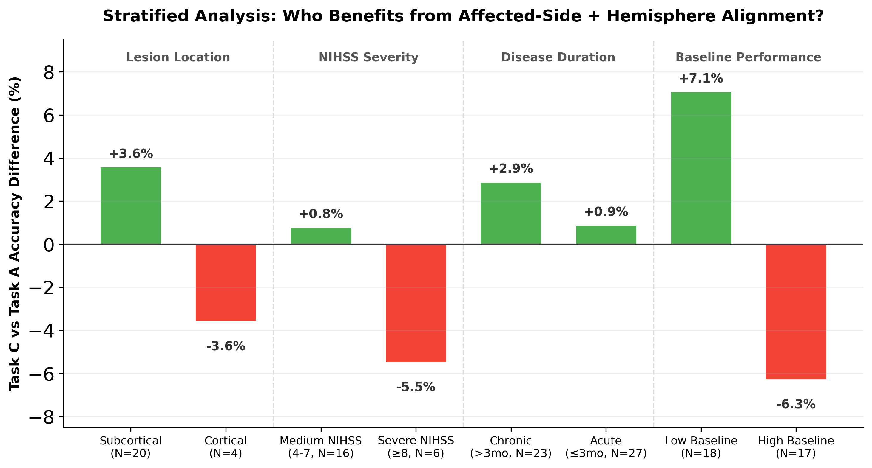
Affected Label Convert: Stratified Analysis
Benefit:
less damaged
deeper lesion
Hurts:
cortical-damage
Assume:
relying on intact motor circuits

Slide 13
Subset Selection
Aspect | CleanC (N=14) | Subset-20 (N=20)
Selection logic | Homogeneity filtering | Stratified sampling
Purpose | Mechanism validation | Fast iteration
Artifact subjects | 0% | 25%
Severe NIHSS | 0% | 10%
Lesion diversity | 100% subcortical only | 55% subcortical + 35% brainstem + 5% cortical
Use case | Upper-bound estimate | Realistic estimate

Slide 14
Domain-Adversarial

Slide 15
04
FEATURE
DIRECTIONS

Slide 16
Clinical Adaptive Framework

Slide 17
External Datasets Validation
Dataset | N and Stage | MI Task | Clinical Information Strength | Overall
Liu25 | 27 patients (1 to 12 mo) | 2-class: Lower-limb gait vs. idle | Moderate, including affected side, lesion location, stroke type, disease duration | Prioritize for validation
Cho21 | 10 patients (~11 mo) | 2-class: Left/right hand grasp attempt | Weak, mainly affected side and basic demographics | Small-sample cross-subject transfer benchmark
Thi25 | 30 patients | 4-class: Left/right hand and left/right lower limb | Strong, including NIHSS, lesion side, lesion location, mRS, Oxford | Strongest clinical stratification

Slide 18
Work Plans
Phase | Status
Full-cohort baseline statistics | Complete
Literature audit + benchmarking | Complete
Subset-20 representative design | Complete
DANN diagnostics | Complete (abandoned)
Subset-20 baseline validation | In progress
Route B: Clinical adaptive framework | Priority #1
External validation | Pending

Slide 19
Reference
H. Liu *et al.*, “An EEG motor imagery dataset for brain computer interface in acute stroke patients,” *Scientific Data*, vol. 11, Jan. 2024, doi: [10.1038/s41597-023-02787-8](https://doi.org/10.1038/s41597-023-02787-8).
Y. Liu *et al.*, “Lower limb motor imagery EEG dataset based on the multi-paradigm and longitudinal-training of stroke patients,” *Scientific Data*, vol. 12, Feb. 2025, doi: [10.1038/s41597-025-04618-4](https://doi.org/10.1038/s41597-025-04618-4).
A. Chowdhury and J. Andreu-Perez, “Clinical Brain–Computer Interface Challenge 2020 (CBCIC at WCCI2020): Overview, Methods and Results,” *IEEE Transactions on Medical Robotics and Bionics*, vol. 3, pp. 661–670, Aug. 2021, doi: [10.1109/TMRB.2021.3098108](https://doi.org/10.1109/TMRB.2021.3098108).
C. M. Thi *et al.*, “UET175: EEG dataset of motor imagery tasks in Vietnamese stroke patients,” *Frontiers in Neuroscience*, vol. 19, Jun. 2025, doi: [10.3389/fnins.2025.1580931](https://doi.org/10.3389/fnins.2025.1580931).

Slide 20
THANKS!

