Slide 1
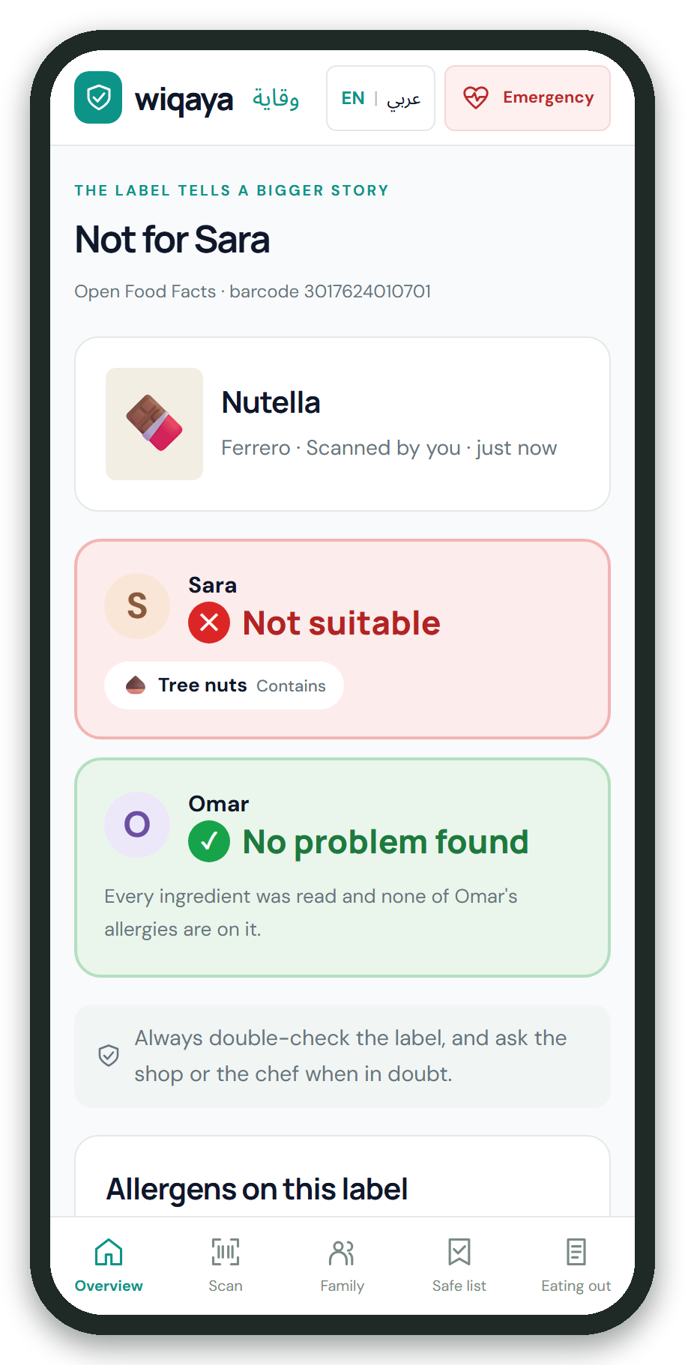
Wiqaya وقاية
By Team Cursors
Scan a food label. Know if it's safe for each child.
Cursors · Yousef Al Masri -Laith Al Ardah – Mustafa Al Shammari
Digital Health & Wellness
Notes:
Wiqaya, Arabic for 'protection': an open-source food-label checker for families in Jordan, built for Hack Day Amman, theme Digital Health & Wellness.

Slide 2



Digital Health & Wellness
The Problem
Our Solution
Target Impact
Foreign labels hide allergens
Scan, and know per child
Every caregiver protected
Notes:
Problem: more than 1 in 10 Jordanian schoolchildren has a food allergy. Imported snacks carry Italian, Turkish or German labels under an Arabic sticker that can drop a 'may contain' line, and the person buying is often a grandparent. Solution: scan the barcode or photograph the label; Gemma 4 reads it in any language and the phone checks it against each child's allergies. Impact: parents, grandparents, schools and restaurants, with no child data leaving the phone.

Slide 3
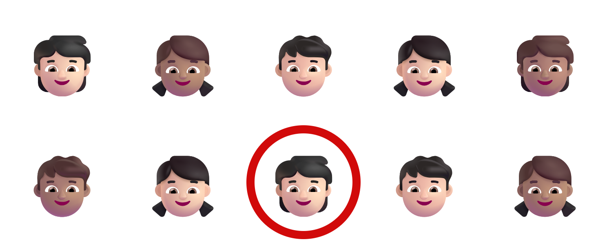


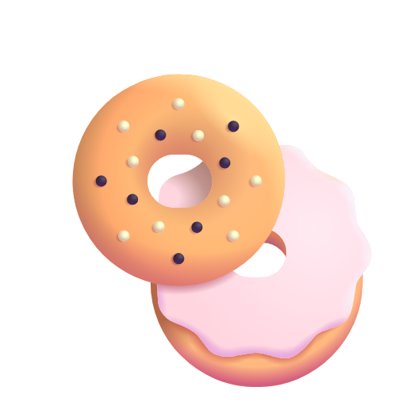
Why it matters
Two labels, one snack
ORIGINAL · ITALIAN
ARABIC STICKER
farina di frumento, zucchero, olio di girasole…
دقيق القمح، سكر، زيت دوار الشمس…
1 in 10
Può contenere frutta a guscio
"may contain nuts" missing
Jordanian schoolchildren has a food allergy
Hidden names
malt
whey
tahini
jameed
Notes:
More than 1 in 10 Jordanian schoolchildren has a food allergy (11.5% of 1,629 children, 2025 study); about 1 in 124 in Irbid screened positive for celiac disease. On imported food, the Arabic sticker can leave out the original's 'may contain' line. And allergens hide behind names: malt extract is gluten, whey is milk, tahini is sesame, jameed is milk.

Slide 4




How it works
From a photo to a verdict for each child
Not suitable
Check first
Scan
Gemma 4 reads
Code checks
Phone decides
No problem found
barcode or photo
any language → JSON
second reading, edges
per child, on device
The AI never sees the child.
Only the label goes to Gemma; allergies stay on the phone.
Notes:
One scan: the phone reads the barcode, or takes a photo of the ingredients and the Arabic sticker. Gemma 4 reads the label in any language and returns structured JSON. Code double-checks the reading: a second reading must agree, and an edge check catches cut-off lists. Then the phone decides for each child: red, amber or green, quoting the label. The AI never learns who is allergic to what.

Slide 5
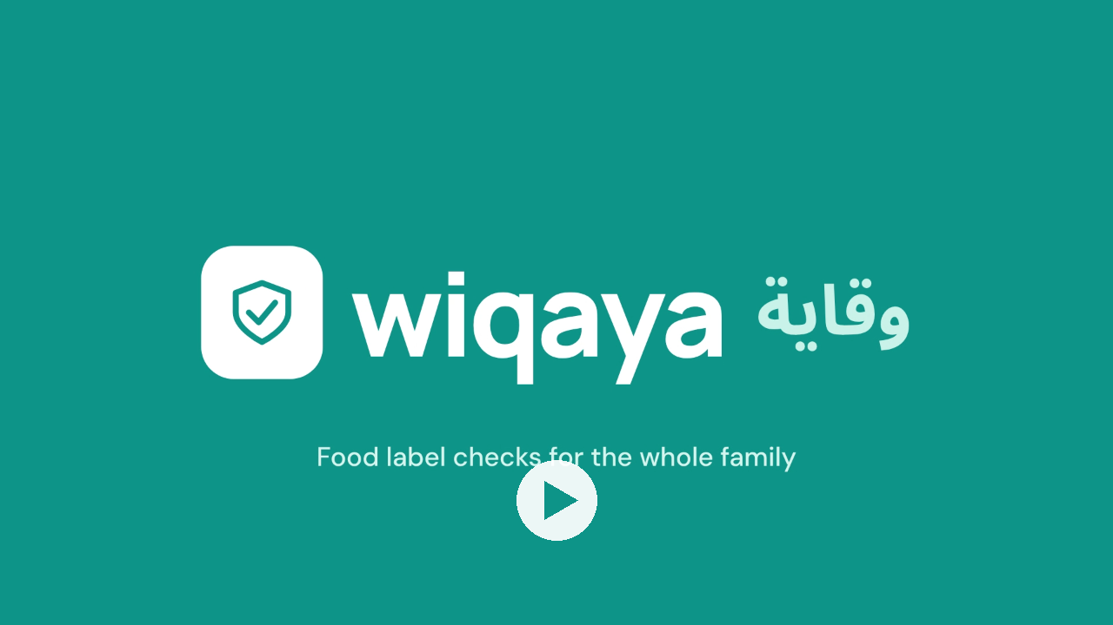
See it in action
Notes:
Play the demo video (68 seconds).

Slide 6
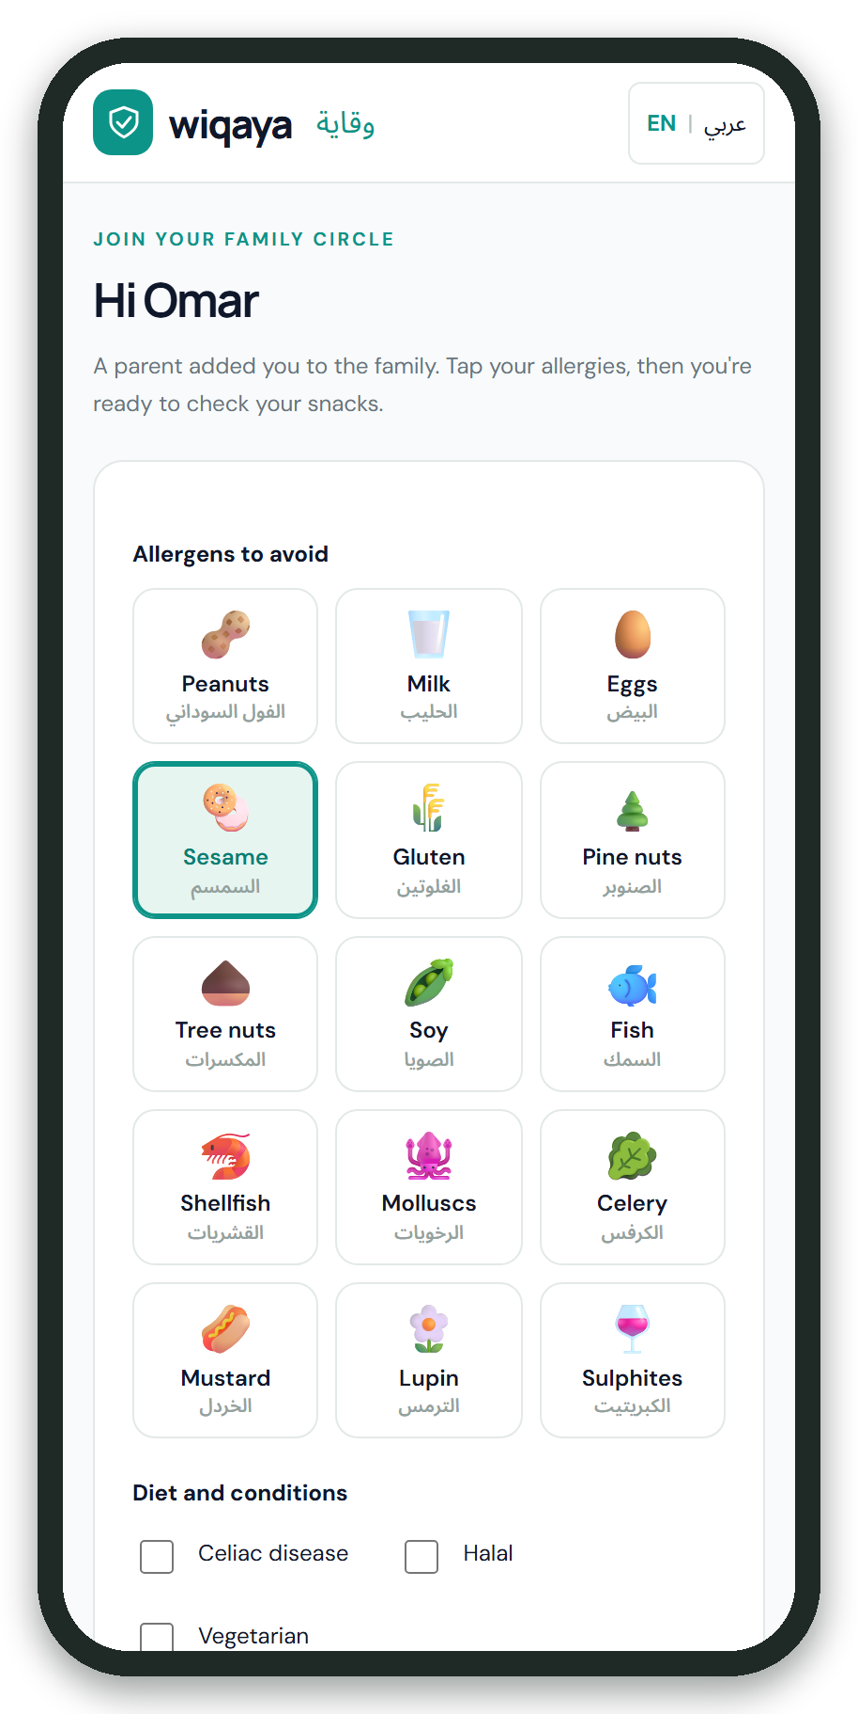
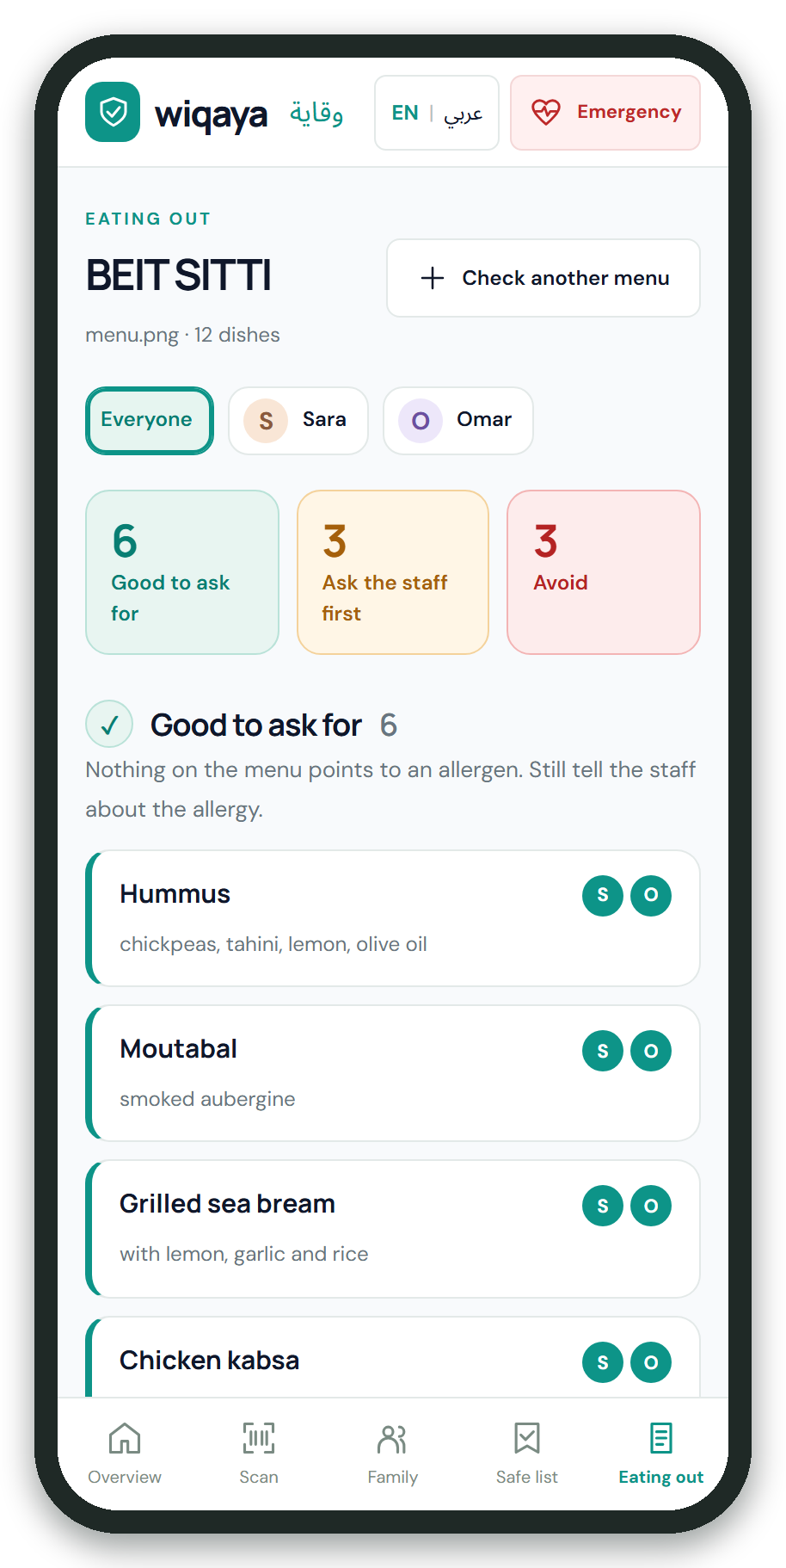
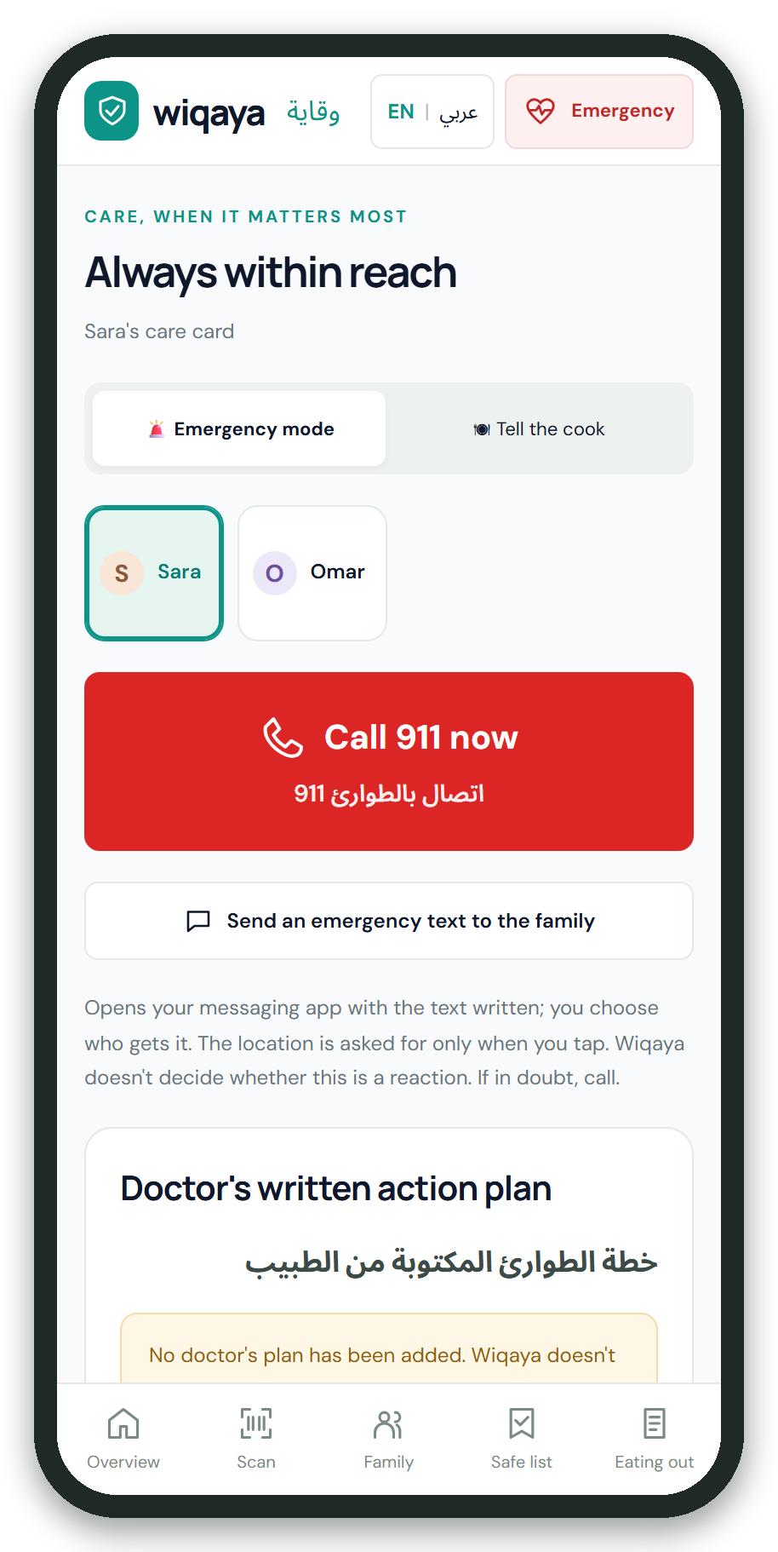
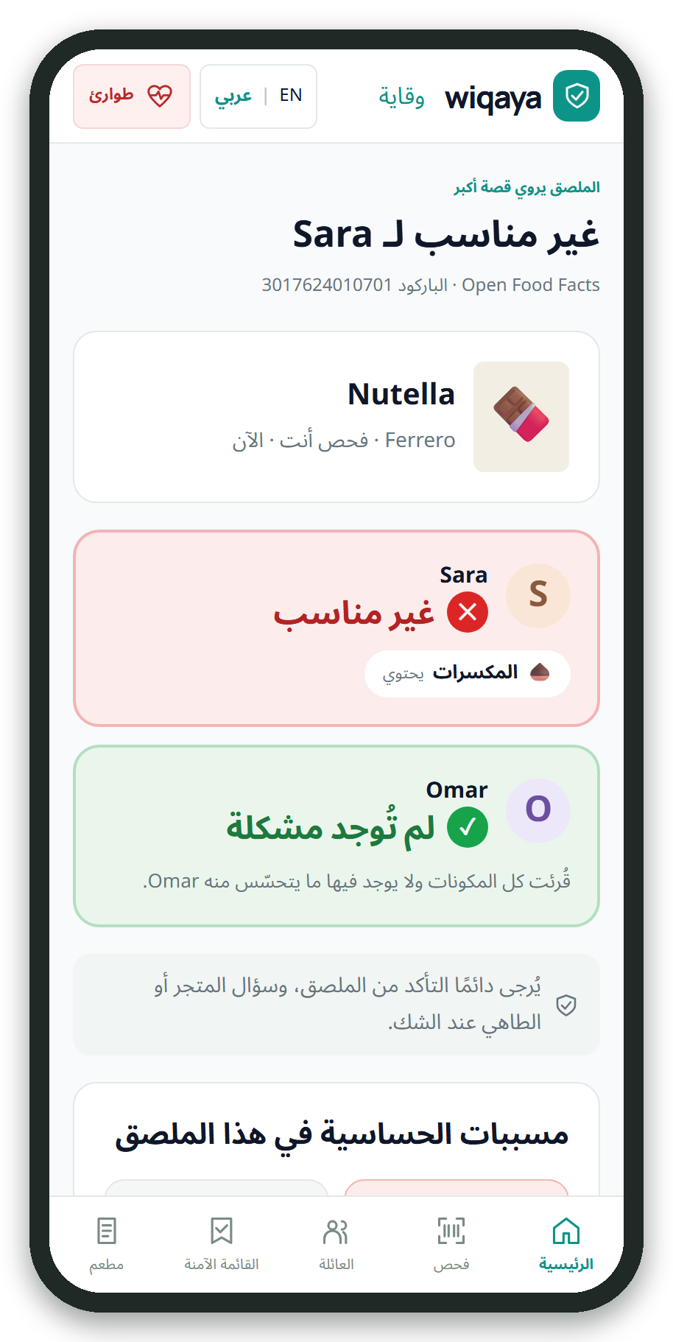




One app for the whole family
Kids join by QR
Eating out
Emergency
Arabic + English
Notes:
Children join on their own phone with a QR code and pick their allergies; the parent checks them. Eating out: a photo of a menu, sorted for each child into good to ask for, ask the staff first, and avoid. Emergency: one tap calls 911, with the doctor's plan for paramedics in Arabic and English. And the whole app works in Arabic, right to left.

Slide 7


How it fits together
Family phones
Wiqaya server
Gemma 4
React 19 · TypeScript
Python · FastAPI
photo
E4B on Ollama
Allergen engine: decides
photo
Cleans photos
JSON · temperature 0 · tools
Barcodes (zxing-wasm)
Double-checks Gemma
JSON
Encrypted profiles
Barcode cache
Open data
barcode
Signed by a parent
E2E
Encrypted relay
Open Food Facts · web search
No names. No allergies. Never.
Notes:
Three parts. The family's phones keep every profile and make every decision. A small open-source server cleans photos, asks Gemma 4 for the ingredient list, double-checks the answer and sends it back: it never receives a name or an allergy. Gemma 4 runs locally on Ollama. Open Food Facts answers barcodes, and web search helps Gemma research unknown ingredients. Family messages travel end-to-end encrypted through a relay that can't read them.

Slide 8




Gemma reads, code decides
0
78/78
24
false greens
allergens caught
real shop photos
AI never sees a child
Encrypted on the phone
End-to-end family chat
No accounts
Red can't be overridden
Doubt is never green
Notes:
A language model can be confidently wrong, so it never makes the safety call: Gemma turns pictures into text, tested code on the phone decides, and Gemma's output can only add caution. Benchmark: 30 synthetic labels in six languages, 78 of 78 allergens flagged, no false greens. On 24 real photos from a shop, every allergen on the pack was flagged, and photos with no ingredient list are never green. Privacy: the AI never sees a child, profiles are encrypted on the phone, family messages are end-to-end encrypted, no accounts.

Slide 9

Thank You!
Questions & Answers
github.com/MasriAm/Wiqaya
Scan for the code
Notes:
Thank you. Everything is open source: github.com/MasriAm/Wiqaya.

