Slide 1

UNIT CONVERTER
SWIFT
By SREEKER KURAGAYALA
ASHISH BEERELLI
SAI TEJASVI RAMSAGAR
MOHIT REDDY VATTI
ABHISHREE PAPPUSETTY

Slide 2
SWIFT
Open source programming language
Safe, Fast, Expressive & Safe
Mostly used on Xcode
2.6 times faster than Objective-C
Supports OOP’s
Supports Concurrency
Supports Exceptional Handling & Event Handling
Supports Functional Programming

Slide 3
ABOUT OUR APP
We have created an Unit conversion app which gives conversions of
Temperature Conversion
Mass Conversion
Time Conversion
Volume Conversion
Distance Conversion
Area Conversion

Slide 4
XCODE code snippets
let unitTypes=[ [UnitLength.feet, UnitLength.kilometers, UnitLength.meters, UnitLength.miles, UnitLength.yards],
[UnitMass.grams, UnitMass.kilograms, UnitMass.ounces, UnitMass.pounds],
[UnitTemperature.celsius, UnitTemperature.fahrenheit, UnitTemperature.kelvin],
[UnitDuration.hours, UnitDuration.minutes, UnitDuration.seconds],[UnitVolume.liters,UnitVolume.gallons,UnitVolume.fluidOunces,UnitVolume.cups,UnitVolume.milliliters],[UnitArea.squareFeet,UnitArea.squareYards,UnitArea.acres,UnitArea.squareInches]
]
let formatter: MeasurementFormatter
var result: String{
let inputMeasurement = Measurement(value: input, unit:inputUnit)
let outputMeasurement=inputMeasurement.converted(to: outputUnit)
return formatter.string(from: outputMeasurement)

Slide 5
GITHUB URL
You can find our code here:
https://github.com/MassUS69/csci_6221.git

Slide 6
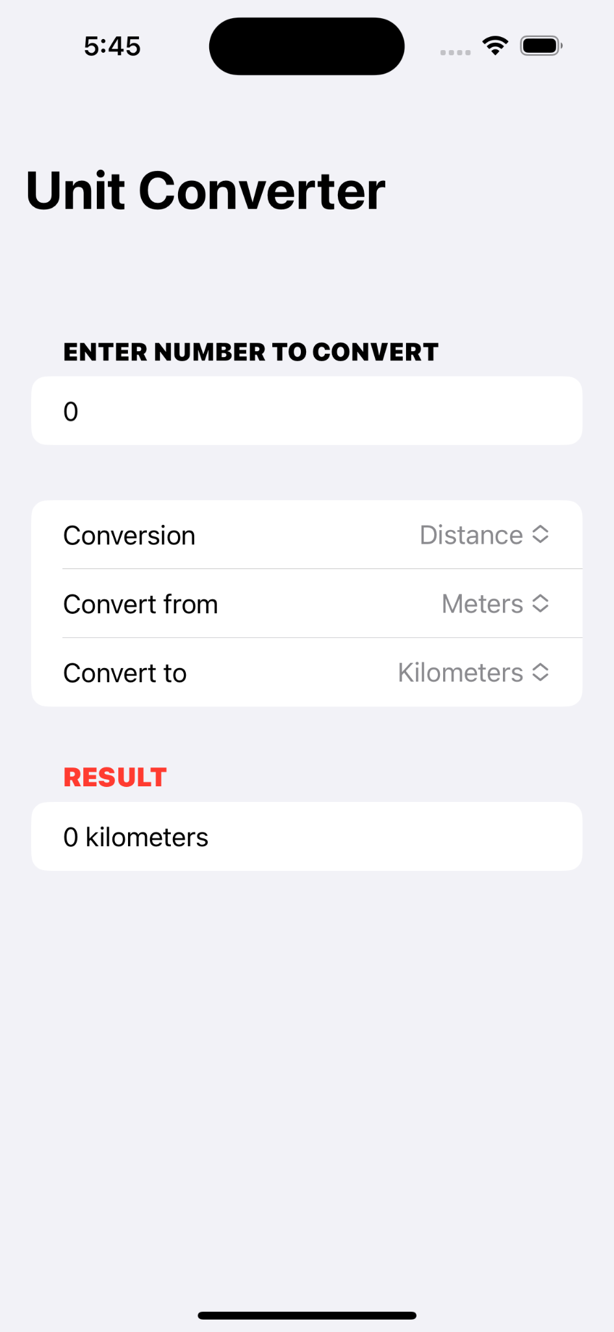

Slide 7
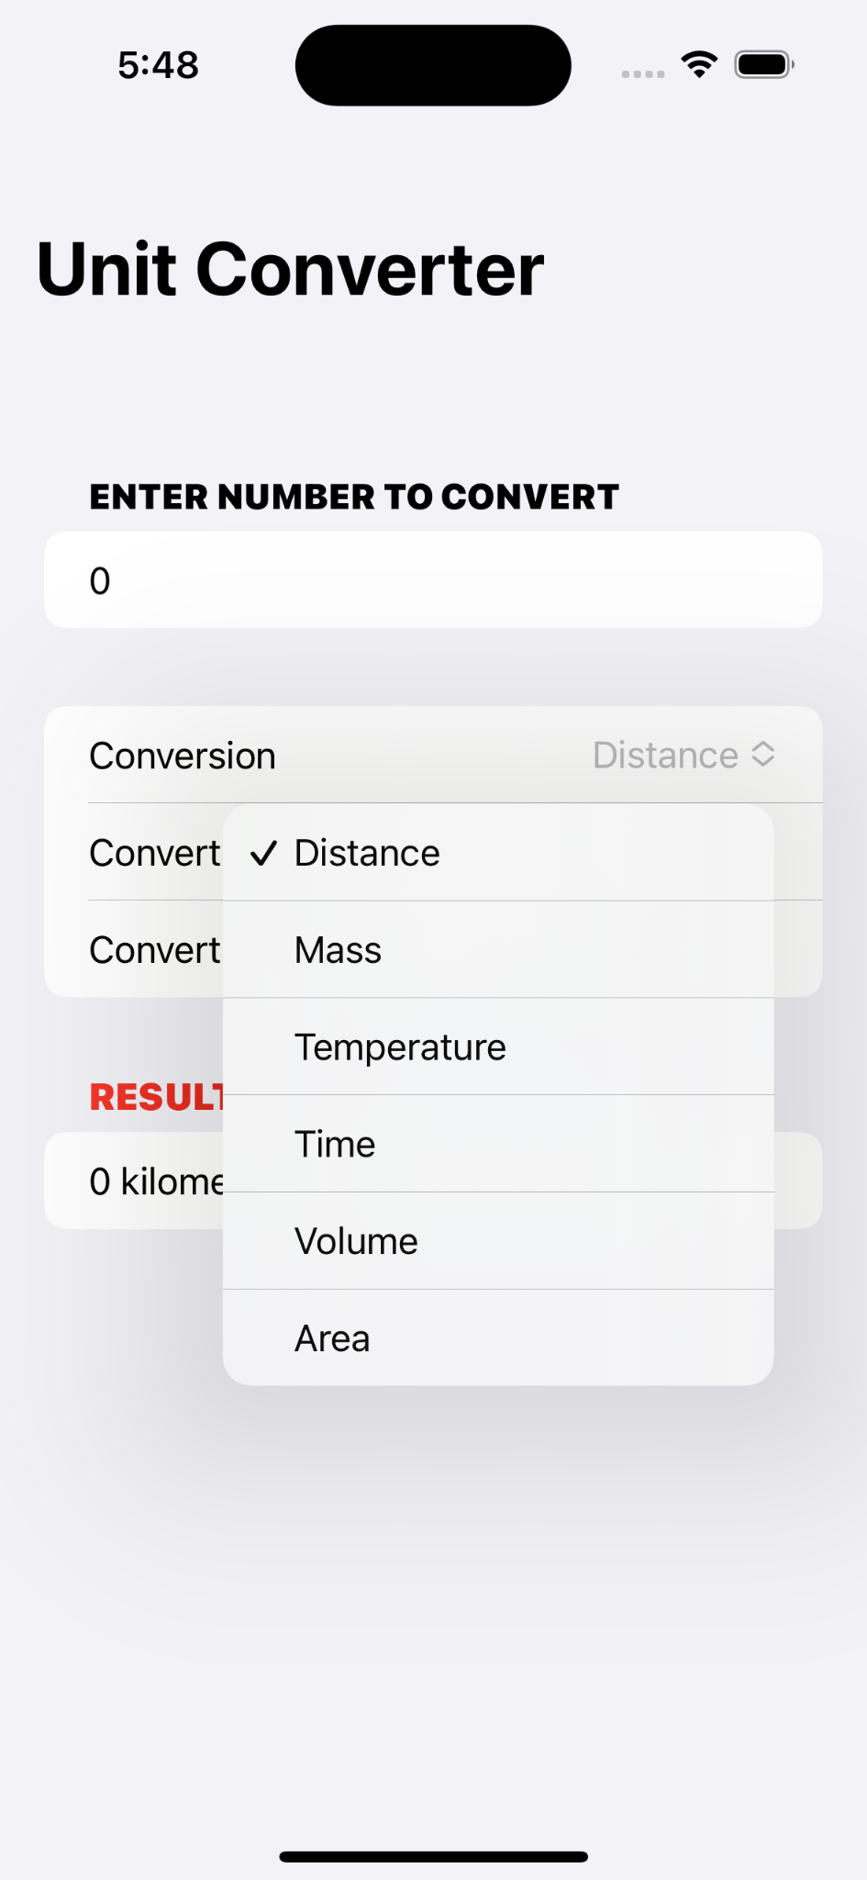
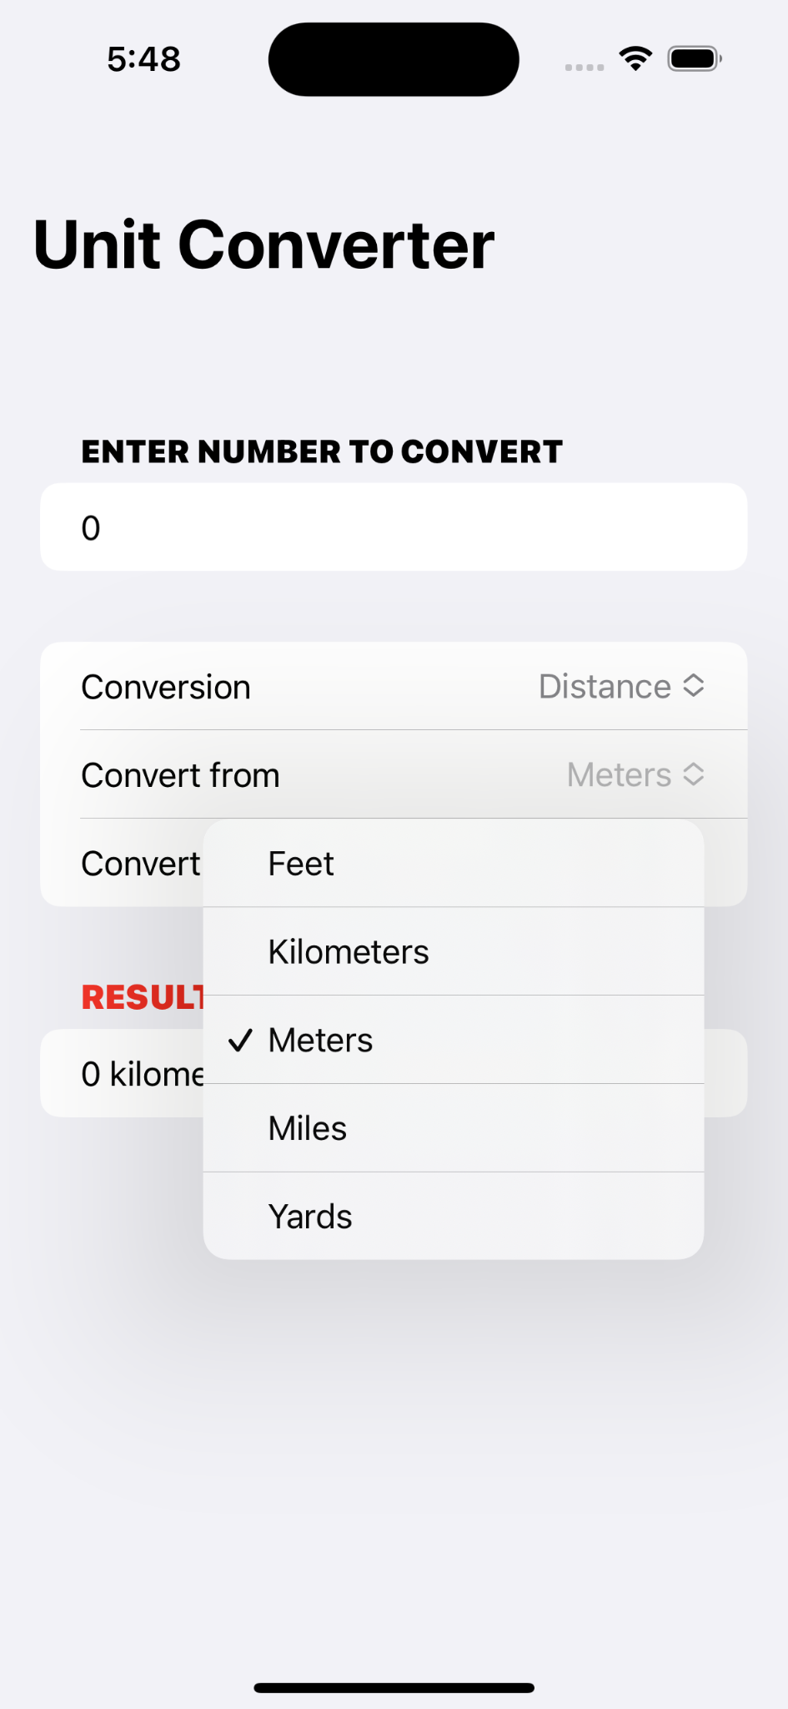
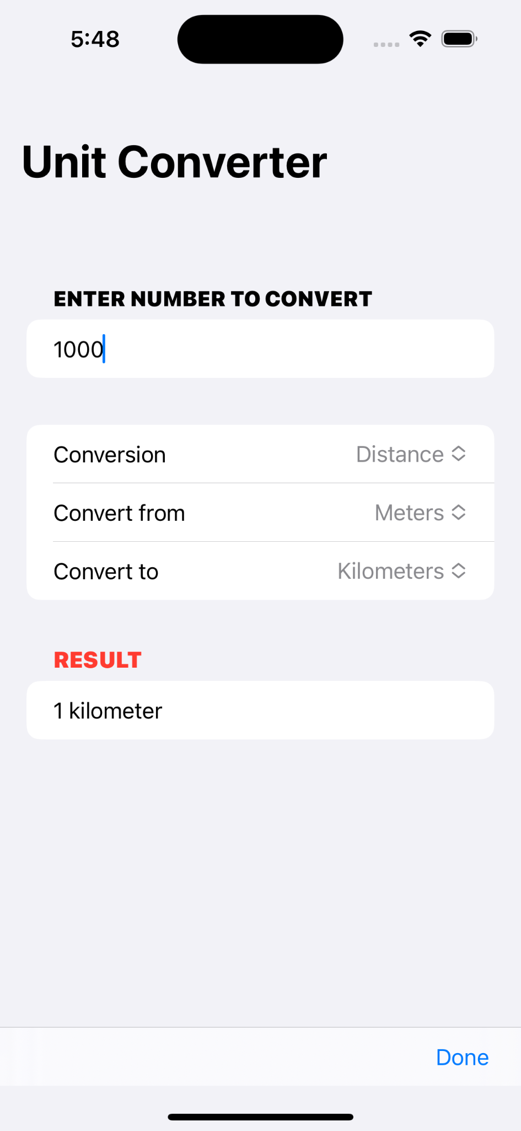

Slide 8
THANK YOU

