Slide 1

Why Java?
Java is a general purpose programming language.
Java is the Internet programming language.

Slide 2
Characteristics of Java
Java Is Simple
Java Is Object-Oriented
Java Is Distributed
Java Is Interpreted
Java Is Robust
Java Is Secure
Java Is Architecture-Neutral
Java Is Portable
Java's Performance
Java Is Multithreaded
Java Is Dynamic

Slide 3
JDK Editions
Java Standard Edition (J2SE)
J2SE can be used to develop client-side standalone applications or applets.
Java Enterprise Edition (J2EE)
J2EE can be used to develop server-side applications such as Java servlets, Java ServerPages, and Java ServerFaces.
Java Micro Edition (J2ME).
J2ME can be used to develop applications for mobile devices such as cell phones.

Slide 4



Popular Java IDEs
IDE ➔ Integrated Development Environment

Slide 5
A Simple Java Program
// This program prints Welcome to Java!
public class Welcome {
public static void main(String[] args) {
System.out.println("Welcome to Java!");
}
}

Slide 6

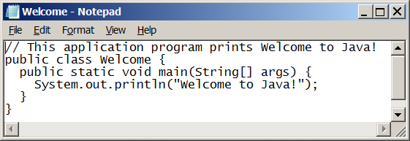
Creating and Editing Using NotePad
To use NotePad, type:
notepad Welcome.java
from the DOS prompt.

Slide 7
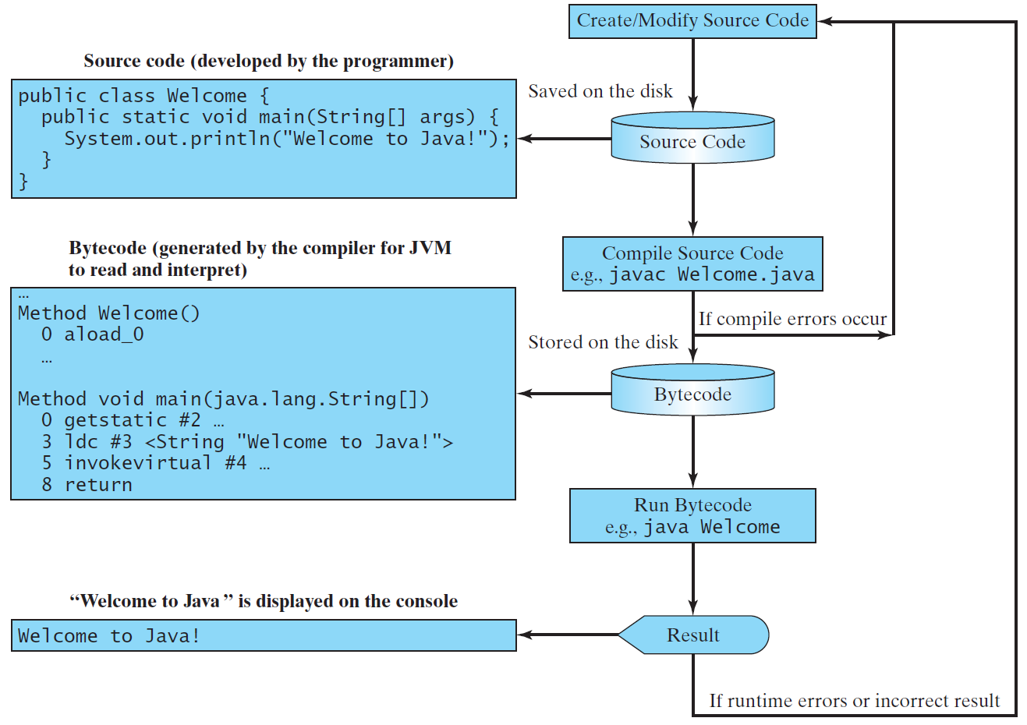
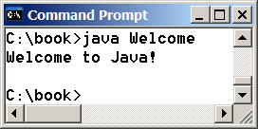
Creating, Compiling, and Running Programs

Slide 8
Compiling and Running Java from the Command Window
Set path to JDK bin directory
set path=c:\Program Files\java\jdk1.8.0_xx\bin
Set classpath to include the current directory
set classpath=.
Compile:
javac Welcome.java
Run:
java Welcome

Slide 9
Anatomy of a Java Program
Class name
Main method
Statements
Statement terminator
Reserved words
Comments
Blocks

Slide 10
Class Name
Every Java program must have at least one class.
Each class has a name.
By convention, class names start with an uppercase letter.
In this example, the class name is Welcome.
//This program prints Welcome to Java!
public class Welcome {
public static void main(String[] args) {
System.out.println("Welcome to Java!");
}
}

Slide 11
Main Method
In order to run a class, the class must contain a method named main.
The program is executed from the main method.
//This program prints Welcome to Java!
public class Welcome {
public static void main(String[] args) {
System.out.println("Welcome to Java!");
}
}

Slide 12
Statement
A statement represents an action or a sequence of actions.
The statement System.out.println("Welcome to Java!") in the program is a statement to display the greeting “Welcome to Java!”.
//This program prints Welcome to Java!
public class Welcome {
public static void main(String[] args) {
System.out.println("Welcome to Java!");
}
}

Slide 13
Statement Terminator
Every statement in Java ends with a semicolon
//This program prints Welcome to Java!
public class Welcome {
public static void main(String[] args) {
System.out.println("Welcome to Java!");
}
}

Slide 14
Reserved Words
Reserved words or keywords are words that have a specific meaning to the compiler and cannot be used for other purposes in the program.
For example, when the compiler sees the word class, it understands that the word after class is the name for the class.
//This program prints Welcome to Java!
public class Welcome {
public static void main(String[] args) {
System.out.println("Welcome to Java!");
}
}

Slide 15
Programming Style and Documentation
Appropriate Comments.
Naming Conventions.
Proper Indentation and Spacing Lines.
Block Styles.

Slide 16
Naming Conventions
Choose meaningful and descriptive names.
Class names:
Capitalize the First Letter of each word in the name. For example, the class name ComputeExpression.

Slide 17
Proper Indentation and Spacing
Indentation
Indent two spaces.
Spacing
Use blank line to separate segments of the code.

Slide 18
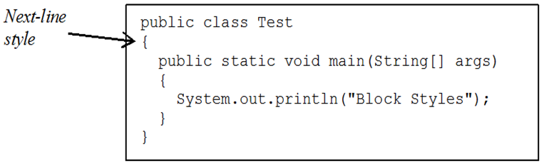
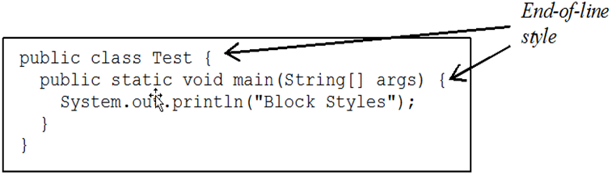
Block Styles

Slide 19
Programming Errors
Syntax Errors
Detected by the compiler
Runtime Errors
Causes the program to abort
Logic Errors
Produces incorrect result

