Slide 1

Elementary Programming

Slide 2

Trace a Program Execution
public class ComputeArea {
/** Main method */
public static void main(String[] args) {
double radius;
double area;
// Assign a radius
radius = 20;
// Compute area
area = radius * radius * 3.14159;
// Display results
System.out.println("The area for the circle of radius " +
radius + " is " + area);
}
}
memory
radius
20
area
1256.636

Slide 3
Identifiers
An identifier is a sequence of characters that consist of letters, digits, underscores (_), and dollar signs ($).
An identifier must start with a letter, an underscore (_), or a dollar sign ($). It cannot start with a digit.
An identifier cannot be a reserved word. (See Appendix A, “Java Keywords”).
An identifier cannot be true, false, or null.
An identifier can be of any length.

Slide 4
Declaring Variables
int x; // Declare x to be an integer variable
double radius; // Declare radius to be a double variable
char a; // Declare a to be a character variable
Assignment Statements
x = 1; // Assign 1 to x
radius = 1.0; // Assign 1.0 to radius
a = 'A'; // Assign 'A' to a

Slide 5
Named Constants
Declaring and Initializing in One Step
int x = 1;
double d = 1.4;
final datatype CONSTANTNAME = VALUE;
final double PI = 3.14159;
final int SIZE = 3;

Slide 6
Naming Conventions
Choose meaningful and descriptive names.
Variables and method names:
Use lowercase.
If the name consists of several words, concatenate all in one, use lowercase for the first word, and capitalize the first letter of each subsequent word in the name.
For example, the variables radius and area, and the method computeArea.

Slide 7
Naming Conventions, cont.
Class names:
Capitalize the first letter of each word in the name.
For example, the class name ComputeArea.
Constants:
Capitalize all letters in constants, and use underscores to connect words.
For example, the constant PI and MAX_VALUE

Slide 8
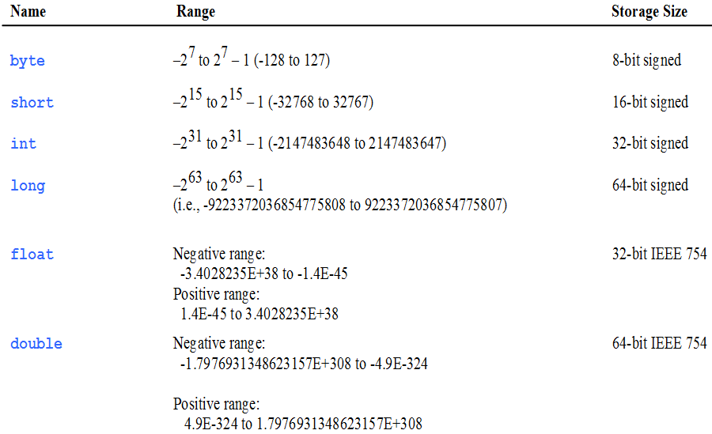
Numerical Data Types

Slide 9


double vs. float
The double type values are more accurate than the float type values. For example,
System.out.println("1.0 / 3.0 is " + 1.0 / 3.0);
System.out.println("1.0F / 3.0F is " + 1.0F / 3.0F);

Slide 10
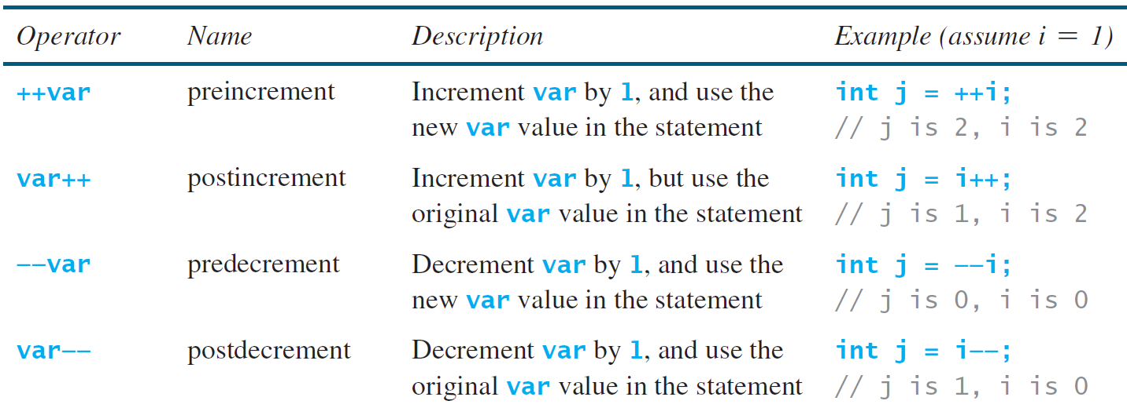
Increment and Decrement Operators

Slide 11
Numeric Type Conversion
Consider the following statements:
byte i = 100;
long k = i * 3 + 4;
double d = i * 3.1 + k / 2;

Slide 12
Conversion Rules
When performing a binary operation involving two operands of different types, Java automatically converts the operand based on the following rules:
1. If one of the operands is double, the other is converted into double.
2. Otherwise, if one of the operands is float, the other is converted into float.
3. Otherwise, if one of the operands is long, the other is converted into long.
4. Otherwise, both operands are converted into int.

Slide 13
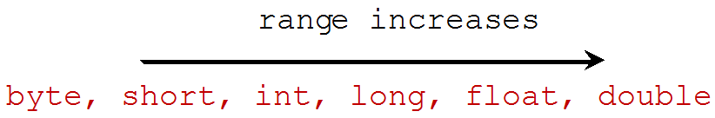
Type Casting
Implicit casting
double d = 3; (type widening)
Explicit casting
int i = (int)3.0; (type narrowing)
int i = (int)3.9; (Fraction part is truncated)
What is wrong? int x = 6 / 2.0;

Slide 14
Character Data Type
char letter = 'A'; (ASCII)
char numChar = '4'; (ASCII)
char letter = '\u0041'; (Unicode)
char numChar = '\u0034'; (Unicode)
NOTE: The increment and decrement operators can also be used on char variables to get the next or preceding Unicode character. For example, the following statements display character b.
char ch = 'a';
System.out.println(++ch);

Slide 15
The String Type
The char type only represents one character. To represent a string of characters, use the data type called String. For example:
String message = "Welcome to Java!";
String is actually a predefined class in the Java library.
The String type is not a primitive type. It is known as a reference type.

Slide 16
String Concatenation
// Three strings are concatenated
String message = "Welcome " + "to " + "Java";
// String Chapter is concatenated with number 2
String s = "Chapter" + 2; // s becomes Chapter2
// String Supplement is concatenated with character B
String s1 = "Supplement" + 'B'; // s1 becomes SupplementB

Slide 17
Console Input
You can use the Scanner class for console input.
Java uses System.in to refer to the standard input device (i.e. Keyboard).
import java.util.Scanner;
public class Test{
public static void main(String[] s){
Scanner input = new Scanner(System.in);
System.out.println(“Enter X : ”);
int x = input.nextInt();
System.out.println(“You entered: ”+ x);
}
}

Slide 18
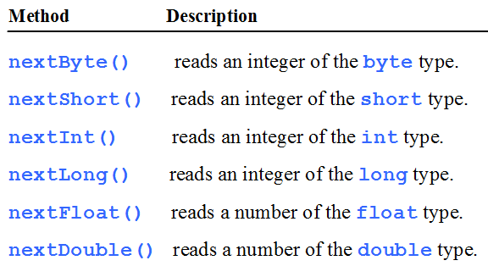
Reading Numbers from the Keyboard
Scanner input = new Scanner(System.in);
int value = input.nextInt();

