Slide 1

Selections

Slide 2
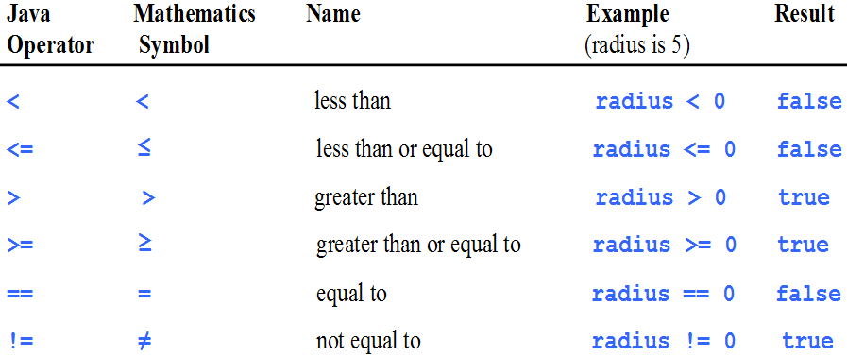
Comparison Operators

Slide 3
if-else
if (radius >= 0) {
area = radius * radius * 3.14159;
System.out.println("The area for the " + "circle of radius " + radius + " is " + area);
}
else {
System.out.println("Negative input");
}

Slide 4
Common Errors
Adding a semicolon at the end of an if clause is a common mistake.
if (radius >= 0) ;
{
area = radius*radius*PI;
System.out.println( "The area for the circle is " + area);
}
This mistake is hard to find, because it is not a compilation error or a runtime error, it is a logic error.
This error often occurs when you use the next-line block style.
Wrong

Slide 5
Logical Operators
Operator Name
! not
&& and
|| or
^ exclusive or

Slide 6
switch Statements
switch (status) {
case 0: compute taxes for single filers;
break;
case 1: compute taxes for married file jointly;
break;
case 2: compute taxes for married file separately;
break;
case 3: compute taxes for head of household;
break;
default: System.out.println("Errors: invalid status");
System.exit(1);
}

Slide 7
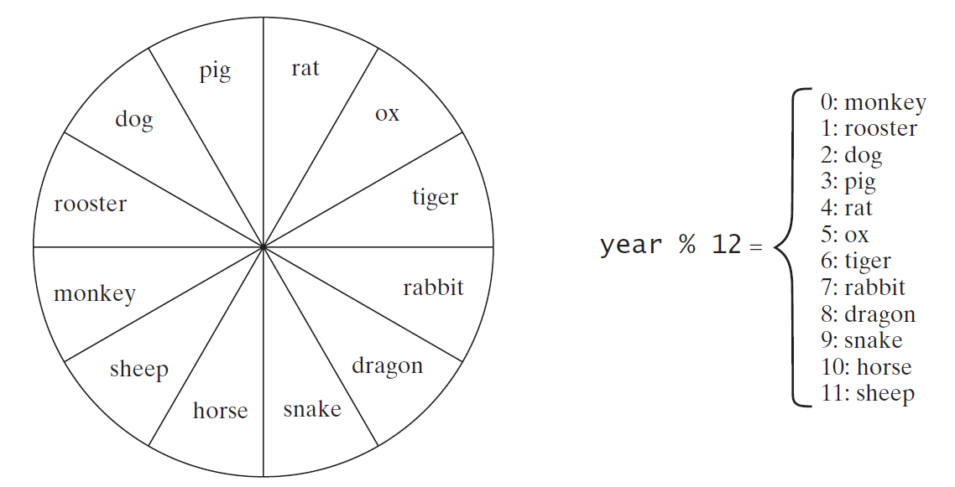
Problem: Chinese Zodiac
Write a program that prompts the user to enter a year and displays the animal for the year.

Slide 8
Conditional Operator
if (x > 0)
y = 1;
else
y = -1;
is equivalent to:
y = (x > 0) ? 1 : -1;
(boolean-expression) ? expression1 : expression2

Slide 9
Conditional Operator
if (num % 2 == 0)
System.out.println(num + “is even”);
else
System.out.println(num + “is odd”);
System.out.println( (num % 2 == 0) ?
num + “is even” : num + “is odd”);

Slide 10
Formatting Output
Use the printf statement:
System.out.printf( format, items );
Where format is a string that may consist of substrings and format specifiers.
A format specifier specifies how an item should be displayed.
An item may be a numeric value, character, boolean value, or a string.
Each specifier begins with a percent sign.

Slide 11
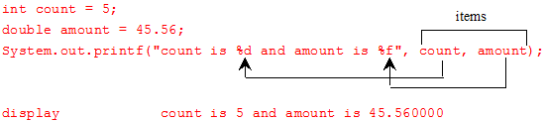
Frequently-Used Specifiers
Specifier Output Example
%b a boolean value true or false
%c a character 'a'
%d a decimal integer 200
%f a floating-point number 45.460000
%e a number in standard scientific notation 4.556000e+01
%s a string "Java is cool"

Slide 12
Operator Precedence
var++, var--
+, - (Unary plus and minus), ++var,--var
(type) Casting
! (Not)
*, /, % (Multiplication, division, and remainder)
+, - (Binary addition and subtraction)
<, <=, >, >= (Comparison)
==, !=; (Equality)
^ (Exclusive OR)
&& (Conditional AND) Short-circuit AND
|| (Conditional OR) Short-circuit OR
=, +=, -=, *=, /=, %= (Assignment operator)

Slide 13
Operator Precedence and Associativity
The expression in the parentheses is evaluated first. (Parentheses can be nested, in which case the expression in the inner parentheses is executed first.)
When evaluating an expression without parentheses, the operators are applied according to the precedence rule and the associativity rule.
If operators with the same precedence are next to each other, their associativity determines the order of evaluation. All binary operators except assignment operators are left-associative.

Slide 14
Operator Associativity
When two operators with the same precedence are evaluated, the associativity of the operators determines the order of evaluation.
All binary operators except assignment operators are left-associative.
a – b + c – d is equivalent to ((a – b) + c) – d
Assignment operators are right-associative. Therefore, the expression
a = b += c = 5 is equivalent to a = (b += (c = 5))

