Slide 1

Loops

Slide 2
Opening Problem
Problem:
System.out.println("Welcome to Java!");
System.out.println("Welcome to Java!");
System.out.println("Welcome to Java!");
System.out.println("Welcome to Java!");
System.out.println("Welcome to Java!");
System.out.println("Welcome to Java!");
…
…
…
System.out.println("Welcome to Java!");
System.out.println("Welcome to Java!");
System.out.println("Welcome to Java!");
100 times

Slide 3
Introducing while Loops
int count = 0;
while (count < 100) {
System.out.println("Welcome to Java");
count++;
}

Slide 4
do-while Loop
do {
// Loop body;
Statement(s);
} while (loop-continuation-condition);

Slide 5
for Loops
for ( initial-action ;
loop-continuation-condition ;
action-after-each-iteration ) {
// loop body;
Statement(s);
}
for (int i = 0 ; i < 100 ; i++) {
System.out.println( "Welcome to Java!");
}

Slide 6
Note
The initial-action in a for loop can be a list of zero or more comma-separated expressions.
The action-after-each-iteration in a for loop can be a list of zero or more comma-separated statements.
Therefore, the following two for loops are correct:
for ( int i = 1 ; i < 100 ; System.out.println(i++)) ;
for ( int i = 0 , j = 0 ; (i + j < 10) ; i++, j++ ) {
// Do something
}

Slide 7

Note
If the loop-continuation-condition in a for loop is omitted, it is implicitly true.
Thus the statement given below in (a), which is an infinite loop, is correct.

Slide 8
Caution
Adding a semicolon at the end of the for clause before the loop body is a common mistake, as shown below:
Logic Error
for (int i=0 ; i<10 ; i++) ;
{
System.out.println("i is " + i);
}

Slide 9
Caution
Similarly, the following loop is also wrong:
int i=0;
while (i < 10);
{
System.out.println("i is " + i);
i++;
}
In the case of the do loop, the following semicolon is needed to end the loop:
int i=0;
do {
System.out.println("i is " + i);
i++;
} while (i<10);
Logic Error
Correct

Slide 10
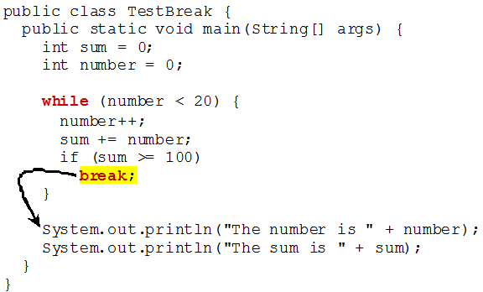
break

Slide 11
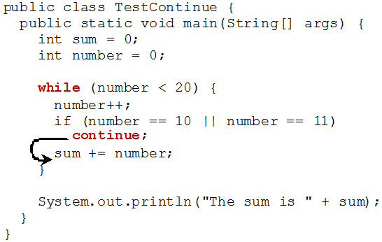
continue

Slide 12
Problem: Displaying Prime Numbers
Problem: Write a program that displays the first 50 prime numbers in five lines, each of which contains 10 numbers. An integer greater than 1 is prime if its only positive divisor is 1 or itself. For example, 2, 3, 5, and 7 are prime numbers, but 4, 6, 8, and 9 are not.
Solution: The problem can be broken into the following tasks:
For number = 2, 3, 4, 5, 6, ..., test whether the number is prime.
Determine whether a given number is prime.
Count the prime numbers.
Print each prime number, and print 10 numbers per line.

