Slide 1

Methods

Slide 2
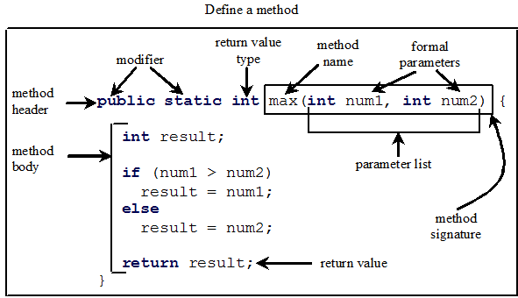
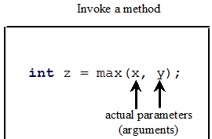
Defining Methods
A method is a collection of statements that are grouped together to perform an operation.

Slide 3
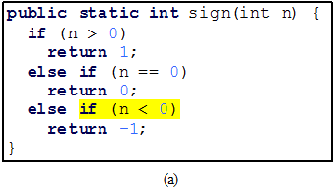
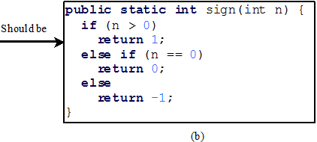
CAUTION
A return statement is required for a value-returning method.
The method shown below in (a) is logically correct, but it has a compilation error because the Java compiler thinks it possible that this method does not return any value.
To fix this problem, delete if (n < 0) in (a), so that the compiler will see a return statement to be reached regardless of how the if statement is evaluated.

Slide 4
Passing Parameters
public static void nPrintln(String message, int n) {
for (int i = 0; i < n; i++)
System.out.println(message);
}
Suppose you invoke the method using
nPrintln(“Welcome to Java”, 5);
What is the output?
Suppose you invoke the method using
nPrintln(“Computer Science”, 15);
What is the output?
Can you invoke the method using
nPrintln(15, “Computer Science”);

Slide 5
Ambiguous Invocation
public class AmbiguousOverloading {
public static void main(String[] args) {
System.out.println(max(1, 2));
}
public static double max(int num1, double num2) {
if (num1 > num2)
return num1;
else
return num2;
}
public static double max(double num1, int num2) {
if (num1 > num2)
return num1;
else
return num2;
}
}

Slide 6
Scope of Local Variables
A local variable: a variable defined inside a method.
Scope: the part of the program where the variable can be referenced.
The scope of a local variable starts from its declaration and continues to the end of the block that contains the variable.
A local variable must be declared before it can be used.

Slide 7
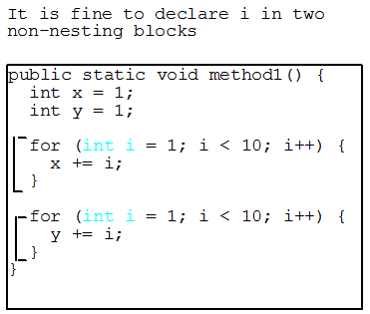
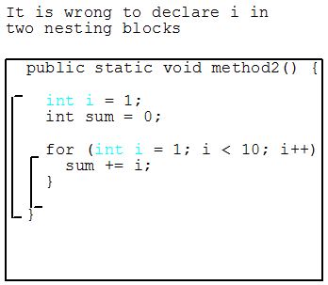
Scope of Local Variables
You can declare a local variable with the same name multiple times in different non-nesting blocks in a method, but you cannot declare a local variable twice in nested blocks.

Slide 8
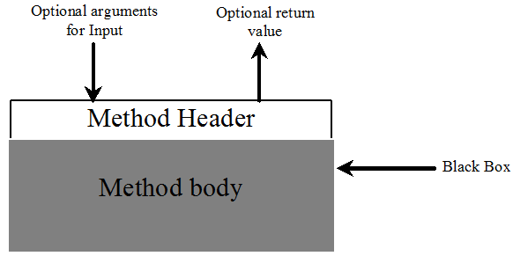
Method Abstraction
You can think of the method body as a black box that contains the detailed implementation for the method.

Slide 9
Benefits of Methods
Write a method once and reuse it anywhere.
Information hiding. Hide the implementation from the user.
Reduce complexity.

Slide 10
The Math Class
Class constants:
PI
E
Class methods:
Trigonometric Methods
Exponent Methods
Rounding Methods
min, max, abs, and random Methods

Slide 11
Trigonometric Methods
sin(double a)
cos(double a)
tan(double a)
acos(double a)
asin(double a)
atan(double a)
Examples:
Math.sin(0) returns 0.0
Math.sin(Math.PI / 6) returns 0.5
Math.sin(Math.PI / 2) returns 1.0
Math.cos(0) returns 1.0
Math.cos(Math.PI / 6) returns 0.866
Math.cos(Math.PI / 2) returns 0.0
Radians
Math.toRadians(90)

Slide 12
Exponent Methods
exp(double a)
Returns e raised to the power of a.
log(double a)
Returns the natural logarithm of a.
log10(double a)
Returns the 10-based logarithm of a.
pow(double a, double b)
Returns a raised to the power of b.
sqrt(double a)
Returns the square root of a.
Examples:
Math.exp(1) returns 2.71
Math.log(2.71) returns 1.0
Math.pow(2, 3) returns 8.0
Math.pow(3, 2) returns 9.0
Math.pow(3.5, 2.5) returns 22.917
Math.sqrt(4) returns 2.0
Math.sqrt(10.5) returns 3.24

Slide 13
Rounding Methods
double ceil(double x) x rounded up to its nearest integer. This integer is returned as a double value.
double floor(double x) x is rounded down to its nearest integer. This integer is returned as a double value.
double rint(double x) x is rounded to its nearest integer. If x is equally close to two integers, the even one is returned as a double.
int round(float x) Return (int)Math.floor(x+0.5).
long round(double x) Return (long)Math.floor(x+0.5).

Slide 14
min, max, and abs
max(a, b) and min(a, b)
Returns the maximum or minimum of two parameters.
abs(a)
Returns the absolute value of the parameter.
random()
Returns a random double value in the range [0.0, 1.0).
Examples:
Math.max(2, 3) returns 3
Math.max(2.5, 3) returns 3.0
Math.min(2.5, 3.6) returns 2.5
Math.abs(-2) returns 2
Math.abs(-2.1) returns 2.1

Slide 15
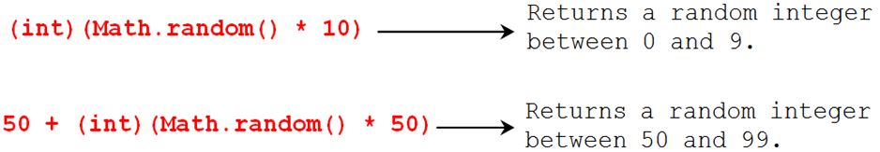
The random Method
Generates a random double value greater than or equal to 0.0 and less than 1.0
(0 <= Math.random() < 1.0)
In general:

Slide 16
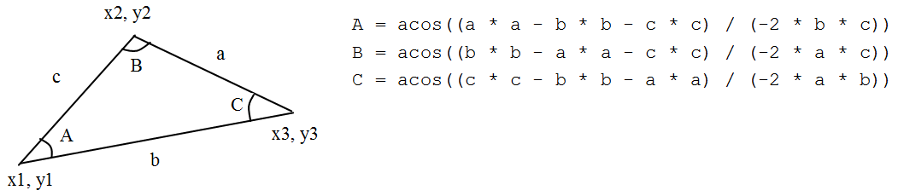
Case Study: Computing Angles of a Triangle
Write a program that prompts the user to enter the x- and y-coordinates of the three corner points in a triangle and then displays the triangle’s angles.

