Slide 1

Arrays

Slide 2
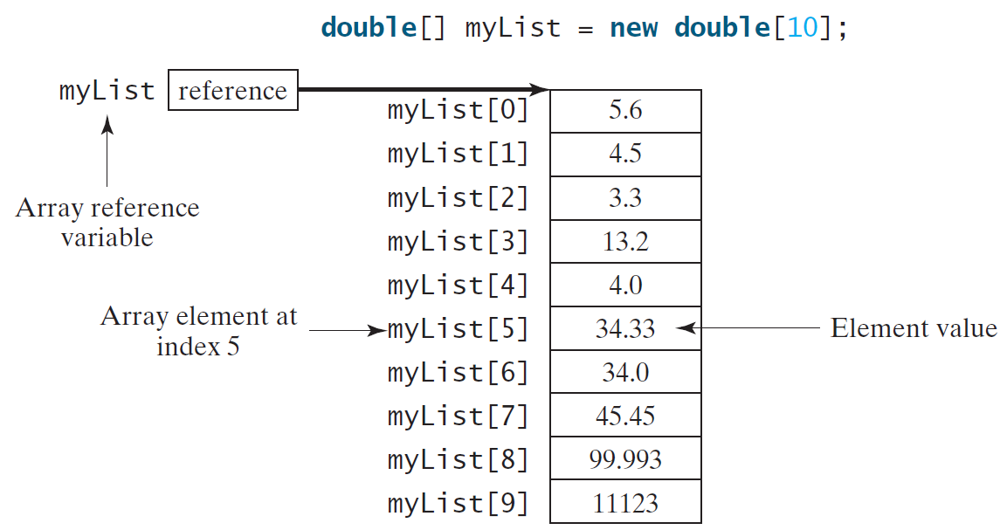
Introducing Arrays
Array is a data structure that represents a collection of the same types of data.

Slide 3
Declaring Array Variables
datatype[] arrayRefVar;
Example:
double[] myList;
datatype arrayRefVar[]; // This style is allowed, but not preferred
Example:
double myList[];

Slide 4
Creating Arrays
arrayRefVar = new datatype[arraySize];
Example:
myList = new double[10];
myList[0] references the 1st element in the array.
myList[9] references the last element in the array.

Slide 5
Declaring and Creating in 1 Step
datatype[] arrayRefVar = new datatype[arraySize];
double[] myList = new double[10];
datatype arrayRefVar[] = new datatype[arraySize];
double myList[] = new double[10];

Slide 6
The Length of an Array
Once an array is created, its size is fixed.
It cannot be changed.
You can find its size using:
arrayRefVar.length
For example:
myList.length ➔ returns 10

Slide 7
Default Values
When an array is created, its elements are assigned the default value of :
0 for the numeric data types.
'\u0000' for char types.
false for boolean types.

Slide 8
Indexed Variables
The array elements are accessed through the index.
The array indices are 0-based, i.e., it starts from 0 to arrayRefVar.length-1.
Each element in the array is represented using the following syntax, known as an indexed variable:
arrayRefVar[index];

Slide 9
Using Indexed Variables
After an array is created, an indexed variable can be used in the same way as a regular variable.
For example, the following code adds the value in myList[0] and myList[1] to myList[2]:
myList[2] = myList[0] + myList[1];

Slide 10
Array Initializers
Declaring, creating, initializing in 1 step:
double[] myList = {1.9, 2.9, 3.4, 3.5};
This shorthand notation is equivalent to the following statements:
double[] myList = new double[4];
myList[0] = 1.9;
myList[1] = 2.9;
myList[2] = 3.4;
myList[3] = 3.5;

Slide 11
Trace Program with Arrays
public class Test {
public static void main(String[] args) {
int[] values = new int[5];
for (int i = 1; i < 5; i++) {
values[i] = i + values[i-1];
}
values[0] = values[1] + values[4];
}
}

Slide 12
Initializing arrays with input values
Scanner input = new Scanner(System.in);
System.out.print("Enter " + myList.length + " values: ");
for (int i = 0 ; i < myList.length ; i++)
myList[ i ] = input.nextDouble();

Slide 13
Initializing arrays with random values
for (int i = 0; i < myList.length; i++)
myList[i] = Math.random() * 100;
Printing arrays
for (int i = 0; i < myList.length; i++)
System.out.print(myList[i] + " ");

Slide 14
Summing all elements
double total = 0;
for (int i = 0; i < myList.length; i++)
total += myList[i];
Finding the largest element
double max = myList[0];
for (int i = 1; i < myList.length; i++) {
if (myList[i] > max)
max = myList[i];
}

Slide 15
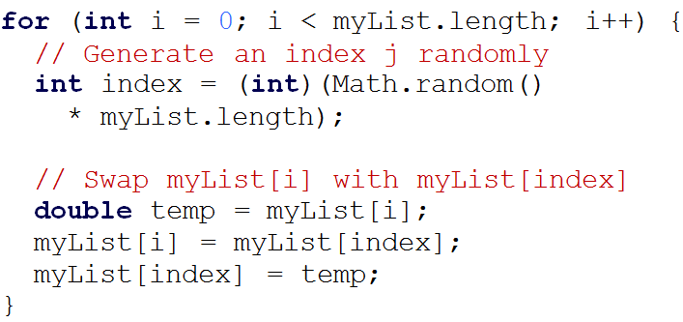
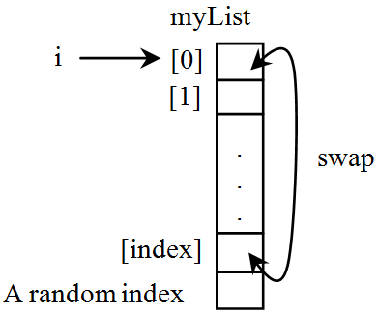
Random Shuffling

Slide 16
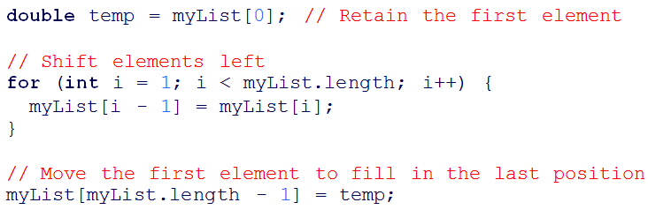
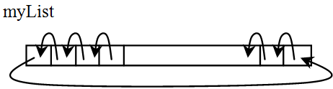
Shifting Elements

Slide 17
Enhanced for Loop (for-each loop)
JDK 1.5 introduced a new for loop that enables you to traverse the complete array sequentially without using an index variable.
For example, the following code displays all elements in the array myList:
for (double value: myList) System.out.println(value);
In general, the syntax is:
for (elementType value: arrayRefVar) {
// Process the value
}
You still have to use an index variable if you wish to traverse the array in a different order or change the elements in the array.

Slide 18
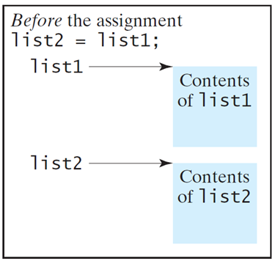
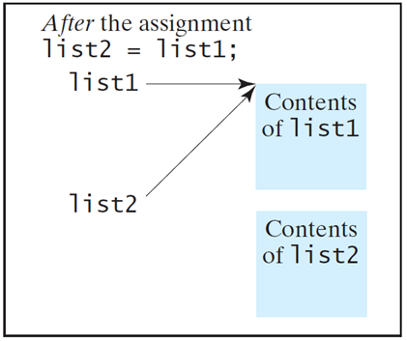
Copying Arrays
Often, in a program, you need to duplicate an array or a part of an array. In such cases you could attempt to use the assignment statement (=), as follows:
list2 = list1;

Slide 19
Copying Arrays
Using a loop:
int[] sourceArray = {2, 3, 1, 5, 10};
int[] targetArray = new int[sourceArray.length];
for (int i = 0; i < sourceArrays.length; i++)
targetArray[i] = sourceArray[i];

Slide 20
The arraycopy Utility
System.arraycopy(sourceArray, src_pos, targetArray, tar_pos, length);
Example:
System.arraycopy(sourceArray, 0, targetArray, 0, sourceArray.length);

Slide 21
Passing Arrays to Methods
public static void printArray(int[] array) {
for (int i = 0; i < array.length; i++) {
System.out.print(array[i] + " ");
}
}
Invoke the method
int[] list = {3, 1, 2, 6, 4, 2};
printArray(list);

Slide 22

Anonymous Array
The statement
printArray(new int[]{3, 1, 2, 6, 4, 2});
Creates array using the following syntax:
new dataType[]{literal0, literal1, ..., literalk}
There is no explicit reference variable for the array.
Such array is called an anonymous array.

Slide 23
Pass by Value
For a parameter of a primitive type value, the actual value is passed.
Changing the value of the local parameter inside the method does not affect the value of the variable outside the method.
For a parameter of an array type, the value of the parameter contains a reference to an array; this reference is passed to the method.
Any changes to the array that occur inside the method body will affect the original array that was passed as the argument.

Slide 24
Simple Example
public class Test {
public static void main(String[] args) {
int x = 1;
int[] y = new int[10];
m(x, y);
System.out.println("x is " + x);
System.out.println("y[0] is " + y[0]);
}
public static void m(int number, int[] numbers) {
number = 1001;
numbers[0] = 5555;
}
}

Slide 25
Returning an Array from a Method
public static int[] reverse(int[] list) {
int[] result = new int[list.length];
for (int i=0, j=result.length - 1; i < list.length/2; i++, j--) {
result[j] = list[i];
}
return result;
}
int[] list1 = {1, 2, 3, 4, 5, 6};
int[] list2 = reverse(list1);

Slide 26
Linear Search
The linear search approach compares the key element, key, sequentially with each element in the array list.
The method continues to do so until the key matches an element in the list or the list is exhausted without a match being found.
If a match is made, the linear search returns the index of the element in the array that matches the key.
If no match is found, the search returns -1.

Slide 27
From Idea to Solution
public static int linearSearch(int[] list, int key) {
for (int i = 0; i < list.length; i++)
if (key == list[i]) return i;
return -1;
}
Trace the method:
int[] list = {1, 4, 4, 2, 5, -3, 6, 2};
int i = linearSearch(list, 4); // returns 1
int j = linearSearch(list, -4); // returns -1
int k = linearSearch(list, -3); // returns 5

Slide 28
The Arrays.binarySearch Method
Since binary search is frequently used in programming, Java provides several binarySearch methods for searching a key in an array of int, double, char, short, long, and float in the java.util.Arrays class.
int[] list = {2, 4, 7, 10, 11, 45, 50, 59, 60, 66, 69, 70, 79};
System.out.println("Index is " + Arrays.binarySearch(list, 11));
char[] chars = {'a', 'c', 'g', 'x', 'y', 'z'};
System.out.println("Index is " + Arrays.binarySearch(chars, 't'));
For the binarySearch method to work, the array must be pre-sorted in increasing order.

Slide 29
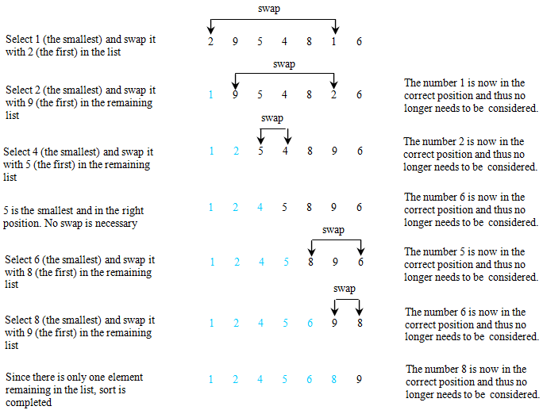
Selection Sort
Selection sort finds the smallest number in the list and places it first. It then finds the smallest number remaining and places it second, and so on until the list contains only a single number.

Slide 30
From Idea to Solution
for (int i = 0; i < list.length; i++) {
select the smallest element in list[i..listSize-1];
swap the smallest with list[i], if necessary;
// list[i] is in its correct position.
// The next iteration apply on list[i+1..listSize-1]
}

Slide 31
The Arrays.sort Method
Java provides several sort methods for sorting an array of int, double, char, short, long, and float in the java.util.Arrays class.
For example, the following code sorts an array of numbers and an array of characters:
double[] numbers = {6.0, 4.4, 1.9, 2.9, 3.4, 3.5};
java.util.Arrays.sort(numbers);
char[] chars = {'a', 'A', '4', 'F', 'D', 'P'};
java.util.Arrays.sort(chars);

Slide 32
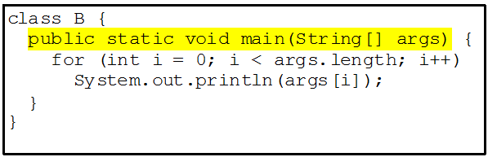
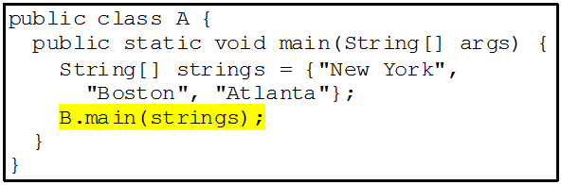
main Method is just a Regular Method
You can call a regular method by passing actual parameters.
You can pass arguments to main.
For example, the main method in class B is invoked by a method in A, as shown below:

Slide 33

Command-Line Parameters
class TestMain {
public static void main(String[] s) {
...
}
}
In the main method, get the arguments from s[0], s[1], ..., s[n], which corresponds to arg0, arg1, ..., argn in the command line.

Slide 34
Problem: Calculator
Objective: Write a program that will perform binary operations on integers. The program receives three parameters: an operator and two integers.
java Calculator 2 + 3
java Calculator 2 - 3
java Calculator 2 / 3
java Calculator 2 . 3

Slide 35
Declare/Create 2D Arrays
// Declare array refvar
dataType[][] refVar;
// Create array and assign its reference to variable
refVar = new dataType[10][10];
// Combine declaration and creation in one statement
dataType[][] refVar = new dataType[10][10];
// Alternative syntax
dataType refVar[][] = new dataType[10][10];

Slide 36
Creating 2D Arrays
int[][] matrix = new int[10][10];
for (int i = 0; i < matrix.length; i++)
for (int j = 0; j < matrix[i].length; j++)
matrix[i][j] = (int)(Math.random() * 1000);

Slide 37
Declaring, Creating, and Initializing Using Shorthand Notations
You can also use an array initializer to declare, create and initialize a 2-dimensional array.
For example:
int[][] array = {
{1, 2, 3},
{4, 5, 6},
{7, 8, 9},
{10, 11, 12}
};

Slide 38
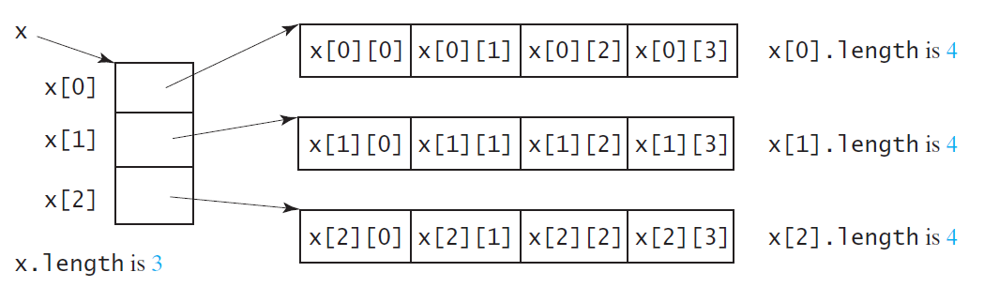
Lengths of 2D Arrays
int[][] x = new int[3][4];

Slide 39
Lengths of 2D Arrays, cont.
int[][] array = {
{1, 2, 3},
{4, 5, 6},
{7, 8, 9},
{10, 11, 12}
};
array.length
array[0].length
array[1].length
array[2].length
array[3].length
array[4].length → ArrayIndexOutOfBoundsException

Slide 40
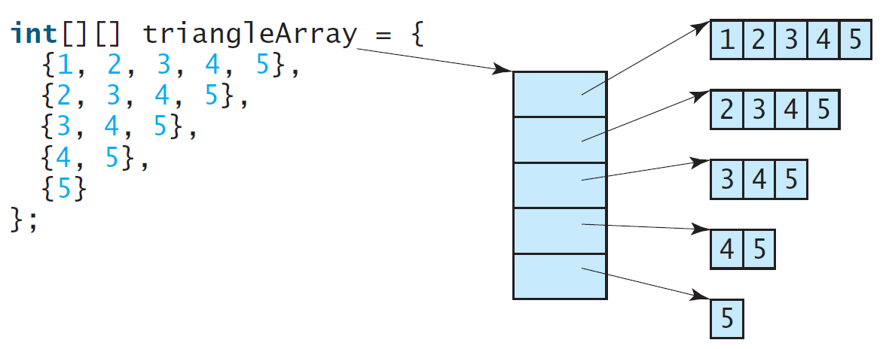
Ragged Arrays
Each row in a 2D array is itself an array. So, the rows can have different lengths.
Such an array is known as a ragged array.
For example:

Slide 41
Printing arrays
for (int row = 0; row < matrix.length; row++) {
for (int column = 0; column < matrix[row].length;
column++) {
System.out.print(matrix[row][column] + " ");
}
System.out.println();
}

Slide 42
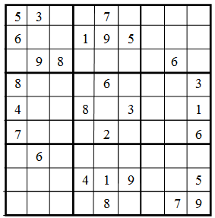
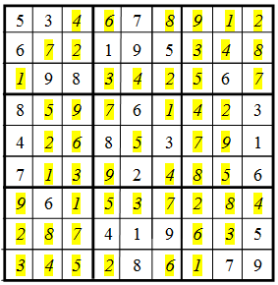
What is Sudoku?
Checking Whether a Solution Is Correct

Slide 43
Multidimensional Arrays
Occasionally, you will need to represent
n-dimensional data structures.
In Java, you can create n-dimensional arrays for any integer n.
The way to declare two-dimensional array variables and create two-dimensional arrays can be generalized to declare n-dimensional array variables and create n-dimensional arrays for n > 2.

Slide 44
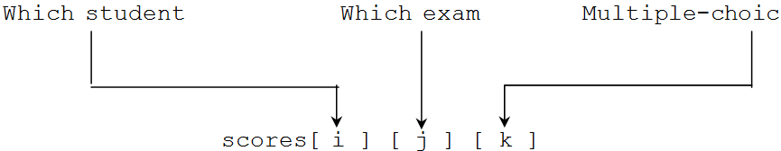
Multidimensional Arrays
double[][][] scores = {
{{7.5, 20.5}, {9.0, 22.5}, {15, 33.5}, {13, 21.5}, {15, 2.5}},
{{4.5, 21.5}, {9.0, 22.5}, {15, 34.5}, {12, 20.5}, {14, 9.5}},
{{6.5, 30.5}, {9.4, 10.5}, {11, 33.5}, {11, 23.5}, {10, 2.5}},
{{6.5, 23.5}, {9.4, 32.5}, {13, 34.5}, {11, 20.5}, {16, 7.5}},
{{8.5, 26.5}, {9.4, 52.5}, {13, 36.5}, {13, 24.5}, {16, 2.5}},
{{9.5, 20.5}, {9.4, 42.5}, {13, 31.5}, {12, 20.5}, {16, 6.5}}};

