Slide 1
OO Basic Concepts

Slide 2
Problems with Procedural Languages
Data does not have an owner.
Difficult to maintain data integrity.
Functions are building blocks.
Many functions can modify a given block of data.
Difficult to trace bug sources when data is corrupted.

Slide 3
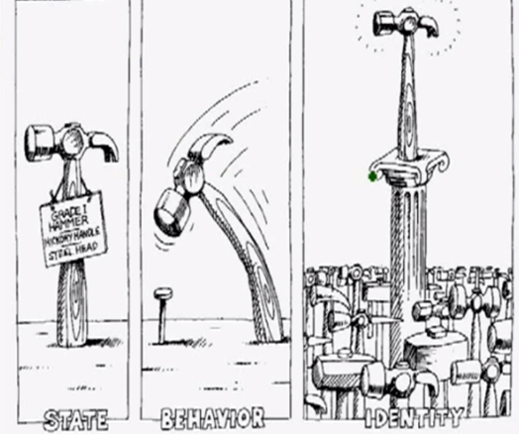
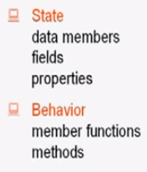
What is Object?
An object has state, exhibits some well defined behaviour, and has a unique identity.

Slide 4
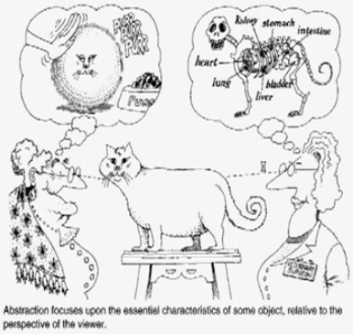
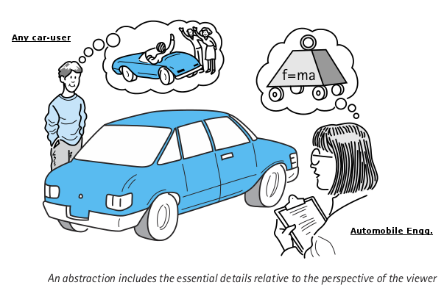
Abstraction - Modeling
Abstraction focuses upon the essential characteristics of some object, relative to the perspective of the viewer.
Notes:
You can see it is the same cat, but from the view point of the owner on the left, she sees it as a cute little fur ball that eats food and makes cute sounds.
But from the view point of the vet surgeon the cat has parts like lungs, liver, kidneys etc.
Two people have different abstract models of the same object.
Procedural programming does not have the ability to create abstraction.

Slide 5
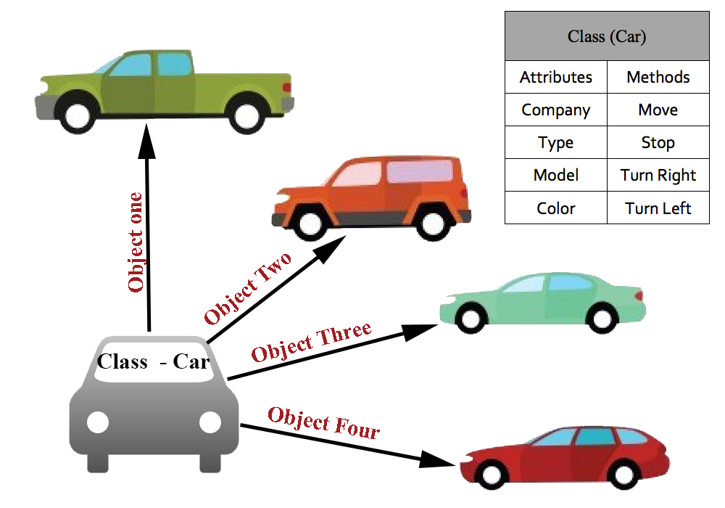
What is Class?
A class represents a set of objects that share common structure and a common behavior.
A class is a blueprint or prototype that defines the variables and methods common to all objects of a certain kind.

Slide 6
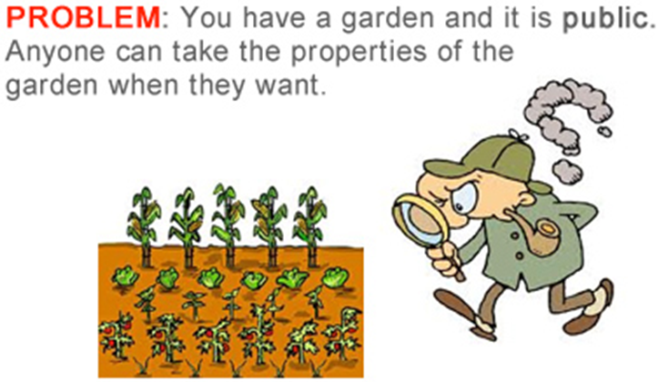
Class Access
Notes:
Any operation by the outside requester to a private property has no effect.
It must go through the setter of the property.
For example if you want to only allow int to be assigned to property $number his can be accomplished by validating the type from the setter method.
You can also only allow number between a certain range to be set.
This allows data rules to be enforced at all times by way of the setters.

Slide 7
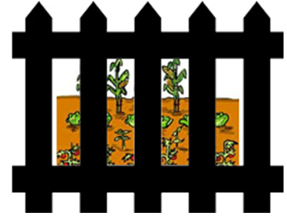
Class Access cont.

Slide 8
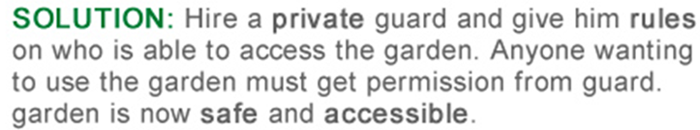
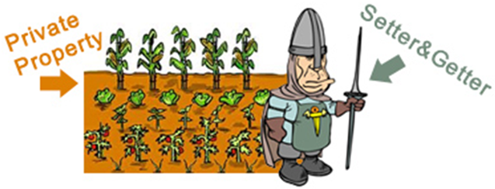
Class Access cont.
Notes:
Again, setters and getters act as guards of internal private properties.
They are interfaced by the external request from the outside world.

Slide 9
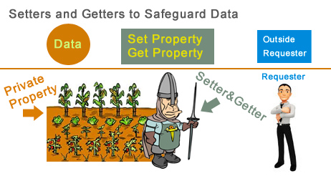
Class Access cont.

Slide 10
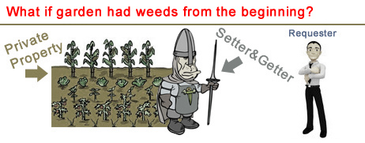
Initialization of Objects
Constructors ensure correct initialization of all data. They are automatically called at the time of object creation.
Destructors on the other hand ensure the de allocation of resources before an object dies or goes out of scope.
Notes:
In other words using contructors to initialize data form the start allows your object to be set or ready for operations.

Slide 11
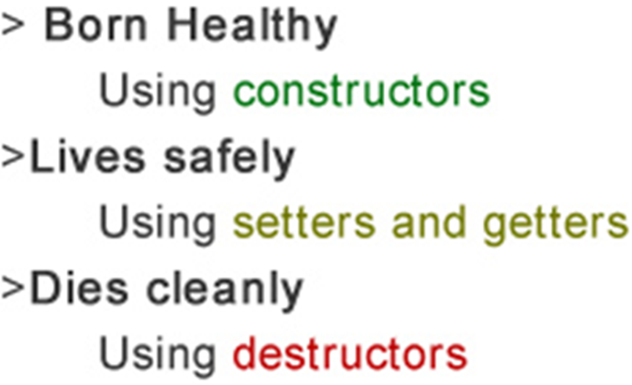
Lifecycle of an Object

Slide 12

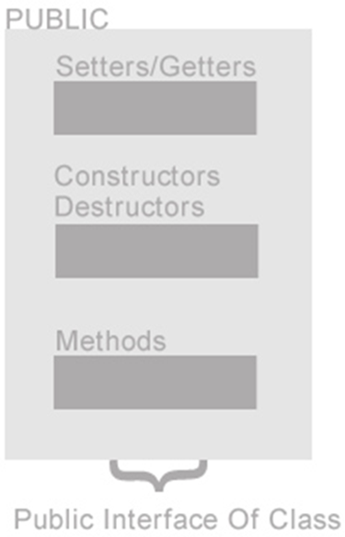
Anatomy of a Class

Slide 13
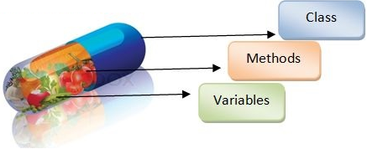
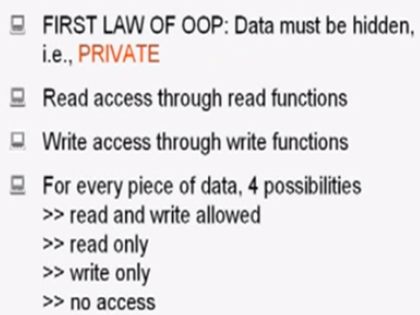
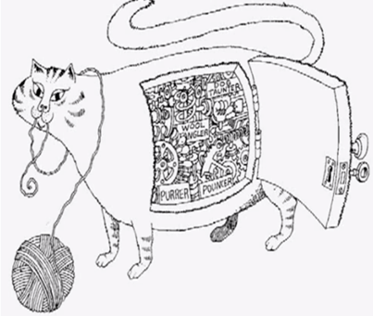
Encapsulation
Notes:
Encapsulation hides the details of the implementation of an object.

Slide 14

Encapsulation
Encapsulation is used to hide unimportant implementation details from other objects.
In real world
When you want to change gears on your car:
You don’t need to know how the gear mechanism works.
You just need to know which lever to move.

Slide 15
Encapsulation cont.
In software programs:
You don’t need to know how a class is implemented.
You just need to know which methods to invoke.
Thus, the implementation details can change at any time without affecting other parts of the program.

Slide 16
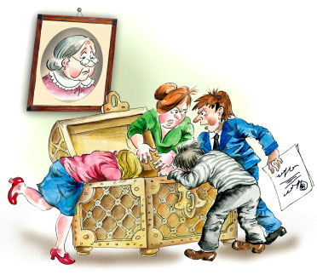
Inheritance
Extending the functionality of a class or
Specializing the functionality of the class.

Slide 17
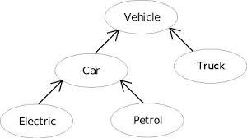
Inheritance cont.
Subclasses: a subclass may inherit the structure and behaviour of it’s superclass.

Slide 18
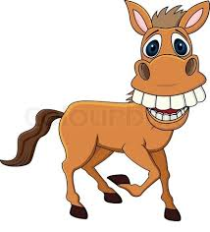

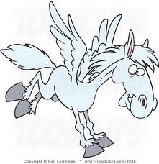
Multiple Inheritance
One class have more than one superclass.
Horse
Eagle
Flying Horse

Slide 19
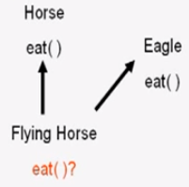
Multiple Inheritance cont.
Ambiguity in multiple inheritance:

Slide 20
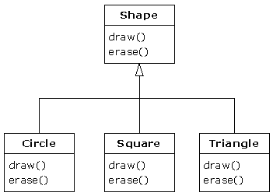
Polymorphism
Polymorphism refers to the ability of an object to provide different behaviours (use different implementations) depending on its own nature. Specifically, depending on its position in the class hierarchy.
drawShape (class Shape)

