Slide 1

Objects & Classes
Notes:
3 lectures...

Slide 2
OO Programming Concepts
Object-oriented programming (OOP) involves programming using objects.
An object represents an entity in the real world that can be distinctly identified.
For example, a student, a desk, a circle, a button, and even a loan can all be viewed as objects.
An object has a unique identity, state, and behaviors.
The state of an object consists of a set of data fields (also known as properties) with their current values.
The behavior of an object is defined by a set of methods.

Slide 3
Objects and Classes
An object has both a state and behavior.
The state defines the object, and the behavior defines what the object does.
Classes are constructs that define objects of the same type.
A Java class uses variables to define data fields and methods to define behaviors.
Additionally, a class provides a special type of methods, known as constructors, which are invoked to construct objects from the class.

Slide 4
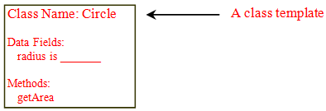
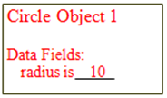

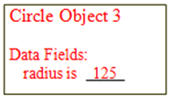

Objects and Classes cont.

Slide 5
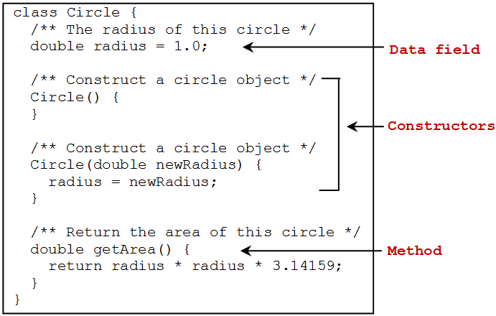
Circle Class

Slide 6
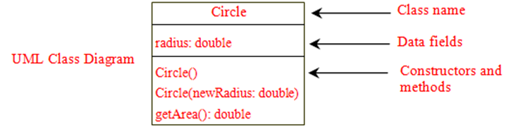




UML Class Diagram

Slide 7
Constructors
Constructors are a special kind of methods that are invoked to construct objects.
Circle() {
}
Circle(double newRadius) {
radius = newRadius;
}

Slide 8
Constructors cont.
A constructor with no parameters is referred to as a no-arg constructor.
Constructors must have the same name as the class itself.
Constructors do not have a return type—not even void.
Constructors are invoked using the new operator when an object is created.
Constructors play the role of initializing objects.

Slide 9
Creating Objects Using Constructors
new ClassName();
Example:
new Circle();
new Circle(5.0);

Slide 10
Default Constructor
A class maybe defined without constructors.
In this case, a no-arg constructor with an empty body is implicitly declared in the class.
This constructor, called a default constructor, is provided automatically ONLY IF no constructors are explicitly defined in the class.

Slide 11
Declaring Object Reference Variables
To reference an object, assign the object to a reference variable.
To declare a reference variable, use the syntax:
ClassName objectRefVar;
Example:
Circle myCircle;

Slide 12
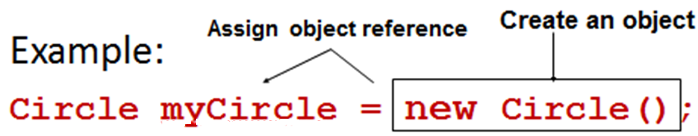
Declaring/Creating Objects in a Single Step
ClassName objectRefVar = new ClassName();

Slide 13
Accessing Object’s Members
Referencing the object’s data:
objectRefVar.data
e.g., myCircle.radius
Invoking the object’s method:
objectRefVar.methodName(arguments)
e.g., myCircle.getArea()

Slide 14
Reference Data Fields
The data fields can be of reference types.
If a data field of a reference type does not reference any object, the data field holds a special literal value, null.
For example, the following Student class contains a data field name of the String type.
public class Student {
String name; // name has default value null
int age; // age has default value 0
boolean isScienceMajor; // default false
char gender; // default value '\u0000'
}

Slide 15
Default Value for a Data Field
The default value of a data field is:
null for a reference type
0 for a numeric type
false for a boolean type
'\u0000' for a char type
However, Java assigns no default value to a local variable inside a method.

Slide 16
Example
Java assigns no default value to a local variable inside a method.
public class Test {
public static void main(String[] args) {
int x; // x has no default value
String y; // y has no default value
System.out.println("x is " + x);
System.out.println("y is " + y);
}
}
Compilation error: variables not initialized

Slide 17
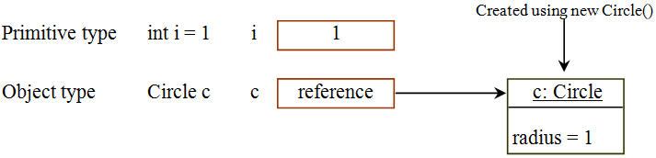
Differences between Variables of Primitive Data Types and Object Types

Slide 18
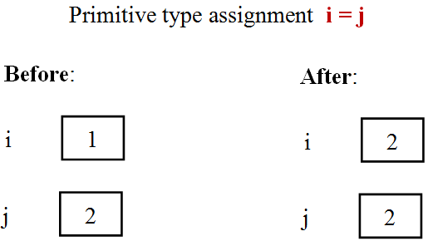
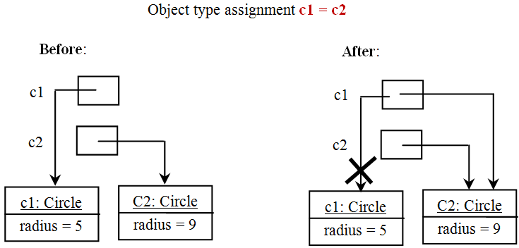
Copying Variables of Primitive Data Types and Object Types

Slide 19
Garbage Collection
As shown in the previous figure, after the assignment statement c1 = c2, c1 points to the same object referenced by c2.
The object previously referenced by c1 is no longer referenced.
This object is known as garbage.
Garbage is automatically collected by JVM.

Slide 20
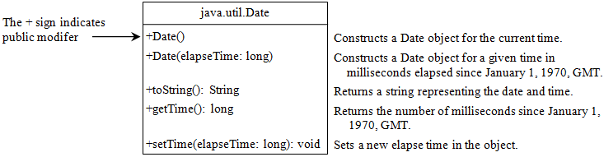
The Date Class
Java provides a system-independent encapsulation of date and time in the java.util.Date class.
You can use the Date class to create an instance for the current date and time and use its toString method to return the date and time as a string.

Slide 21
The Date Class Example
For example, the following code:
java.util.Date date = new java.util.Date();
System.out.println(date.toString());
displays a string like:
Mon Nov 04 19:50:54 IST 2013

Slide 22
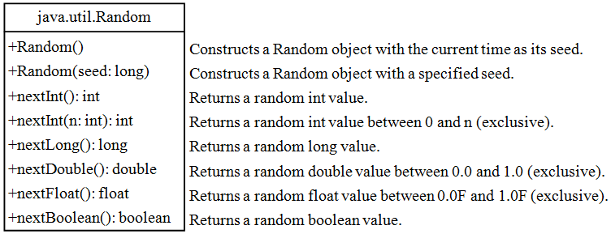
The Random Class
You have used Math.random() to obtain a random double value between 0.0 and 1.0 (excluding 1.0).
A more useful random number generator is provided in the java.util.Random class.

Slide 23
Instance Variables, and Methods
Instance variables belong to a specific instance.
Instance methods are invoked by an instance of the class.

Slide 24
Static Variables, Constants, and Methods
Static variables are shared by all the instances of the class.
Static methods are not tied to a specific object.
Static constants are final variables shared by all the instances of the class.
To declare static variables, constants, and methods, use the static modifier.

Slide 25

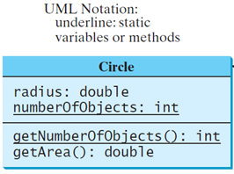
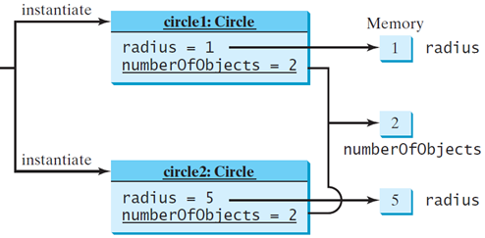
Static

Slide 26
Static Variable
It is a variable which belongs to the class and not to the object (instance).
Static variables are initialized only once, at the start of the execution. These variables will be initialized first, before the initialization of any instance variables.
A single copy to be shared by all instances of the class.
A static variable can be accessed directly by the class name and doesn’t need any object.
Syntax : <class-name>.<static-variable-name>

Slide 27
Static Method
It is a method which belongs to the class and not to the object (instance).
A static method can access only static data. It can not access non-static data (instance variables).
A static method can call only other static methods and can not call a non-static method from it.
A static method can be accessed directly by the class name and doesn’t need any object.
Syntax : <class-name>.<static-method-name>
A static method cannot refer to “this” or “super” keywords in anyway.
main method is static, since it must be accessible for an
application to run, before any instantiation takes place.

Slide 28
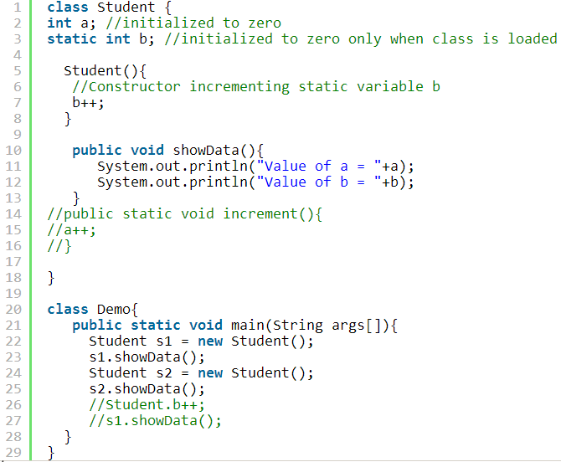

Static example
Notes:
Step 4) It is possible to access a static variable from outside the class using the syntax ClassName.Variable_Name. Uncomment line # 27 & 28 . Save , Compile & Run . Observe the output.
Step 5) Uncomment line 15,16 & 17 . Save , Compile & Run. Step 5) Error = ? This is because it is not possible to access instance variable “a” from static method “increment“.

Slide 29
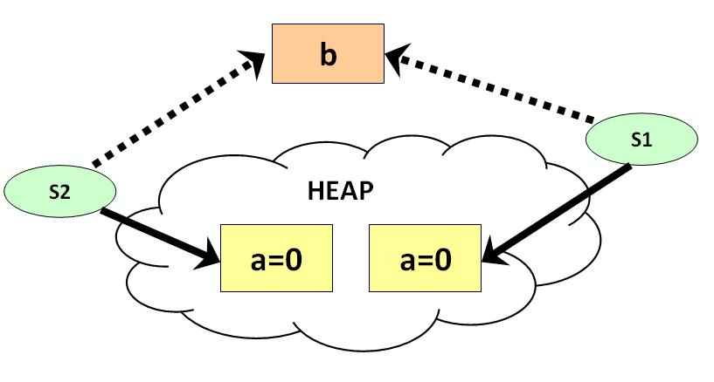
Static example cont.
Following diagram shows , how reference variables & objects are created and static variables are accessed by the different instances.

Slide 30
Visibility Modifiers
By default, the class, variable, or method can be accessed by any class in the same package.
public: The class, data, or method is visible to any class in any package.
private: The data or methods can be accessed only by the declaring class.
The get and set methods are used to read and modify private properties.

Slide 31
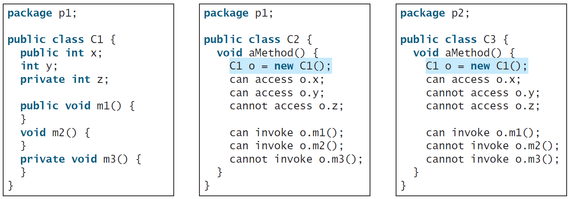
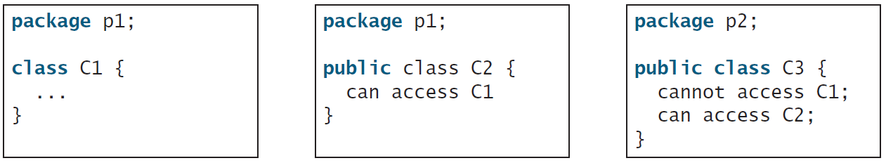
The private modifier restricts access to within a class.
The default modifier restricts access to within a package.
The public modifier enables unrestricted access.

Slide 32
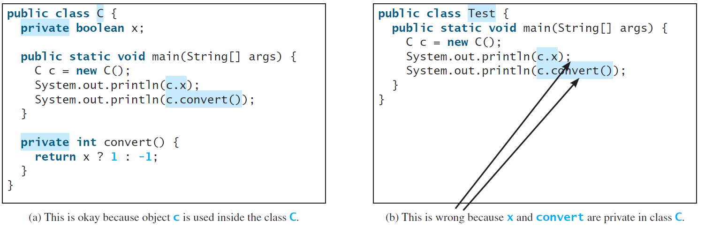
NOTE
An object cannot access its private members, as shown in (b). It is OK, however, if the object is declared in its own class, as shown in (a).

Slide 33
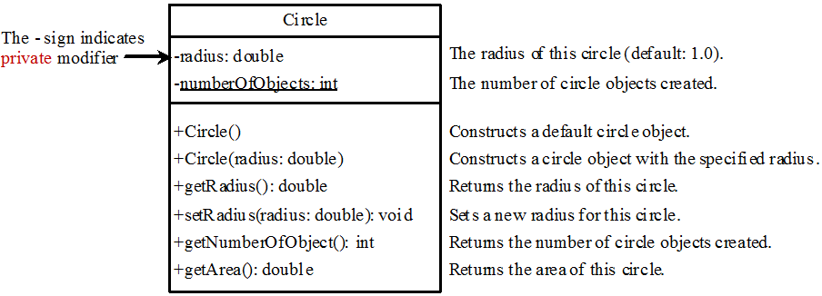

Example of Data Field Encapsulation

Slide 34
Overloading Methods and Constructors
In a class, there can be several methods with the same name. However they must have different signature.
The signature of a method is comprised of its name, its parameter types and the order of its parameter.
The signature of a method is not comprised of its return type nor its visibility nor its thrown exceptions.

Slide 35
Passing Objects to Methods
Passing by value for primitive type value (the value is passed to the parameter).
Passing by value for reference type value (the value is the reference to the object).

Slide 36
Passing Objects to Methods
public class TestPassObject {
public static void main(String[] args) {
Circle myCircle = new Circle(1);
// Print areas for radius 1, 2, 3, 4, and 5.
int n = 5;
printAreas(myCircle, n);
System.out.println("\n" + "Radius is " + myCircle.getRadius());
System.out.println("n is " + n);
}
/** Print a table of areas for radius */
public static void printAreas( Circle c, int times) {
System.out.println("Radius \t\tArea");
while (times >= 1) {
System.out.println(c.getRadius() + "\t\t" + c.getArea());
c.setRadius(c.getRadius() + 1);
times--;
}
}
}

Slide 37
Array of Objects
Circle[] circleArray = new Circle[10];
An array of objects is actually an array of reference variables.
So invoking circleArray[1].getArea() involves two levels of referencing as shown in the next figure.
circleArray references to the entire array.
circleArray[1] references to a Circle object.

Slide 38
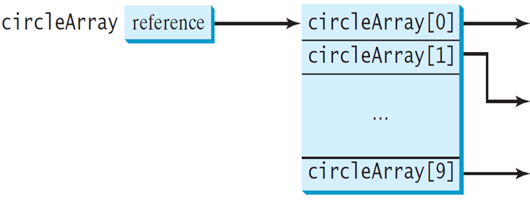
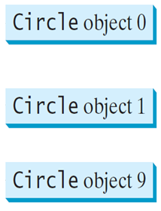
Array of Objects
Circle[] circleArray = new Circle[10];
NULL
NULL
NULL
circleArray[0] = new Circle();
circleArray[1] = new Circle();
:
circleArray[9] = new Circle();

Slide 39

Immutable Objects and Classes
If the contents of an object (instance) can't be changed once the object is created, the object is called an immutable object and its class is called an immutable class.
Notes:
غير قابل للتغيير Immutable

Slide 40
Immutable Objects and Classes
If you delete the set method in the Circle class, the class would be immutable because radius is private and cannot be changed without a set method.
public class Circle { private double radius = 1; public double getArea() { return radius * radius * Math.PI; }
public void setRadius(double r) { radius = r; } }
Notes:
غير قابل للتغيير Immutable

Slide 41
Immutable Objects and Classes
A class with all private data fields and without mutators is not necessarily immutable.
For example, the following class Student has all private data fields and no mutators, but it is mutable!!!

Slide 42
Example
import java.util.Date;
public class Student { private int id; private Date birthDate; public Student(int ssn, Date newBD) { id = ssn; birthDate = newBD; } public int getId() { return id; } public Date getBirthDate() { return birthDate; } }
public class Test { public static void main(String[] args) {
java.util.Date bd = new java.util.Date(); Student student = new Student(111223333, bd); java.util.Date date = student.getBirthDate(); date.setMonth(5); // Now the student birthdate is changed! } }

Slide 43
What Class is Immutable?
For a class to be immutable:
It must mark all data fields private.
Provide no mutator methods.
No accessor methods that would return a reference to a mutable data field object.

Slide 44
Scope of Variables
The scope of instance and static variables is the entire class. They can be declared anywhere inside a class.
The scope of a local variable starts from its declaration and continues to the end of the block that contains the variable.
A local variable must be initialized explicitly before it can be used.

Slide 45
Scope of Variables
What is the output?
public class A{ int year = 2014; // instance variable void p() {
System.out.println(“Year: ”+ year); int year = 2015; // local variable
System.out.println(“Year: ”+ year); } }

Slide 46
The this Keyword
The this keyword is the name of a reference that refers to an object itself.
One common use of the this keyword is reference a class’s hidden data fields.
Another common use of the this keyword to enable a constructor to invoke another constructor of the same class.

Slide 47
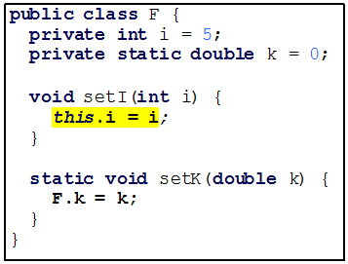
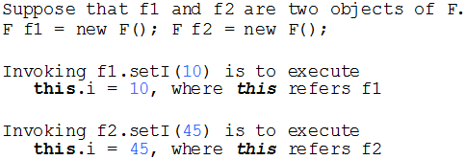
Reference the Hidden Data Fields

Slide 48
Calling Overloaded Constructor
public class Circle {
private double radius;
public Circle(double radius) {
this.radius = radius;
}
public Circle() {
this(1.0);
}
public double getArea() {
return this.radius * this.radius * Math.PI;
}
}
this must be explicitly used to reference the data field radius of the object being constructed
this is used to invoke another constructor
Every instance variable belongs to an instance represented by this, which is normally omitted

