Slide 1

Strings

Slide 2
Constructing Strings
String newString = new String(stringLiteral);
String message = new String("Welcome to Java");
Since strings are used frequently, Java provides a shorthand initializer for creating a string:
String message = "Welcome to Java";

Slide 3
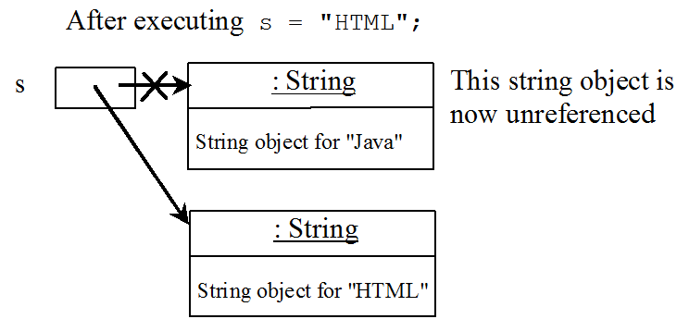
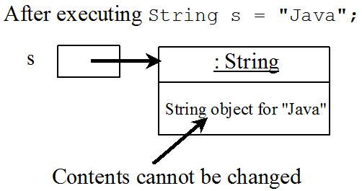
Strings Are Immutable
A String object is immutable; its contents cannot be changed.
Does the following code change the contents of the string s?
String s = "Java";
s = "HTML";

Slide 4
Interned Strings
Since strings are immutable and are frequently used, to improve efficiency and save memory, the JVM uses a unique instance for string literals with the same character sequence.
Such an instance is called interned.

Slide 5
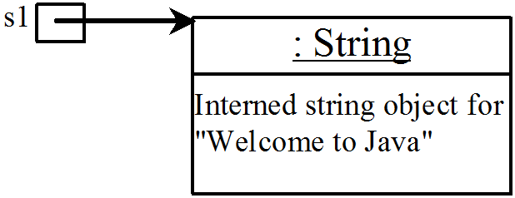

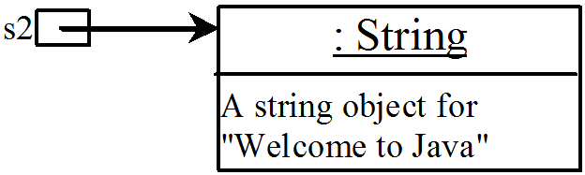
Example
String s1 = "Welcome to Java";
String s2 = new String("Welcome to Java");
String s3 = "Welcome to Java";
System.out.println("s1 == s2 is " + (s1 == s2));
System.out.println("s1 == s3 is " + (s1 == s3));
Display:
s1 == s2 is false
s1 == s3 is true
A new object is created if you use the new operator.
If you use the string initializer, no new object is created if the interned object is already created.

Slide 6
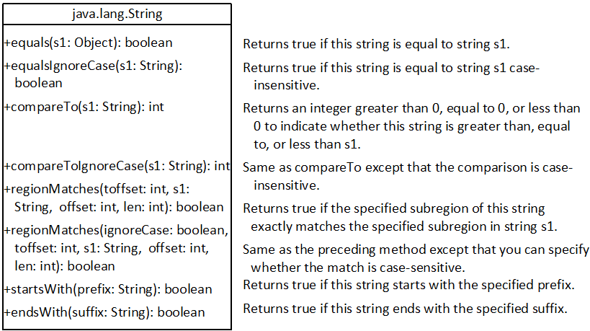
String Comparisons

Slide 7
String Comparisons
String s1 = new String("Welcome");
String s2 = “Welcome";
if (s1.equals(s2)){
// s1 and s2 have the same contents
}
if (s1 == s2) {
// s1 and s2 have the same reference
}

Slide 8
String Comparisons
compareTo(Object object)
String s1 = new String("Welcome");
String s2 = “Welcome";
if (s1.compareTo(s2) > 0) {
// s1 is greater than s2
}
else if (s1.compareTo(s2) == 0) {
// s1 and s2 have the same contents
}
else {
// s1 is less than s2
}

Slide 9
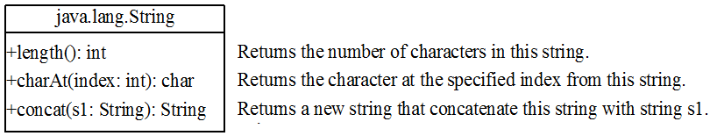
String Length, Characters, and Combining Strings
Finding String Length
Finding string length using the length() method:
message = "Welcome to Java";
message.length(); // returns 15

Slide 10
Retrieving Individual Characters in a String
Do not use message[0]
Use message.charAt( index )
Index starts from 0

Slide 11
String Concatenation
String s3 = s1.concat( s2 );
String s3 = s1 + s2;
s1 + s2 + s3 + s4 + s5
same as
(((s1.concat(s2)).concat(s3)).concat(s4)).concat(s5);

Slide 12
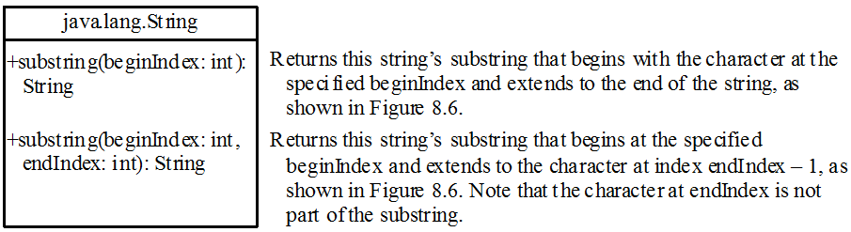
Extracting Substrings

Slide 13
Extracting Substrings
You can extract a single character from a string using the charAt method.
You can also extract a substring from a string using the substring method in the String class.
String s1 = "Welcome to Java";
String s2 = s1.substring(0, 11) + "HTML";

Slide 14
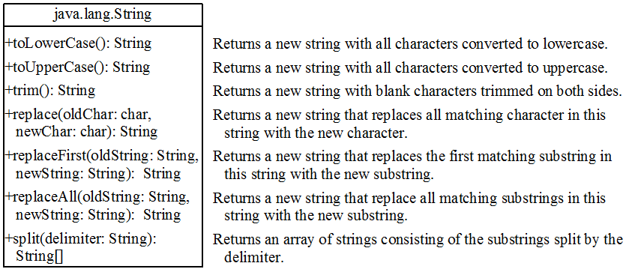
Converting, Replacing, and Splitting Strings

Slide 15
Examples
"Welcome".toLowerCase()
returns a new string, welcome
"Welcome".toUpperCase()
returns a new string, WELCOME
" Welcome ".trim()
returns a new string, Welcome
"Welcome".replace('e', 'A')
returns a new string, WAlcomA
"Welcome".replaceFirst("e", "AB")
returns a new string, WABlcome
"Welcome".replaceAll("e", "AB")
returns a new string, WABlcomAB

Slide 16
Splitting a String
String s1 = "Java#HTML#Perl“;
String[] tokens = s1.split( "#" , 0);
for (int i = 0; i < tokens.length; i++)
System.out.println( tokens[i] );
Displays:
Java
HTML
Perl

Slide 17
Matching, Replacing and Splitting by Patterns
You can match, replace, or split a string by specifying a pattern.
This is an extremely useful and powerful feature, commonly known as regular expression.
"Java".matches("Java")
"Java".equals("Java")
"Java is fun".matches("Java.*")
"Java is cool".matches("Java.*")

Slide 18
Matching, Replacing and Splitting by Patterns
The replaceAll, replaceFirst, and split methods can be used with a regular expression.
For example, the following statement returns a new string that replaces $, +, or # in "a+b$#c" by the string NNN.
String s = "a+b$#c".replaceAll("[$+#]", "NNN");
System.out.println(s);
Here the regular expression [$+#] specifies a pattern that matches $, +, or #.
So, the output is aNNNbNNNNNNc

Slide 19
Matching, Replacing and Splitting by Patterns
The following statement splits the string into an array of strings delimited by some punctuation marks:
String[] tokens = "Java,C?C#,C++".split("[.,:;?]");
for (int i = 0; i < tokens.length; i++)
System.out.println(tokens[i]);
Java
C
C#
C++

Slide 20
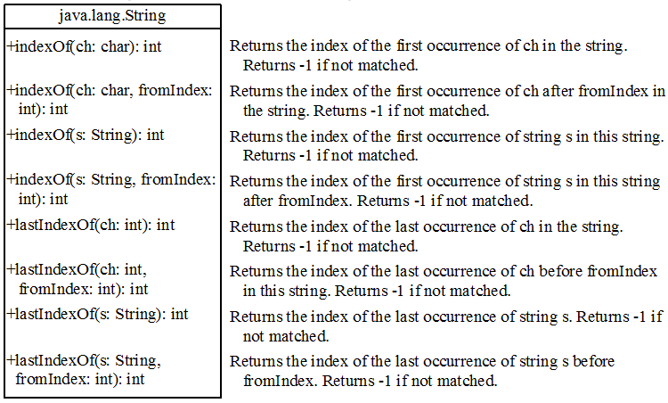
Finding a Character or a Substring in a String

Slide 21
Finding a Character or a Substring in a String
String s = "Welcome to Java”;
s.indexOf('W') returns 0
s.indexOf('x') returns -1
s.indexOf('o', 5) returns 9
s.indexOf("come") returns 3
s.indexOf("Java", 5) returns 11
s.indexOf("java", 5) returns -1
s.lastIndexOf('a') returns 14

Slide 22
Convert Character and Numbers to Strings
The String class provides several static valueOf methods for converting a character, an array of characters, and numeric values to strings.
These methods have the same name valueOf with different argument types char, char[], double, long, int, and float.
For example, to convert a double value to a string, use String.valueOf(5.44). The return value is string consists of characters ‘5’, ‘.’, ‘4’, and ‘4’.

Slide 23
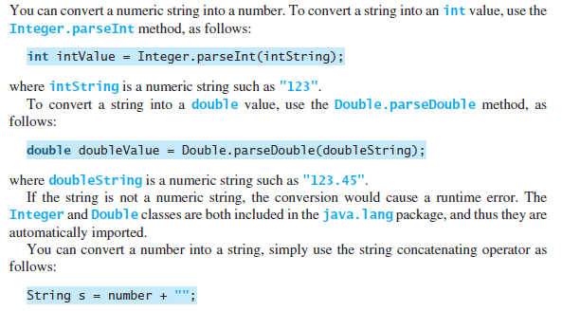

Slide 24
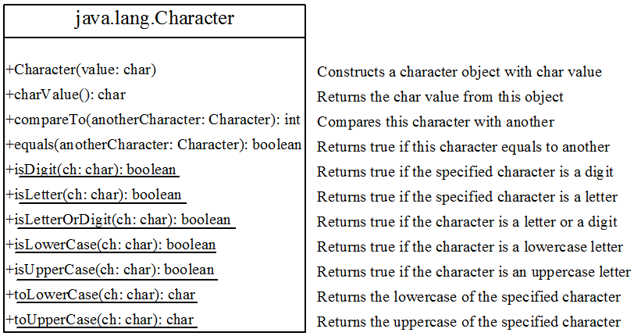
The Character Class

Slide 25
Examples
Character c = new Character('b');
c.compareTo(new Character('a')) returns 1
c.compareTo(new Character('b')) returns 0
c.compareTo(new Character('c')) returns -1
c.compareTo(new Character('d') returns -2
c.equals(new Character('b')) returns true
c.equals(new Character('d')) returns false

Slide 26
StringBuilder and StringBuffer
The StringBuilder/StringBuffer class is an alternative to the String class.
In general, a StringBuilder/StringBuffer can be used wherever a String is used.
StringBuilder/StringBuffer is more flexible than String.
You can add, insert, or append new contents into a string buffer, whereas the value of a String object is fixed once the string is created.

Slide 27
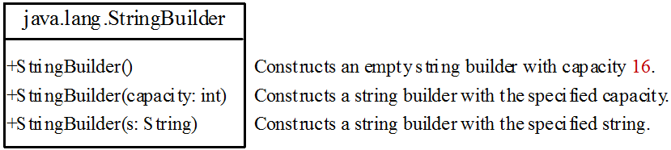
StringBuilder Constructors

Slide 28
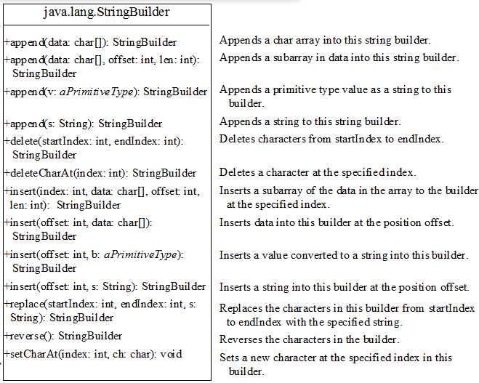
Modifying Strings in the Builder

Slide 29
Examples
StringBuilder sb = new StringBuilder(“Welcome to “);
sb.append("Java");
sb.insert(11, "HTML and ");
sb.delete(8, 11) ;
// changes the builder to Welcome Java
sb.deleteCharAt(8) ;
// changes the builder to Welcome o Java
sb.reverse() ;
// changes the builder to avaJ ot emocleW
sb.replace(11, 15, "HTML") ;
// changes the builder to Welcome to HTML
sb.setCharAt(0, 'w') ;
// sets the builder to welcome to Java

Slide 30
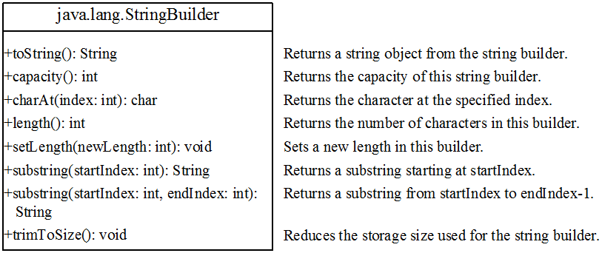
The toString, capacity, length, setLength, and charAt Methods

