Slide 1

Inheritance and Polymorphism
Notes:
3 lectures...

Slide 2
Motivations
Suppose you will define classes to model circles, rectangles, and triangles.
These classes have many common features.
What is the best way to design these classes so to avoid redundancy?
The answer is to use inheritance.

Slide 3
Superclasses and Subclasses

Slide 4


Superclass
Subclass

Slide 5
Are Superclass’s Constructor Inherited?
No. Unlike properties and methods, a superclass's constructors are not inherited in the subclass.
They are invoked explicitly or implicitly.
Explicitly using the super keyword.
They can only be invoked from the subclasses' constructors, using the keyword super.
If the keyword super is not explicitly used, the superclass's no-arg constructor is automatically invoked.

Slide 6
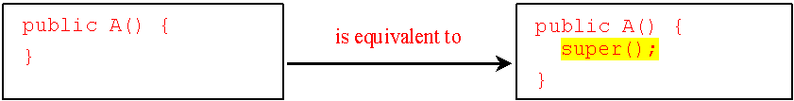
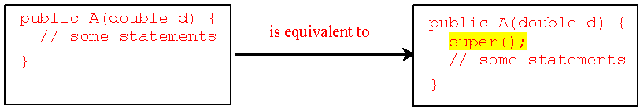
Superclass’s Constructor is Always Invoked
A constructor may invoke an overloaded constructor or its superclass’s constructor.
If none of them is invoked explicitly, the compiler puts super() as the first statement in the constructor.
For example:

Slide 7
Using the Keyword super
The keyword super refers to the superclass of the class in which super appears.
super keyword can be used in two ways:
To call a superclass constructor.
To call a superclass method.

Slide 8
Caution
You must use the keyword super to call the superclass constructor.
Invoking a superclass constructor’s name in a subclass causes a syntax error.
Java requires that the statement that uses the keyword super appear first in the constructor.

Slide 9
Constructor Chaining
Constructing an instance of a class invokes all the superclasses’ constructors along the inheritance chain. This is called constructor chaining.
public class Faculty extends Employee {
public static void main(String[] args) {
Faculty f = new Faculty();
}
public Faculty() {
System.out.println("(4) Faculty's no-arg constructor is invoked");
}
}
class Employee extends Person {
public Employee() {
this("(2) Invoke Employee’s overloaded constructor");
System.out.println("(3) Employee's no-arg constructor is invoked");
}
public Employee(String s) {
System.out.println(s);
}
}
class Person {
public Person() {
System.out.println("(1) Person's no-arg constructor is invoked");
}
}
Super(); →
Super(); →
Super(); →

Slide 10
Example on the Impact of a Superclass without no-arg Constructor
Find out the errors in the following program:
public class Apple extends Fruit {
}
public class Fruit {
public Fruit(String name) {
System.out.println("Fruit's constructor is invoked");
}
}
Notes:
Fruit has no-arg constructor

Slide 11
Defining a Subclass
A subclass inherits from a superclass. You can also:
Add new properties.
Add new methods.
Override the methods of the superclass.

Slide 12
Calling Superclass Methods
You could rewrite the printCircle() method in the Circle class as follows:
public void printCircle() {
System.out.println("The circle is created " +
super.getDateCreated() +
" and the radius is " + radius);
}

Slide 13
Superclasses and Subclasses

Slide 14
Overriding Methods in the Superclass
Sometimes it is necessary for the subclass to modify the implementation of a method defined in the superclass.
This is referred to as method overriding.
public class Circle extends GeometricObject {
// Other methods are omitted
/** Override the toString method defined in GeometricObject */
public String toString() {
return super.toString() + "\n radius is " + radius;
}
}

Slide 15
Note
An instance method can be overridden only if it is accessible.
Thus a private method cannot be overridden, because it is not accessible outside its own class.
If a method defined in a subclass is private in its superclass, the two methods are completely unrelated.

Slide 16
Note cont.
Like an instance method, a static method can be inherited.
However, a static method cannot be overridden.
If a static method defined in the superclass is redefined in a subclass, the method defined in the superclass is hidden.

Slide 17
Overriding vs. Overloading
public class Test {
public static void main(String[] args) {
A a = new A();
a.p(10);
a.p(10.0);
}
}
class B {
public void p(double i) {
System.out.println(i * 2);
}
}
class A extends B {
// This method overrides the method in B
public void p(double i) {
System.out.println(i);
}
}

Slide 18
Overriding vs. Overloading
public class Test {
public static void main(String[] args) {
A a = new A();
a.p(10);
a.p(10.0);
}
}
class B {
public void p(double i) {
System.out.println(i * 2);
}
}
class A extends B {
// This method overloads the method in B
public void p(int i) {
System.out.println(i);
}
}

Slide 19

The Object Class
Every class in Java is descended from the java.lang.Object class.
If no inheritance is specified when a class is defined, the superclass of the class is Object.

Slide 20
The toString() method in Object
The toString() method returns a string representation of the object.
The default implementation returns a string consisting of:
A class name of which the object is an instance.
The at sign (@).
A number representing this object.

Slide 21
The toString() method in Object
Circle c = new Circle();
System.out.println(c.toString());
The code displays something like:
Circle@15037e5
This message is not very helpful or informative.
Usually you should override the toString method so that it returns an informative string representing the object.

Slide 22
class GraduateStudent extends Student {
}
class Student extends Person {
public String toString() {
return "Student";
}
}
class Person extends Object {
public String toString() {
return "Person";
}
}

Slide 23
Polymorphism
public class Demo {
public static void main(String[] a) {
m(new Object());
m(new Person());
m(new Student());
m(new GraduateStudent());
}
public static void m(Object x){
System.out.println(x.toString());
}
}
Method m takes a parameter of the Object type.
You can invoke it with any object.
An object of a subtype can be used wherever its supertype value is required.
This feature is known as polymorphism.

Slide 24
Dynamic Binding
public class Demo {
public static void main(String[] a) {
m(new GraduateStudent());
m(new Student());
m(new Person());
m(new Object());
}
public static void m(Object x) {
System.out.println(x.toString());
}
}
This capability is known as dynamic binding.
When the method m(Object x) is executed, the argument x’s toString method is invoked. x may be an instance of GraduateStudent, Student, Person, or Object.
Classes GraduateStudent, Student, Person, and Object have their own implementation of the toString method. Which implementation is used will be determined dynamically by the JVM at runtime.

Slide 25
Dynamic Binding
Dynamic binding works as follows:
Suppose an object o is an instance of classes C₁, C₂, ..., C_{n-1}, and C_{n}, where C₁ is a subclass of C₂, C₂ is a subclass of C₃, ..., and C_{n-1} is a subclass of C_{n}.
That is, C_{n} is the most general class, and C₁ is the most specific class.

Slide 26
Dynamic Binding cont.
Dynamic binding works as follows:
If o invokes a method p, the JVM searches the implementation for the method p in C₁, C₂, ..., C_{n-1} and C_{n}, in this order, until it is found.
Once an implementation is found, the search stops and the first-found implementation is invoked.

Slide 27
Generic Programming
public class Demo {
public static void main(String[] a) {
m(new GraduateStudent());
m(new Student());
m(new Person());
m(new Object());
}
public static void m(Object x){
System.out.println(x.toString());
}
}
Polymorphism allows methods to be used generically for a wide range of object arguments.
This is known as:
generic programming
If a method’s parameter type is a superclass (e.g., Object), you may pass an object to this method of any of the parameter’s subclasses (e.g., Student).
When an object (e.g., a Student object) is used in the method, the particular implementation of the method of the object that is invoked (e.g., toString) is determined dynamically.

Slide 28
Casting Objects
Casting can also be used to convert an object of one class type to another within an inheritance hierarchy.
m( new Student() );
assigns the object new Student() to a parameter of the Object type. This statement is equivalent to:
Object o = new Student(); // Implicit casting
m( o );
The statement Object o = new Student(), known as implicit casting, is legal because an instance of Student is automatically an instance of Object.
Notes:
You have already used the casting operator to convert variables of one primitive type to another.

Slide 29
Why Casting is Necessary?
Suppose you want to assign the object reference o to a variable of the Student type using the following statement:
Student b = o ; // A compile error would occur.
Why does the statement Object o = new Student() work and the statement Student b = o doesn’t?
This is because a Student object is always an instance of Object, but an Object is not necessarily an instance of Student.
Even though you can see that o is really a Student object, the compiler is not so clever to know it.

Slide 30
Why Casting Is Necessary?
To tell the compiler that o is a Student object, use an explicit casting.
The syntax is similar to the one used for casting among primitive data types.
Enclose the target object type in parentheses and place it before the object to be cast, as follows:
Student b = (Student) o ; // Explicit casting

Slide 31
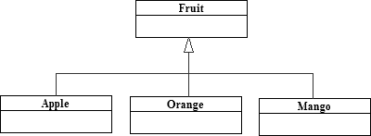
Casting from Superclass to Subclass
Explicit casting must be used when casting an object from a superclass to a subclass.
Fruit fruit = new Apple();
Apple a = (Apple) fruit;
Orange o = (Orange) fruit;
This type of casting may not always succeed.

Slide 32
The instanceof Operator
Use the instanceof operator to test whether an object is an instance of a class:
Object myObject = new Circle();
:
// Perform casting if myObject is an instance of Circle
if (myObject instanceof Circle) {
System.out.println("The circle diameter is " +
( (Circle)myObject).getDiameter() );
}

Slide 33
The equals Method
The equals() method compares the contents of two objects.
The default implementation of the equals method in the Object class is as follows:
public boolean equals (Object obj) {
return ( this == obj );
}
public boolean equals(Object o) {
if (o instanceof Circle) {
return radius == ((Circle)o).radius;
}
else
return false;
}
For example, the equals method is overridden in the Circle class.

Slide 34
Note
The == comparison operator is used for comparing two primitive data type values or for determining whether two objects have the same references.
The equals method is intended to test whether two objects have the same contents, provided that the method is modified in the defining class of the objects.

Slide 35
The ArrayList Class
You can create an array to store objects.
But the array’s size is fixed once the array is created.
Java provides the ArrayList class that can be used to store an unlimited number of objects.

Slide 36
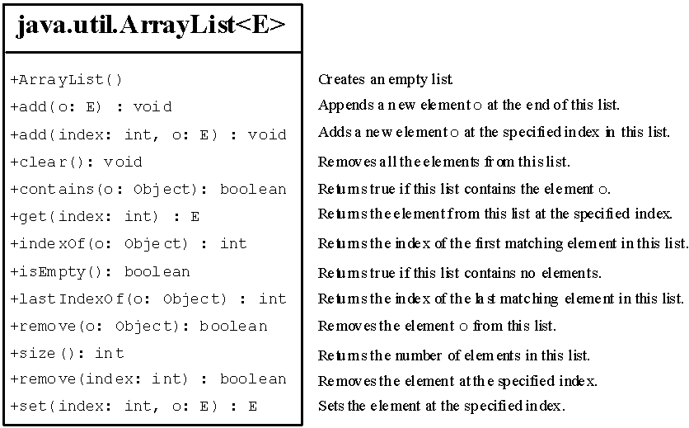
The ArrayList Class

Slide 37
Generic Type <E>
ArrayList is known as a generic class with a generic type E.
You can specify a concrete type to replace E when creating an ArrayList.
For example, the following statement creates an ArrayList and assigns its reference to variable cities. This ArrayList object can be used to store strings:
ArrayList<String> cities = new ArrayList<String>();
ArrayList<String> cities = new ArrayList<>();

Slide 38
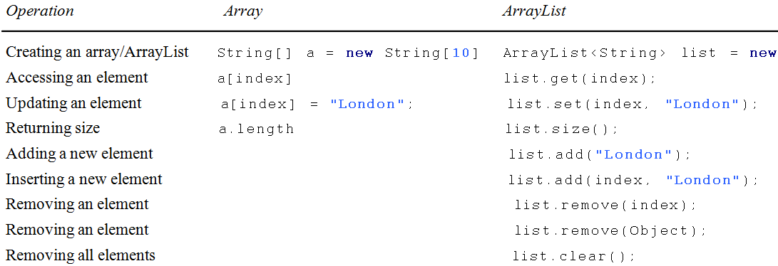
Differences and Similarities between Arrays and ArrayList

Slide 39
ArrayLists from/to Arrays
Creating an ArrayList from an array of objects:
String[] array = {"red", "green", "blue"};
ArrayList<String> list = new
ArrayList<>(Arrays.asList(array));
Creating an array of objects from an ArrayList:
String[] array1 = new String[list.size()];
list.toArray(array1);

Slide 40
max and min in an ArrayList
java.util.Collections.max(list)
java.util.Collections.min(list)
Shuffling an ArrayList
Integer[] array = {3, 5, 95, 4, 15, 34, 3, 6, 5};
ArrayList<Integer> list = new
ArrayList<>(Arrays.asList(array));
java.util.Collections.shuffle(list);
System.out.println(list);

Slide 41
The protected Modifier
The protected modifier can be applied on data and methods in a class.
A protected data/method in a public class can be accessed by any class in the same package or its subclasses, even if the subclasses are in a different package.

Slide 42
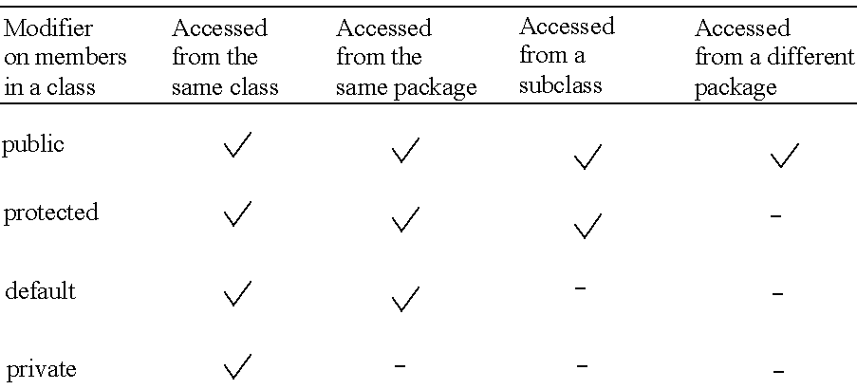
Accessibility Summary

Slide 43
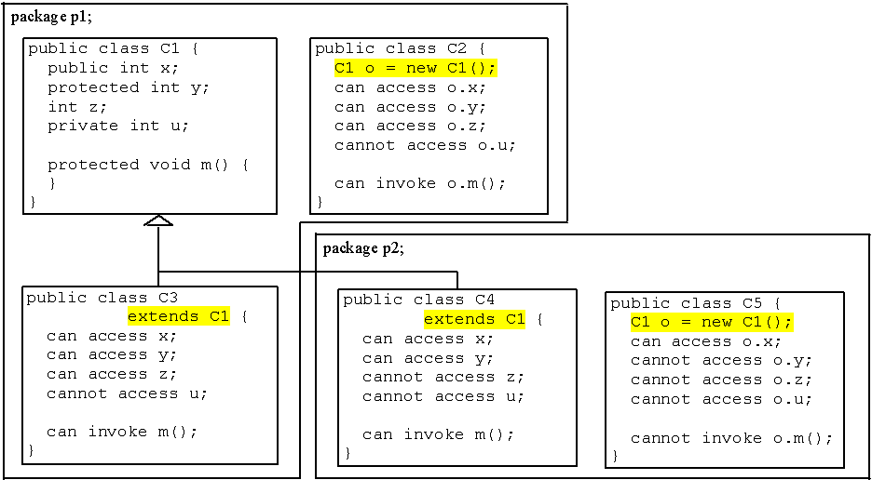
Visibility Modifiers

Slide 44
A Subclass Cannot Weaken the Accessibility
A subclass may override a protected method in its superclass and change its visibility to public.
However, a subclass cannot weaken the accessibility of a method defined in the superclass.
For example, if a method is defined as public in the superclass, it must be defined as public in the subclass.

Slide 45
The final Modifier
The final class cannot be extended:
final class Math {
...
}
The final variable is a constant:
final static double PI = 3.14159;
The final method cannot be overridden by its subclasses.

Slide 46
Note
The modifiers are used on classes and class members (data and methods), except that the final modifier can also be used on local variables in a method.
A final local variable is a constant inside a method.

