Slide 1

Exception Handling and Text IO

Slide 2
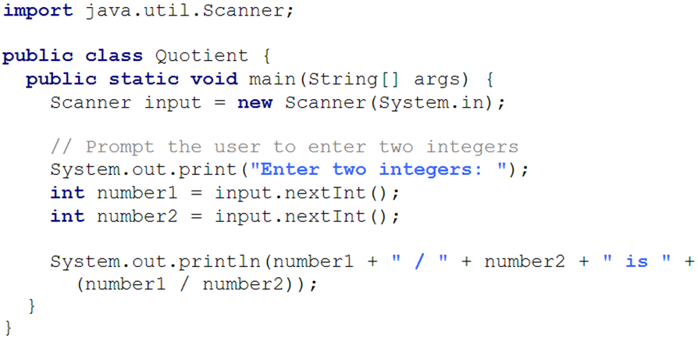
Runtime Error?

Slide 3
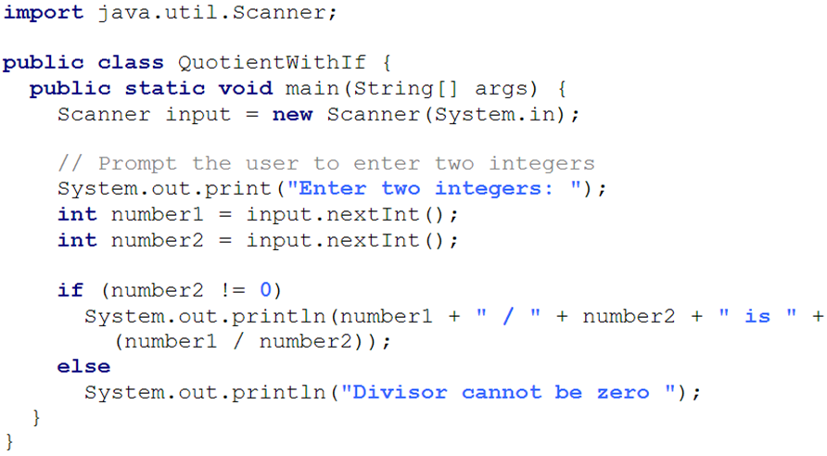
Fix it Using an if Statement

Slide 4
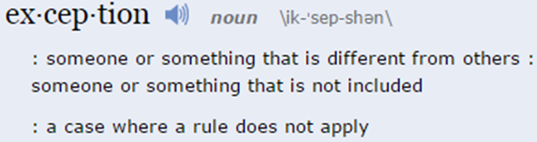
Exception Handling
Exception handling technique enables a method to throw an exception to its caller.
Without this capability, a method must handle the exception or terminate the program.

Slide 5
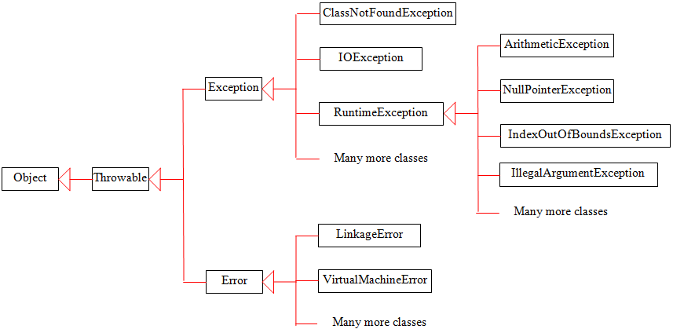
Exception Types

Slide 6
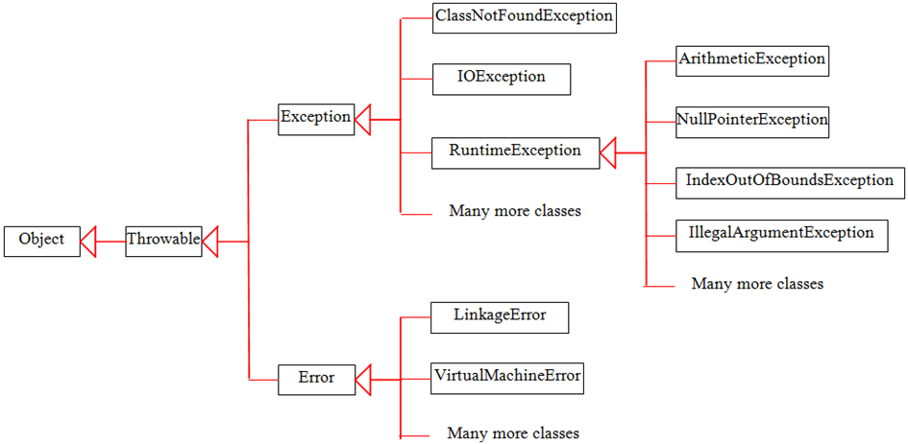
System Errors
System errors are thrown by JVM and represented in the Error class. The Error class describes internal system errors.
Notes:
Such errors rarely occur. If one does, there is little you can do beyond notifying the user and trying to terminate the program gracefully.

Slide 7
Exceptions
Exception describes errors caused by your program and external circumstances.
These errors can be caught and handled by your program.

Slide 8
Runtime Exceptions
RuntimeException is caused by programming errors, such as bad casting, accessing an out-of-bounds array, and numeric errors.

Slide 9
Checked Exceptions vs. Unchecked Exceptions
RuntimeException, Error and their subclasses are known as unchecked exceptions.
All other exceptions are known as checked exceptions, meaning that the compiler forces the programmer to check and deal with the exceptions.

Slide 10
Unchecked Exceptions
In most cases, unchecked exceptions reflect programming logic errors that are not recoverable.
For example:
a NullPointerException is thrown if you access an object through a reference variable before an object is assigned to it.
an IndexOutOfBoundsException is thrown if you access an element in an array outside the bounds of the array.
These are the logic errors that should be corrected in the program.

Slide 11
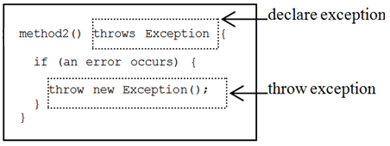
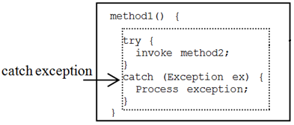
Declaring, Throwing, and Catching Exceptions

Slide 12
Declaring Exceptions
Every method must state the types of checked exceptions it might throw.
This is known as declaring exceptions.
public void x() throws IOException
public void y() throws IOException, OtherException

Slide 13
Throwing Exceptions
When the program detects an error, the program can create an instance of an appropriate exception type and throw it.
This is known as throwing an exception.
throw new TheException();
TheException ex = new TheException(); throw ex;

Slide 14
Throwing Exceptions Example
public void setRadius(double newRadius)
throws IllegalArgumentException {
if (newRadius >= 0)
radius = newRadius;
else
throw new IllegalArgumentException(
"Radius cannot be negative");
}

Slide 15
Catching Exceptions
try {
statements; // Statements that may throw exceptions
}
catch (Exception1 exVar1) {
handler for exception1;
}
catch (Exception2 exVar2) {
handler for exception2;
}
...
catch (ExceptionN exVar3) {
handler for exceptionN;
}

Slide 16
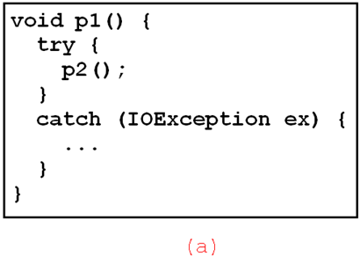
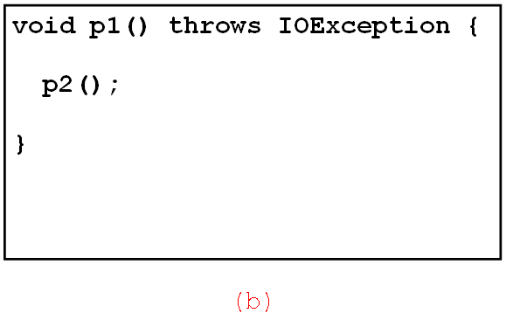
Catch or Declare Checked Exceptions
Java forces you to deal with checked exceptions.
You must invoke it in a try-catch block or declare to throw the exception in the calling method.
For example, suppose that method p1 invokes method p2 and p2 may throw a checked exception (e.g., IOException), you have to write the code as follow:

Slide 17
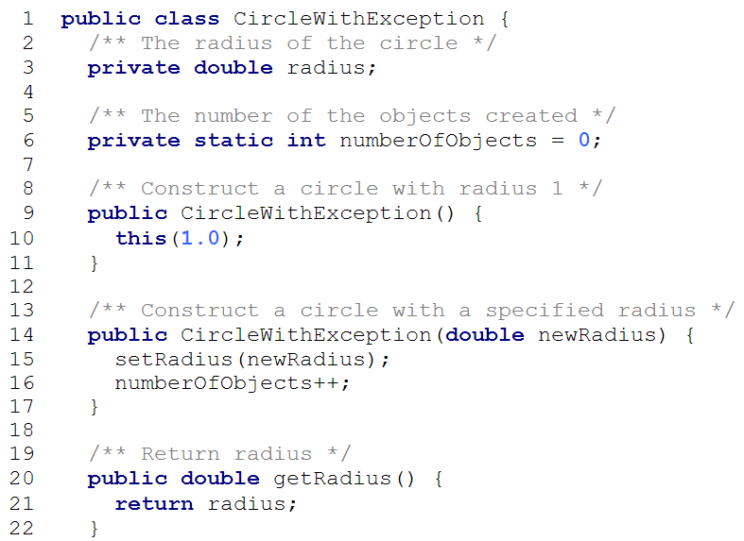
throws IllegalArgumentException

Slide 18
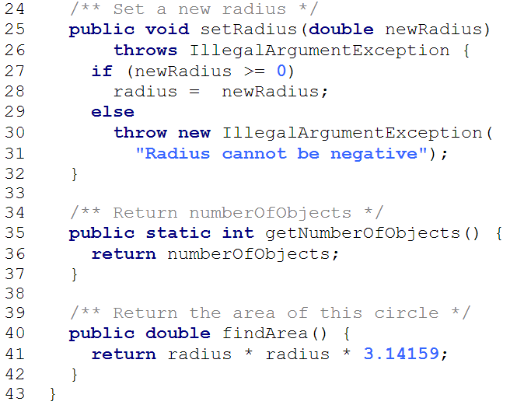

Slide 19
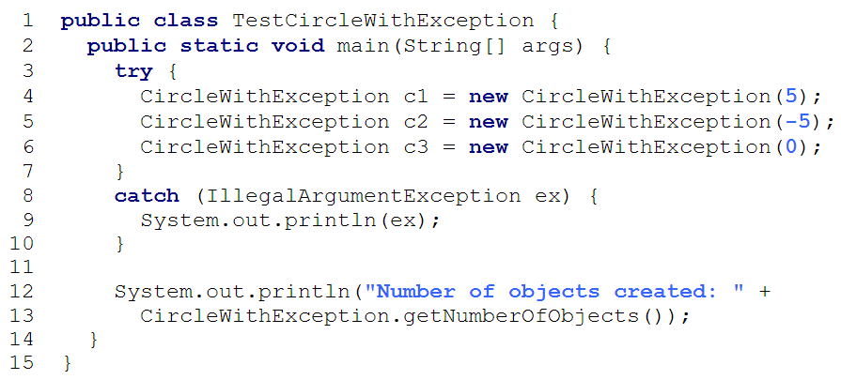

Slide 20
Rethrowing Exceptions
try {
statements;
}
catch(TheException ex) {
perform operations before exits;
throw ex;
}

Slide 21
The finally Clause
try {
statements;
}
catch(TheException ex) {
handling ex;
}
finally {
finalStatements;
}

Slide 22
Trace a Program Execution
try {
statements;
}
catch(TheException ex) {
handling ex;
}
finally {
finalStatements;
}
Next statement;
Suppose no exceptions in the statements

Slide 23
Trace a Program Execution
try {
statements;
}
catch(TheException ex) {
handling ex;
}
finally {
finalStatements;
}
Next statement;
The final block is always executed

Slide 24
Trace a Program Execution
try {
statements;
}
catch(TheException ex) {
handling ex;
}
finally {
finalStatements;
}
Next statement;
Next statement in the method is executed

Slide 25
Trace a Program Execution
try {
statement1;
statement2;
statement3;
}
catch(Exception1 ex) {
handling ex;
}
finally {
finalStatements;
}
Next statement;
Suppose an exception of type Exception1 is thrown in statement2

Slide 26
Trace a Program Execution
try {
statement1;
statement2;
statement3;
}
catch(Exception1 ex) {
handling ex;
}
finally {
finalStatements;
}
Next statement;
The exception is handled.

Slide 27
Trace a Program Execution
try {
statement1;
statement2;
statement3;
}
catch(Exception1 ex) {
handling ex;
}
finally {
finalStatements;
}
Next statement;
The final block is always executed.

Slide 28
Trace a Program Execution
try {
statement1;
statement2;
statement3;
}
catch(Exception1 ex) {
handling ex;
}
finally {
finalStatements;
}
Next statement;
The next statement in the method is now executed.

Slide 29
Trace a Program Execution
try {
statement1;
statement2;
statement3;
}
catch(Exception1 ex) {
handling ex;
}
catch(Exception2 ex) {
handling ex;
throw ex;
}
finally {
finalStatements;
}
Next statement;
statement2 throws an exception of type Exception2.

Slide 30
Trace a Program Execution
try {
statement1;
statement2;
statement3;
}
catch(Exception1 ex) {
handling ex;
}
catch(Exception2 ex) {
handling ex;
throw ex;
}
finally {
finalStatements;
}
Next statement;
Handling exception

Slide 31
Trace a Program Execution
try {
statement1;
statement2;
statement3;
}
catch(Exception1 ex) {
handling ex;
}
catch(Exception2 ex) {
handling ex;
throw ex;
}
finally {
finalStatements;
}
Next statement;
Execute the final block

Slide 32
Trace a Program Execution
try {
statement1;
statement2;
statement3;
}
catch(Exception1 ex) {
handling ex;
}
catch(Exception2 ex) {
handling ex;
throw ex;
}
finally {
finalStatements;
}
Next statement;
Rethrow the exception and control is transferred to the caller

Slide 33
Cautions When Using Exceptions
Exception handling separates error-handling code from normal programming tasks, thus making programs easier to read and to modify.
Be aware, however, that exception handling usually requires more time and resources because it requires instantiating a new exception object, rolling back the call stack, and propagating the errors to the calling methods.

Slide 34
When to Throw Exceptions
An exception occurs in a method.
If you want the exception to be processed by its caller, you should create an exception object and throw it.
If you can handle the exception in the method where it occurs, there is no need to throw it.

Slide 35
When to Use Exceptions
You should use it to deal with unexpected error conditions.
Do not use it to deal with simple, expected situations. For example, the following code:
try {
System.out.println(refVar.toString());
}
catch (NullPointerException ex) {
System.out.println("refVar is null");
}

Slide 36
When to Use Exceptions
is better to be replaced by:
if (refVar != null)
System.out.println(refVar.toString());
else
System.out.println("refVar is null");

Slide 37
Defining Custom Exception Classes
Use the exception classes in the API whenever possible.
Define custom exception classes if the predefined classes are not sufficient.
Define custom exception classes by extending Exception or a subclass of Exception.

Slide 38
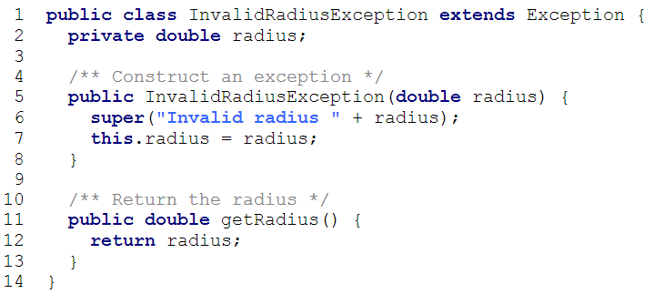
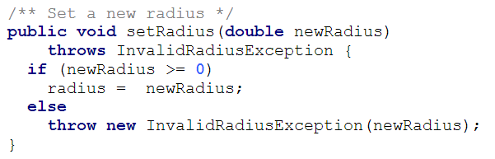
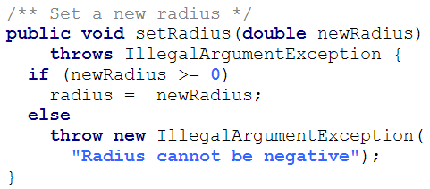
Custom Exception Class Example

Slide 39
The File Class
The File class is intended to provide an abstraction that deals with most of the machine-dependent complexities of files and path names in a machine-independent fashion.
The filename is a string.
The File class is a wrapper class for the file name and its directory path.

Slide 40
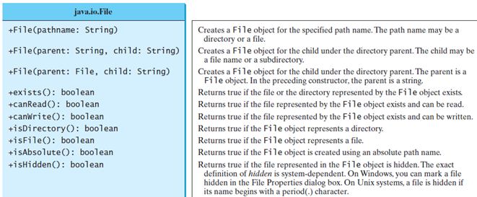
File class

Slide 41
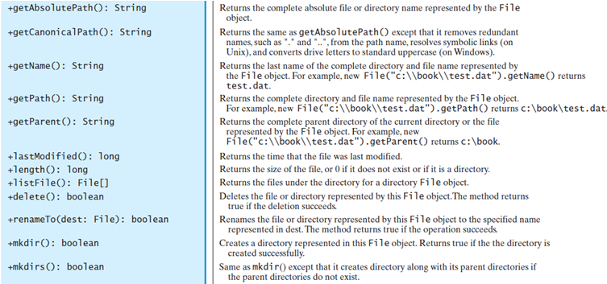
File class

Slide 42
Text I/O
A File object encapsulates the properties of a file or a path, but does not contain the methods for reading/writing data from/to a file.
In order to perform I/O, you need to create objects using appropriate Java I/O classes.
The objects contain the methods for reading/writing data from/to a file.
This section introduces how to read/write strings and numeric values from/to a text file using the Scanner and PrintWriter classes.

Slide 43
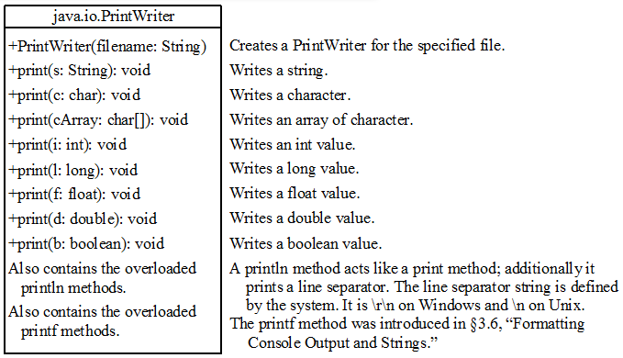
PrintWriter class

Slide 44
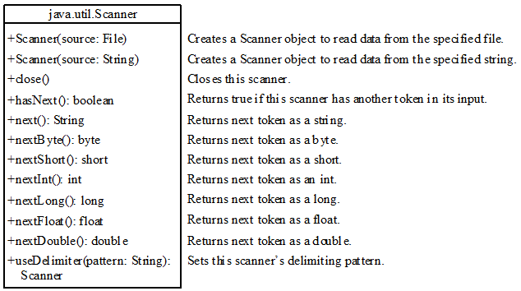
Scanner class

Slide 45
Problem: Replacing Text
Write a class named ReplaceText that replaces a string in a text file with a new string. The filename and strings are passed as command-line arguments as follows:
java ReplaceText sourceFile targetFile oldString newString

Slide 46
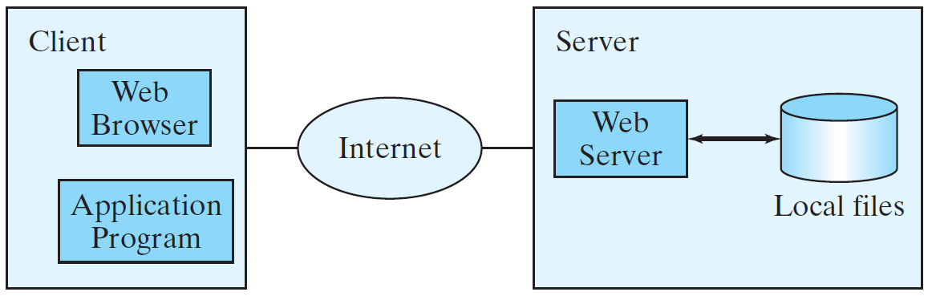
Reading Data from the Web
Just like you can read data from a file on your computer, you can read data from a file on the Web.

Slide 47
Reading Data from the Web
URL url = new URL("www.google.com/index.html");
After a URL object is created, you can use the openStream() method defined in the URL class to open an input stream and use this stream to create a Scanner object as follows:
Scanner input = new Scanner(url.openStream());

Slide 48
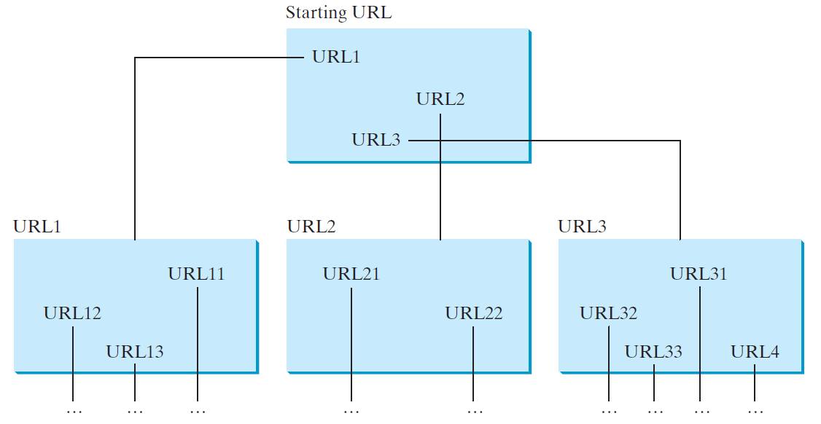
Case Study: Web Crawler
This case study develops a program that travels the Web by following hyperlinks.

Slide 49
Case Study: Web Crawler
The program follows the URLs to traverse the Web.
To avoid that each URL is traversed only once, the program maintains two lists of URLs.
One list stores the URLs pending for traversing and the other stores the URLs that have already been traversed.
The algorithm for this program can be described as follows:

Slide 50
Case Study: Web Crawler
Add the starting URL to a list named listOfPendingURLs;
while listOfPendingURLs is not empty {
Remove a URL from listOfPendingURLs;
if this URL is not in listOfTraversedURLs {
Add it to listOfTraversedURLs;
Display this URL;
Exit the while loop when the size of S is equal to 100.
Read the page from this URL and for each URL contained in the page {
Add it to listOfPendingURLs if it is not is listOfTraversedURLs;
}
}
}

