Slide 1

Event-Driven Programming

Slide 2
Procedural vs. Event-Driven Programming
Procedural programming is executed in procedural order.
In event-driven programming, code is executed upon activation of events.

Slide 3
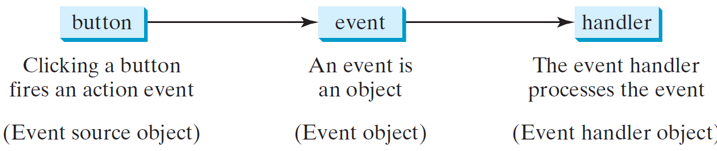
Handling GUI Events
Source object (e.g., button)
Listener object contains a method for processing the event.
3

Slide 4
Events
An event can be defined as a type of signal to the program that something has happened.
The event is generated by external user actions such as mouse movements, mouse clicks, or keystrokes.

Slide 5
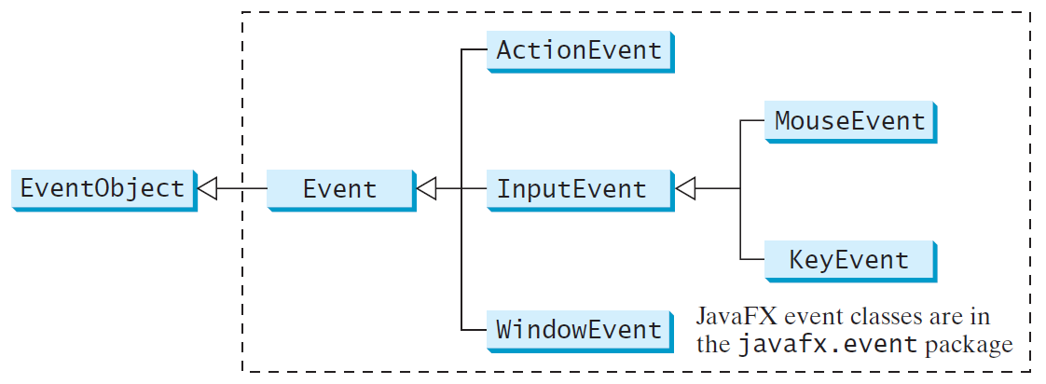
Event Classes

Slide 6
Event Information
An event object contains whatever properties are pertinent to the event.
You can identify the source object of the event using the getSource() instance method in the EventObject class.
The subclasses of EventObject deal with special types of events, such as button actions, window events, component events, mouse movements, and keystrokes.

Slide 7
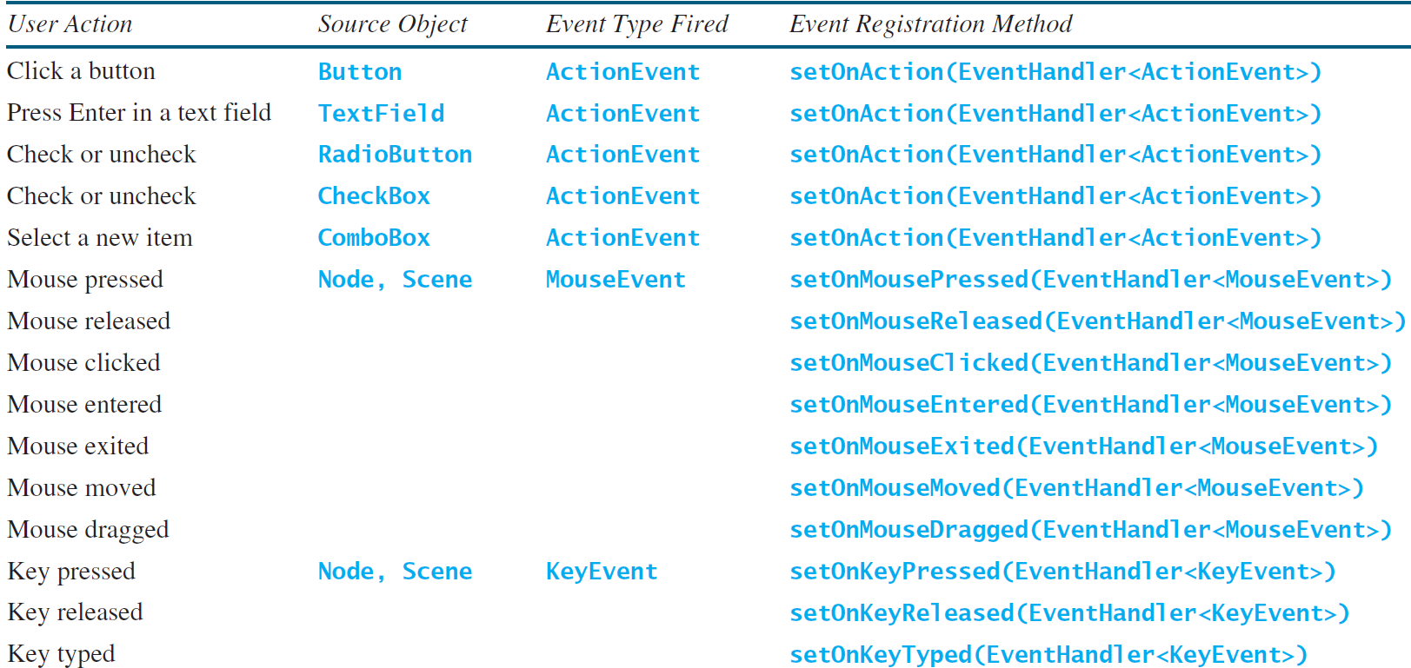
Selected User Actions and Handlers

Slide 8
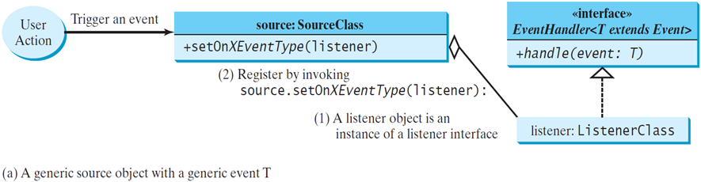
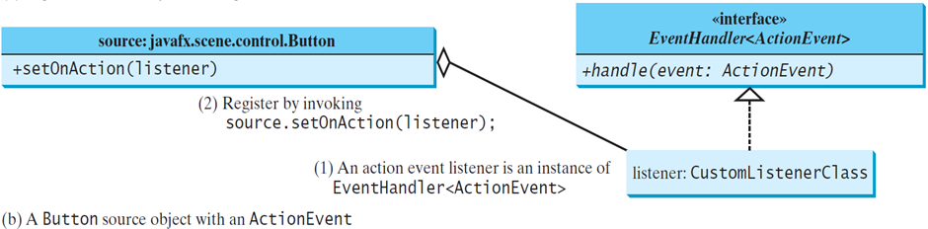
The Delegation Model

Slide 9
The Delegation Model: Example
Button btOK = new Button("OK");
OKHandlerClass handler = new OKHandlerClass();
btOK.setOnAction(handler);

Slide 10
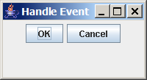
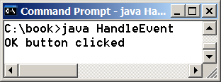
public class HandleEvent extends Application {
public void start(Stage primaryStage) {
…
OKHandlerClass handler1 = new OKHandlerClass();
btOK.setOnAction(handler1);
CancelHandlerClass handler2 = new CancelHandlerClass();
btCancel.setOnAction(handler2);
…
primaryStage.show(); // Display the stage
}
}
class OKHandlerClass implements EventHandler<ActionEvent> {
@Override
public void handle(ActionEvent e) {
System.out.println("OK button clicked");
}
}
1. Start from the main method to create a window and display it
2. Click OK
3. Click OK. The JVM invokes the listener’s handle method
10

Slide 11
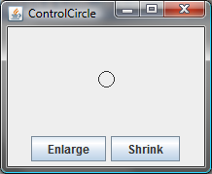
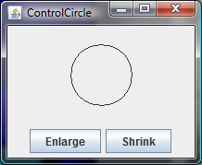
Example: ControlCircle
Now let us consider to write a program that uses two buttons to control the size of a circle.

Slide 12
Inner Class Listeners
A listener class is designed specifically to create a listener object for a GUI component (e.g., a button).
It will not be shared by other applications.
So, it is appropriate to define the listener class inside the frame class as an inner class.

Slide 13
Inner Classes
Inner class: A class is a member of another class.
Advantages: In some applications, you can use an inner class to make programs simple:
An inner class can reference the data and methods defined in the outer class in which it nests, so you do not need to pass the reference of the outer class to the constructor of the inner class.

Slide 14
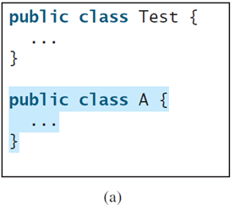
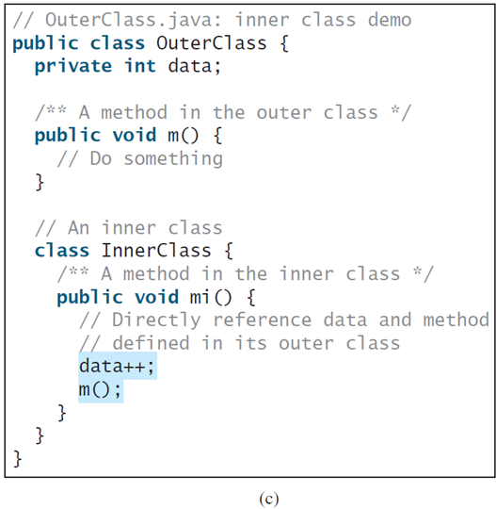
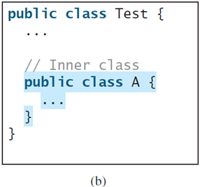
Inner Classes cont.

Slide 15
Inner Classes cont.
Inner classes can make programs simple and concise.
An inner class supports the work of its containing outer class and is compiled into a class named OuterClassName$InnerClassName.class.
For example, the inner class InnerClass in OuterClass is compiled into OuterClass$InnerClass.class.

Slide 16
Inner Classes cont.
An inner class can be declared public, protected, or private subject to the same visibility rules applied to a member of the class.
An inner class can be declared static.
A static inner class can be accessed using the outer class name.
A static inner class cannot access non-static members of the outer class

Slide 17

Anonymous Inner Classes
An anonymous inner class must always extend a
superclass or implement an interface, but it cannot have an explicit extends or implements clause.
An anonymous inner class must implement all the abstract methods in the superclass or in the interface.
An anonymous inner class always uses the no-arg constructor from its superclass to create an instance. If an anonymous inner class implements an interface, the constructor is Object().
An anonymous inner class is compiled into a class named OuterClassName$n.class.
For example, if the outer class Test has two anonymous inner classes, these two classes are compiled into Test$1.class and Test$2.class.

Slide 18
Anonymous Inner Classes cont.
Inner class listeners can be shortened using anonymous inner classes.
An anonymous inner class is an inner class without a name.
It combines declaring an inner class and creating an instance of the class in one step.
An anonymous inner class is declared as follows:
new SuperClassName/InterfaceName() {
// Implement or override methods in superclass or interface
// Other methods if necessary
}

Slide 19
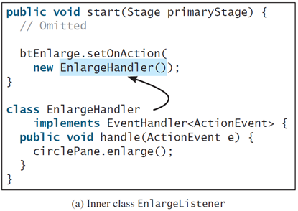
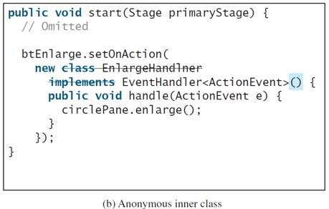
Anonymous Inner Classes cont.

Slide 20
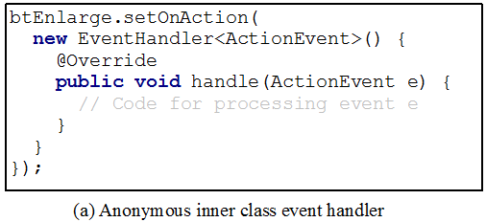
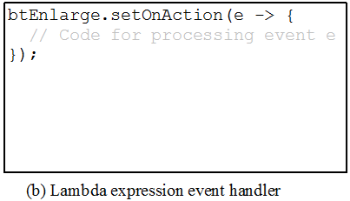
Simplifying Event Handing Using Lambda Expressions
Lambda expression is a new feature in Java 8.
Lambda expressions can be viewed as an anonymous method with a concise syntax.
For example, the following code in (a) can be greatly simplified using a lambda expression in (b) in three lines.

Slide 21
Basic Syntax for a Lambda Expression
The basic syntax for a lambda expression is either:
(type1 param1, type2 param2, ...) -> expression
or
(type1 param1, type2 param2, ...) -> { statements; }
The data type for a parameter may be explicitly declared or implicitly inferred by the compiler.
The parentheses can be omitted if there is only one parameter without an explicit data type.

Slide 22
Single Abstract Method Interface (SAM)
The statements in the lambda expression is all for that method.
If it contains multiple methods, the compiler will not be able to compile the lambda expression.
So, for the compiler to understand lambda expressions, the interface must contain exactly one abstract method.
Such an interface is known as a functional interface, or a Single Abstract Method (SAM) interface.

Slide 23
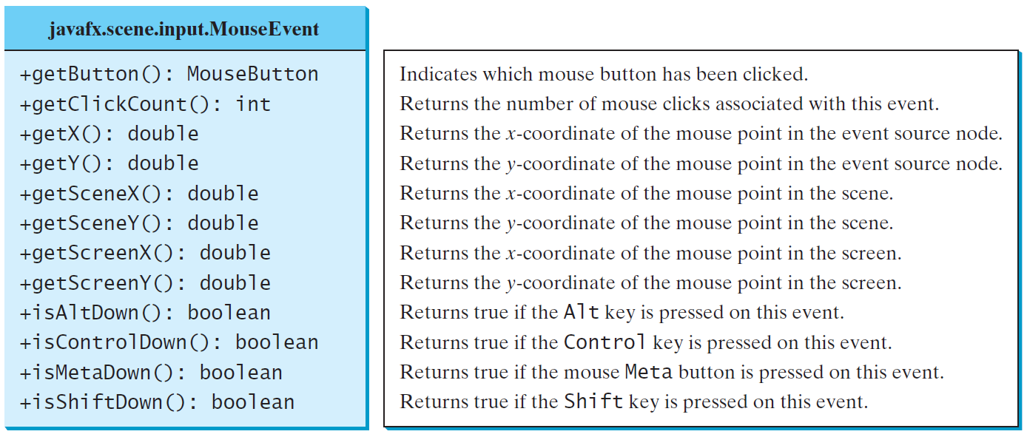
MouseEvent

Slide 24
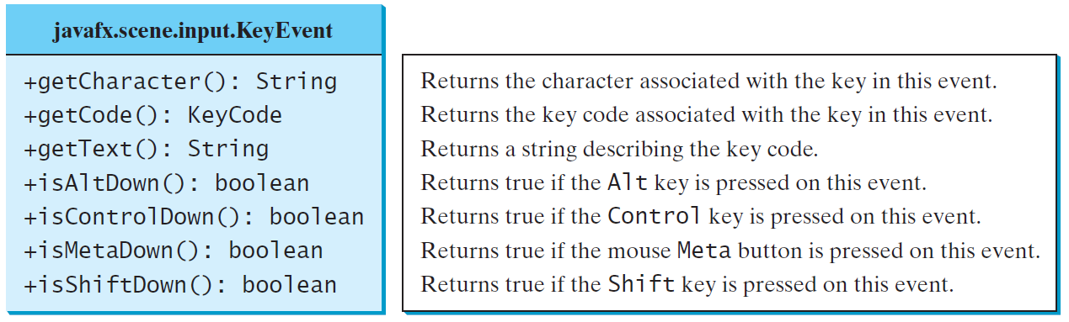
The KeyEvent Class

Slide 25
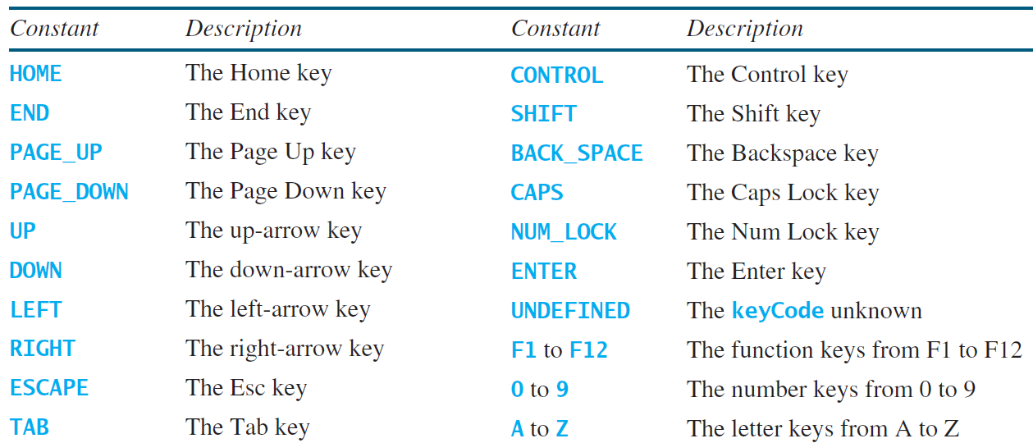
The KeyCode Constants

Slide 26
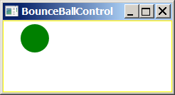

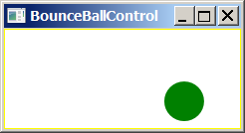
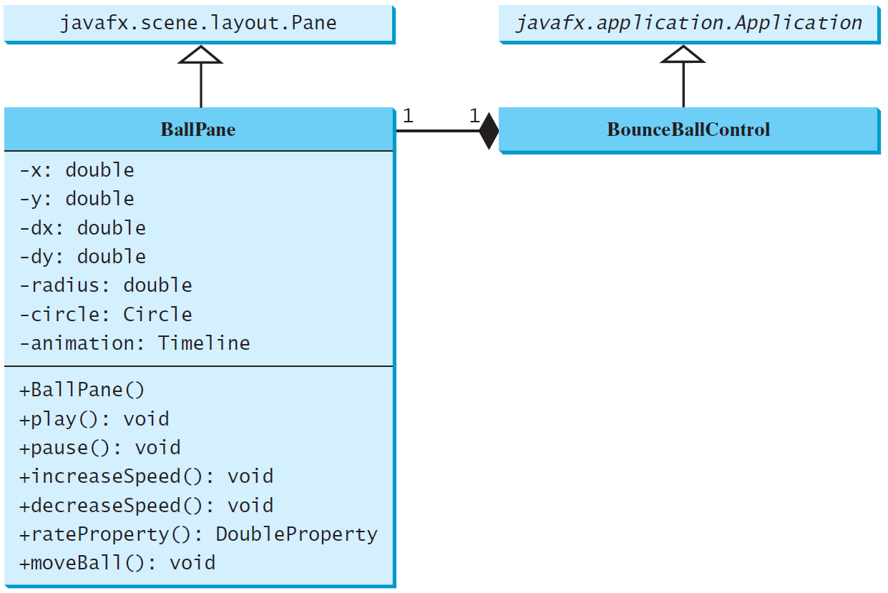
Case Study: Bouncing Ball
BallPane
BounceBallControl

