Slide 1

Thinking in Objects
Notes:
3 lectures...

Slide 2
Class Abstraction and Encapsulation
Class abstraction means to separate class implementation from the use of the class.
The creator of the class provides a description of the class and let the user know how the class can be used.
The user of the class does not need to know how the class is implemented.
The detail of implementation is encapsulated and hidden from the user.
Class implementation is like a black box hidden from the clients
Class
Class Contract (Signatures of public methods and public constants)
Clients use the class through the contract of the class

Slide 3
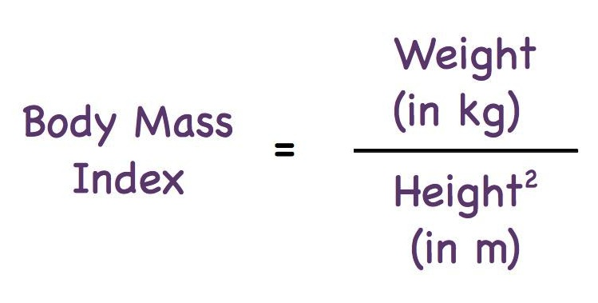
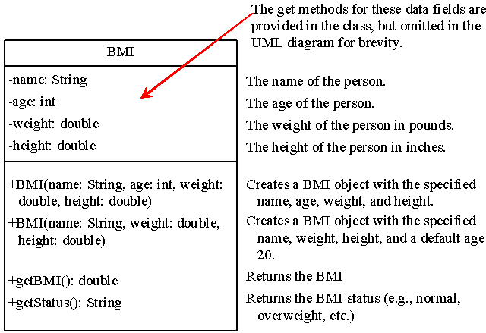

Case Study: The BMI Class

Slide 4

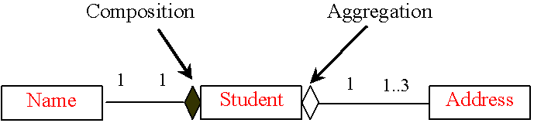
Object Composition
Aggregation models has-a relationships and represents an ownership relationship between two objects.
The owner object is called an aggregating object and its class an aggregating class.
The subject object is called an aggregated object and its class an aggregated class.
Composition is actually a special case of the aggregation relationship.
Notes:
Aggregation implies a relationship where the child can exist independently of the parent. Example: Class (parent) and Student (child). Delete the parnet Class and the Students still exist.
Composition implies a relationship where the child cannot exist independent of the parent. Example: House (parent) and Room (child). Rooms don't exist separate to a House.

Slide 5
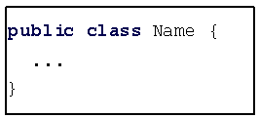
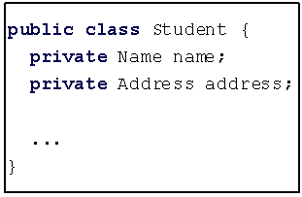
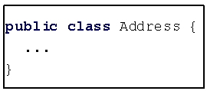
Class Representation
An aggregation relationship is usually represented as a data field in the aggregating class.
For example, the relationship in the previous Figure can be represented as follows:

Slide 6

Aggregation Between Same Class
Aggregation may exist between objects of the same class.
For example, a person may have a supervisor:
public class Person {
// The type for the data is the class itself
private Person supervisor;
...
}

Slide 7

Aggregation Between Same Class
What happens if a person has several supervisors?
public class Person {
private Person[ ] supervisors;
...
}

Slide 8
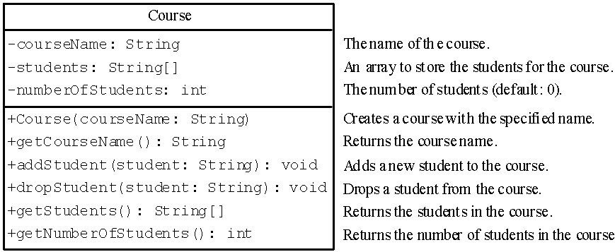
Example: The Course Class

Slide 9
Designing a Class
(Coherence) A class should describe a single entity, and all the class operations should logically fit together to support a coherent purpose.
You can use a class for students, for example, but you should not combine students and staff in the same class, because students and staff have different entities.
Notes:
Coherence تماسك

Slide 10
Designing a Class cont.
(Separating responsibilities) A single entity with too many responsibilities can be broken into several classes to separate responsibilities.
Example: the classes String, StringBuilder, and StringBuffer all deal with strings, for example, but have different responsibilities:
  String class deals with immutable strings.
  StringBuilder class is for creating mutable strings.
  StringBuffer class is similar to StringBuilder except that StringBuffer contains synchronized methods for updating strings.

Slide 11
Designing a Class cont.
Classes are designed for reuse.
Users can incorporate classes in many different combinations, orders, and environments. Therefore, you should design a class that imposes no restrictions on what or when the user can do with it:
  Design the properties to ensure that the user can set properties in any order, with any combination of values.
  Design methods to function independently of their order of occurrence.

Slide 12
Designing a Class cont.
Follow standard Java programming style and naming conventions:
  Choose informative names for classes, data fields, and methods.
  Always place the data declaration before the constructor, and place constructors before methods.
  Always provide a constructor and initialize variables to avoid programming errors.

Slide 13
Wrapper Classes
Boolean
Character
Short
Byte
Integer
Long
Float
Double
NOTE:
The wrapper classes do not have no-arg constructors.
The instances of all wrapper classes are immutable, i.e., their internal values cannot be changed once the objects are created.

Slide 14
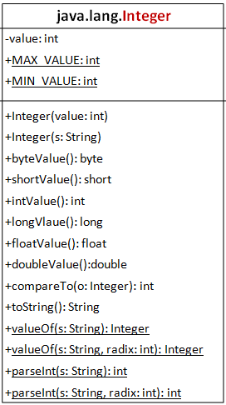
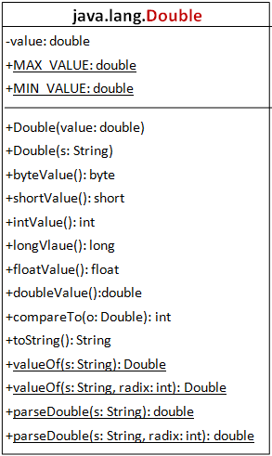
The Integer and Double Classes

Slide 15
Numeric Wrapper Class Constructors
You can construct a wrapper object either from a primitive data type value or from a string representing the numeric value.
The constructors for Integer and Double are:
  public Integer(int value)
  public Integer(String s)
  public Double(double value)
  public Double(String s)

Slide 16
Numeric Wrapper Class Constants
Each numerical wrapper class has the constants MAX_VALUE and MIN_VALUE.
MAX_VALUE represents the maximum value of the corresponding primitive data type.
For Byte, Short, Integer, and Long, MIN_VALUE represents the minimum byte, short, int, and long values.
For Float and Double, MIN_VALUE represents the minimum positive float and double values.

Slide 17
Conversion Methods
Each numeric wrapper class implements the abstract methods doubleValue, floatValue, intValue, longValue, and shortValue, which are defined in the Number class.
These methods “convert” objects into primitive type values.

Slide 18
The Static valueOf Methods
The numeric wrapper classes have a useful class method, valueOf(String s).
This method creates a new object initialized to the value represented by the specified string.
For example:
Double doubleObject = Double.valueOf("12.4");
  Integer integerObject = Integer.valueOf("12");

Slide 19
The Methods for Parsing Strings into Numbers
You have used the parseInt method in the Integer class to parse a numeric string into an int value and the parseDouble method in the Double class to parse a numeric string into a double value.
Each numeric wrapper class has two overloaded parsing methods to parse a numeric string into an appropriate numeric value.

Slide 20

Automatic Conversion Between Primitive Types and Wrapper Class Types
JDK 1.5 allows primitive type and wrapper classes to be converted automatically. For example, the following statement in (a) can be simplified as in (b):
Integer[] arr = {1, 2, 3};
System.out.println(arr[0] + arr[1] + arr[2]);
Unboxing

Slide 21
BigInteger and BigDecimal
If you need to compute with very large integers or high precision floating-point values, you can use the BigInteger and BigDecimal classes in the java.math package.
Both are immutable.

Slide 22
BigInteger and BigDecimal
BigInteger a = new BigInteger("9223372036854775807");
BigInteger b = new BigInteger("2");
BigInteger c = a.multiply(b); // 9223372036854775807 * 2
System.out.println(c);
BigDecimal a = new BigDecimal(1.0);
BigDecimal b = new BigDecimal(3);
BigDecimal c = a.divide(b, 20, BigDecimal.ROUND_UP);
System.out.println(c);

